Slide 1

Grocery Basket Insights
CDACL-006 Market Analysis · Power BI project
Online grocery orders: 49,355 products, 63,100 customers, 20 questions
Notes:
Hello. This is my Power BI project for CDACL-006 Market Analysis. I analysed an online grocery database with five tables: orders, order products, products, aisles and departments. I answered the 20 questions in the brief and turned the results into marketing recommendations.

Slide 2




Project goal and the 20 questions
Understand customer purchasing behaviour and product performance, then use it to improve marketing and customer satisfaction.
Catalogue
Time
Q1, Q2, Q3, Q20
Q7, Q8, Q15, Q18
Aisles, departments and how products are spread
When customers order: hour and day of week
Products and baskets
Customers
Q4, Q9, Q11–Q14, Q16
Q5, Q6, Q10, Q17, Q19
Top products, reorders and order sizes
Users, order gaps, loyalty and aisle reorder rates
Notes:
The goal is to understand how customers buy and which products perform best. I grouped the 20 questions into four themes: the product catalogue, ordering time, products and baskets, and customers.

Slide 3
Five tables joined in one data model
aisles
134 rows
key: aisle_id
products
order_products_train
49,355 rows
key: product_id
1,048,575 rows
key: order_id + product_id
departments
21 rows
key: department_id
orders
All relationships are one-to-many (1 → *), single direction. Arrows point from the "one" side to the "many" side.
1,048,575 rows
key: order_id
Notes:
The model has five tables. Aisles and departments link to products. Products link to order_products_train on product_id, and orders link to order_products_train on order_id. All four relationships are one-to-many. The orders relationship was missing at first, which made every day show the same basket size, so I added it in Model view.

Slide 4
Data checks and how I handled them
Issue found | How I handled it
days_since_prior_order blank for 63,100 first orders | Kept as blank. A first order has no previous order
1,254 products with aisle/department "missing" | Kept in totals, shown grey, left out of top-10 lists
249 product IDs not in the products table (0.65% of rows) | Filtered out as (Blank) in charts
Only 30,252 orders appear in both order tables | Used for day-of-week and department-user questions
Brief names order_products_prior | Database has order_products_train, so I used that
order_dow is a number 0–6 | Added Day Name column (0 = Sunday), sorted by order_dow
Notes:
Before building charts I checked the data. The main issues were: blank days for each user's first order, products with a "missing" aisle and department, a small number of unknown product IDs, and the fact that only about 30 thousand orders exist in both order tables. I kept the data honest and noted these limits on the dashboard.

Slide 5
Key DAX columns and measures
Measures
Product Count = COUNTROWS(products)
Total Orders = DISTINCTCOUNT(order_products_train[order_id])
Unique Users = DISTINCTCOUNT(orders[user_id])
Reorder Rate = AVERAGE(order_products_train[reordered])
Avg Products per Order = DIVIDE([Total Items Ordered], [Total Orders])
Users per Department = CALCULATE(DISTINCTCOUNT(orders[user_id]),
CROSSFILTER(order_products_train[order_id], orders[order_id], BOTH))
Columns and tables
Day Name = SWITCH(orders[order_dow], 0,"Sunday", … 6,"Saturday")
Times Ordered / Times Reordered (products)
Top in Department = 1 for the most reordered product per department
Order Sizes = SUMMARIZE(order_products_train, [order_id], "Size", COUNTROWS(…))
User Gaps = SUMMARIZE(orders, [user_id], "Avg Gap", AVERAGE([days_since_prior_order]))
Notes:
These are the main DAX formulas. Measures count products, orders and users and calculate the reorder rate. CROSSFILTER lets a department filter reach the orders table so I can count users per department. I also created helper tables: Order Sizes, one row per order, and User Gaps, one row per user.

Slide 6
The business at a glance
49,355
63,100
99,574
59.9%
products in 134 aisles
unique customers (Q5)
orders with product details
of items are reorders
Average basket: 10.5 items (Q11, Q14) · Average gap between orders: 15.4 days per user (Q6)
6 in 10 items in a basket are products the customer bought before, so this is a repeat-shopping business.
Notes:
Here are the headline numbers. The store has 49,355 products and 63,100 customers. About 60 percent of items are reorders, so customers come back for the same products. An average basket has 10.5 items and customers order about every 15 days.

Slide 7
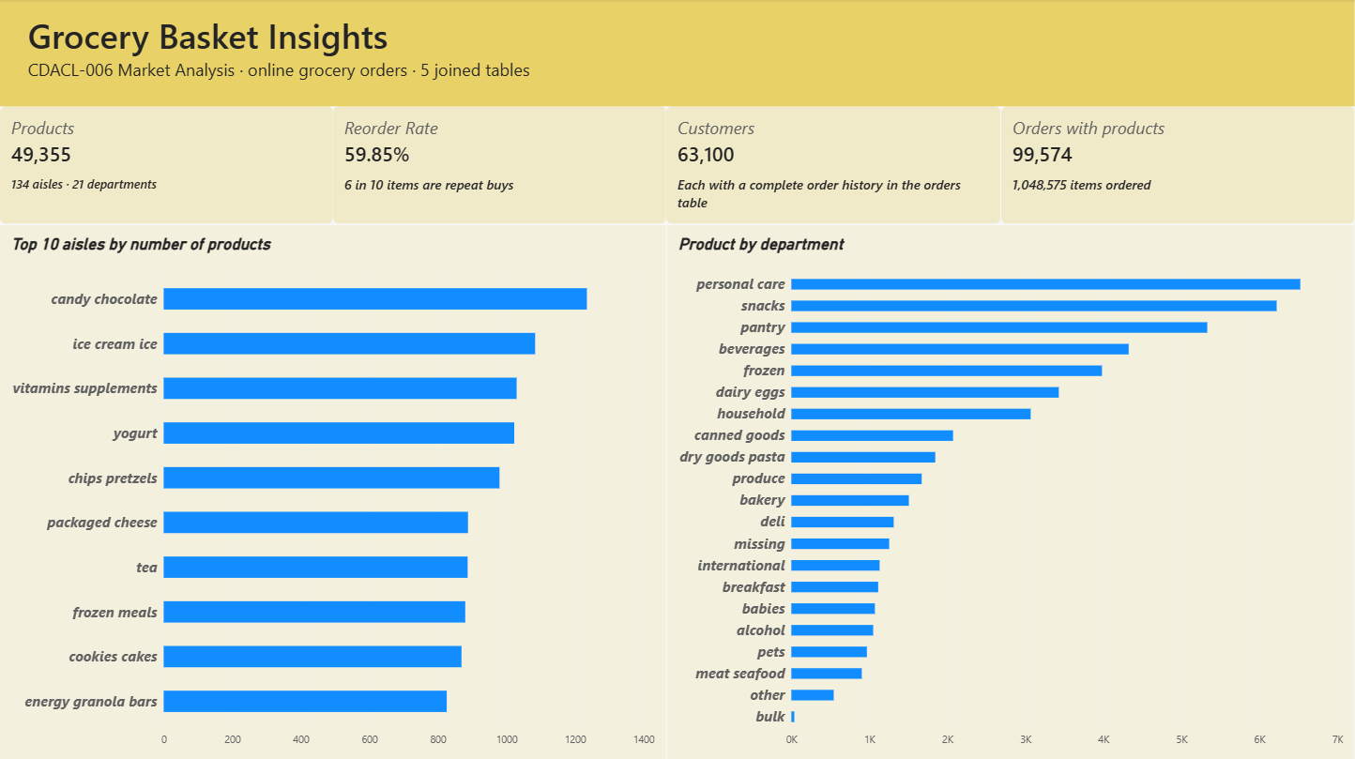
Overview: catalogue size
Q1 · Q3
Q1: Candy chocolate has the most products (1,235), then ice cream (1,084) and vitamins (1,030)
Q3: Personal care (6,524), snacks (6,221) and pantry (5,331) are the biggest departments
Bulk is the smallest with only 38 products
Power BI page 1
Notes:
Page 1 is the overview. The top aisle by number of products is candy chocolate with 1,235 products. By department, personal care, snacks and pantry are the largest. Bulk has only 38 products.

Slide 8
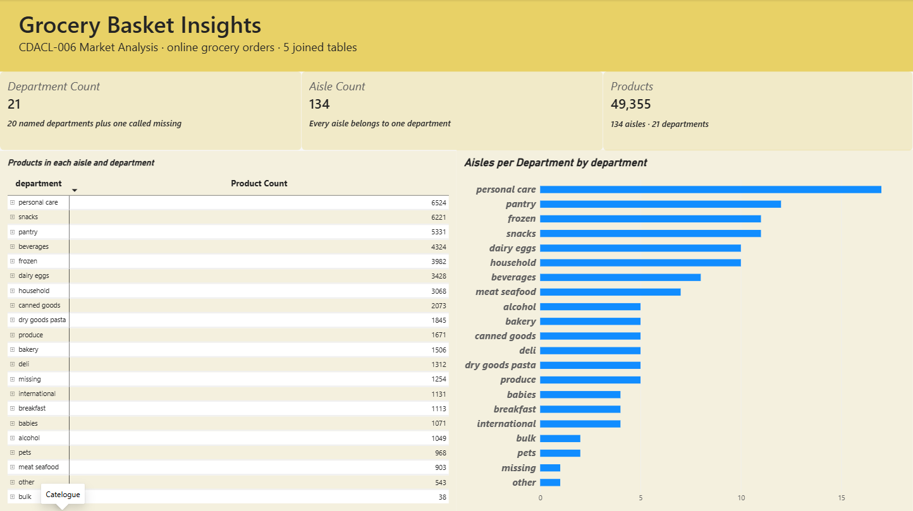
Catalogue: aisles and departments
Q2 · Q20
Q2: 21 departments (20 named + "missing")
Q20: 134 aisles. The matrix shows products in every aisle under its department
Personal care spreads 6,524 products over 17 aisles; pantry uses 12
Power BI page 2
Notes:
Page 2 covers the catalogue. There are 21 departments, including one called missing, and 134 aisles. The matrix answers question 20: you can expand each department to see how many products are in each of its aisles. Personal care has the most aisles, 17.

Slide 9
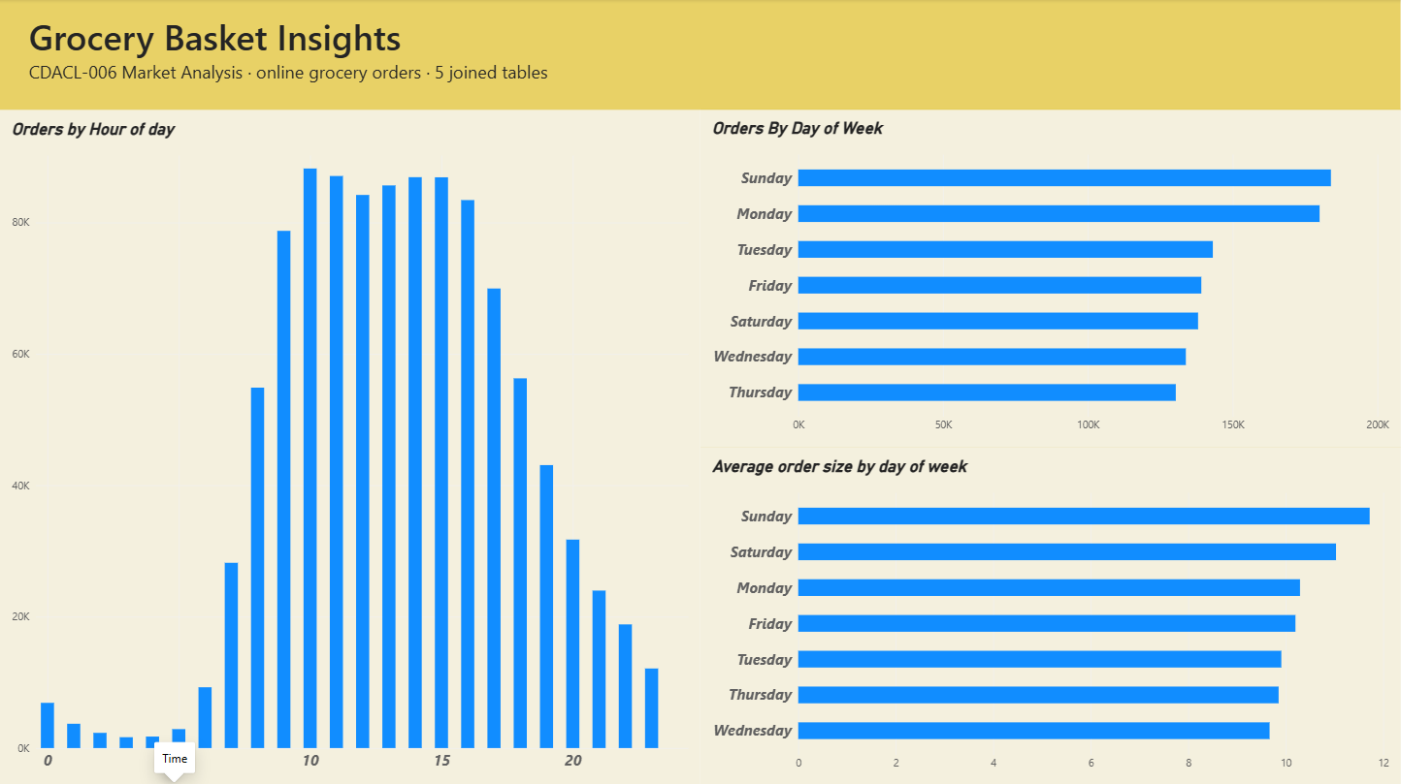
Time: when customers order
Q7 · Q8 · Q15 · Q18
Q7/Q15: Orders rise from 7 am; peak at 10 am (88,228) and stay high until 4 pm
Q8: Sunday (183,939) and Monday (180,025) are busiest; Thursday is quietest
Q18: Baskets are biggest on Sunday (11.6 items) and smallest on Wednesday (9.6)
Power BI page 3
Notes:
Page 3 shows timing. Orders start rising at 7 am and peak at 10 am, staying high until 4 pm. Very few orders come at night. Sunday and Monday are the busiest days, and weekend baskets are the biggest, 11.6 items on Sunday.

Slide 10
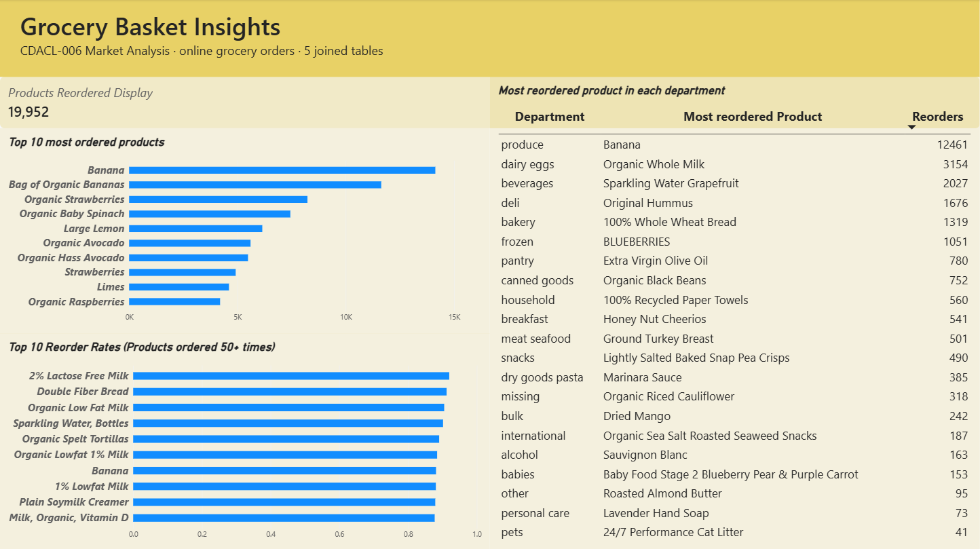
Products: best sellers and repeat buys
Q4 · Q9 · Q12 · Q13
Q9: Banana is ordered most (12,461), then Bag of Organic Bananas (11,639)
Q4: 2% Lactose Free Milk has the highest reorder rate (92%); 6 of the top 10 are milk
Q12: Banana leads produce with 12,461 reorders
Q13: 19,952 products were reordered more than once (54%)
Power BI page 4
Notes:
Page 4 is about products. Banana is the most ordered product. Milk products have the highest reorder rates, above 88 percent. The table shows the most reordered product in each department, and 19,952 products were reordered more than once.

Slide 11
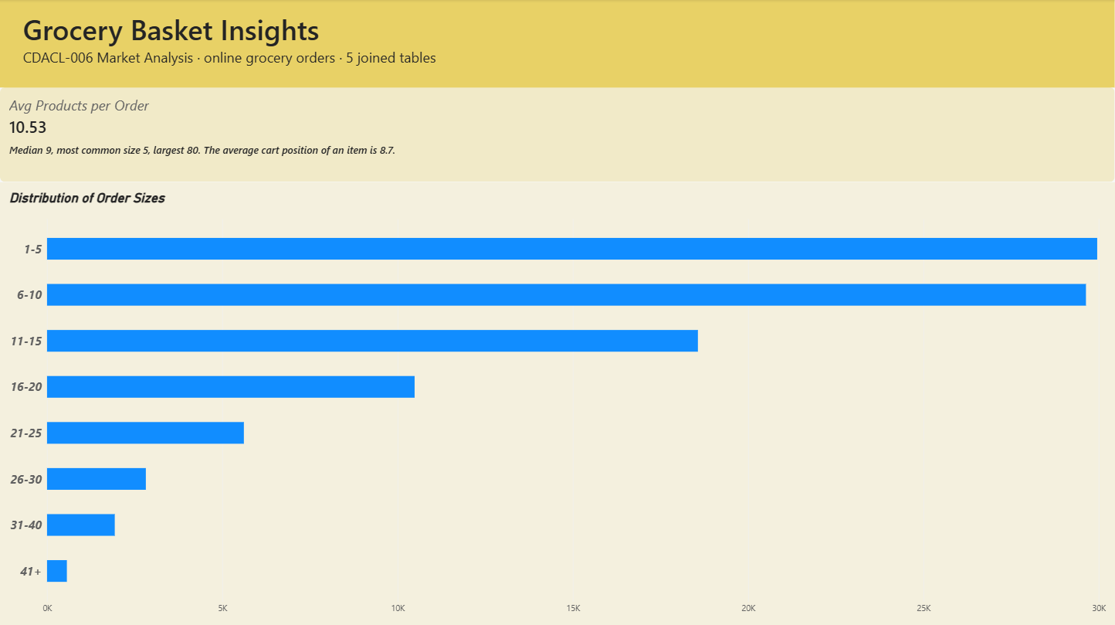
Baskets: how big is an order
Q11 · Q14 · Q16
Q11/Q14: An order has 10.5 products on average (median 9)
Most common size is 5; the largest order has 80 items
Q16: 60% of orders have 10 items or fewer; only 2.5% have more than 30
Power BI page 5
Notes:
Page 5 looks at basket size. The average order has 10.5 products and the median is 9. Most orders are small: 60 percent have 10 items or fewer.

Slide 12
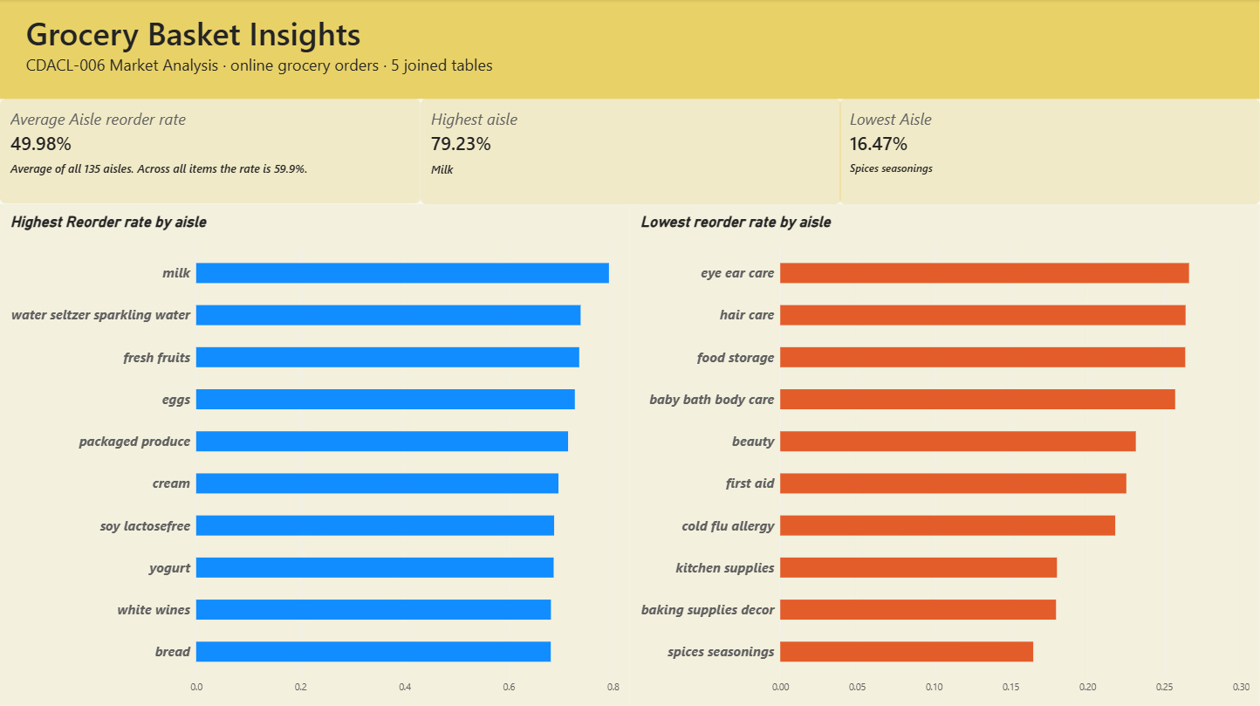
Reorders: which aisles bring customers back
Q17
Milk has the highest aisle reorder rate (79.2%), then water and fresh fruit
Spices seasonings is lowest (16.5%), with baking and kitchen supplies
The average aisle reorder rate is about 50%
Power BI page 6
Notes:
Page 6 shows reorder rates by aisle. Daily staples such as milk, water, fresh fruit and eggs have the highest reorder rates. Spices, baking and kitchen supplies have the lowest because people buy them only occasionally.

Slide 13
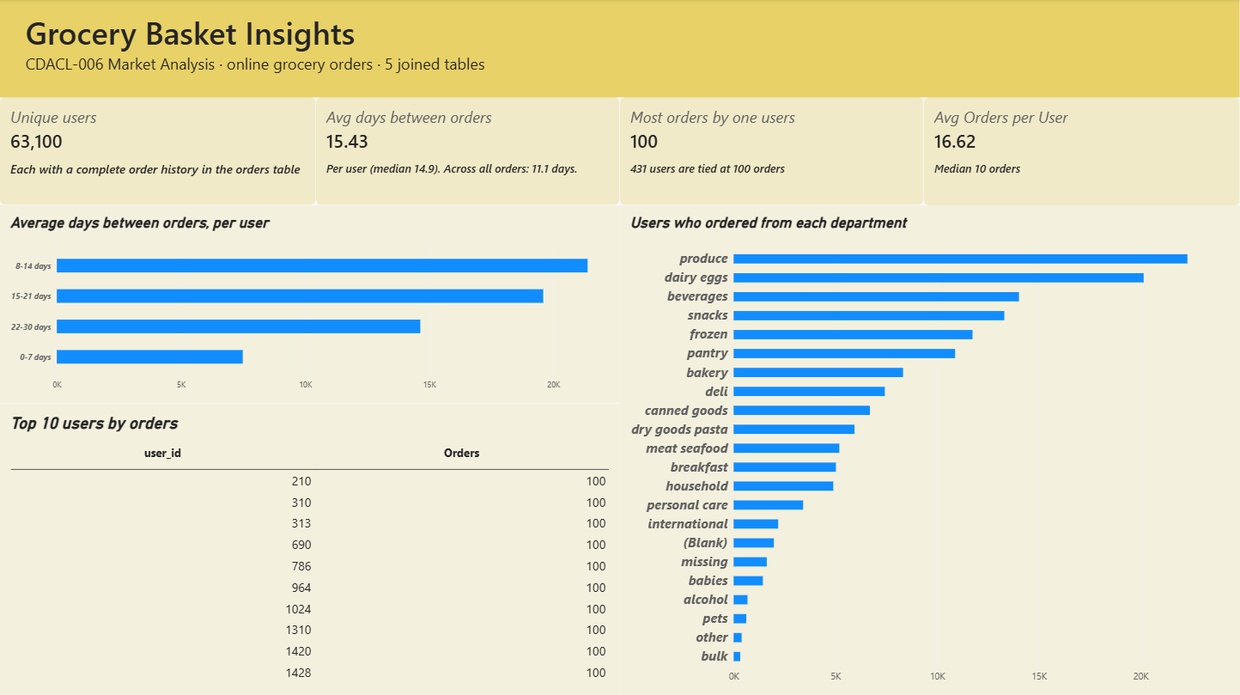
Customers: loyalty and habits
Q5 · Q6 · Q10 · Q19
Q5: 63,100 unique users
Q6: Users order every 15.4 days on average; the biggest group is 8–14 days
Q10: Produce reaches 22,303 users, dairy eggs 20,153
Q19: 431 users are tied at 100 orders; average is 16.6
Power BI page 7
Notes:
Page 7 is about customers. There are 63,100 users, and on average they order every 15.4 days. Produce and dairy reach the most customers. The most loyal customers placed 100 orders each, and 431 users share that top spot.

Slide 14
Answers to the 20 questions (Q1–Q10)
Q | Question | Answer
Q1 | Top 10 aisles by products | Candy chocolate 1,235; ice cream 1,084; vitamins 1,030
Q2 | Unique departments | 21 (20 named + "missing")
Q3 | Products across departments | Personal care 6,524; snacks 6,221; bulk 38
Q4 | Top reorder rates (50+ orders) | 2% Lactose Free Milk 92.0%; 6 of 10 are milk
Q5 | Unique users | 63,100
Q6 | Avg days between orders per user | 15.4 days (median 14.9)
Q7 | Peak hours | 10 am (88,228 orders); busy 10 am–4 pm
Q8 | Orders by day of week | Sunday 183,939 and Monday 180,025 highest
Q9 | Top 10 most ordered products | Banana 14,136; Bag of Organic Bananas 11,639
Q10 | Users per department | Produce 22,303; dairy eggs 20,153
Notes:
This slide lists the answers to questions 1 to 10, so the reader can check every question in one place.

Slide 15
Answers to the 20 questions (Q11–Q20)
Q | Question | Answer
Q11 | Avg products per order | 10.5 (median 9, max 80)
Q12 | Most reordered per department | Banana (produce) 12,461; Organic Whole Milk 3,154
Q13 | Products reordered more than once | 19,952 of 36,615 ordered products (54%)
Q14 | Avg products added to cart per order | 10.5; average cart position 8.7
Q15 | Orders by hour of day | Low at night (3 am: 1,649), rise from 7 am, fall after 4 pm
Q16 | Order size distribution | 1–5 items: 29,956 orders; 60% have ≤10 items
Q17 | Avg reorder rate per aisle | Milk 79.2% highest; spices 16.5% lowest; average ~50%
Q18 | Avg order size by day | Sunday 11.6 items; Wednesday 9.6
Q19 | Top 10 users by orders | 431 users tied at 100 orders; average 16.6
Q20 | Products per aisle and department | 134 aisles; personal care 17 aisles, 6,524 products
Notes:
This slide lists the answers to questions 11 to 20.

Slide 16




Key insights about customer behaviour
Fresh produce and dairy drive the business
Banana is the #1 product and 74% of matched users buy produce
Customers buy the same things again
6 in 10 items are reorders; milk is reordered 79% of the time
Ordering peaks 10 am to 4 pm
Sunday and Monday are the busiest days
Weekend baskets are bigger
11.6 items on Sunday vs 9.6 on Wednesday
Most customers return every 1–3 weeks
Average gap 15.4 days; 21,379 users order every 8–14 days
Notes:
Five insights stand out. Fresh produce and dairy drive the business. Most items are repeat purchases. Orders peak between 10 am and 4 pm, and on Sundays and Mondays. Weekend baskets are bigger. Most customers come back every one to three weeks.

Slide 17






Recommendations for marketing and service
Stock
Operations
Marketing
Keep milk, bananas, eggs and bread always in stock, especially before Sunday and Monday
Add delivery slots and staff from 10 am to 4 pm
Run weekend "big basket" offers to grow Saturday and Sunday orders
Retention
Growth
Loyalty
Send a reminder offer about 14 days after a customer's last order
Promote low-reorder aisles (spices, baking, personal care) with bundles
Reward the 431 most loyal users (100 orders each) with a loyalty programme
Notes:
Based on these insights I recommend six actions: keep staples in stock, add delivery capacity at peak hours, run weekend big-basket offers, send reminder offers about two weeks after the last order, promote low-reorder aisles with bundles, and reward the most loyal customers.

Slide 18

Limitations of the data
The orders and order lines tables each stop at 1,048,575 rows (database export limit).
Only 30,252 orders appear in both order tables; Q10 and Q18 use these orders.
The brief names order_products_prior, but the database contains order_products_train.
1,254 products have aisle and department "missing"; 249 product IDs are unknown (0.65% of rows).
order_dow 0 is assumed to be Sunday. days_since_prior_order is capped at 30.
Notes:
Some limits to keep in mind: the database export stopped at about one million rows, only part of the orders have product details, and a small share of products are unlabelled. These do not change the main findings, but the exact numbers would be larger with the full data.

Slide 19
Thank you
Grocery Basket Insights · CDACL-006 Market Analysis
Built in Power BI
Notes:
Thank you for watching. That completes my Power BI project on grocery market analysis.

