Slide 1
HR Analytics Dashboard
PRDA-03 · Workforce overview, attrition analysis and recommendations
Power BI · Tableau · MySQL · Excel
Notes:
Introduce the project: an HR analytics dashboard built on 22,214 employee records.

Slide 2
About the dataset
Source: MySQL database project_hr_analytics, table HR
One row per employee: name, birthdate, age, gender, race, department, job title
Location (Headquarters or Remote), city and state
hire_date and termdate (blank if still employed)
Goal: understand the workforce and why people leave
22,214
employees
13
columns
2000–2020
hire dates

Slide 3




Data cleaning and preparation
Loaded all rows
Fixed date formats
Removed the 1,000-row limit: 22,214 rows, no duplicate IDs
hire_date and birthdate read as day-month-year; termdate trimmed to the date only
Handled missing termdate
Added new columns
18,285 blanks and 1,030 future dates treated as Active employees
Employee Status, Age Group, Hire Year, Term Year, Tenure, Tenure Group

Slide 4
Key performance indicators
22,214
75.2%
24.8%
38.4
13.1%
Total employees
At headquarters
Working remotely
Average age (years)
Attrition rate
19,313 active employees · 2,901 have left · leavers stayed 8 years on average
Attrition counts termdates up to the date of analysis, so it can differ by 0.01% between tools.

Slide 5
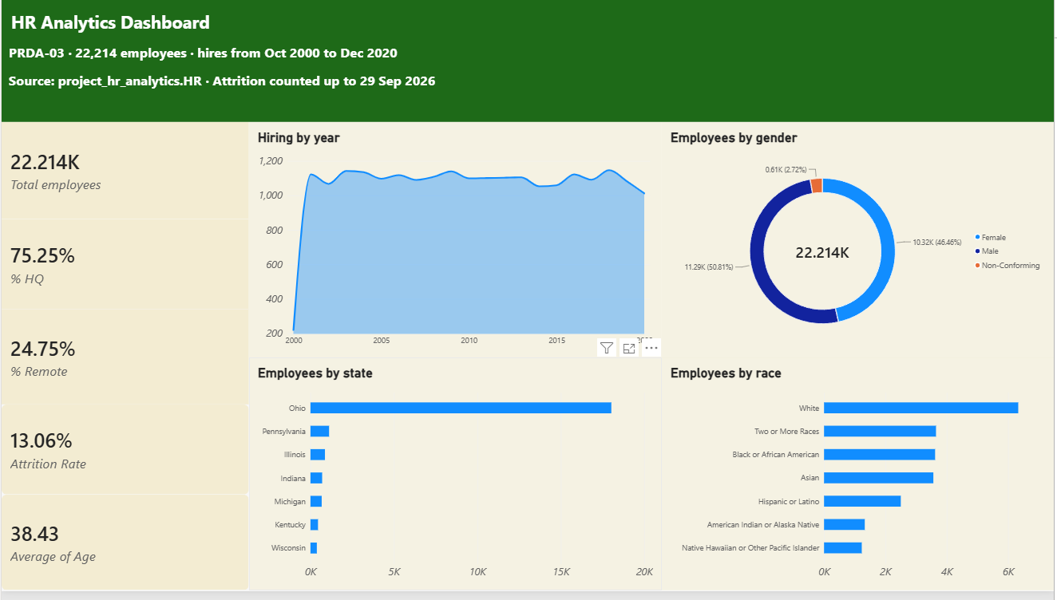
Power BI dashboard: workforce overview

Slide 6
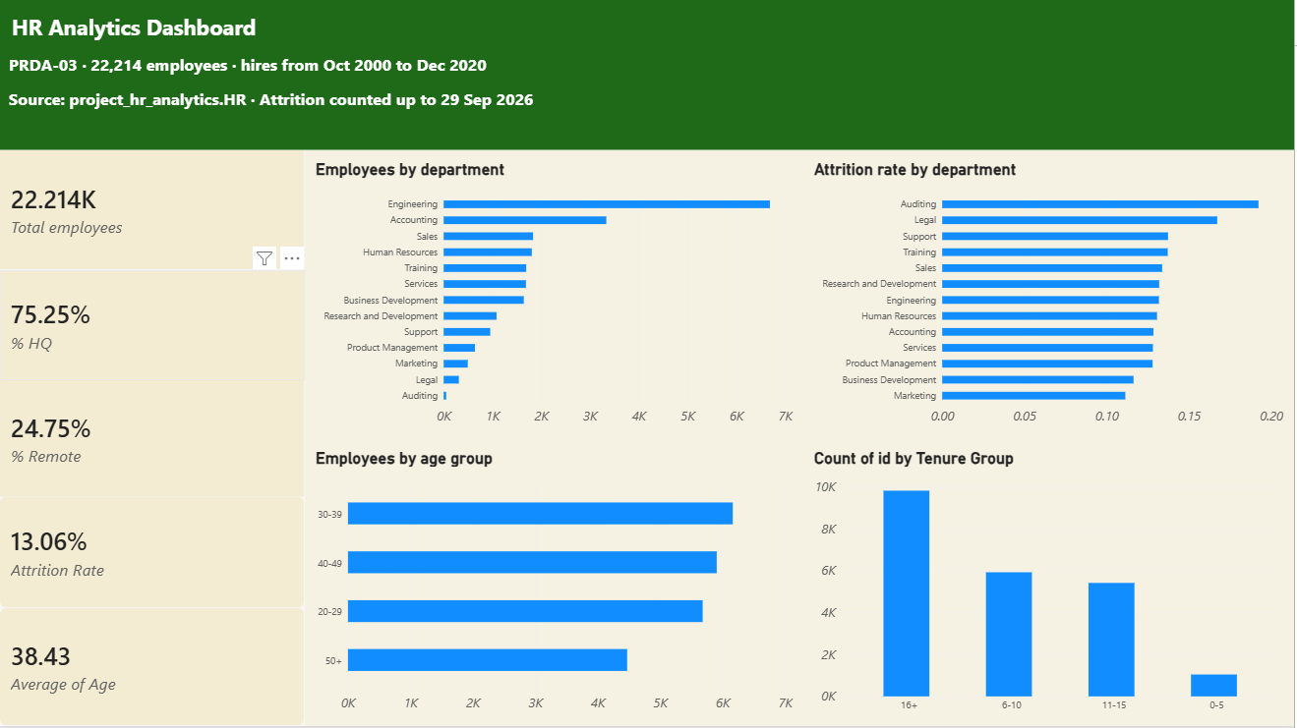
Power BI dashboard: departments and attrition

Slide 7
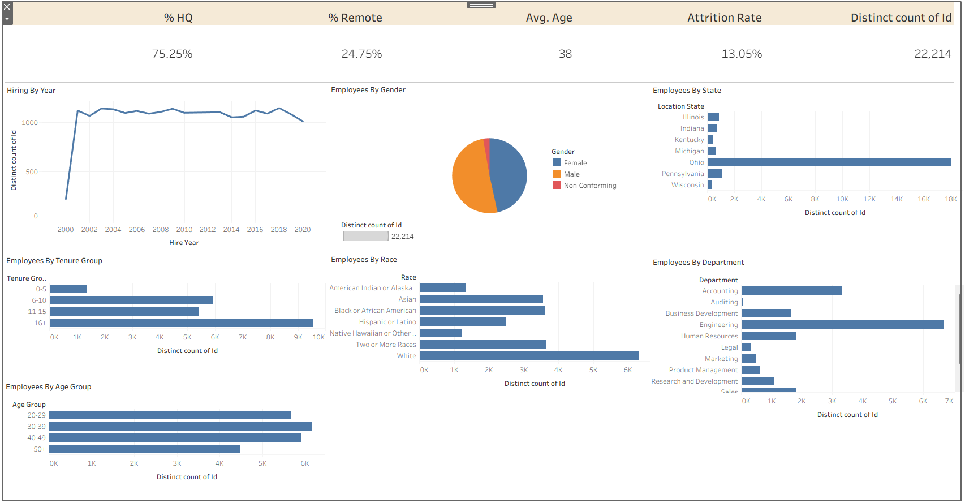
Tableau dashboard

Slide 8
Hiring has been steady for 20 years
≈1,100
hires every year, 2001–2020
No big growth or freeze. 2000 is low (220) only because the data starts in October 2000.

Slide 9
Balanced gender, concentrated in Ohio
Women are 43–48% of every department. 81% of employees work in Ohio.

Slide 10
Engineering and Accounting are half the company
Engineering (30%) and Accounting (15%) are the core teams. No race group other than White is above 17%.

Slide 11
Legal and Auditing lose the most staff
19.2%
Auditing attrition
Legal follows at 16.7%. Auditing has only 52 people, so Legal (311 people) is the more reliable warning sign. Most teams sit near 13%.

Slide 12
Leavers keep rising each year
7 → 205
leavers in 2001 vs 2021
Hiring stayed flat at about 1,100 a year while leavers grew every year, so net growth is slowing. 2026 covers January to September only.

Slide 13
Most leavers go in their first 5 years
39%
of leavers left within 5 years
The longer people stay, the less likely they are to leave. Early-career retention is the biggest opportunity.

Slide 14
Attrition is similar across groups
12.3%
remote attrition (HQ 13.3%)
Remote employees stay slightly longer. Gender, age and race all sit between 11% and 15%, so no group leaves at a much higher rate.

Slide 15






Key insights
Steady hiring
Balanced and diverse
About 1,100 hires a year for 20 years
50.8% male, 46.5% female, 7 race groups
One main location
Rising attrition
81% in Ohio, 75% at headquarters
13.1% have left; leavers grow every year
Early leavers
Hot spots
39% of leavers go within 5 years
Legal 16.7% and Auditing 19.2% attrition

Slide 16
Suggestions for the company
1
Improve early-career retention
2
Investigate Legal and Auditing
Better onboarding, mentors and regular check-ins
Exit interviews and engagement surveys
3
Plan hiring against attrition
4
Support flexible work
Track hires minus leavers every quarter
Remote staff leave less: offer hybrid options
5
Prepare for retirements
6
Widen the location base
20% are 50+: start succession planning
Grow branches and remote hiring beyond Ohio
7
Keep diversity strong
8
Improve HR data quality
Monitor gender and race balance every year
Fix future termdates and add hires after 2020

Slide 17
Conclusion
A large, diverse and stable workforce, but attrition is rising and most people leave early. Focusing on early-career retention and the high-attrition teams will keep the company growing.

