Slide 1

Minimum Variance Hedging of Electricity Price Risk
A Cross-Market Analysis of Nordic & European Electricity Markets
Using Historical Day-Ahead Prices (2015-2025)
Master 2 Finance & Big Data
2026/2027
Groupe A
Akram BENAISSA - Rania BESSROUR - HENIN Baptiste - Mon-desir honce ABDIAS MADOU - Lilian NKWEMFO TCHAMI
Notes:
Good morning everyone. Imagine a manufacturer in western Denmark whose production depends on electricity every hour. It cannot control electricity prices, but it needs predictable costs. Our project asks a simple question: can price movements in neighboring markets help reduce the risk it faces in DK1? We use optimization to compare three approaches.

Slide 2
ROADMAP
1
Motivation and Optimisation Problem
2
Data and Methodology
3
Variance & CVaR Results
4
Conclusion & Limitations
5
2
Notes:
We'll start with the company's problem and why DK1 matters, then explain our data and optimization methods. After that, we'll compare the results and finish with what we can conclude from this study.

Slide 3

Motivation and Optimisation Problem
Notes:
Let's begin with the business problem, before moving to the mathematics.

Slide 4
Motivation and Optimisation Problem
The client: an industrial company in DK1
A hypothetical Danish manufacturer with electricity-intensive operations
Business model
Financial exposure
Management mandate
Production requires continuous electricity consumption. The company purchases power at prices linked to the DK1 market.
Hourly price fluctuations create uncertainty in procurement expenditure and operating margins.
Explore whether neighboring electricity markets can help stabilize the company’s price exposure.
The goal is lower cost variability, not necessarily lower average electricity prices.
Notes:
Our client is a hypothetical electricity-intensive manufacturer in western Denmark, known as DK1. Sudden price increases can make its electricity expenditure less predictable and put pressure on margins. Management wants to stabilize this exposure, rather than simply chase the lowest possible average price. So we explore whether neighboring electricity markets can act as statistical hedges.

Slide 5
Motivation and Optimisation Problem
The client: an industrial company in DK1
We start with hourly price changes before modelling real procurement cash flows
Electricity procurement cost
What this study measures
Costₜ = Consumptionₜ × DK1 priceₜ
ΔPₜ = Pₜ − Pₜ₋₁
Actual costs also depend on load volumes and contract terms.
Risk = variance of hourly DK1 price changes.
Research question: Can cross-market price movements reduce DK1 price-change variance?
Notes:
In reality, the company's electricity cost is consumption multiplied by price. Since we don't have its actual hourly consumption or procurement contracts, we focus on something we can measure: hourly changes in DK1 prices. Our research question becomes: can a combination of other markets reduce the variability of those changes?

Slide 6
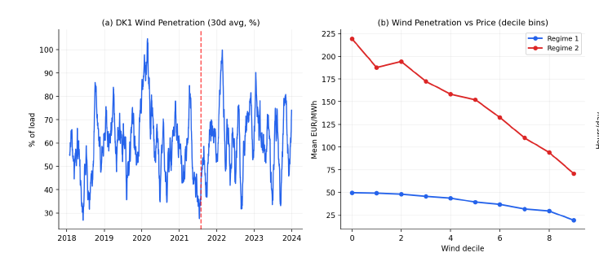
Motivation and Optimisation Problem
Why DK1 is a demanding hedging environment
High renewable penetration
Wind-driven variability and negative-price episodes
DK1
High wind penetration is associated with stronger price variability and more frequent negative-price episodes.
Sources: Unger et al. (2018); Grohnheit & Sneum (2023).
Source: Author’s calculations.
Notes:
DK1 is particularly interesting because wind generation plays a major role. Wind output varies with weather, influencing electricity supply and sometimes contributing to very low or negative prices. This creates an unpredictable environment for a company that needs electricity continuously.

Slide 7
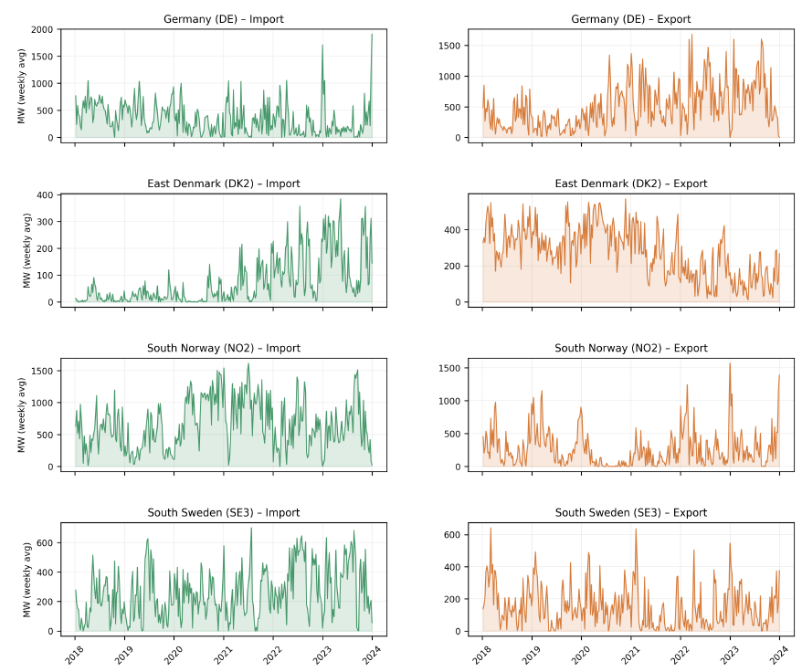
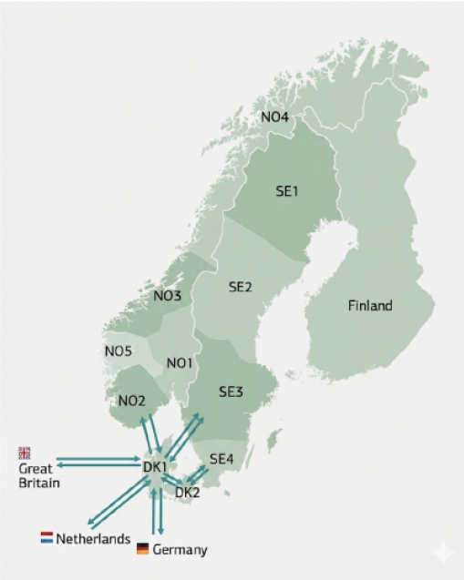
Motivation and Optimisation Problem
Why DK1 is a demanding hedging environment
High renewable penetration
Strong market integration
Wind-driven variability and negative-price episodes
Nordic and Continental market exposure
DK1
Source: Energinet (2024)
Source: Author’s calculations.
Notes:
DK1 is also closely connected to Germany and the Nordic markets. Electricity flows across borders, so their prices often move together. That gives us the idea behind our hedge: use movements in other markets to offset part of DK1's movements.

Slide 8
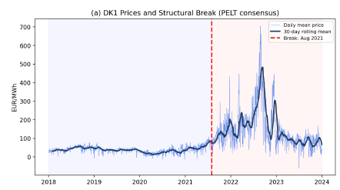
Motivation and Optimisation Problem
Why DK1 is a demanding hedging environment
High renewable penetration
Strong market integration
Wind-driven variability and negative-price episodes
Nordic and Continental market exposure
DK1
Structural instability
2021–2023 European energy crisis
Source: Author’s calculations.
Notes:
Finally, the energy crisis changed the market dramatically. Prices surged and the usual patterns became less stable. That's why we cannot judge a hedge only on the data used to build it. We need to test whether it works on later observations.

Slide 9
Data & Methodology
Notes:
With that context, let's look at the data and translate our idea into an optimization problem.

Slide 10
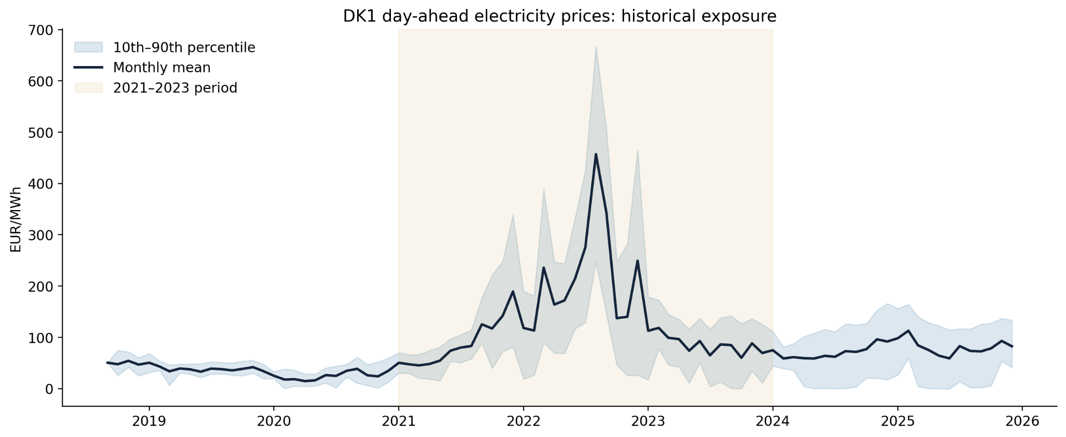
Electricity prices changed the risk landscape
The 2021 to 2023 crisis shows why the company needs to manage price uncertainty.
NEOMA | Electricity price risk hedging | Statistical spot-price proxy
Notes:
This historical chart shows why price uncertainty matters. Before 2021, DK1 prices were relatively moderate. During the crisis, both average prices and the range of possible outcomes rose sharply. For our manufacturer, that makes electricity costs difficult to anticipate.

Slide 11
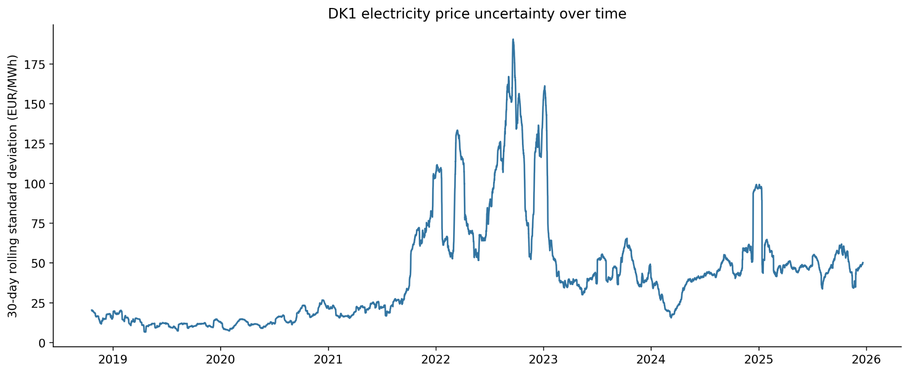
Price uncertainty rises sharply in stress periods
The 30-day rolling standard deviation captures changes in market risk over time.
NEOMA | Electricity price risk hedging | Statistical spot-price proxy
Notes:
This second chart measures volatility over time using a rolling 30-day standard deviation. The peaks show that risk is not constant. This motivates two different questions: how can we reduce overall fluctuations, and how can we limit the most extreme upward price movements?

Slide 12
Data & Methodology
Five interconnected electricity markets
Historical hourly day-ahead prices (EUR/MWh), original ENTSO-E exports
DK1
DE
DK2
NO2
SE4
TARGET
HEDGE
HEDGE
HEDGE
HEDGE
Western Denmark
Germany
Eastern Denmark
Southern Norway
Southern Sweden
Data preparation
Parse hourly delivery intervals → convert CET/CEST to UTC → align common timestamps → calculate consecutive hourly changes.
Notes:
We use hourly day-ahead prices for five markets: DK1 as the target, and Germany, DK2, NO2 and SE4 as potential hedges. We align timestamps, handle time zones and calculate hourly price changes in euros per megawatt-hour. We use absolute changes because electricity prices can be zero or negative.

Slide 13
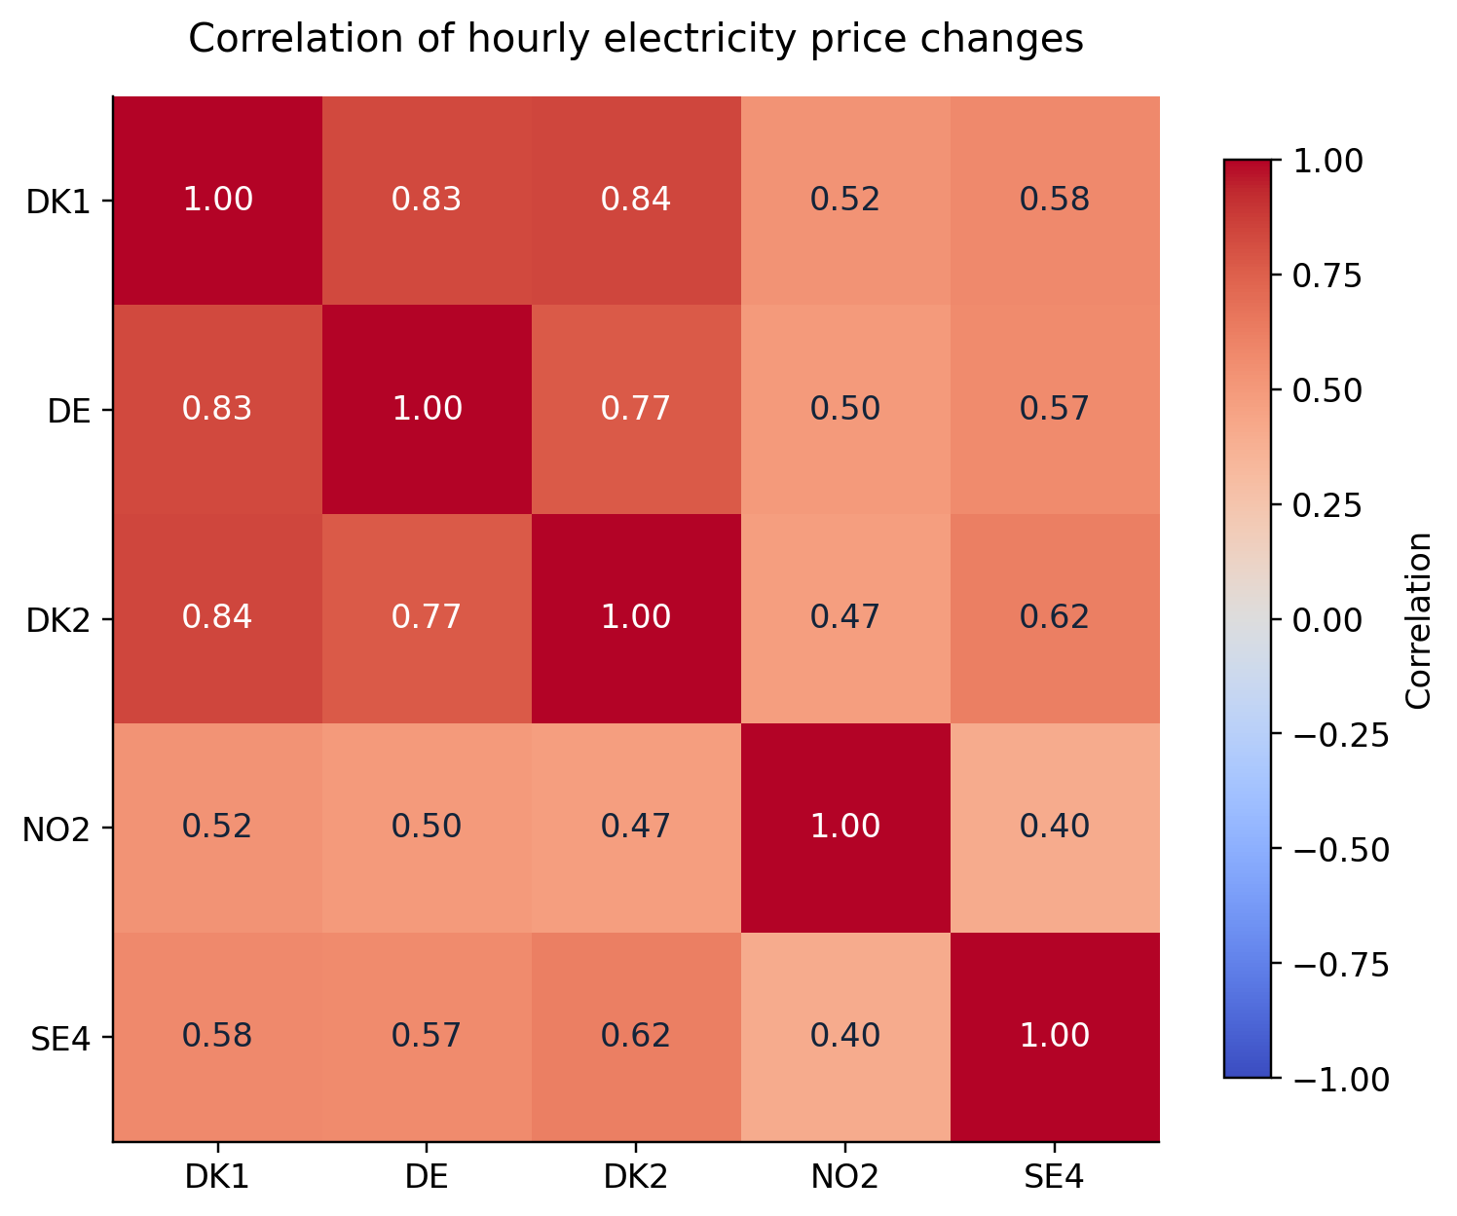
Data & Methodology
Minimum-variance hedging framework
Correlations of hourly price changes motivate a cross-market proxy hedge.
Notes:
The correlation matrix gives us an encouraging starting point. DK1 changes are strongly correlated with Germany, at 0.83, and DK2, at 0.84. Norway and Sweden are less correlated. But correlation alone cannot tell us the best combination, so we turn to optimization.

Slide 14
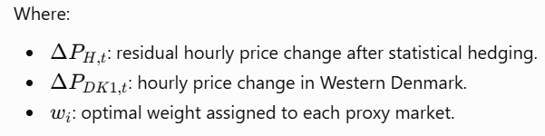


Data & Methodology
Minimum-variance hedging framework
Four proxy hedge weights are estimated on historical hourly price changes
Objective
Constraints
Estimation
Minimize the variance of the residual hourly price changes.
0 ≤ each weight ≤ 1; total weight ≤ 1.
SciPy SLSQP; chronological 70% train / 30% test.
*Only spot prices are used
Notes:
Our first model is minimum variance. We take the DK1 hourly price change and subtract weighted changes from the four other markets. We choose weights to minimize the variance of what remains. Each weight is between zero and one, and their sum cannot exceed one. We estimate on the first 70% of observations and test on the last 30%.

Slide 15


Data & Methodology
Beyond volatility: why optimize CVaR?
The company also wants protection against unusually large upward price changes
MINIMUM VARIANCE
MINIMUM CVaR
Minimize the dispersion of residual hourly price changes.
Focus: overall volatility.
Minimize the average residual price increase in the worst 5% or 1% of scenarios.
Focus: adverse upper-tail outcomes.
Both methods use the same constraints: 0 ≤ each weight ≤ 1 and total weights ≤ 1.
Notes:
Minimum variance treats large upward and downward moves as risk. But for a company buying electricity, large upward moves are especially painful. So we also optimize CVaR at 95% and 99%. CVaR focuses on the average outcome in the worst 5% or 1% of upward residual price changes, using the same weight constraints.

Slide 16
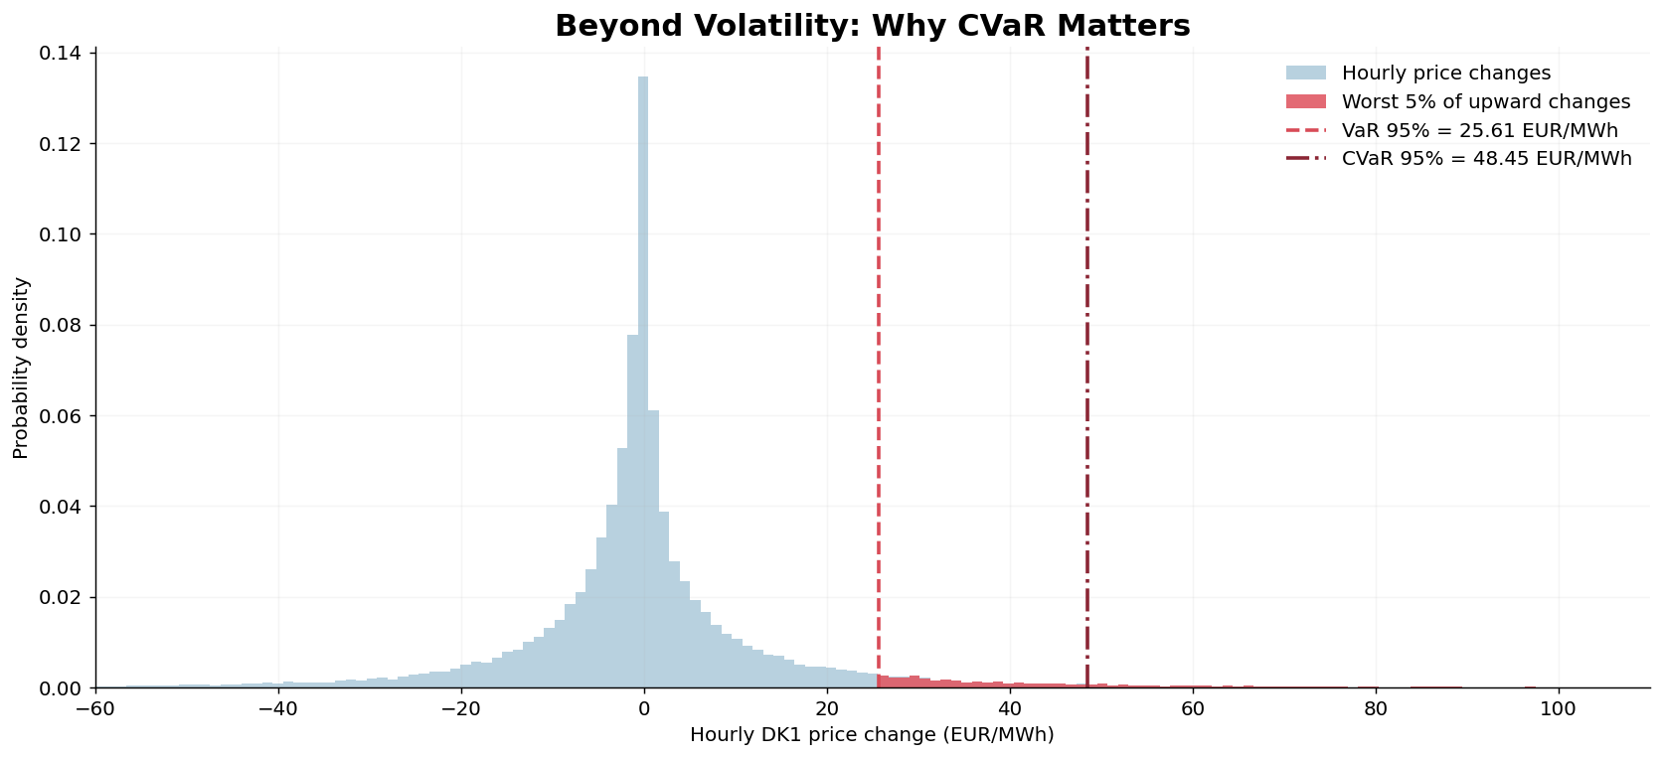
Data & Methodology
Beyond volatility: why optimize CVaR?
The company also wants protection against unusually large upward price changes
MINIMUM CVaR
Minimize the average residual price increase in the worst 5% or 1% of scenarios.
Focus: adverse upper-tail outcomes.
Both methods use the same constraints: 0 ≤ each weight ≤ 1 and total weights ≤ 1.
Notes:
This histogram makes CVaR intuitive. Most hourly price changes are close to zero, but some increases are much larger. VaR at 95% marks the start of the worst 5% of increases. CVaR measures their average size. In short, VaR gives us the threshold; CVaR tells us how severe those extreme observations are.

Slide 17
Empirical Results
Notes:
Now we can compare the three optimized strategies, using the same held-out test period.

Slide 18
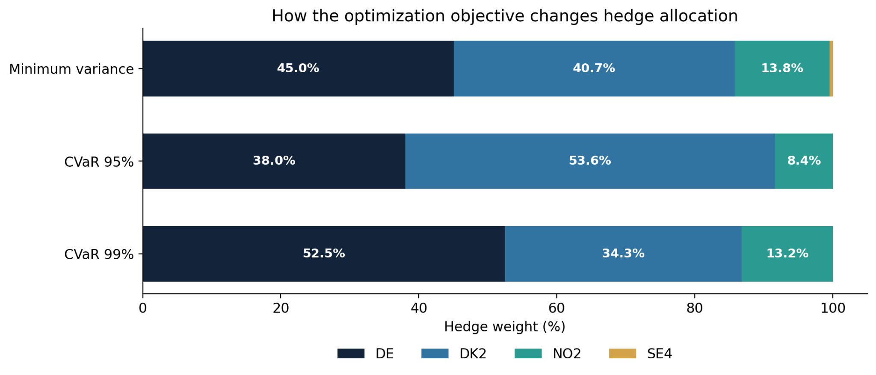
Empirical Results
Different risk objectives lead to different allocations
Minimum variance, CVaR 95% and CVaR 99% shift exposure between DE and DK2.
Notes:
The objectives produce different weights. Minimum variance allocates roughly 45% to Germany and 41% to DK2. CVaR 95% favors DK2 more strongly, while CVaR 99% puts more weight on Germany. So changing the objective changes the hedge composition. But does it change the performance just as much?

Slide 19
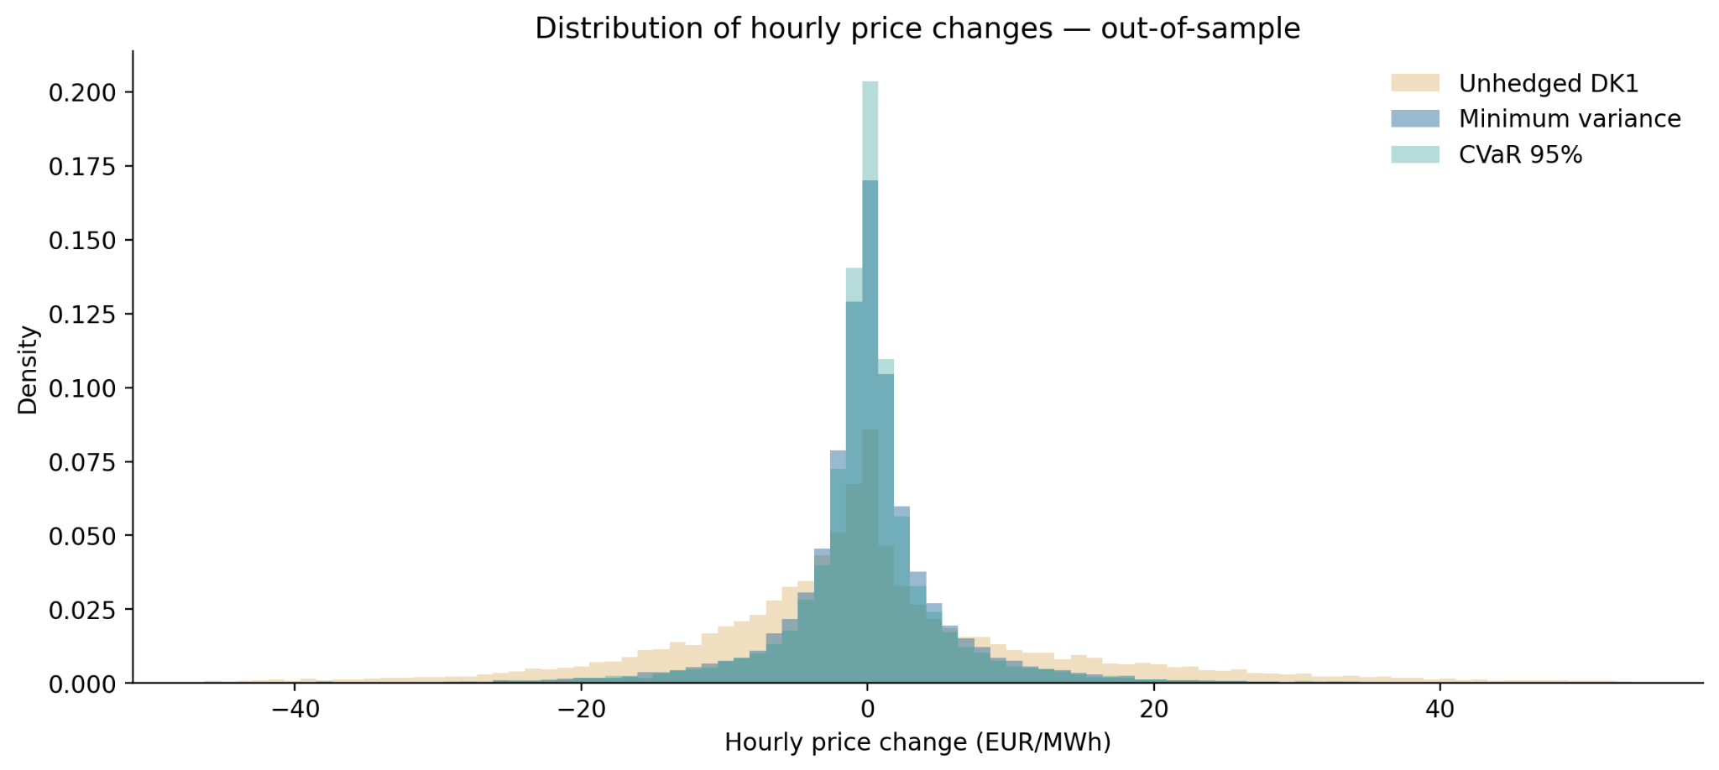
Empirical Results
The hedged distribution is much narrower
Out-of-sample residual price changes show less dispersion than unhedged DK1.
Notes:
The distribution chart gives us the first answer. Compared with unhedged DK1, the hedged hourly changes are much more concentrated around zero. That means the other markets offset a substantial part of DK1's movements in our test data.

Slide 20
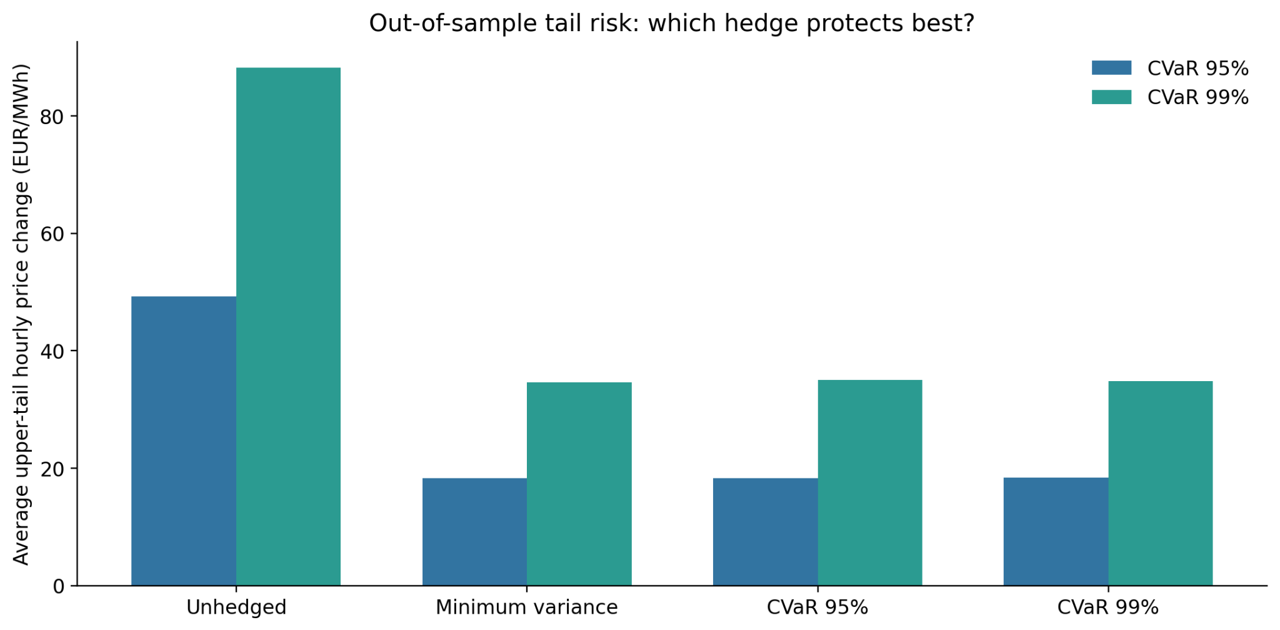
Empirical Results
Tail-risk protection is strong across all three hedges
CVaR 95% has a slight edge at 95%, while minimum variance is lowest at 99%.
Notes:
The tail-risk results are also strong. Without a hedge, CVaR is about 49.3 euros per megawatt-hour at 95% and 88.2 at 99%. All three strategies reduce these figures sharply. CVaR 95% performs best at the 95% level, reaching 18.25, while minimum variance is best at 99%, reaching 34.62.

Slide 21
Empirical Results
Tail-risk protection is strong across all three hedges
CVaR 95% has a slight edge at 95%, while minimum variance is lowest at 99%.
Notes:
What's surprising is how close the results are. CVaR 95% improves its own tail measure by just 0.072 euros per megawatt-hour compared with minimum variance. So a more specialized objective changes the allocations quite noticeably, but does not necessarily deliver a large improvement out of sample.

Slide 22
Empirical Results
What did we actually find?
The same historical data tells a clear story about DK1 price risk
The main result
The interesting surprise
On our common test sample, minimum variance reduces the variance of hourly DK1 price changes by about 85.4%. The other optimized strategies also sharply reduce tail risk.
CVaR 95% has the lowest observed 95% tail risk, but only by 0.072 EUR/MWh versus minimum variance. At the 99% level, minimum variance performs slightly better.
Takeaway: changing the objective changes the weights much more than the final risk results.
Notes:
Our main finding is that the minimum variance hedge reduces the variance of DK1 hourly price changes by about 85.4% on the test sample. CVaR strategies also perform well, but none dominates across every measure. The cross-market approach matters more here than the choice between these objectives.

Slide 23
Conclusion & Limitations
Notes:
Let's finish by returning to the manufacturer's original question and the limits of what we tested.

Slide 24
Conclusion
What we tested, and what we learned
Four key steps from our analysis, using hourly spot prices
01
Build a common dataset
Align DK1, DE, DK2, NO2 and SE4 hourly prices, then calculate price changes.
02
Optimize three strategies
Estimate minimum variance, CVaR 95% and CVaR 99% weights on the training sample.
03
Test on unseen observations
Keep the weights fixed and compare risk on 18,974 common test hours.
04
Compare the trade-offs
Review hedge weights, standard deviation and upper-tail CVaR side by side.
Notes:
We built an hourly dataset, estimated three constrained optimization strategies, and evaluated their performance on observations they had not seen. The results show that neighboring market price changes can substantially reduce measured DK1 price-change risk in our sample.

Slide 25
Conclusion
So, which approach would we keep?
The simplest benchmark is surprisingly hard to beat
CVaR 95%: best on its target
Minimum variance: nearly the same
Lowest test CVaR 95%: 18.250 EUR/MWh.
It also has the lowest standard deviation: 7.318 EUR/MWh.
Test CVaR 95%: 18.322 EUR/MWh.
Lowest test CVaR 99%: 34.620 EUR/MWh.
Our conclusion: all three reduce risk strongly, but CVaR adds only a small out-of-sample benefit here.
Notes:
If we had to retain one benchmark, minimum variance is a strong choice: it is simple, delivers major variance reduction, and even has the lowest observed 99% CVaR. CVaR 95% has a slight edge at its own tail level. Importantly, these are statistical spot-price hedges, not actual trades or proven electricity-bill savings. Our conclusion is that cross-market optimization is promising, and the objective changes allocations more than test-period performance. Thank you.

