Slide 1
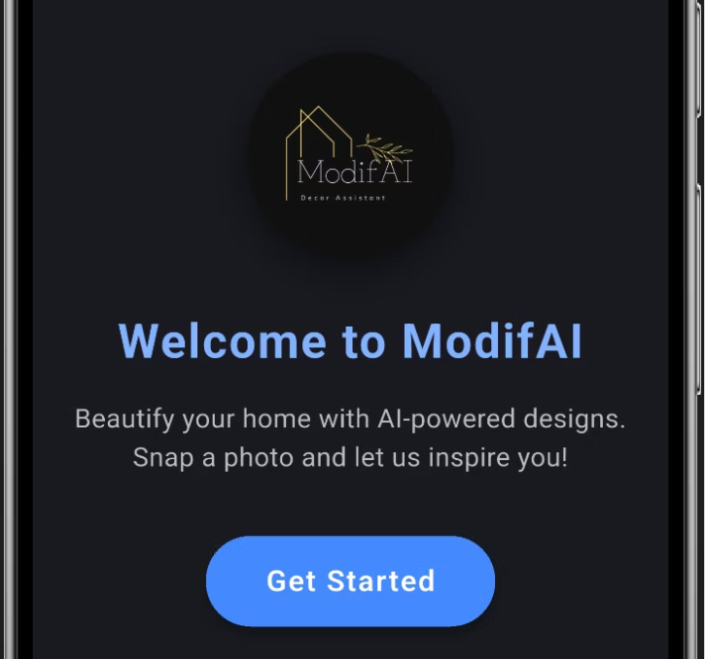
Project ModifAI – Smart AI Home Decore Assistant
Course Code & Section: CSE299.4 Project Group No.: 2Group Members:Akram Hossain Apu Khan – 2231090642Mehedi Hasan Dip – 2232167042Hacibull Hashan Tosher – 2111626642

Slide 2
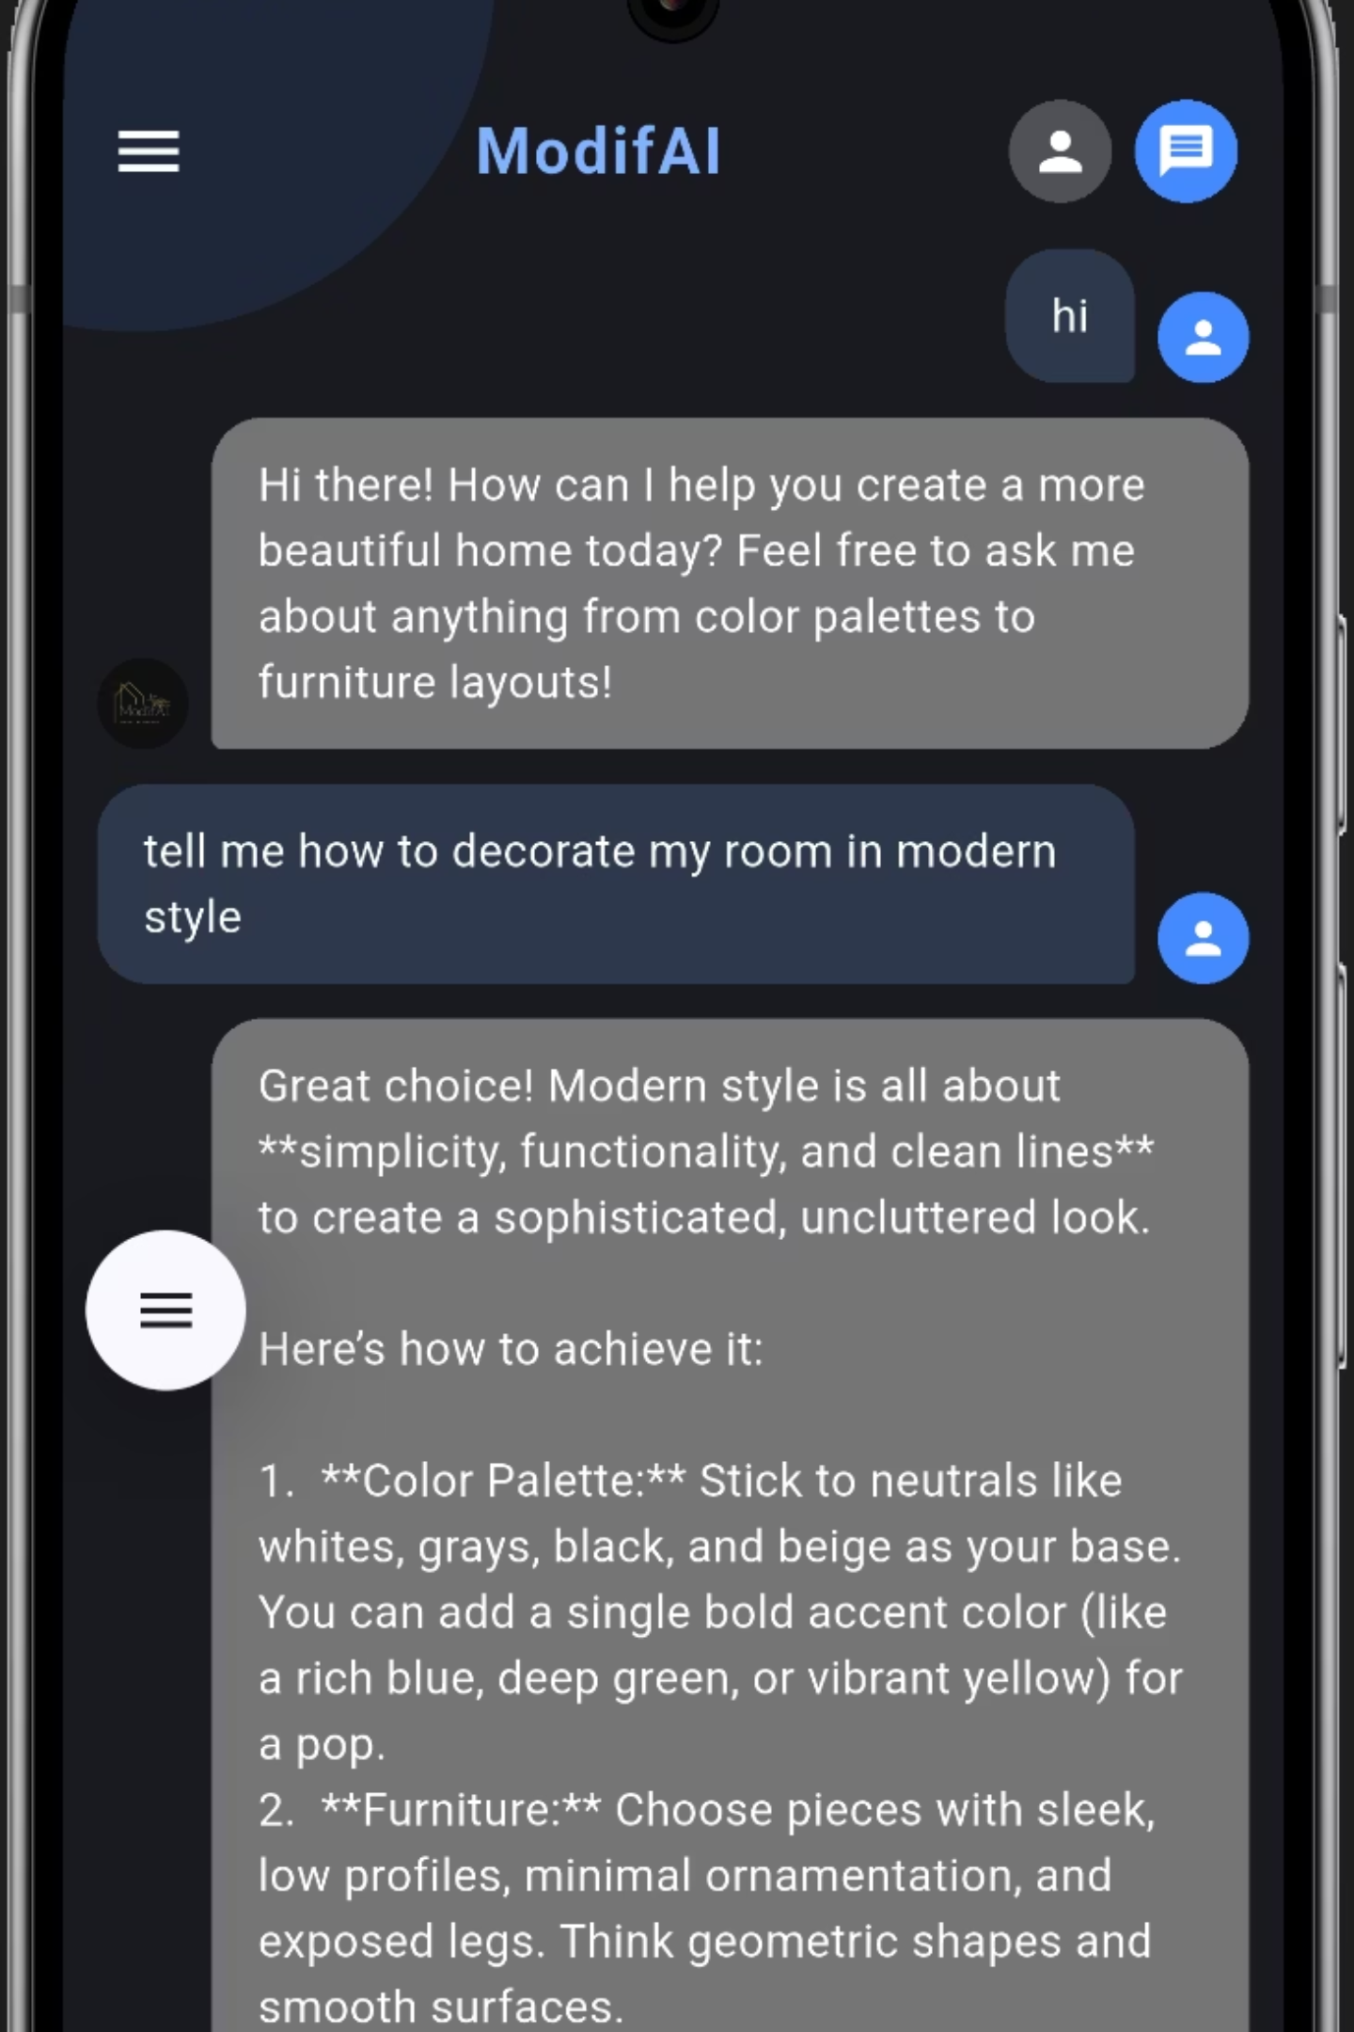
Project Overview: ModifAI
ModifAI is an innovative AI-powered assistant designed to enhance user interaction through intelligent chat and advanced image recognition.
Dynamic Communication: Seamlessly understand and respond to diverse user queries.
Visual Intelligence: Integrate image analysis for richer interactions.
Personalized Experience: Tailor responses to individual user profiles and past interactions.

Slide 3


Core Objectives
Integrated AI Chatbot
Multimodal Input
Develop and seamlessly embed an intelligent AI chatbot within our application.
Enable the system to process both text and image inputs for comprehensive understanding.
Enhanced Personalization
Modern UI/UX
Implement robust user profile features for tailored responses and an individualized experience.
Ensure a responsive, intuitive, and visually appealing user interface across all devices.

Slide 4
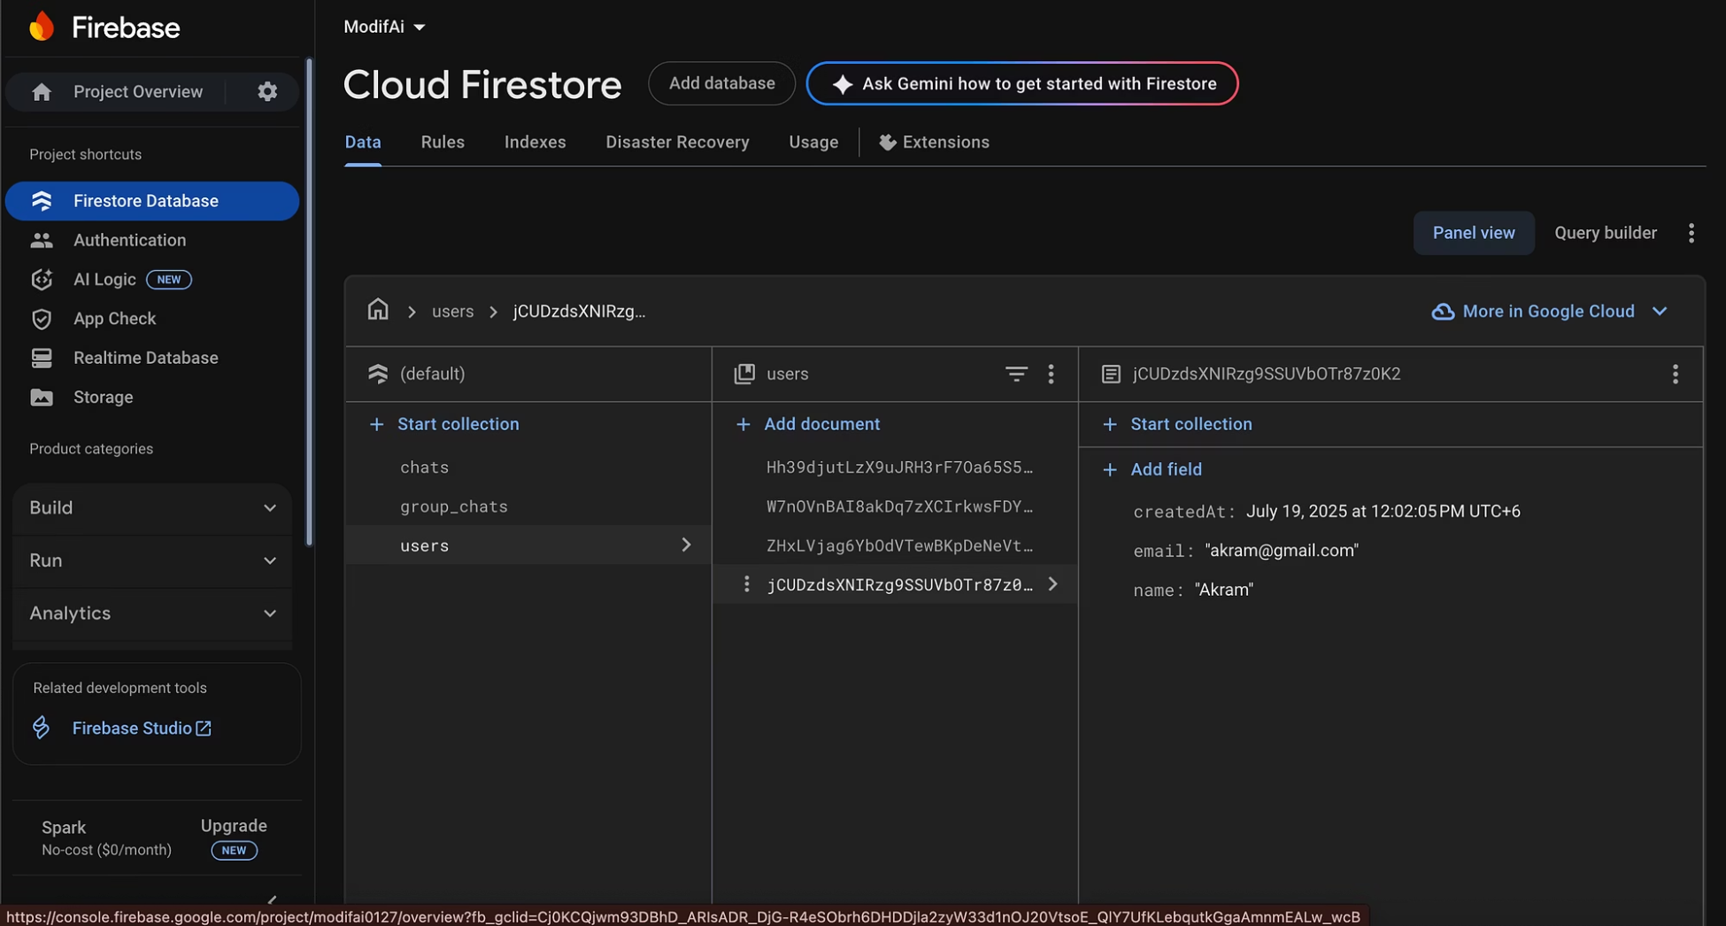
System Architecture
ModifAI's robust architecture ensures seamless communication and efficient data processing.
Client: User interface for interaction.
Firebase: Backend services for real-time data and authentication.
AI API: Core intelligence for chat and image processing.
Cloud Storage: Securely stores user data and images.
TURN/Signaling: Facilitates direct and efficient communication.

Slide 5
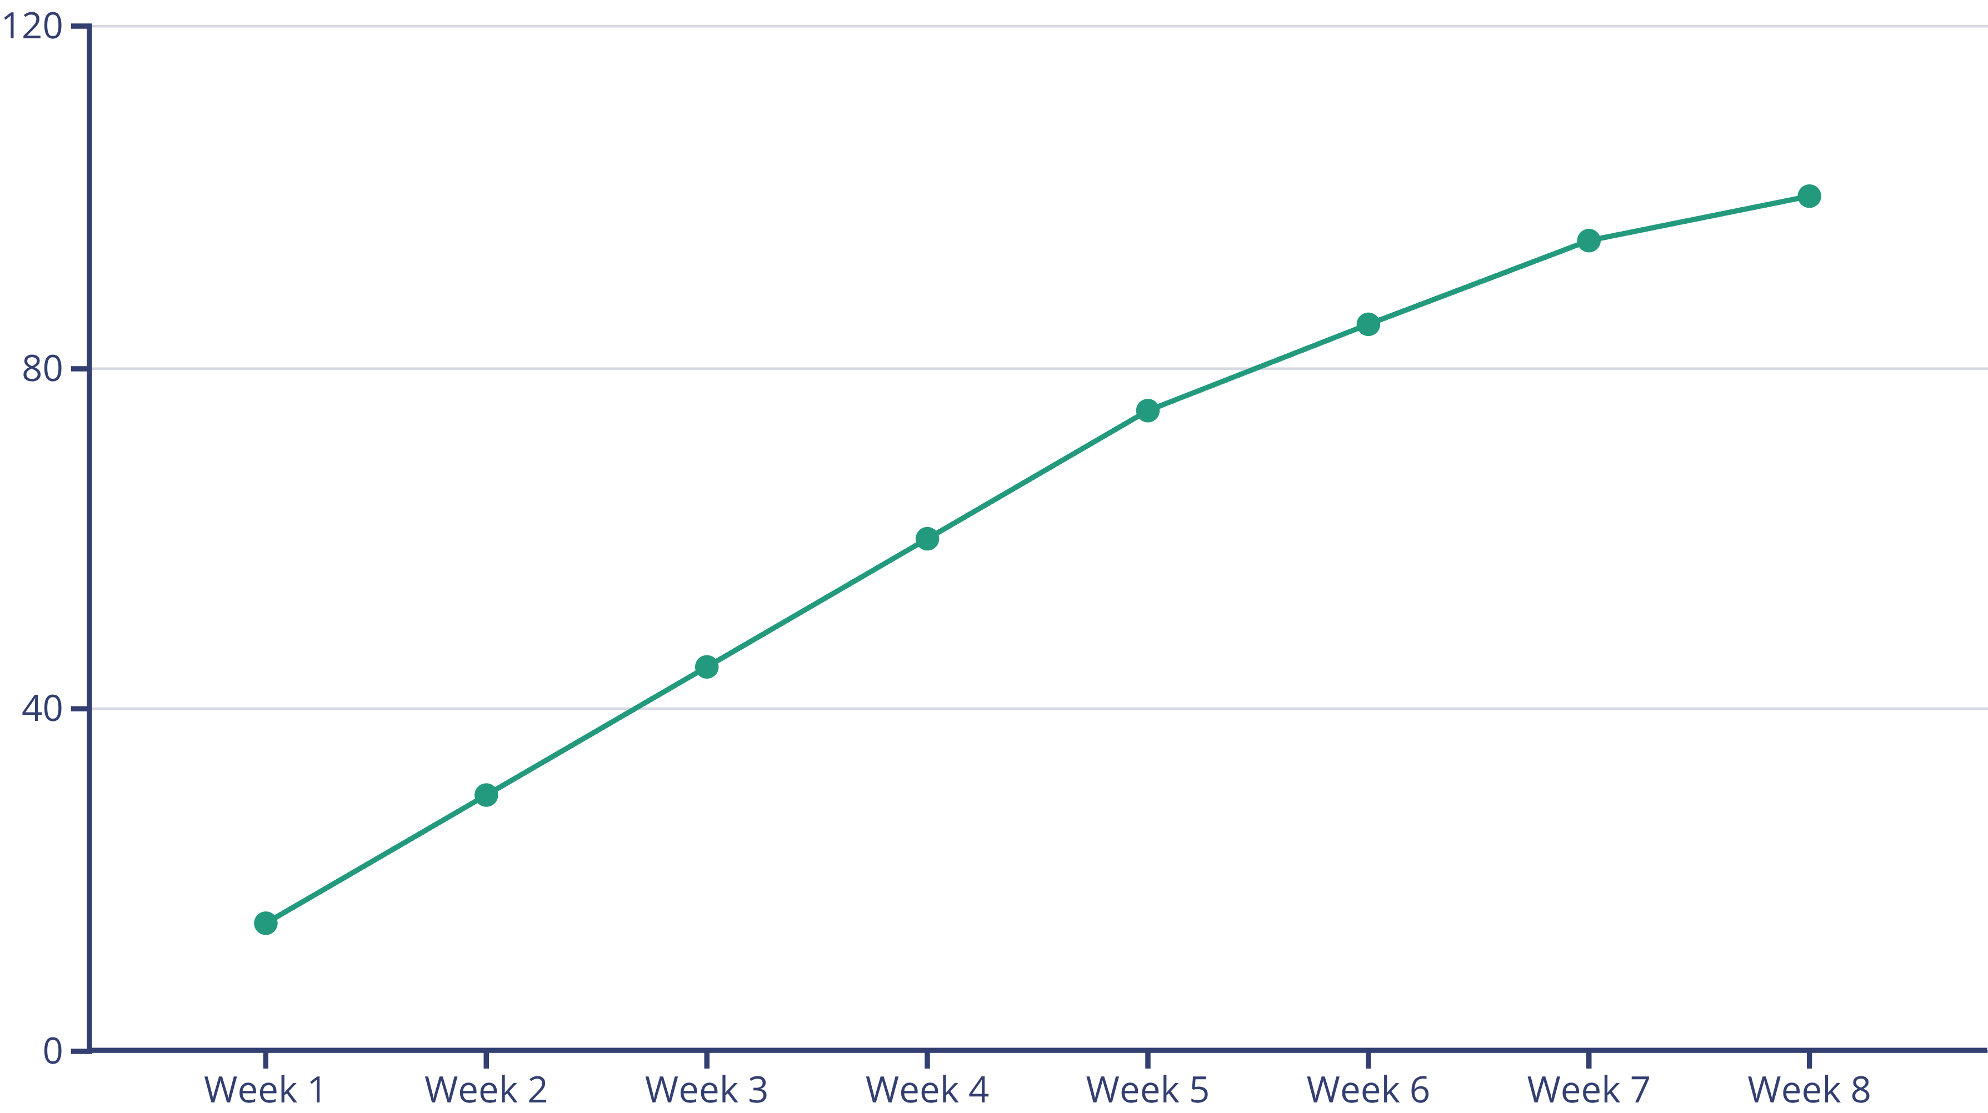
Progress Timeline
Our structured approach ensured consistent progress throughout the project lifecycle.
Key milestones included repository setup, initial UI design, core AI integration, image response capabilities, profile system updates, and rigorous testing phases.

Slide 6
Key Features Implemented
Intelligent Chatbot
Image-Based Interactions
Our AI chatbot can now process and respond to a wide range of user queries, providing relevant and context-aware information.
Users can upload images, and the AI will provide descriptions or answer questions based on the visual content.
Personalized Profiles
Continuous UI Improvements
A dedicated profile page allows users to manage their preferences and view interaction history, enhancing personalization.
Regular updates to the user interface ensure a smooth, intuitive, and visually pleasing experience for all users.

Slide 7
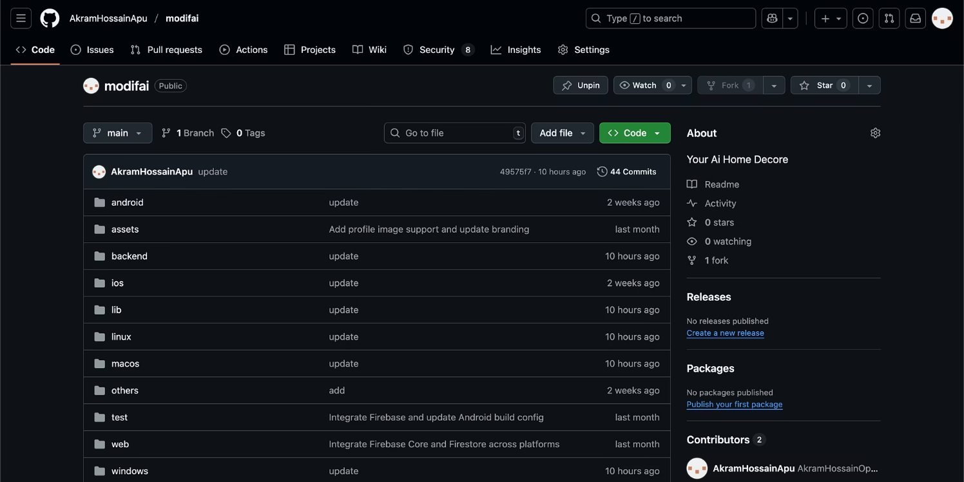
GitHub & Code Demo
GitHub Repository
Our public GitHub repository showcases the entire codebase, including detailed documentation in the README file.
Demo Video: A concise 1-minute video will demonstrate Project ModifAI in action, showcasing its core functionalities.

Slide 8
Results & Learnings
Current Application Status
Challenges & Solutions
ModifAI successfully integrates AI-driven chat with image recognition, providing a functional and user-friendly experience.
We overcame several technical hurdles during development, leading to valuable insights.
UI Freezing: Resolved through asynchronous operations and optimized rendering.
Responsive and intuitive UI.
Accurate AI responses to text and image queries.
Firebase Setup: Streamlined authentication and database rules.
Stable Firebase integration.
AI Response Tuning: Implemented iterative testing for higher accuracy.
Key Learnings: The project reinforced the importance of strong teamwork, consistent commits, and agile problem-solving in complex AI system integration.

Slide 9




Future Work & Enhancements
Group Chat Feature
Advanced AI Personalization
Introduce multi-user chat capabilities, allowing collaborative AI interactions.
Implement deeper learning from user interactions to provide even more tailored responses over time.
Expanded Profile Customization
Enhanced AI Models
Offer more options for users to personalize their profiles and interface preferences.
Integrate cutting-edge AI models for superior response quality and multimodal understanding.

Slide 10
Project ModifAI: An AI-driven chatbot with multimodal support.
Our dedicated teamwork ensured steady progress and strong results, delivering a robust and innovative solution.
CSE299.4 | Group 2 – Akram, Mehedi, Hashan

