Slide 1
Presented by:
Akram Abuhajar 184650
GravaFun
A physics educational game.

Slide 2
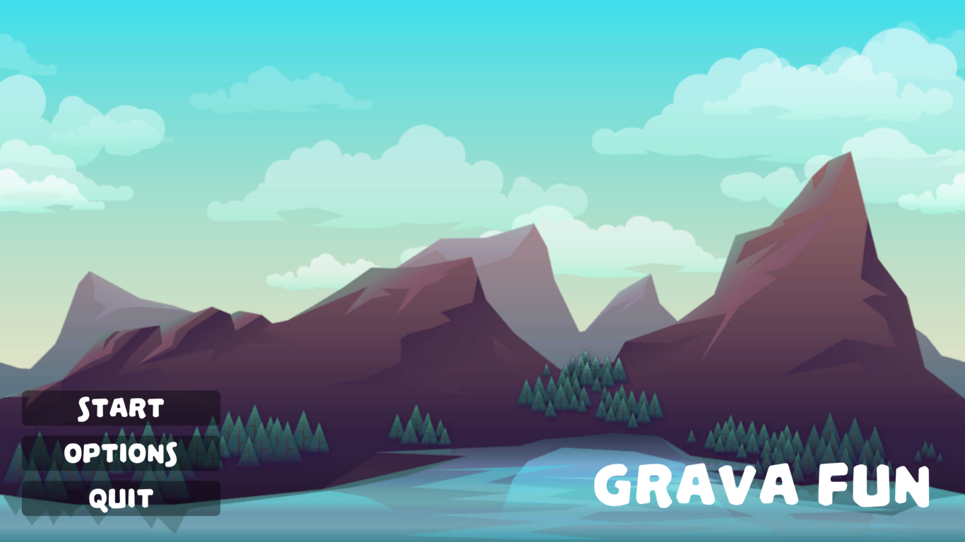

So what is it about?
A game development project.
Where fun, entertainment and learning get combined together.
Mostly Focusing on.
The most basic law’s of physics, specially the ones the child can relate to in his/her real life daily activities.
S

Slide 3
Concept of implementation.
The perfect formula to achieve
the balance.
G
D
Education.
Providing a good amount of educational material that will be benefitial to such an age genre
Entertainment
Providing a product that will attract customers, connect them with the gameplay, and get a good experience out of it.
C
Education
Entertainment

Slide 4
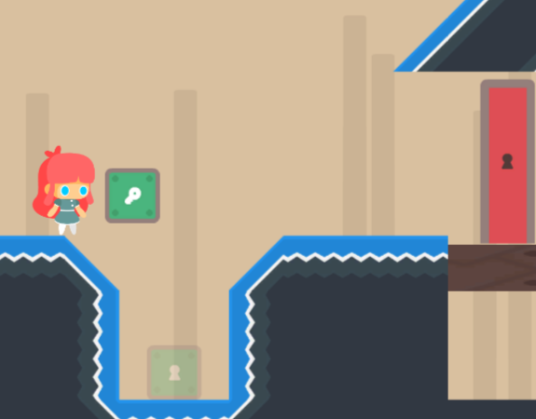
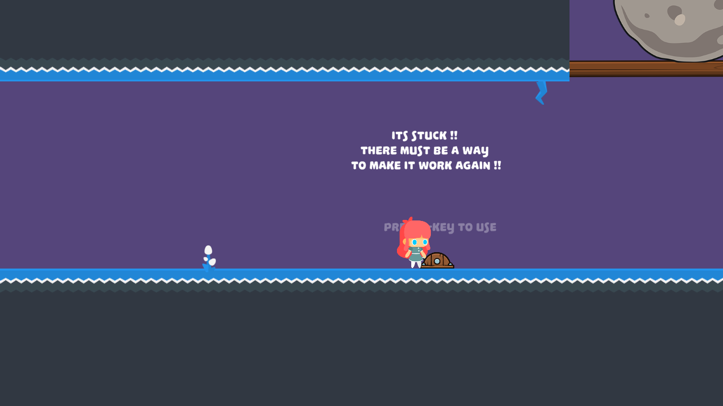
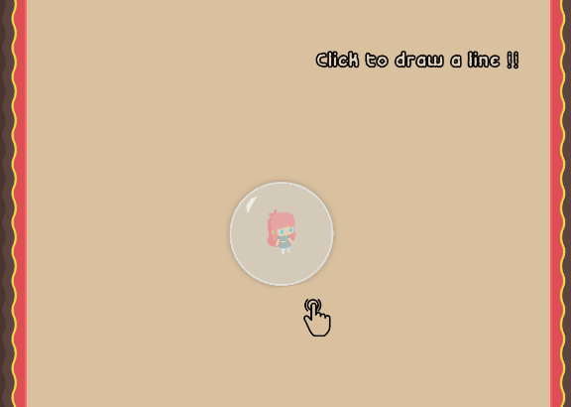
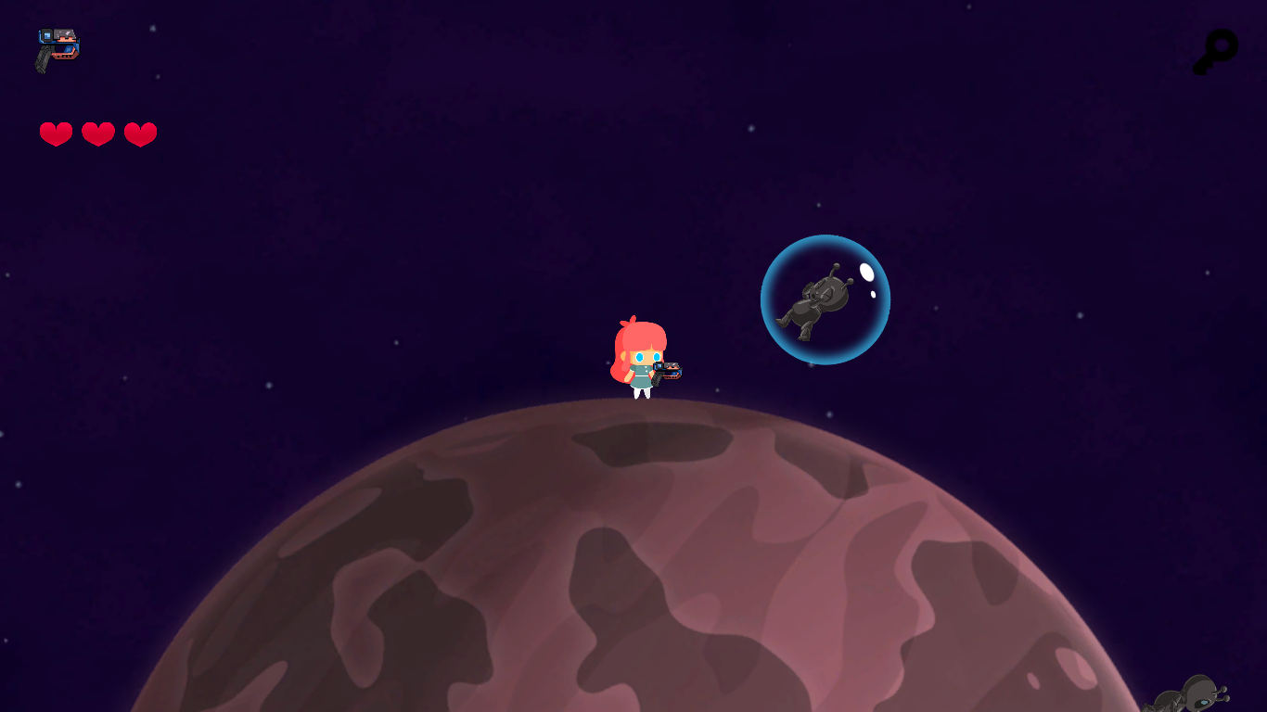
Variety of gameplay
Experience different environments and sceneries !
The intro-level
Introduction to the movement mechanics.
Introduction to the puzzle solving concept.
Itroduction to the purpose of the game.
The puzzle platformer
A puzzle focusing on the first low of motion.
Explore, try and fail, memorize to solve the puzzle.
Clues and explanations are given in texts, SFX, and many more.
The free-faller
A puzzle focusing on Newton’s law of universal gravitation.
Strengthen’s consumer memory muscle for patterns.
Simple and entertaining environment and concept.
Into the space
A different physics from all previous levels.
Depends on interaction with the surrounding environment
Introduced an appropriate combat system as a solution for the puzzle.

Slide 5
Tools and others.
Unity
One of the leading game development platforms.
01
S
C# language
It is the scripting language for developing functionalities for objects.
02
Q
These are the main tools and applications that i have used in creating and developing my project.
VSCODE
Visual Studio code, the top editor to use when it comes to programming under unity platform.
03
L
Adobe photoshop
It was used for multiple designs and modifications on textures.
T
04

Slide 6
Completeley made for the consumer benefit
1- Develops a good understanding of the surrounding world.
2- Develops the consumer’s memory and improves brain reflex and action taking rate.
3- Fun, Entertaining
environment that is appropriate for the consumer age with embedded benefits.
Goals and purposes for
this project.

