Slide 1
Digital Twin of Refrigerator Cooling Circuit Design

Slide 2
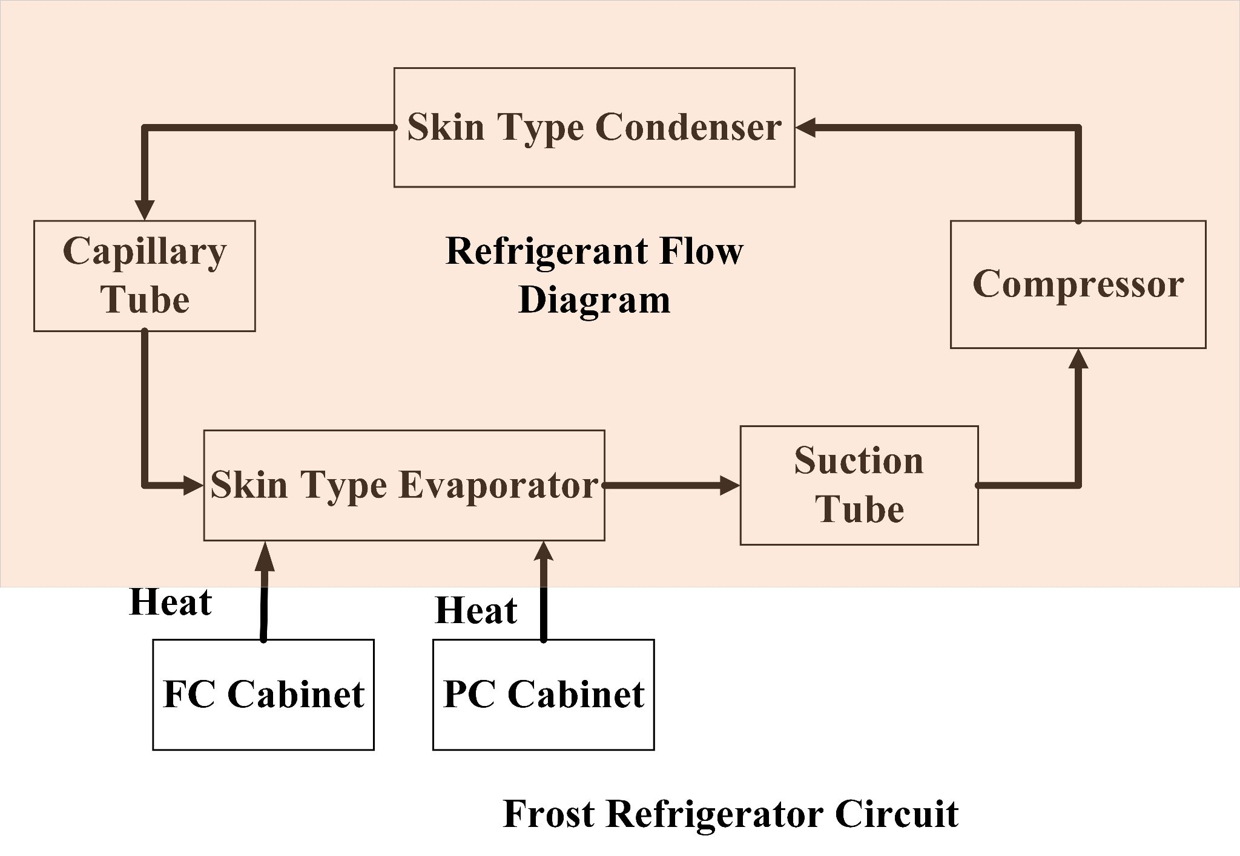

Slide 3
Architecture
Input Condition
Condenser Temperature
Evaporator Temperature
Ambient Temperature
Refrigerator Dimension
Compressor Type
Resultant
Condenser Length
Capillary Tube/Expansion Valve Length
Evaporator Length
RefGO Agent

Slide 4
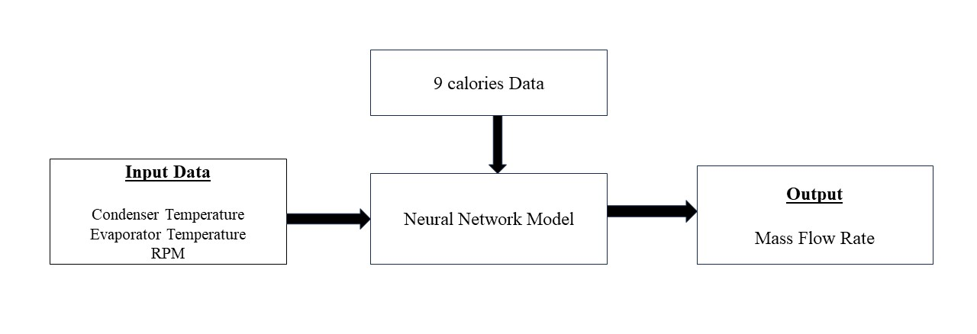
Compressor Modeling

Slide 5
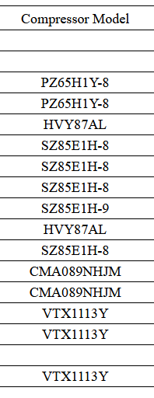
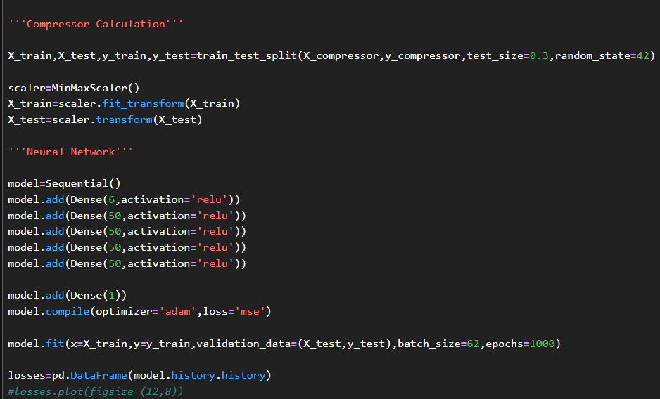
Compressor Modeling

Slide 6
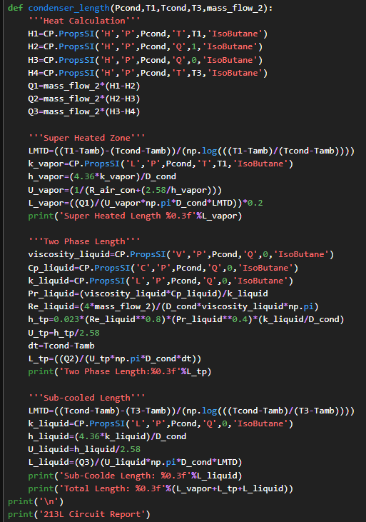
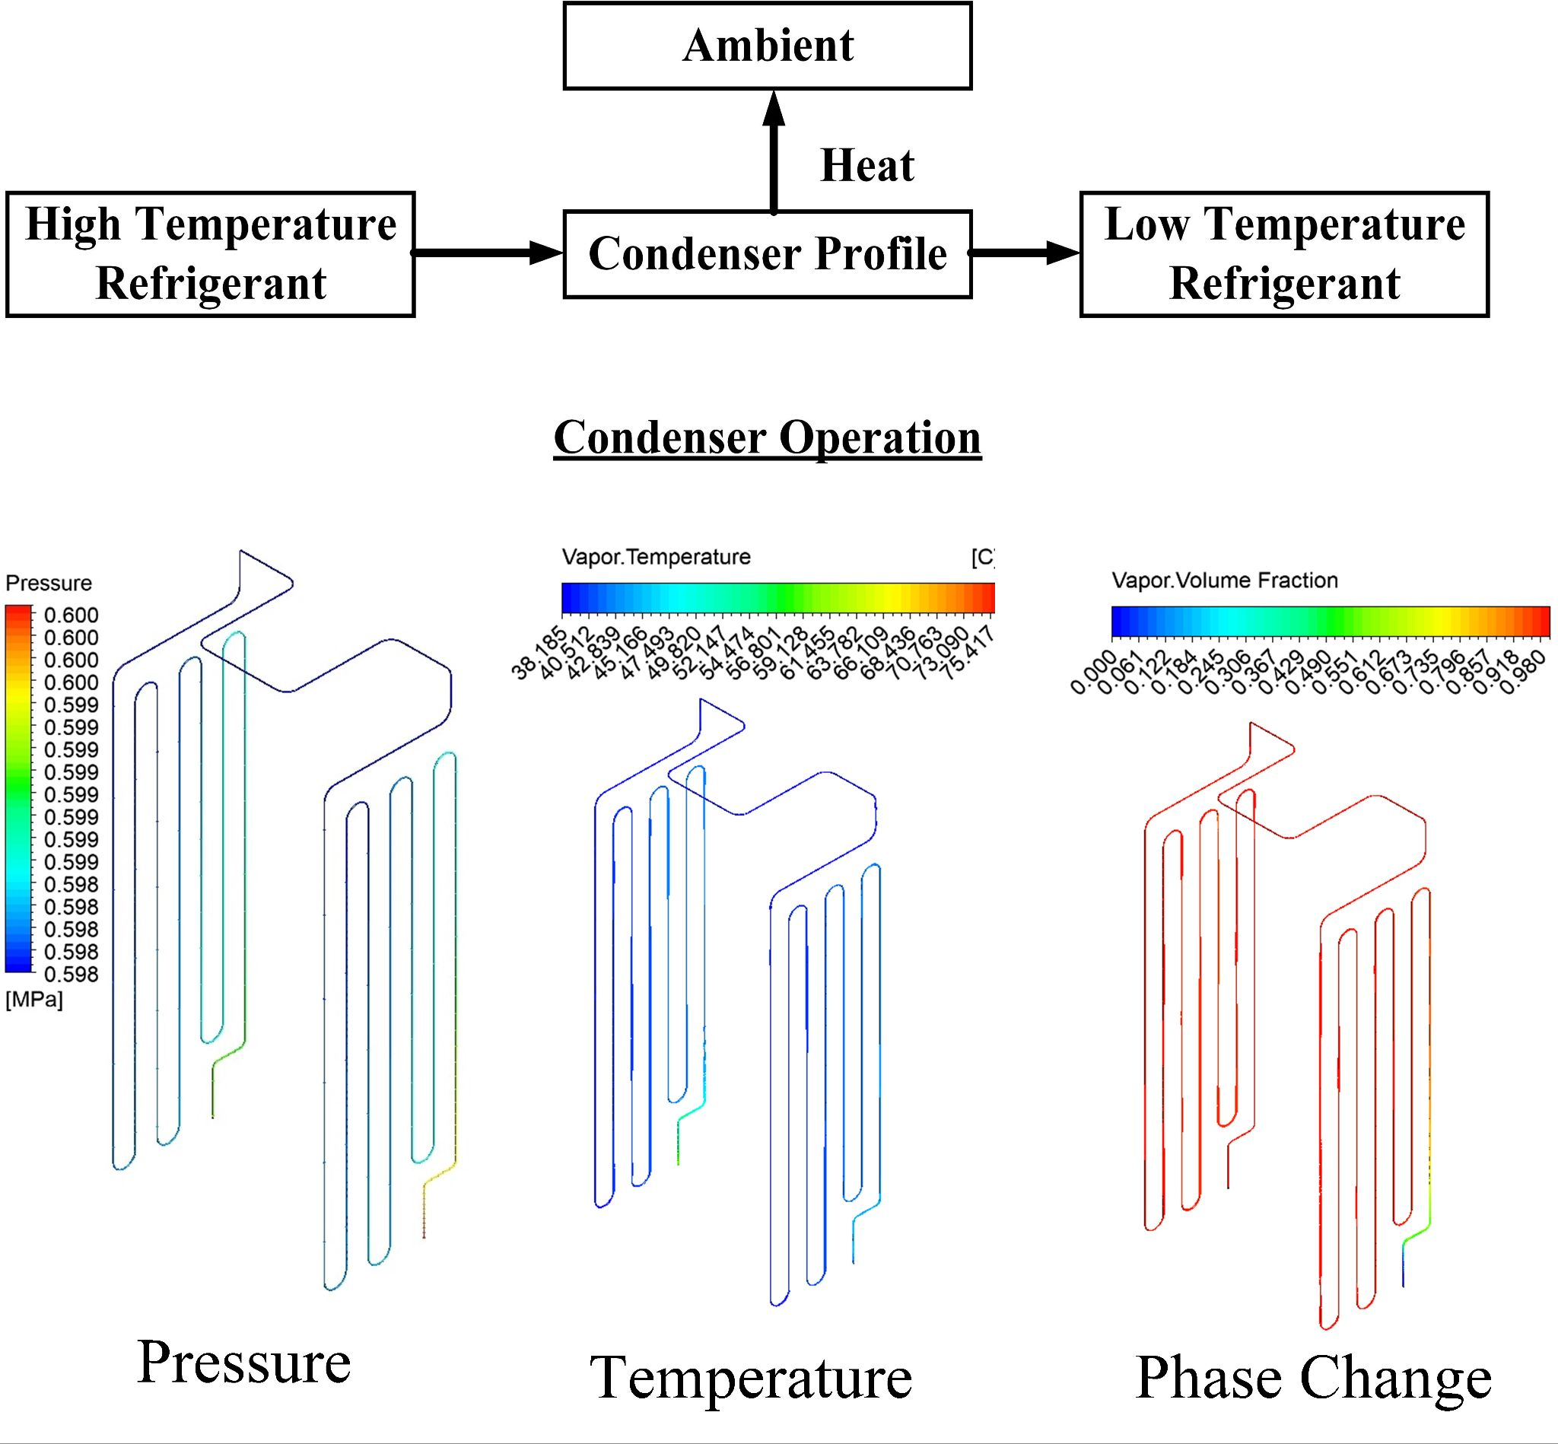
Condenser Modeling

Slide 7
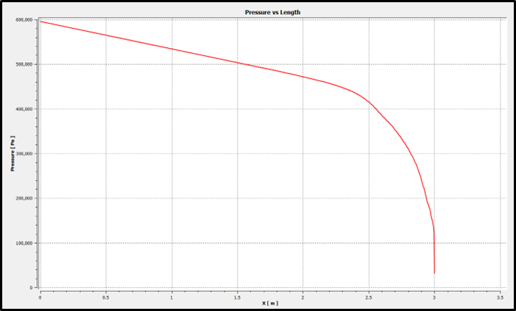
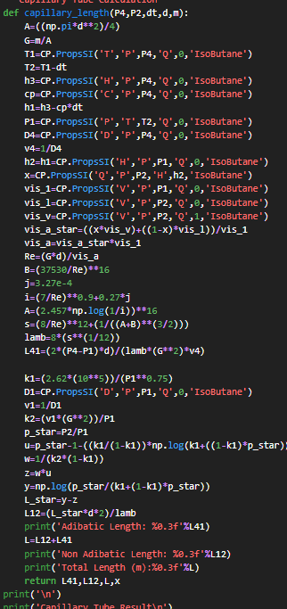
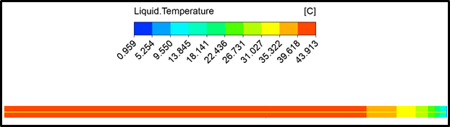
Capillary Tube Modeling

Slide 8
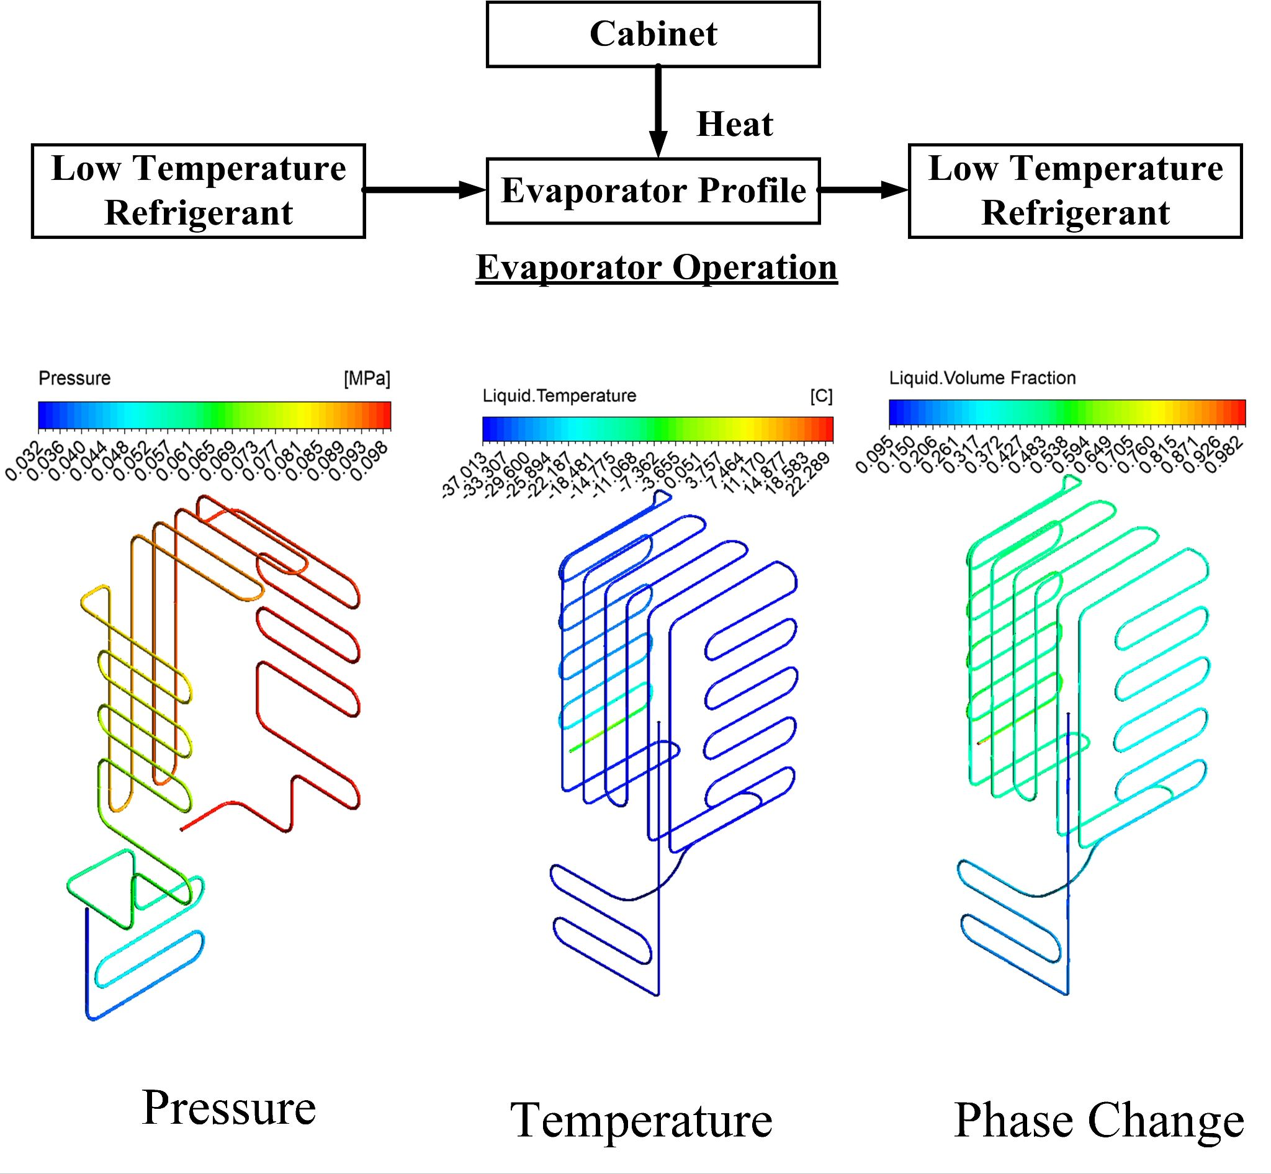
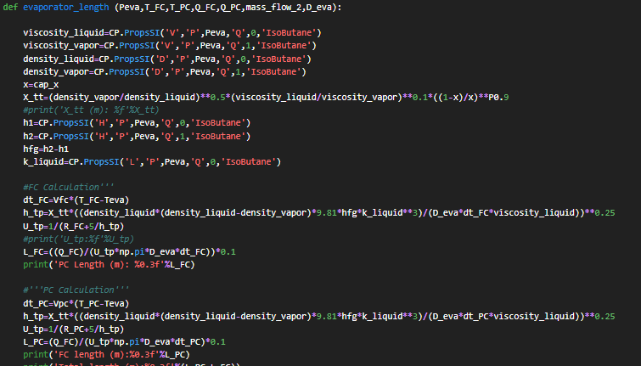
Evaporator Modeling

Slide 9
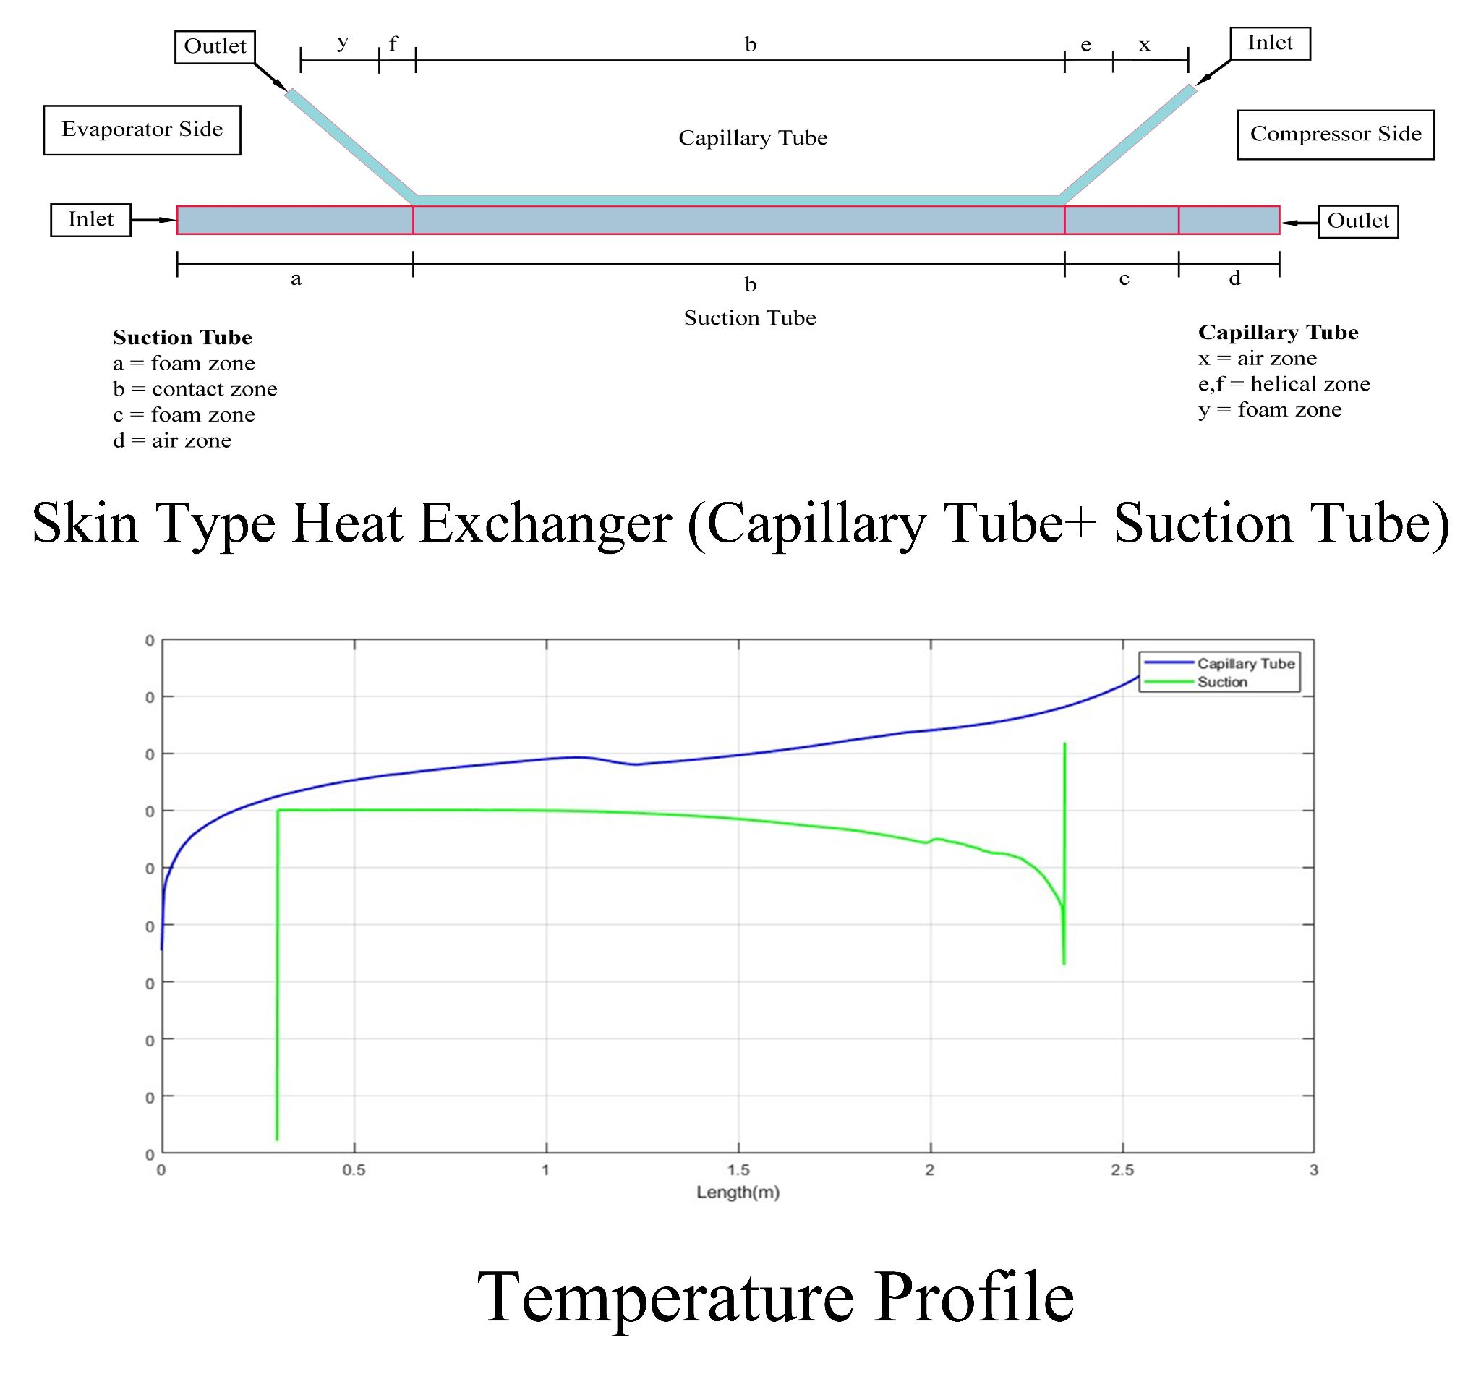
Skin Type Heat Exchanger Modeling

Slide 10
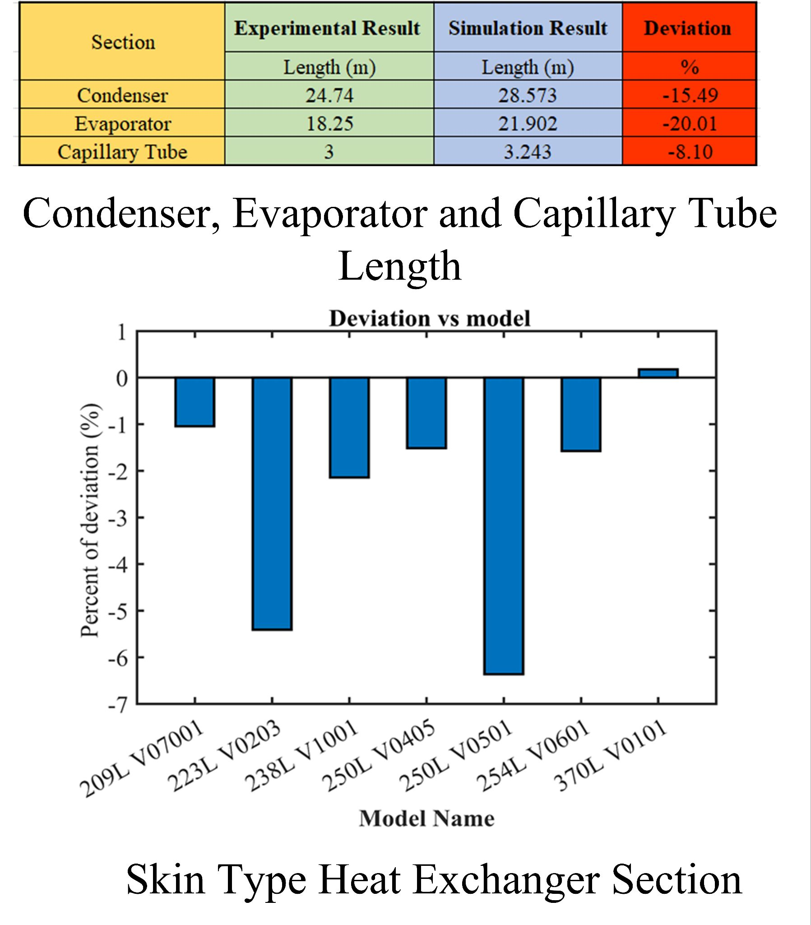
Performance

Slide 11
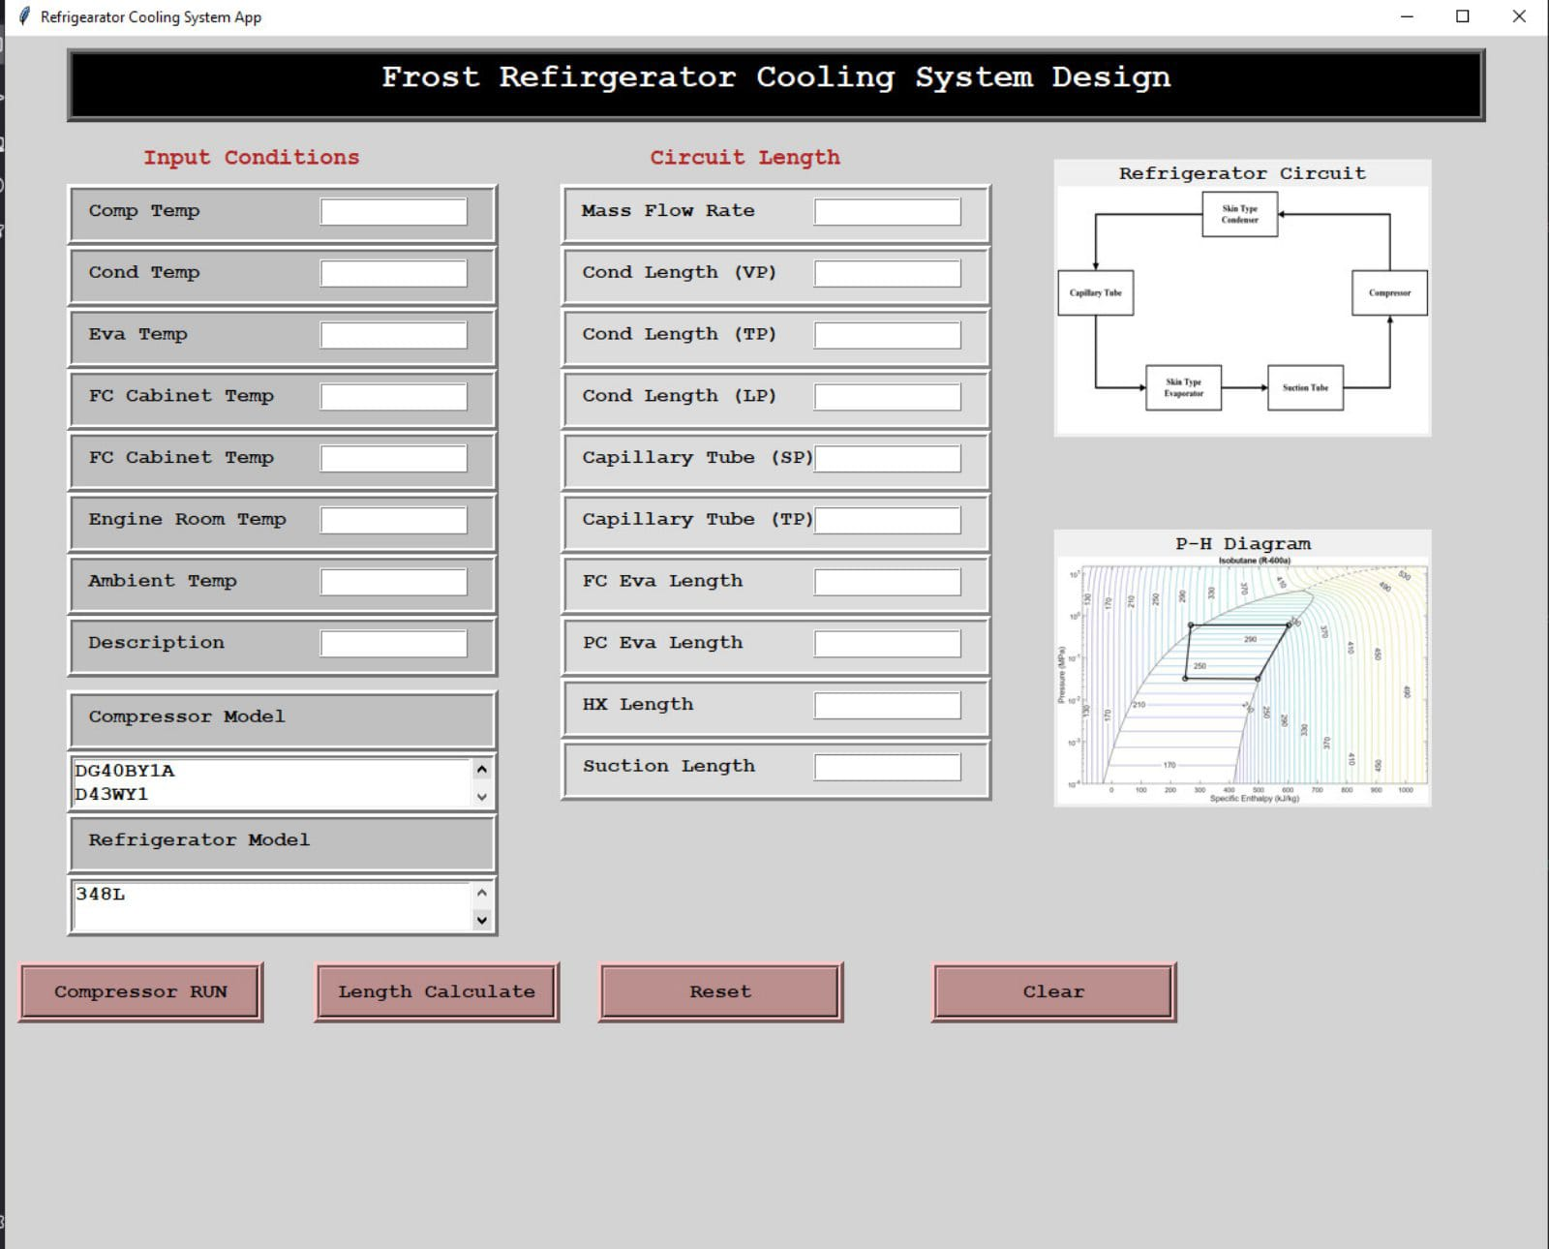
User Interface

