Slide 1
In this tutorial we will be learning about how to make a simple CRUD application on students data using the MERN stack. This tutorial will be focusing more on the integration of each technology to build a full stack app rather than diving deep into each technology. However few prerequisites are expected to be met.
Prerequisites
Javascript:
Ternary operators
Arrow functions
JSON objects
Object and Array destructuring
try-catch
Promises
Async/Await
Array map function
ReactJS:
create-react-app
States and props
Importing modules
useEffect
useState
axios
NodeJS:
Handling http requests
Importing modules
req and res
What are http endpoints

Slide 2
Module 1:
The Database

Slide 3


MongoDB is a nosql database which stores data in the form of key-value pairs in documents.
MongoDB service can be accessed via two methods:
One is installing MongoDB locally and starting up the MongoDB server in your local machine.
Direct communication within the system
Your local machine
The other one is through Atlas, which is cloud service offered by MongoDB where your data is stored in the cloud similar to google drive. The cloud is managed by MongoDB and all you need to do is just connect to your cloud instance and start accessing the database.
Internet
Atlas Cloud

Slide 4
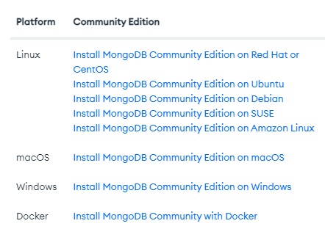
In this tutorial we will be using the local MongoDB service. Use the link given below to install a community edition based on your operating system
LINK:
https://www.mongodb.com/docs/manual/installation/#mongodb-installation-tutorials
Follow the default installation guide given in the documentation.

Slide 5
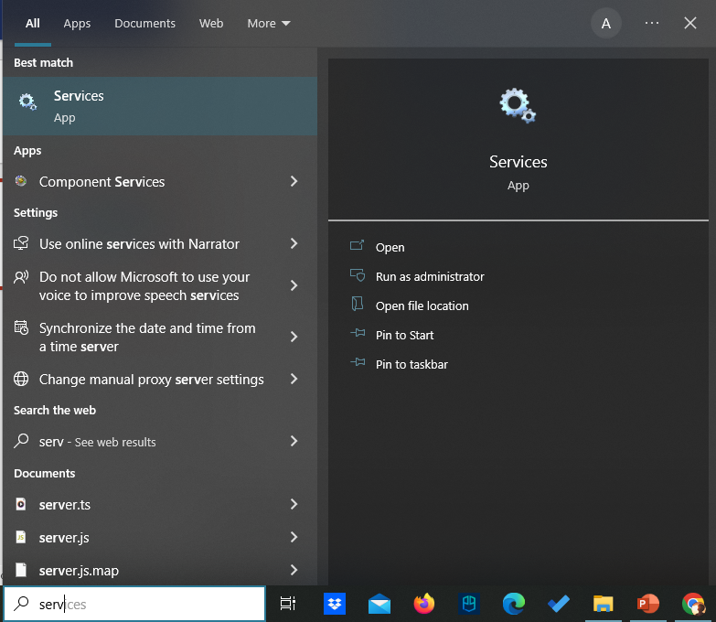
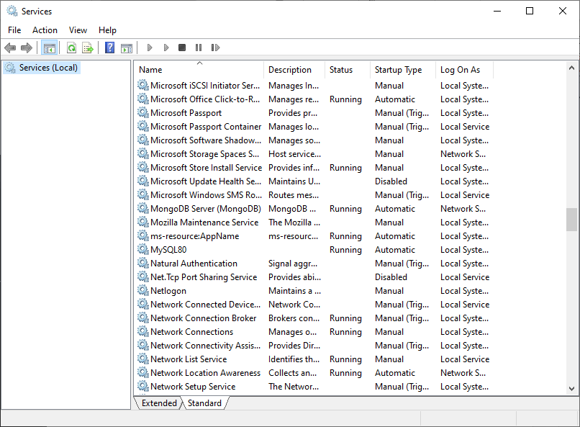
Make sure MongoDB instance is running in your system after successful installation.

Slide 6
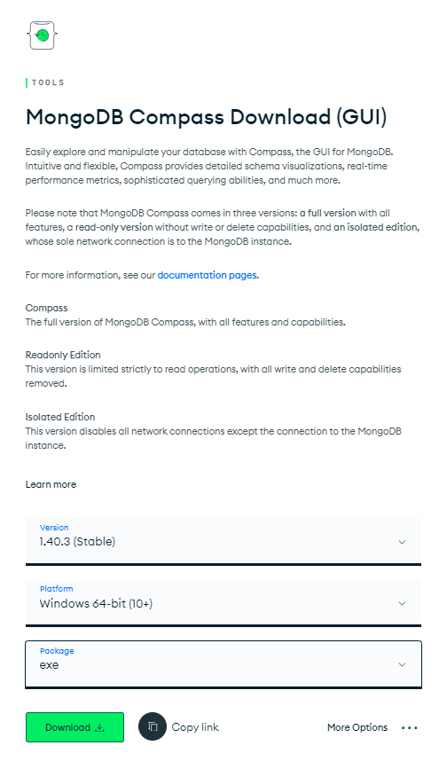
Install MongoDB Compass.
It allows us to view our database through a graphical user interface which can be helpful for beginners and debugging.
LINK:
https://www.mongodb.com/try/download/compass

Slide 7
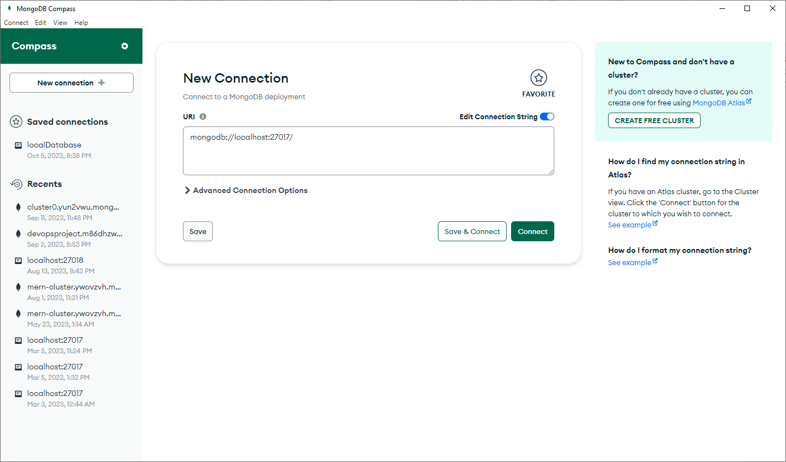
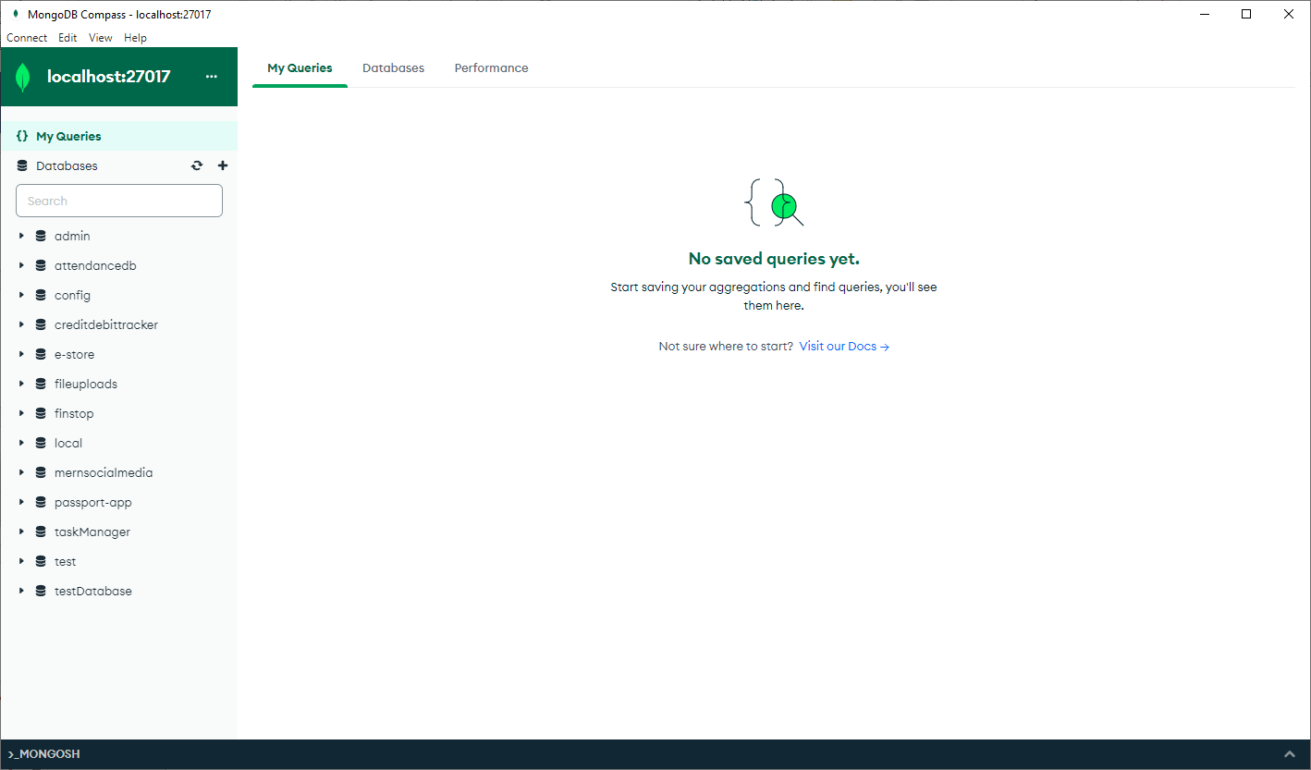
Once installed, launch it and click on the connect button. The illustration below has a list of database created and worked on, you will have a list of default databases. Now you can create a database, or a collection inside a database through the GUI. Collections are where documents are stored. As we won’t be exploring much on how to use the GUI as it is self explanatory, we will be using the GUI just to show the updates made in the database.
If you get the below error on trying to connect, make sure your MongoDB server is running in the services

Slide 8
Module 2:
The Backend

Slide 9
All the further modules from here assumes you have Nodejs installed in your system.
Open the command line and type the command: node --version
If you get an output showing the version of node, you are good to go, else install
Nodejs before continuing further

Slide 10
NODEJS:
Node.js is a runtime environment that allows you to run JavaScript on the server side. It enables developers to use JavaScript to write server-side scripting and produce dynamic web page content before the page is sent to the user's browser.
NPM (Node Package Manager):
It's the default package manager for Node.js, enabling developers to share and distribute solutions or modules, and it's one of the largest software registries in the world. npm is installed along with nodejs.
EXPRESSJS
Express.js, often simply called Express, is a minimal and flexible Node.js web application framework. It provides a robust set of features for web and mobile applications. While Node.js can handle HTTP requests and responses on its own, Express makes it much easier and more intuitive to build web applications by providing a simpler interface and middleware support.
Node.js is the runtime environment that allows you to run JavaScript on the server. Express.js, on the other hand, is a framework that runs on top of Node.js to simplify the development of web applications. In many web projects, you'll find them used together, with Express streamlining the process of handling HTTP requests and other web application features on top of Node.js.

Slide 11
Folder structure for the project
MERN-crud-project
client
Everything related to frontend
server
Everything related to backend

Slide 12
Let’s start building our server

Slide 13
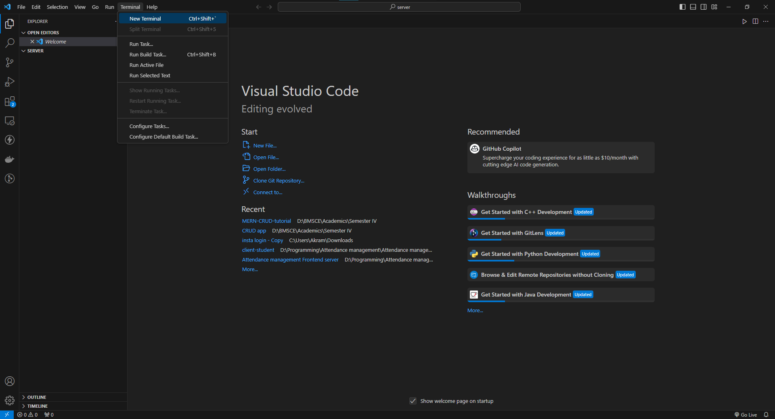
Open VS Code and open the server folder created according the folder structure in the previous slide
Open a new terminal

Slide 14
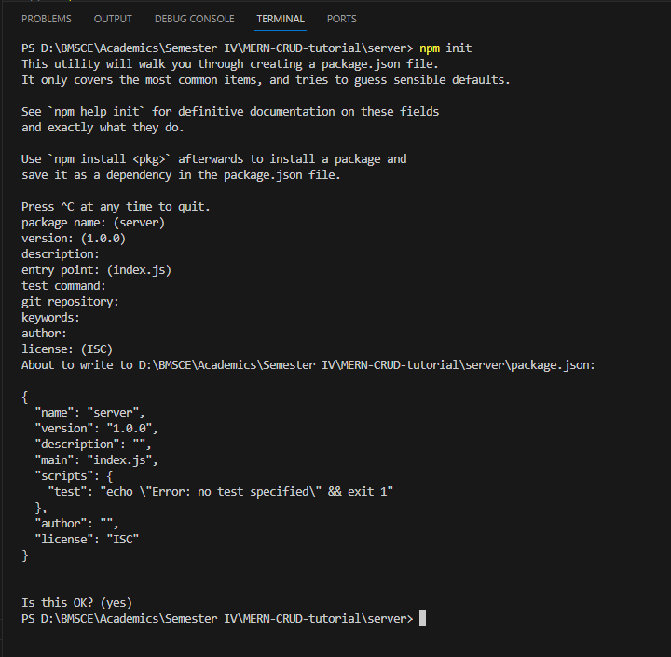
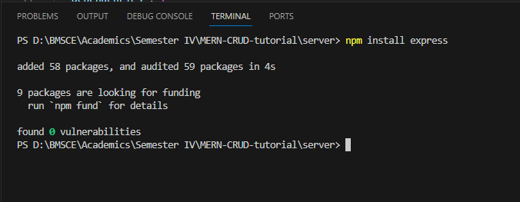
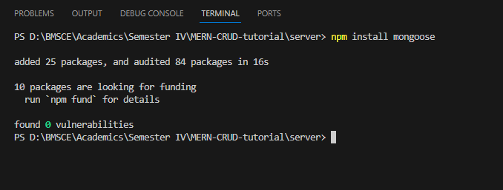
Type the following commands in the terminal
npm init
Continue pressing enter to go with default configurations until the command is complete
Once completed you can see a package.json file created which has basic configurations of the project
npm install express
The above command installs express library which is used to build a http server
npm install mongoose
The above command installs mongoose library which is used to work with the database
npm install cors
The above command install a library used to allow requests from different origin which is your frontend
You can now see a node_modules folder, it is where all the libraries are present.

Slide 15
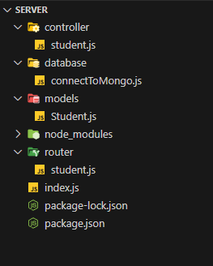
Create the following folder structure and files in the server folder. We will populate each file one be one starting from models/Student.js to /index.js
Core logic file
Database connector file
Model structures for documents
Router file
Root server file

Slide 16
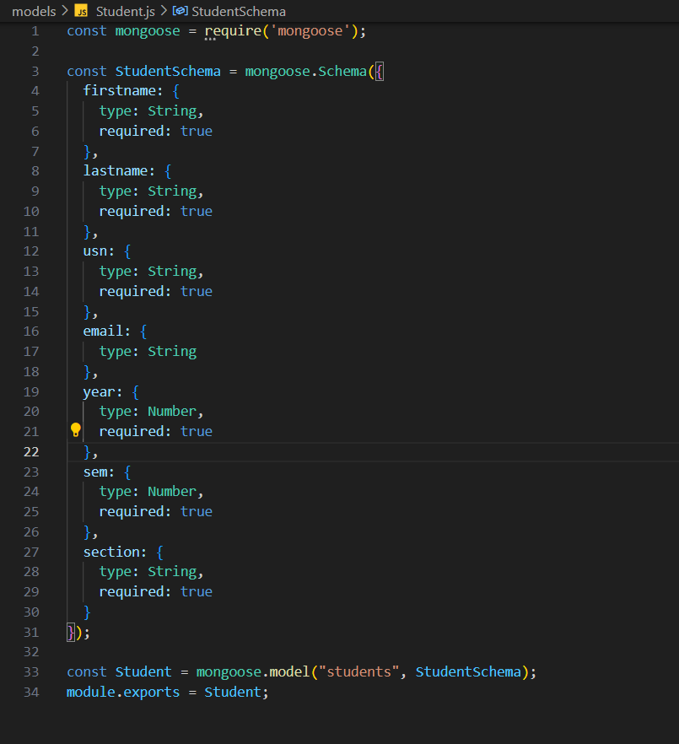
MODELS:
The model defines how a document should look like. It defines the keys and type of values of each keys. Fill the student.js file under the model directory according to the following file description. We define how a student document should be structured, it contains attributes such as name, usn, email and the appropriate data type of the values of each attributes
This creates a students collection where the students data can be stored as per the structure defined in the StudentSchema.

Slide 17
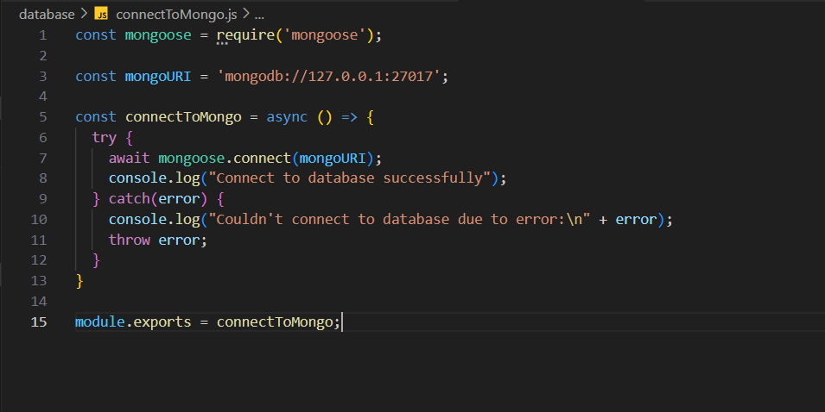
DATABASE CONNECTOR:
We need to connect to the MongoDB server running in our local machine. The connection function expects a connection string which points to the running MongoDB server. The MongoDB server usually runs on the port 27017. Fill the connectToMongo.js file under database according to the file below.

Slide 18
HTTP Methods and Endpoints:
HTTP (Hypertext Transfer Protocol) methods, sometimes referred to as HTTP verbs, dictate the type of action a request intends to perform on a given resource. Each of these methods indicates a specific type of operation and has a specific meaning in terms of the effects it has and the expected outcomes. The following are the standard HTTP methods:
GET: Retrieves data from the server. It should only fetch data and should have no other effect. It is considered a safe and idempotent method.
POST: Sends data to the server for processing and creation of a new resource. It's often used when submitting form data or uploading a file. POST requests are neither safe nor idempotent.
PUT: Updates or replaces the resource at a specific URI or creates it if it doesn't exist. PUT requests are idempotent but not safe. This means that making the same PUT request multiple times will result in the same outcome.
DELETE: Removes the resource specified by the URI. DELETE requests are considered idempotent but not safe.

Slide 19
HTTP Methods and Endpoints:
HTTP Endpoints are unique paths that can be used to avail different services from a server.
Example:
http://localhost:4000/users
http://localhost:4000/products/price
http://localhost:4000/questions/description

Slide 20
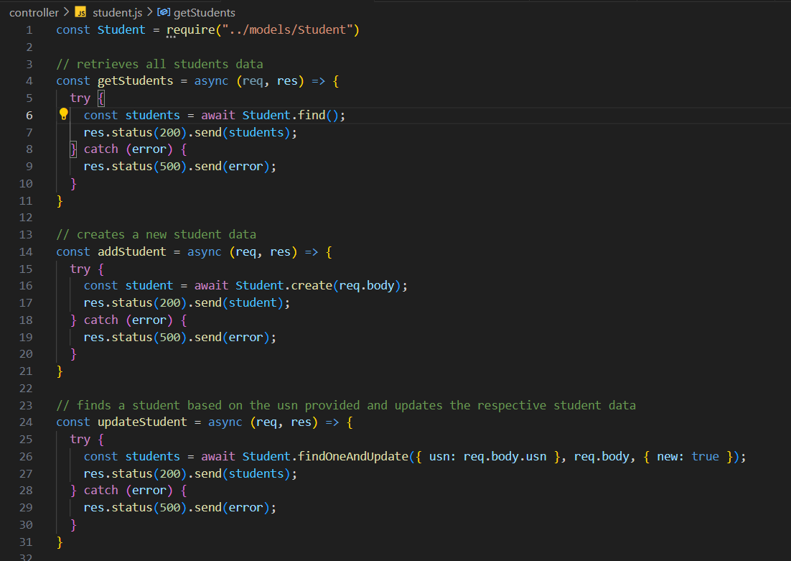
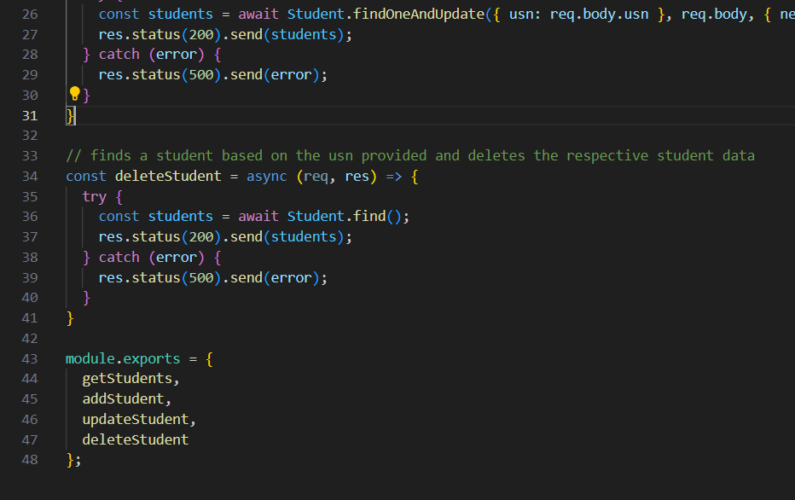
CONTROLLER:
We will now define the core logic that needs to be performed for different requests. Fill the student.js file under the controller folder according to the following file.

Slide 21
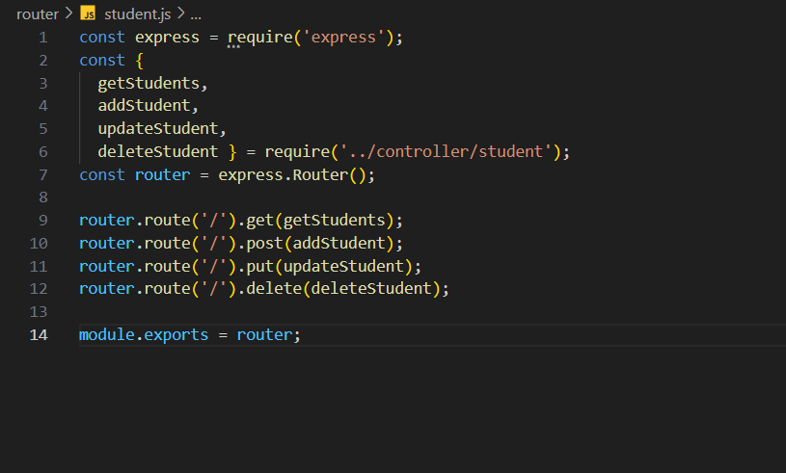
ROUTER:
We will now define the router file which will route the incoming requests to the core logic functions in order to service the incoming requests. Fill the student.js file under the router folder according to the following file.

Slide 22
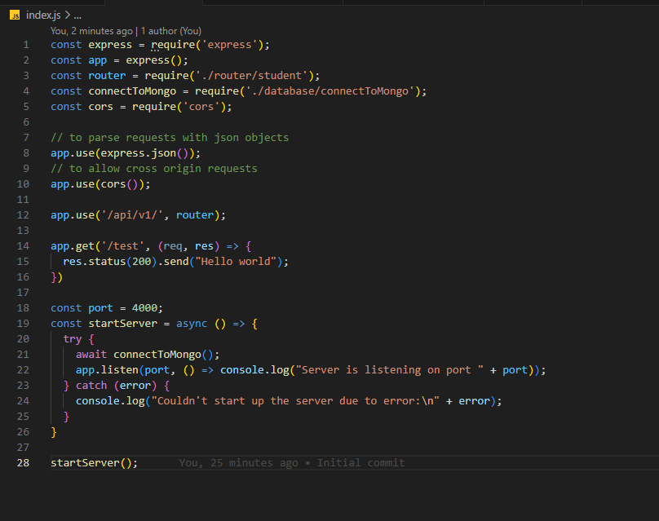
ROOT SERVER:
Now it’s time to finally write the entry point of the server. This file imports only the router and mongodb connection function as rest other functions are modularized into the router. In this file we will create an express server which will listen to http requests on port 4000 and forward the requests to the router to service them.

Slide 23
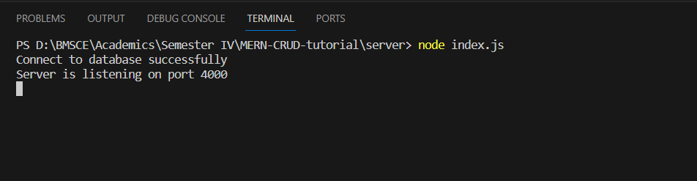
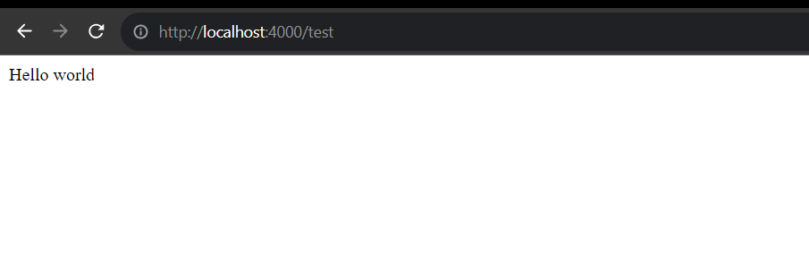
STARTING THE SERVER:
In order to start the server, type the following command in the terminal. The output should be as follows. You can test the server response by typing the test endpoint on a browser

Slide 24
Module 2:
The Frontend

Slide 25
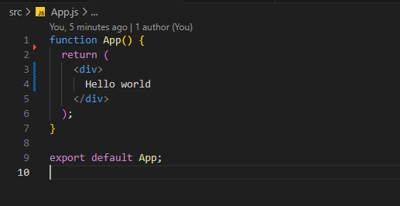
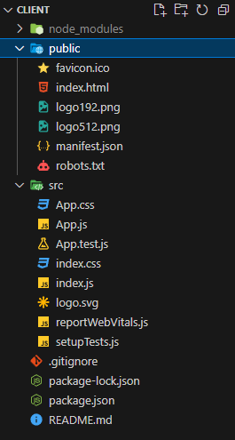
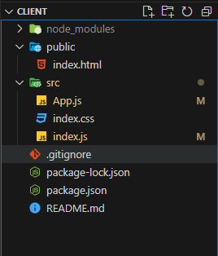
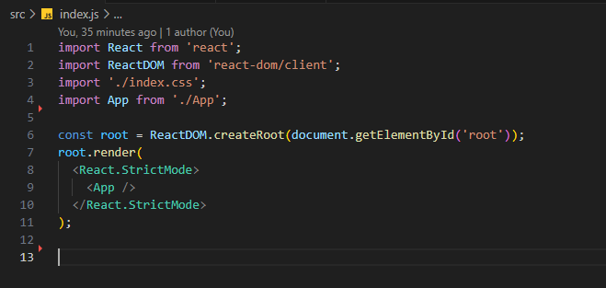
CREATING REACT APP:
Type the following command in the terminal inside the client folder. Once the react app is created, some new files and folders will be created. The files marked red can be deleted as we don’t need them for our project(these files has a different application which is out of the scope of current project). Clean up the index.js and App.js files according to the images given below.
Delete
Unnecessary
Files
Clean up

Slide 26
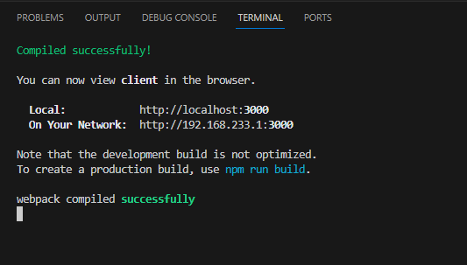
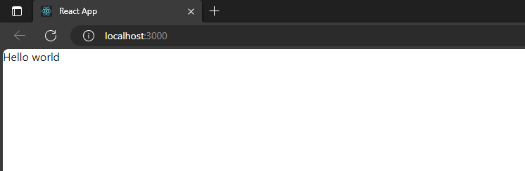
Type the following command in the terminal and open up the browser in port 3000 to view the frontend running.
Once all this is set up, we are good to get started with frontend development.

Slide 27
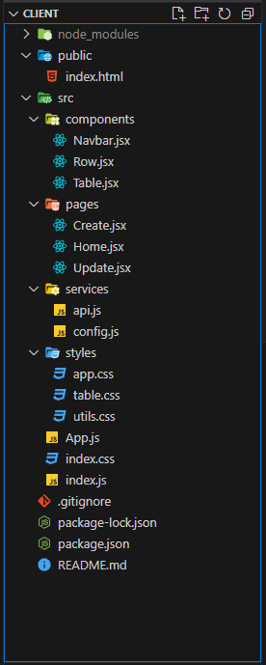
Create a folder and files structure as shown below.
NOTE: As this project won’t be focusing much on the CSS part you can get the CSS files from the GitHub link of the project given at the end of the presentation.

Slide 28
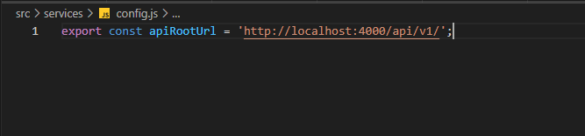
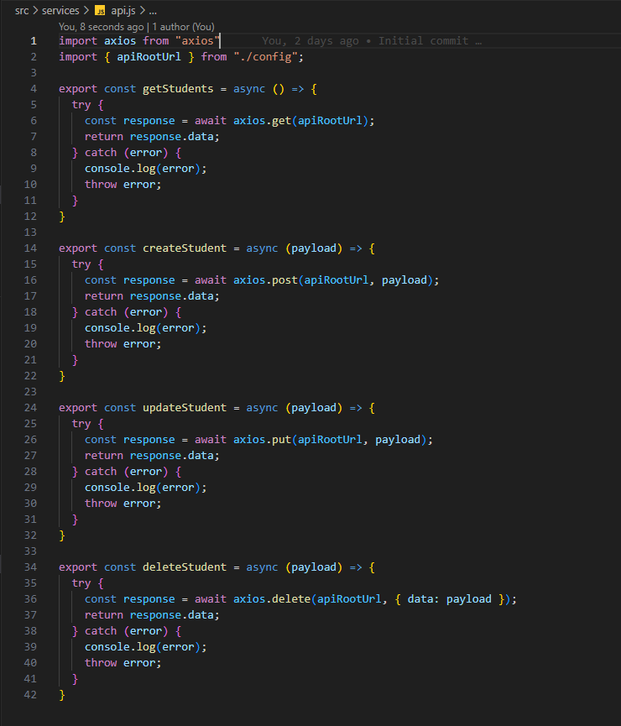
config.js:
THE API:
Starting out with the api in the services folder, which takes care of making http requests to the server. By separating it out from the UI layer we can modularize our project efficiently. First set up the config file which contains the server url to make the http requests followed by the api file which contains the function definitions to make http requests.
Install the axios library using the command “npm install axios” in the terminal.
Import the axios library in the api.js file. Axios is a library to make asynchronous http requests.
As we can see all four functions for the CRUD operations are defined.
Though each of them look very similar and can be compressed into one function, we refrain from doing that because structuring the application this way allows us to scale and add more features to each operation in an isolated manner without touching the rest.
The payload in each function is an argument passed by the calling function in the UI layer which contains information about student data.
Note that the getStudents function does not have any payload as it is used to retrieve all the students from the backend which does not require any arguments.
Also note in the config file, the port 4000 is the port in which our server is running.
api.js:

Slide 29
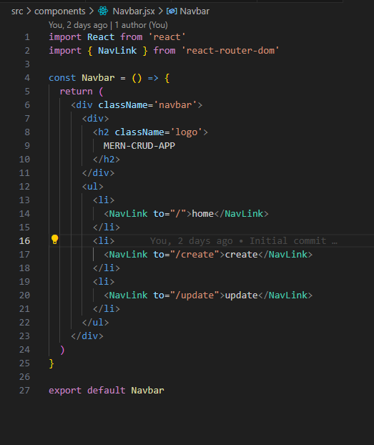
Components – Navbar:
A Navbar is a straightforward component with no much logic except links to the different pages in the application.
Install react-router-dom using the command “npm install react-router-dom” in the terminal.
This library is used for frontend routing between different pages.
Import the NavLink component from react-router-dom which acts as a link to different pages. Follow the syntax as given in the picture.
Note the classNames used in the components have been defined in the CSS files. You can download them from the github link given at the end of the ppt.

Slide 30
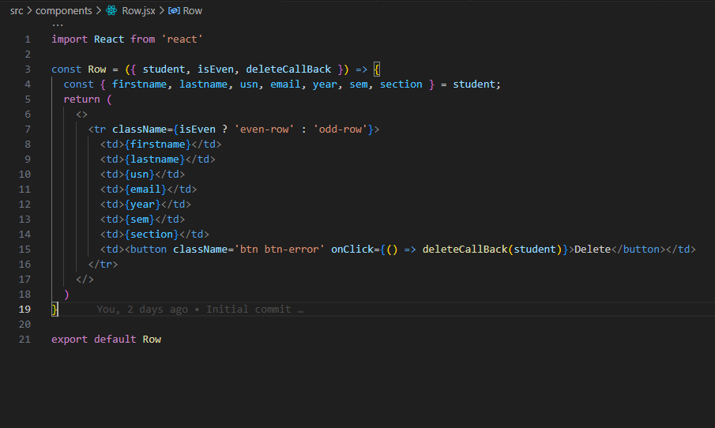
Components – Row:
The Row component is nothing but a native HTML table row element which is used to render the student details.
The Row component receives the student data through props from the Parent component Table which will be discussed further.
It also receives an argument isEven which denotes whether the current row is an even or odd number of row which is used for striped design of the table.
The deleteCallBack function is passed on to the Row component from the Home component which will be discussed later. This function is triggered when the delete button is clicked on a particular row.
This way of passing the callback functions to child components from the parent component is known as prop drilling. This can be used for small scale projects but as the applications grow, it will become difficult to manage states and triggers through prop drilling. Hence we recommend the students to learn a global state management which makes things easier in large scale projects.
Recommended state management - Redux

Slide 31
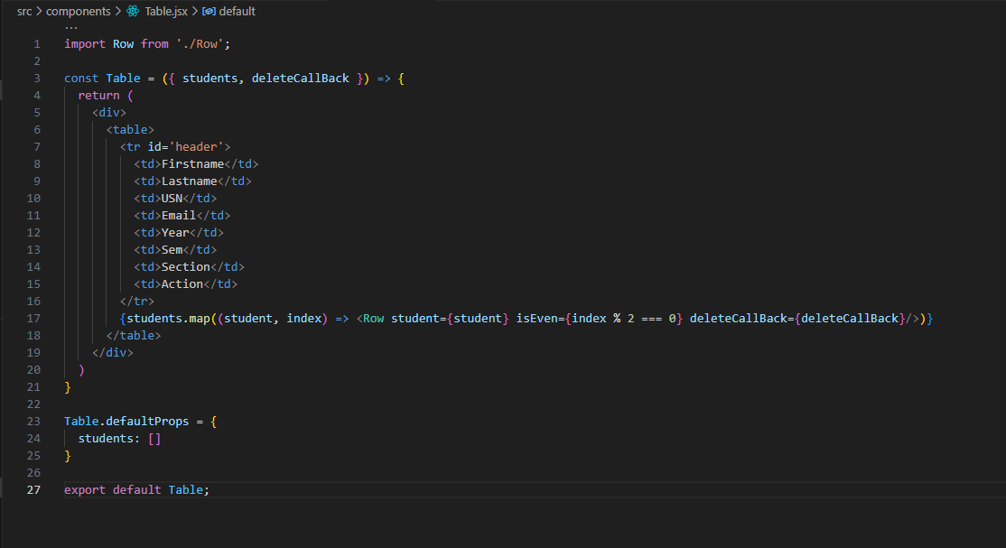
Components – Table:
The table component renders a HTML table element to display the students data
It receives an array of students data through props from it’s parent component which is the Home component.
It renders a list of Row component discussed previously for each student data through the array map function.
The default prop for students is set as an empty array to prevent errors when no prop is sent from the parent component
Notice the deleteCallBack function received as a prop from the parent component which is again passed on to the child Row component for triggering delete function for each student.

Slide 32
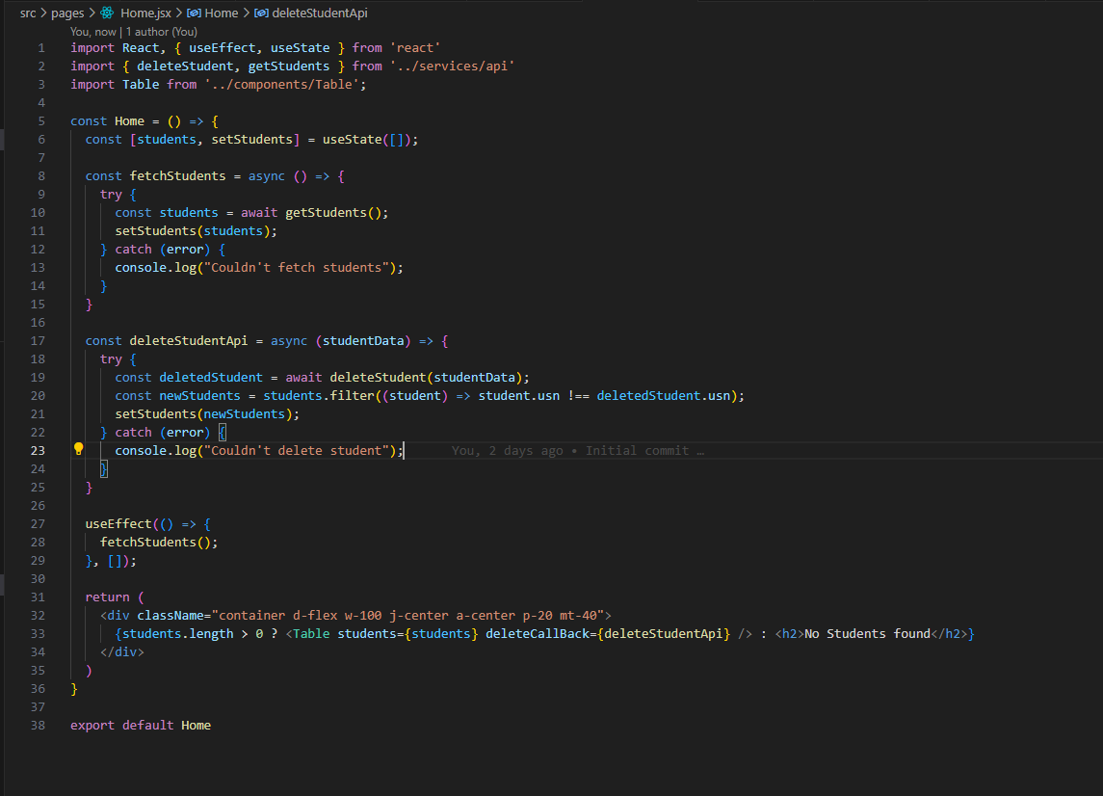
Pages – Home:
It makes more sense to structure the Home component into the pages folder as Home can be referred to as a page.
The Home component is responsible for fetching the students from the api and passing on to the Table component for rendering.
We have set up a state called students using useState which is an empty array initially and will be populated using the setStudents function after fetching the students from the backend. This state is passed on to the Table component for rendering on the page.
useEffect Hook is used to trigger the fetchStudents function whenever the home component is mounted. This function has to be executed only once when the component is mounted. Therefore an empty array is given as the list of dependencies.
We have imported the functions defined in the api file to make http requests and make the calls to those functions from here which is the UI layer.
Note the deleteStudentApi function which is passed on as the callback as mentioned in the previous components.

Slide 33
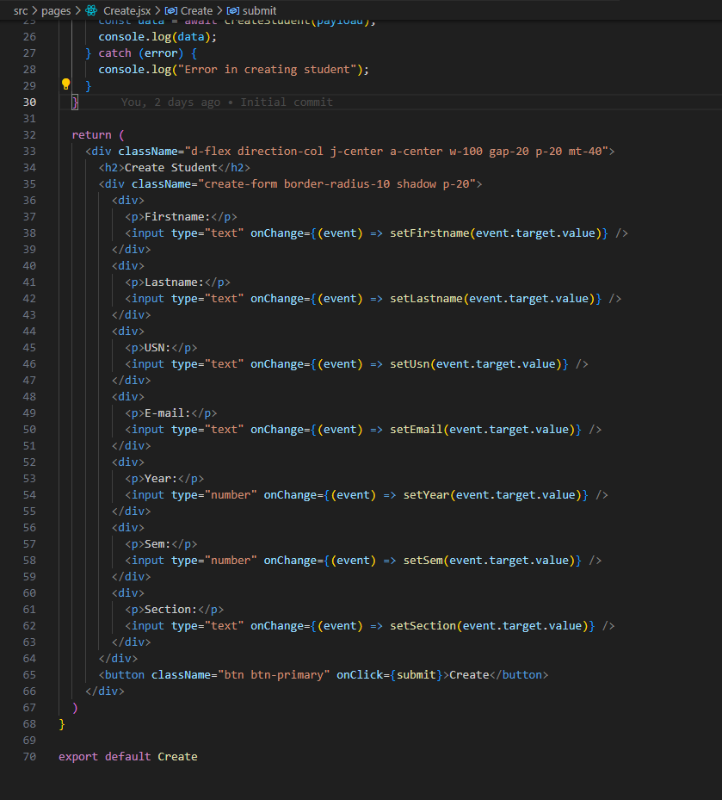
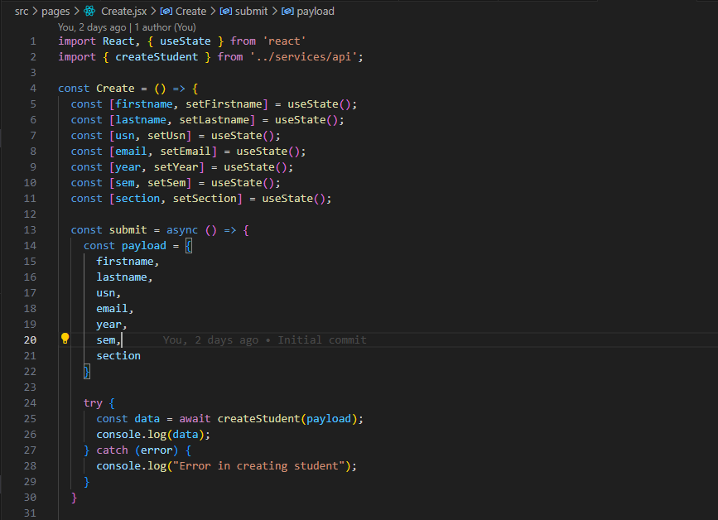
Pages – Create:
The create page contains a form to create a student data.
We have set up the states of each field which is updated on the input change using the set function of each state.
When the create button is clicked the states are used to form a payload and it is sent as an argument to the api function to create a new student data.

Slide 34
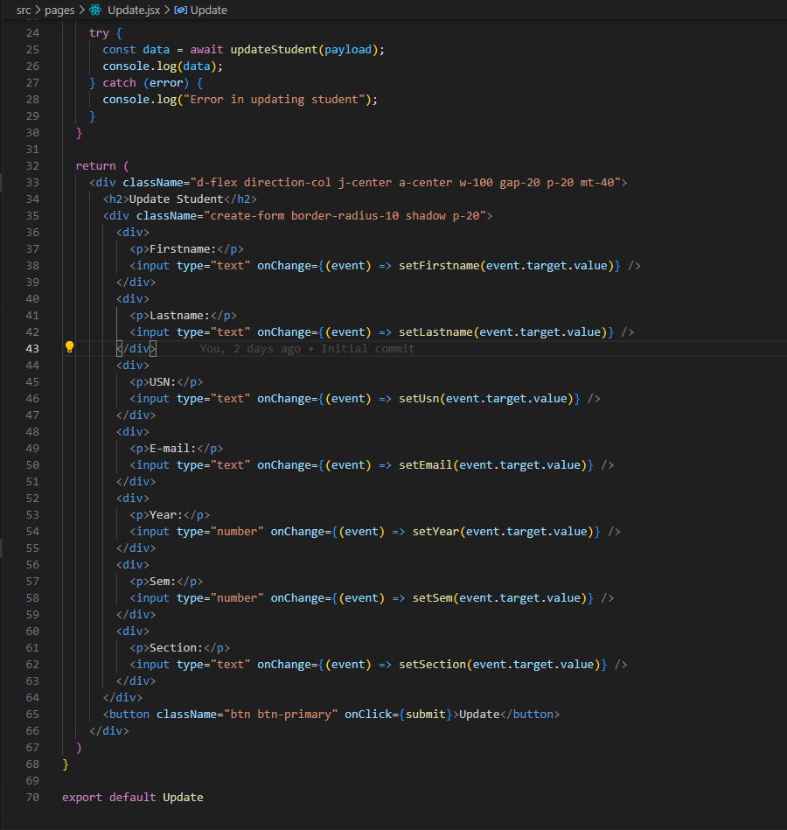
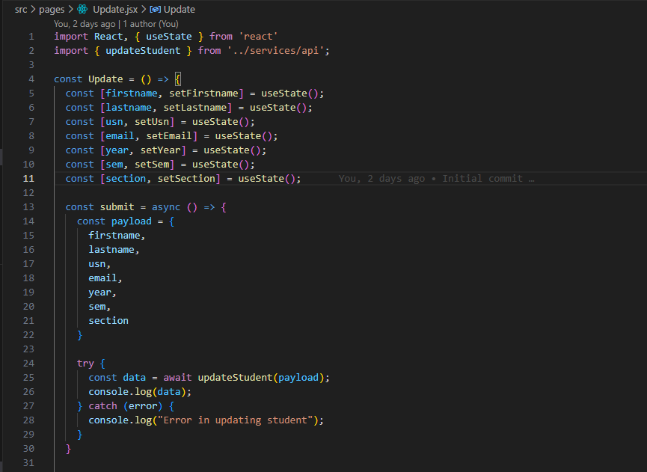
Pages – Update:
This page is very much similar to create page with the only difference that it makes a call to the update function in the api layer.

Slide 35
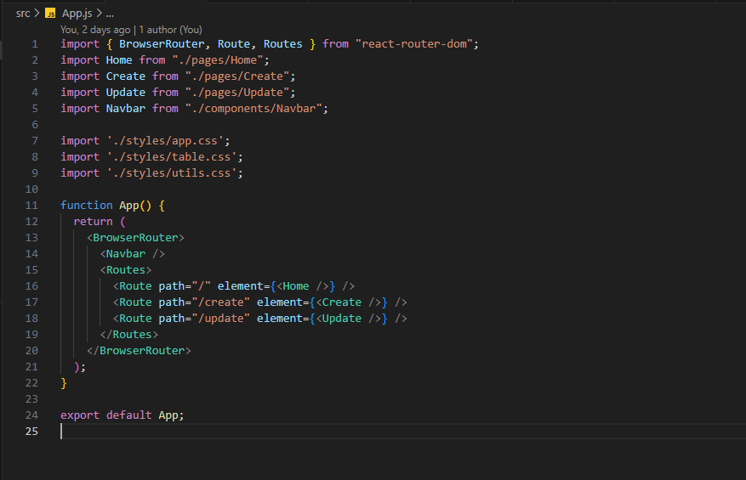
App.js:
Finally set up the root App.js file. Make sure to import all the css files and set up the router from react-router-dom
Index.js:
Nothing needs to be done in the index.js file further. Following the clean up mentioned earlier is sufficient.

Slide 36
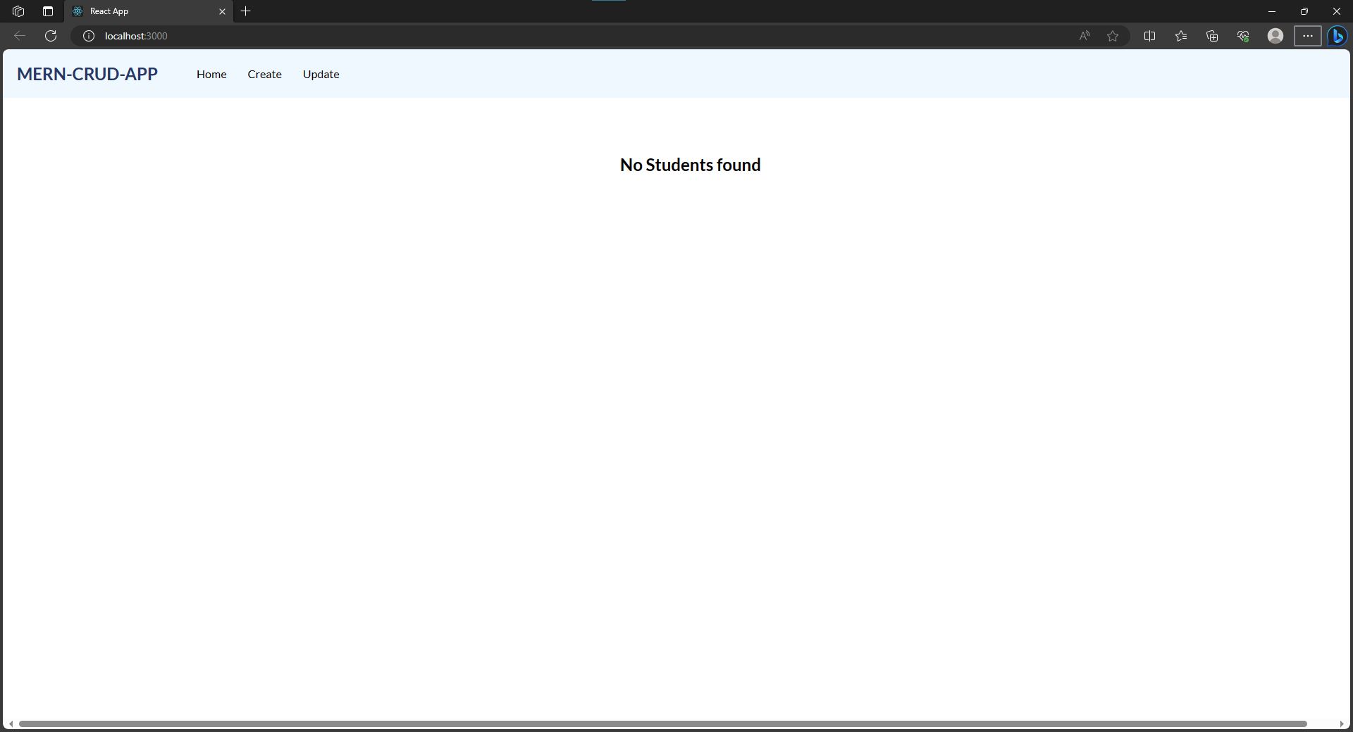
The frontend is finally ready. Type “npm start” in the terminal to start up the frontend. You can view the frontend at localhost:3000. Make sure the backend server is running too, else all the http calls will fail.

Slide 37
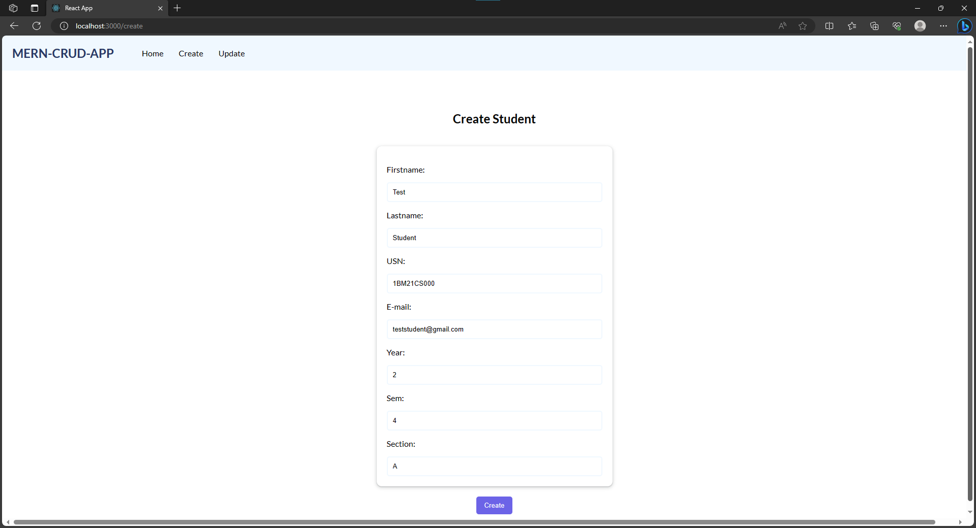

Slide 38
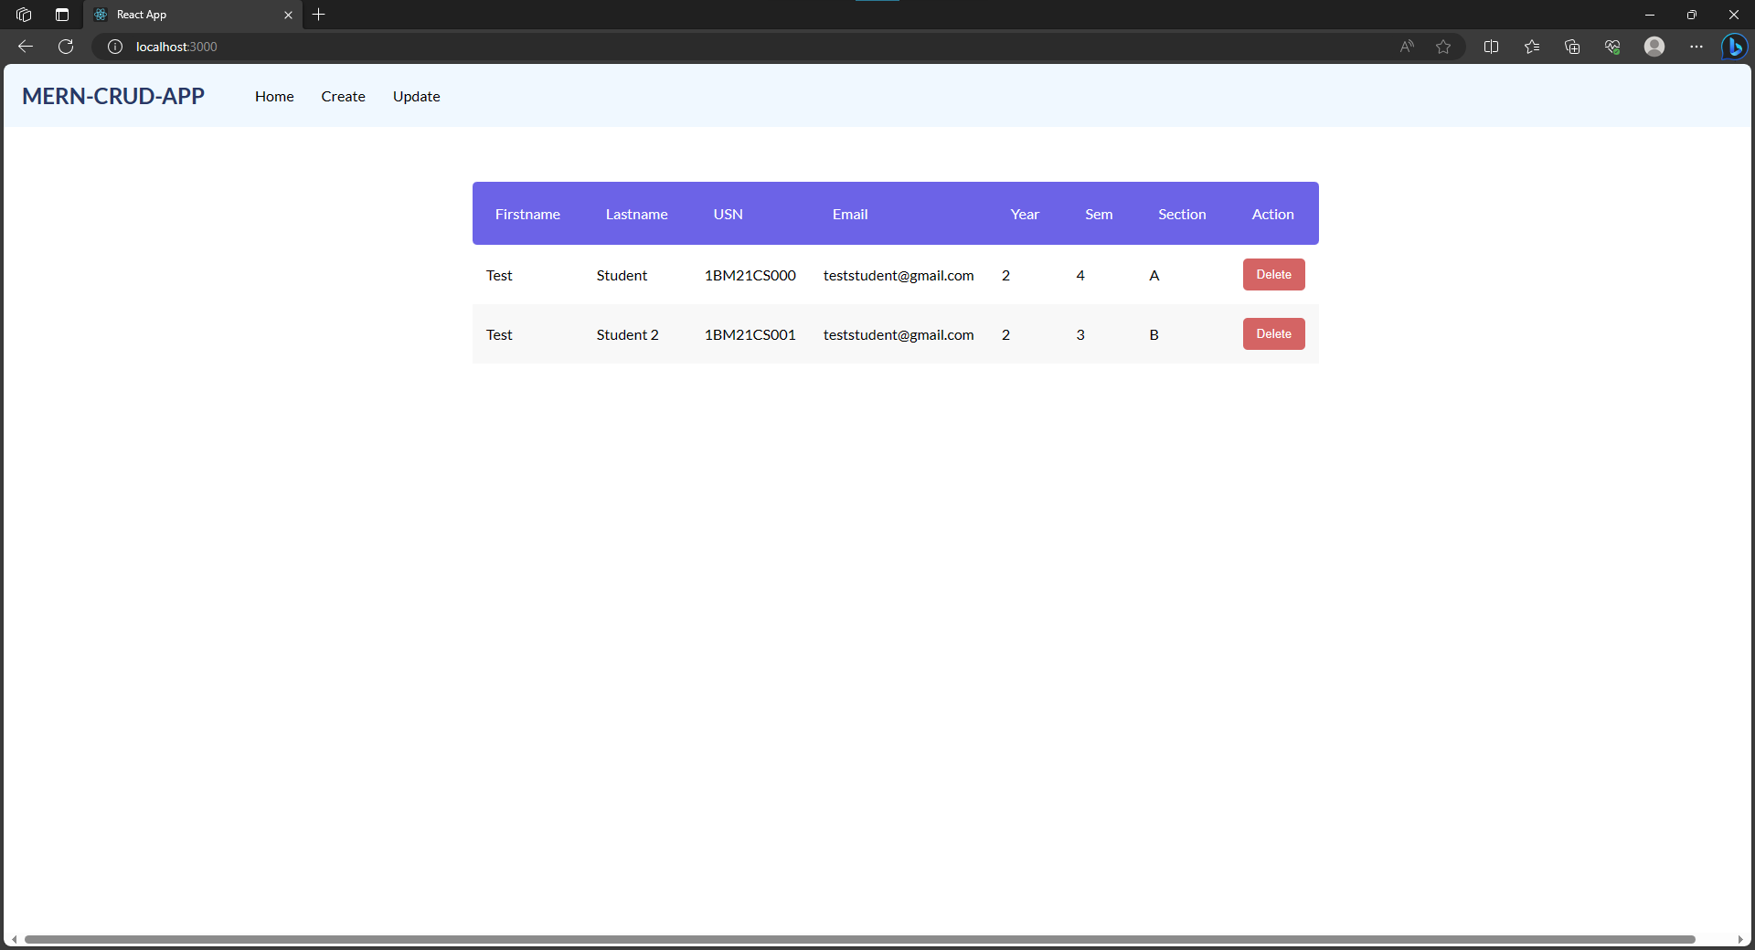

Slide 39
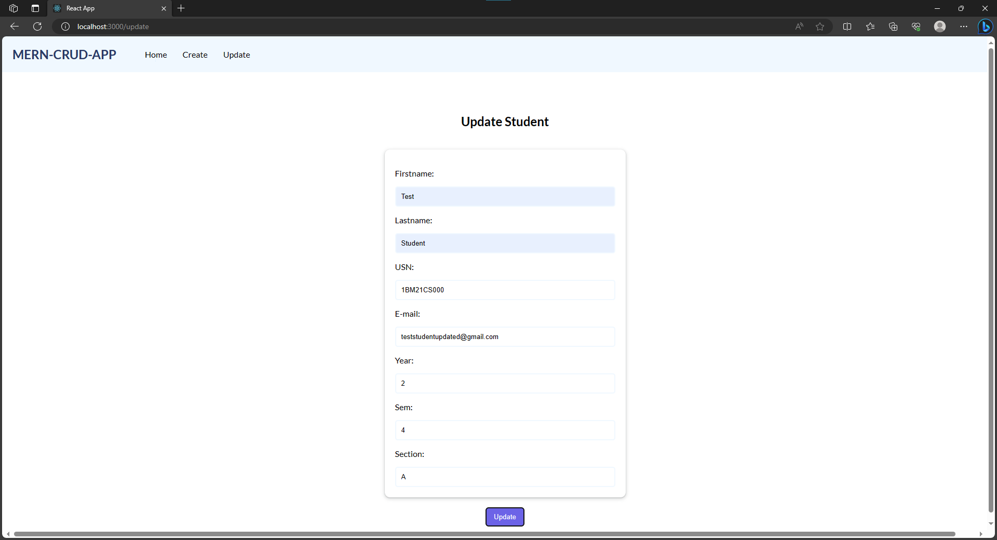

Slide 40
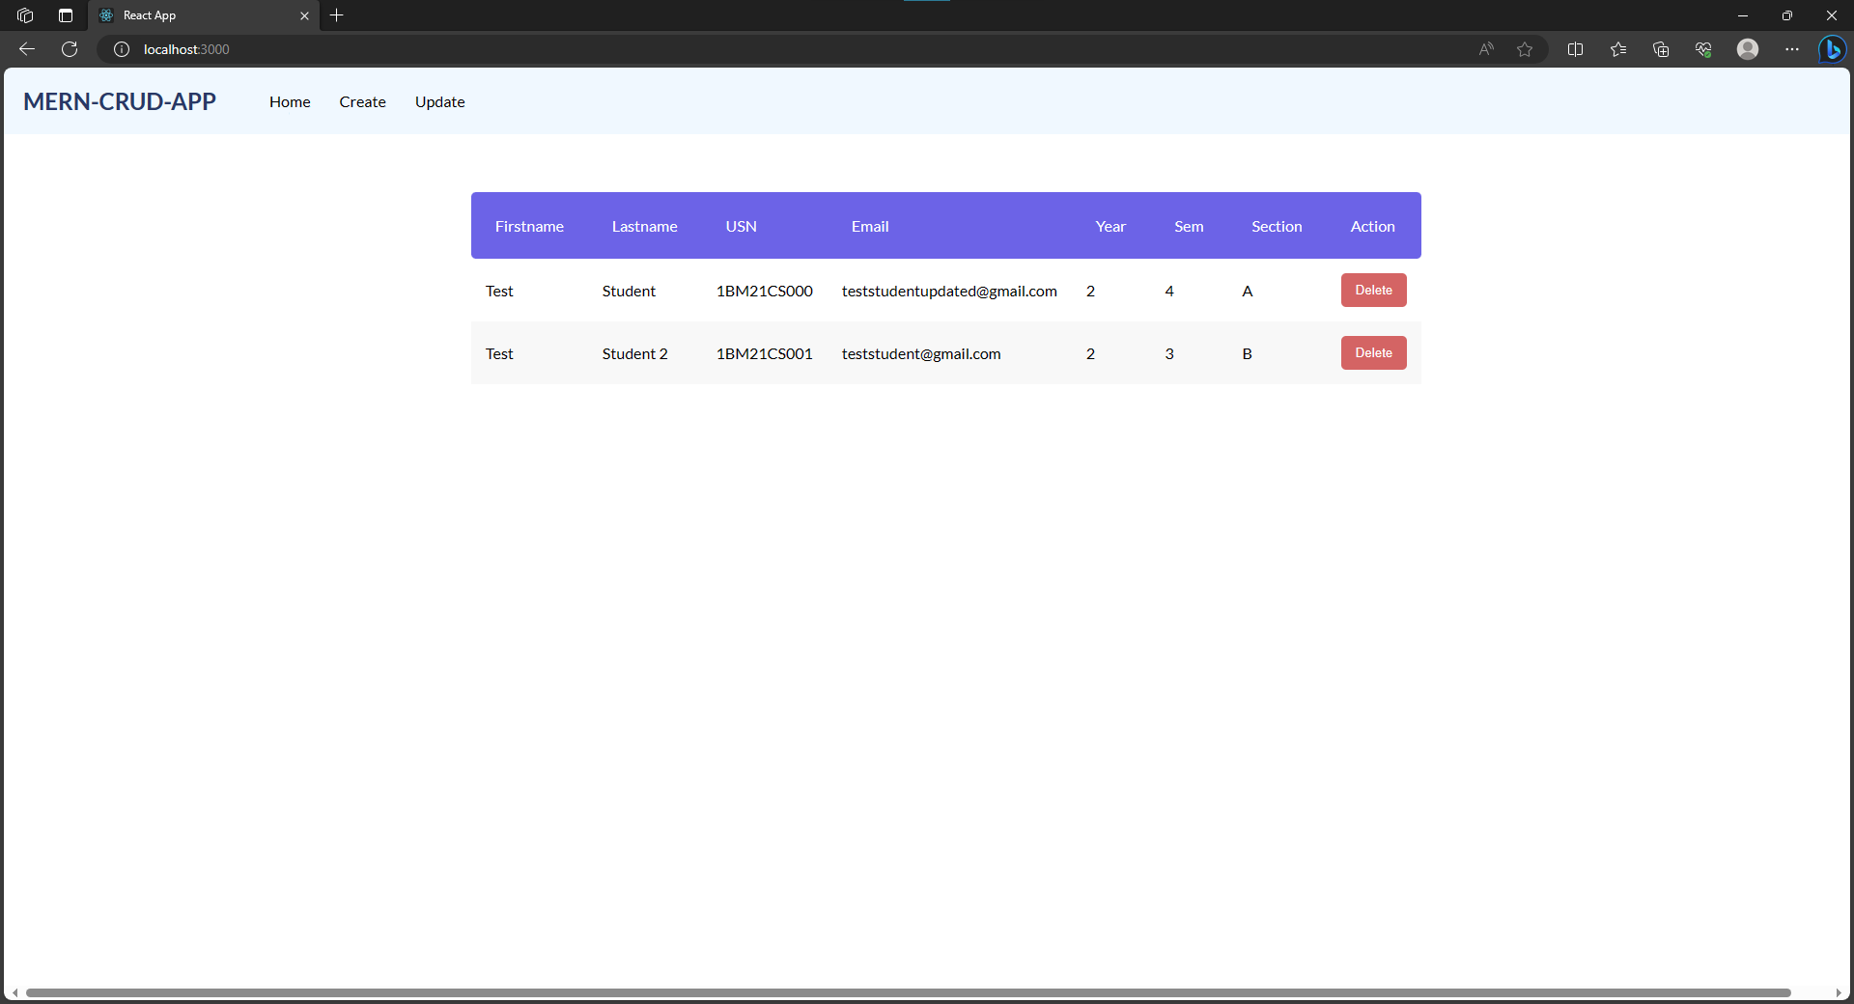

Slide 41
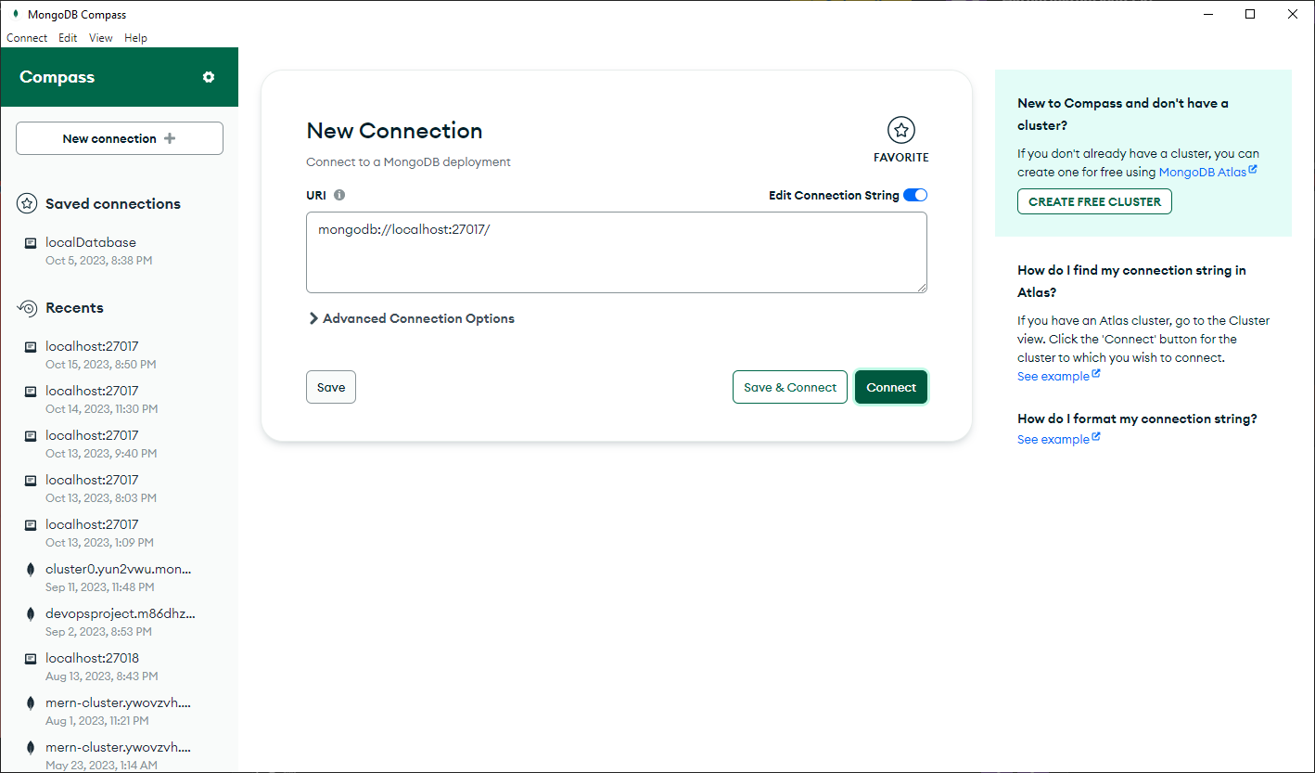
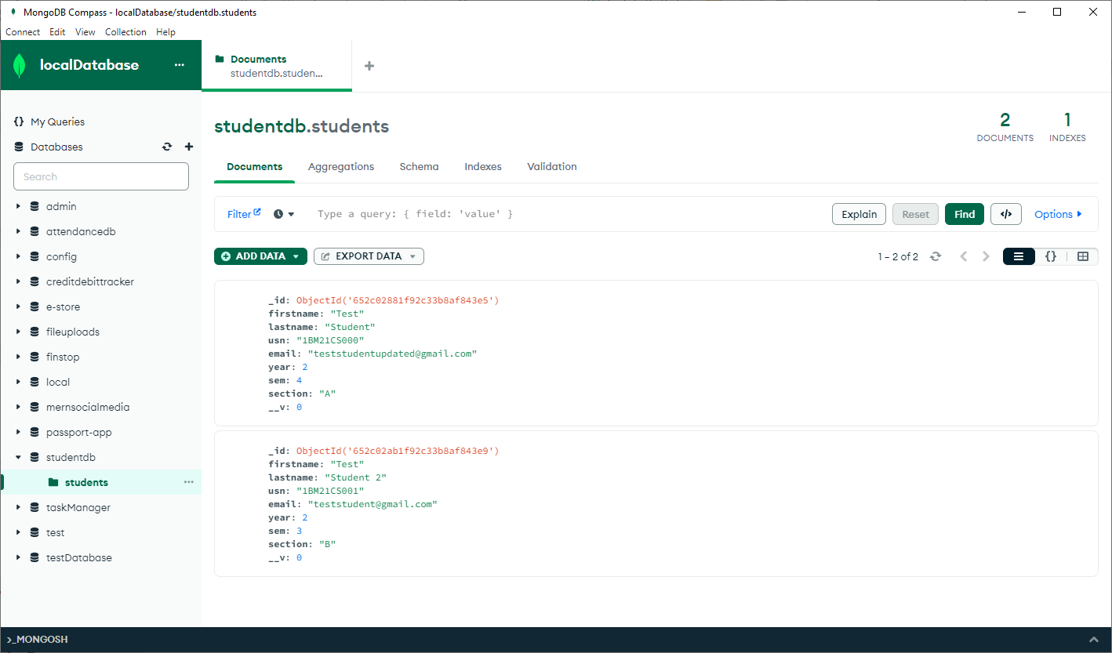
You can view the data created in the mongodb compass. Open the compass and click on connect to connect to the local database. Open the studentdb on the left panel to view the students collection and the documents created.

Slide 42
GitHub link:
https://github.com/AkramShafeek/MERN-CRUD-tutorial

