Slide 1
Lecture 3: Images & Assets
Dr.Taraggy Ghanim

Slide 2
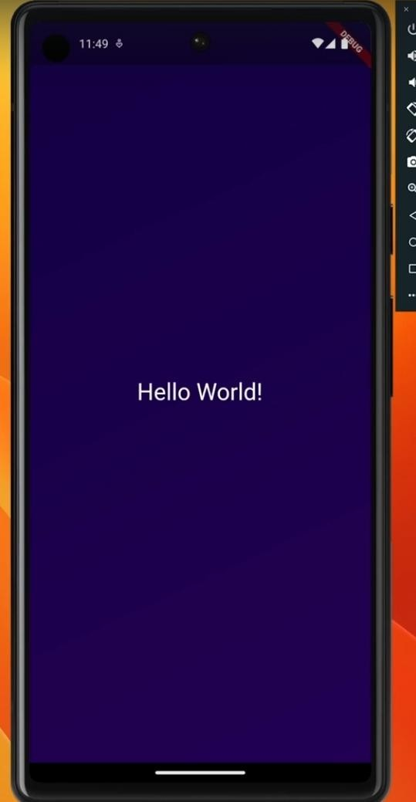
Exercise 1

Slide 3
Exercise 1
Copy the contents of Exercise 1 in your
Main.dart
Complete the missing parts to implement
the following design

Slide 4
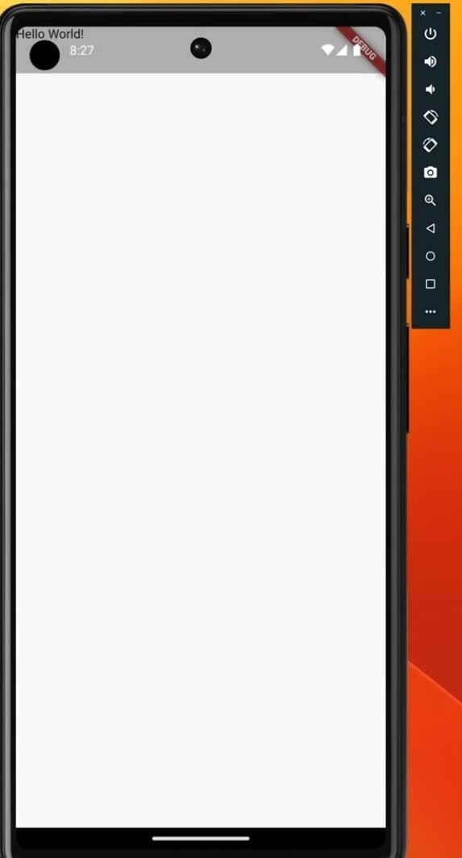
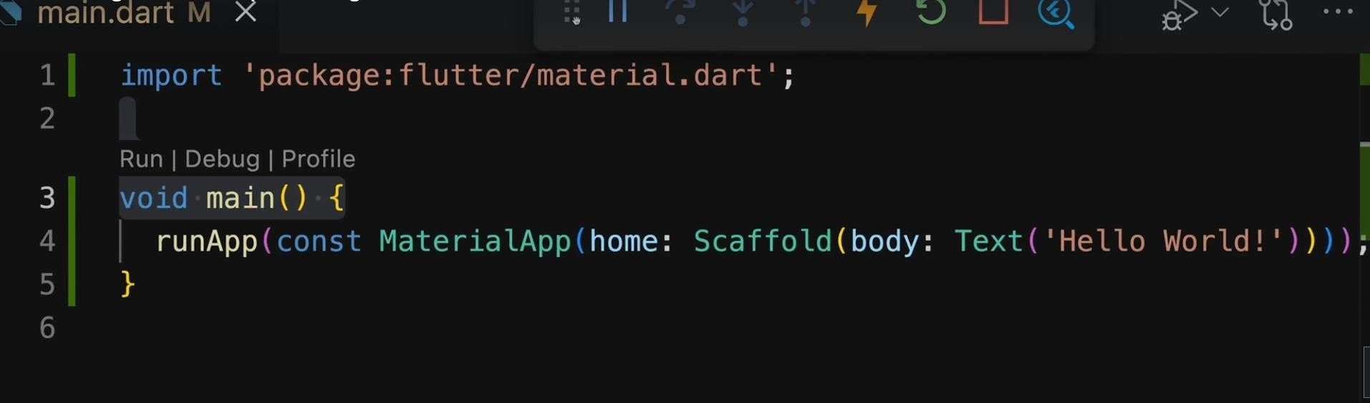
Scaffold

Slide 5
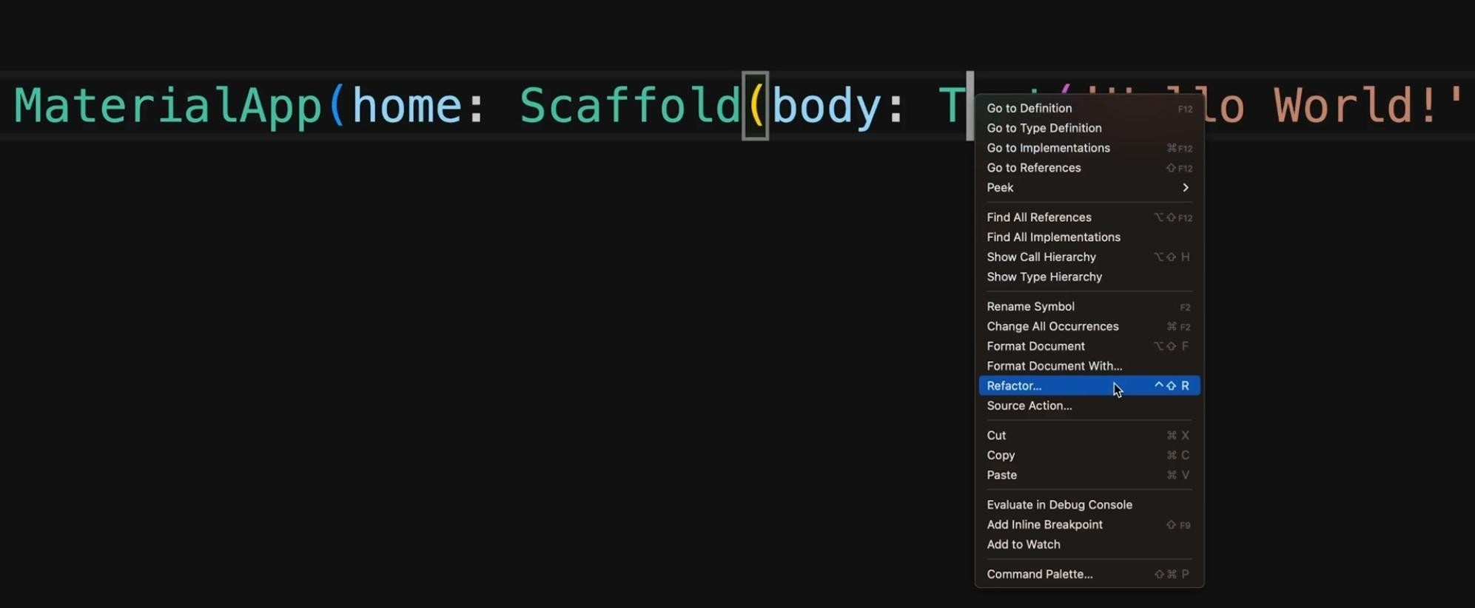
Refactor

Slide 6
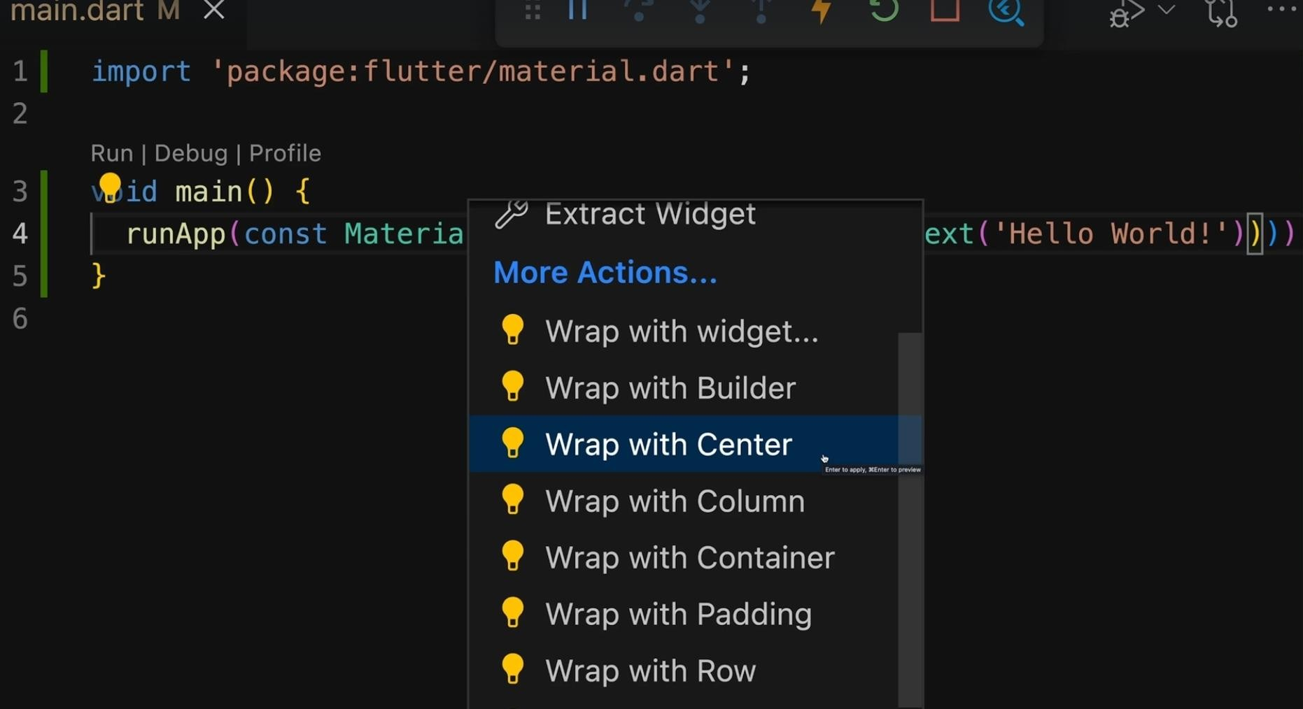
Wrap with centre

Slide 7
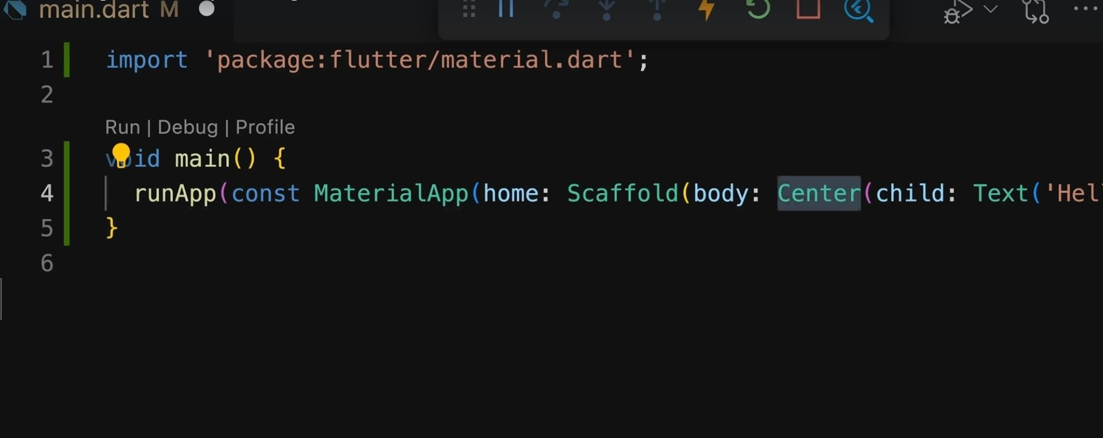

Slide 8
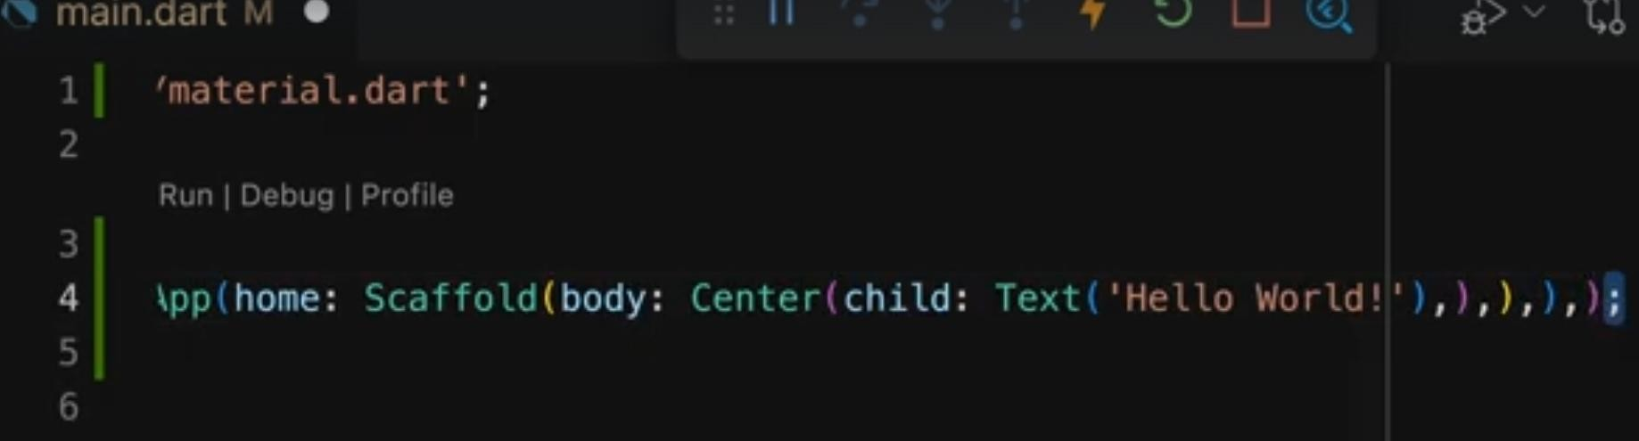
Formatting

Slide 9
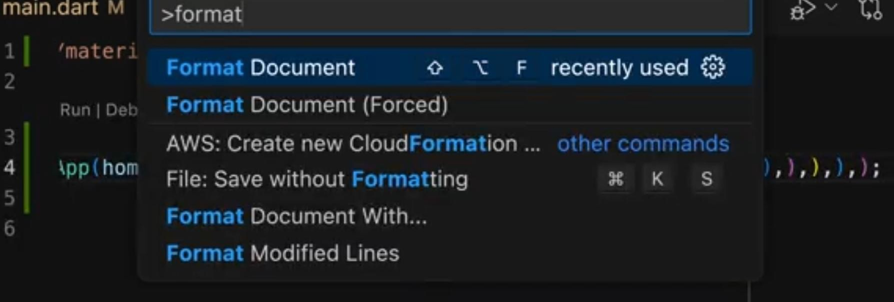
View- Command Pallete - Format Document

Slide 10
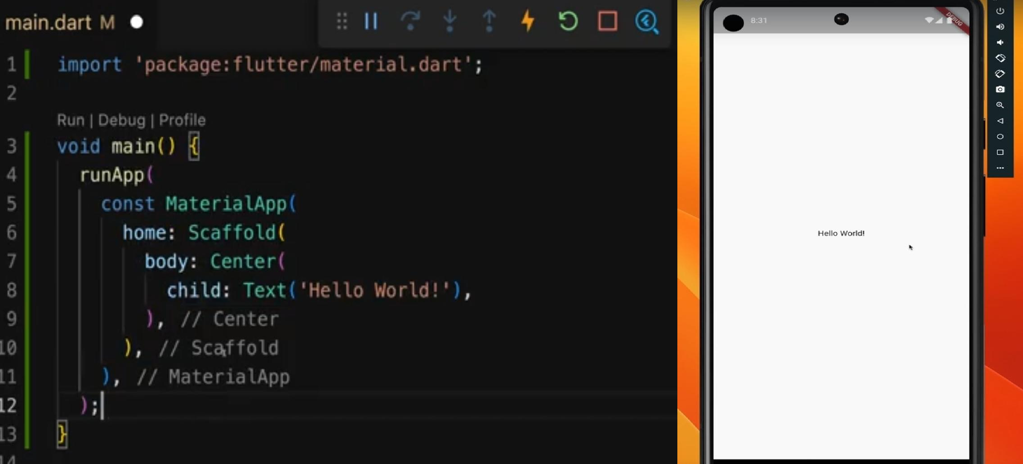

Slide 11
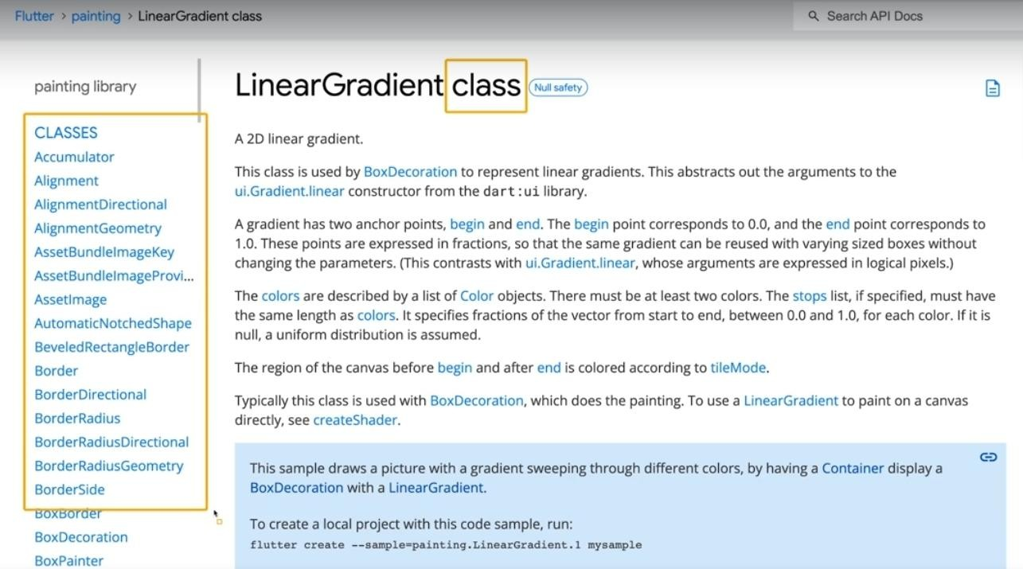
Linear Gradient Class

Slide 12
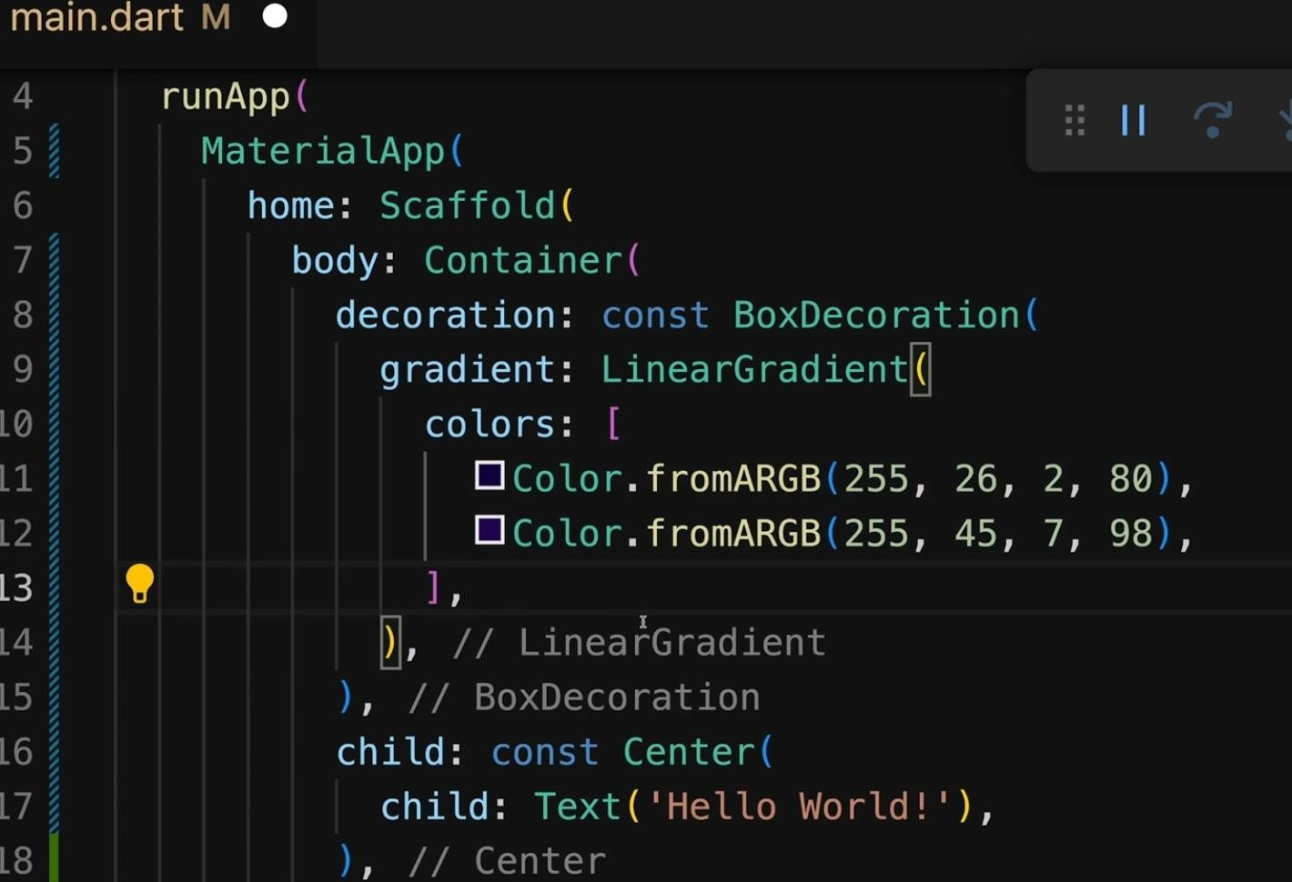
Linear Gradient parameter is a list of colors

Slide 13
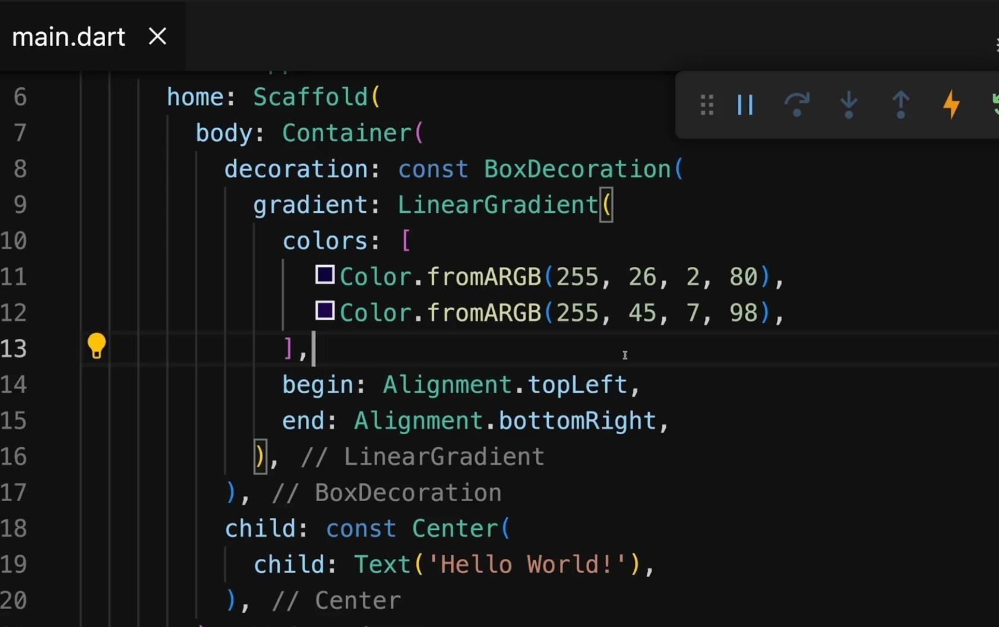
Gradient Direction ( begin & end)

Slide 14
Exercise 2

Slide 15
Exercise 2
Copy the contents of Exercise 2 in your
Main.dart
Complete the missing parts to add
gradient colors to the following design

Slide 16
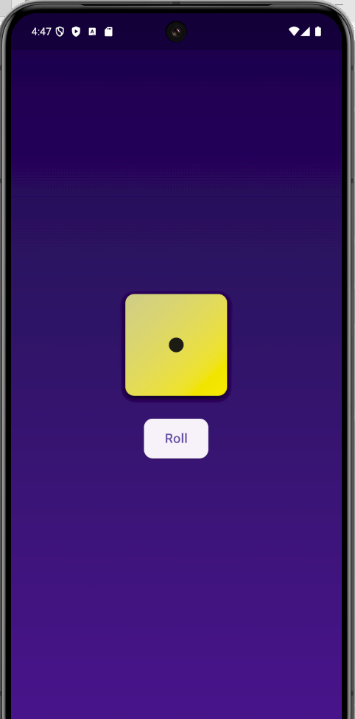
Exercise 3

Slide 17
Replace the Hello World witn the dice image and Button
Step 1: Add assets folder to your project
Step 2: Add the following section in your yaml file (Make sure the indent is 2 spaces)
flutter:
uses-material-design: true
assets:
- assets/dice1.png
- assets/dice2.png
- assets/dice3.png
- assets/dice4.png
- assets/dice5.png
- assets/dice6.png
Step3: Run the code of Exercise 3

Slide 18
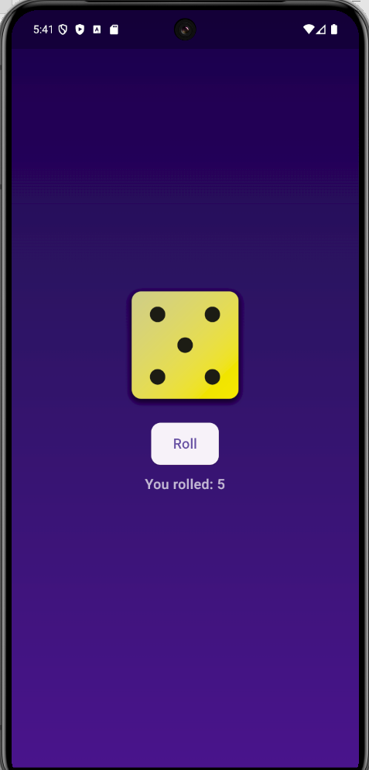
Exercise 4: Roll Dice

Slide 19
Task 1 — Convert to StatefulWidget and show a dice image
Goal: Replace “Hello World!” with a dice image that reads from assets.
Do
Change HelloScreen from StatelessWidget to StatefulWidget.
Add an integer state int _face = 1;.
Show the image with a path that uses _face: Image.asset('assets/dice$_face.png').

Slide 20
Task 2 — Add a “Roll” button that randomizes the dice (setState)
Goal: Pressing the button should change the dice face randomly (1..6).
Do
Import dart:math and create a Random instance.
In onPressed, compute a random newFace from 1..6 and call setState(() { _face = newFace; });

Slide 21
Task 3 — Add a bounce animation when the dice changes
Goal: The dice should “pop/bounce” on every roll.
Do
Make HelloScreenState mix in SingleTickerProviderStateMixin.
Create an AnimationController and a Curved scale animation (e.g., Curves.elasticOut).
Wrap the Image.asset with a ScaleTransition.
In onPressed, when you roll, restart the animation with controller.forward(from: 0).

Slide 22
Task 4 — Show the rolled number under the button
Goal: Display text like “You rolled: 5”.
Do
Add a Text('You rolled: $_face') under the button with a readable style.

Slide 23
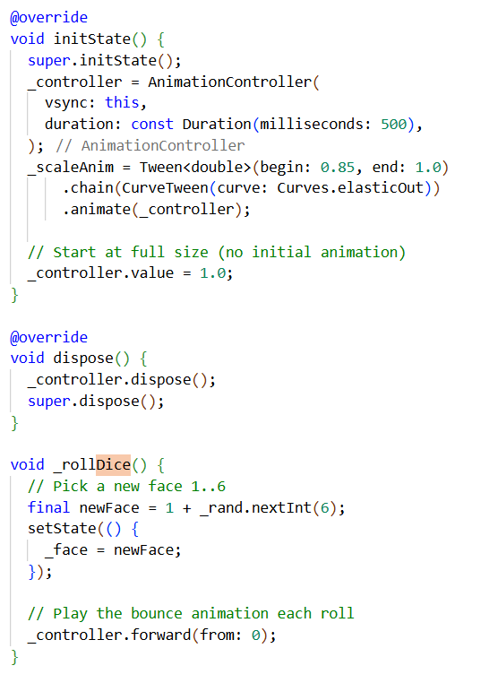
initState, dispose, rand.nextInt, setstate

Slide 24
Other Ways to use Images

Slide 25
Images from URL (Network)
Use Image.network for online images
Use FadeInImage.assetNetwork for placeholder + fade-in
Consider caching for performance and offline reuse

Slide 26
Network Image — Snippets
// Simple network image: Image.network( 'https://example.com/dice3.png', width: 160, height: 160, fit: BoxFit.contain, ); // Placeholder + fade-in: FadeInImage.assetNetwork( placeholder: 'assets/dice1.png', image: 'https://example.com/dice3.png', width: 160, height: 160, fit: BoxFit.contain, )

Slide 27
Optional: Cached Network Images — pubspec
dependencies: cached_network_image: ^latest

Slide 28
Optional: Cached Network Images — Code
import 'package:cached_network_image/cached_network_image.dart'; CachedNetworkImage( imageUrl: 'https://example.com/dice3.png', width: 160, height: 160, placeholder: (ctx, _) => const CircularProgressIndicator(), errorWidget: (ctx, _, __) => const Icon(Icons.error), )

Slide 29
Images from Gallery / Camera
Add image_picker to pubspec (Android/iOS support)
Use Image.file(File(path)) to display picked image

Slide 30
image_picker — pubspec
dependencies: image_picker: ^latest

Slide 31
Pick from Gallery — Code
import 'dart:io'; import 'package:image_picker/image_picker.dart'; final _picker = ImagePicker(); File? _imageFile; Future<void> _pickFromGallery() async { final XFile? picked = await _picker.pickImage(source: ImageSource.gallery); if (picked != null) setState(() => _imageFile = File(picked.path)); } // Widget: _imageFile != null ? Image.file(_imageFile!, width: 160, height: 160, fit: BoxFit.contain) : const Icon(Icons.image, size: 100, color: Colors.white70);

Slide 32
Take Photo with Camera — Code
Future<void> _takePhoto() async { final XFile? taken = await _picker.pickImage(source: ImageSource.camera); if (taken != null) setState(() => _imageFile = File(taken.path)); } // Button: ElevatedButton(onPressed: _takePhoto, child: const Text('Open Camera'));

Slide 33
Where to Plug Into the Dice App
// Replace the asset in your dice app: Image.asset('assets/dice$_face.png') // with a network image: Image.network('https://example.com/dice$_face.png') // Or show the gallery/camera result instead of the asset: _imageFile != null ? Image.file(_imageFile!) : Image.asset('assets/dice$_face.png');

Slide 34
Quick Comparison of Image Sources
Source | Widget | Pros | Cons/Notes
Assets | Image.asset | Offline, fast, version-controlled | Increases app size
URL | Image.network | Dynamic, no APK bloat | Needs internet; cache recommended
Gallery/Camera | Image.file (+ image_picker) | User content, interactive | Permissions and file handling

Slide 35


Column & Row
Column() & Row() can be used to place multiple children widgets next to each other
Column()
Main Axis: Vertical Axis
Cross Axis: Horizontal Axis
By default, occupies the entire available height but only the width required by its content (children)
Row()
Main Axis: Horizontal Axis
Cross Axis: Vertical Axis
By default, occupies the entire available width but only the height required by its content (children)

Slide 36
Alignment

Slide 37
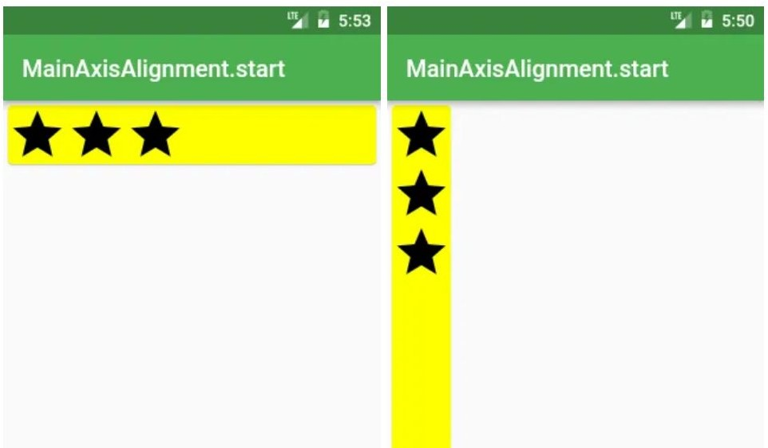
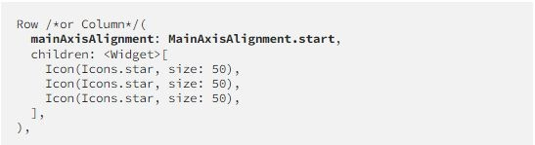

Slide 38
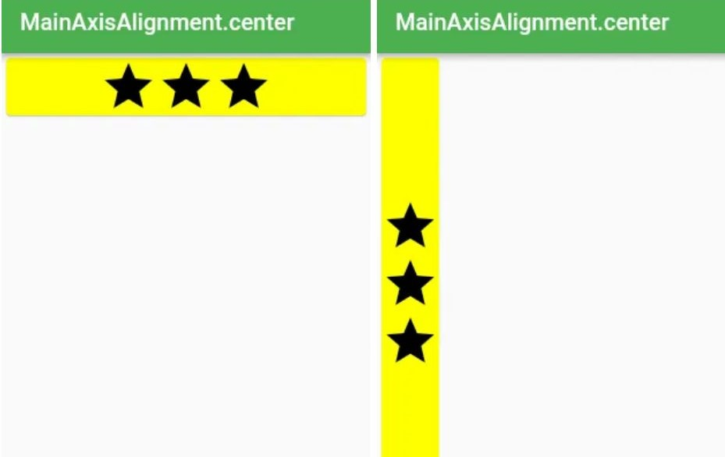
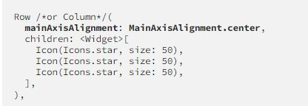

Slide 39
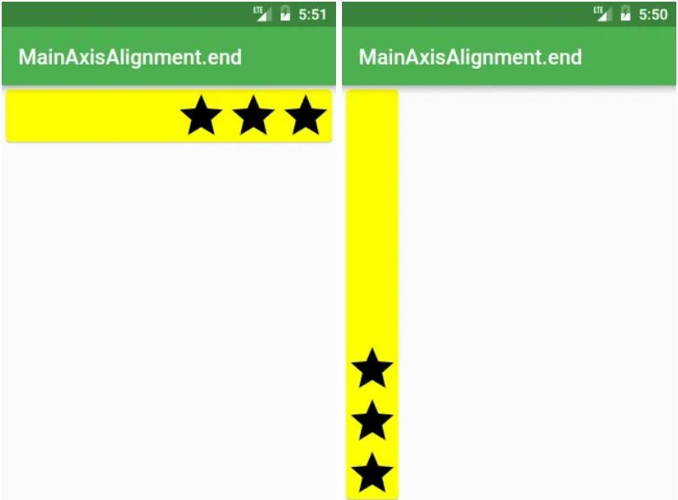
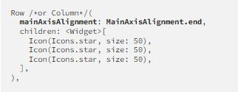

Slide 40
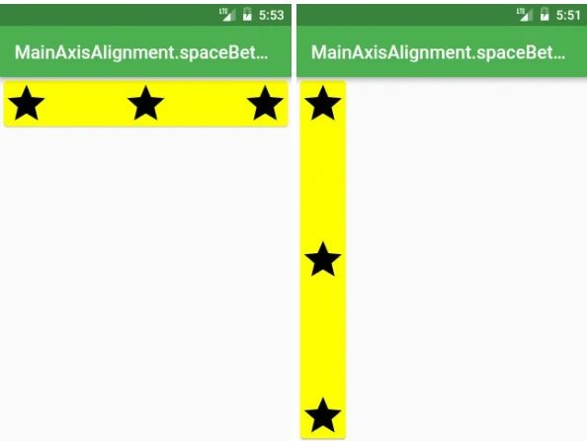
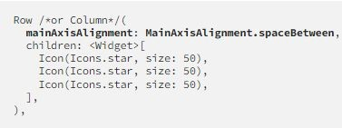

Slide 41
