Slide 1
Lecture 1: Mobile Programming using Flutter
Dr.Taraggy Ghanim

Slide 2
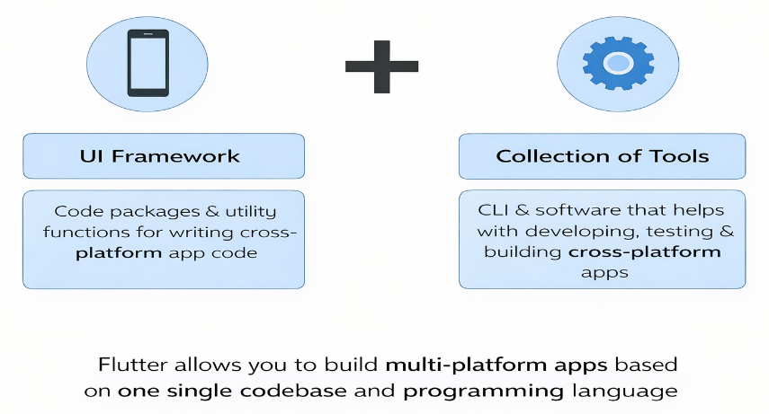
What is Flutter?

Slide 3
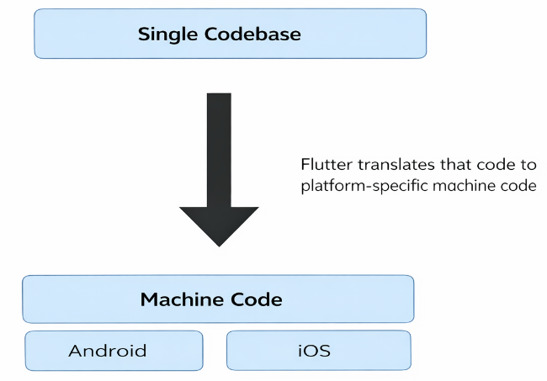
From Flutter Code to Plateform Code

Slide 4
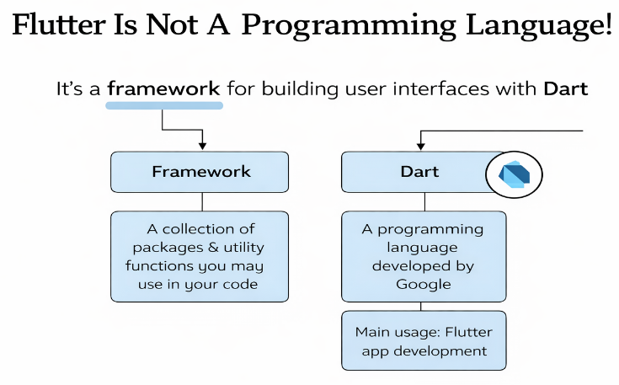

Slide 5
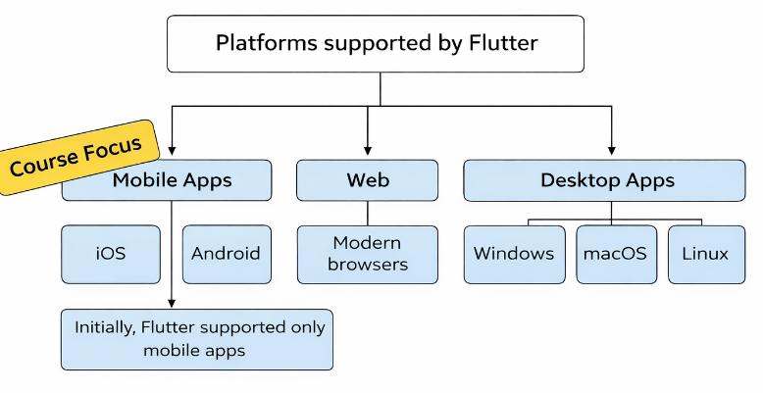
Platforms Supported by Flutter

Slide 6
Target Platforms
You can write the code of all platforms on the same machine.
You can only test and run ios & macos on macos machine. You can only test and run Windows app on Windows machine. You can only test and run Linux app on Linux machine.
Android and Web apps can be built on any machine

Slide 7
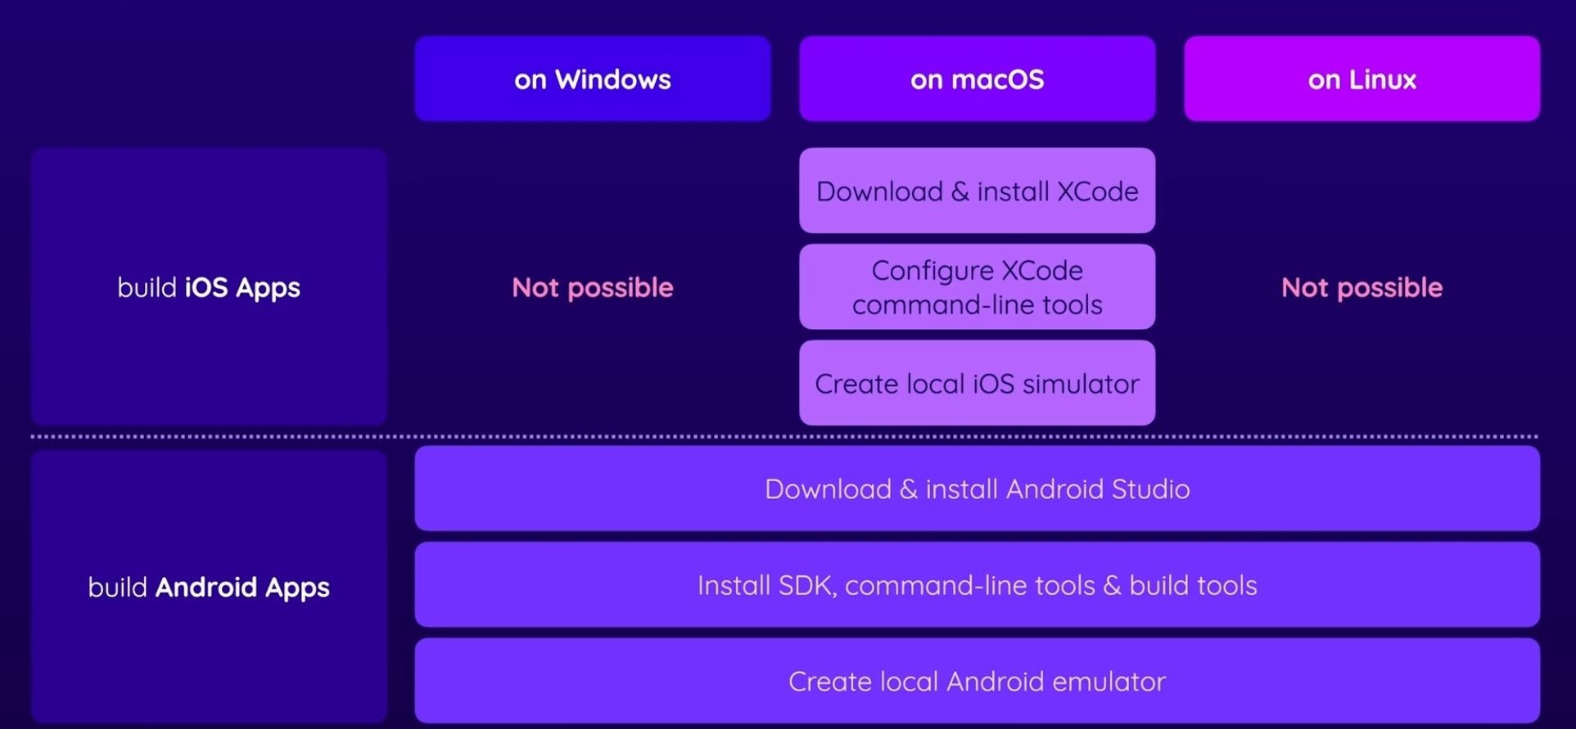
Target Platform Tools &Devices Setup

Slide 8
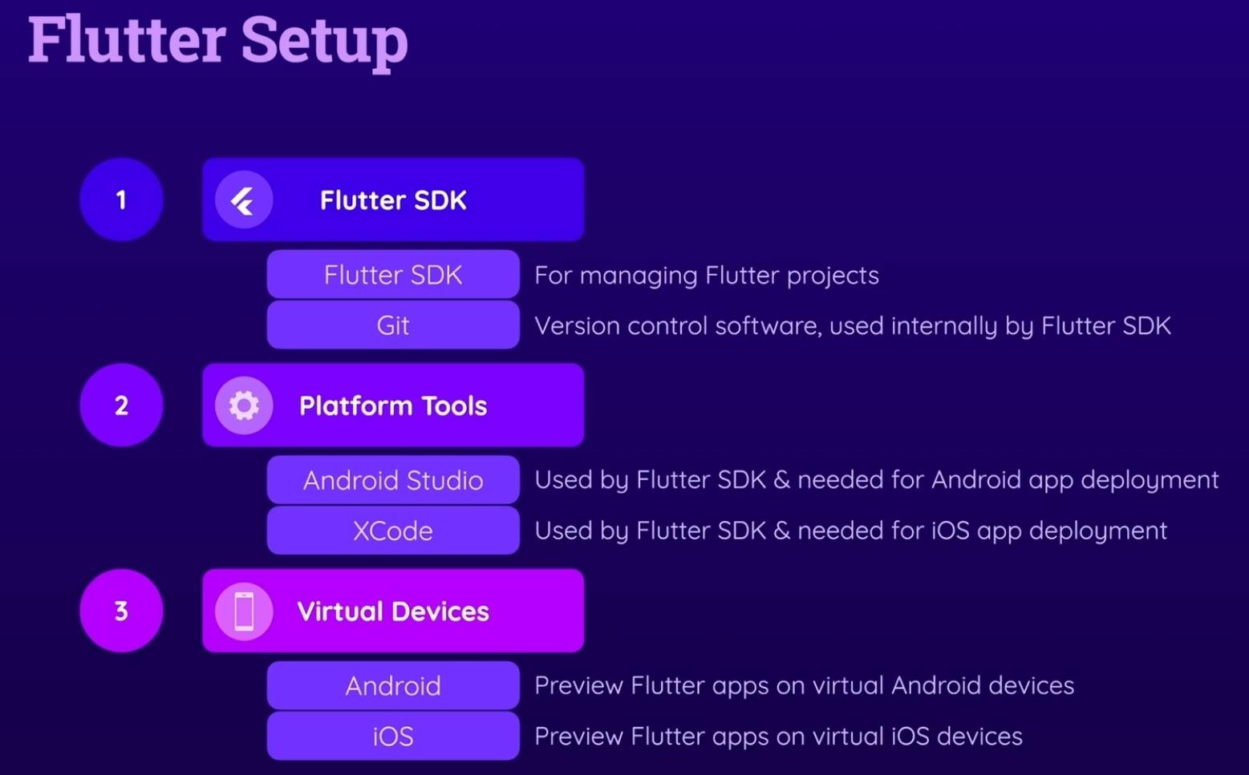

Slide 9
Starting our First Program

Slide 10
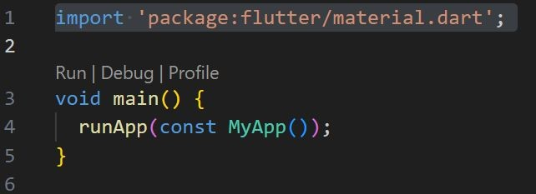
import 'package:flutter/material.dart'
material.dart
library contains a set of pre-built
widgets that implement the Material Design guidelines.
Material Design is an open-source design system built and supported by Google designers and developers.

Slide 11
main() runApp() functions
the main() function is used to start the program.
runApp() function is used to return the widgets that are connected to the screen as the root of the widget tree to be rendered on the screen.

Slide 12
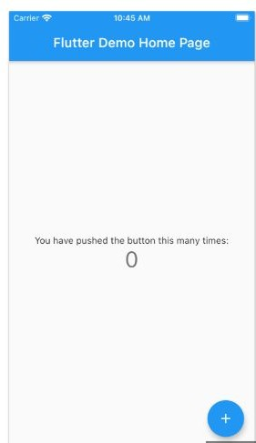
What are Widgets ?
Each element on a screen of the Flutter app is a widget. Each widget is a part of a user interface
Widget Tree : position widgets within each other to build simple and complex layouts

Slide 13
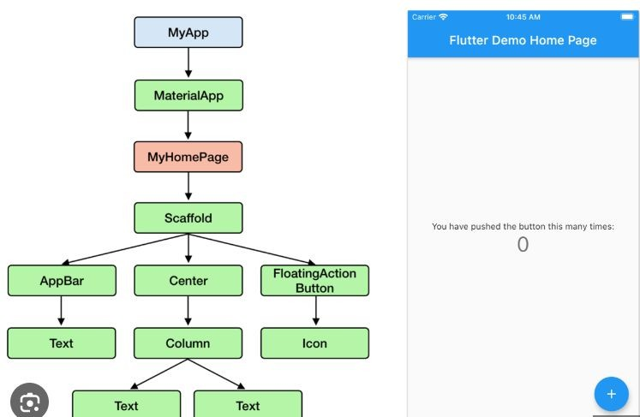
Widget Tree

Slide 14
Center
A widget that centers its child within itself.
This widget will be as big as possible if its dimensions are constrained and widthFactor and heightFactor are null. If a dimension is unconstrained and the corresponding size factor is null then the widget will match its child's size in that dimension. If a size factor is non-null then the corresponding dimension of this widget will be the product of the child's dimension and the size factor. For example if widthFactor is 2.0 then the width of this widget will always be twice its child's width.

Slide 15
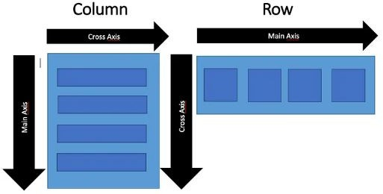
Column
A widget that displays its children in a vertical array.
To cause a child to expand to fill the available vertical space, wrap the child in an Expanded widget.
The Column widget does not scroll (and in general it is considered an error to have more children in a Column than will fit in the available room). If you have a line of widgets and want them to be able to scroll if there is insufficient room, consider using a ListView.

Slide 16
Category of Widgets:
There are mainly 14 categories in which the ﬂutter widgets are divided. They are mainly segregated on the basis of the functionality they provide in a ﬂutter application.
Accessibility: These are the set of widgets that make a ﬂutter app more easily accessible.
Animation and Motion: These widgets add animation to other widgets.
Assets, Images, and Icons: These widgets take charge of assets such as display images and show icons.
Async: These provide async functionality in the ﬂutter application.
Basics: These are the bundle of widgets that are absolutely necessary for the development of any ﬂutter application.
Cupertino: These are the iOS designed widgets.
Input: This set of widgets provides input functionality in a ﬂutter application.
Interaction Models: These widgets are here to manage touch events and route users to different views in the application.
Layout: This bundle of widgets helps in placing the other widgets on the screen as needed.
Material Components: This is a set of widgets that mainly follow material design by Google.
Painting and effects: This is the set of widgets that apply visual changes to their child widgets without changing their layout or shape.
Scrolling: This provides scrollability of to a set of other widgets that are not scrollable by default.
Styling: This deals with the theme, responsiveness, and sizing of the app.
Text: This displays text.

Slide 17
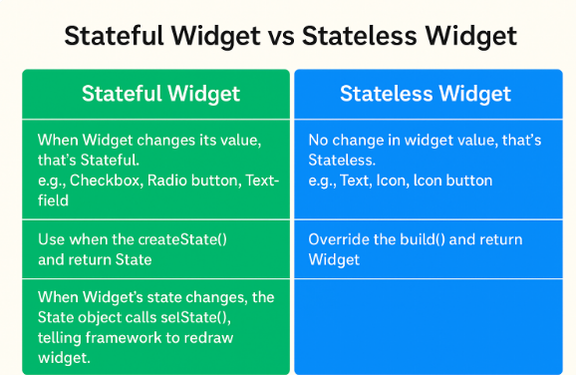
1. Stateless Widget
2. Stateful Widget
Types of Widgets:

Slide 18
Stateful vs Stateless
“You are developing a Flutter app. One screen displays a static company logo, and another screen displays a counter that updates when a button is pressed. Which widget types will you use and why?”
Answer:
StatelessWidget → For the company logo since it never changes.
StatefulWidget → For the counter, as it updates when the button is clicked.

Slide 19
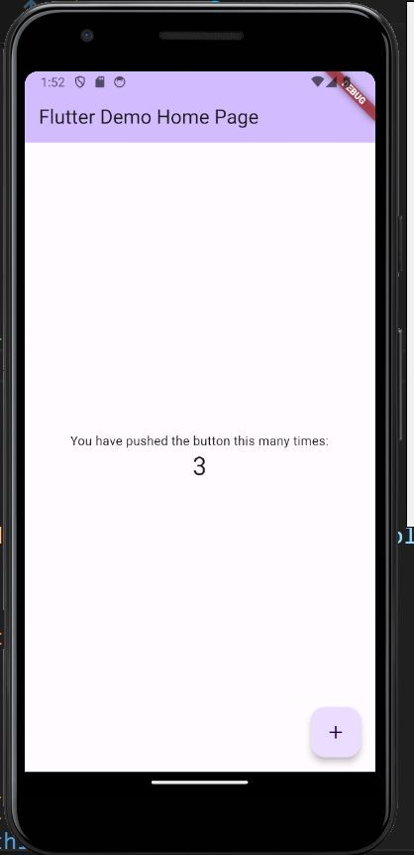
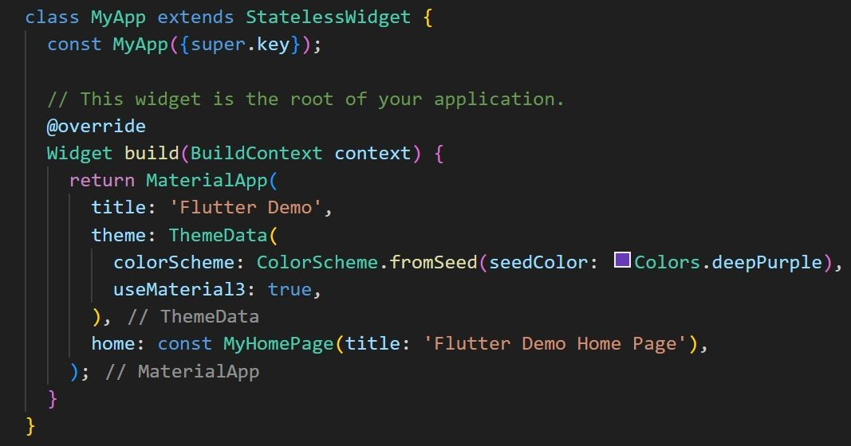
MaterialApp → widget that wraps a number of widgets

Slide 20
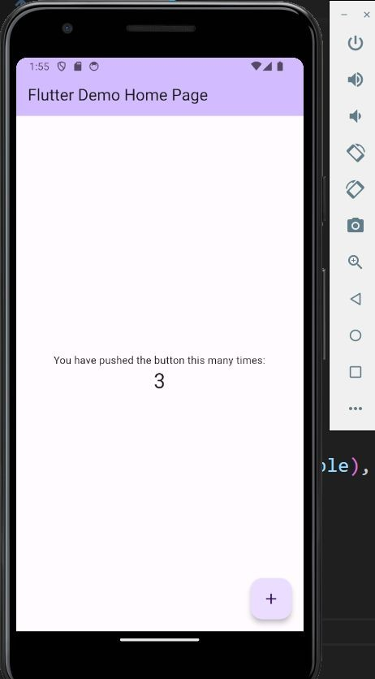
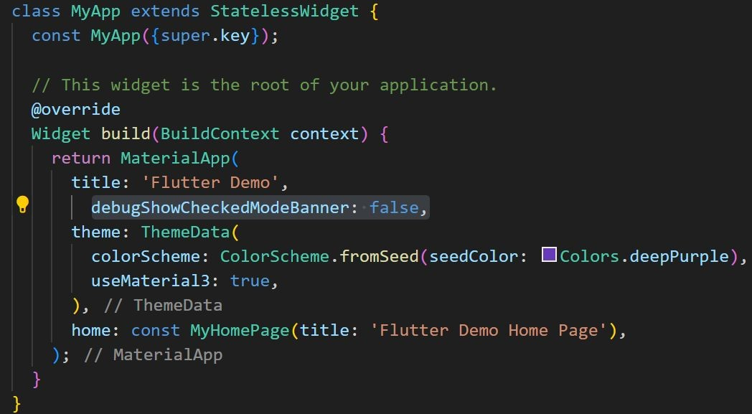
Remove the debug Banner

Slide 21
Bool useMaterial3→ updated version than material 2 with more effects and colors
Home property:
displayed first when the application is started normally

Slide 22
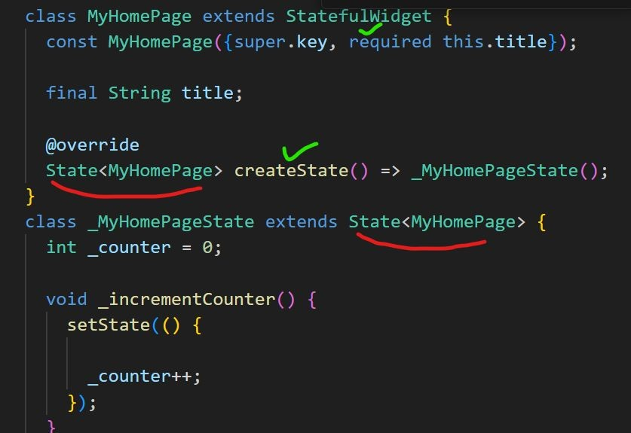
StatefulWidget related to State Class
fat arrow notation ( => ). A fat arrow is used to define a
single expression in a function. This is a cleaner way to write functions with a single statement.
_ means private member
Each time setState is called, the build function is re-excuted

Slide 23
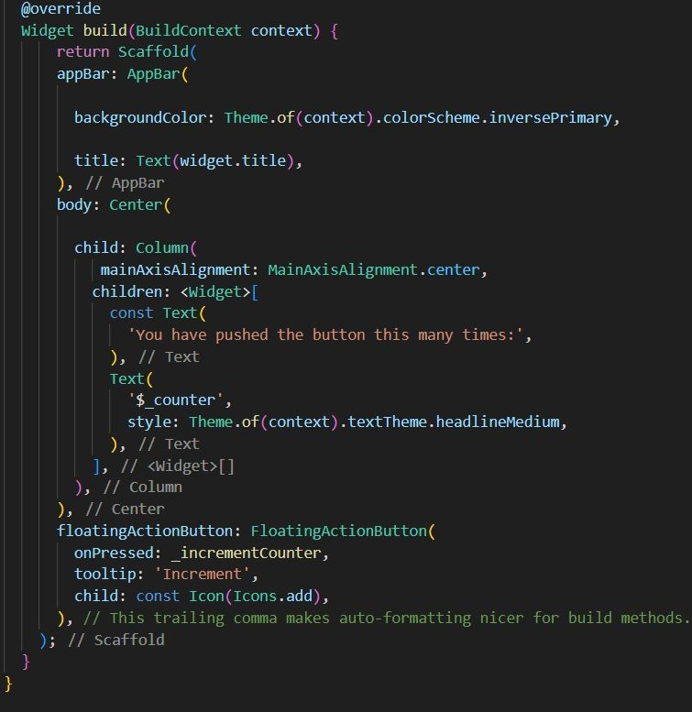
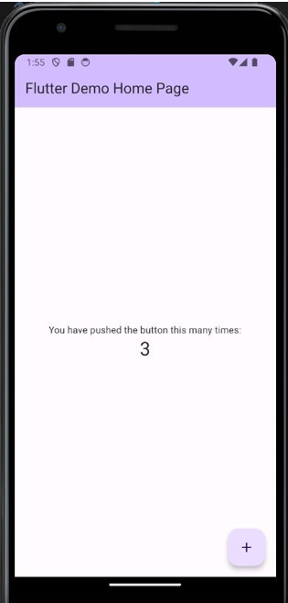

Slide 24
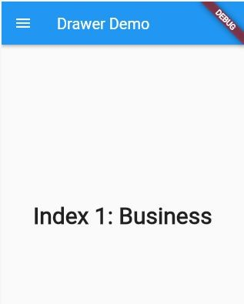
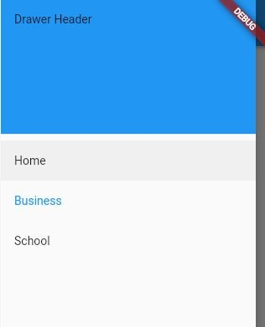
Scaffold
Scaffold is a class in flutter which provides many widgets
APIs like Drawer, Snack-Bar, Bottom-Navigation-Bar,
Floating-Action-Button, App-Bar,
Scaffold will expand or occupy the whole device screen. It will occupy the available space.

Slide 25
Snackbar
Explore the following link
https://docs.flutter.dev/cookbook/design/snackbars
Solve Exercise Snackbars :
Open New flutter project,
Copy the snackbar code in an empty project
Run the code
Change the duration of the snackbar appearance
Change the displayed message
Remove the debug mode sign
Upload the screenshot of the output
Be ready for discussion with dr Taraggy

Slide 26
Drawer
Explore the following link
Note the following:
List
TextStyle
IconButton
ListView
ListTile
Navigator.pop
https://docs.flutter.dev/cookbook/design/drawer
Solve Exercise Drawer on Moodle
Open new empty flutter project
Copy the sample code from the link https://docs.flutter.dev/cookbook/design/drawer
Add items to the list view
Change the Colors and Font
Upload the screenshot of your modified code
Be ready for discussion with dr Taraggy

Slide 27
Simple Exercise (Fill in the blanks)
class MyStatelessWidget extends StatelessWidget {
@override
Widget ____________(BuildContext context) {
return Text('I am a Stateless Widget');
}
}
build

Slide 28
Simple Exercise (Fill in the blanks)
class MyStatefulWidget extends StatefulWidget{
@override
State<MyStatefulWidget> createState() =>_______________________________;
}
class _MyStatefulWidgetState() extends _____________________________ {
int counter = 0;
@override
Widget build (BuildContext context) {
return Column(
_________________________: [
Text('Counter: $counter'),
ElevatedButton(
____________________: () {
setstate(() {
counter++;
});
},
child: Text('Increment'),
),
],
);
}
}
_MyStatefulWidgetState()
State<MyStatefulWidget>
children
onPressed

Slide 29
Given the following code using a Column widget:
Container(
padding: EdgeInsets.all(16),
child: Row(
mainAxisAlignment: MainAxisAlignment.spaceEvenly,
children: [
Text("Item 1"),
Text("Item 2"),
Text("Item 3"),
],
),)
Column(
children: [
Text("Item 1"),
Text("Item 2"),
Text("Item 3"),
],
)
Modify it to:
Display items horizontally instead of vertically.
Add spacing between items.
Wrap it in a Container with padding.

