Slide 1
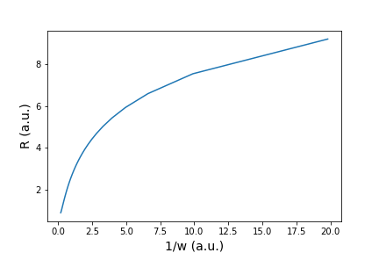
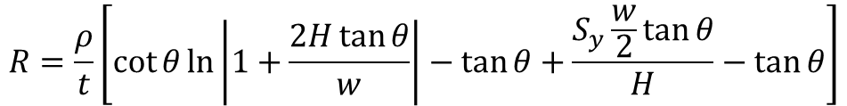
θ
H
w
Sy
$$R=\frac{ρ}{t}\left[\cot{θ}\ln\left|1+\frac{2H\tan{θ}}{w}\right|−\tan{θ}+\frac{S_{y}\frac{w}{2}\tan{θ}}{H}−\tan{θ}\right]$$

Slide 2
