Slide 1

RTL Implementation of the
KCF / MOSSE Visual Tracking Algorithm on FPGA
Akhil Sriram | Roll No. 2210110134 | B.Tech ECE
Supervisor: Dr. Venkatnarayan Hariharan
Department of Electrical Engineering | Shiv Nadar Institution of Eminence
April 2026

Slide 2
Presentation Outline
1. The Problem
2. KCF Algorithm
• Why FPGA for tracking?
• Frequency-domain insight
• NCC / MOSSE / KCF comparison
• Hann window & Gaussian label
• Training: alpha = Y/(|X|^2 + lambda)
• Detection & response map
3. Live Demo
4. Hardware & Integration
• Frame 1 — target selection + training
• Frame 2 — NCC full-image search
• Frame 3 — KCF-only tracking
• 7-stage RTL pipeline (~19,300 cycles)
• AXI interface & processor integration
• Future work

Slide 3
The Visual Tracking Problem

Slide 4
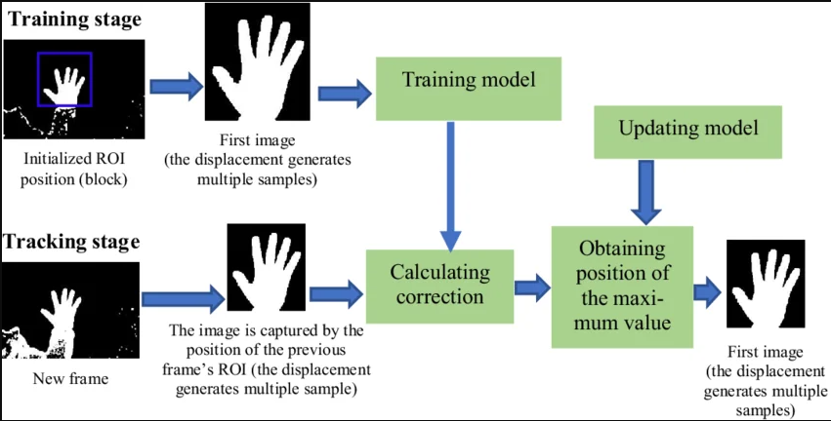
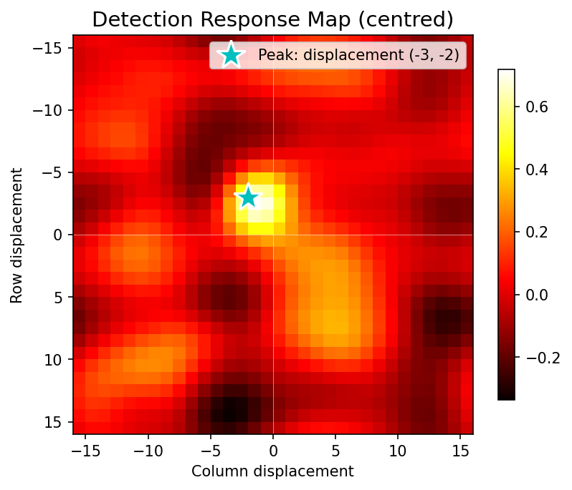
Why FPGA? The Frequency-Domain Insight
• Challenge: Real-time tracking on edge devices needs low latency and low power — CPUs execute serially and are too slow for high-frame-rate video.
• Key Insight: KCF exploits that all cyclic shifts of a patch form a circulant matrix diagonalised by the DFT — tracking reduces to element-wise division: alpha = Y / (|X|^2 + lambda)
• FPGA Advantage: Dedicated parallel dataflow maps directly to the FFT butterfly pipeline. Fixed-point arithmetic eliminates FPUs, cutting LUT usage significantly.

Slide 5
Algorithm Survey: NCC vs MOSSE vs KCF
Property
NCC
MOSSE
KCF
Purpose
Target acquisition
Fast tracking
Robust per-frame tracking
Feature space
Raw pixels
Raw pixels
Kernel (linear / RBF)
Complexity
O(MN log MN)
O(N^2 log N)
O(N^2 log N)
Robustness
Low
Medium
High
Update rule
None
Online average
Learning rate eta
HW cost
Medium (1 FFT pair)
Low (2 FFT)
Medium (6 FFT)
This project
Frame 2 only
Algorithm basis
Frames 3+

Slide 6
KCF Algorithm

Slide 7
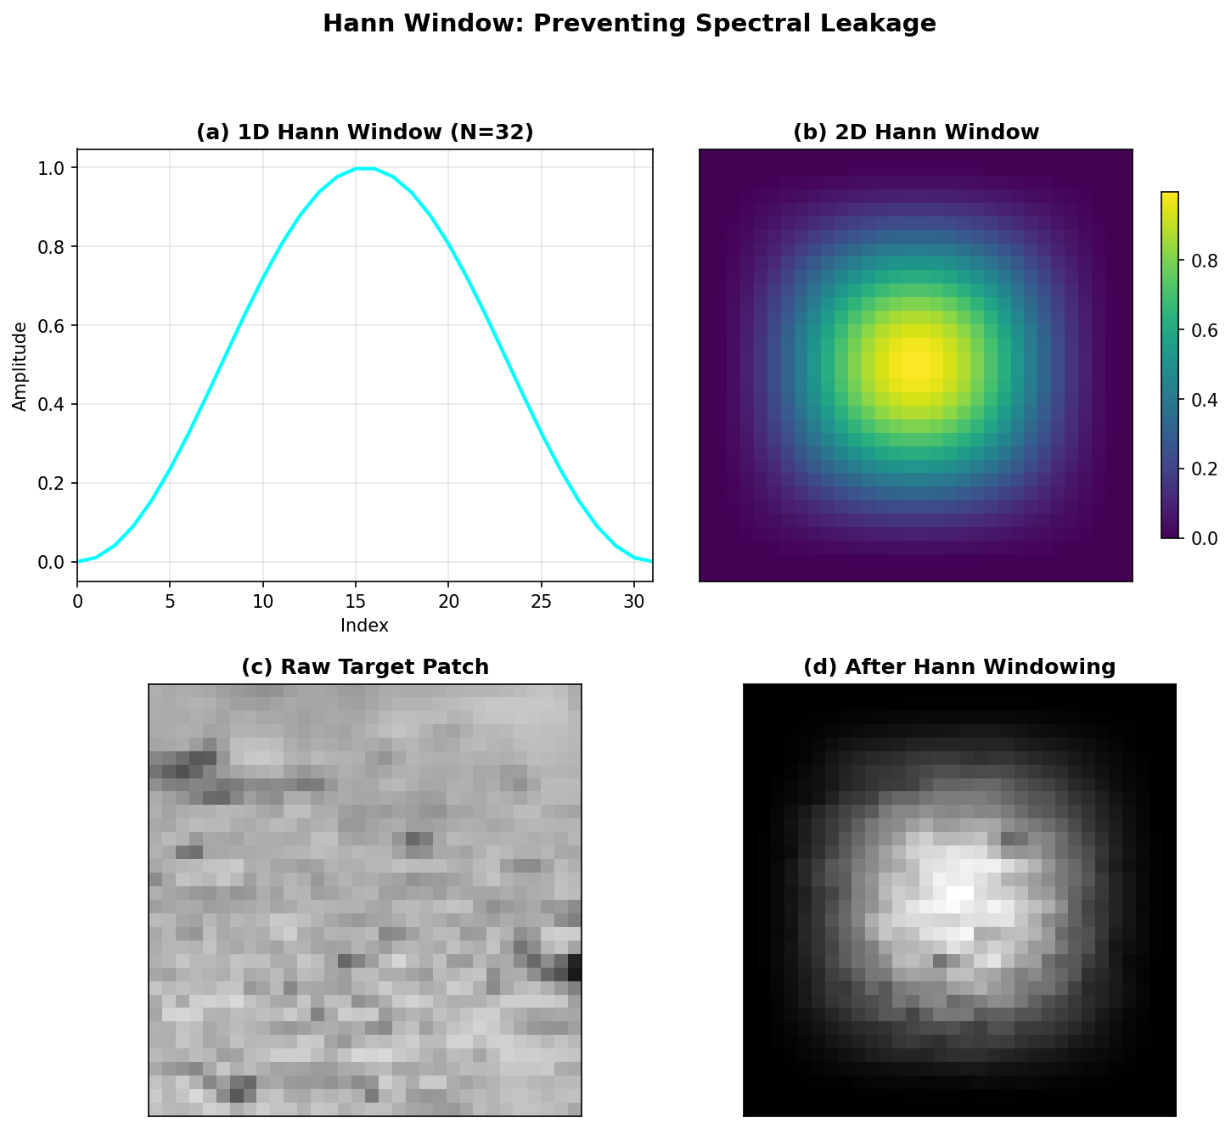
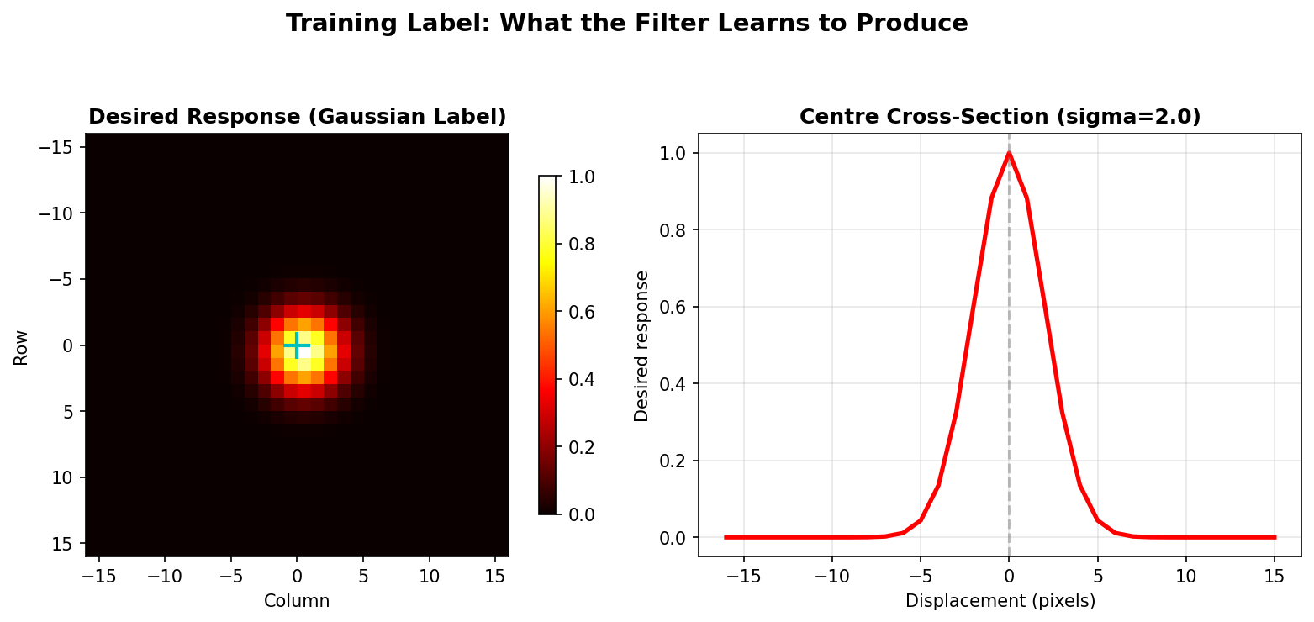
KCF Training: Hann Window & Gaussian Label
alpha = Y / ( |X|^2 + lambda )
> 1. Extract 32x32 patch x from Frame 1
> 2. Apply Hann window: x_w = x * w^2
> 3. Compute FFT: X = FFT2(x_w)
> 4. Gaussian label: Y = FFT2(y, sigma=2.0)
> 5. alpha = Y / (|X|^2 + lambda), lambda=0.01
> 6. Store alpha in ROM — computed once offline

Slide 8
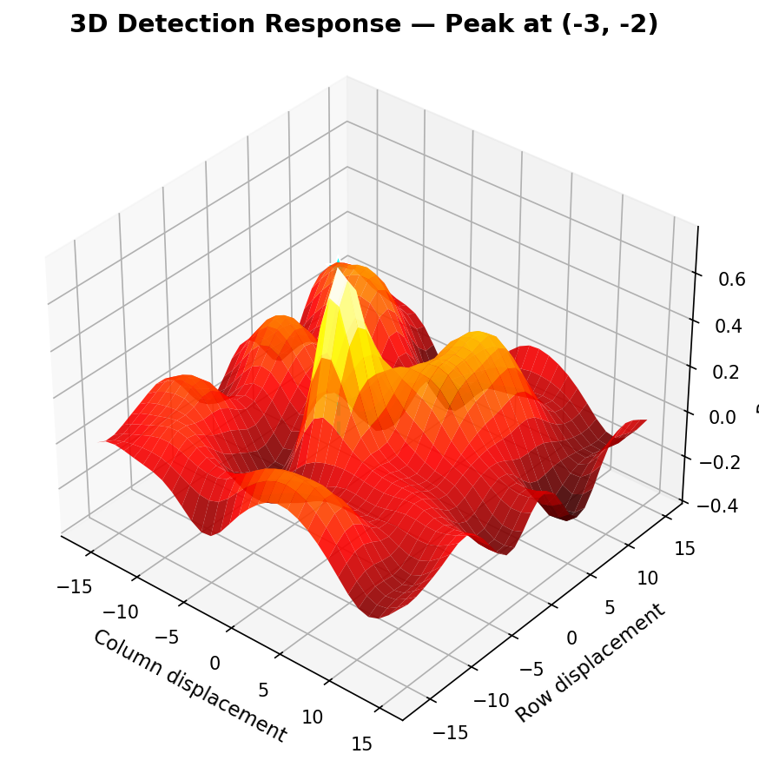
KCF Detection: Response Map & Peak Finding
R = IFFT2( conj(X) . Z . alpha )
> 1. Extract 32x32 patch z around last known position
> 2. Apply Hann window: z_w = z * w^2
> 3. Compute FFT: Z = FFT2(z_w)
> 4. Correlate: R_hat = conj(X) . Z . alpha (element-wise)
> 5. IFFT via conjugate trick: R = IFFT2(R_hat)
> 6. Peak of R gives displacement (d_row, d_col) -> new target position

Slide 9
Live Demo: NCC to KCF Tracking Pipeline

Slide 10
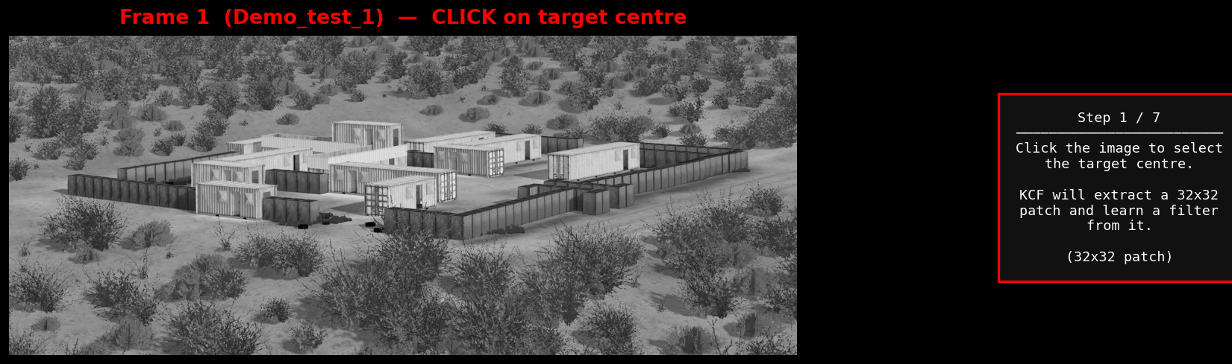
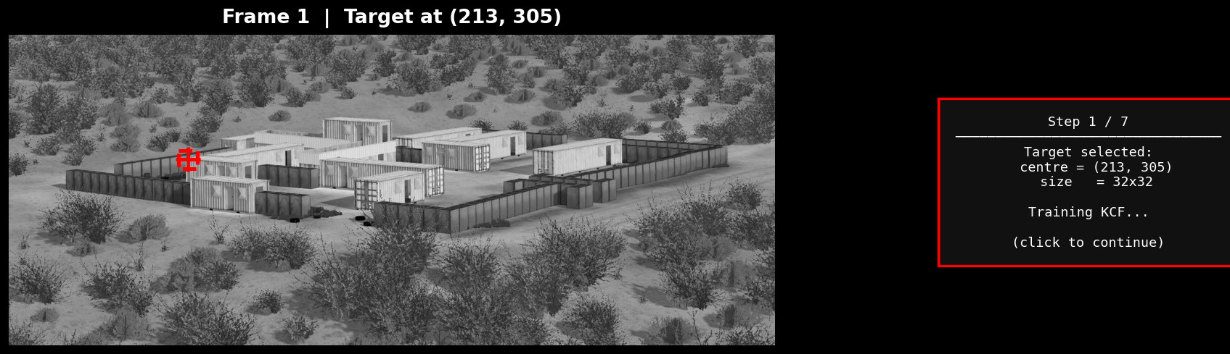
Frame 1 — Target Selection & KCF Training
Step 1-2 / 7
User clicks to select a 32x32 target patch -> KCF filter alpha computed offline and stored in ROM

Slide 11
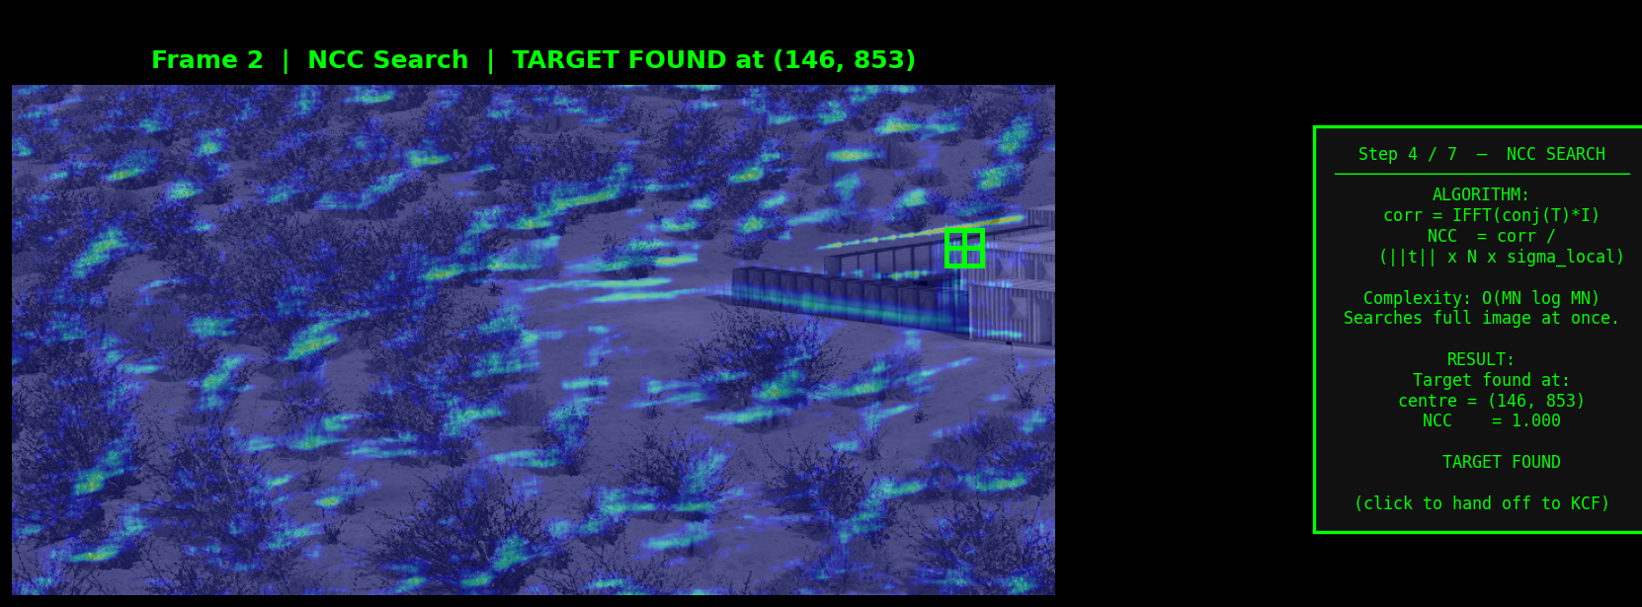
Frame 2 — NCC Full-Image Search
Step 4 / 7
NCC score = 1.000 | Target found at (146, 853) | NCC used ONCE for initial acquisition — too slow for every frame

Slide 12
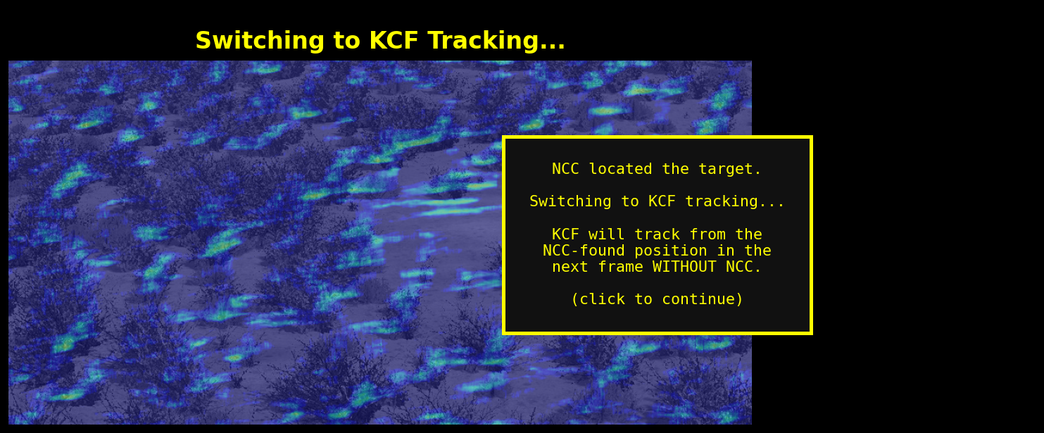
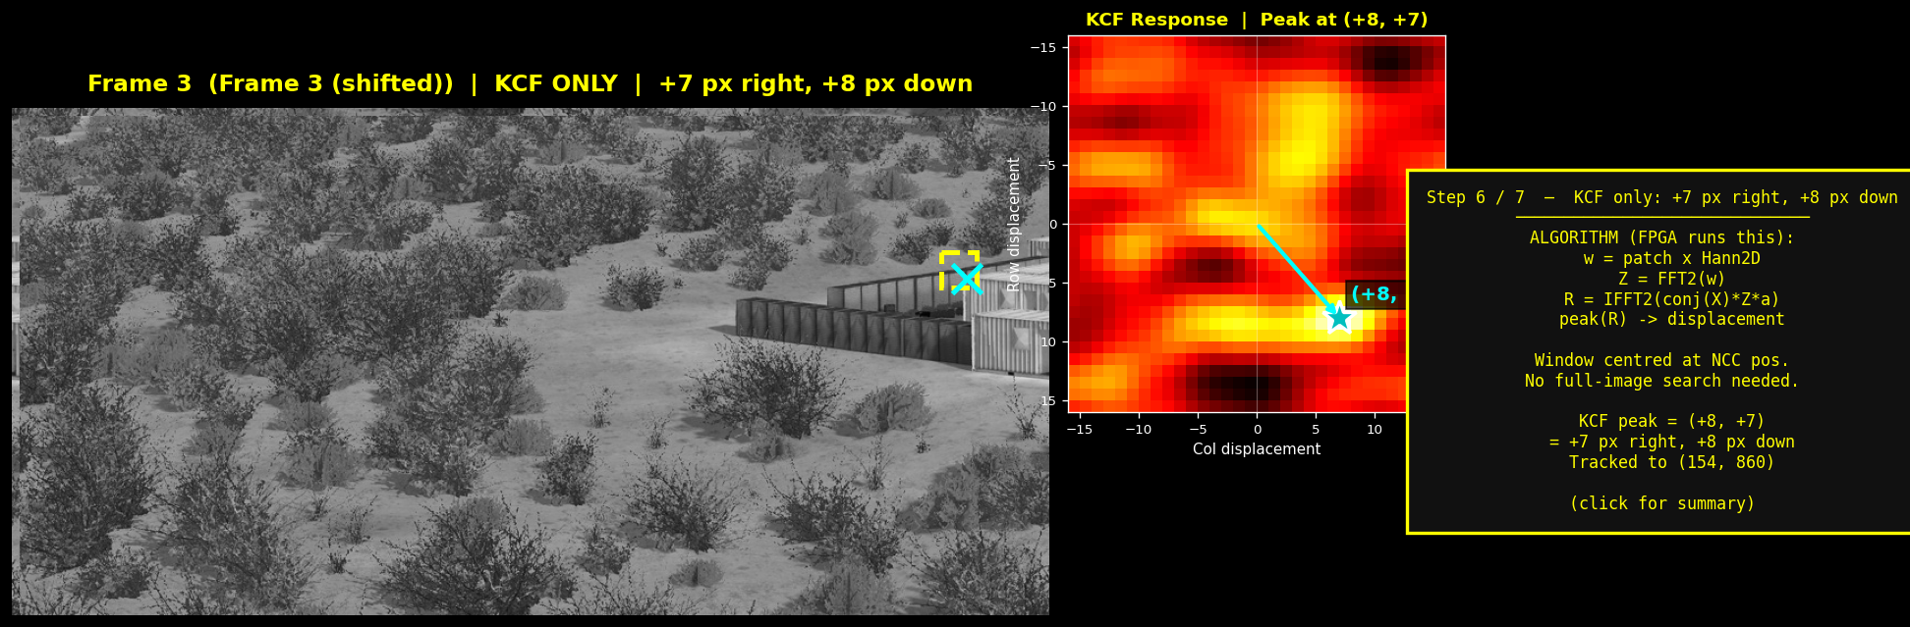
NCC -> KCF Handoff & Frame 3 Tracking
Steps 5-6 / 7

Slide 13
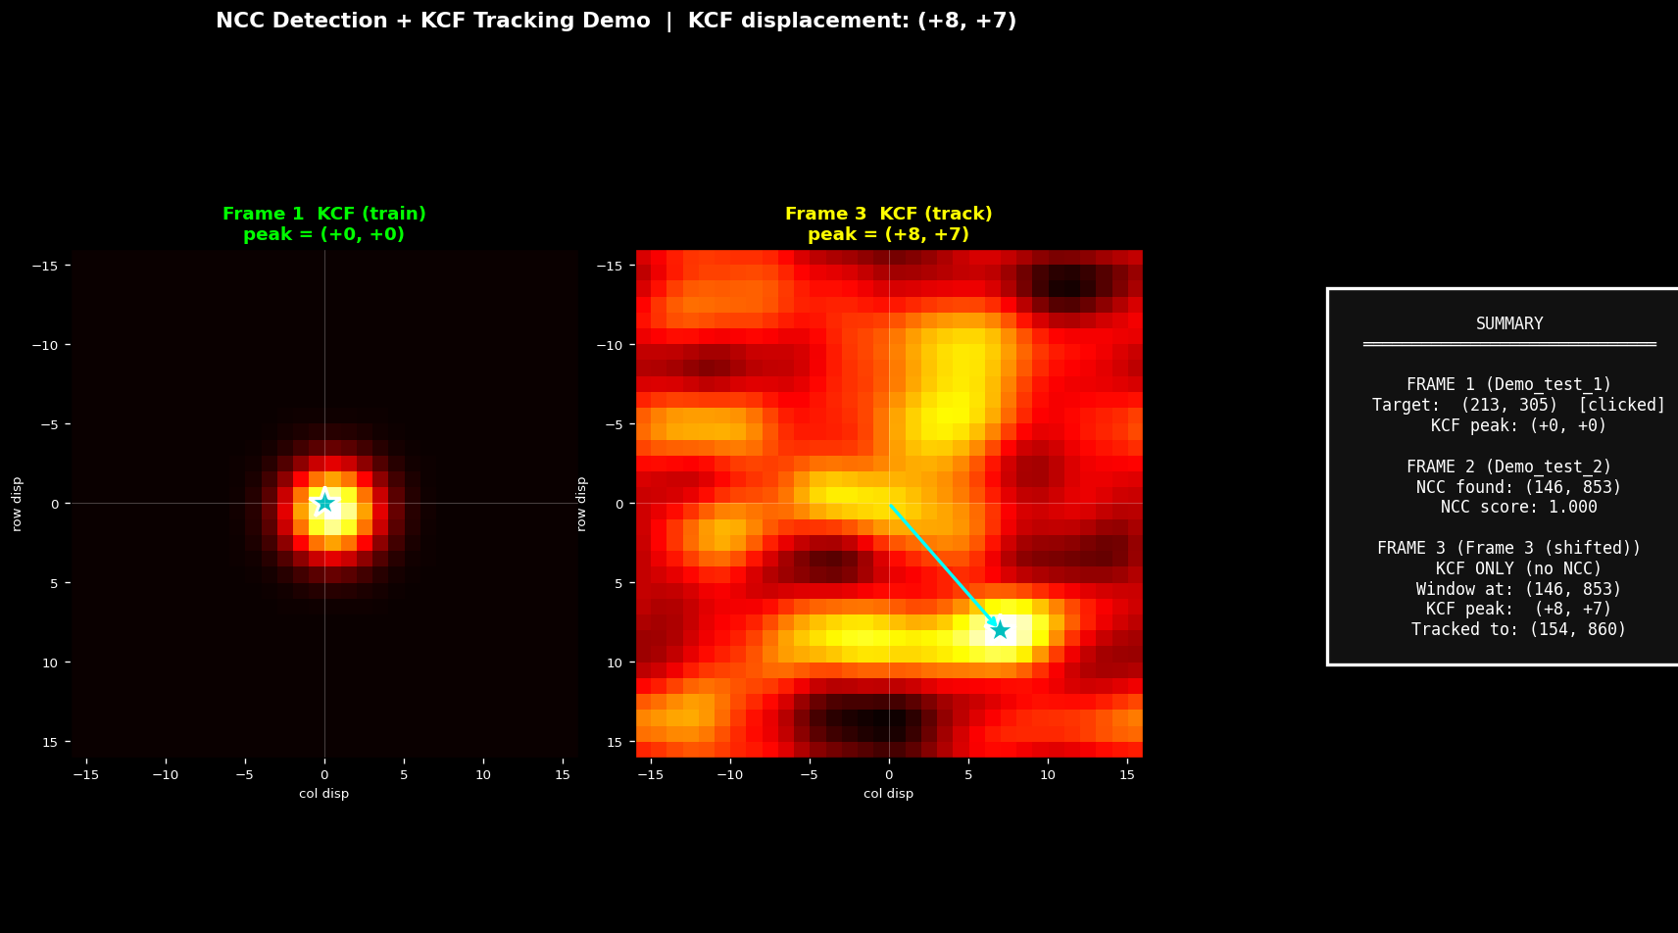
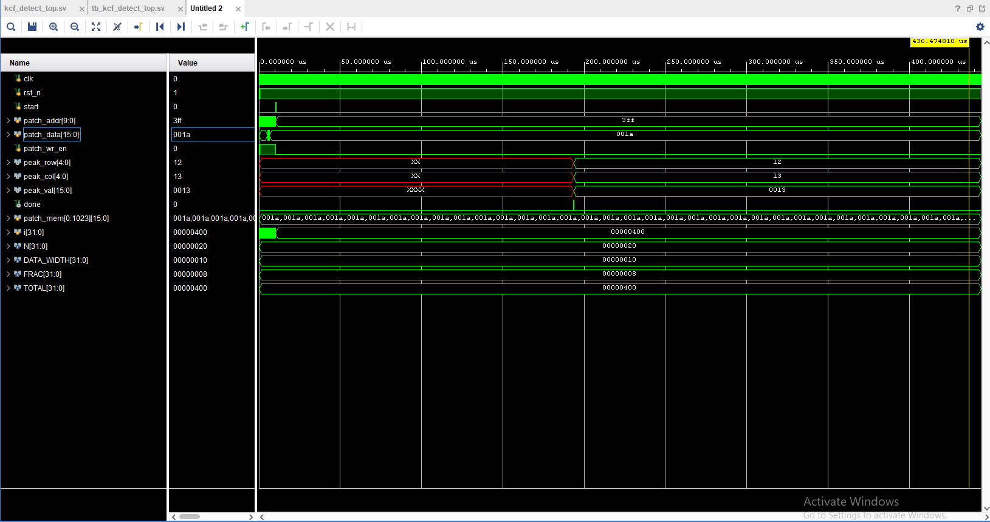
Results Summary
Response maps + hardware simulation
Hardware Simulation
v done pulse confirmed in Vivado
v ~19,300 cycles = 193 us @ 100 MHz
v peak_row / peak_col match Python ref
v Hardware-software agreement verified

Slide 14
RTL Hardware & Integration

Slide 15
RTL Pipeline & Processor Integration
7-Stage Detection Pipeline
AXI Interface — Processor Integration
Stage
Cycles
Operation
Offset
Register
Access
0x00
CTRL
W — trigger start
S_HANN_WIN
1,024
Hann window multiply
0x04
THRESHOLD
R/W — confidence level
S_FFT_RUN
~5,600
2D-FFT (32 row + 32 col)
0x08
PEAK_ROW
R — row index (0-31)
S_ELEM_MUL
1,024
conj(X).Z.alpha element-wise
0x0C
PEAK_COL
R — col index (0-31)
0x10
PEAK_VAL
R — response magnitude
S_IFFT_RUN
~5,600
2D-IFFT (conjugate trick)
0x14
TARGET_FOUND
R — valid detection bit
S_PEAK_RUN
1,024
Scan for response peak
AXI4-Stream: 1024 x 16-bit pixel stream (tready / tvalid / tlast) AXI4-Lite: control + result registers Integration with processor via AXI interconnect
TOTAL
~19,300
~193 us @ 100 MHz

Slide 16
Future Work & Thank You
Future Work
> FPGA Synthesis
Artix-7 LUT/FF/BRAM utilisation + timing closure at 100 MHz
Thank You
> 64x64 Resolution
6-stage FFT for higher accuracy on larger targets
Questions?
> Gaussian Kernel
Akhil Sriram | 2210110134
Hardware exponential LUT for RBF kernel — improves robustness
Dr. Venkatnarayan Hariharan
> Online Update
Shiv Nadar Institution of Eminence
Adaptive filter: alpha_new = (1-eta)*alpha_old + eta*alpha_frame
> Camera Pipeline
MIPI CSI-2 / OV7670 input + HDMI output on Nexys A7

