Slide 1

RTL Design of a KCF Visual Tracker
ECE499 Major Project — Mid-Semester Presentation
Akhil Sriram
Supervisor: Dr. Venkatnarayan Hariharan
Department of Electrical Engineering, Shiv Nadar University
Spring 2026

Slide 2
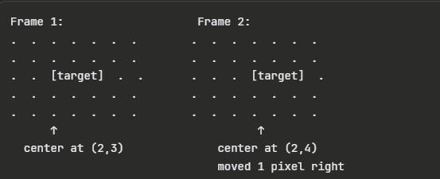
The Visual Tracking Problem
Given: Frame 1 + bounding box around target
Goal: Find the same target in Frame 2, 3, 4, ...
Naive approach: Slide template across entire search area
Complexity: O(N^4) — far too slow for real-time
Key insight: Use the FFT to test ALL shifts at once
Frequency-domain correlation: O(N^2 log N)
Enables real-time tracking at 100+ FPS

Slide 3

MOSSE: Minimum Output Sum of Squared Error
Learn filter H* in the frequency domain from training frames
Detection: G = H* (element-wise) F — single FFT + multiply + IFFT
Achieves 600+ FPS on a single CPU core (Bolme et al., CVPR 2010)
Limitation: Operates on raw pixel intensities only
Cannot handle non-linear appearance changes (rotation, lighting)
Only captures linear correlations — low robustness to clutter

Slide 4
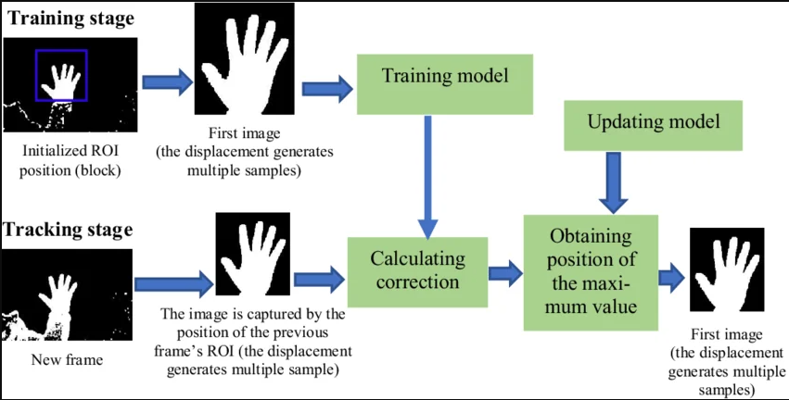
KCF: Kernelized Correlation Filter
Extends MOSSE with the kernel trick (Henriques et al., 2015)
Maps patches into higher-dimensional feature space
Key insight: Kernel correlations of circulant data
are still diagonalised by the DFT!
Linear kernel: equivalent to MOSSE, better regularised
Gaussian kernel: captures non-linear relationships,
significantly improves robustness to appearance changes
Same O(N^2 log N) complexity as MOSSE

Slide 5
MOSSE vs KCF: Why KCF Wins
Property | MOSSE | KCF
Feature space | Raw pixels (linear) | Kernel-mapped (non-linear)
Core operation | H* . F | alpha . k^xz
Computational backbone | FFT / IFFT | FFT / IFFT
Training complexity | O(N^2 log N) | O(N^2 log N)
Robustness to clutter | Low | High
Non-linear appearance | No | Yes (Gaussian kernel)
OTB-2013 precision | 66.9% | 73.2%
Hardware cost | Low | Low (linear) / Moderate (Gaussian)

Slide 6

Circulant Matrices and the DFT
All cyclic shifts of a patch x form a circulant matrix C(x)
Circulant matrices are diagonalised by the DFT
Operations on ALL shifts become element-wise in frequency domain
This is why KCF can test every possible displacement in one pass
Complexity drops from O(N^4) spatial to O(N^2 log N) frequency

Slide 7

Training: Learning the Filter
Given target patch x and desired Gaussian response y (sigma=2.0)
Linear kernel: K_hat = |X_hat|^2 (power spectrum)
Ridge regression in frequency domain gives alpha_hat
Lambda = 0.01 prevents division by zero, improves stability
Training is done OFFLINE in Python for this MVP

Slide 8

Detection: Locating the Target
Given new search patch z from the next frame:
1. Apply Hann window to z, compute FFT(z)
2. Element-wise multiply: conj(X) * Z_hat * alpha_hat
3. Inverse FFT gives the response map (32x32 real values)
4. Peak of response = displacement of target between frames
Entire detection: one FFT + one multiply + one IFFT

Slide 9

Combined Filter for Hardware
Hardware multiplier computes: a * conj(b)
Store f_stored = conj(alpha) * X in a single ROM
At detection: Z_hat * conj(f_stored) = conj(X) * Z * alpha
This IS the correct KCF detection equation!
Advantage: One ROM instead of two, no Verilog changes needed

Slide 10
DFT Displacement Convention
Response map uses circular (DFT) indexing:
Index 0, 1, 2, ... = positive displacement
Index 31, 30, 29, ... = negative displacement (-1, -2, -3, ...)
Unwrapping rule (N=32):
If peak < 16: displacement = +peak
If peak >= 16: displacement = peak - 32
Example: peak at (29, 30)
29 - 32 = -3 rows, 30 - 32 = -2 cols
Target moved 3 pixels up, 2 pixels left

Slide 11
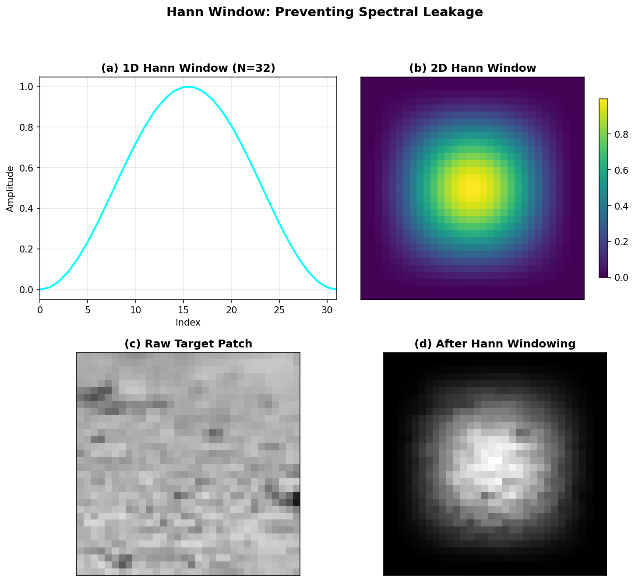
The Hann Window: Preventing Spectral Leakage
The Hann window smoothly tapers patch edges to zero, preventing sharp boundary artifacts in the FFT.

Slide 12
Hardware Architecture Overview
7-stage Finite State Machine in kcf_detect_top.sv
Input: 32x32 patch (1024 pixels, Q8.8 fixed-point)
Output: (peak_row, peak_col) = target displacement
Total latency: ~19,300 clock cycles
At 100 MHz: ~193 microseconds per detection
Throughput: ~5,200 detections/second
All arithmetic in Q8.8 (16-bit signed, 8 fractional bits)

Slide 13
Pipeline Stages
1. S_HANN_WIN (1024 cyc) — Apply 2D Hann window
2. S_FFT_LOAD (1024 cyc) — Load windowed patch into FFT
3. S_FFT_RUN (~5400 cyc) — 2D FFT (32 rows + 32 cols)
4. S_ELEM_MUL (1024 cyc) — Conjugate multiply with filter
5. S_IFFT_LOAD (1024 cyc) — Load product into IFFT
6. S_IFFT_RUN (~6400 cyc) — 2D IFFT (conjugate trick)
7. S_PEAK_RUN (1026 cyc) — Scan response, find maximum
Pipeline is fully sequential — one stage at a time
Each 1D FFT: 5 butterfly stages x 16 operations = 80 ops

Slide 14
Q8.8 Fixed-Point Representation
16-bit signed: 1 sign + 7 integer + 8 fractional bits
Range: -128.000 to +127.996
Resolution: 1/256 = 0.00390625
THE PROBLEM:
2D FFT scales by 1/N per pass = 1/N^2 = 1/1024 total
Response values fall below smallest Q8.8 value!
Everything rounds to zero
This required a careful scaling solution...

Slide 15
The Scaling Solution
Asymmetric FFT Scaling:
Forward FFT: scale row pass (1/N), skip column pass
IFFT: full scaling on both passes for correct normalisation
Net forward attenuation: 1/N (not 1/N^2)
Adaptive Pre-Scaling:
Multiply filter coefficients by K (largest power of 2
such that max|filter * K| < 120)
Synthetic data: K=64, Real image: K=2
Final output = (K/N) x true_response
Comfortably within Q8.8 dynamic range

Slide 16
Key RTL Building Blocks
Butterfly Unit (butterfly.sv):
out_a = a + W*b, out_b = a - W*b
Single-cycle combinational, with scaled variant (>>1)
Twiddle ROM (twiddle_rom_32.sv):
16 complex values, symmetry: W^(k+N/2) = -W^k
1D FFT (fft1d_32.sv): Radix-2 DIT, iterative single-butterfly
2D FFT (fft2d_32.sv): Row-column decomposition
2D IFFT (ifft2d_32.sv): Conjugate trick reuses FFT hardware
IFFT(X) = conj(FFT(conj(X))) / N^2
Peak Finder (peak_finder.sv): Sequential max scan, 1026 cycles

Slide 17
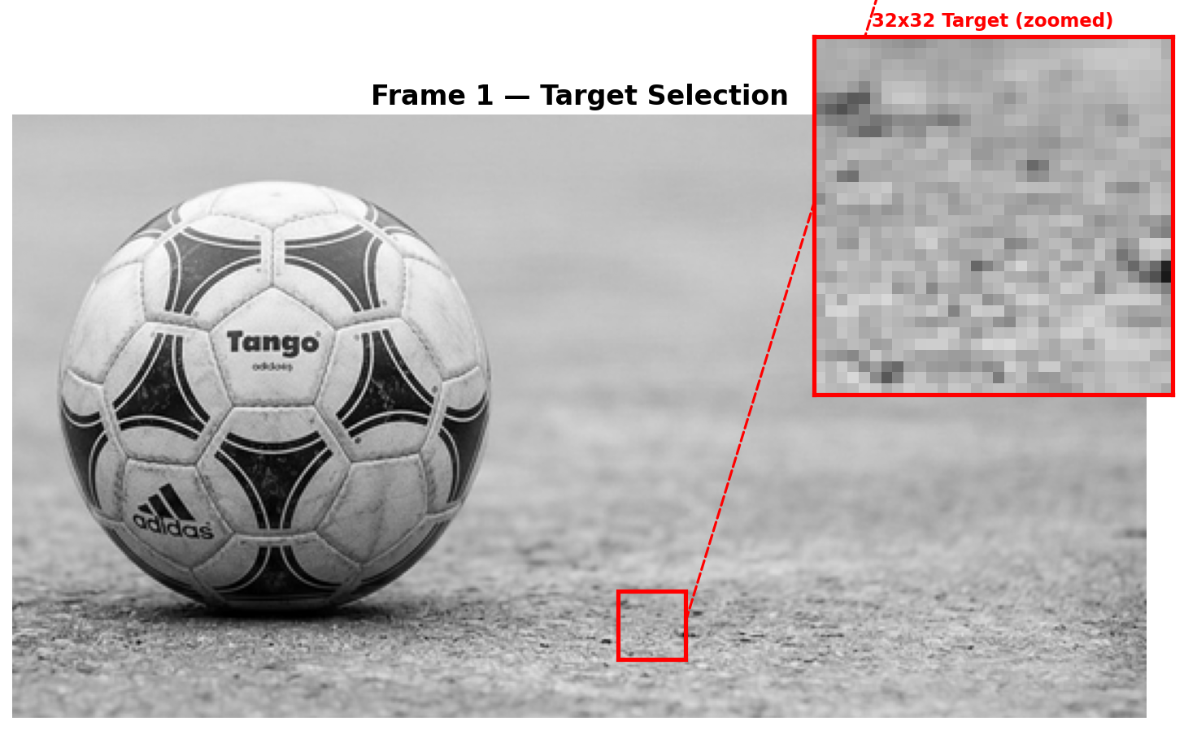
Real Image: Target Selection
Test image: soccer ball on pavement (284x533). Target: textured ground at (240, 300).

Slide 18
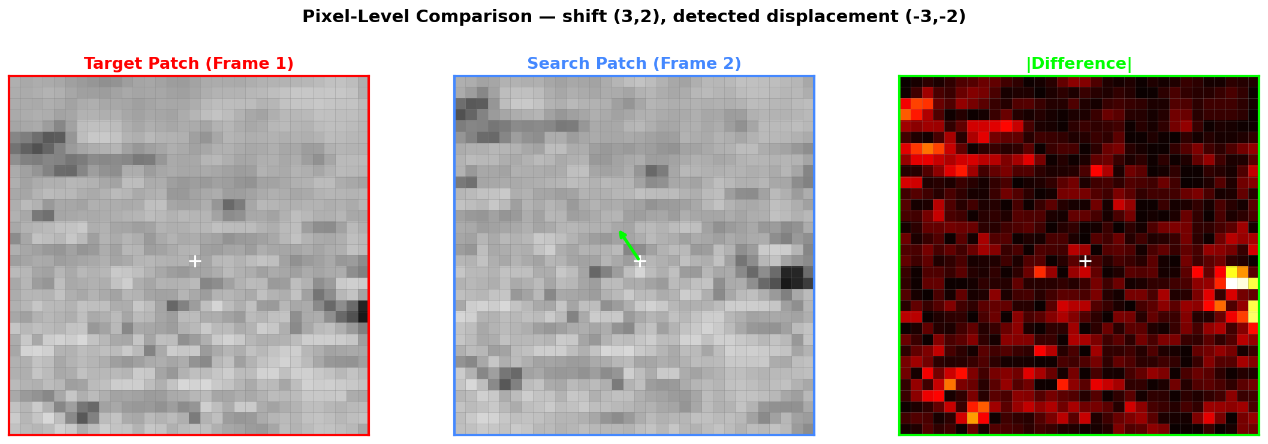
Simulated Frame-to-Frame Motion
Search patch cropped 3 rows down, 2 cols right. Difference map highlights shifted content at edges.

Slide 19
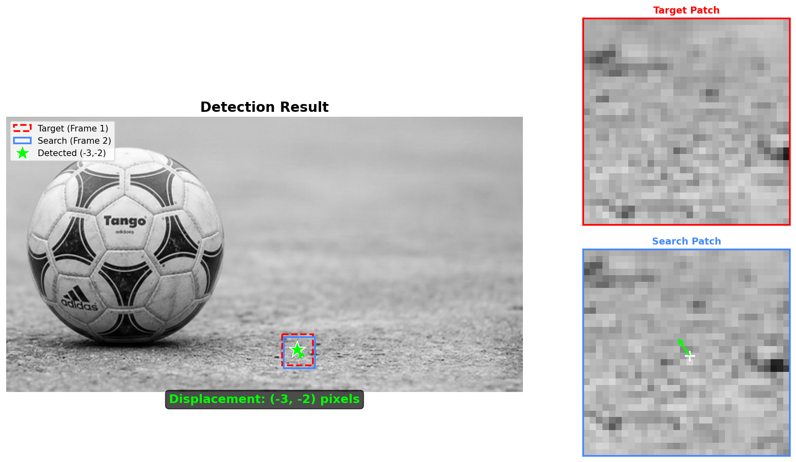
Detection Result on Real Image
KCF correctly detects displacement (-3, -2) — matching the simulated 3-pixel shift.

Slide 20
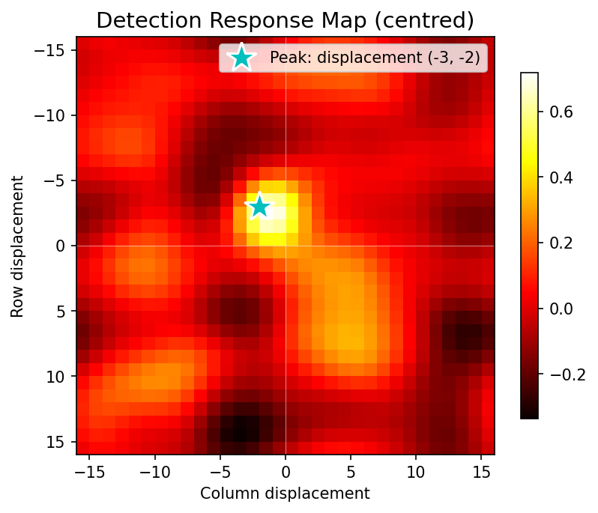
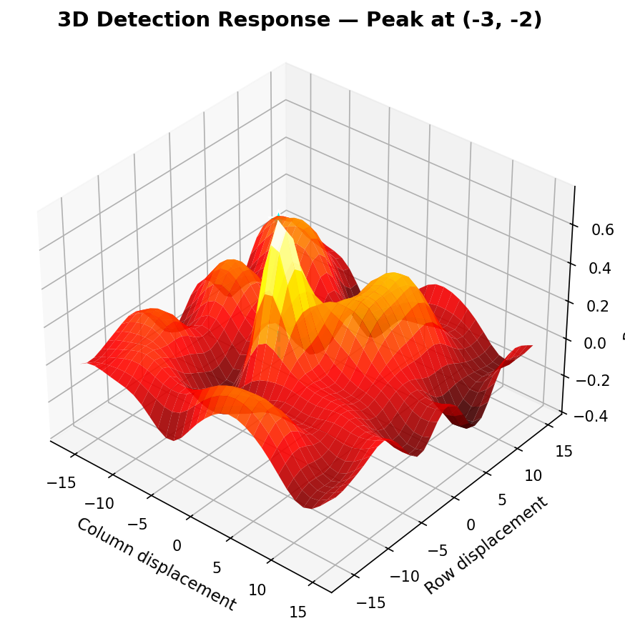
Response Map: Algorithm Confidence
2D heatmap (centred with fftshift)
3D surface — sharp peak at (-3, -2)

Slide 21
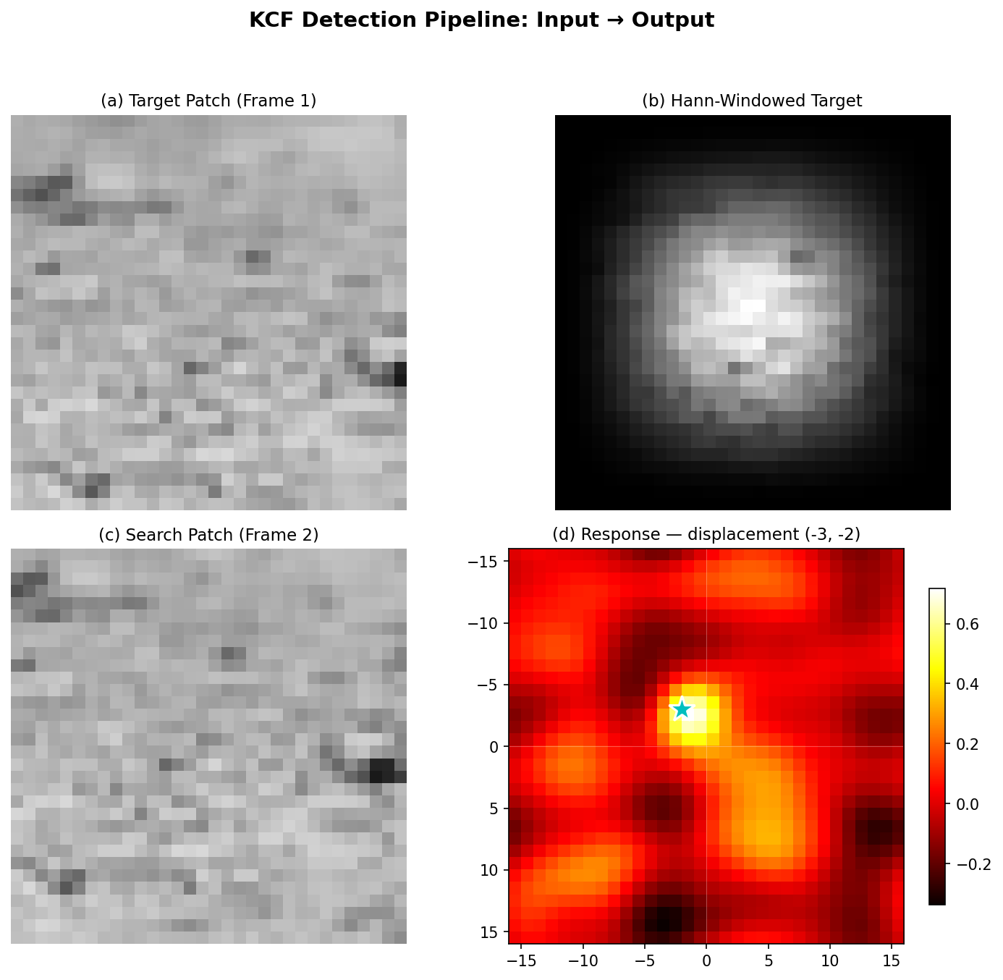
KCF Detection Pipeline: Input to Output
(a) Target patch (b) Hann-windowed (c) Search patch (d) Response map with detected displacement

Slide 22
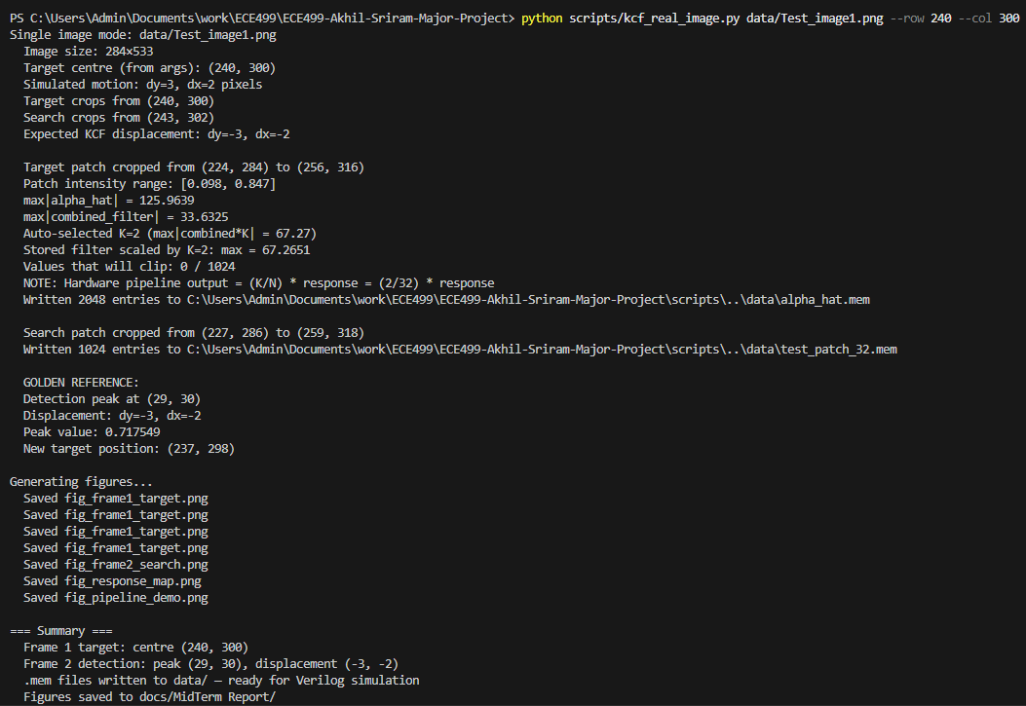
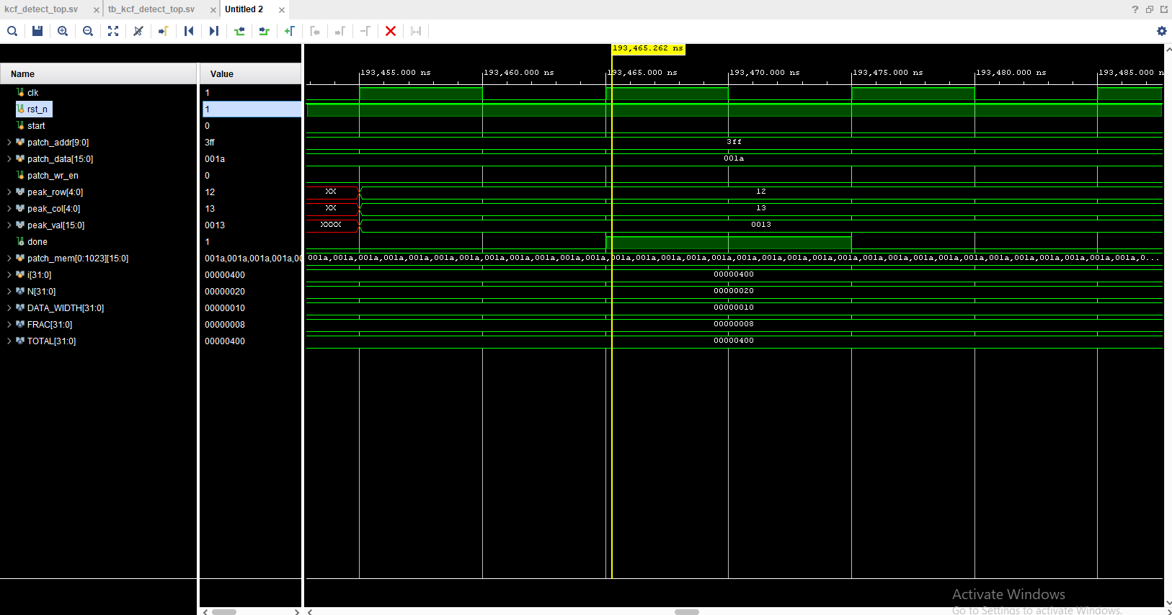
Hardware-Software Agreement
Python golden reference: peak (29, 30) = displacement (-3, -2)
Vivado waveform: done pulse at ~193 us, matching peak coordinates

Slide 23
Real Tracking System vs Our Demo
Real Tracking System
Our Mid-Semester MVP
Continuous video stream (30+ FPS)
Model updates every frame
Larger patches (64x64 or 128x128)
Gaussian kernel for robustness
AXI bus for pixel streaming
Handles occlusion, scale changes
Real-time closed-loop operation
Single image, simulated motion
Frozen offline-trained filter
32x32 patches
Linear kernel (simpler hardware)
Direct write port (no AXI)
Detection phase only
~193 us per detection at 100 MHz

Slide 24
What We Achieved
Complete 7-stage KCF detection pipeline in synthesisable SystemVerilog
Custom 2D FFT/IFFT using iterative single-butterfly architecture
Q8.8 fixed-point with asymmetric scaling — solved precision challenge
Correct combined-filter formulation for hardware efficiency
Python toolchain: training, data generation, golden reference
Real-image demonstration with exact HW-SW agreement
~19,300 cycles = 193 us per detection at 100 MHz
Verified in both Icarus Verilog and Xilinx Vivado 2024.2

Slide 25
Future Work Roadmap
1. FPGA Synthesis: Deploy on Xilinx Artix-7,
evaluate timing, resource consumption, power
2. Resolution Scaling: 64x64 patches
(6th FFT stage, 4x memory buffers)
3. Gaussian Kernel: Hardware exponential LUT
for improved tracking robustness
4. Online Model Update: Adapt filter to appearance
changes in real-time (rotation, lighting)
5. AXI4-Stream Interface: SoC integration with
DMA pixel streaming from camera

Slide 26
Thank You
Questions?
Akhil Sriram | ECE499 | Spring 2026 | Shiv Nadar University

