Slide 1
Precision Guidance System
- By Team Risky 5
Notes:
Hi good evening we are team Risky 5 and Our project name is

Slide 2
Team Details
Team Name: Risky 5​
Startup Name: InfraCore Systems LLP
Name of Team Lead: Kalrav Mathur​
Name of the Institution: Shiv Nadar University
Name of the processor: SHAKTI Yamuna
Name of the Mentor: Dr. Venkatnarayan Hariharan
Notes:
I am Kalrav Mathur team lead for this project, and we are representing SNU, Our mentor is Dr Venkathariharan, and other members include Akhil Sriram, Akansh Saraf, Saksham Mahajan and Tushar Juneja.
We will be using Shakti Yamuna processor.

Slide 3
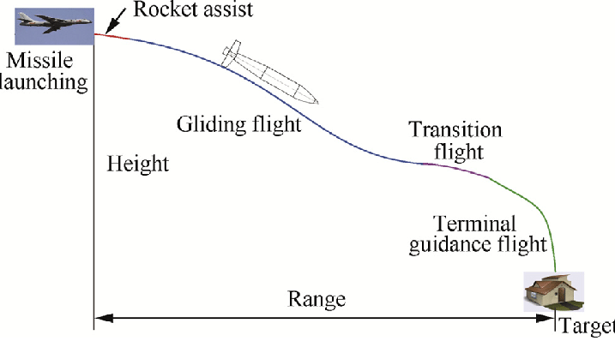

Precision Guidance System​
Target Application: Security and Surveillance
Objectives of the proposal: ​
To develop a terminal-phase Imaging Infrared (IIR) seeker prototype for a precision guided missile system on a fully indigenous hardware stack using the SHAKTI processor.
Running the main logic on the SHAKTI Yamuna​ and offloading compute intensive tasks of image correlation algorithms to FPGA for parallel execution.
To deliver a physical prototype that demonstrates the complete guidance functionality. This system will lock onto a physical target, visually track it by matching live thermal images with preloaded satellite imagery, and output the exact guidance commands.
Notes:
Lets discuss the objectives of this project.
We want to develop a terminal phase infrared seeker, that tracks a target by doing real time calculations for minimizing the error from the target.
We will implement software design that runs the main error calculation and correction software on the processor, and a hardware accelerator IP block that takes on the image processing and does all the heavy compute for the cpu,
this reduces image processing delays which will bethere if we do this on the processor.
Overall our system will achive l
locking onto a physical target, and
computing the errors from the incoming image frames,
Output the correction control signals to correct the error from the target

Slide 4
Novelty
The project addresses a critical capability gap for India's strategic autonomy by replacing imported IIR-guided systems like SCALP-EG and HAMMER, and lays the foundation for future R&D in seeker design.
Its core novelty is the implementation of a terminal-phase IIR seeker emulator on fully indigenous hardware, eliminating reliance on foreign black-box CPUs/GPUs and the security risks they pose.
Rather than simply running software on a processor, we use a hybrid architecture where the FPGA handles parallel pixel-level tasks, freeing the SHAKTI core for high-level processing — enabling real-time performance.
Unlike proprietary military systems, our emulator is modular and adaptable, allowing repurposing for civilian and security applications like drone navigation, border surveillance, precision agriculture, and disaster relief.
The project provides a low-cost, indigenous compute platform for thermal-guided systems, enabling scalable deployment by Indian MSMEs under Make in India and iDEX (Innovations for Defence Excellence) , ideal for disposable military use.
Notes:
The project addresses a critical capability gap for India's strategic autonomy by replacing imported IIR-guidedsystems like SCALP-EG and HAMMER, and lays the foundation for future R&D in seeker design.
Its core novelty is the implementation of a terminal-phase IIR seeker emulator on fully indigenous hardware,eliminating reliance on foreign black-box CPUs/GPUs and the security risks they pose.
Rather than simply running software on a processor, we use a hybrid architecture where the FPGA handlesparallel pixel-level tasks, freeing the SHAKTI core for high-level processing — enabling real-time performance.
Unlike proprietary military systems, our emulator is modular and adaptable, allowing repurposing for civilian andsecurity applications like drone navigation, border surveillance, precision agriculture, and disaster relief.
The project provides a low-cost, indigenous compute platform for thermal-guided systems, enabling scalabledeployment by Indian MSMEs under Make in India and iDEX — ideal for disposable military use.
This replaces foreign compute hardware with India-based processors, reducing costs and enabling broad use inexpendable platforms like UAVs and guided munitions.

Slide 5
Proposed Approach
Our goal is to guide a "Fire & Forget" ballistic missile in its terminal phase (after cruising stage to blast) towards its target.
We take inputs from a camera (in Infra-Red spectrum) and use image-corelation algorithms to compute the shift in missile's heading.
This can then be translated into the control signals that govern the missile's heading (yaw, pitch, roll, AoA (Angle of Attack), etc.).
We get additional information about heading from the inertial sensors mentioned above.

Slide 6
LWIR Sensor
Captures images continuously.
SPI and I2C
Image Processing Block
Does contrast enhancements and other image preprocessing.
AXI4
Shakti CPU
Calculates the error and its correction based on thermal images and inertial data.
SPI/I2C
Flight Controller
Control signals are received from Shakti CPU which are then actuated by flight controller.
Flow Chart

Slide 7
Inertial Measurement Unit
LWIR Sensor
FPGA FABRIC
Custom Image Processing IP
Shakti CPU
Flight Controller
Block Diagram
Notes:
This the the block diagram of our project.
1. First we can see that a lwir sensor is interfaced with the custom image processing IP
2. This module then sends the processed image to the shakti cpu
3. Shakti cpu on the basis of the image inference and IMU data, perfoms calculations to deduce the error
4. The cpu then sends the correction commands to the flight controller, which then does the actuations of those commands

Slide 8
Project Milestones Overview
Milestone 1: MVP (Due 24th Oct 2025)
Goal: Basic Image Capture & Processing Pipeline
Environment setup for Artix-7 FPGA & SHAKTI RISC-V
Interface LWIR sensor to capture single thermal frame
Verilog logic for frame transfer to SHAKTI soft-core
C/C++ matching algorithm detects predefined target
Deliverables:
Live image via SHAKTI serial output
“MATCH FOUND” result + coordinates
Milestone 2: PoC (Due 25th Dec 2025)
Goal: Real-time Video Processing Pipeline
Continuous thermal video stream(>10 FPS)
FPGA IP: contrast, filtering, edge detection
Real-time target detection (NCC) +IMU interfacing
Deliverables:
Processed video on monitor
LED indicator for “TARGET LOCKED”
Serial output: error vector + IMU data
Source code (FPGA + SHAKTI)
Milestone 3: Final Demo (Due 20th Apr 2026)
Goal: Full Guidance System with Live Target Tracking
Image + IMU fused for control commands
Robustness to occlusions & reacquisition
Real-time bounding box + command output
Deliverables:
Working prototype on test stand
Live demo with target lock & recovery
Guidance commands (e.g., YAW_RIGHT: 3.2°)
Final report + code + demo video

Slide 9
Business Potential
Large and Growing Global PGM Market The global PGM market is valued at USD 35–38 billion today, rising to USD 50–55 billion by 2030, with consistent CAGR around 5–6%
Substantial Indian Defence Funding India’s defence budget is ₹6.81 trillion (~USD 78 B) for FY 2025–26, with ₹1.8 trillion (~26%) dedicated to modernization and procurement
Strong Push for Domestic Procurement The government has earmarked 75% of modernisation capital (~₹1.11 lakh crore) exclusively for domestic sourcing, reinforcing self-reliance goals
Export Potential via ITAR-Free, Sensor‑Agnostic Design As defense exports rise toward USD 6 billion by 2029, an indigenous compute-and-guidance platform built on open Indian standards unlocks opportunities in friendly markets across Asia, Africa, and Latin America

Slide 10
Implementation strategy
Target Market / Initial Application
The solution is aimed at key stakeholders in the Indian defence ecosystem, including DRDO labs, the armed forces, and private defense
Manufacturers. The initial application focuses on expendable compute modules for UAVs, loitering munitions, and training munitions,
where cost-efficiency is critical.
Go-to-Market Approach
We plan to engage with DRDO and BEL through initiatives like iDEX and TDF to support early-stage development and validation, while
partnerships with Indian MSMEs will enable manufacturing and field deployment, positioning the product as a cost-effective alternative
to imported compute boards.
IP & Licensing
Our architecture is modular and reusable — it can be licensed to defense manufacturers or spun off into a startup. We're also open to
joint development and integration with existing seeker/guidance platforms.
Prototype & Pilot Phase
We'll prototype the system using SHAKTI/VEGA processors, followed by testing in simulated UAV or missile environments to
demonstrate real-time performance and robustness.
Scaling Strategy
Once validated, we plan to scale through MSME manufacturing under Make in India. In the future, the same platform can be adapted for
civilian drone-based applications such as disaster response, border monitoring, and surveillance.

Slide 11
Review Meeting 2
20 December 2025

Slide 12
Action Points discussed in last meeting
Communication Protocols:
Flight Controller Module
LWIR Camera
LUT Usage Optimization:
Image Processing IP LUT Utilization
Shakti SOC Peripheral Optimization
Code Showcase:
Shakti Embedded Application
Image Processing IP

Slide 13
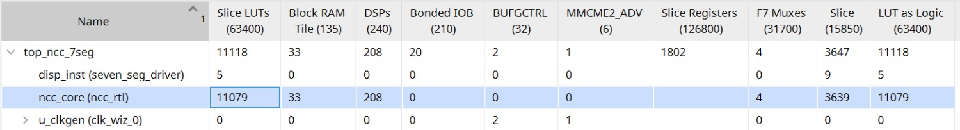
Progress Made since last meeting
Custom Image Processing IP:
Implementation of NCC Algorithm without OpenCV in C++.
Conversion of C++ code to Verilog. (Manually)
Functional verification and debugging the Verilog Module.
Optimization on 2 grounds i.e. LUT usage and Parallel Execution.

Slide 14
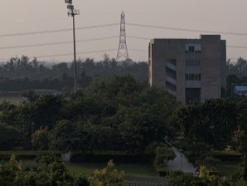
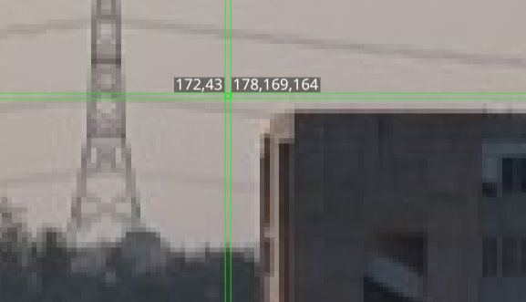

Progress Made since last meeting
Custom Image Processing IP: Test Inputs
298 x 224 Image
64x64 Template
(172,43) Top Left Coordinate

Slide 15
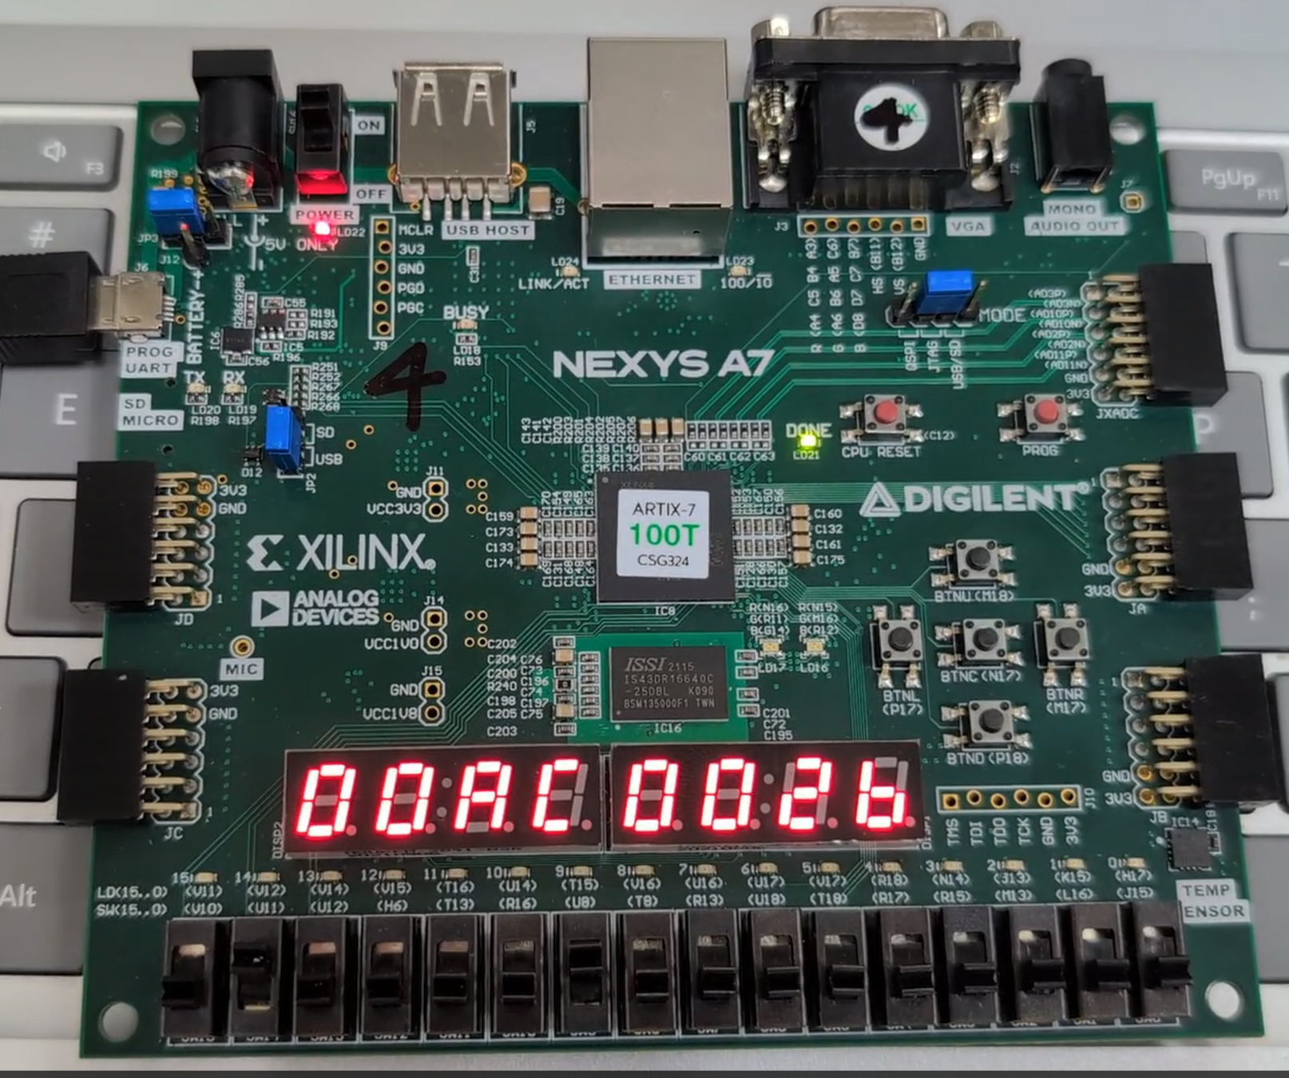
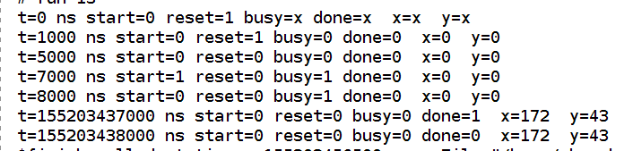
Progress Made since last meeting
Custom Image Processing IP: Results
Behavioral Simulation
Result display using 7 segment display on Artix-7 FPGA

Slide 16
Progress Made since last meeting
Shakti Embedded Application:
Understanding and getting familiar with Shakti SDK.
Initial FreeRTOS application development with interrupts, other required peripherals and GPIOs.
Architecture design of the application.
Tasks implementation and Inter-Process communication setup.
Core logic implementation with PID controller for correction.

Slide 17
RTOS Application Architecture
LWIR Sensor
LWIR Interface
Frame Ready
Image Processing IP
SPI
Direct Memory Access
Frame Ready
O/P Valid
IMU Sensor
IMU Interface
ISR
SPI/I2C
imu_data_q
co-ord_q
Control Logic
Waits on this queue
FC Module
FC Interface
flight_cmd_q
SPI/I2C

Slide 18
Progress Made since last meeting
Shakti Custom Peripheral SOC:
- Required Peripherals
1 UART (Serial monitor & debug)
1 SPI (camera interface/data)
1 I2C (camera control commands)
Status
Removal of unused peripherals is in progress
Debugging build issues arising from peripheral removal in the modified SoC

Slide 19
Progress Made since last meeting
Component Research:
Selection
LWIR Sensor: Selected Waveshare Thermal Camera HAT for R&D. Features 80×62 resolution at 25 FPS.
Flight Controller & IMU: Selected Radiolink F722. Eliminates the need for a separate IMU by leveraging the onboard ICM42688 Gyroscope and BMP280 Barometer.
Interfacing Protocols
LWIR Sensor: Utilizes a dual-protocol interface; I2C for configuring camera registers and SPI for thermal video data.
Flight Controller: Standardized communication (UART/SBUS) to receive guidance commands from the Shakti SoC.

Slide 20
Startup Formation Status
Certificate of Incorporation
LLP Agreement
PAN of LLP
Company Bank Account
DPIIT Registration Certificate

Slide 21
Proposed Plan
Finish development of optimized and balanced Image Processing IP.
Complete the startup formalities.
Order the required Hardware Modules. (LWIR sensor and Flight Controller).
Interfacing and testing of the hardware modules.
Further development for integrating everything in embedded application.

Slide 22
Review Meeting 3
24 January 2026

Slide 23
Progress Made since last meeting
Shakti Embedded Application:
Implemented UART, SPI and I2C bare-metal helper functions.
PID control loops for Pitch and Yaw error correction done.
Calculation of correction commands is implemented.
Interfacing development for CAM, IMU and Image IP is ongoing.
Development NCC algorithm for target matching on Yamuna SOC is ongoing.

Slide 24
Progress Made since last meeting
Shakti Custom Peripheral SOC:
- Required Peripherals
2 UART (Serial monitor and IMU module)
1 SPI (interface with Camera Module)
- Status
Critical peripherals required for our use case had been identified and necessary addition/removal has been done.

Slide 25
Progress Made since last meeting
Components:
Hardware Procured:
Camera Module: Seeed Studios XIAO ESP32S3 Sense
Supports I2C, SPI and UART.
IMU Module: Adafruit BNO085
Supports I2C, SPI and UART.

Slide 26
Progress Made since last meeting
Custom Image Processing IP:
Optimization is ongoing for making it faster and smaller.
Interfacing with Shakti SOC is ongoing.

Slide 27
Project Milestones Overview
Milestone 1: MVP
Goal: Basic Image Capture & Processing Pipeline
Environment setup for Artix-7 FPGA & SHAKTI RISC-V
Interface LWIR sensor to capture single thermal frame
Verilog logic for frame transfer from SHAKTI soft-core
C/C++ matching algorithm detects predefined target
Deliverables:
Live image via SHAKTI serial output
“MATCH FOUND” result + coordinates
Milestone 2: PoC
Goal: Real-time Video Processing Pipeline
Continuous thermal video stream(>10 FPS)
FPGA IP: contrast, filtering, edge detection
Real-time target detection (NCC) +IMU interfacing
Deliverables:
Processed video on monitor
LED indicator for “TARGET LOCKED”
Serial output: error vector + IMU data
Source code (FPGA + SHAKTI)
Milestone 3: Final Demo
Goal: Full Guidance System with Live Target Tracking
Image + IMU fused for control commands
Robustness to occlusions & reacquisition
Real-time bounding box + command output
Deliverables:
Working prototype on test stand
Live demo with target lock & recovery
Guidance commands (e.g., YAW_RIGHT: 3.2°)
Final report + code + demo video

Slide 28
Thank You

Slide 29
Precision Guidance System
MVP Presentation - Infracore Systems LLP (Team Risky 5)
27 February 2026

Slide 30
Team Details
Team Name: Risky 5​
Startup Name: Infracore Systems LLP
Name of Team Lead: Kalrav Mathur​
Name of the Institution: Shiv Nadar Institution of Eminence, Delhi NCR
Name of the processor: Shakti Yamuna
Name of the Mentor: Dr. Venkatnarayan Hariharan
Notes:
I am Kalrav Mathur team lead for this project, and we are representing SNU, Our mentor is Dr Venkathariharan, and other members include Akhil Sriram, Akansh Saraf, Saksham Mahajan and Tushar Juneja.
We will be using Shakti Yamuna processor.

Slide 31
Project Milestones Overview
Milestone 1: MVP
Goal: Basic Image Capture & Processing Pipeline
Environment setup for Artix-7 FPGA & SHAKTI RISC-V
Interface LWIR sensor to capture single thermal frame
Verilog logic for frame transfer from SHAKTI soft-core
C/C++ matching algorithm detects predefined target
Deliverables:
Live image via SHAKTI serial output
“MATCH FOUND” result + coordinates
Milestone 2: PoC
Goal: Real-time Video Processing Pipeline
Continuous thermal video stream(>10 FPS)
FPGA IP: contrast, filtering, edge detection
Real-time target detection (NCC) +IMU interfacing
Deliverables:
Processed video on monitor
LED indicator for “TARGET LOCKED”
Serial output: error vector + IMU data
Source code (FPGA + SHAKTI)
Milestone 3: Final Demo
Goal: Full Guidance System with Live Target Tracking
Image + IMU fused for control commands
Robustness to occlusions & reacquisition
Real-time bounding box + command output
Deliverables:
Working prototype on test stand
Live demo with target lock & recovery
Guidance commands (e.g., YAW_RIGHT: 3.2°)
Final report + code + demo video
Notes:
Milestones for MVP
We are going to discuss our milestone achievments.
we have completed most of it
more about each milestone later
will come back to this slide after discussion on each development

Slide 32

Precision Guidance System​
Target Application: Security and Surveillance
Objectives of the proposal: ​
To develop a terminal-phase Imaging Infrared (IIR) seeker prototype for a precision guided missile system on a fully indigenous hardware stack using the SHAKTI processor.
Running the main logic on the SHAKTI Yamuna​ and offloading compute intensive tasks of image correlation algorithms to FPGA for parallel execution.
To deliver a physical prototype that demonstrates the complete guidance functionality.
This system will lock onto a physical target, visually track it by matching live thermal images with preloaded satellite imagery, and output the exact guidance commands.
Notes:
Lets discuss the objectives of this project.
We want to develop a terminal phase infrared seeker, that tracks a target by doing real time calculations for minimizing the error from the target.
We will implement software design that runs the main error calculation and correction software on the processor, and a hardware accelerator IP block that takes on the image processing and does all the heavy compute for the cpu,
this reduces image processing delays which will bethere if we do this on the processor.
Overall our system will achive l
locking onto a physical target, and
computing the errors from the incoming image frames,
Output the correction control signals to correct the error from the target

Slide 33
Block Diagram
Inertial Measurement Unit
LWIR Sensor/Camera
FPGA
Custom Image Processing IP
Shakti Yamuna
Flight Controller
Notes:
This the the block diagram of our project.
1. First we can see that a lwir sensor is interfaced with the custom image processing IP
2. This module then sends the processed image to the shakti cpu
3. Shakti cpu on the basis of the image inference and IMU data, perfoms calculations to deduce the error
4. The cpu then sends the correction commands to the flight controller, which then does the actuations of those commands

Slide 34
Yamuna Application Architecture
Camera Module
Camera Interface
AXI4
Image Processing IP
UART
Direct Memory Access
Frame Ready
O/P Valid
IMU Sensor
IMU Interface
ISR
UART
imu_data_q
co-ord_q
Control Logic
Waits on this queue
FC Module
FC Interface
flight_cmd_q
Yamuna RTOS Application
UART/SPI/I2C
Notes:
Complete architecture of our project.
We can see how each module is interfaced.
Using uart for the IMU and camera interface
The application follows a typical rtos application structure with many queues, tasks and other interprocess comm objects.
For high deterministic behaviour, low latency and to achieve concurrency.

Slide 35
Shakti Custom Peripheral SOC
Required Peripherals
3 UART
Camera
IMU
Serial Monitor
Removed Peripherals
2 SPI Controllers
2 I2C Controllers

Slide 36
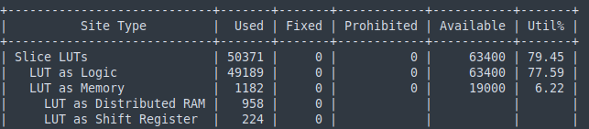
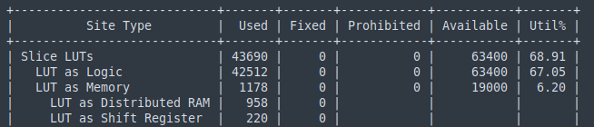
LUTs Utilization - Before Optimization v/s After
Default configuration – LUTs
Optimized configuration - LUTs
After removing the unused peripherals, the LUTs utilization was reduced by ~10.54% (~13.26% relative reduction).
Notes:
Camera interfacing with ESP32s3 with yamuna is done over uart.
Tested with multiple baud rates to find the greatest baud rate with low baud error and 100% reliabilty.
Sending frames continuously over uart from esp32
Filling the frame buff byte by byte as I recv at yamuna
We can verify the results by seeing that we have got the exact amount of data. So no loss or packet drop

Slide 37
Hardware Procured
Camera Module: Seeed Studios XIAO ESP32S3 Sense
Inertial Measurement Unit: Adafruit BNO085 IMU
Breadboard, jumper wires and Qwiic Connectors.
Interfacing Protocols
Camera: UART
IMU: UART
Notes:
From the seed funding we have bought some modules

Slide 38
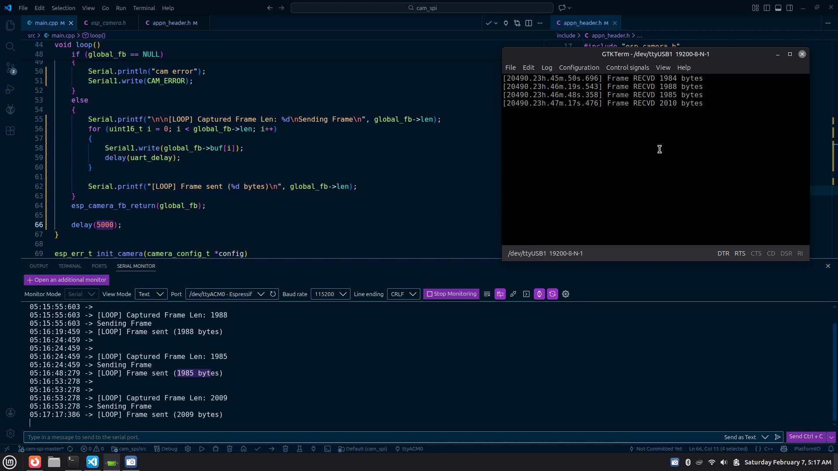
Camera Interface
UART interface between ESP32S3 cam and Shakti Yamuna.
153600 baud rate, 2 stop bits at ESP (1 at Yamuna). No RTS/CTS.
Frame bytes being sent from ESP32S3
Frame bytes being received at Yamuna
Notes:
Camera interfacing with ESP32s3 with yamuna is done over uart.
Tested with multiple baud rates to find the greatest baud rate with low baud error and 100% reliabilty.
Sending frames continuously over uart from esp32
Filling the frame buff byte by byte as I recv at yamuna
We can verify the results by seeing that we have got the exact amount of data. So no loss or packet drop

Slide 39
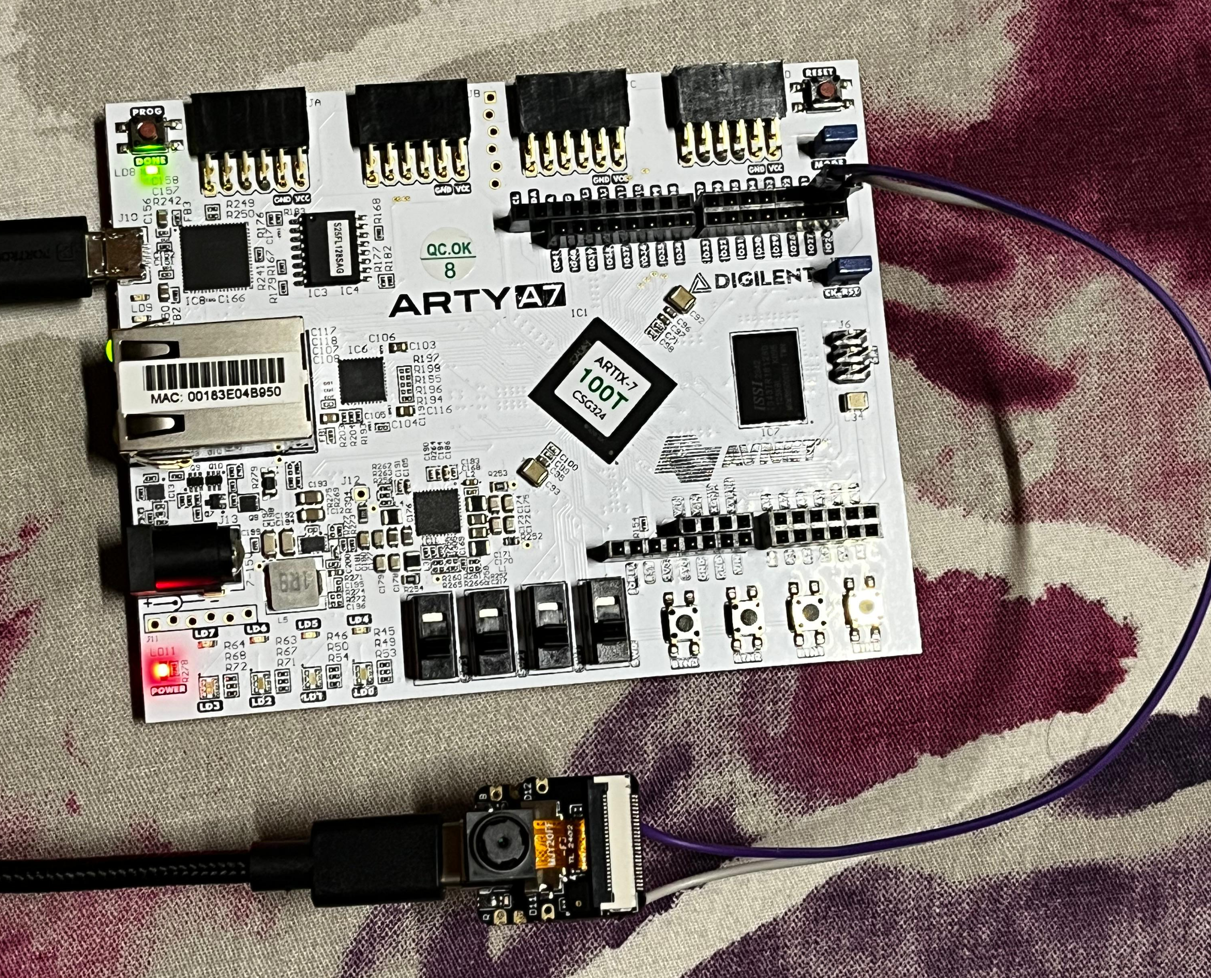

Slide 40
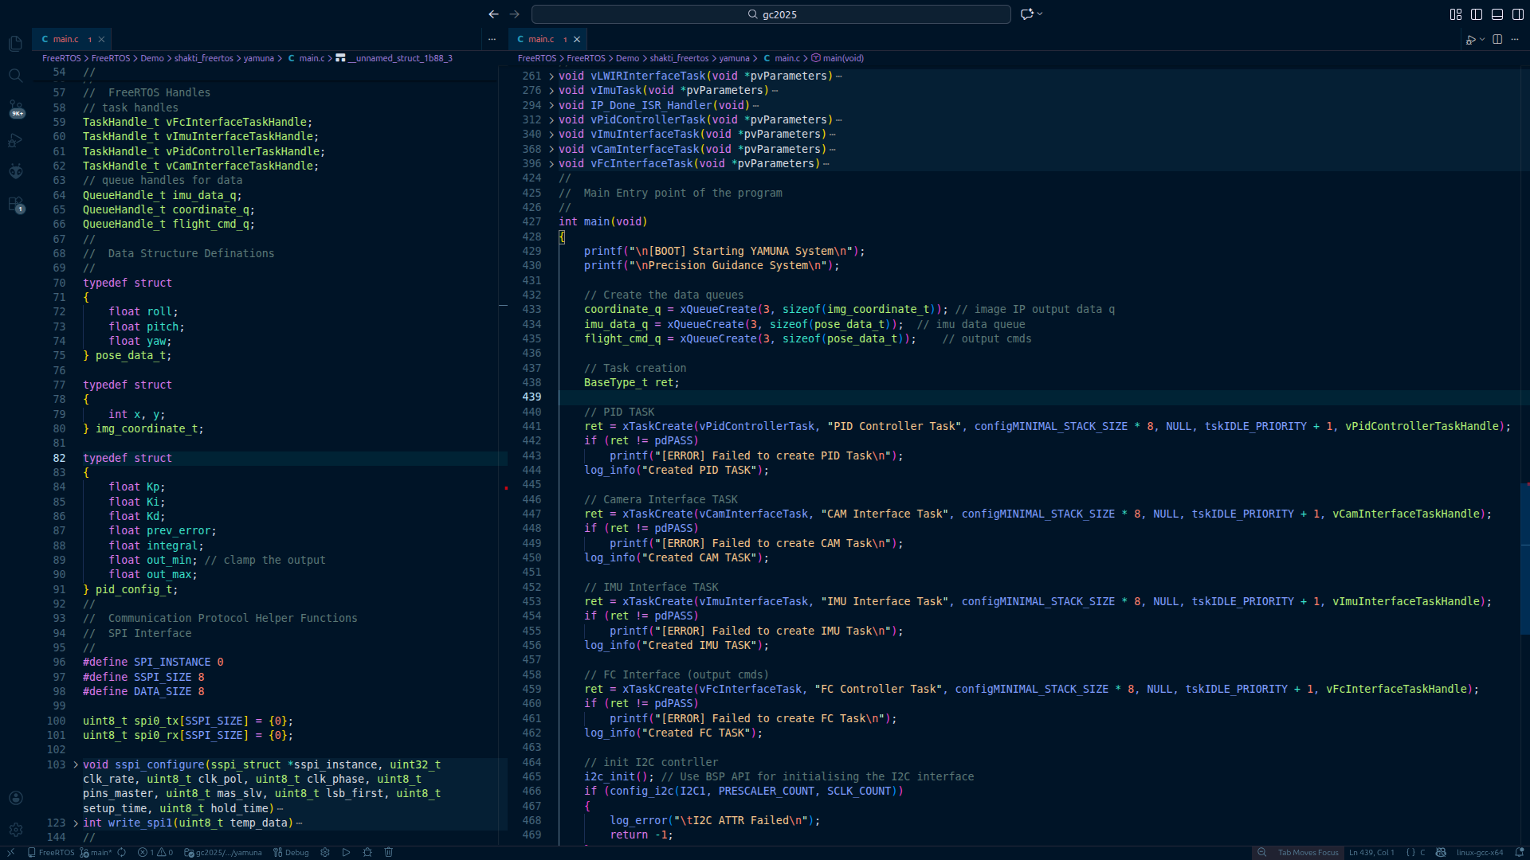
RTOS Application
Notes:
RTOS application for yamuna
Multiple task handlers. Queue handlers, structs
Explain the flow of the execution
PID tasks waits on IMU data and img data then calculates the output and puses to fc cmd q.

Slide 41
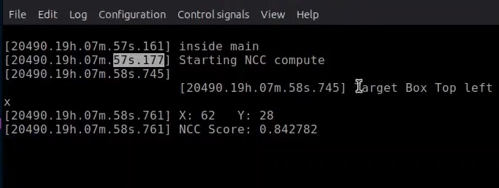
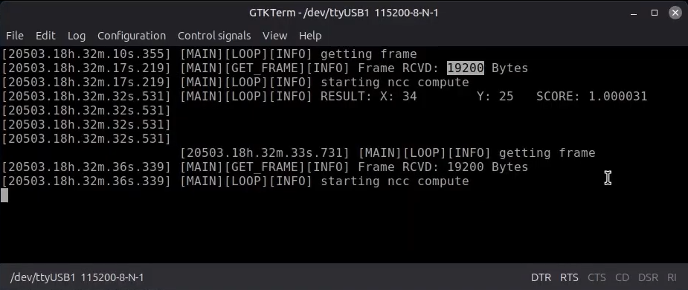
NCC Algorithm Implementation
NCC Compute with pre-stored images
NCC Compute with live images
Notes:
NCC algorithm implemented on shakti yamuna in c.
We successfully implemented and validated this algo on yamuna.
First tried with pre stored image and target image in header file.
Then integrated with cam interface to capture and compute ncc on live frames.
Use the img rep in binary to calculate ncc score then output the coordinate with best score.
High res image takes v long low res is faster.

Slide 42
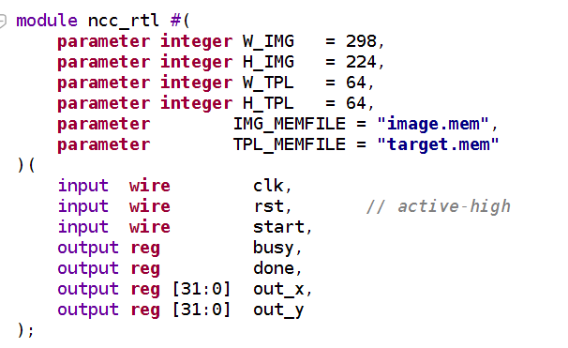
Custom Image Processing IP
Implementation of Normalized Cross Correlation (NCC) Algorithm in Verilog RTL
Functional Verification using Vivado testbench
Implemented on Artix 7 FPGA

Slide 43
Custom Image Processing IP: Test Inputs
298 x 224 Image
64x64 Template
(172,43) Top Left Coordinate

Slide 44
Custom Image Processing IP: Results
Behavioral Simulation
Ongoing interfacing with Shakti core and optimization on 2 grounds: LUT usage and Parallel Execution

Slide 45
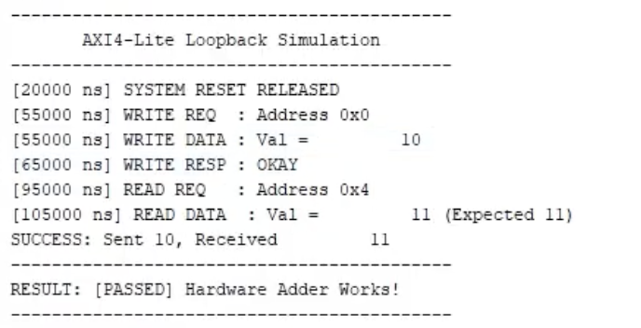
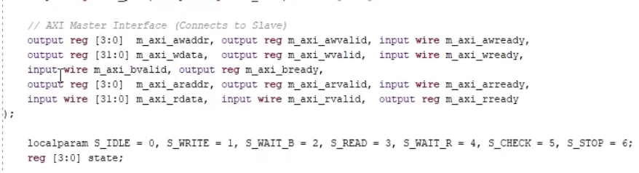
AXI Standalone IP For Testing
Implementation of a simple AXI interfacing module.
Functional Verification using Vivado testbench
Working on creating a wrapper around our existing Verilog Image IP.
Currently experimenting with AXI4-Lite and Axi Stream.

Slide 46
Market Need & Strategic Opportunity
India depends heavily on imported high-end guidance and vision systems, which are expensive, restricted, and not fully customizable for Indian operational needs
Government and industry are actively looking for indigenous alternatives under AtmaNirbhar Bharat, iDEX, and defence innovation programs

Slide 47
How the Startup Makes Money
Primary customers include government labs, defence PSUs, and Indian deep-tech startups working on drones, surveillance systems, and autonomous platforms
Revenue is generated through paid pilots, licensing, customization contracts, and long-term support, rather than one-time sales

Slide 48
Scaling into a Sustainable Indian Startup
Start with the Defence Application then expand to multiple civilian and dual-use sectors, including security, infrastructure monitoring, and disaster response
Grow as an IP-driven company aligned with national priorities, enabling exports to friendly countries and partnerships with Indian manufacturers

Slide 49
Startup Formation Status
Certificate of Incorporation
LLP Agreement
PAN of LLP
Company Bank Account
DPIIT Registration Certificate

Slide 50
Thank You

Slide 51
Precision Guidance System
MVP Evaluation Feedback & Next Steps - Infracore Systems LLP (Team Risky 5)
14th March 2026

Slide 52
Key Feedback from MVP Evaluation
GPS-denied navigation is considered a largely solved problem, with existing approaches such as triangulation and other alternative navigation techniques already available.
Since missiles or drones typically use GPS for long-range navigation, the value addition of our proposed system needs clearer justification.
Existing sensing and guidance solutions were highlighted, and clear differentiation from current approaches was recommended.
Standard IR sensors are commonly used for tracking moving targets with strong heat signatures; the choice of LWIR sensors in our design needs further justification.

Slide 53
Key Feedback from MVP Evaluation
A human-in-the-loop approach was suggested, where live camera feeds could be transmitted toa ground station for manual guidance decisions.
Further clarity on the novelty and practical contribution of the proposed system was recommended.
We are currently in discussions with a domain expert to onboard them as a mentor/advisor and incorporate their guidance in refining the project direction.

Slide 54
Thank You

Slide 55
Infrared Search and Track System
POC Presentation - Infracore Systems LLP (Team Risky 5)
11 April 2026

Slide 56
POC Overview
Project Title: Infrared Search and Track System
Team Name: Infracore Systems LLP (Risky 5​)
Members: Akansh S., Akhil S., Dr. Venkatnarayan H., Kalrav M., Saksham M., Tushar J. ​
Problem Statement: Active radar systems are highly vulnerable to electronic warfare (jamming/spoofing) and struggle to detect low-RCS (Radar Cross Section) threats.
Solution: A passive Infrared Search and Track system. We utilize an FPGA for parallel spatial-temporal pattern matching to isolate targets, combined with a Shakti RISC-V processor to provide real-time I/O feedback to defence actuators.
Notes:
I am Kalrav Mathur team lead for this project, and we are representing SNU, Our mentor is Dr Venkathariharan, and other members include Akhil Sriram, Akansh Saraf, Saksham Mahajan and Tushar Juneja.
We will be using Shakti Yamuna processor.

Slide 57
Progress and Milestones
Achieved
Planned
Interface sensor to capture single frame
Verilog logic for frame transfer from SHAKTI soft-core
NCC matching algorithm detects predefined target
Live image via SHAKTI serial output
“MATCH FOUND” result + coordinates
KCF Fast pattern match algorithm implementation
Architecture design for IRST
Yamuna Embedded RTOS application to handle feedback
Interface KCF with Yamuna using AXI and DMA (Ongoing)
KCF Algorithm port to Verilog
Complete the detection and notification loop
Benchmark and compare response time
Optimize the latency and delays in the loop
Notes:
I am Kalrav Mathur team lead for this project, and we are representing SNU, Our mentor is Dr Venkathariharan, and other members include Akhil Sriram, Akansh Saraf, Saksham Mahajan and Tushar Juneja.
We will be using Shakti Yamuna processor.

Slide 58
Project Milestones Overview
Milestone 1: MVP
Goal: Basic Image Capture & Processing Pipeline
Environment setup for Artix-7 FPGA & SHAKTI RISC-V
Interface LWIR sensor to capture single thermal frame
Verilog logic for frame transfer from SHAKTI soft-core
C/C++ matching algorithm detects predefined target
Deliverables:
Live image via SHAKTI serial output
“MATCH FOUND” result + coordinates
Milestone 2: PoC
Goal: Real-time Video Processing Pipeline
Continuous thermal video stream(>10 FPS)
FPGA IP: contrast, filtering, edge detection
Real-time target detection (NCC) +IMU interfacing
Deliverables:
Processed video on monitor
LED indicator for “TARGET LOCKED”
Serial output: error vector + IMU data
Source code (FPGA + SHAKTI)
Milestone 3: Final Demo
Goal: Full Guidance System with Live Target Tracking
Image + IMU fused for control commands
Robustness to occlusions & reacquisition
Real-time bounding box + command output
Deliverables:
Working prototype on test stand
Live demo with target lock & recovery
Guidance commands (e.g., YAW_RIGHT: 3.2°)
Final report + code + demo video
Notes:
Milestones for MVP
We are going to discuss our milestone achievments.
we have completed most of it
more about each milestone later
will come back to this slide after discussion on each development

Slide 59
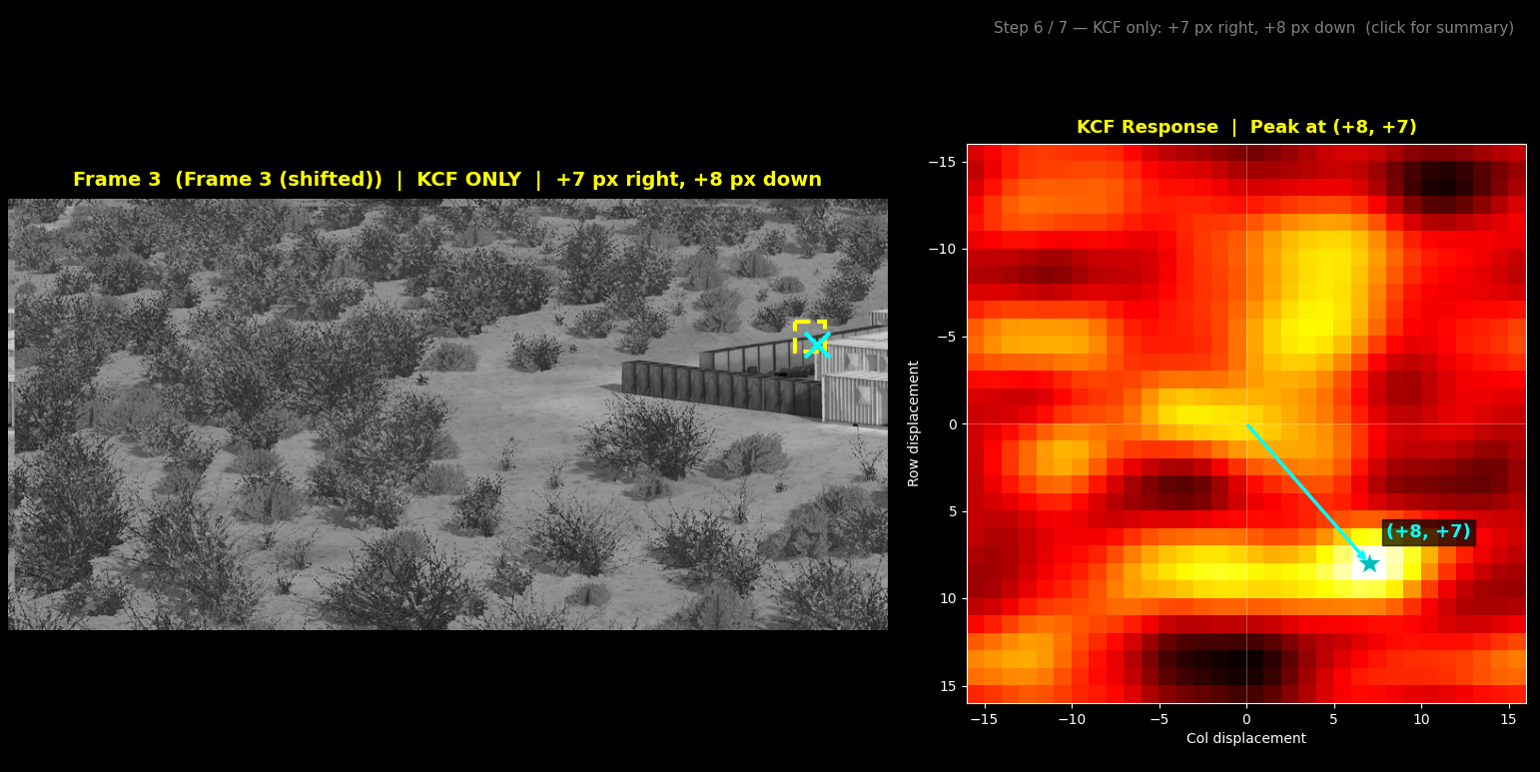
POC Demonstrations
Notes:
I am Kalrav Mathur team lead for this project, and we are representing SNU, Our mentor is Dr Venkathariharan, and other members include Akhil Sriram, Akansh Saraf, Saksham Mahajan and Tushar Juneja.
We will be using Shakti Yamuna processor.

Slide 60
Domain Expert Review & Feedback
Name: Mr. Senthilkumaran
Organization: TVS Sundaram Industries Pvt Ltd, Defence Business Group
Expertise: Engineering Leader in Defense and Aerospace sector with rich experience in R&D, complete product development for EV, Radar, Aerospace global customers
Key Suggestions:
Full aerodynamic guidance is out of scope for a hardware PoC and distracts from the core processing goals.
Prioritize the critical "Sensor-to-Shooter" loop latency and accuracy.
Shift focus to demonstrating Shakti’s capability for deterministic I/O in bounded timeframes.
Actions Taken / Planned:
Transitioned entirely from drone guidance to a passive Infrared pattern recognition system.
Realign the project to target Counter-UAS and defence surveillance, validating Shakti’s I/O reliability in real-world tactical scenarios.
Notes:
I am Kalrav Mathur team lead for this project, and we are representing SNU, Our mentor is Dr Venkathariharan, and other members include Akhil Sriram, Akansh Saraf, Saksham Mahajan and Tushar Juneja.
We will be using Shakti Yamuna processor.

Slide 61
MVP Panel Feedback & Improvements
Key Suggestions
GPS-denied navigation is an established, solved problem
LWIR selection lacked strong tactical justification over standard IR.
Autonomous missile guidance is risky; a Human-In-The-Loop approach is preferred.
Practical differentiation from existing defence solutions was unclear.
Changes Implemented
Dropped aerodynamic guidance to build a passive Infrared Search and Track architecture for Counter-UAS.
Repositioned LWIR specifically for SWaP-C optimized tracking of airframe thermal contrast at tactical ranges.
FPGA performs parallel pixel processing; Shakti RISC-V handles deterministic actuator I/O interface.
Impact
Delivers an emissions-free, tracking solution immune to radar jamming and electronic warfare.
Explicitly validates Shakti’s bare-metal, jitter-free I/O reliability in mission-critical defence loops.
Directly aligns with high-demand Anti-Terrorism Force Protection systems by solving edge-processing bottlenecks.

Slide 62
Challenges and Learnings
Challenges Faced
Image Processing Performance Limitations
Addressing panel skepticism during the MVP phase and formulating a robust justification for using LWIR sensors over standard IR.
Changes Implemented
Shift Algorithm from NCC to KCF
S
S
Impact
Performance Improvement
S
S
S
Notes:
I am Kalrav Mathur team lead for this project, and we are representing SNU, Our mentor is Dr Venkathariharan, and other members include Akhil Sriram, Akansh Saraf, Saksham Mahajan and Tushar Juneja.
We will be using Shakti Yamuna processor.

Slide 63
Execution Plan for Finals
What will be demonstrated
Seamless integration of the camera sensor, FPGA processing pipeline, and Shakti control unit.
A clean physical casing for the final module.
Key tasks to be completed:
Translate the validated Python KCF tracking model into optimized RTL/Verilog for the FPGA.
Fuse the Shakti processor with the custom KCF FPGA IP core.
SWaP-C Optimization: Design and fabricate a custom PCB to house the integrated architecture (if required).
Conduct rigorous latency benchmarking to maximize tracking accuracy and minimize the "Sensor-to-Shooter" response time.
Implementation plan:
Shift the KCF matrix operations from Python validation to Verilog to achieve fast pattern match.
Upgrade the camera interface from UART to a high-speed parallel bus to drastically cut data ingestion latency (If possible with the current hardware constraints).
Validation approach:
Benchmark lock-on and tracking stability using predefined static and moving reference targets.
Determine the maximum target velocity before lock-loss or tracking degradation occurs.
Timeline
[30 April] KCF Verilog Porting & AXI Interface.
[30 April] Shakti RTOS application
[30 May] Shakti + FPGA IP Integration.
[30 August] Final Benchmarking & Module Casing.
Notes:
I am Kalrav Mathur team lead for this project, and we are representing SNU, Our mentor is Dr Venkathariharan, and other members include Akhil Sriram, Akansh Saraf, Saksham Mahajan and Tushar Juneja.
We will be using Shakti Yamuna processor.

Slide 64
Thank You

