Slide 1
INFRACORE SYSTEMS LLP
Precision Guidance for GPS-Denied Environments
An indigenous, FPGA-accelerated terminal-phase tracking system built on the SHAKTI RISC-V platform
TEAM
Risky 5 — InfraCore Systems LLP
INSTITUTION
Shiv Nadar Institution of Eminence
MENTOR
Dr. Venkatnarayan Hariharan
DIR-V | April 2026

Slide 2
The Problem
Why terminal-phase visual guidance matters
THE GAP
OUR ANSWER
GPS is not reliable in the terminal phase
100% Indigenous Hardware
Adversarial jammers are deployed precisely at the last moment. A missile relying only on GPS coordinates becomes blind exactly when it matters most.
SHAKTI Yamuna RISC-V processor + Artix-7 FPGA — no foreign CPUs, no black boxes, no ITAR constraints.
Existing seekers rely on foreign compute
Works when GPS is Jammed
SCALP-EG, HAMMER, and similar IIR seekers run on proprietary foreign black-box processors — creating supply-chain risk and ITAR dependency.
Onboard image tracking takes over autonomously in the terminal phase. The system locks on visually and guides itself to target.
LWIR: Tracks Thermally Passive Targets
Standard IR sensors only track hot targets
Long-Wave IR detects intrinsic heat of any object — structures, vehicles at rest, infrastructure. No active heat source required.
Conventional IR seekers need an active heat source (jet exhaust, engine). Stationary infrastructure, grounded vehicles, and inanimate targets are invisible to them.
Real-Time at < 200 microseconds
FPGA-accelerated correlation: 19,300 clock cycles per tracking decision at 100 MHz. Faster than any software solution.
Modular & sensor-agnostic — same platform adapts to UAVs, loitering munitions, border surveillance

Slide 3
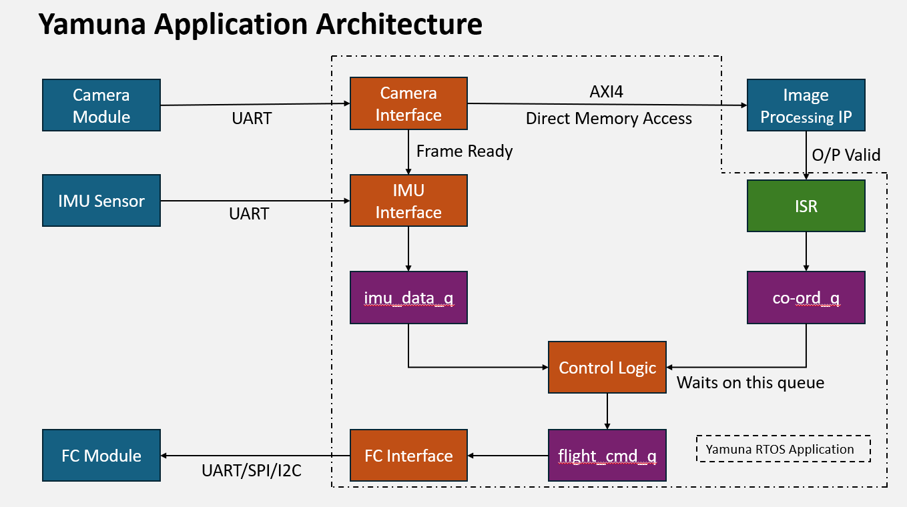
Core Technology
FPGA-accelerated image correlation on indigenous hardware
HOW IT WORKS
1. Acquire
Camera/LWIR frame arrives. NCC (Normalised Cross-Correlation) scans the full image to find and lock on to the target.
2. Track
KCF algorithm tracks the target frame-to-frame in the frequency domain — no re-scanning needed. Fixed compute cost regardless of image size.
3. Decide
FPGA writes displacement (Δx, Δy) to a register. SHAKTI RTOS reads it, fuses with IMU data, and outputs a guidance command.
4. Correct
Flight controller receives YAW / PITCH corrections and adjusts heading — closing the loop autonomously.
Yamuna RTOS Application — SHAKTI processor manages sensor fusion, queues results, and dispatches guidance commands.
193 µs
32 × 32
5,000+
100% Indigenous
Per tracking decision
Patch size (scalable to 64×64)
Decisions per second
SHAKTI + FPGA no foreign silicon

Slide 4
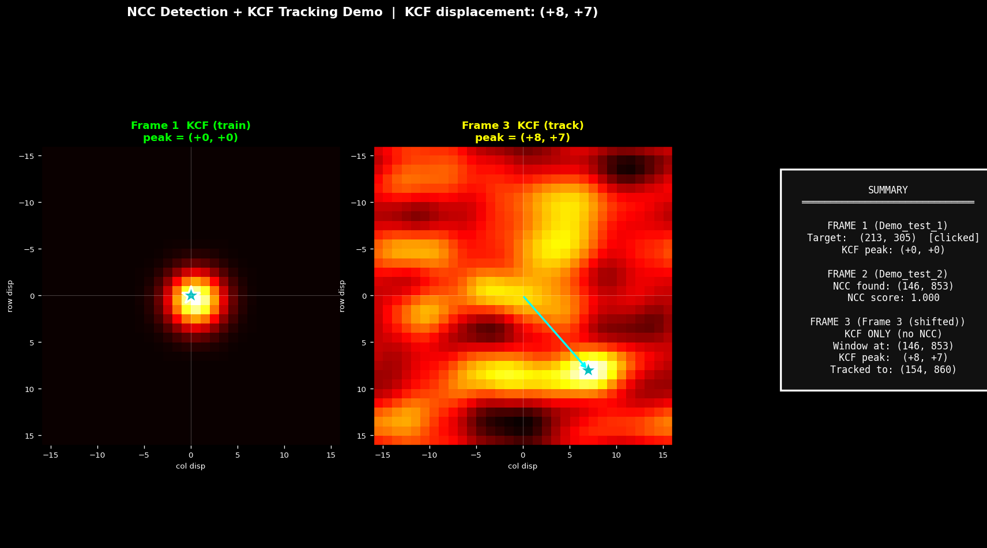
Where We Are
Status, demonstrated results, and what we need next
DEMONSTRATED
NEXT MILESTONES
KCF/MOSSE tracking RTL verified in Vivado simulation — outputs match Python reference model exactly
Continuous video streaming (>10 FPS) through FPGA pipeline
End-to-end frame capture: camera module → SHAKTI Yamuna SoC (serial logs on physical hardware)
LWIR thermal sensor integration (replacing current camera surrogate)
NCC → KCF handoff pipeline: target selected on Frame 1, found by NCC on Frame 2, tracked by KCF from Frame 3
IMU sensor fusion on SHAKTI RTOS
AXI4-Lite register interface designed — SHAKTI reads displacement and TARGET_FOUND flag from FPGA
Full hardware close-loop test on physical FPGA board
RTOS application architecture: task queues, ISR, control logic, flight command dispatch
WHAT WE ARE LOOKING FOR
• Technical feedback from domain experts on image-based terminal guidance
• Access to test environments or UAV/munition simulation platforms
• Potential collaboration or field validation opportunities
• Guidance on iDEX / TDF funding pathways for next phase

