Slide 1
Flight Price Prediction Project

Slide 2

Problem Statement

Slide 3
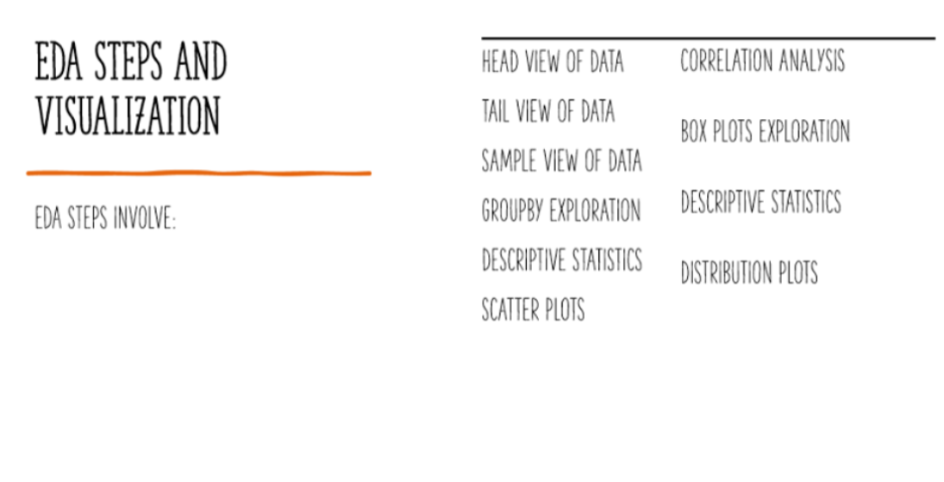

Slide 4
Dashboards

Slide 5
Dataframe View
https://docs.google.com/spreadsheets/d/1BcxTRkYat8TlHQ35WjviCbmuBcQ9TpuBmBA0dHoq9JE/edit?usp=sharing

Slide 6
Categorical View Analysis
https://docs.google.com/spreadsheets/d/1zRBnzBfrn06Ip3Ztew-ifQT5xhNG-nuplFCaoHbLqIg/edit?usp=sharing

Slide 7
Distribution Plots Analysis
https://docs.google.com/spreadsheets/d/11aaWnLDCOk_3OxmIxa-E9i5Q5Djidj5btNaj21m5NlY/edit?usp=sharing

Slide 8
Descriptive Analysis
https://docs.google.com/spreadsheets/d/1d95xWuFk026-TytCxlVYUVt5SgWN91CEzRt3aQcWdf8/edit?usp=sharing

Slide 9
Box Plot Analysis
https://docs.google.com/spreadsheets/d/1wi3l_U59TCL6ZoPGOsKqzI-SU0VrJMOfiX-SHjiisFU/edit?usp=sharing

Slide 10
Correlation Analysis
https://docs.google.com/spreadsheets/d/1JrB96CFH2ZVug7wGFlDakAwhRJOyN9Tcew8d_atfJTA/edit?usp=sharing

Slide 11
Scatter Plot Analysis
https://docs.google.com/spreadsheets/d/1Qa3IOUpyVLk-7F0LlWu2fGzcWmLuuMgGkhOumoLoWhE/edit?usp=sharing

Slide 12
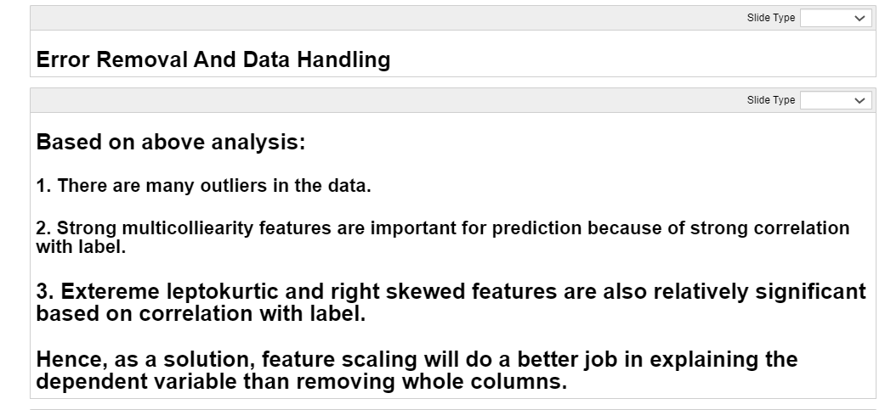
EDA Conclusion

Slide 13
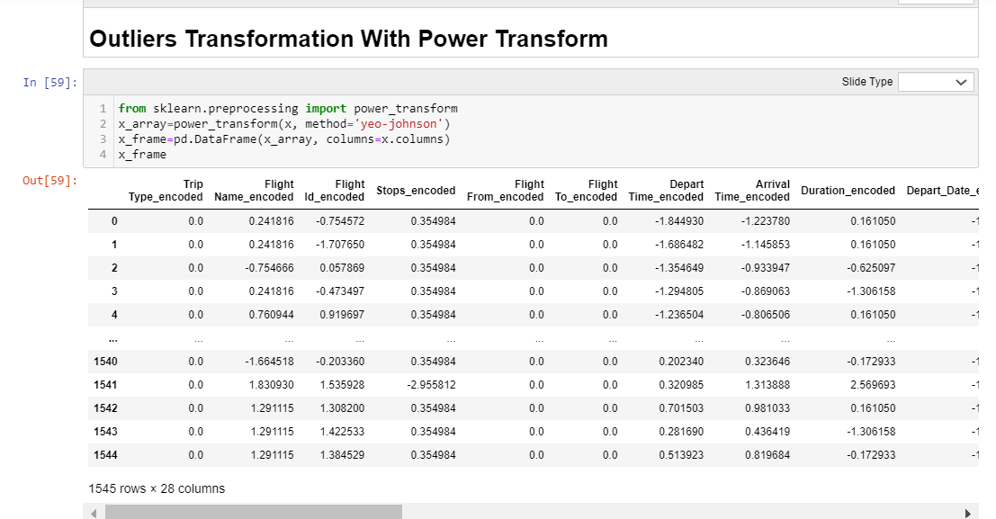
Outliers Transformation

Slide 14
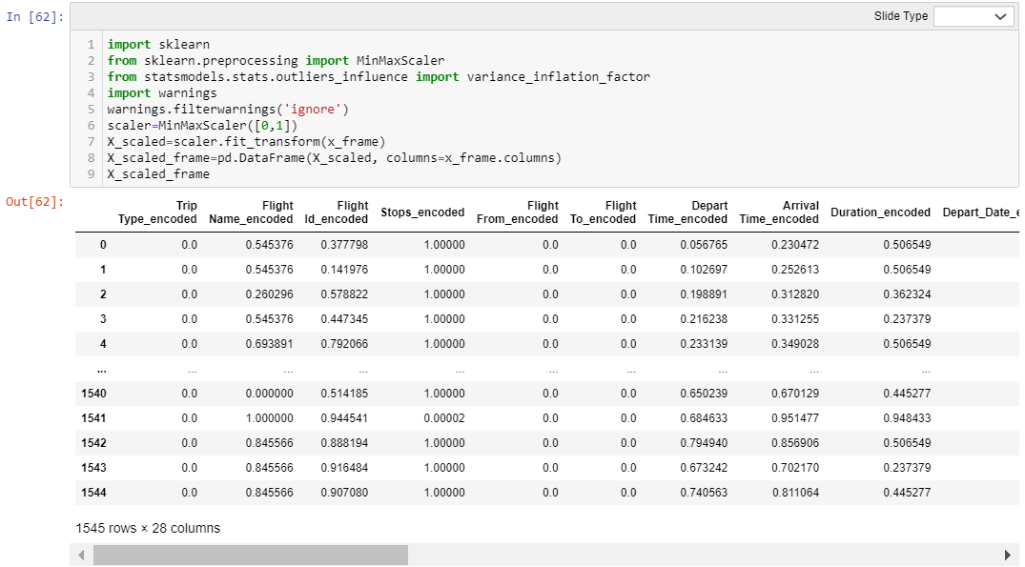
Min Max Scaling

Slide 15
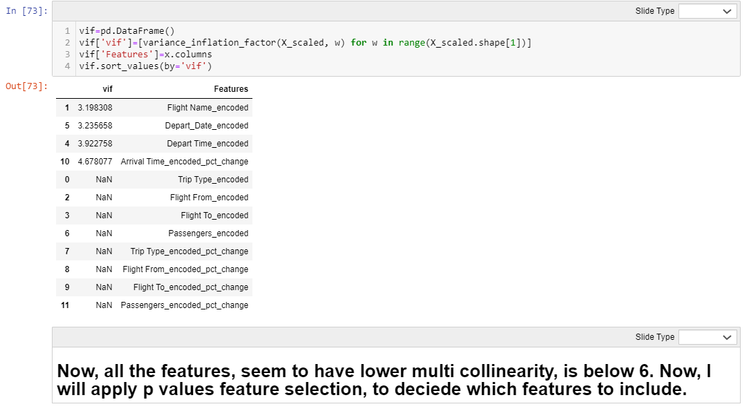
VIF Test

Slide 16
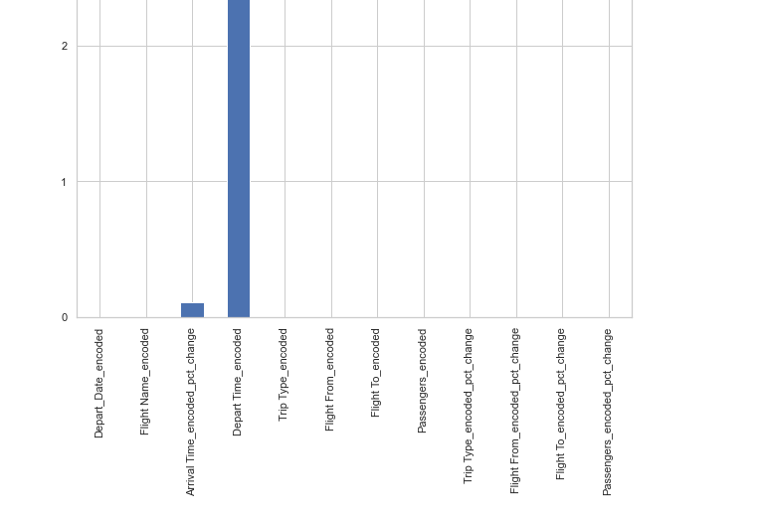
ANOVA TEST

Slide 17


Slide 18
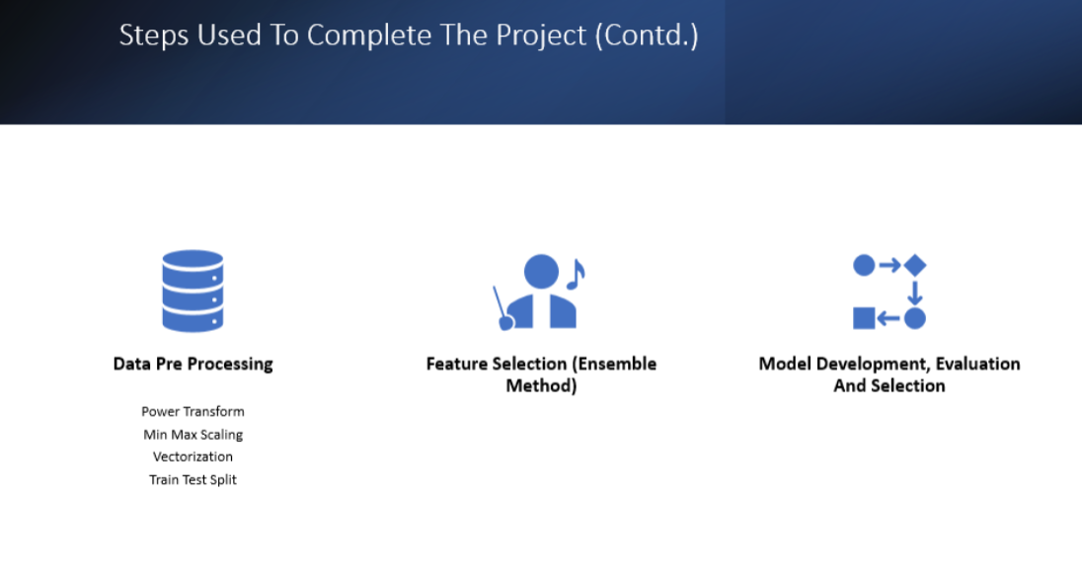

Slide 19
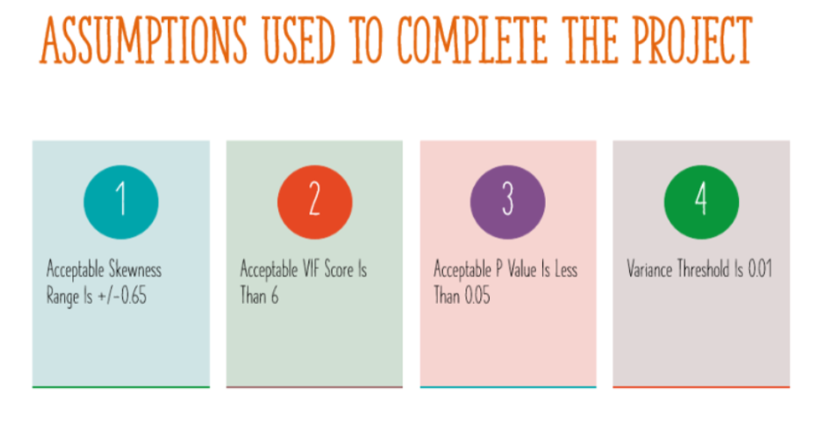

Slide 20
Models Dashboard
https://docs.google.com/spreadsheets/d/12dCTv2HCX_gxafSXbNRfM-K4NI_beEdblLqp4yqEGUU/edit?usp=sharing

Slide 21
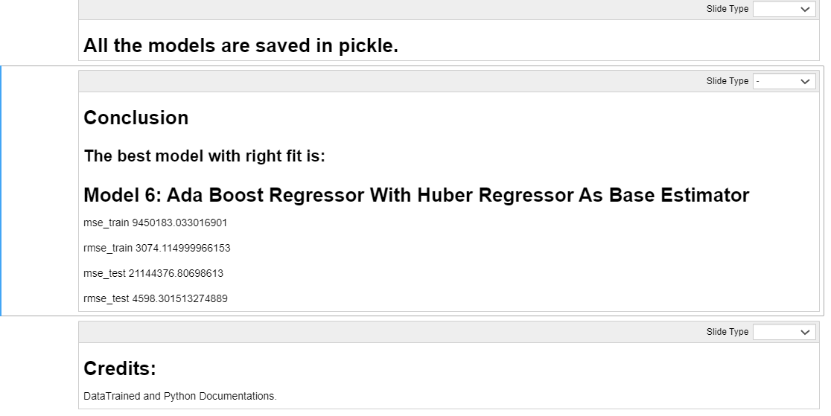
Conclusion

Slide 22
Thank You

