Slide 1

MICRO CREDIT PROJECT: Customer DEFAULT PREDICTION

Slide 2
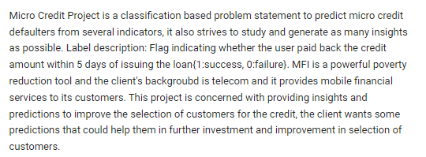
PROBLEM STATEMENT

Slide 3
EDA STEPS AND VISUALIZATION
LOG & CUMSUM VIEWS HEAD VIEW OF DATA TAIL VIEW OF DATA SAMPLE VIEW OF DATA GROUPBY EXPLORATION DESCRIPTIVE STATISTICS SCATTER PLOTS | CORRELATION ANALYSIS BOX PLOTS EXPLORATION DESCRIPTIVE STATISTICS DISTRIBUTION PLOTS
EDA STEPS INVOLVE:

Slide 4

VISUALIZATIONS DASHBOARD

Slide 5
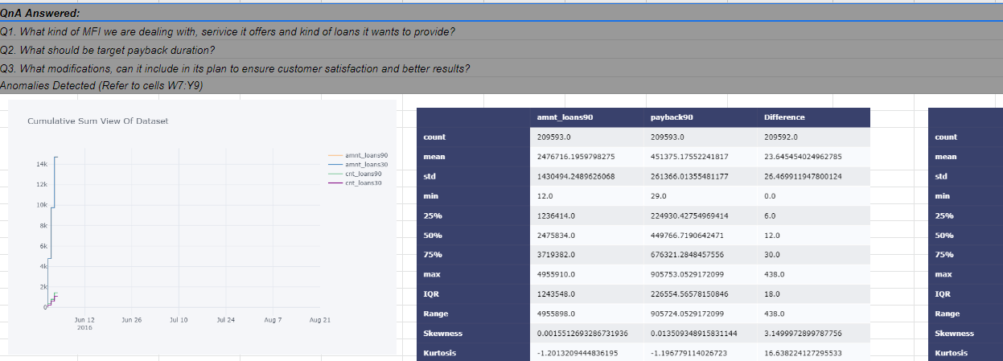
LOG AND CUMSUM VIEWS
FOLLOW THE LINK TO THE DASHBOARD: https://docs.google.com/spreadsheets/d/1wEgp5xKLCykpivGxlDrialuBTrEhKa_AEeKH01wnXMY/edit?usp=sharing
Please Visit Dashboard

Slide 6
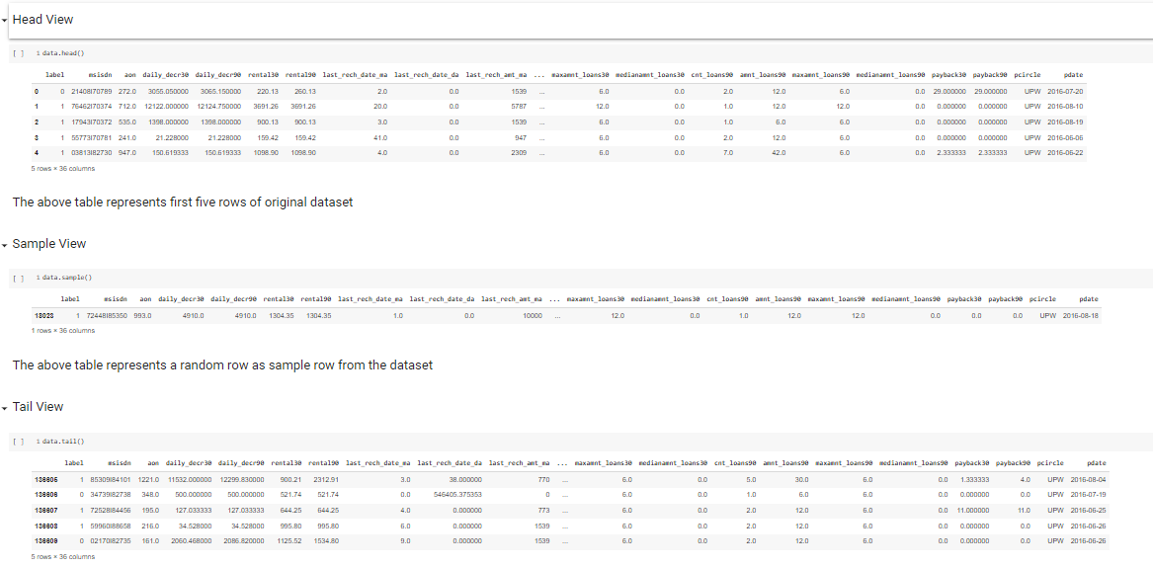
HEAD VIEW, TAIL VIEW AND SAMPLE VIEW
https://docs.google.com/spreadsheets/d/1d1ixblgxC86MrFE2zjB3BepgPMtgIJuCtrhRenFrWQw/edit?usp=sharing
Please Visit Dashboard

Slide 7
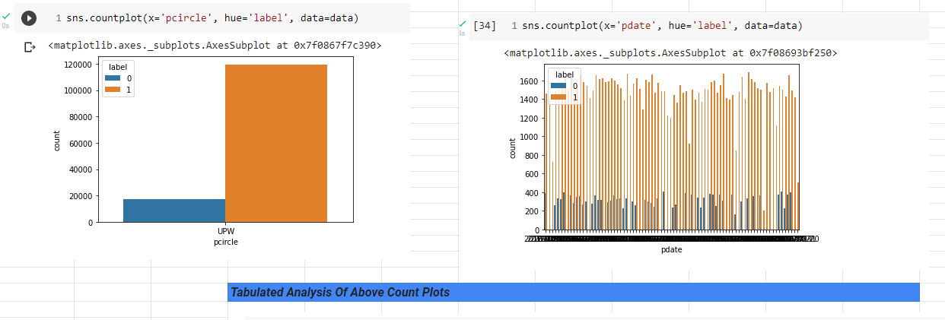
GROUPBY COUNT OF DEFAULT AND SUCCESS IN EACH CASE
https://docs.google.com/spreadsheets/d/1OwcCvO9vY5b5UTBR8_r0-rsChG4K9pLL2Hxo1aev-4M/edit?usp=sharing
Please Visit Dashboard

Slide 8
DESCRIPTIVE STATISTICS
Follow the link to the dashboard:
https://docs.google.com/spreadsheets/d/1_qmUX1jXKiEGZDP3symS1VlZKxOg_7nlhq8Kl7ZrXRI/edit?usp=sharing

Slide 9
SCATTER PLOTS
Follow the link to the dashboard:
https://docs.google.com/spreadsheets/d/1p_B4bUvKvDGGjXBbwzjADuIIphEWqnYApzoEfekEtj8/edit?usp=sharing

Slide 10
CORRELATION ANALYSIS
Follow the link to the dashboard:
https://docs.google.com/spreadsheets/d/1QnC77IXeSpTk__Rfz_WJlXwNaDyPHbWJhwFVpm4Q4HY/edit?usp=sharing

Slide 11
BOX PLOTS EXPLORATION
Follow the link to the dashboard:
https://docs.google.com/spreadsheets/d/186CvJpOSw521aU54LZn4TYK0m-2o96ub98xZ_MTFjBw/edit?usp=sharing

Slide 12
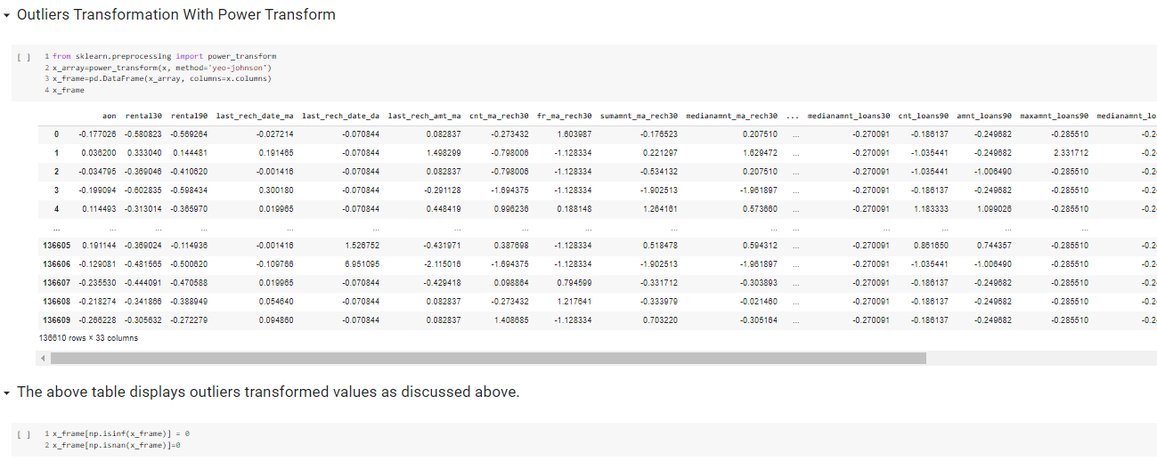
OUTLIERS TRANSFORMATION

Slide 13
DISTRIBUTION PLOTS
Follow the link to the dashboard:
https://docs.google.com/spreadsheets/d/171asS_59gZxz8uhHiNHUUtlg4gj0dvLSZWllNb95u14/edit?usp=sharing

Slide 14
EDA CONCLUSION

Slide 15
CONCLUSION
# Based on above analysis, these columns have significant outliers, hence, are platykurtic, hence, I am removing these columns.
i. Daily Decr 30
ii. Daily Decr 90
I will do further vif test to remove multicollinearity from the data.
# Concluding Points:
1. As part of data handling, I have removed features with high outliers (by analyzing box plots, dist plots, variable plot and scatter plots).
2. I have removed multicollinearity by analyzing correlation, correlation heatmaps and variance inflation factor.
3. Hence, the model can be expected to be low bias model.

Slide 16
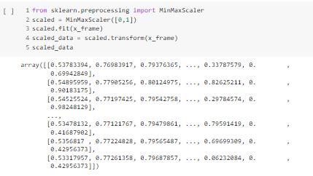
MIN MAX SCALING

Slide 17
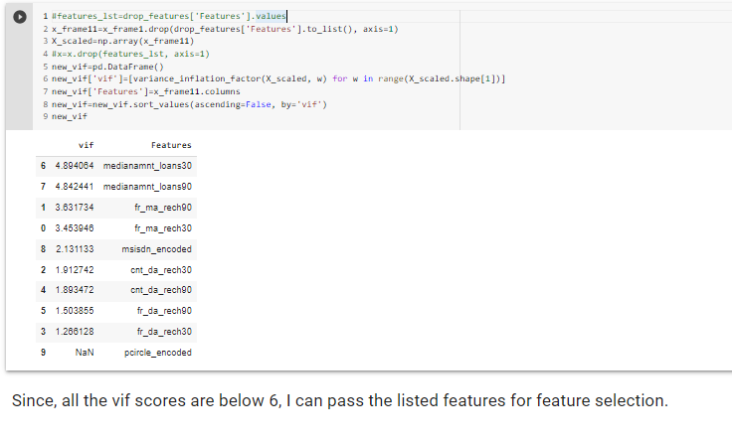
VIF TEST

Slide 18
STEPS USED TO COMPLETE THE PROJECT
Data Extraction
Data Cleaning
EDA
VIF TEST
POWER TRANSFORM
Data Pre Processing
POWER TRANSFORM
MIN MAX SCALING
VECTORIZATION
TRAIN TEST SPLIT
FEATURE SELECTION (ENSEMBLE METHODS)
MODEL DEVELOPMENT, EVALUATION AND SELECTION
Feature Engineering
Encoding
Extracted Features
RESAMPLING

Slide 19
ASSUMPTIONS USED TO COMPLETE THE PROJECT
Acceptable Skewness Range Is +/-0.65
1
Acceptable VIF Score Is Than 6
2
Acceptable P Value Is Less Than 0.05
3
Variance Threshold Is 0.01
4

Slide 20
MODELS DASHBOARD (SOLUTION TO PROBLEM STATEMENT)
Follow the link to dashboard:
https://docs.google.com/spreadsheets/d/1TuNyvHS9SMSplSkHTN0_OEhV4isocrpgNdzR_IpV1xs/edit?usp=sharing

Slide 21
CONCLUSION
As a conclusion, the best model is RFC With Default Hyper Parameter tuning on resampled data, the most challenging part in models development process was to reduce overfitting and biasness in the data, that is why I have applied ensemble methods on base estimators... RFC provided the best framework to reduce overfitting. By running it on resampled data, I achieved an accuracy score of 0.74.

Slide 22
THANK YOU

