Slide 1
Online Course Recommendation System
TEAM MEMBERS:
1.Akriti chhaya
2.Niharika Gedela
TEAM MEMBERS:
1.Akriti chhaya
2.Niharika Gedela
3.Aashritha Molleti
4.Raksha sai Gowda
5.Aditya Hase
tha Mo,msjadhwfjcncknn
Mentor :Geethika
Mentor :Sravani

Slide 2
Objective
To design and develop an intelligent online course recommendation system that suggests relevant courses to learners based on their preferences, engagement behavior, and course attributes using data science and machine learning techniques.

Slide 3
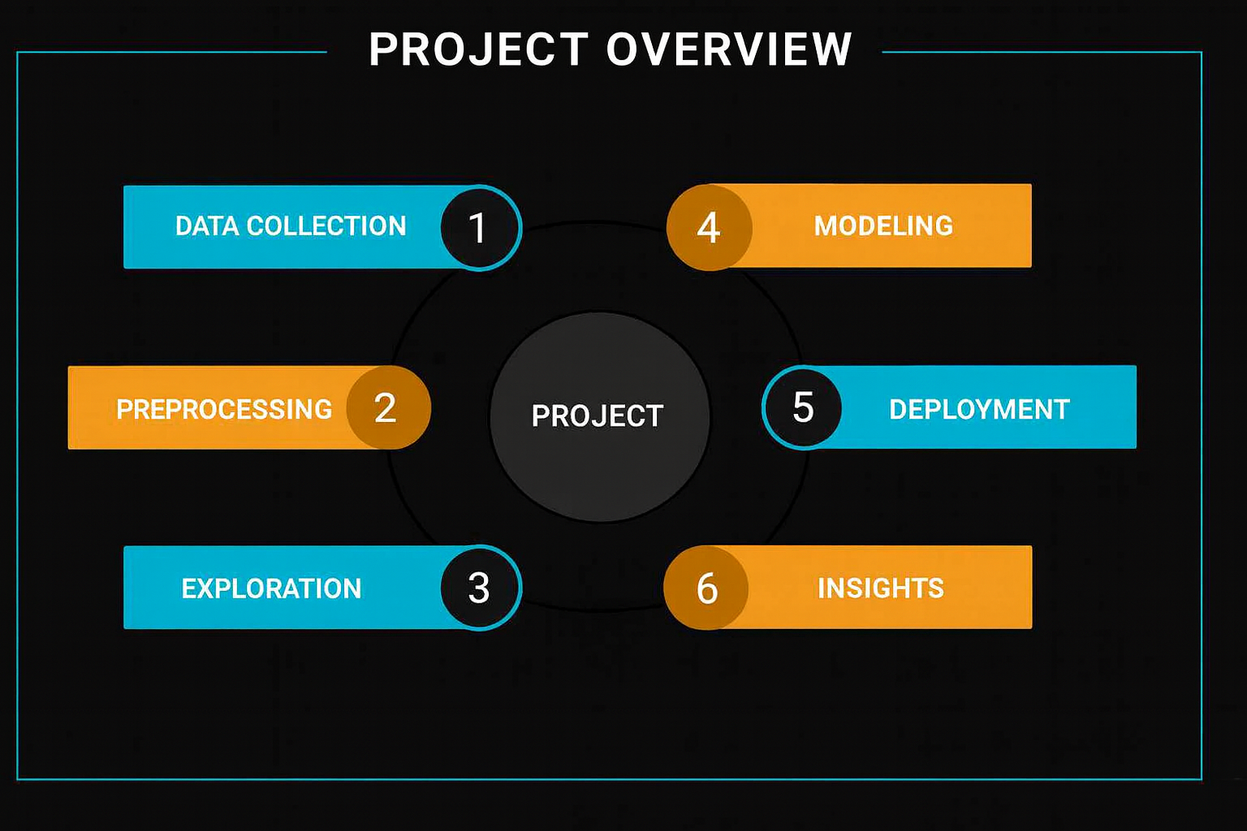

Slide 4
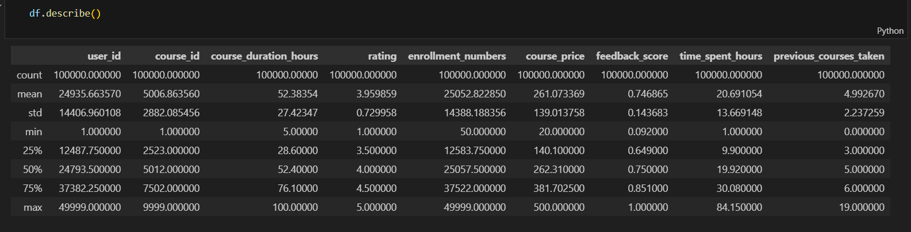
Statistical Summary

Slide 5
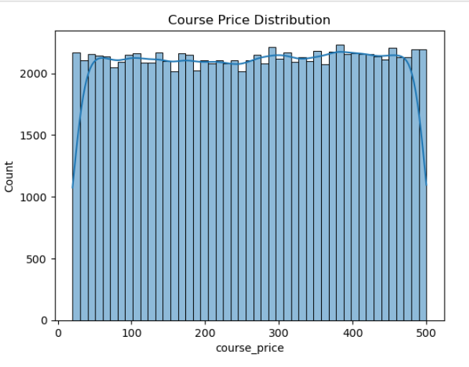
Graph: Histogram with KDE for course_price

Slide 6
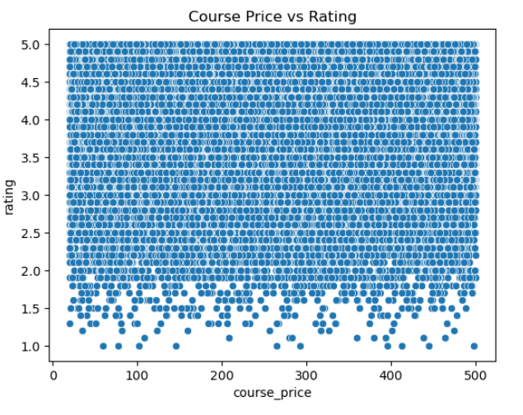
Graph: Scatter plot (course_price vs rating)

Slide 7
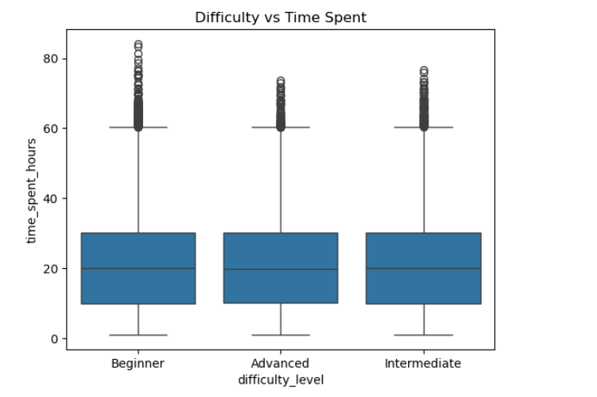
Graph: Difficulty Level vs Time Spent (Box Plot)

Slide 8
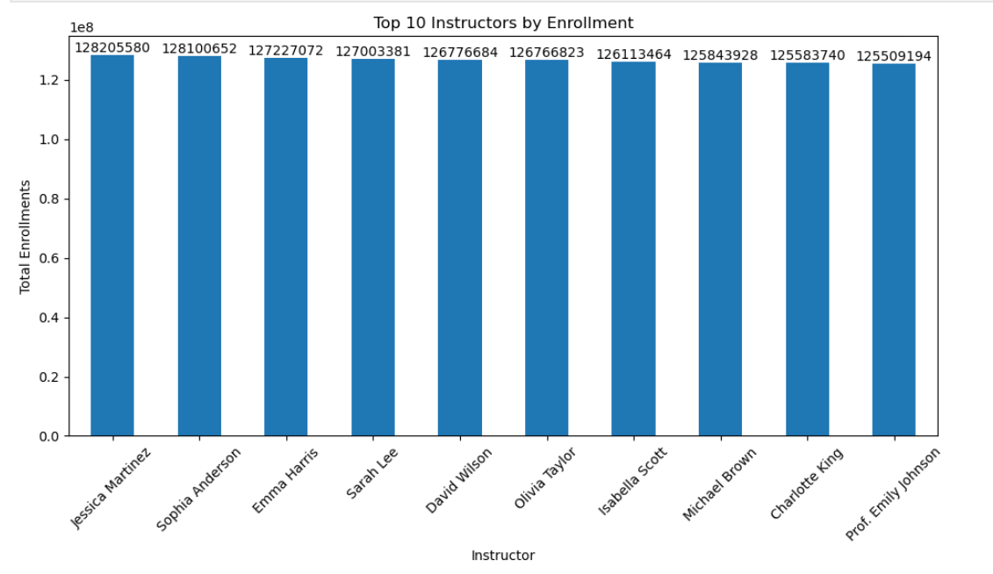
Graph: Top 10 Instructors by Enrollment (Bar Chart)

Slide 9
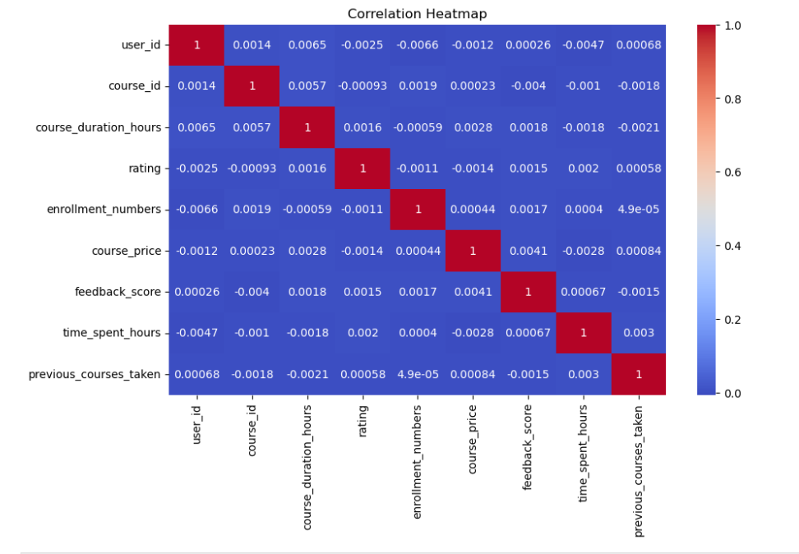
Graph: Correlation Heatmap (Numeric Features)

Slide 10
🛠️ Model Building
Models Used:
  ARIMA and SARIMA for time series forecasting
  XGBoost and Random
1️⃣ User-Based Collaborative Filtering
User-Based Collaborative Filtering recommends courses by finding users with similar
How it works in this project
Each user is represented by the set of courses they have enrolled in
Users with overlapping courses are considered similar
Courses taken by similar users but not yet taken by the target user are recommended
2️⃣ Domain-Based Content Filtering
Domain-Based Content Filtering recommends courses based on course domain similarity.
How it works in this project
Course domains (Programming, DevOps, Networking, etc.) are extracted from course titles
A user’s preferred domain is identified from their previously enrolled courses
Only courses from the same domain are considered for recommendation

Slide 11
🛠️ Model Building
Models Used:
  ARIMA and SARIMA for time series forecasting
  XGBoost and Random
3️⃣ Two-Stage Hybrid Recommendation Model
A Hybrid Recommendation Model that combines multiple techniques to improve recommendation quality.
How it works in this project
Stage 1 – Domain-Based Filtering (Primary – 85%)
Recommends courses from the same domain as the user’s past enrollments
Stage 2 – Collaborative Filtering (Secondary – 15%)
Adds courses preferred by similar users
Appears only after domain-based results
4️⃣ Ranking Strategy
Courses are ranked using:Score = Rating × log(Enrollment + 1)

Slide 12
🖥️ Model Deployment Overview
The objective of deployment is to make the recommendation system:
Interactive
User-friendly
Accessible in real time
The trained recommendation logic is deployed as a web application using Streamlit.
User Interaction Flow
Step-by-Step Process
User selects User ID from the sidebar
Previously enrolled courses are displayed
User selects number of recommendations (1–10)
System generates recommendations using hybrid model
Results are displayed in ranked order
Layer | Technology
Frontend | Streamlit
Backend | Python
Data Handling | Pandas, NumPy
Visualization | Streamlit Tables
Deployment Platform | Streamlit Cloud / Local

Slide 13
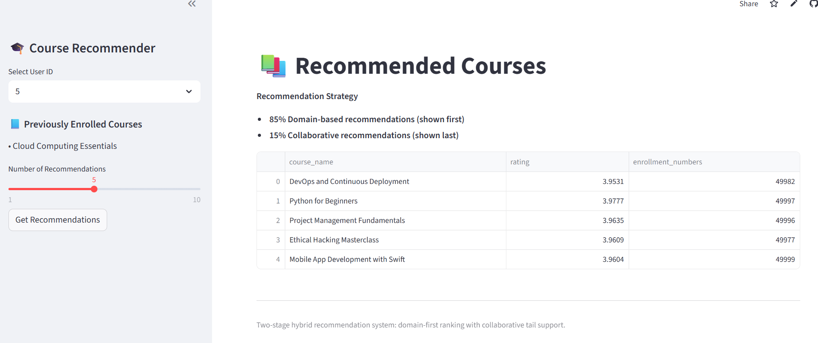
Recommendations
Recommendations for user-id 5 :-

Slide 14
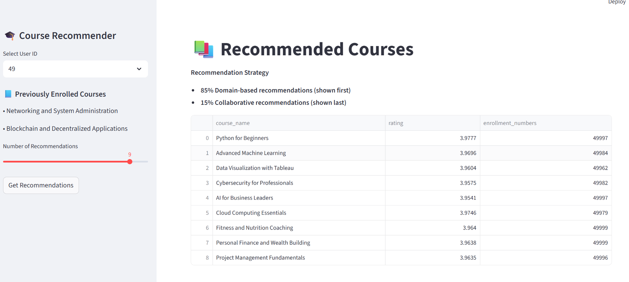
Recommendations for user-id 49:-

Slide 15
✅ conclusion
>Successfully developed and deployed a predictive model to forecast Apple Inc.’s stock prices for the next 30 days.
>Conducted comprehensive EDA to identify trends, seasonality, and volatility in stock movement.
>Implemented and compared ARIMA, SARIMA, XGBoost, and Random Forest models for forecasting accuracy.
A hybrid course recommendation system was successfully developed
Combined domain-based content filtering with user-based collaborative filtering
Domain-first strategy ensured high relevance despite sparse and old data
Collaborative filtering added personalization using user behavior
Ranking based on rating and enrollment numbers improved recommendation quality
System was deployed using Streamlit for real-time interaction

Slide 16
🚀 Future Scope
>Enhance the Streamlit dashboard with interactive analytics, visual comparisons, and model selection options.
>Allow users to compare multiple stocks at the same time.
>Add a notification or alert system for sudden trend changes..
>Deploy on a cloud platform (like AWS or Azure) for faster performance and wider access.
Real-Time Data Integration
Replace static CSV with live databases or APIs
Keep course and user data up to date
Time-Aware Recommendations
Prioritize recent user activity and trending courses
Handle outdated data more effectively
Automatic Weight Optimization
Dynamically adjust domain and collaborative weights
Remove manual tuning

Slide 17
Thank you !

