Slide 1
Portfolio Web Application
Professor: Dr. Robert Gilliland
Team Members : Akruth Reddy Gaddam (Y00861805)
Rohith Reddy Koyya (Y00860838)
Pradeep Narikelapu (Y00860604)

Slide 2
Overview
Developed a personal portfolio website using HTML, CSS, and JavaScript.
Purpose: To create an online presence showcasing the student’s skills, experiences, and projects.
Key Achievements:
Completed wireframe design, HTML structure, CSS styling, and JavaScript interactivity.
Delivered a fully responsive and interactive website. Deployed application using AWS

Slide 3
Introduction
Background
The personal portfolio website acts as an essential tool for personal branding and showcasing skills.
Technologies used: HTML, CSS, JavaScript
Problem Statement
In today’s competitive job market, presenting a structured, professional, and visually appealing online portfolio is critical.
Objectives
Build a structured HTML foundation.
Style the website using CSS for visual appeal and responsiveness. Enhance interactivity using JavaScript.
Ensure cross-device compatibility with responsive design. Deploying application in AWS using s3 bucket

Slide 4
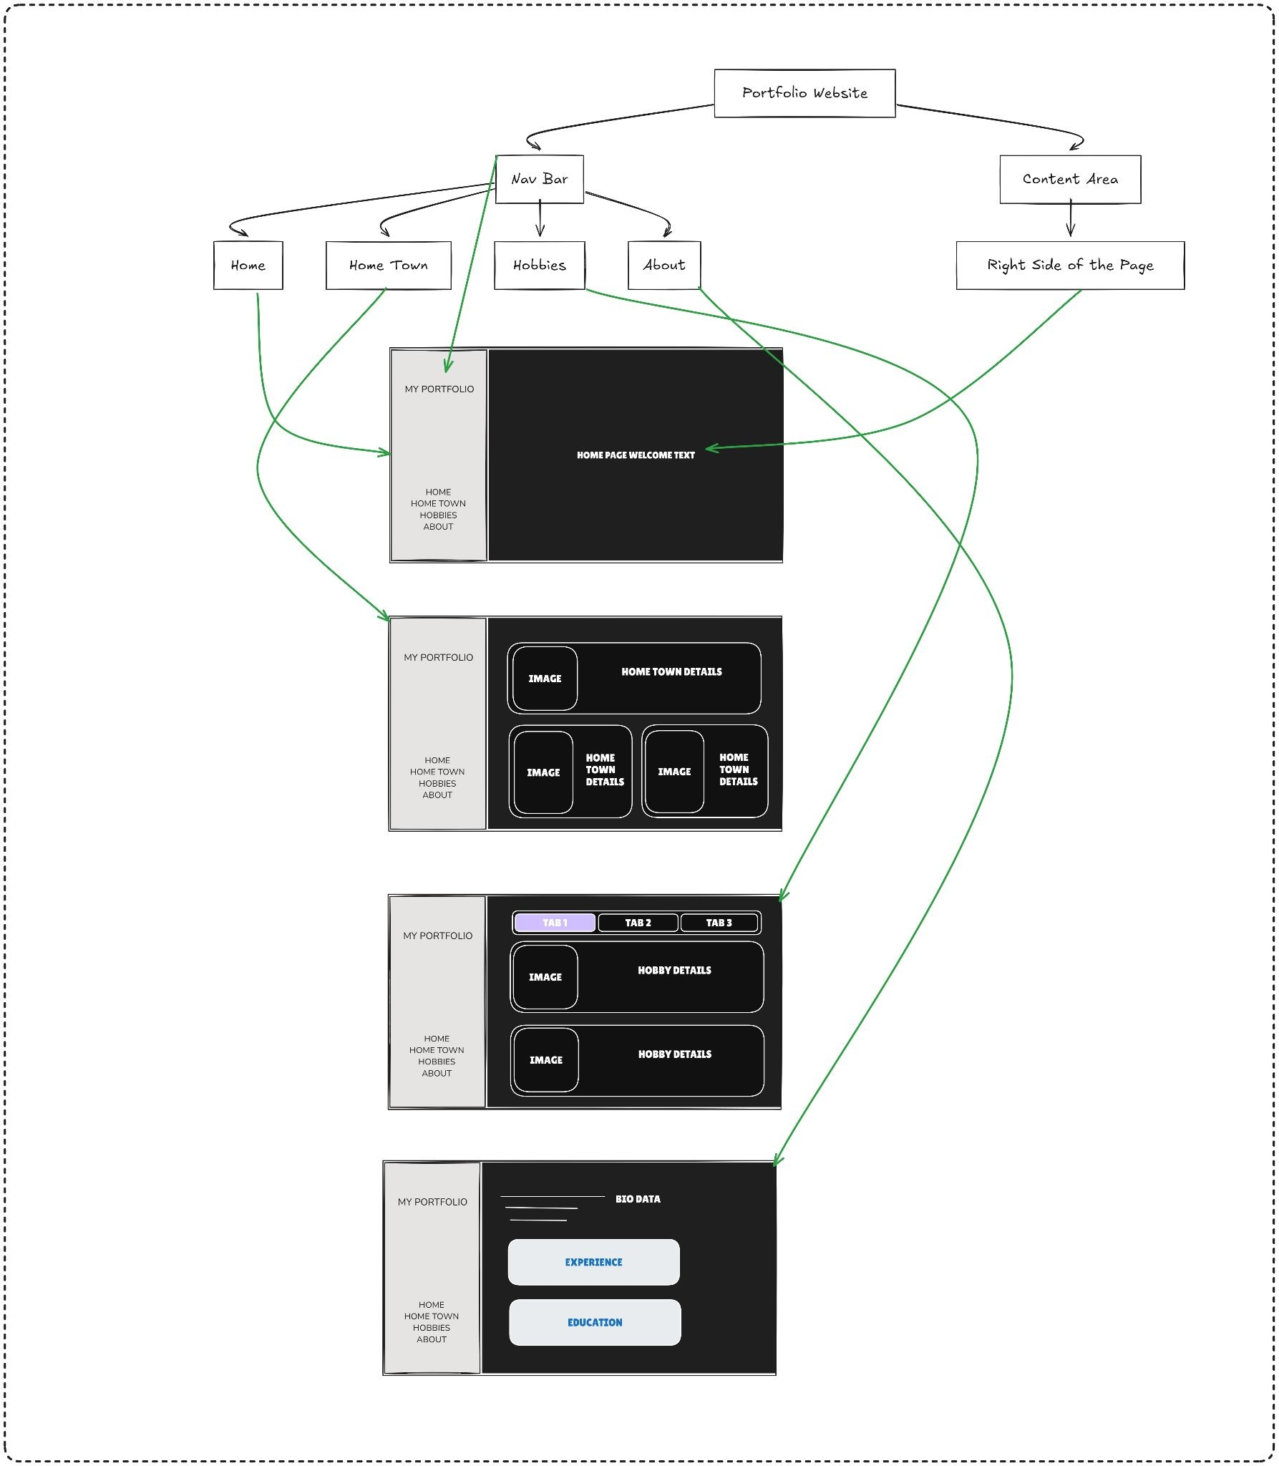
Wireframe Design
Overview of Wireframe:
Divided into four main sections: Home: Welcome message.
Hometown: Images and details. Hobbies: Tabbed interface showcasing hobbies.
About Me: Describing about my personal data and contact form
Purpose:
Served as a blueprint for development. Ensured a consistent and user-friendly flow.

Slide 5
Development Progress
HTML Structure
Completed Tasks:
Built the structure of Home, Hometown, Hobbies, and About Me sections. Navigation bar created and linked.
Semantic HTML for scalability and compliance with web standards.
CSS Styling
Responsive design using media queries.
Styled navigation bar with hover effects and active link highlighting. Flexbox and Grid used for content layout.
JavaScript Integration
Interactive Features Added:
Tabbed interface for hobbies section. Form validation for contact inputs.

Slide 6
Key Challenges
Wireframe Refinement:
Several iterations were required to optimize clarity and usability.
Responsive Design:
Adapting layouts for various devices required extensive testing.
JavaScript Integration:
Ensuring smooth interactions and debugging logic for the tabbed interface.
AWS Deployment:
Deploying application in AWS using s3 bucket service

Slide 7
Project timeline
OCT
OCT
OCT
OCT
NOV
NOV
Wireframe Design
HTML Structure
CSS Styling
JavaScript Integration
Testing & Bug Fixing
AWS
Deployment

Slide 8
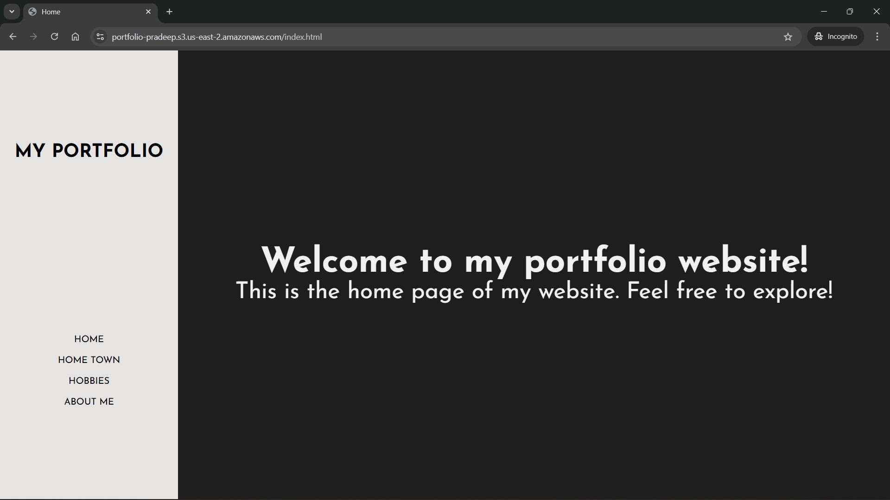
Live Website Demo
Deployed Application URL
DESKTOP WALKTHROUGH:
DASHBOARD / LANDING PAGE:

Slide 9
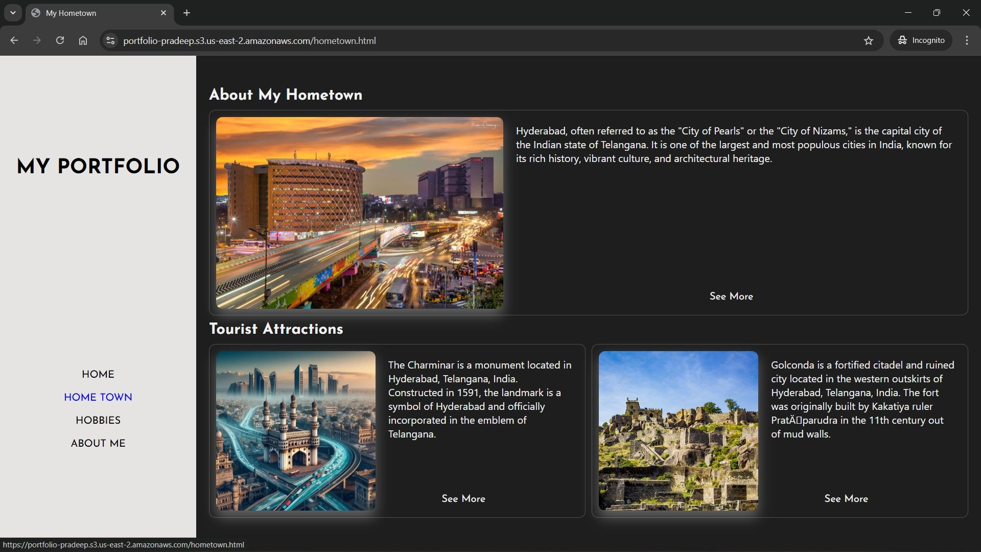
HOME TOWN

Slide 10
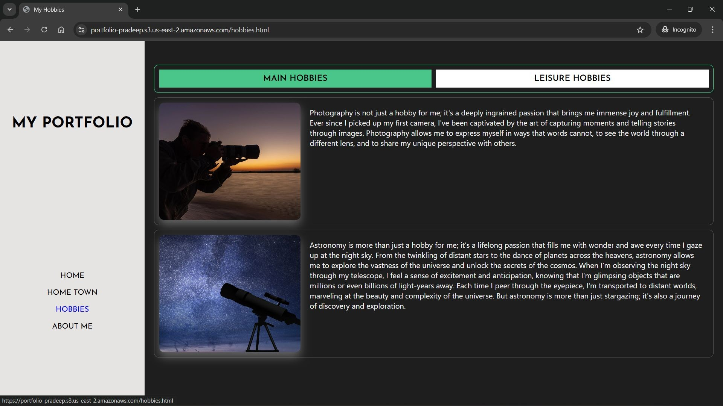
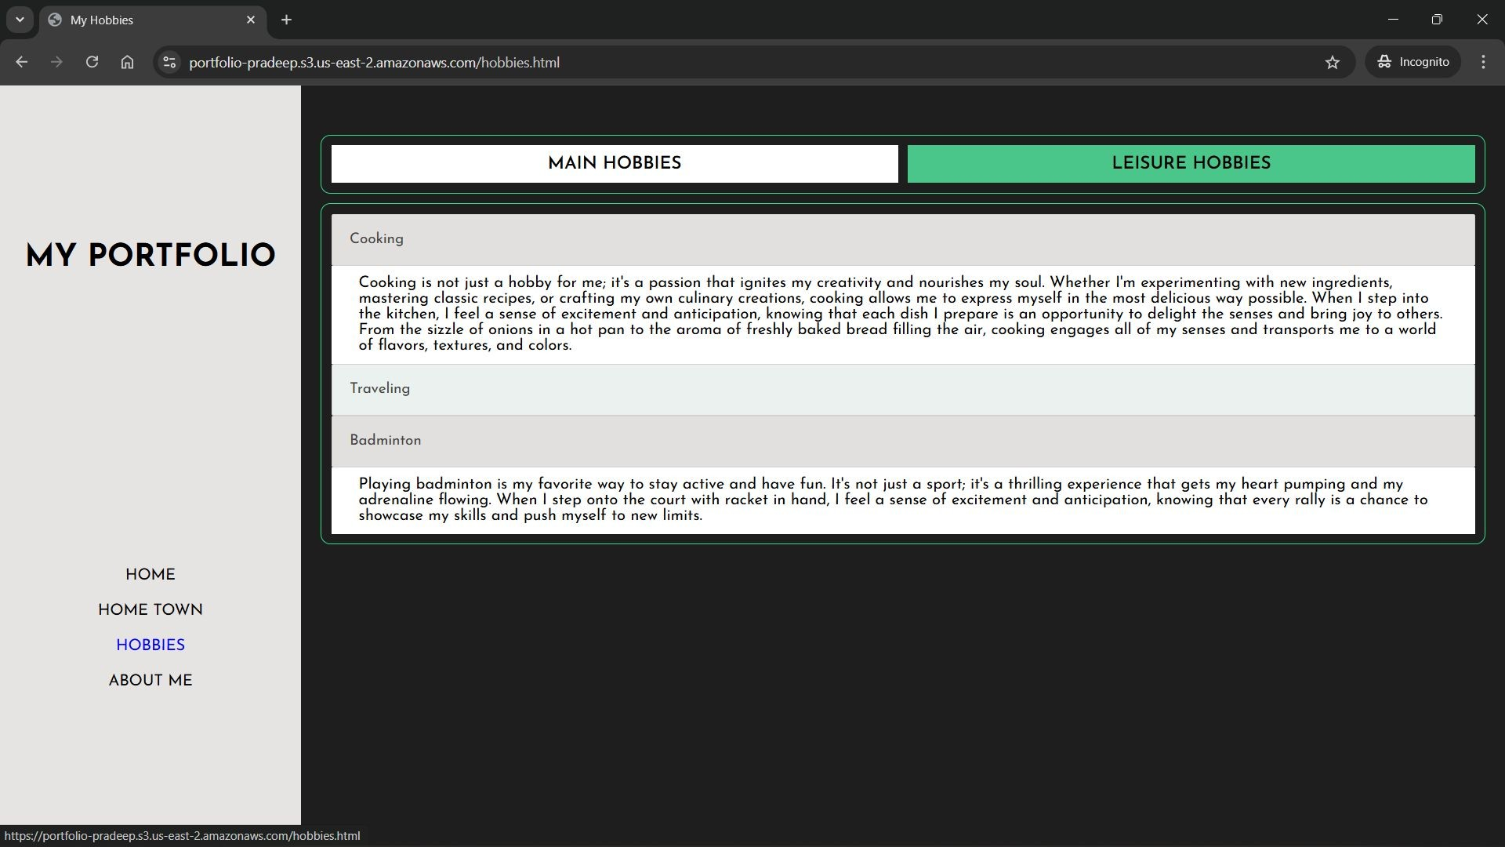
HOBBIES

Slide 11
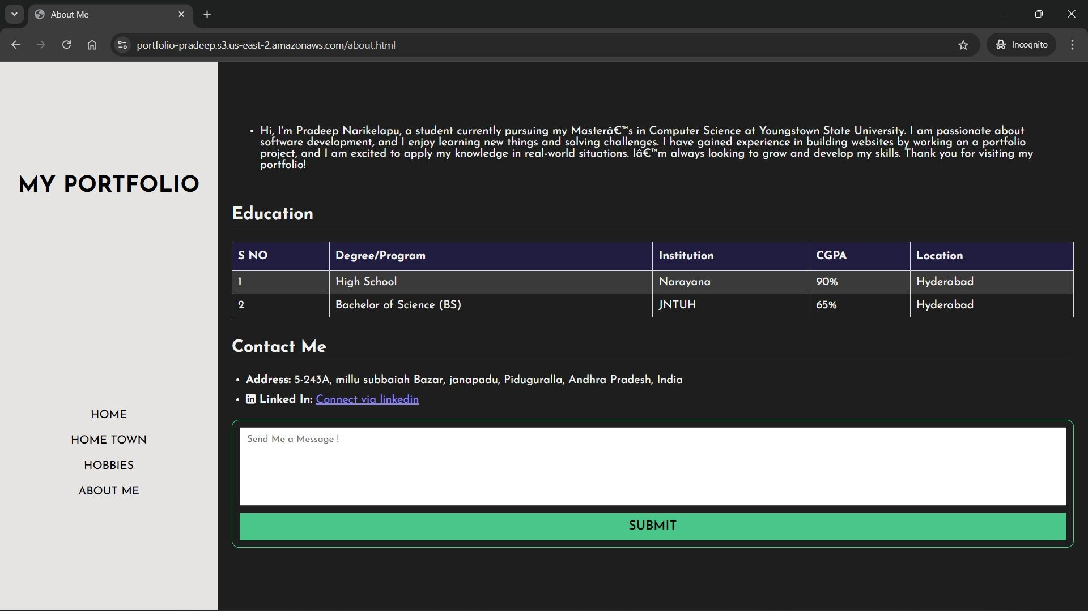
ABOUT ME

Slide 12
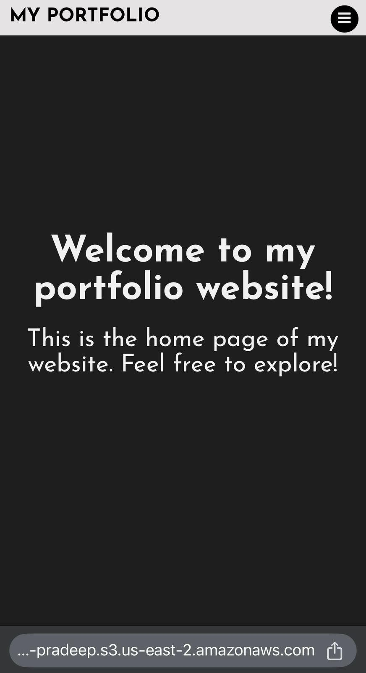
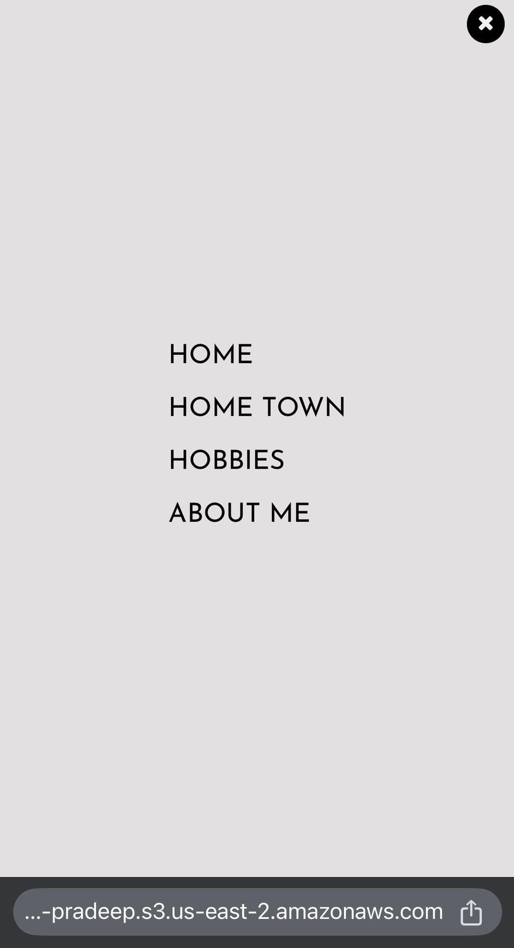
Mobile Walkthrough
DASHBOARD
RESPONSIVE NAV BAR

Slide 13
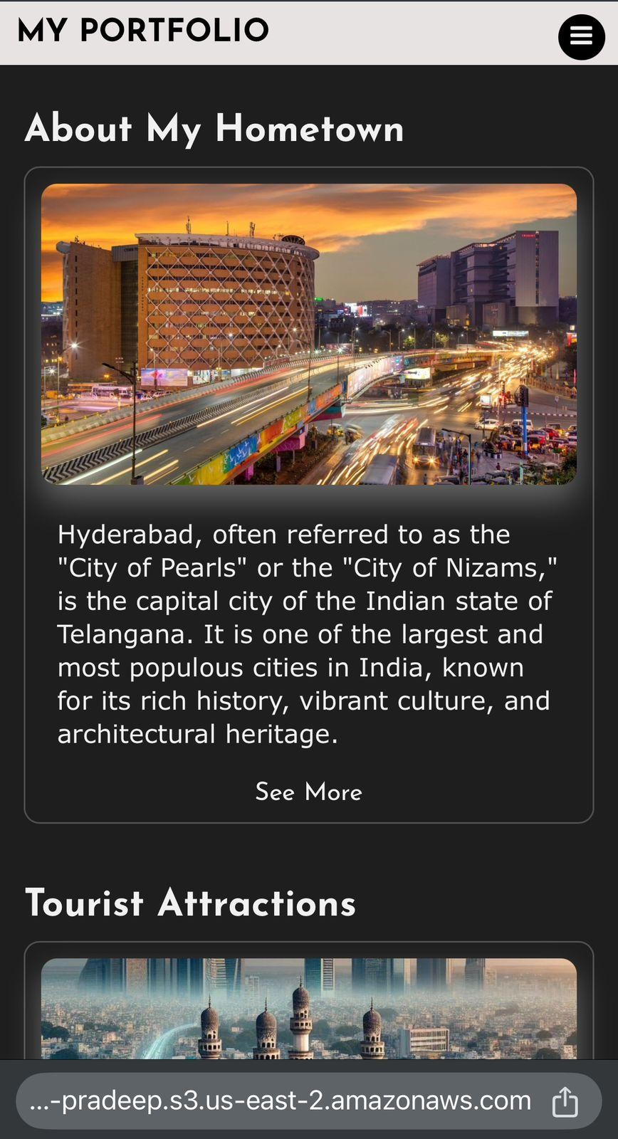
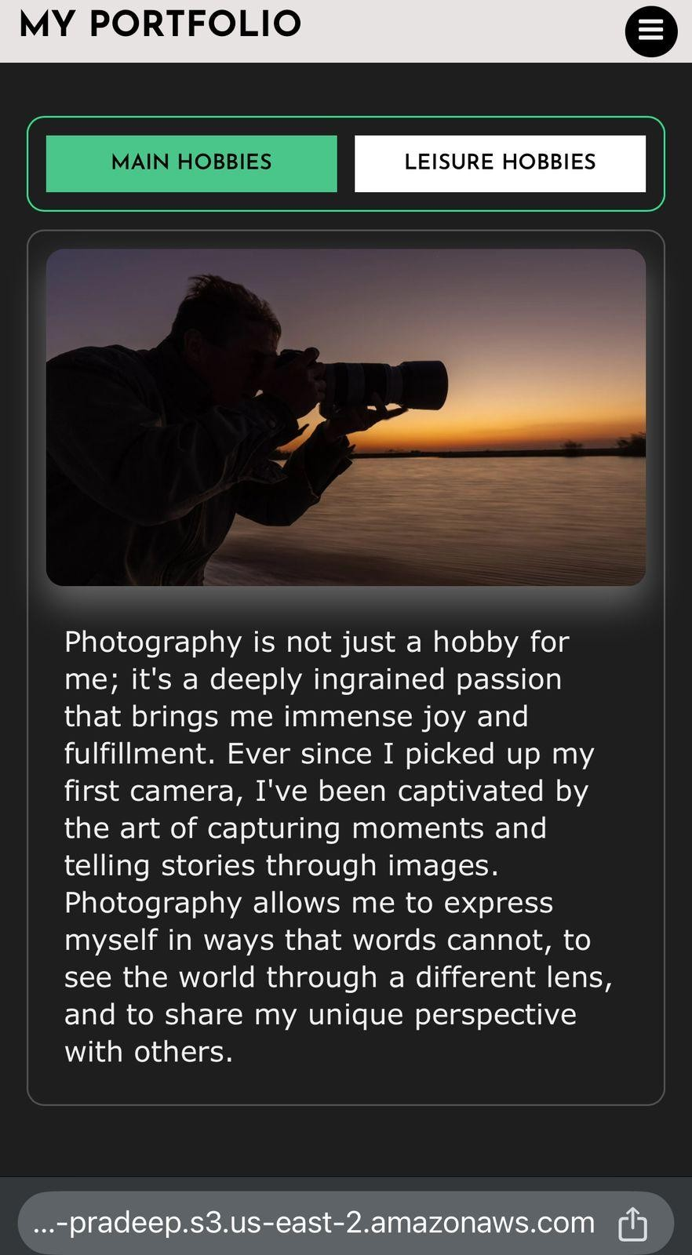
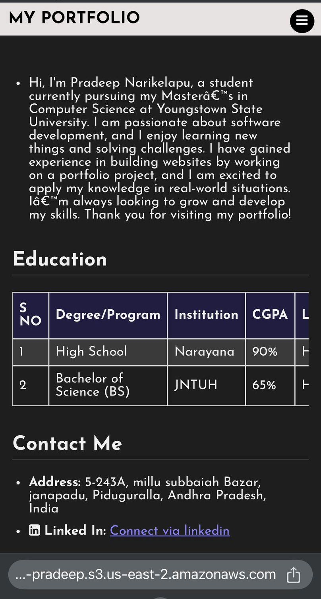
HOMETOWN , HOBBIES , ABOUT ME

Slide 14
Conclusion
Project Outcome: Delivered a fully functional, visually appealing, and interactive portfolio website.
Compatibility: Tested across 5 major browsers.
Responsive Design: Passed testing on mobile, tablet, and desktop. Hosting Website: Deployed application using AWS S3 bucket.
User Feedback:
Collected feedback from peers and mentors; the design and usability were highly appreciated.

Slide 15
Team Member Contribution
Gaddam Akruth Reddy Contributions:
Led the wireframe design process to ensure a clear and professional structure. Developed the HTML structure for the portfolio, including navigation and placeholders. Assisted in testing the website for cross-browser compatibility.
Rohith Reddy Koyya Contributions:
Focused on CSS styling, ensuring a responsive and visually appealing layout. Implemented Flexbox and Grid for optimal content positioning across devices. Enhanced navigation aesthetics with hover effects and active link highlights.
Pradeep Narikelapu Contributions:
Led the JavaScript integration, adding dynamic functionality like the tabbed hobbies section. Conducted form validation to improve interactivity.
Deployment Collaboration Joint Efforts:
All team members worked collaboratively to deploy the website on AWS S3. Configured the AWS bucket for public access and ensured proper hosting. Conducted testing to validate deployment and accessibility.

Slide 16





Thank you!

