Slide 1

Predict of Weather Forecasting using Machine Learning
Prepared by,
Aksa Anna Jose

Slide 2
CONTENTS
Abstract
Introduction
Literature Survey
Methodology
Results and Discussion
Conclusion
References

Slide 3
ABSTRACT
Weather changes have an incredibly negative impact on the environment and triggers natural disasters all of a sudden. To forecast these changes, there are several machine learning techniques and algorithms through which the weather changes can be predicted earlier.
It has been noted that, from previous analysis there are many other approaches available for weather prediction. Based on those, various parameters like temperature, humidity, wind direction, precipitation, evaporation etc are considered.
After surveying the emerging techniques and datasets, a proposed system is inculcated to include the approaches such as knn algorithm used to predict the wind speed, forecast time and day to interpret the environmental changes.

Slide 4
INTRODUCTION
The base of Nearest-neighbor classifiers is learning by resemblance, which is by comparing a given test sample with the available training samples which are similar to it.
KNN algorithm can be used for both classification and regression problems. The knn algorithm uses ‘feature similarity’ to predict the value of any new data points. This means that new points is assigned a value based on how closely it resembles the points in the train set.
The KNN algorithm can compete with the most accurate models because it makes highly accurate predictions. The quality of the predictions depends on the distance measure. Therefore, the KNN algorithm is suitable for applications for which sufficient domain knowledge is available. This knowledge supports the selection of an appropriate measure.The KNN algorithm is a type of lazy learning, where the computation for the generation of the predictions is deferred until classification.
Based on the climatic conditions at our place, the parameters like temp, humidity, pressure, precipitation etc. are considered and a dataset is framed. These values are considered based on our city’s weather situations.

Slide 5
Literature Survey
Reference Link | Contents
An Ensemble Approach to predict weather forecast using Machine Learning Published on 07 October 2020 N.Sravanthi; S.Harshini | An Ensemble Approach to predict weather forecast using machine learning, propose to forecast weather changes periodically. several machine learning technique and algorithm such as Ensemble model Bagging, Boosting, Random Forest, stacking algorithm, SVM to implement a proactive disaster recognition system to avoid the future loss of human lives and related environmental effect.
Deep Learning based weather forecast: A prediction Published on 21 June 2021 Sachin Soni; Kuldeep Vashishtha;Chandra Bhandubey | Next generation radar system will enhance the extreme weather detection, rainfall forecast and winter weather warnings.

Slide 6
Literature Survey
Reference Link | Contents
An Intelligent weather prediction system based on IOT Published on 21 June 2021 Mrinmoy Sadhukhan; Sudakshina Dasgupta;Indrajit Bhattacharya | This paper proposed an improved solution for weather monitoring using low-cost GPS-enabled IOT devices, connected with different sensors. The sensed information is stored in the server to predict the weather parameters.
Smart Real Time weather forcasting system Published on 09 March 2022 Shivanshu; Palash Nagwanshi;Anamika Chauhan | Smart Real Time weather forecasting is a smart system introduce to get the live reporting of weather conditions.
Ship path planning based on Deep Reinforcement Learning and weather forecast Published on 07 July 2021 | Ship path planning based on Deep learning Reinforcement Learning and weather forecast proposed Artificialntelligence algorithms could assist them in their naval operations. Predicting the path of a Maritime Surface Ship (MSS) in a dynamic environment.
Short-Term Solar Power Forecasts Considering Various Weather Variables Published on 08 April 2021,You-Jing Zhong;Yuan-Kang Wu | predict solar power generation focuses on numerical weather prediction (NWP) data, which includes meteorological data such as radiation, precipitation.

Slide 7
METHODOLOGY
K nearest neighbour algorithm
KNN algorithm can be used for both classification and regression problems. The KNN algorithm uses ‘feature similarity’ to predict the value of any new data points. This means that new points is assigned a value based on how closely it resembles the points in the train set. Learning through similarity or comparing a given test sample with accessible training example that are similar to it.
The base of Nearest-neighbor classifiers is learning by resemblance, which is by comparing a given test sample with the available training samples which are similar to it.
The KNN algorithm can compete with the most accurate models because it makes highly accurate predictions. The quality of the predictions depends on the distance measure.

Slide 8
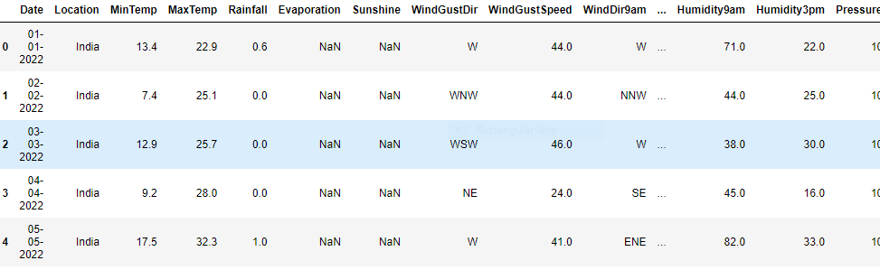
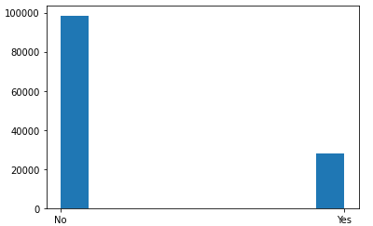
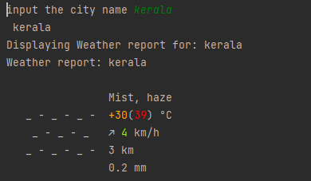
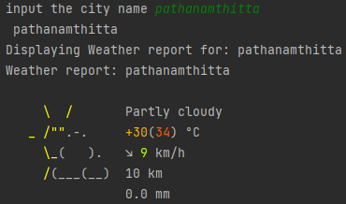
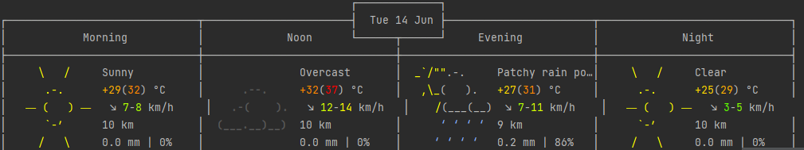
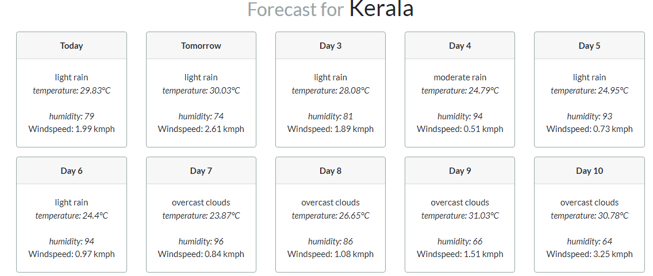
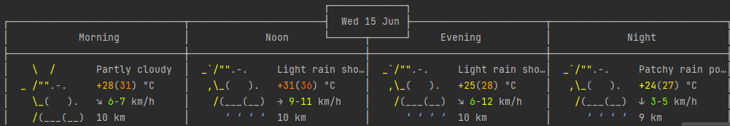
RESULTS AND DISCUSSION
Knn algorithm used to predict the temperature,wind speed,forecast rain and wind based on past data for predict the future date and day to expect the rate of temperature ,wind speed, rain.

Slide 9
CONCLUSION
The proposed research work has developed a model for weather prediction that can be utilized to provide better performance without much additional cost and also prediction variance can be reduced.
Weather plays a major role in our daily life, and without the meteorologist and forecaster, it would have faced difficulty in planning the daily activities. Meteorologist and forecasters predict the weather and its possible changes, The framework used to predict weather forecast of today, tomorrow and after 15 days we could analyze the environmental changes through KNN algorithm.

Slide 10
REFERENCES
An Ensemble Approach to predict weather forecast using Machine Learning
Proceedings of the International Conference on Smart Electronics and Communication (ICOSEC 2020)
IEEE Xplore Part Number: CFP20V90-ART; ISBN: 978-1-7281-5461-9
Deep Learning based weather forecast:A prediction
Sachin Soni;Kuldeep Vashishtha;Chandra Bhandubey 2021 5th International Conference on Trends in Electronics and Informatics (ICOEI)
An Intelligent weather prediction system based on IOT
Mrinmoy Sadhukhan;Sudakshina Dasgupta;Indrajit Bhattacharya 2021 Devices for Integrated Circuit (DevIC)
Smart Real Time weather forecasting system
Shivanshu;Palash Nagwanshi;Anamika Chauhan 2021 3rd International Conference on Advances in Computing, Communication Control and Networking (ICAC3N)
Ship path planning based on Deep Reinforcement Learning and weather forecast
Eva ARTUSI 2021 22nd IEEE International Conference on Mobile Data Management (MDM)
Short-Term Solar Power Forecasts Considering Various Weather Variables
You-Jing Zhong;Yuan-Kang Wu 2020 International Symposium on Computer, Consumer and Control (IS3C)

Slide 11
THANK YOU

