Slide 1
JukeByte
Advisor:
Joe Kasprzyk
Summer 2019
Abdou K. Sene & Ariel Torres

Slide 2
Table of contents:
Student Learning Objectives
Background Information
Problem Specification
Description of Functionalities
Diagrams
Solution Design
Tools List
Benchmark Specifications
Grading Scheme
List of Deliverables

Slide 3
Student Learning Objectives:
Throughout the course of our project, we intend to achieve the following learning
objectives:
O1: Learn how to configure a server
O2: Learn how to use CPanel in order to upload music into the database
O3: Figure out how to use PHPMyAdmin (MySQL) to manage the database
O4: Explore how to create a PHP file to upload to the database without having to do it manually
O5: Create the PHP that will make sure the app will be able to track likes
O6: Understand how to automate the running of the script (with Cron on Linux)
O7: Learn Swift and associated libraries, functions and implementation.
O8: Improve and expand on our understanding of Xcode.
O9: Learn how to manipulate and access different IOS functions
O10: Implementing Music kit with a Database of our choice as our resource for music.
O11: Understand how to make the database and devices communicate with each other.
O12: Exploring how to design and create a fully functioning application.

Slide 4
Background Information:
Music is mostly used as a source of common interest between strangers, and many times it helps create friendships.
Music serves as a therapeutic method for a lot of people throughout the world.
Music tends to help people with stress, illnesses. It has a beneficial effect on our physiological functions such as slowing the pulse, heart rate, lowering blood pressure, etc.
However, because of the various forms of music that may not mean that everyone has the same taste. Most get-togethers usually have one DJ who is given the task to entertain a group of people. Though one can try but it’s a near impossible tasks because everyone is different.

Slide 5
Problem Specification:
During the 40s and 50s, jukeboxes were popular amongst crowds in bars, clubs, etc…
We wanted to bring that same feel back to a now tech-dominant world.
The goal we want to achieve in our project is to provide users with the ability to interact with one another at gatherings.
We will design an application that will allow users to connect with one another via a “virtual party”, where music can be selected from our database.

Slide 6
Description of Functionalities:
The main functions that JukeByte will provide for our user(s) are as follows:
For the User:
Create/manage account
Ability to like music
Request music (similar to juke boxes/DJs)
Join Party
For the “DJ” (Maintenance Purposes):
Create/manage account
Ability to upload music
Host Party

Slide 7
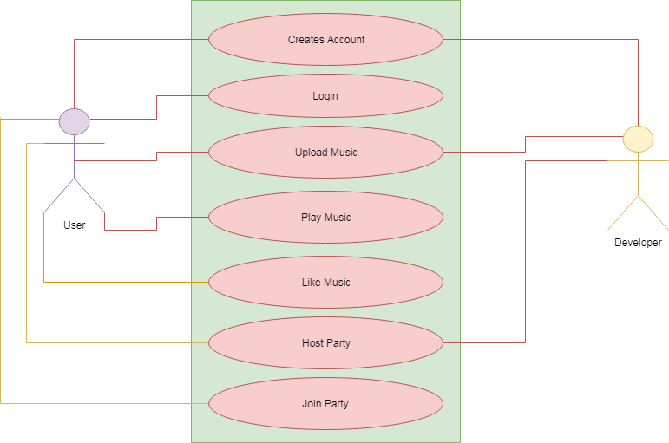
Draft Use-Case Diagram:

Slide 8
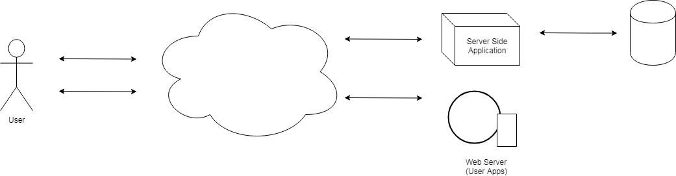
System-level Architecture Diagram:
Database

Slide 9
Solution Design:
Our application allows users:
To be able to create/log in to account.
The application will let the user play music and vote for what will be played next through our liking system.
Songs liked by any user will be saved and reflected in the database.
The user will also be able to join a party then choose what will be played.
The “DJ” will be able do the following for maintenance purposes:
To access our server and manage music currently uploaded.
The server contains the script which automatically uploads music but the developer can also add or manage music in the database.
The developer can also host a party and choose music to be played by default.

Slide 10
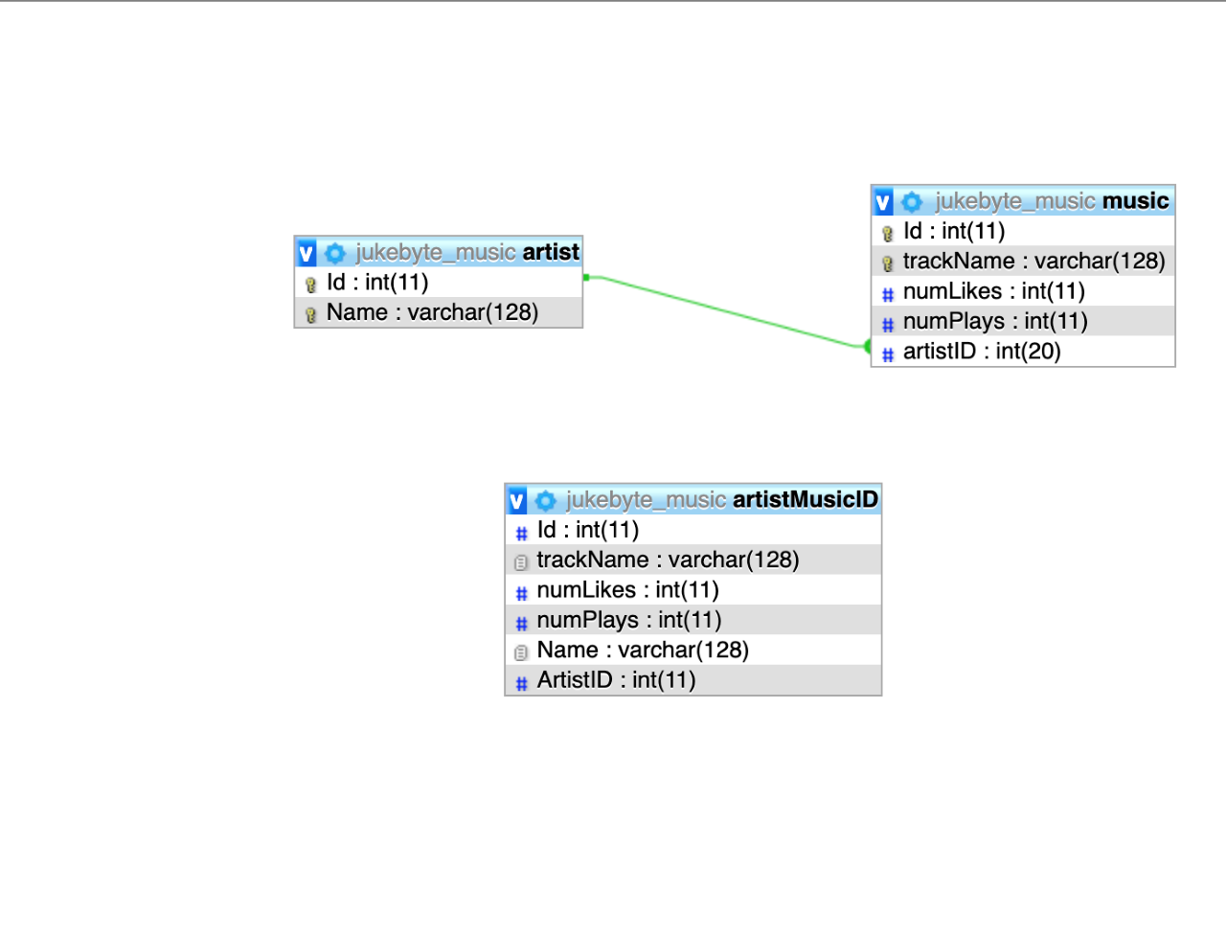
Entity-Relationship Diagram(Revised from original proposal)

Slide 11
Tools List
Programming Languages:
PHP
Swift
SQL
IDE/Interface:
CPanel Code editor
XCode
Backend/Database:
SiteGround
CPanel
PHPMyAdmin (MySQL)
Cron (CPanel)

Slide 12
Benchmarks
Database Designed and Implemented
Database Populated
Application Designed and Implemented
Application Linked to Database and Tested
Final Integration Testing
Presentation Preparation

Slide 13
Time Schedule
Database Designed and Implemented ….…………………………….. 1 - 2 Weeks
Database Populated ……….…………………………………………… 1 Week
Application Designed and Implemented ……………………………… 1 - 5 Weeks
Application Linked to Database and Tested ..……….…………………. 1 - 3 Weeks
Final Integration Testing ...………………………………………………. 1 - 2 Weeks
Presentation Preparation ……………….………………………………… Final Week

Slide 14
Grading Scheme
Application design ……………………….…………………………………….... 30%
Database implementation and design .......…...………………………………. 20%
Time Scheduling ……….…………………………………………………………..10%
Functionality ..………………………………………………………………….... 10%
Testing Robustness ………...……………...…………………………………… 20%
Presentation …..………….………...…………………………………………… 10%

Slide 15
List of Deliverables
The following will be delivered:
Original proposal
Entity-Relationship Diagram
Appropriately Commented Source code
Documentation
Presentation Documents
Post-mortem
List of components left incomplete, accompanied by an explanation as to why
Proposal slideshow presentation

Slide 16
Live Demo

Slide 17
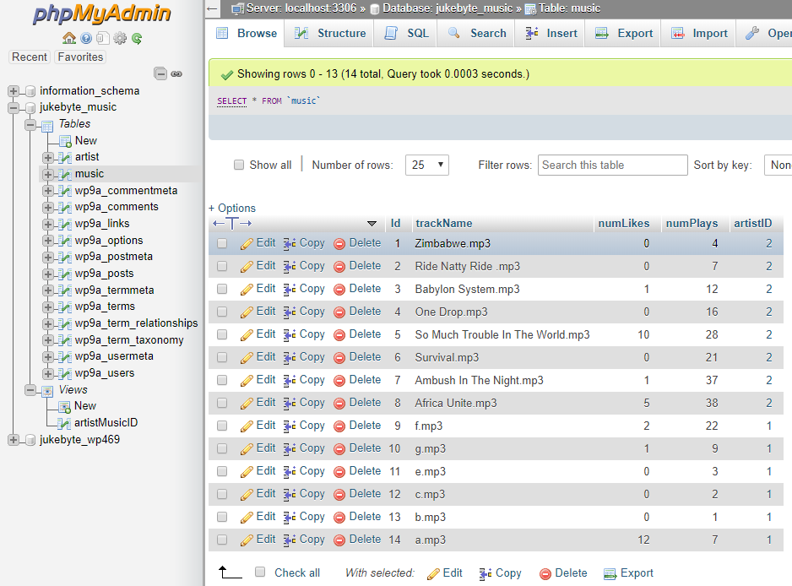
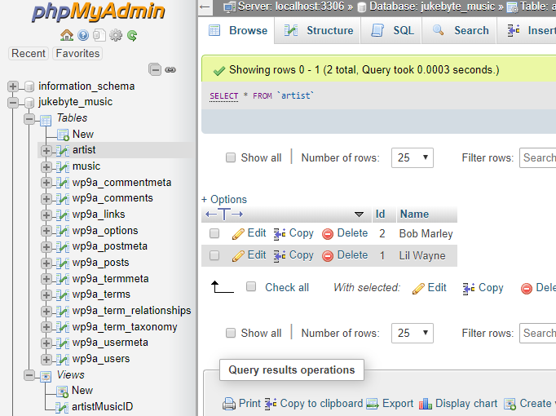
Demo Time
Music Table Populated
Artist Table Populated

Slide 18
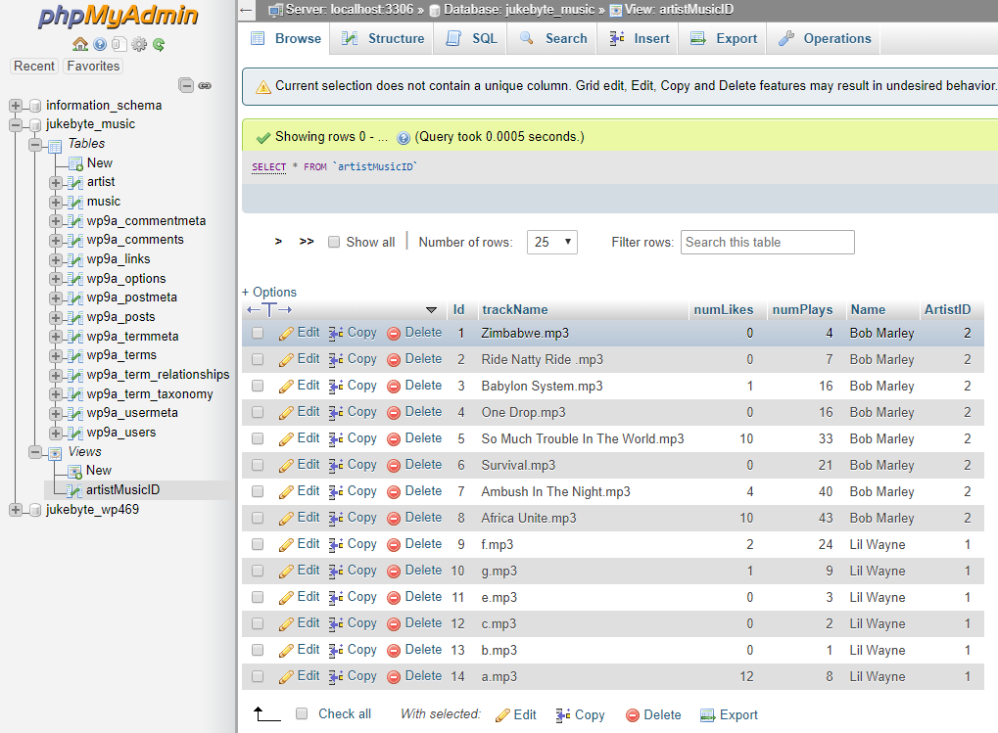
artistMusicView

Slide 19
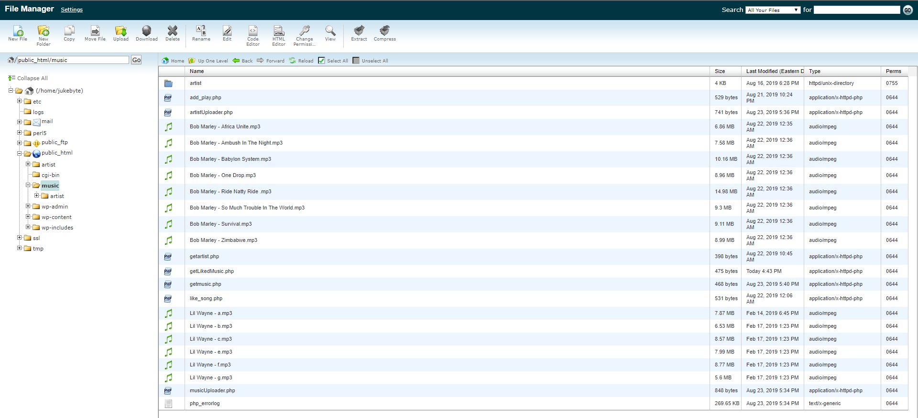
cPanel (File Manager)

Slide 20
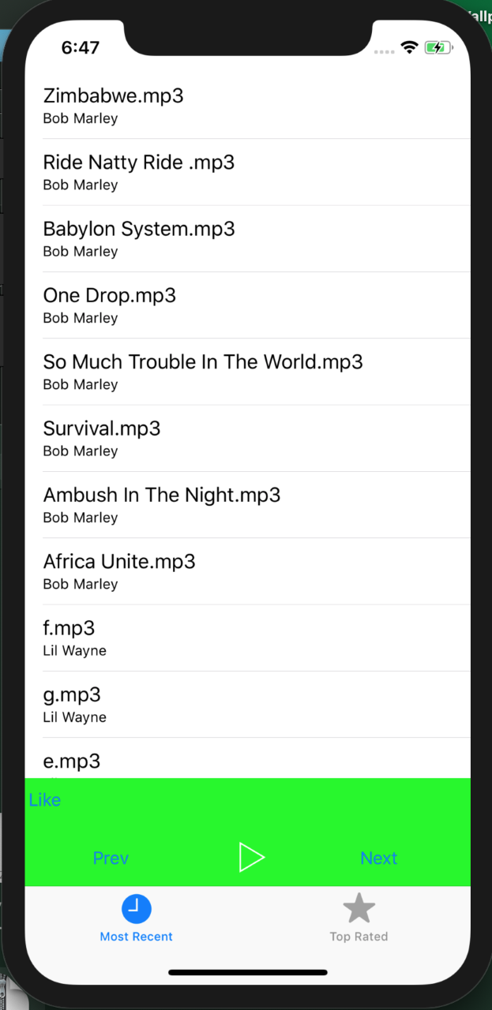
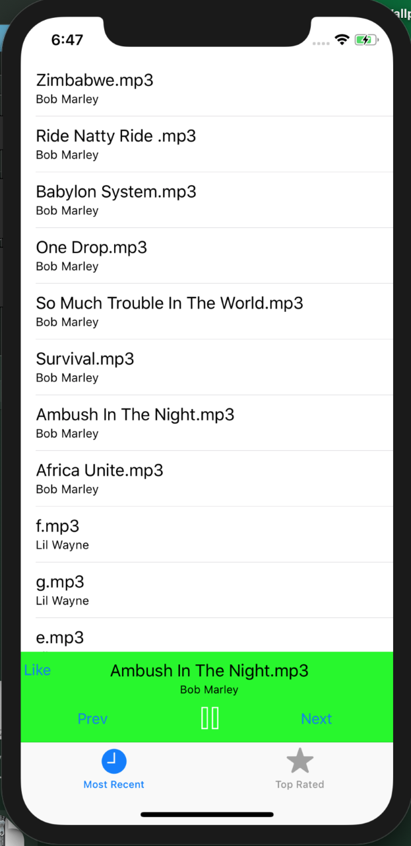
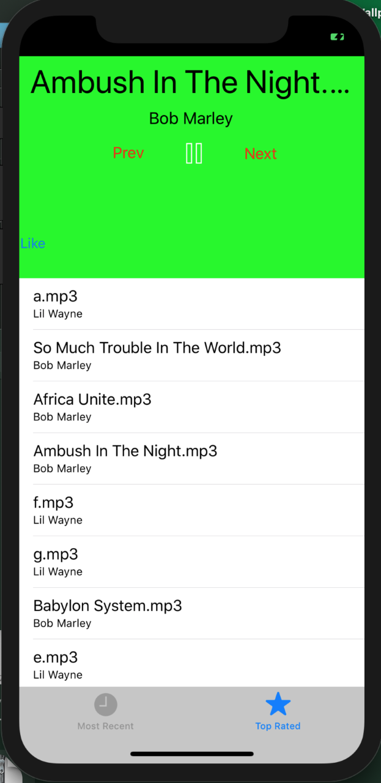
App Design
Page 1
Page 2
Page 3
We went with a tabbed application because we found it to be a smoother process to work with as opposed to a single view application.
When a song is selected it is also reflected on the second screen as seen in the images to the right

Slide 21
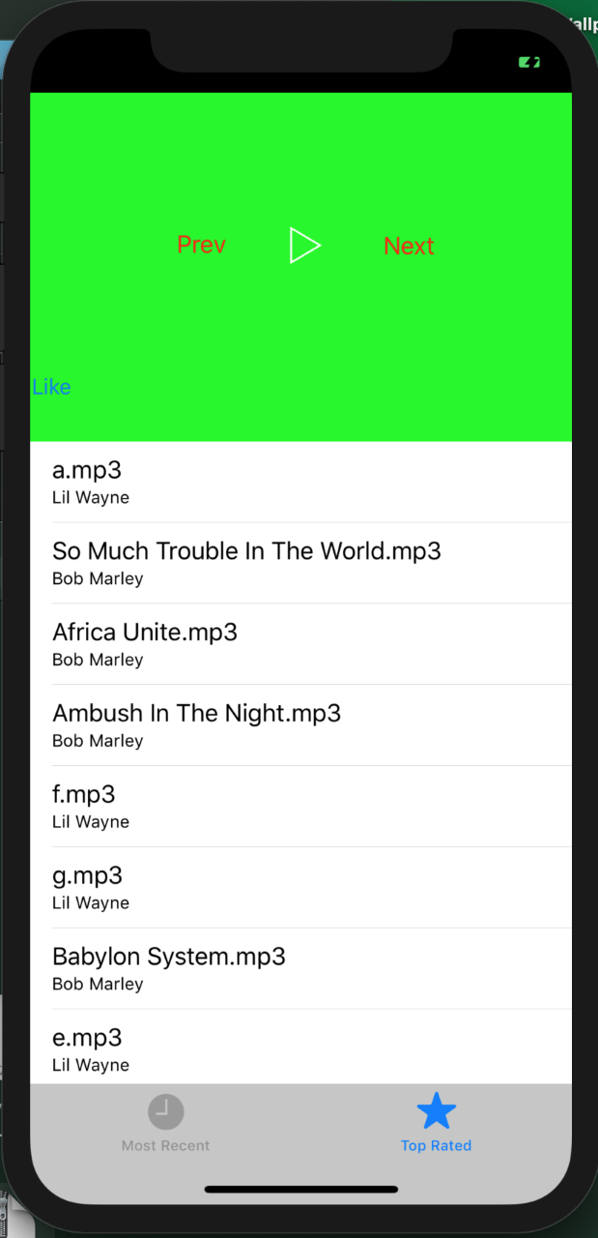
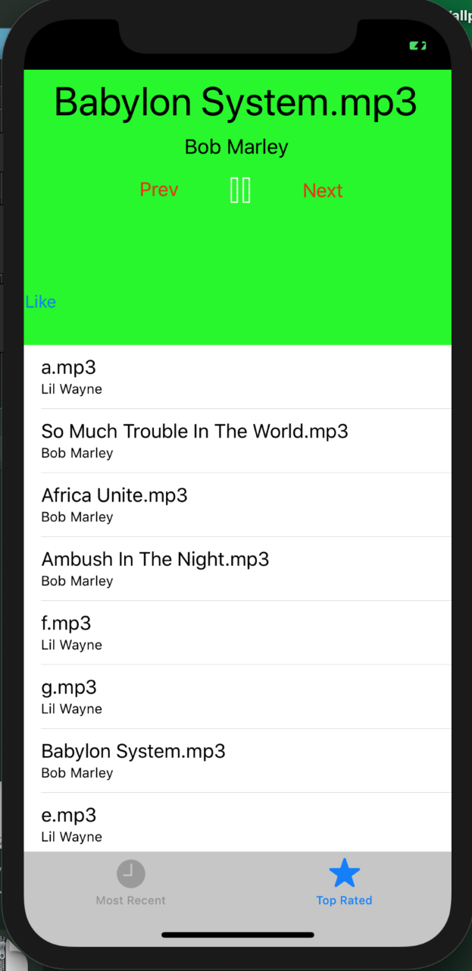
App Design Continued
Page 1
Page 2
In this second view we are just showing how songs are displayed once selected from the options in the menu.

Slide 22
Post-mortem
From this project we learned:
There's a lot of moving parts to creating an app
From the database design, to writing scripts that populated the datatbase, etc.
The database design is crucial to making everything work!
Developing IOS applications seem way simpler than they are
Passing data between classes is a tedious process.

Slide 23
List of components left incomplete
Features we didn't include:
Users/DJ's being able to create/manage account(s) and requesting music. We were too ambitious with our project proposal and realized that these features that would've taken up most our time.
We also didn't use Apple's MusicKit because we found AVplayer library, used in the swift language, to be more useful in the scope of our project
Adding genre because it would’ve been rinse and repeating, making our application big for no reason.

Slide 24
Any comments, questions or concerns?

Slide 25
Thank You!

