Slide 1
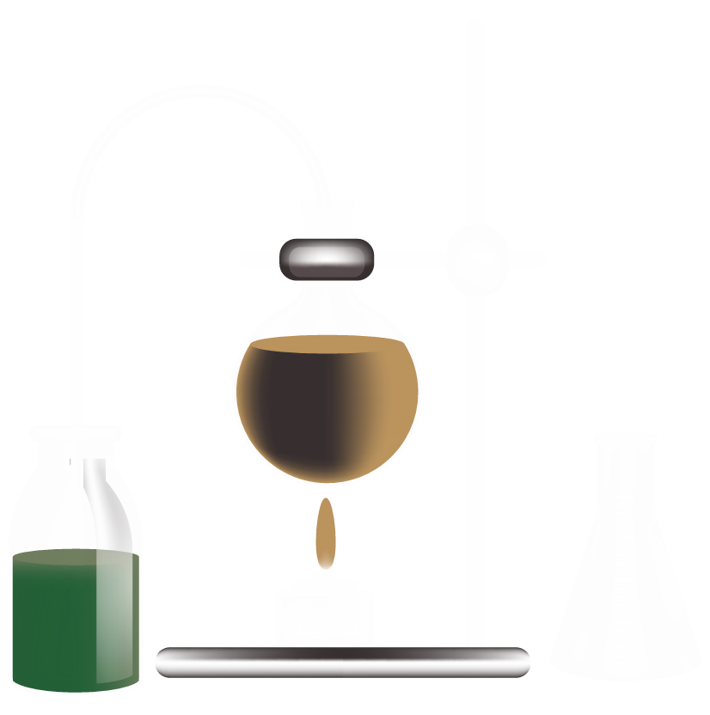

AIML Catalyst Prediction and Generation

Slide 2
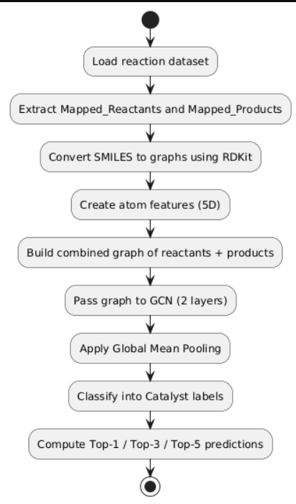
Approach 1: Catalyst Prediction
🔧 Objective
Given a pair of reactants and products, predict the most likely catalyst using a classification model.
⚙️ Technical Stack
Frameworks: PyTorch, PyTorch Geometric
Dataset: all_mapped_reactions_combined.csv (≥ 0.5 Confidence)
Input Features:
Atoms: Atomic number, degree, formal charge, hybridization, aromaticity → 5D
Vector
Graph: Reactants and products converted to graphs using RDKit
Output: One-hot label for catalyst (multi-class classification)

Slide 3
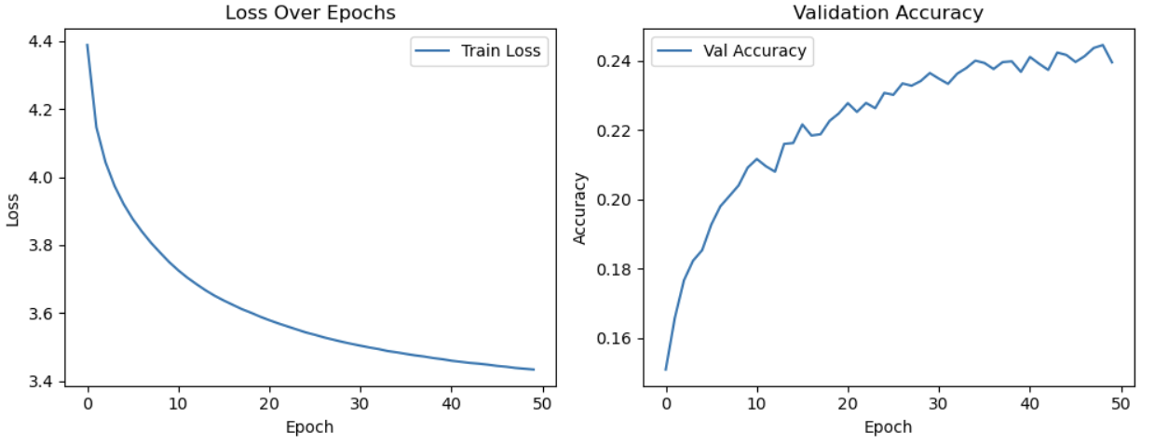
🧠 Model Architecture
Graph Encoder: GCNConv
Classifier Head:
Linear Layer → Output size = Number of unique catalysts (868)
🏁 Performance
Epochs: 50
Best Val Accuracy: ~0.24
Top-3 Accuracy: ~43.6%
Top-5 Accuracy: ~53.1%
✅ Why GCN?
GCN is fast, scalable for this classification task and handles molecular graphs well using topological information.

Slide 4

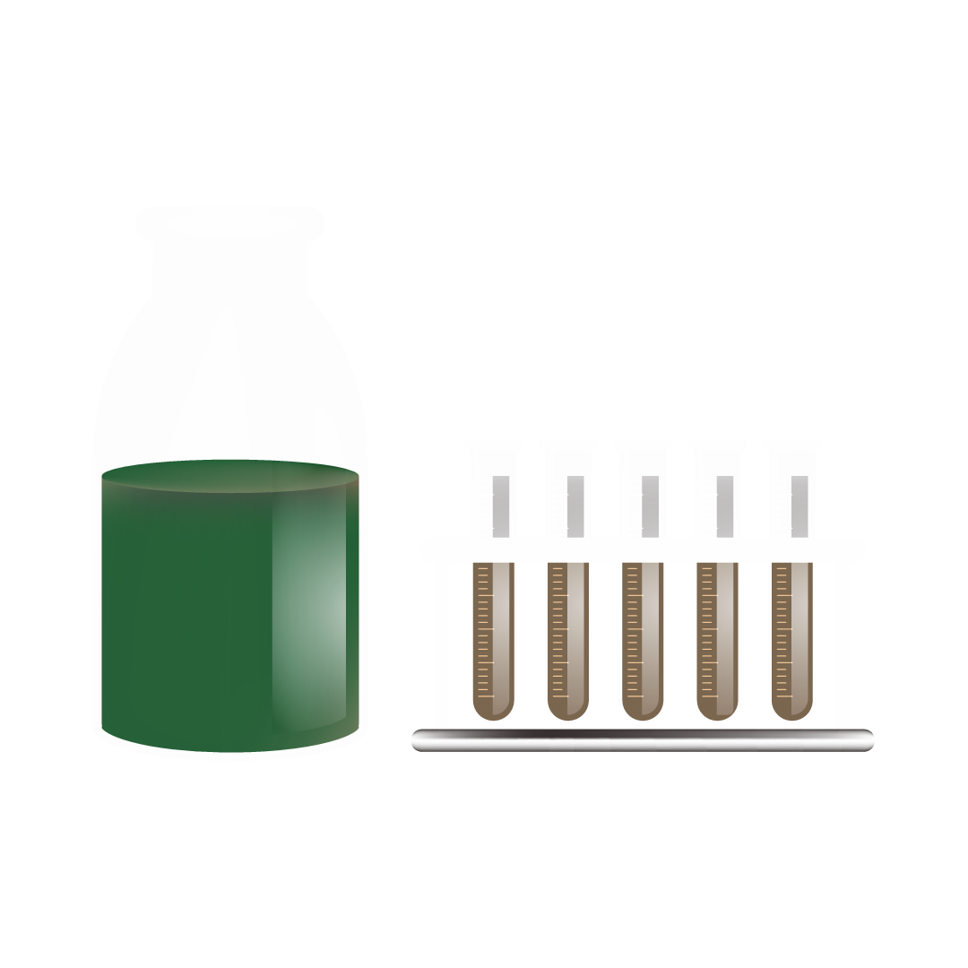
Approach 2: Catalyst Generation
🔧 Objective
Generate new catalyst SMILES for a given reaction (reactants + product) and score their suitability.
⚙️ Technical Stack
Data: cleaned_mapped_reactions.csv
Filter: Only reactions with catalysts containing: Pd, Pt, Rh, Ni, Cu, Fe, Ru, Ir, Zn
SELFIES: Used for tokenization and generation (robust alternative to SMILES)

Slide 5
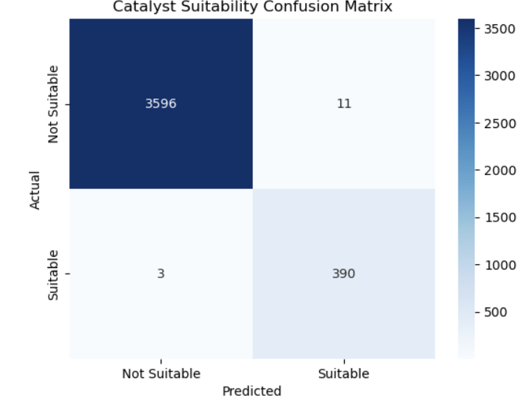
🧠 Model Architecture
🔹 Encoder: Graph Neural Network (GINEConv)
Input: Reaction graph (reactants + products)
Atom Features: Same 5D vector
Bond Features: Bond type, aromaticity, conjugation, ring (4D)
Output: 64D vector (graph-level)
🔹 Decoder: Transformer
Embedding Dim: 64
Heads: 4
Layers: 2 encoder, 2 decoder
Output: SELFIES token sequences
Vocab Size: 45 tokens
🔹 Post-filter
Generated molecules are converted back to SMILES and passed to a GNN-based suitability classifier:
Classifier: GINEConv + MLP → outputs sigmoid score

Slide 6
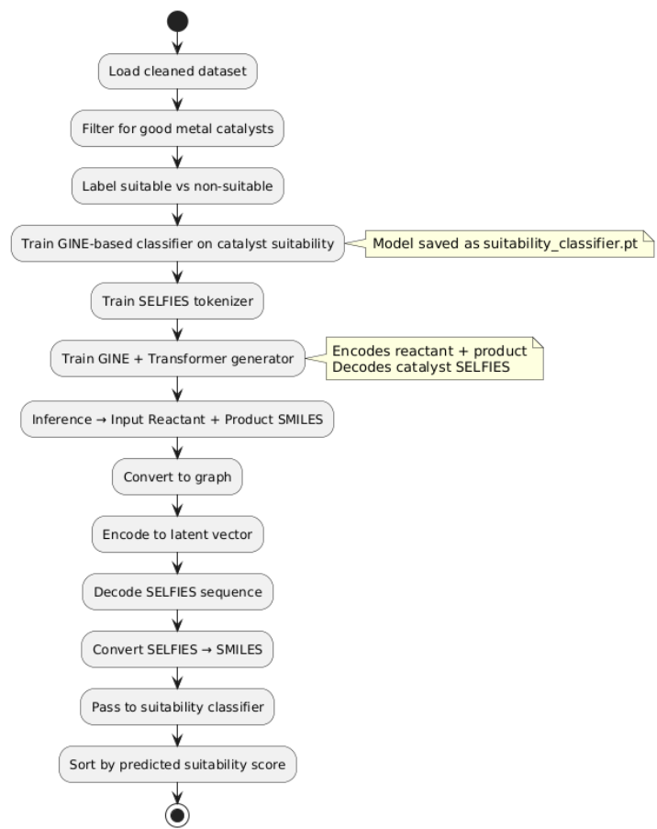
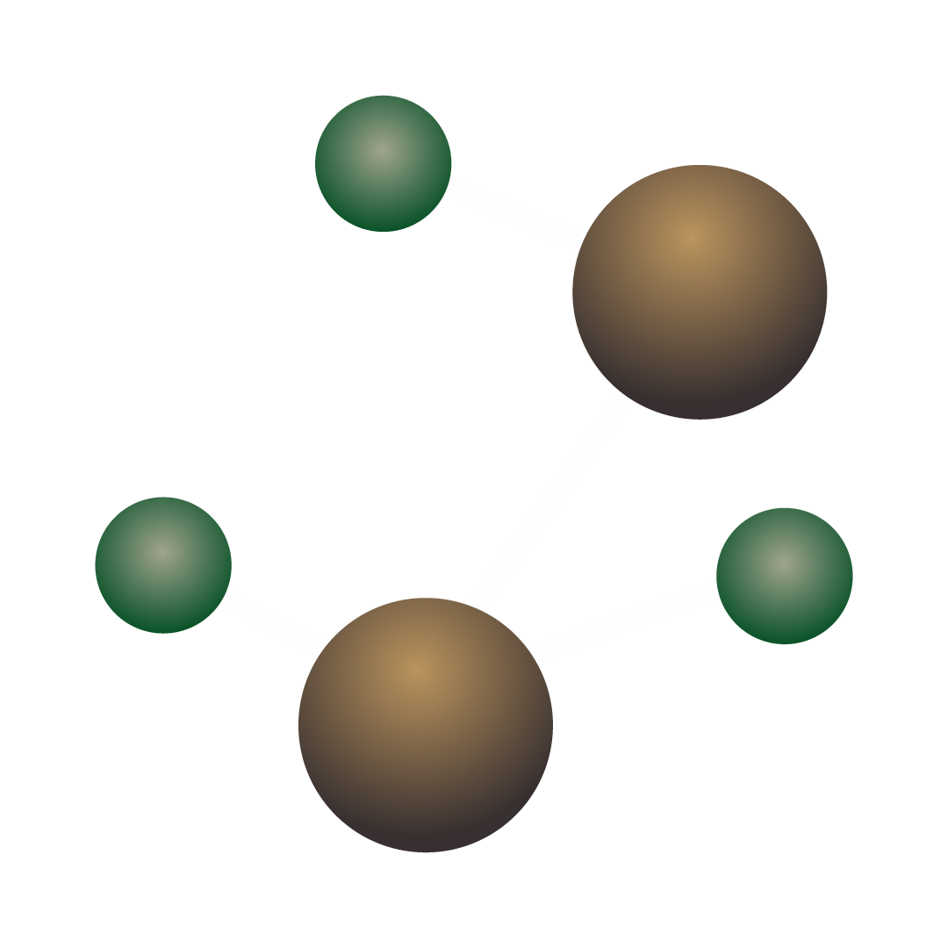
✅ Why Transformer + SELFIES?
Transformer handles sequence generation flexibly
SELFIES ensures generated tokens are chemically valid
Suitability Scoring (Post-processing):
Each candidate is converted to a graph.
Passed through a separate binary classifier trained on ~20k reactions with good vs bad catalysts.
Output: Score ∈ [0, 1] (suitability).

Slide 7
Thank You

