Slide 1
Intermediate
- Aksh Patel

Slide 2
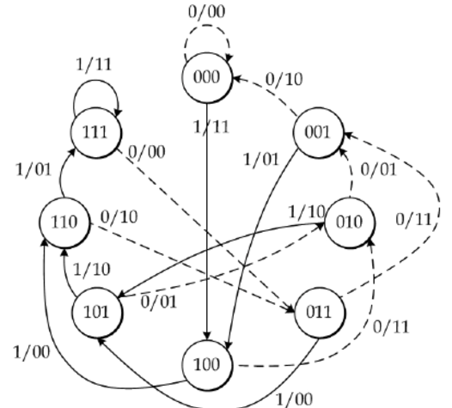
Encoder Part -1 (K=4 rate=1/2)
As k=4 ,
Number of states = 2^{(K-1)} = 2³ = 8 states.
G1=[1 1 0 1] , G2=[1 1 1 0].
P0[n]=x[n]+x[n-1]+x[n-3].
P1[n]=x[n]+x[n-1]+x[n-2].
P0 and P1 are two parity bits.
Also, we have to insert 3 zeros at end of
message bit.
If k is the length of message bits then length of
encoded bits =2*(k+3).

Slide 3
Encoder Part -2 (K=4 rate=1/3)
As k=4 ,
Number of states = 2^{(K-1)} = 2³ = 8 states.
G1=[1 1 0 1] , G2=[1 1 1 0] , G3=[1 1 1 1].
P0[n]=x[n]+x[n-1]+x[n-3].
P1[n]=x[n]+x[n-1]+x[n-2].
P2[n]=x[n]+x[n-1]+x[n-2]+x[n-3].
P0 ,P1 and P2 are three parity bits.
Also , we have to insert 3 zeros at end of
message bit.
If k is the length of message bits then length of
encoded bits =3*(k+3).

Slide 4
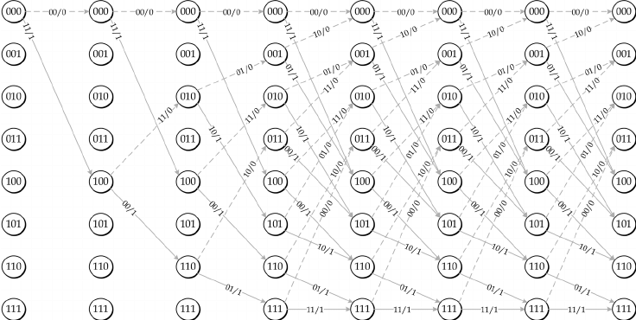
Decoder part -1(k=4 rate=1/2)

Slide 5
Decoder part -1 (k=4 rate=1/3)
We have similar diagram as described in previous slide except we have 3 parity bits.
The path metric computation may be thought of as an add-compare-select procedure:
1. Add the branch metric to the path metric for the old state.
2. Compare the sums for paths arriving at the new state (there are only two such paths to compare at each new state because there are only two incoming arcs from the previous column).
3. Select the path with the smallest value, breaking ties arbitrarily. This path corresponds to the one with fewest errors.

Slide 6
Analysis of part -1 (k=4 and rate=1/2)
As we increase the value of SNRDB then BER(bit error rate) decreases.
As compared to basic graph i.e.
at K=3 we get a better BER in
intermediate graph i.e. K=4
(as seen in the dotted graph).
But the cost that we have to pay
to improve BER is that the no. of
states increases from 4 to 8.

Slide 7
Analysis of part -2 (K=4 and rate=1/3)
As we increase the value of SNRDB then BER (bit error rate) decreases.
As compared to basic graph i.e.
at K=3 and rate=1/2 we get a better BER
in intermediate graph i.e. K=4 and
rate=1/3 (as seen in the dotted graph).
But the cost that we have to pay
to improve BER is that the no. of
states increases from 4 to 8 and also we
have to increase the parity bit by 1 i.e.
from parity bit 2 to 3.

