Slide 1
Team name: unkilS
Team members
Problem title
VISHWAS BHEDA
AKSHIT KACHHADIYA
INDRAREET KHATRI
MUKESH SAHU
“CUSTOMIZED WEBSITE FOR TEXT IMAGE TO SPEECH IN MULTIPLE LANGUAGES “

Slide 2
PROBLEM STATEMENT
“ The main motive of this model is to make the evaluation of the text in photos simpler by converting photo to text and text to speech ”
Also aligned towards blind people’s education.

Slide 3
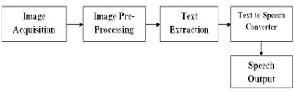
Approach for the Solution of the problem
In this process first we will use opencv to scan the photo through our algorithm we will extract the text from it.
Then we will put this text for identification of the language.
then the text will be converted into voice.
Through the same steps we will convert the voice into text.
Finally Translation of the extracted text also takes place.

Slide 4

features
It will convert speech into text and text into speech.
Translation of the extracted text.
Keyword tagging enabled(help in searching)

Slide 5



Technology stack:

Slide 6
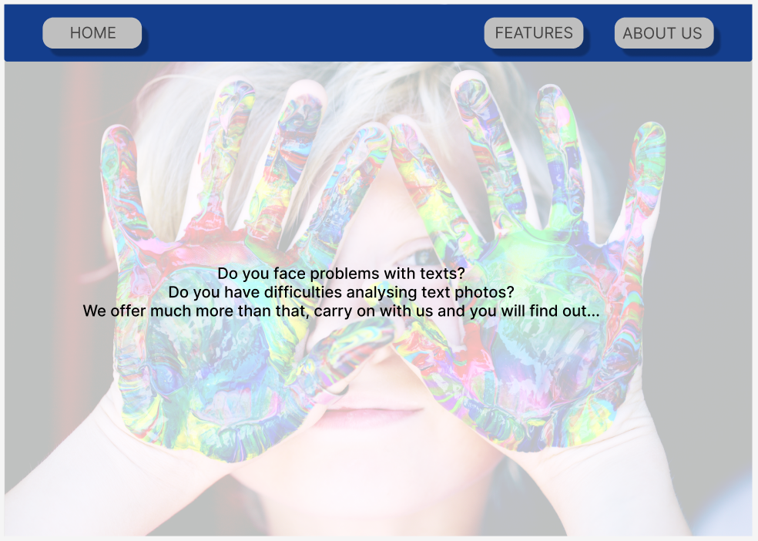
We created the rough design of website as follows-
This is the rough landing page which contains home, Features, About us.

Slide 7
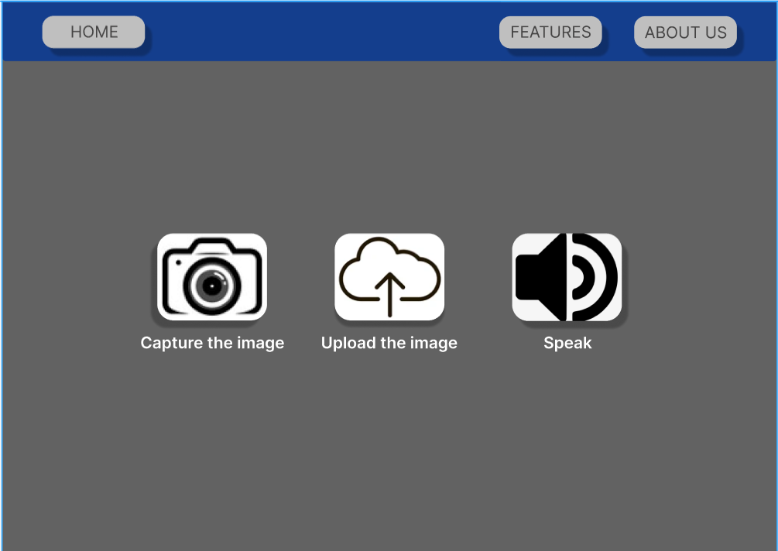
The next page given below starts showing the features of our website and the page below particularly gives options to the user to insert the image or speech.
First button directly captures the image which user is trying to examine.
Second button uploads image from the device
Third button takes the input from the user in the form of speech and converts it into text.

Slide 8
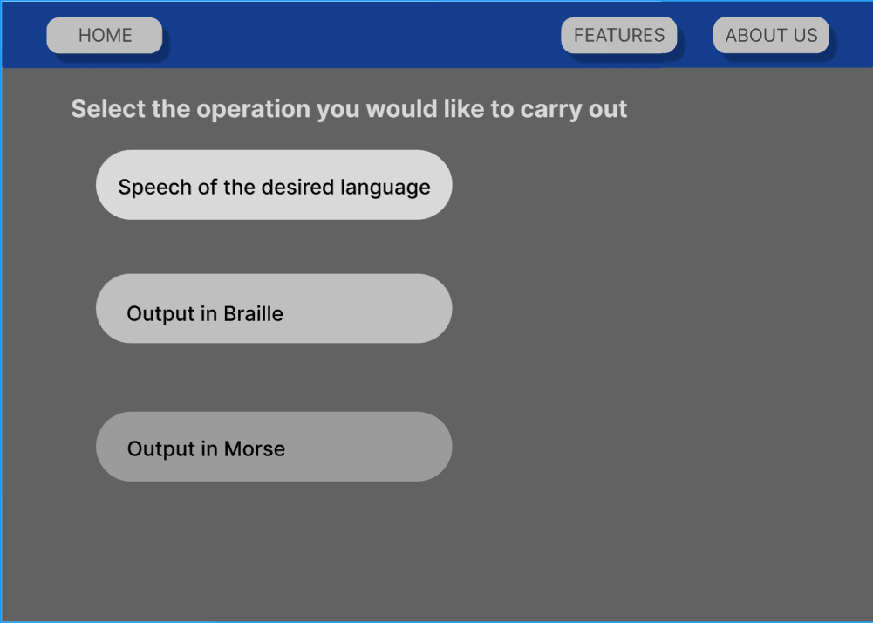
In Third page, the user gets to decide which operation should be carried out as per their will.
The page contains of 3 choices and they are –
Speech of desired language, where the input is converted into the speech output of selected language.
Output in Braille
Output in Morse

Slide 9
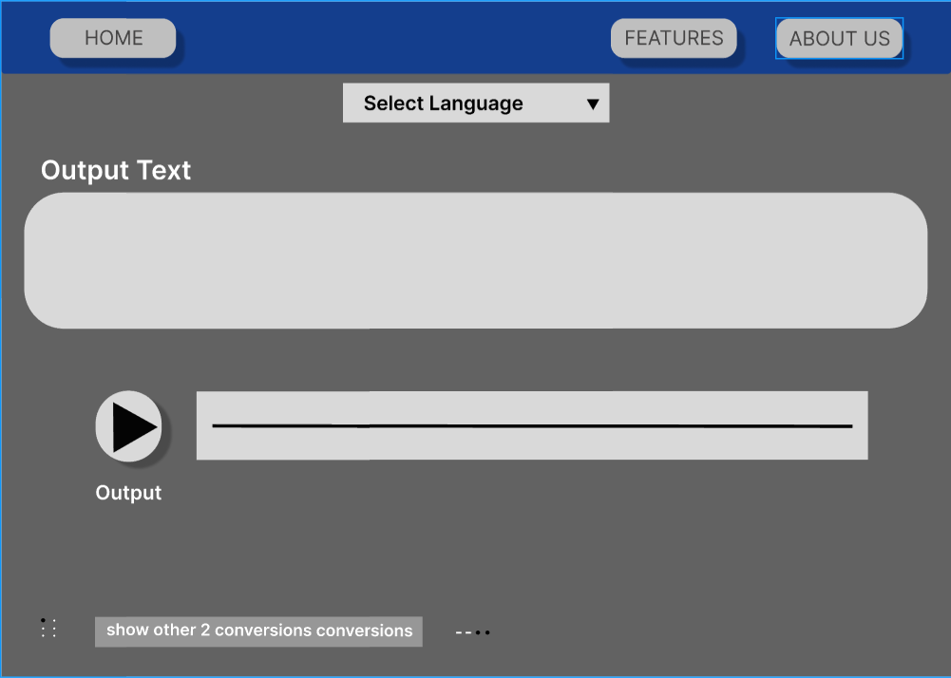
The 4th page shows the result page of “Speech of the desired language”.

Slide 10
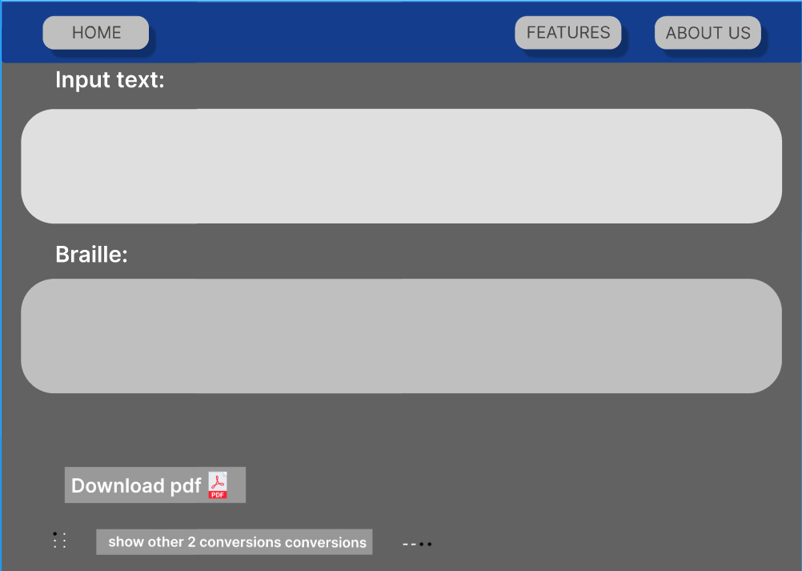
The 5th page shows the result page of “Output in Braille”.

Slide 11
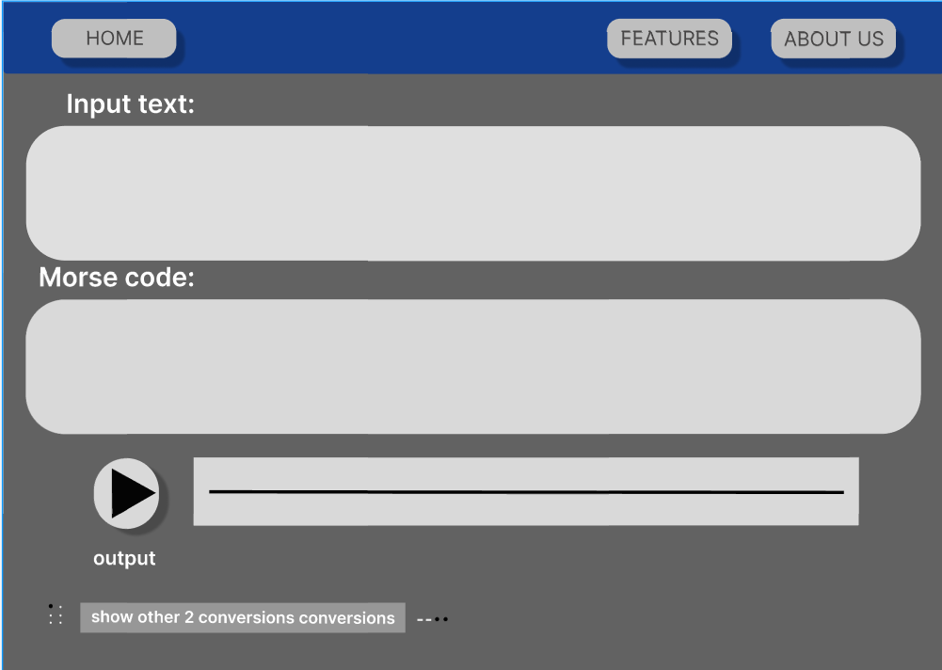
The 6th page shows “Output in Morse”.

Slide 12
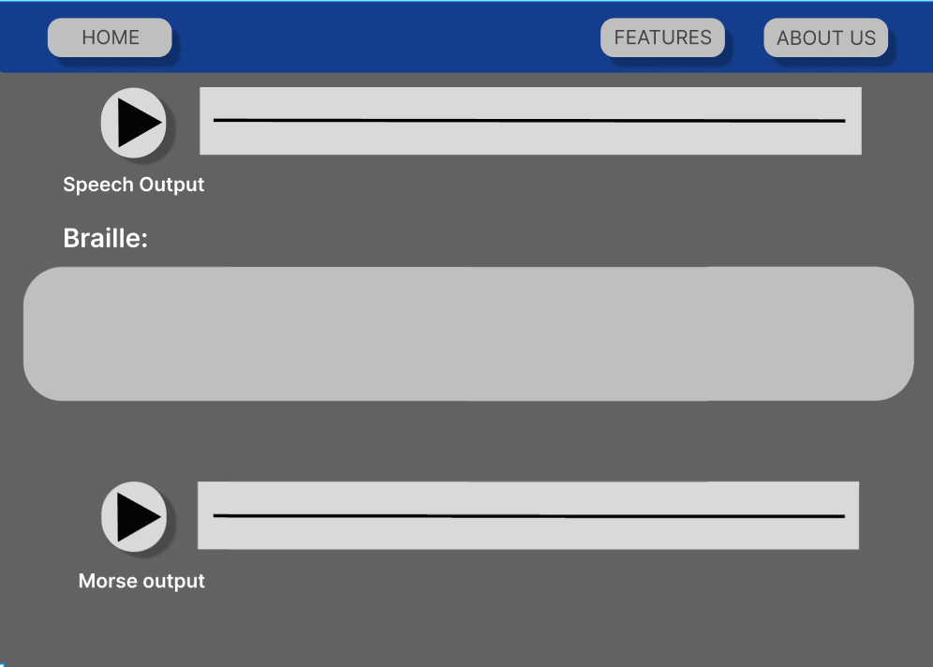
This is the output if user demands all the 3 types of conversions.

Slide 13
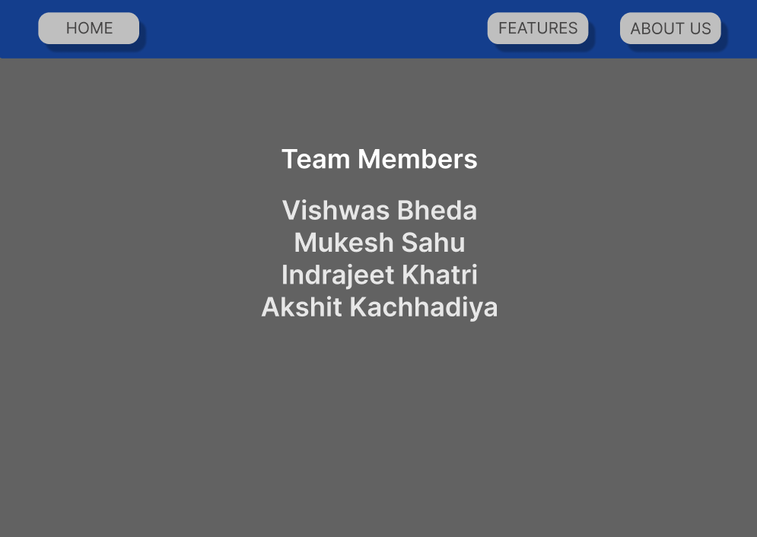
About us page.

