Slide 1
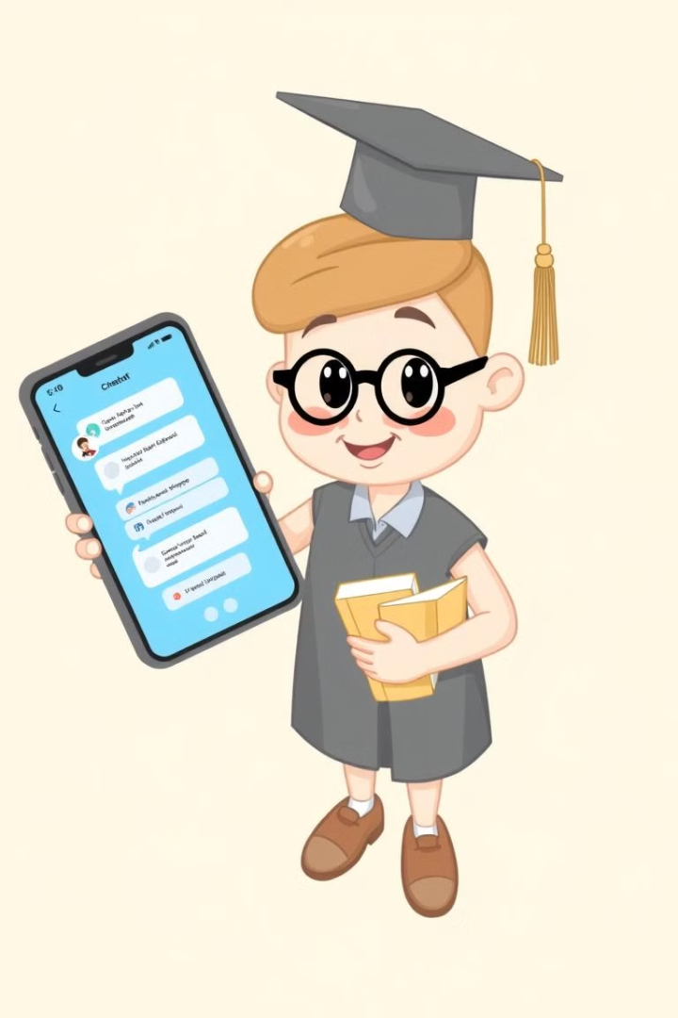
Vidyarthi Saathi: A Personalized Learning Assistant

Slide 2

Introduction: Empowering 8th Grade Students
Bridging the Gap
Vidyarthi Saathi empowers 8th grade students with personalized learning support, addressing the unique challenges of this crucial stage in education.
Subject-Specific Chatbots: These chatbots are programmed to answer students' queries based exclusively on the content of the provided textbooks.
This project integrates technology with education, aiming to provide a user-friendly, engaging, and efficient learning tool. By leveraging natural language processing (NLP) for the chatbots, the app ensures precise and context-relevant answers to students’ questions.
The app’s ultimate goal is to make learning more accessible, interactive, and convenient for 8th-grade students, bridging the gap between traditional and digital education.

Slide 3

Objectives: Enhancing Learning Outcomes
1
Increased Engagement
2
Improved Understanding
Boost student engagement and motivation by providing interactive learning experiences.
Deepen understanding of core subjects by providing accessible, tailored learning materials.
3
Personalized Assistance
Offers responses based on specific queries, catering to the individual needs of students.

Slide 4



Problem Statement: Addressing Gaps in Traditional Education
Lack of Individualized Learning
1
One-size-fits-all teaching fails to meet the diverse needs of learners.
Limited Access to Resources
2
Students may lack access to quality learning materials and support systems.
Difficulty in Conceptual Understanding
3
Complex concepts often remain unclear without proper explanation and practice.

Slide 5





Key Features: Tailored Content, Interactive Chatbot
Interactive Chatbot
Subject-Specific Content
Provides instant answers to questions, clarifies doubts, and offers personalized guidance.
Offers comprehensive e-books and video resources aligned with the 8th-grade curriculum.
Interactive Quizzes
Progress Tracking
Offers quizes to improve student's understanding while
Add a feature to track the student's progress and performance in understanding key concepts.

Slide 6
Ebook and Video Resources: Comprehensive Study Materials
History
1
Explore key historical events, learn about civilizations, and understand historical figures.
2
Geography
Discover diverse geographical features, learn about maps and globes, and study world regions.
Maths
3
Master essential math concepts, practice problem-solving techniques, and improve critical thinking.
4
English
Develop strong reading, writing, and communication skills through engaging texts and exercises.
Science
5
Uncover the wonders of science, explore scientific principles, and conduct experiments.
6
Hindi
Strengthen language proficiency, learn about grammar and vocabulary, and engage in interactive exercises.

Slide 7

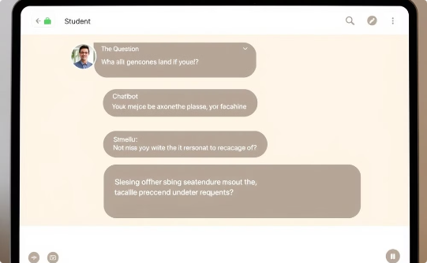

Custom AI: Leveraging In-house Developed Capabilities
Custom Training Pipeline
Natural Language Processing
User-Friendly Interface
The AI model is trained on the textbook's dataset, ensuring it aligns perfectly with the curriculum.
The chatbot uses NLP to understand student queries and provide relevant answers.
Provides an intuitive platform for enhanced student experience.

Slide 8
Conclusion: Transforming the 8th Grade Learning Experience
Progress Tracking
1
Logs student activity to show what topics they have mastered and where they need improvement.
Interactive Engagement
2
The chatbot provides an engaging and interactive learning experience, encouraging active participation and curiosity.
Enhanced Learning Outcomes
3
Vidyarthi Saathi aims to improve learning outcomes, leading to greater confidence and success in academics.

