Slide 1
UART to PC Communication
Presented by:
Nawin K Sharma

Slide 2
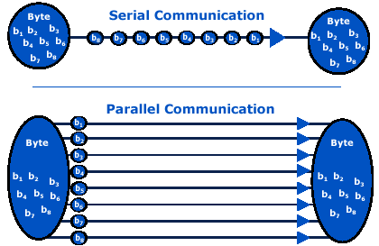
Introduction
UART stands for Universal Asynchronous Receivers/Transmitters.
UART is a simple half-duplex, asynchronous, serial communication system.
Half-duplex: Two way communication, either in speaking mode or listening mode
Universal: Its parameters (format, speed) are configurable.

Slide 3
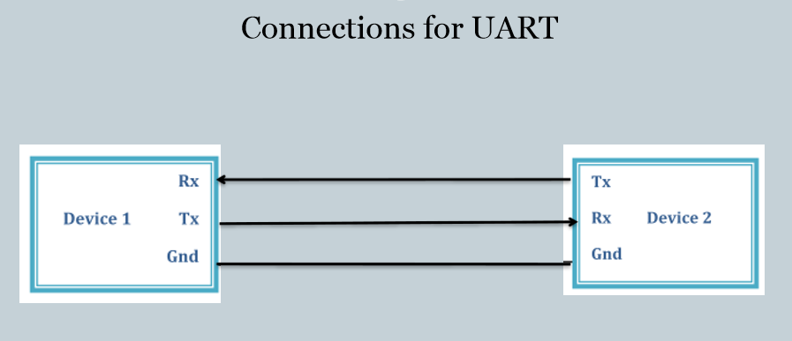
Introduction
Asynchronous: It doesn’t have a clock.
The transmitting UART converts parallel data from a controlling device like a CPU into serial form, transmits it in serial to the receiving UART, which then converts the serial data back into parallel data for the receiving device.

Slide 4
Why UART?
A UART may be used when high speed is not required.
UART communication is very cheap .
simple hardware.
This serial port allows the microcontroller to communicate with devices such as other computers, printers, input sensors, and LCDs.

Slide 5
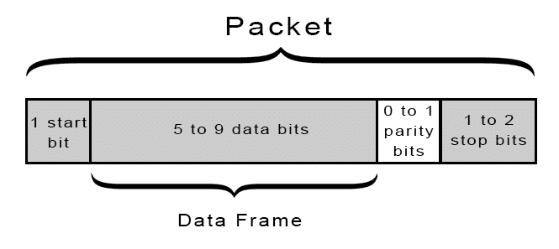
UART packet
Before transmission begins, transmitter and receiver must agree on :
Baud rate
Number of stop bits
Number of data bits
even, odd or no parity
The UART data transmission line is normally held at a high voltage level when it’s not transmitting data.
To start the transfer of data, the transmitting UART pulls the transmission line from high to low for one clock cycle.
When the receiving UART detects the high to low voltage transition, it begins reading the bits in the data frame at the frequency of the baud rate.
UART frame

Slide 6
UART in Tiva
First of all the TM4C123GH6PM has 8 UART.
In the Launchpad you can use UART0 to communicate through the USB programming port into a COM.
Baud Rate: Baud rate refers to the number of signal or symbol changes that occur per second, where every symbol can represent more than one bit.
Baud rate affects how fast you can send data.
The reciprocal of the baud rate is the symbol time, which is the time to send one symbol.
For our case, a symbol consists one bit only.
Max Baud rate: 115200

Slide 7
UART in Tiva (continued….)
UART0_DR_R : UART data register
TXFF: Transmit FIFO full flag
RXFE: Receive FIFO Empty flag
For UART0, PA1 is Tx and PA0 is Rx.

Slide 8
Links
Download Link for Putty: https://www.chiark.greenend.org.uk/~sgtatham/putty/latest.html
For more details: http://users.ece.utexas.edu/~valvano/Volume1/E-Book/C11_SerialInterface.htm

Slide 9
Exercise
Implement a UART communication system, where on typing a number from 0 to 2 on PuTTy serial communication software, LED on PD0-2 should glow respectively.
Implement a UART communication system, where on typing a color name on PuTTy serial communication software, Inbuilt RBG LED should glow the same color. If external switch to PD3 is pressed, it should disable UART communication.

