Slide 1


A Project Based Learning project
Desktop Voice Assistant
Presented by
Name | Roll No. | Seat No.
Sarang Deshpande | 2116 | S400100687
Uday Dherange | 2117 | S400100829
Akshad Ambekar | 2103 | S400100666
Sai Abhang | 2101 | S400100663
Under the guidance of Prof. A. R. Nehe
Amrutvahini College of Engineering, Sangamner

Slide 2
CONTENTS
Introduction
Need for project
Problem Statement/Aim
Objectives
Literature Review
Methodology/ Flow chart
Design of Model
Assembly and working of Model
Results of project and discussions
Conclusion
Future scope
References

Slide 3
Introduction
Project on a Python-based voice assistant involves designing and building a voice-controlled assistant that can perform basic tasks based on user commands as it is free of source. The goal of the project is to develop an assistant that can understand natural language input, process it using various Python libraries, and respond with appropriate output.

Slide 4
Need of the Project
What is the need of this project?
Why are we designing this project?
There are several reasons why there’s a need for voice assistants in today's world.
Here are a few :
Convenience: Voice assistants allow users to interact with technology hands-free, making tasks more convenient and efficient. Users can complete various tasks without having to physically interact with their devices
Personalization: Voice assistants can learn about a user's preferences and behavior patterns, allowing them to provide personalized recommendations and suggestions. This can help users save time and make their lives easier.

Slide 5
Problem Statement/Aim
We all are well aware about Siri, Google Assistant and many other virtual assistants which are designed to aid the tasks of users in Windows, Android, and iOS platforms. But to our aim is to know how these things actually work.
It looks very fascinating how these applications work and we aspire to tell everyone how we can develop these by using some coding knowledge.

Slide 6
Objectives
The objectives of our project are as follows:
It keeps listening continuously for hot-word and wakes up into action when called with its name.
Browsing through the web based on the individual’s spoken parameters and then issuing a desired output through input, and at the same time, it will print the output on the screen. Other useful services such as playing news, browsing weather forecasts, play music, setting alarms, calculations, etc. are provided as a result of spoken commands.

Slide 7
Literature Review
Sr. No | Authors | Name of Topic | Major Findings
1 | Sowmya Vajjala. & Anuj Gupta. | Practical natural Language Processing | A Comprehensive Guide to build Real-World NLP Systems
2 | Jalaj Thanali. | Python Natural Language Processing | Encompasses various techniques and tools for processing and analyzing natural language using Python.
3 | Sebastian Raschka. & Vahid Mirjalili. | Python Machine Learning | Working of AI specifically for voice assistant.

Slide 8
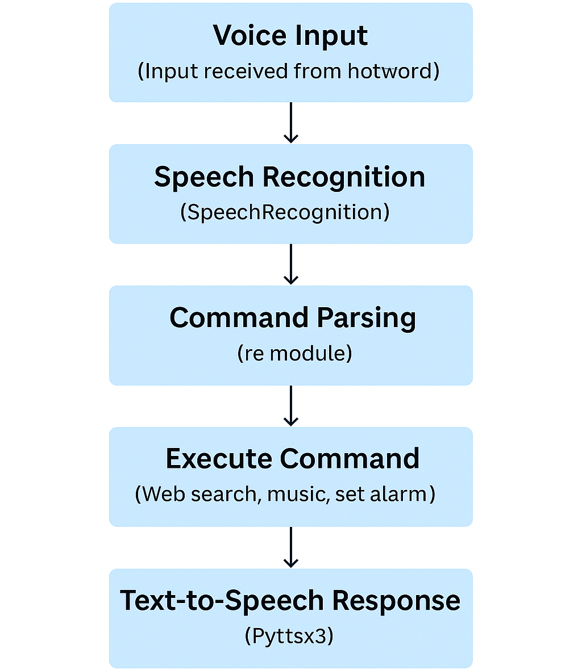
Methodology

Slide 9

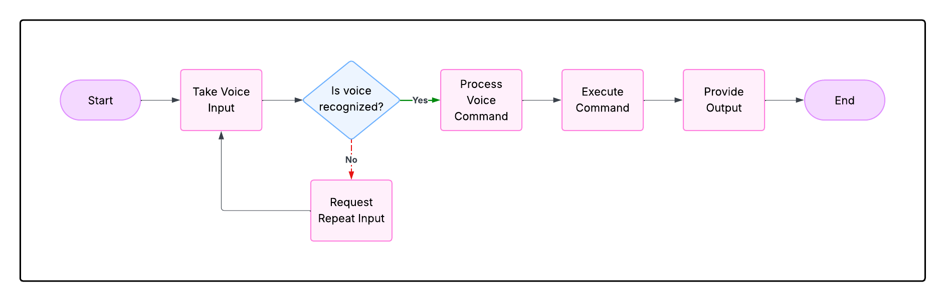
Design of Model

Slide 10

Assembly and working of Model
The model needs following software and hardware requirements:
Software requirements are:
Python version should be 3.5 or above
OS version should support Python
Hardware requirement are:
Processor : Intel, AMD
RAM : 2GB
OS: Windows, MacOS
Microphone (voice input)
Source code link :- https://github.com/AkshadAmbekar/voice-assistant-pbl

Slide 11
Results and discussions
The project work of voice assistant has been clearly explained in the report , how useful it is and how we can reply on voice assistant for basic task that user want to perform. Development of the software is almost completed from our side and it is also working as we excepted. So , many modification can be done on it now.

Slide 12
Conclusion
It uses Natural Language Processing to process the language spoken by the human and understand the query and process the query and respond to the human with the result.
It perform basic tasks such as battery percentage, music, current weather, news, send email, time and etc. and ultimately helping physically challenged people.

Slide 13
Future scopes
Sending emails with voice assistant.
Scheduling appointments using voice assistant.
Improve user interface of voice assistant (UI).
Speed and Efficiency.
Intuitiveness and convenience.

Slide 14
References
Internet sources:
YouTube - Code With Harry
Wikipedia
IEEE Research Paper - https://ieeexplore.ieee.org/document/9210344
Books:
Python Machine Learning by Sowmya Vajjala & Anuj Gupta.
Practical natural Language Processing by Sebastian Raschka & Vahid Mirjalili.

