Slide 1





Pareto-Based Multi-Objective Optimization Framework for Public Transport Scheduling
Presented By
1 | Shubhangi Nimbalkar | 29 | 22320155
2 | Akshada Mane | 60 | 22210114
3 | Sakshi Hedke | 72 | 22210064
4 | Isha Haval | 99 | 22211634

Slide 2




Problem Statement
Managing public transport well is very important for smart cities. The main challenge is to balance cost and passenger waiting time — making one better can make the other worse.
This project uses a Pareto-based optimization method to find the best balance between saving money and giving good service, making bus schedules both affordable and efficient.

Slide 3

Application Domain
In city bus systems, it’s hard to keep both low costs and good service at the same time. Adding more buses makes passengers happy but costs more money, while fewer buses save money but increase waiting time.
Because these goals conflict, a Pareto-based optimization method is used to find the best balance between cost and service quality.

Slide 4
Why This Framework Was Chosen
Traditional methods focus on either low cost or short waiting time, but not both together. The Pareto-based approach handles both goals at the same time, giving several balanced solutions instead of just one. City planners can then choose the best schedule based on demand — cheaper during off-peak hours or frequent during rush hours. This makes transport planning more flexible, efficient, and cost-effective, improving service without wasting resources.

Slide 5
Algorithm
1. Initialization: Generate a random population of possible bus schedules. Each schedule contains the number of buses assigned to different routes.
2. Evaluation: For each schedule, calculate:
a. Operational cost = (number of buses × route length × cost per km)
b. Average waiting time = inversely proportional to the number of buses (more
buses → less waiting time)
3. Non-Dominated Sorting: Classify the population into different fronts (Pareto levels).
The first front represents the best trade-off solutions.

Slide 6
4. Crowding Distance Calculation: Maintain diversity among solutions by preferring those
that are far apart in objective space.
5. Selection, Crossover, and Mutation: Select parents based on rank and crowding distance.
Apply Simulated Binary Crossover (SBX) and Polynomial Mutation to create new offspring.
6. Replacement: Combine old and new populations and select the top individuals for the next generation.
7. Termination: Repeat for a fixed number of generations until convergence is achieved.
Finally, display the Pareto front and choose the most suitable solution.

Slide 7
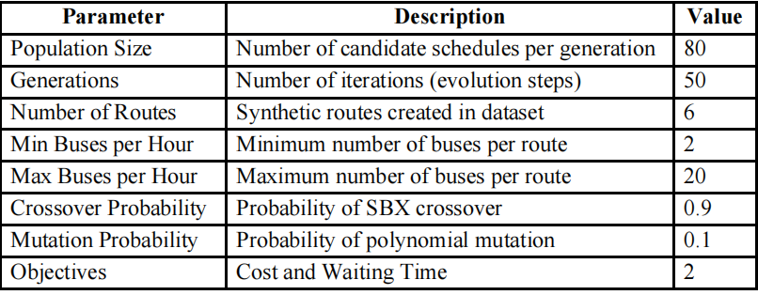

Experimental Setup

Slide 8
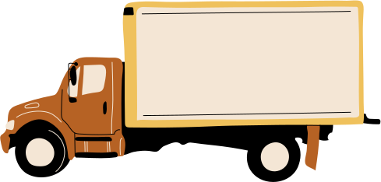
Results and Observation
•Best Recommended Solution:
• Average Bus Frequency: ~10 minutes
• Operational Cost: ≈ ₹25,000
• Service Quality Score: 9.5 / 10
• Passenger Satisfaction: 95%
• Efficiency Score: 3.8 (Quality per ₹1,000 spent)
• NSGA-II effectively balanced both objectives.
• The Pareto front helped visualize the trade-off between service improvement and cost
control.

Slide 9
Conclusion
This project shows how Pareto-based multi-objective optimization (using NSGA-II) helps plan better public transport schedules. It finds the best balance between low cost and good service quality, giving many smart options instead of one fixed plan. With Streamlit and Plotly, the system becomes interactive and easy to use. Overall, this method offers a practical and flexible solution that can also be applied to traffic,logistics, energy, and other smart city systems.

Slide 10
Thank you !

