Slide 1
YTL HACKATHON 2026 / ENTERPRISE TRACK A
PROJECT
UDYAM DIGITAL
THE PROMISE
01
Discover
Making small businesses go digital
in one sitting.
02
Quote
03
Verify
04
Activate
ACCEL BUSINESS · PRODUCT + ENGINEERING + UNIT ECONOMICS
Prototype and business case | 15 July 2026 reference date

Slide 2
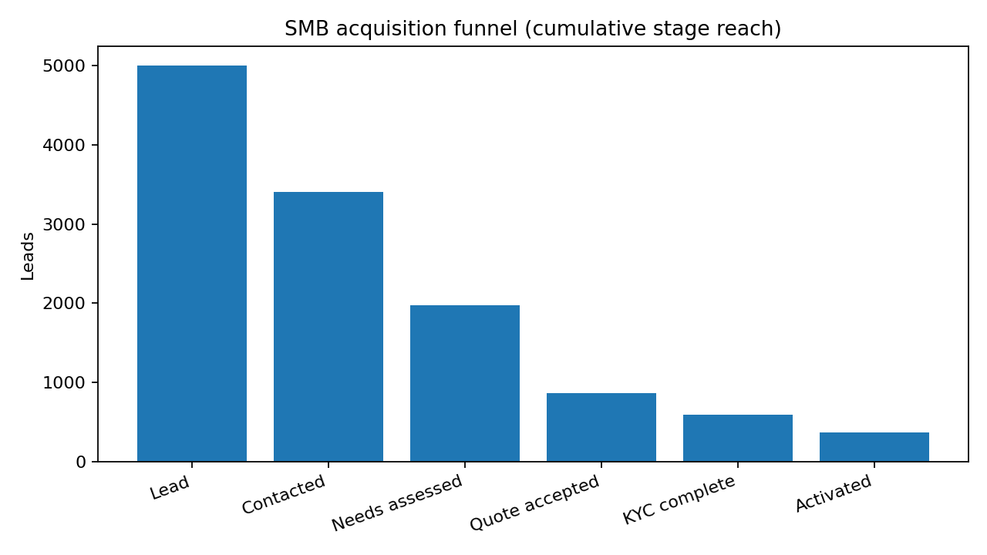
01 · THE PROBLEM
The leak is in the journey — not just the product
5,000 synthetic leads, Apr–Jun 2026. Only 368 reached activation (7.36%).
LEADS
ACTIVATED
AVG. ACTIVATION
CAC / ACTIVATION
5,000
368
17.6 days
₹15,053
100%
7.36% of leads
Lead to go-live
₹55.40L total cost / 368
•
805 unreachable after 3 attempts; 531 owners had no time for a visit.
•
1,113 assessed leads did not accept a quote — largest mid-funnel leak.
•
Quote clarity, self-serve discovery, KYC pre-check and install visibility address distinct failure modes.
PROJECT UDYAM DIGITAL · YTL HACKATHON 2026 · SYNTHETIC DATA
02

Slide 3
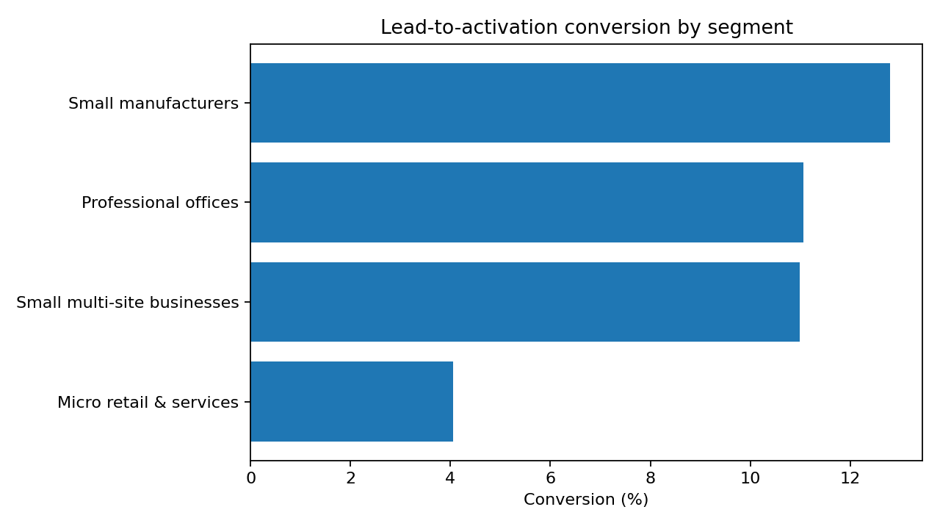
02 · WHERE TO PLAY
Lead with professional offices; serve micro through low-touch channels
CAC uses total acquisition cost across all leads in the segment divided by activated customers.
SEGMENT | ACTIVATION | CAC / WIN | MEDIAN MRR | 6M CHURN | NPS
Micro retail | 4.1% | ₹20,007 | ₹2,470 | 22.7% | 7.0
Professional offices | 11.1% | ₹10,695 | ₹6,575 | 13.8% | 6.9
Small manufacturers | 12.8% | ₹15,324 | ₹15,910 | 8.1% | 6.5
Small multi-site | 11.0% | ₹15,614 | ₹28,080 | 10.8% | 6.7
•
Professional offices: 11.1% conversion, ₹10.7k CAC, ₹6.6k median monthly billings. Best initial digital wedge.
•
Micro: 4.1% conversion, ₹20.0k CAC, ₹2.47k monthly billings and 22.7% 6m churn. WhatsApp/partner-assisted, entry-priced.
•
Multi-site + manufacturing: high monthly value, but assisted survey / SLA sales and install orchestration required.
PROJECT UDYAM DIGITAL · YTL HACKATHON 2026 · SYNTHETIC DATA
03

Slide 4
03 · WHAT TO SELL
Four catalogue-backed bundles — simple entry, expandable value
Illustrative monthly prices use catalogue midpoints, indicative quantities and 5% discount for 3+ distinct products; GST extra.
MICRO START
OFFICE PRO
Biz Fibre 100 + Business Postpaid 299
Fibre 300 + 2 business lines + 8 email seats + endpoint security
₹1,448
12 mo
Self-serve / WhatsApp
₹3.9k
12 mo
Digital; human exception
MULTI-SITE CONTROL
MANUFACTURING SLA
Fibre 300 × sites + failover + secure Wi-Fi + cloud email
Leased Line 20 + 20 mobile lines + 20 email + endpoint + firewall
₹20.8k*
12–24 mo
Partner + field seller
₹30.1k*
24 mo
Named seller + site survey
*Multi-site example assumes 5 sites / 10 employees; manufacturing example assumes 1 site / 20 employees. All prices before GST; actual quote is quantity- and eligibility-aware.
PROJECT UDYAM DIGITAL · YTL HACKATHON 2026 · SYNTHETIC DATA
04

Slide 5
04 · PRODUCT & ENGINEERING
LLM explains. Rules decide. KYC evidence gates activation.
A hard boundary between conversational AI and deterministic commercial / compliance decisions.
01
02
03
04
05
06
OWNER UI
→
ADVISOR
→
RULES ENGINE
→
QUOTE
→
SMART KYC
→
ORDER TRACKER
Mobile-first · Hindi / English
6-question discovery
LLM-ready dialogue
Catalogue eligibility
Dependencies + install days
Midpoint price bands
Contract + GST + add-ons
Consent → OCR → registry
Name / date / signatory checks
Critical-path ETA
Per-product status + alerts
MOCK REGISTRIES + OCR
BACK OFFICE
GSTIN / Udyam CSV lookups · Tesseract OCR · checksum · 90-day address rule · manual review queue
Logistic propensity score · reason codes · partner attribution · assisted follow-up
Safety boundary: no raw PII in prompts. LLM is not allowed to alter eligibility, pricing, KYC decisions or installation promises.
PROJECT UDYAM DIGITAL · YTL HACKATHON 2026 · SYNTHETIC DATA
05

Slide 6
05 · CONVERSION MODEL
A 12% activation target is built from explicit stage improvements
Scenario for 5,000 leads; each conversion is conditional on the immediately previous stage.
STAGE | BASELINE | PILOT TARGET | TARGET LEADS
Lead → contacted | 68.1% | 75.0% | 3,750
Contacted → assessed | 58.0% | 60.0% | 2,250
Assessed → quote accepted | 43.6% | 50.0% | 1,125
Quote → KYC complete | 68.3% | 75.0% | 844
KYC → activated | 62.6% | 71.1% | 600
TARGET ACTIVATIONS
600
12.0% of 5,000 leads
CAC AT FLAT SPEND
₹9,233
₹55.40L / 600 activations
Leak closure levers: self-serve + verified contact links improve reach; asynchronous needs discovery removes visit friction; instant plain-language quotes improve acceptance; OCR / registry pre-checks reduce KYC rework; install-day-aware routing protects final activation.
PROJECT UDYAM DIGITAL · YTL HACKATHON 2026 · SYNTHETIC DATA
06

Slide 7
06 · GO-TO-MARKET
Digital should make partners more productive — not disintermediate them
Observed source economics: referral and inbound are the most efficient acquisition channels in this sample.
SOURCE | CONVERSION | CAC / WIN | ACTION
Referral | 14.8% | ₹4,099 | Scale
Inbound call | 9.5% | ₹5,113 | Scale
Channel partner | 8.0% | ₹20,851 | Optimise attribution & targeting
Field sales | 7.3% | ₹24,335 | Optimise attribution & targeting
Website form | 4.3% | ₹6,352 | Optimise attribution & targeting
WhatsApp campaign | 2.8% | ₹4,026 | Fix / controlled test
•
Referral + inbound: scale; use referral IDs and a fast callback SLA.
•
Partner + field: shared lead ID, attribution lock and commission protection; redeploy field sellers to multi-site / manufacturing and installation.
•
Website: improve qualification and quote UX. WhatsApp: controlled test; 2.8% observed conversion is low despite low CAC.
ROLLOUT
Pilot: Tier 1–2 cities · professional offices + micro. Then expand multi-site and manufacturing with assisted delivery.
PROJECT UDYAM DIGITAL · YTL HACKATHON 2026 · SYNTHETIC DATA
07

Slide 8
07 · TRUST & DELIVERY RISK
Fast onboarding only works when trust and operations are designed in
Production launch requires telecom/KYC legal review and real provider contracts; this prototype uses mock services.
GST / KYC fraud
Registry + checksum + OCR cross-check; ambiguous OCR → manual review; cancelled/suspended GSTIN blocked.
LLM hallucination
LLM explains only; server-side rules own eligibility, price, dependency and ETA.
DPDP / data misuse
Purpose notice + explicit consent before upload; minimise, mask, encrypt, retain 180 days then delete subject to legal holds.
Partner conflict
Shared lead ID, source attribution, commission protection and transparent ownership.
Install SLA failure
Catalogue install-day critical path, per-product status, exception alerts and honest ETA.
Privacy contact in prototype is a fictional placeholder. Production needs named grievance owner, access controls, breach response and processor / cross-border assessment.
PROJECT UDYAM DIGITAL · YTL HACKATHON 2026 · SYNTHETIC DATA
08

Slide 9
08 · SCORECARD
Pilot targets — measured as outcomes, not demo claims
Targets are hypotheses for a controlled pilot, anchored to observed funnel arithmetic and current synthetic baseline.
METRIC | BASELINE | PILOT TARGET | WHY IT IS PLAUSIBLE
Lead → activation | 7.36% | 12.0% | 5,000 × 75% × 60% × 50% × 75% × 71.1% ≈ 600
Lead → activation time | 17.6 days avg | ≤12 days avg | Instant quote + progressive KYC + install critical-path visibility
CAC / activation | ₹15,053 | ≤₹9,233 | Flat ₹55.40L acquisition spend / 600 activations
Status-chase calls | 3.0 avg | ≤1.0 | Owner-visible tracker + proactive milestone notifications
6-month churn | 15.2% | ≤12.0% | Right-fit bundles + early service-risk outreach; pilot hypothesis
Decision ask: approve a 6–8 week pilot in 2 cities, start with professional offices + micro, randomise eligible leads into digital vs current journey, and review activation, CAC, time-to-go-live, calls and churn weekly.
PROJECT UDYAM DIGITAL · YTL HACKATHON 2026 · SYNTHETIC DATA
09

