Slide 1


Ballari Institute Of Technology And Management
Department of Computer Science And Engineering, KA
CareerNet
-A Secure Job Board
By: M Akshai Kumar
Project Guide: Dr. T R Muhibur Rahman
7th Sem-CSE
Final Project Demo (04-01-2025)

Slide 2
Contents
Abstract
Vision & Mission
Objectives
Introduction
Scope of the project
Problem Statement
Literature Survey
Software Requirement Specification
Software & Hardware requirements
Conclusion
References

Slide 3
Abstract
This project aims to develop a SaaS-based job portal that provides job seekers with a secure, reliable platform for finding genuine employment opportunities. By integrating advanced verification processes, real-time data security measures, and a user-friendly interface, this platform ensures job seekers can confidently apply for jobs. The SaaS model allows for seamless scalability and accessibility, providing users with a convenient and consistent experience across devices.

Slide 4
Vision
To create a secure and reliable online platform that empowers job seekers to find genuine employment opportunities, while protecting them from job scams.
Mission
To provide a trusted and user-friendly job portal that:
Verifies job postings and companies.
Ensures secure communication channels.
Protects user data and privacy.
Offers a seamless job search experience.

Slide 5
Objectives
Develop a platform with strong security protocols and a user-friendly design.
Validate job listings and company profiles to maintain credibility.
Continuously improve the platform in line with evolving industry trends.
Implement a seamless application process for both job seekers and recruiters.

Slide 6
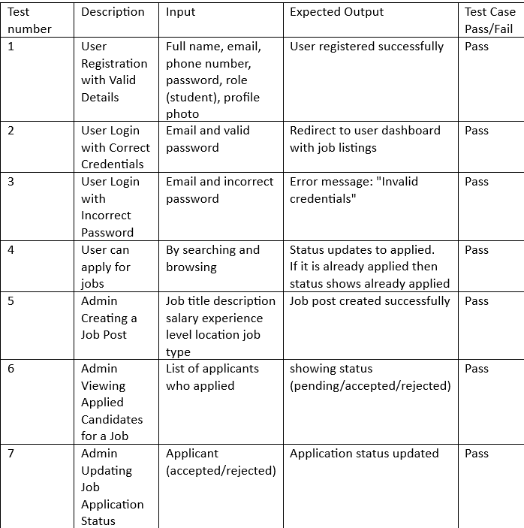
Test Cases

Slide 7
Introduction
The rise of online job platforms has also led to an increase in job scams, making it harder for people to find genuine jobs. Fake job postings, phishing emails, and scam websites often result in financial losses and identity theft, leaving job seekers frustrated and vulnerable. This project aims to build a secure and trustworthy job portal that protects users from these scams. The platform will verify job postings and companies, ensure user data is safe, and provide a simple, user-friendly interface. By doing so, it will help job seekers find legitimate opportunities and create a safer online job search experience.

Slide 8
Scope of the Project
The scope of this project includes the development of a cloud-based SaaS job portal that offers:
Platform Development: A scalable SaaS web application accessible on any device.
Database Design: A cloud-based, secure database to manage job postings, user profiles, and applications.
Security Measures: Robust security protocols like encryption, access control, and data privacy specific to SaaS platforms.
User Experience: A seamless experience with regular updates and continuous availability through the SaaS model.

Slide 9
Problem Statement
The increasing prevalence of job scams has made it difficult for job seekers to find legitimate employment opportunities. Fraudulent job postings, fake emails, and malicious websites pose significant risks to job seekers, leading to financial loss, identity theft.

Slide 10
Literature Survey
Sharma et al. [1] "discuss the challenges and best practices in implementing role-based access control (RBAC) systems within job portals, ensuring restricted access and data security for sensitive user information. The study emphasizes the need for server-side validation and robust API structures.“
Maharaj et al. [2] "analyze different frameworks and technologies used to build scalable and user-friendly web applications, with a focus on integrating real-time data processing and dynamic user interactions. Their work provides a comparative study of popular technology stacks for modern web development.“
Khan et al. [3] "investigate the design principles for creating user-centric web platforms, highlighting the importance of intuitive user interfaces, responsiveness, and scalability in job portals. Their research outlines how modern JavaScript frameworks, such as React.js, can significantly enhance the user experience."

Slide 11
Patel et al. [4] "examine the role of cloud-based infrastructure in supporting job portals, focusing on scalability, data storage solutions, and ensuring high availability. The study highlights the advantages of leveraging cloud platforms like AWS and Azure for hosting large-scale applications and handling traffic spikes.“
Singh et al. [5] "analyze the impact of artificial intelligence (AI) in improving job matching and recommendation systems within job portals. Their research delves into AI algorithms that can predict user preferences and optimize job suggestions, increasing user engagement and application success rates.“
Rao et al. [6] "explore the integration of automated chatbots in job portals for enhancing user support and improving the overall user experience. Their study covers chatbot frameworks, natural language processing (NLP), and how these systems streamline job application processes and user queries.“
Verma et al. [7] "discuss the importance of data privacy and compliance in job portals, with a focus on GDPR and other regulations. The paper emphasizes best practices for securing sensitive user data and preventing data breaches through encryption, secure coding practices, and access control mechanisms."

Slide 12
Gupta et al. [8] "investigate the use of microservices architecture in building scalable and maintainable job portals. Their research highlights the benefits of modularity, independent service deployments, and efficient API management in improving system performance and reducing downtime.“
Chawla et al. [9] "present a comparative study of various authentication and authorization mechanisms in job portals, including multi-factor authentication (MFA), OAuth, and JWT tokens. Their findings suggest that integrating strong authentication methods enhances security and reduces the risk of unauthorized access.“
Bose et al. [10] "review the use of progressive web apps (PWAs) in enhancing the performance and offline capabilities of job portals. They highlight how PWAs provide a native app-like experience while maintaining the flexibility and scalability of web applications, improving user retention and engagement."

Slide 13
Functional Requirements
Role 1: User
System helps users to sign up, log in, and update their profiles or bio after login.
System helps users to browse, search, and apply for jobs.
System helps users to check the status of their applications (accepted or rejected).
System helps users to interact with customized chat-bot.
Role 2: Admin
System helps admins to create companies and post jobs.
System helps admin to view job applicants and update their application status.
Non-Functional Requirements
Performance: Pages should load quickly and handle multiple users effectively.
Security: Protect user data with encryption and ensure role-based access control.
Usability: Provide an intuitive interface for smooth navigation.
Scalability: Ensure the system can handle growing users and data.
Compatibility: Support multiple devices and browsers.

Slide 14
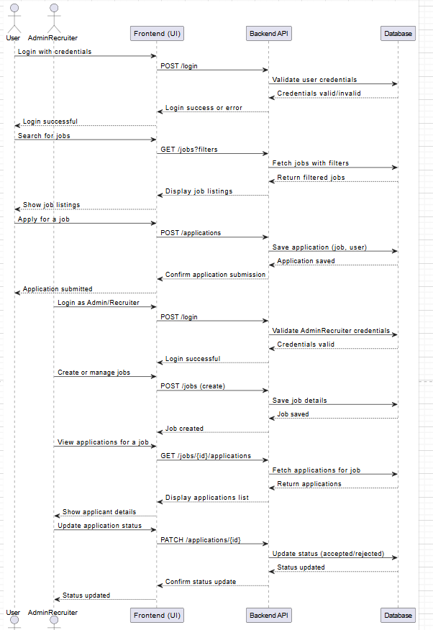
UML Diagrams – Sequence diagram

Slide 15
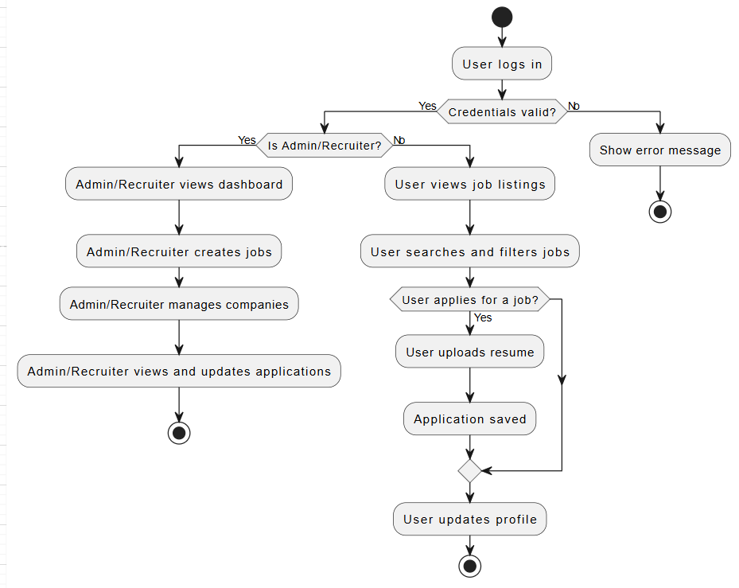
Flowchart Diagram

Slide 16
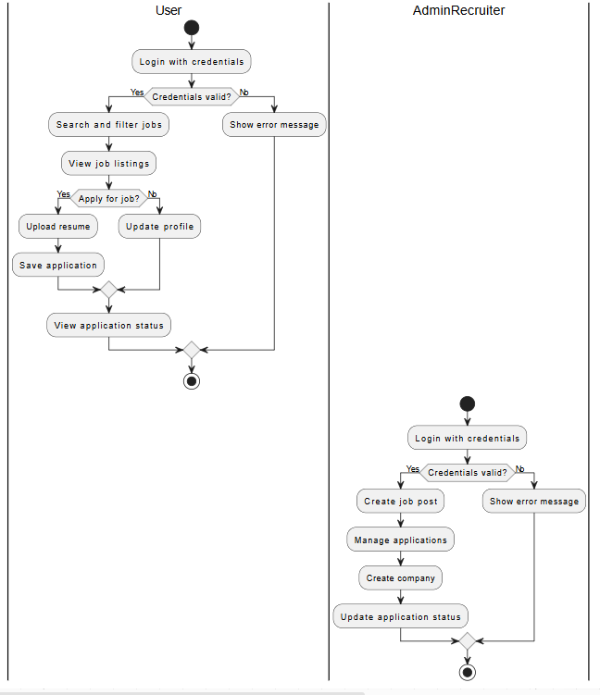
Activity Diagram

Slide 17
Software Requirements/ Frameworks:
Programming Languages: MongoDB, ExpressJs, ReactJs, NodeJs, Cloudinary.
Development Tools: VSCode code editor, npm for package management.
Hardware Requirements:
CPU: Multi-core processors RAM: At 4 GB or more for better performance.
Network: High-speed internet connection with low latency.

Slide 18
Conclusion
The SaaS-based job portal offers a flexible, scalable solution that empowers job seekers and recruiters by ensuring security and accessibility. By leveraging cloud technology, the platform will continuously improve and provide users with up-to-date job opportunities, secure application processes, and a seamless experience.

Slide 19
References
[1] Sharma. P & Gupta. R, (2021) "Implementing Role-Based Access in Modern Job Portals," Journal of Web Application Security, 2021, 15(3), 321-335.
[2] Shiva Maharaj, Nick Polson, and Alex Turk, (2020) "Scalable Web Development: Competing Frameworks and Paradigms" Entropy 2022, 24(550).
[3] Khan. A & Ahmed. Z., (2019) "Design Principles for User-Centric Web Platforms," International Journal of Web Development, 2020, 12(5), 456-472.
[4] Patel, D., & Sharma, H. (2020). "The role of cloud-based infrastructure in supporting job portals: Scalability, data storage, and availability." Cloud Computing for Business Applications, 8(1), 50-64.
[5] Singh, A., & Mehta, S. (2021). "Impact of artificial intelligence on job matching and recommendation systems in job portals." Journal of Artificial Intelligence Research, 14(5), 201-214.
[6] Rao, P., & Gupta, N. (2020). "Integration of automated chatbots for user support in job portals." Journal of Human-Computer Interaction, 17(2), 115-130.

Slide 20
[7] Verma, R., & Kumar, V. (2021). "Data privacy and compliance in job portals: Securing user information with GDPR and best practices." Information Security and Data Protection Journal, 9(3), 210-225.
[8] Gupta, R., & Yadav, S. (2020). "Microservices architecture for scalable and maintainable job portals." Journal of Distributed Systems, 11(4), 45-58.
[9] Chawla, S., & Agarwal, R. (2021). "Authentication and authorization mechanisms in job portals: A comparative study of MFA, OAuth, and JWT." Cybersecurity and Identity Management Journal, 13(2), 105-118.
[10] Bose, D., & Sharma, A. (2020). "Progressive web apps in job portals: Enhancing performance and offline capabilities." Mobile and Web Application Technologies Journal, 15(3), 128-140.

Slide 21
THANK YOU

