Slide 1
Secure Data Hiding In Images Using Steganography
CAPSTONE PROJECT
Presented By: M Akshai Kumar
Student Name : M Akshai Kumar
College Name & Department : Ballari Institute Of Technology And Management & CSE

Slide 2
OUTLINE
Problem Statement
Technology used
Wow factor
End users
Result
Conclusion
Git-hub Link
Future scope

Slide 3
Problem Statement
The increasing reliance on digital communication has created a growing need for methods that not only secure information but also ensure its transmission remains undetected. Traditional encryption, while securing the content, often signals the presence of a secret communication, making it a target for scrutiny. This project seeks to address this challenge by developing a steganography-based solution. By utilizing Least Significant Bit (LSB) encoding, this project aims to create a tool capable of embedding secret messages within images, enabling users to communicate discreetly without raising suspicion.

Slide 4
Technology used
Python 3.x – Main programming language
OpenCV – Image processing and manipulation
Bitwise Operations – LSB encoding and extraction
File Handling – Read/write encrypted images
Terminal Input/Output – Interactive user experience

Slide 5
Wow factors
Secure Message Concealment – Uses LSB encoding to hide messages inside images without visually altering them.
Passcode Protection – Only authorized users can retrieve the hidden message.
Lightweight Execution – No NumPy dependency, making it compact and efficient.
Cross-Platform Compatibility – Works on Windows, Linux, and macOS.
No Size Restriction – Large messages can be hidden in high-resolution images.

Slide 6
End users
Journalists & Whistleblowers – To securely communicate sensitive information.
Cybersecurity Enthusiasts – To learn and implement steganographic techniques.
Researchers & Developers – For secure data transmission and cryptographic research.
Everyday Users – To send private messages without detection.

Slide 7
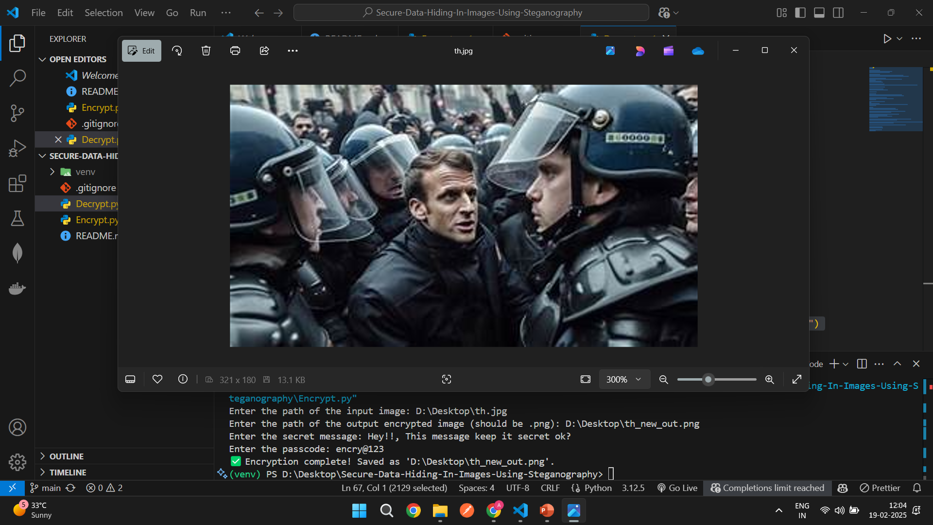
Results

Slide 8
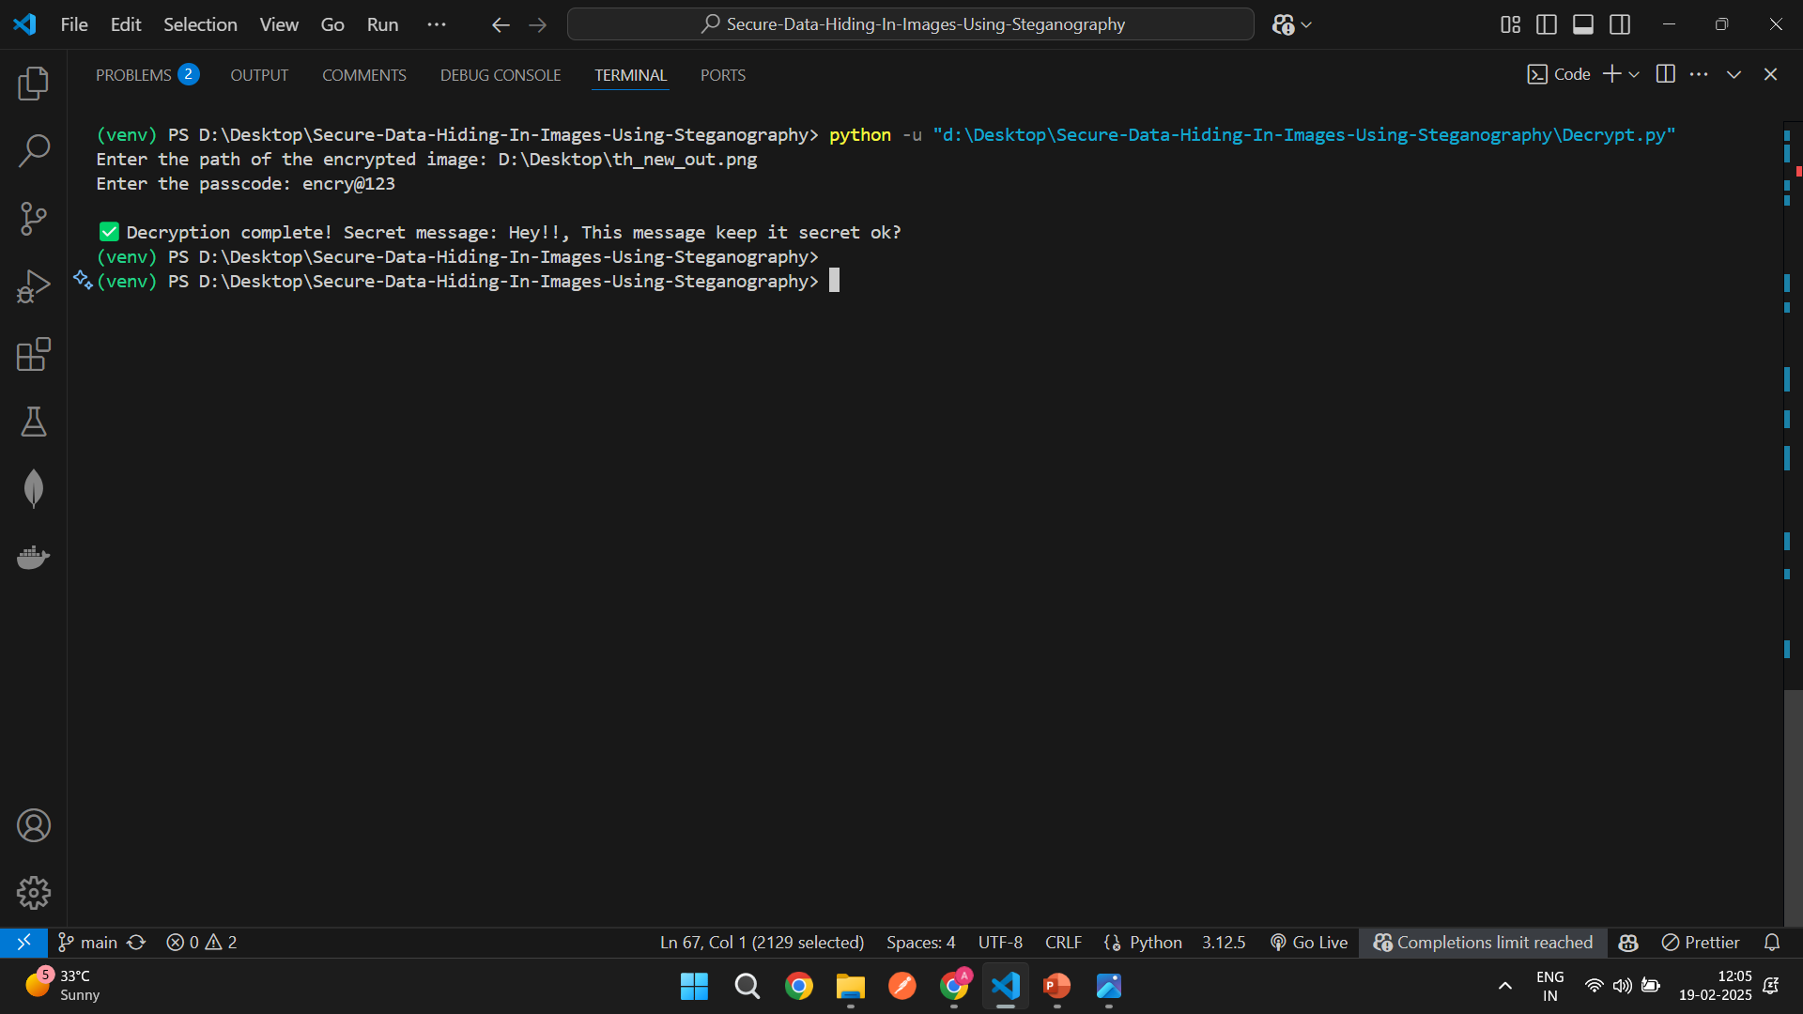

Slide 9
Conclusion
SteganoCrypt provides a simple yet powerful way to conceal sensitive messages within images using LSB steganography. This method enhances data security and privacy, ensuring that secret communications remain undetected.

Slide 10
GitHub Link
https://github.com/Akshai-M/Secure-Data-Hiding-In-Images-Using-Steganography

Slide 11
Future scope
Support for Audio & Video Steganography – Extending the project to embed data in audio/video files. 🔹 GUI-Based Implementation – Creating a user-friendly interface for non-technical users. 🔹 AI-based Image Optimization – Ensuring that encrypted images remain indistinguishable even under analysis. 🔹 Multi-layered Security – Implementing AES encryption alongside steganography for added security. 🔹 Mobile App Version – Developing an Android/iOS application for on-the-go usage.

Slide 12
THANK YOU

