Slide 1
Semiconductor Industry Supply Chain Dynamics: A Simplified Overview
Team Members :
Akshaj Khirwadkar
Sandeep Modugu
Raghavendra Pariti
Nina Chen

Slide 2
Problem Statement
The semiconductor supply chain faces complexity and variability, requiring efficient coordination and quality control. To enhance supply chain efficiency, product quality, and customer satisfaction in the semiconductor industry, we aim to create a database which would enable us to -
1. Foundry Performance and Efficiency Analysis
2. Financial Performance Analysis
3. Performance-to-Cost Ratio
4. Quality Control and Monitoring
Notes:
Raghav’s Slide

Slide 3
Semiconductor Manufacturing Process Overview
Notes:
Raghav’s Slide

Slide 4
Assumptions
Notes:
Akshaj’s Slide
Chip Design Simplification: The model reflects chip design with 5 key attributes, omitting complex factors like heat dissipation and size constraints.
Foundry Costs Omission: Excludes fixed costs such as machinery, location rent, and employee wages associated with running a foundry.
Limited Testing Parameters: Only 4 types of testing are modeled, not covering the extensive range of tests performed in industry standards.
Exclusion of Chip Storage: Warehousing and inventory management for chip storage are not currently represented in the model.
Logistics Simplification: Delivery and distribution logistics, crucial for supply chain realism, are not included.
Market Dynamics: Does not account for market demand fluctuations and supply chain responsiveness.
Third-Party Vendors: The role of subcontractors and specialized manufacturers is overlooked.
Trade and Geopolitics: International trade, tariffs, and geopolitical factors affecting supply chain are not considered.
For sake of simplicity we have kept one purchase order per customer, which in real-world scenario will not be true.

Slide 5
ER DIAGRAM

Slide 6
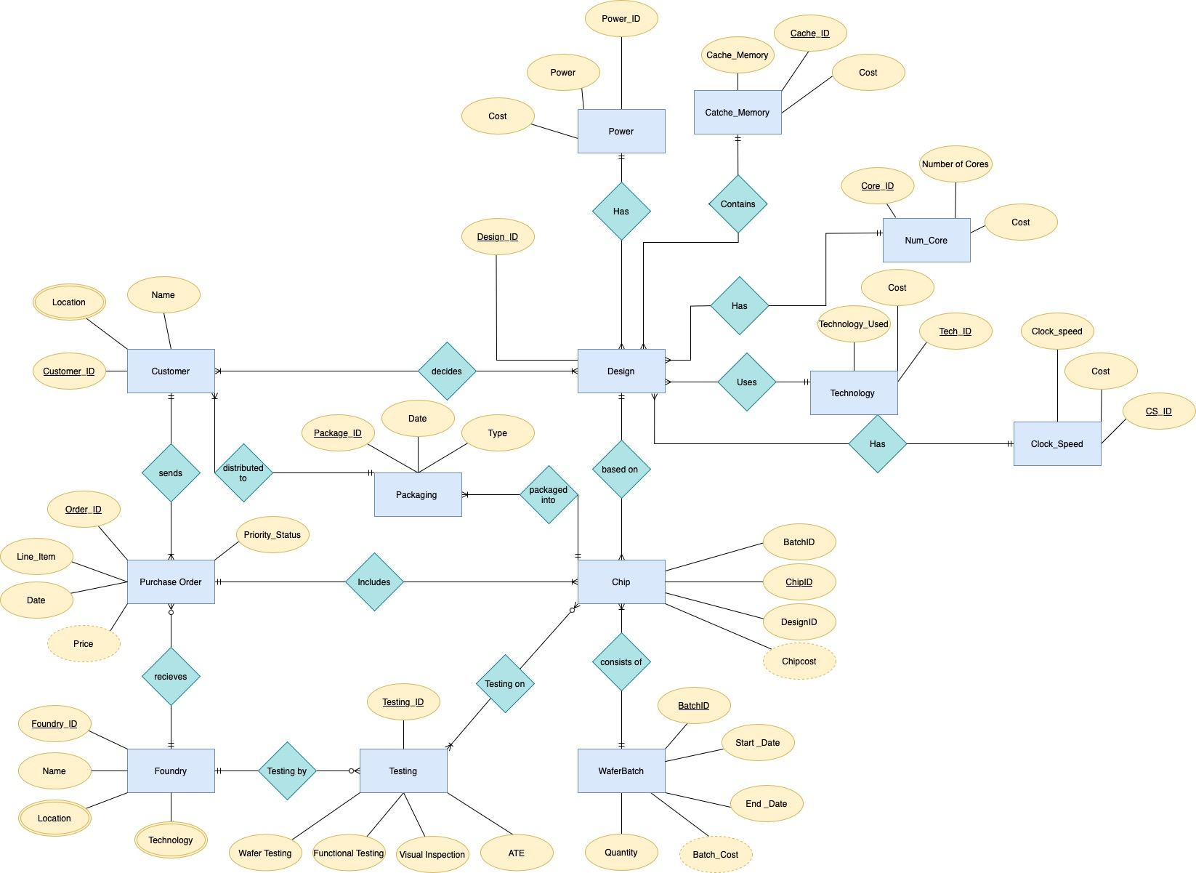
Notes:
Akshaj’s & Sandeep's Slide

Slide 7
Relational Schema Mapping of the ERD
Customer (Customer_id, Name, Package_ID[FK])
Cust_loc (customer_id[FK] , Location)
Purchase_Order(Order_Id,Line_item,Date,Priority_Status,Customer_Id[FK],Foundry_ID[FK])
Foundry(Foundry_ID,Name,Technology)
Foundry_Loc (Foundry_ID[FK] , Location)
Testing (Testing_ID,Wafer_Testing,Functional_Testing,Visual_Inspection,ATE, Foundry_ID[FK])
Testing_ON (Testing_ID[FK] , Chip_ID[FK] )
WaferBatch(Batch_ID ,StartDate,EndDate,Quantity)
Notes:
Sandeep’s Slide

Slide 8
Relational Schema Mapping of the ERD
Chip(ChipID ,BatchID[FK],Order_ID[FK], Design_ID[FK])
Packaging(PackageId ,Date,Type,ChipID[FK])
Decides(Customer_ID[FK] , Design_ID[FK])
Design(Design_ID , CS_ID[FK], Tech_ID[FK], Core_ID[FK], Cache_ID[FK], Power_ID[FK])
Clock_Speed(CS_ID , Clock_Speed, Cost)
Technology(Tech_ID , Technology_Used, Cost)
Num_Core(Core_ID , Number_of_Cores, Cost)
Cache_Memory(Cache_ID , Cache_Memory, Cost)
Power(Power_ID , Power, Cost)
Notes:
Sandeep’s Slide

Slide 9
Foundry Performance and Efficiency Analysis
In the semiconductor industry, where production speed, cost efficiency, and the capacity to fulfill orders are crucial, assessing the overall performance of a foundry is essential. This involves considering not only how quickly and cost-effectively a foundry can produce chips but also its ability to handle and complete customer orders.
The following metrics are crucial for this analysis:
Production Efficiency Rate: This measures the average number of chips produced per day, indicating the foundry's production speed and capacity.
Cost Efficiency Ratio: This ratio reflects how cost-effectively the foundry operates, calculated by dividing the total production cost by the average production time in days. It provides insight into the foundry's cost management relative to its production timeline.

Slide 10
Foundry Efficiency Ratio: A crucial metric for this analysis, calculated by dividing the Production Efficiency Rate by the Cost Efficiency Ratio. A higher ratio suggests a better balance between production speed and cost-effectiveness, indicating a more efficient overall operation.
Total Orders: Reflects the foundry's market demand and capacity to handle customer orders, with a higher number of orders possibly indicating better market trust and operational capability.

Slide 11
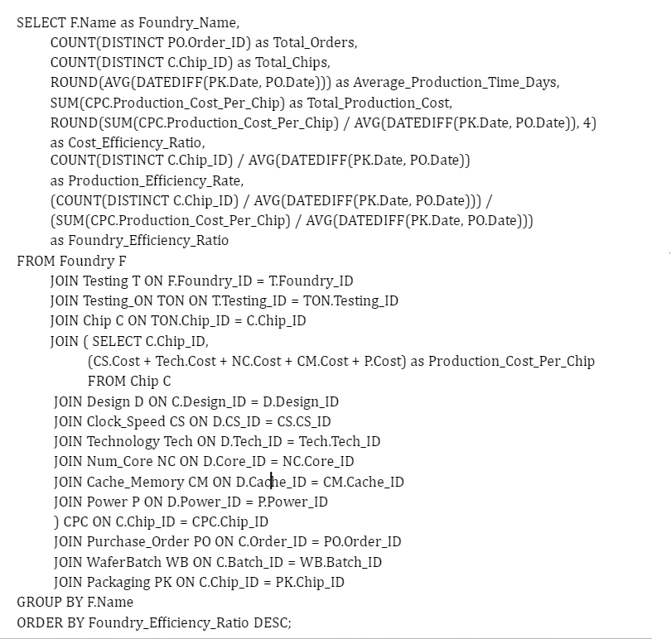
Foundry Performance and Efficiency – SQL QUERY 1
Which semiconductor foundry exhibits the best balance of production efficiency, cost management, and order fulfillment capacity

Slide 12
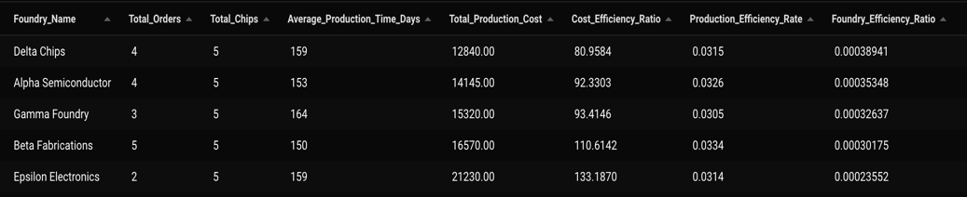

Slide 13
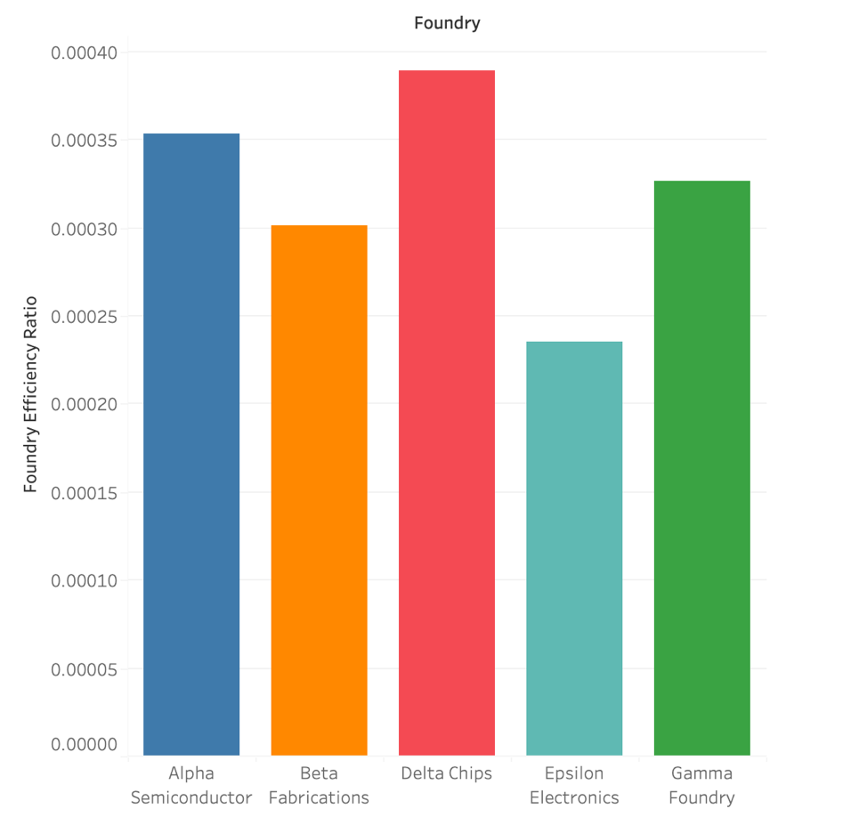

Slide 14
Necessity of Financial Analysis
The semiconductor industry is characterized by intensive capital and research investments, resulting in a complex web of costs associated with design, manufacturing, and testing of chips.
Companies in this sector need to maintain a delicate balance between the costs incurred in designing and producing chips and the revenues generated from their sales.
Accurate financial performance analysis is critical to ensure profitability, competitive pricing, and optimal allocation of resources.
To quench this need of specific metrics and evaluate customers based on their performance I have designed a couple of queries.
Notes:
Akshaj’s Slide

Slide 15
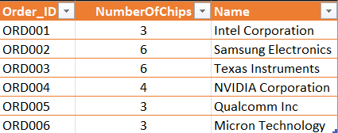
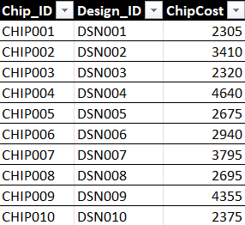
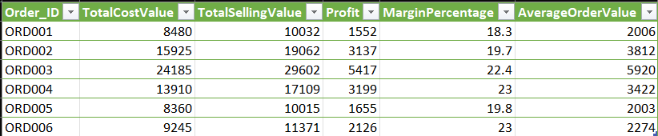
Financial Overview (Customer POV)
Notes:
Akshaj’s Slide

Slide 16
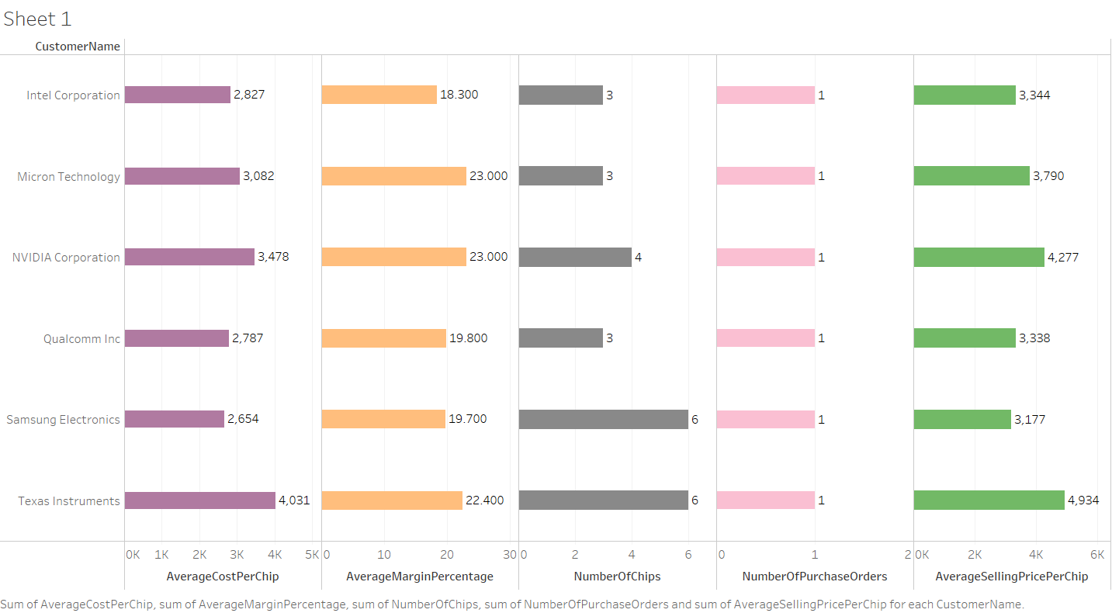
Notes:
Akshaj’s Slide

Slide 17
Performance-to-Cost Ratio
The Performance-to-Cost Ratio is a metric used to evaluate the efficiency or value of a product, system, or service in terms of its performance relative to its cost. In the context of chip design or any technology product, this ratio can be particularly insightful for comparing different designs or models.
The Performance-to-Cost Ratio is calculated by dividing a measure of the product's performance by its cost. A higher ratio indicates that you're getting more performance per unit of cost, which is generally desirable. For instance, if you have two chip designs and one has twice the performance of the other but costs the same, it will have a higher Performance-to-Cost Ratio.
The ratio is then used to compare different chip designs, indicating which designs offer more processing power per unit of cost. This analysis is valuable in product development and strategic decision-making, particularly in industries where both performance and cost efficiency are crucial.
Notes:
Raghav’s Slide

Slide 18
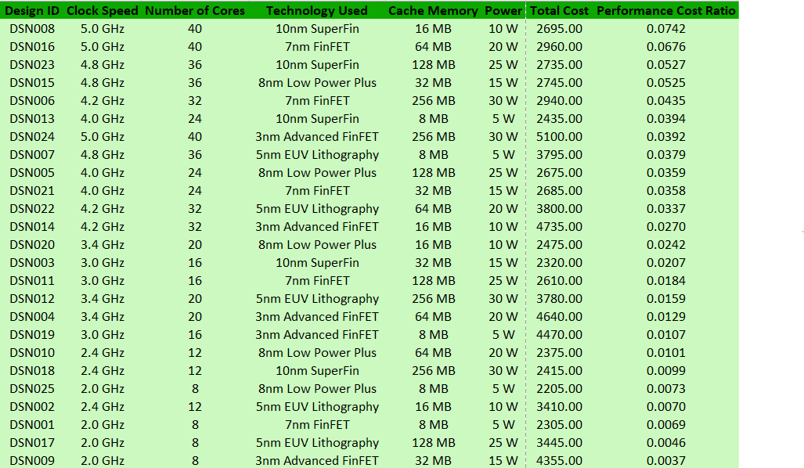
Queries
Which chip designs have the best performance-to-cost ratio based on clock speed, number of cores, and power consumption?
Notes:
Raghav’s Slide

Slide 19
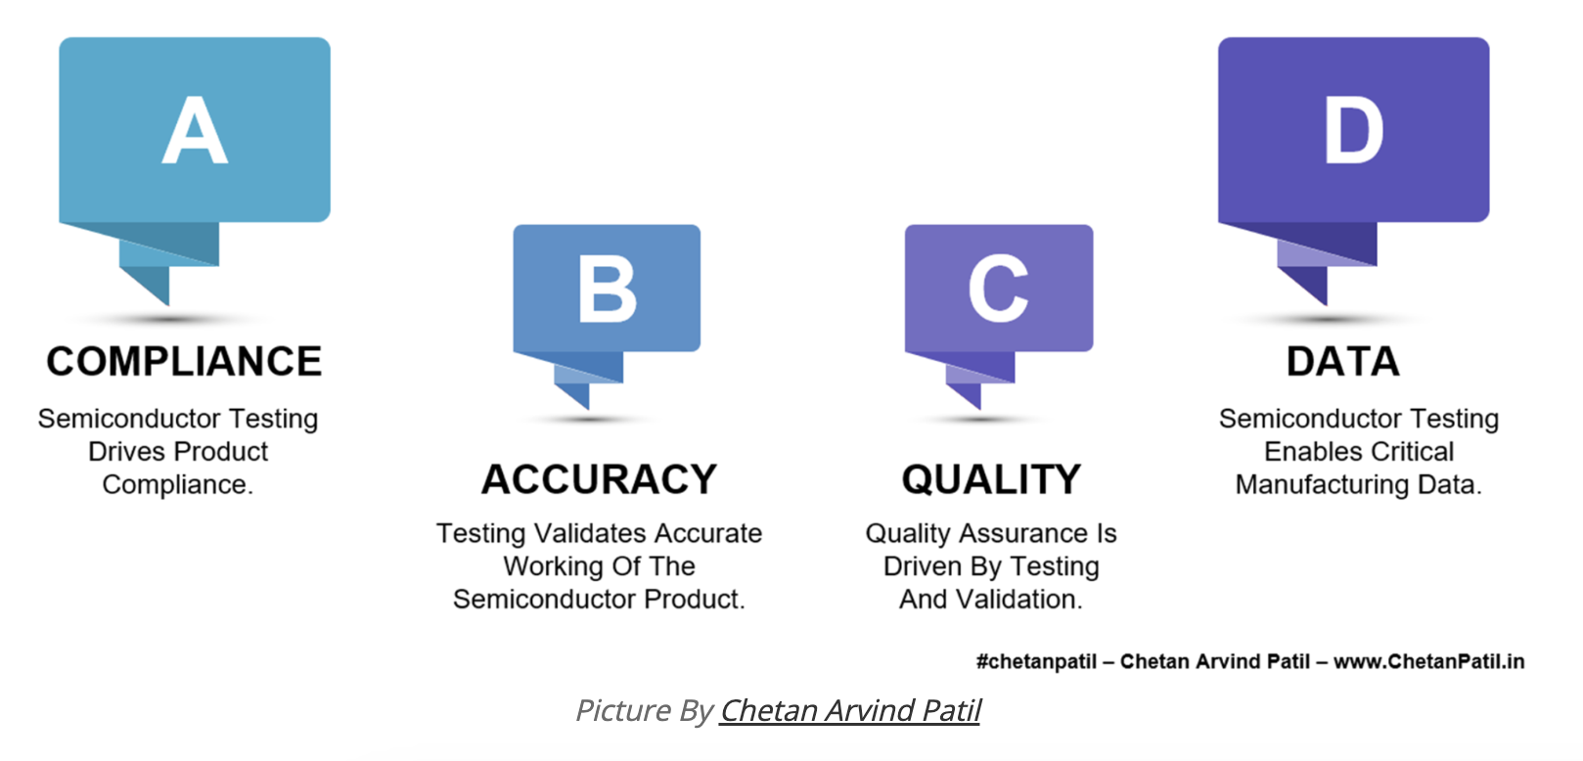
Testing In Semiconductor Manufacturing
Semiconductor testing assures functionality, conformance, sustainability of performance, and economic manufacturability essential for companies producing electronic components.
Catching defects and early life failures helps improve long-term reliability and lifespan for end users.
Notes:
Nina’s Slide

Slide 20
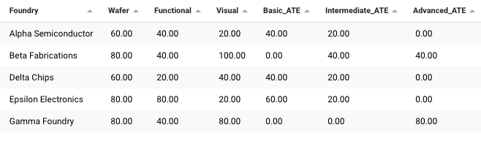
Quality Control and Monitoring
Show the semiconductor testing pass rates for each foundry, broken down by the different testing methods including wafer testing, functional testing, visual inspection, and automatic test equipment.
Notes:
Nina’s Slide

Slide 21
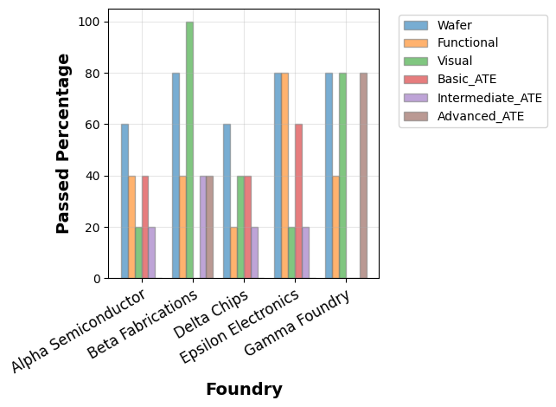
Notes:
Nina’s Slide

Slide 22
A review of lessons learned and Future directions
Foundational knowledge of relational models and database terminology
Practiced conceptual, logical, and physical database design
Implemented databases using SQL
Wrote meaningful queries to manipulate SQL data
Understood foundations of business intelligence & Visualization
Notes:
Nina’s Slide

Slide 23
Data Source and Tools
The dataset we are working with here is fictitious data created manually.
SQL, Maria DB (Beekeeper Studio)
Visualization : Python, Draw.io , Tableau
Notes:
Nina’s Slide

Slide 24
Thank You for Listening

