Slide 1
Ultra Light Dark Matter
Akshank Tyagi
IISc Bangalore
Ref: ULDM Review by ElisaG.M.Ferreira 2021

Slide 2
Properties:
Composed of bosons with mass ranging :
10⁻²⁴ eV < m < 1 eV
(M_{e} = 0.511 MeV , M_{p} = 0.938 GeV, M_{axions} = 10⁻⁵ eV to 1 ev)
Forms Bose- Einstein Condensates or a SuperFluids on Galactic Scales (Upon Condensation, particles behave as a single coherent state described by the cumulative wavefunction of the condensate)
Outside the Galactic haloes, on larger scales it recovers ΛCDM Properties.

Slide 3
Properties:
Classified Models possibles(different non-linear evolution and structures they form in galaxies):
Fuzzy Dark Matter
Self Interacting FDM
DM Superfluid
FDM has interesting phenomenology at 10⁻²² eV that manifest in different Astrophysical consequences
Wave nature of Dark Matter on Galactic Scale provides a non-CDM behaviour

Slide 4
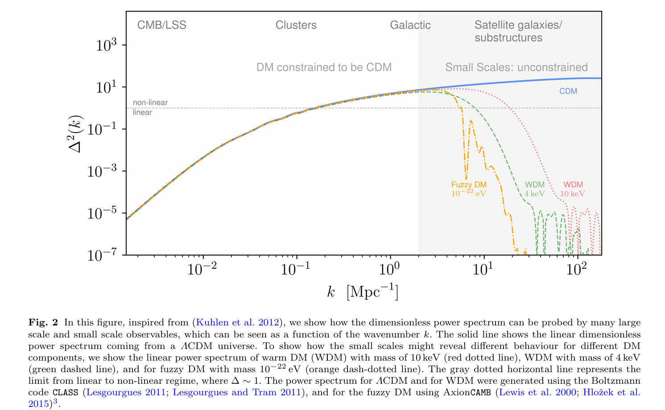

Slide 5
Discrepancies from ΛCDM model on small scales
Cusp- Core Problem:
Expected density profile from colissionless simulations is the NFW(Navarro- Frank-White) cuspy profile at galactic Center:
ρ ≈ 1/ r^{γ}
NFW has γ = -1
THINGS and LITTLE THINGS measured Rotation curves of multiple dwarf galaxies and found smaller γ = 0.29 + 0.07
Solved by BEC Dark Matter and MOND

Slide 6
Discrepancies from ΛCDM model on small scales
Missing Sattelite Problem: DM Subhaloes
simulations predict several hundreds of subhalos with v_{max} = 10 - 30kms, that are large enough to host a galaxy around a Milky Way size galaxy
While till now SDSS and DES data shows 12 classical and around 40 Ultra faint Satellites for MW. Much less than predicted
Solution : One can expect that for low mass subhalos, galaxy formation is suppressed by striping gas mechanisms

Slide 7
Discrepancies from ΛCDM model on small scales
Missing Sattelite Problem: Massive DM Subhaloes
Most Massive subhalos predicted by those simulations have central masses (V_{max} > 30kms) that are too large to host the observed satellite galaxies of MW which have (12 < Vmax < 25kms) which are not massive enough
The puzzle is why should the most massive subhaloes, where the gravitational potential is the strongest and the striping gas mechanisms cited above are not important, be too big to fail to form stars and galaxies?
Solution : BEC suppresses the formation of small scale subhaloes, and reduces the central densities of massive subhaloes (or modifies the dynamics of the central regions)

Slide 8

Discrepancies from ΛCDM model on small scales
Scaling Relations:
BTFR Baryonic Tully-Fischer Relation that relates total baryon mass of the galaxy to the asymptotic circular velocity in galaxies,
This empirical scaling relation is shown to hold for large ranges of masses, almost 6 orders of magnitude
the slope of the BTFR is different from the one predicted by CDM, V_{f}³ α M_{b}
Mass discrepancy Acceleration Relation (MDAR) : a relation between the gravitational acceleration from baryons alone and acceleration inferred from rotation curves.

Slide 9
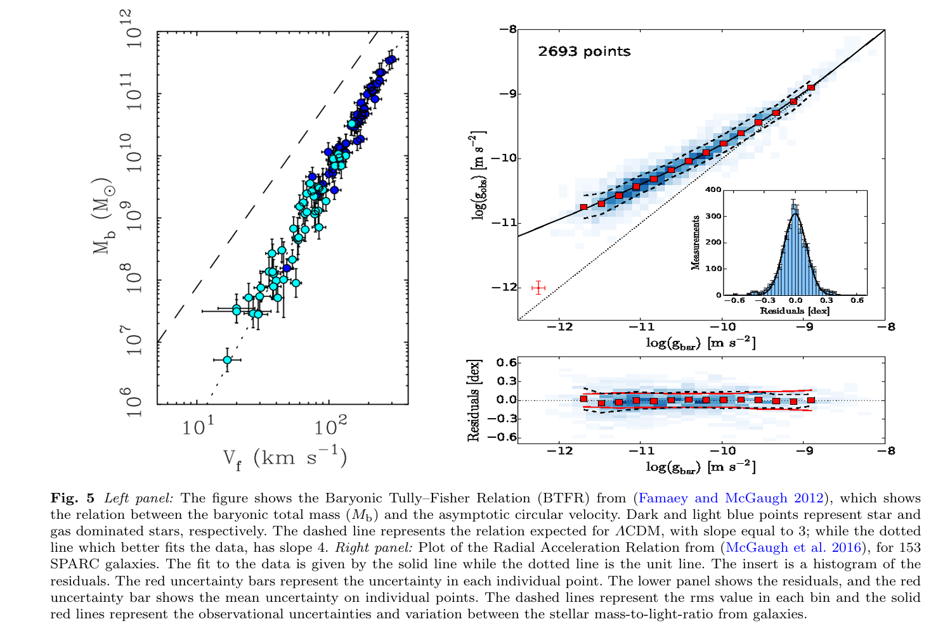

Slide 10
Discrepancies from ΛCDM model on small scales
Scaling Relations:
These empirical relations, coming directly from observations, show the surprising feature that in galaxies the dynamics is dictated by the baryon content, even when DM dominates.
Even more unexpected these relations are very tight, showing very little spread, even if they come from very diverse types of galaxies
Solution : new high resolution simulations, like EAGLE, have been able to reproduce features of the rotation curves of galaxies within CDM include several baryonic effects (like star formation, stellar evolultion, metal enrichment, gas cooling/heating, galactic outflows and BH feedback)

Slide 11
Discrepancies from ΛCDM model on small scales
These discrepancies can be addressed as:
Within CDM, this can done by including baryonic effects, which seem to address partially some of those puzzles.
Another proposal for solving some of the puzzles of galactic evolution is more radical and propose a universe without DM that has a modified force law for small accelerations, the MOdified Newtonian Dynamics(MOND).
Modifying the DM paradigm using Ultra Light Dark Matter candidates

Slide 12
ULDM Models
Inside a virizalized DM halo, ULDM thermalizes and forms gravitationally bounded cores that can be described as a BEC or a superfluid
these models behave like CDM on large scales, with modified initial conditions, while inside galaxies they present a wave-like behaviour.
The mass of the ULDM (mdel-independent) has to be:
10⁻²⁵ eV < m < 2 eV
The lower bound comes from the fact that the size of the condensate core cannot be larger than the halo
The Upper bound is from the de Broglie wavelength of the ULDM particle is of the size of the galaxy
Notes:
recovering the incredible observational successes of this description

Slide 14
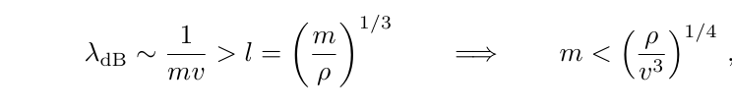
ULDM Models
The Upper bound is from the de Broglie wavelength of the ULDM particle is of the size of the galaxy
This translates to the condition that de Broglie wavelength of the boson DM is larger than the inter-particle distance between each boson
ULDM presents masses that are very small cannot be produced thermally in the early universe. Therefore, ULDM is a non-thermal relic of the Early Universe
The QCD axions and axion like particles (ALPs) can have similar Properties to Fuzzy Dark matter

Slide 15
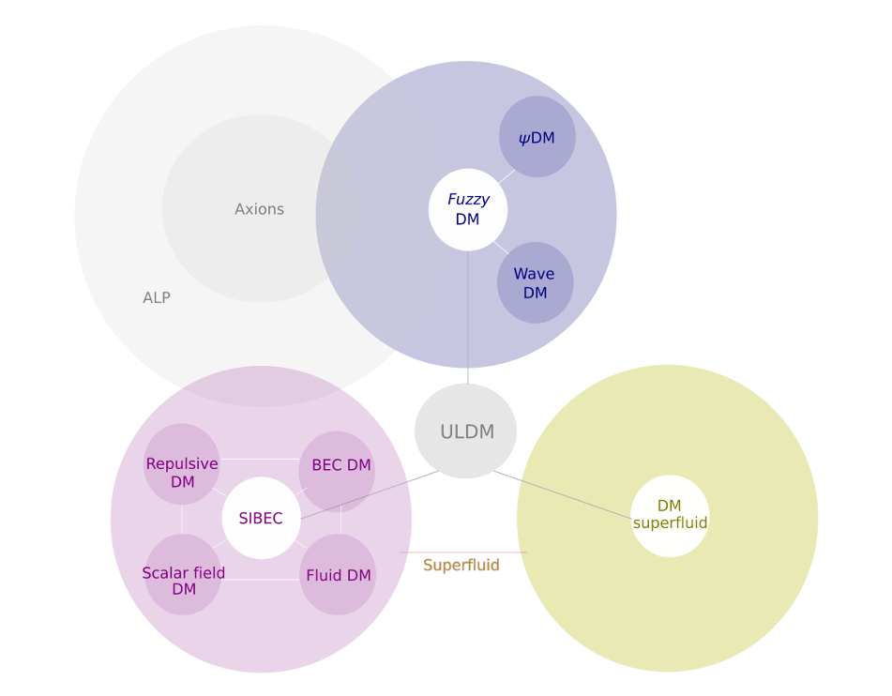

Slide 16
Fuzzy Dark Matter:
a gravitationally bounded scalar field model.
In this model condensation under the influence of the gravitational potential is achieved in galaxies where the gravitational attraction is counteracted by the quantum pressure.
One of its main candidates, where the DM is given by a light particle with m = 10⁻²² eV. With a particle with this mass, the FDM model is known to be able to solve some of the challenges from small scales that we discussed, and to be in agreement with large scale observations.
Forms gravitationally bounded BEC in Galactic halos
this model has one free parameter, the mass of the FDM
Notes:
The mass of this model does not have to necessarily have this value and need to be determined by observations, although this is the value that gives the most appealing modi cations on small scales

Slide 17
Self-Interacting FDM:
a scalar field model, in the presence of gravity, with a 2-body self-interaction(or higher)
Presence of these weak interaction makes this model present superfluidity upon condensation. This case is described by a interacting BEC
The presence of the interaction controls the stability of the core and this this model presents a different phenomenology depending not only on the mass of the particle, as for FDM, but given the strength and sign of the interaction.
this model has two free parameters
For a repulsive interaction, the condensate has a long range coherence and presents superfluidity.
The 2-body case is characterized by having an equation of state :
EoS, P α n²
Notes:
The mass of this model does not have to necessarily have this value and need to be determined by observations, although this is the value that gives the most appealing modi cations on small scales

Slide 18
Dark Matter SuperFluid:
This was proposed with the goal of reproducing the MOND empirical law on small scales.
Different than in the case of SIFDM, in order to reproduce MOND it requires that the equation of state is given by
EoS, P α n³
The model is described using the Effective Field Theory of Superfluids

Slide 19
Cosmological and Astrophysical constraints,
UV luminosity function
Black hole superradiance
Probing the wave nature ofULDM
Vortices
Interference fringes

