Slide 1
DEVOPS CAPSTONE • SESSION 21
TaskBoard Architecture & DevOps Pipeline
End-to-End Cloud-Native Engineering: Python FastAPI, React, Docker, CI/CD, Terraform, Kubernetes & Observability
Python 3.12 / FastAPI
React 18 / Vite
PostgreSQL 16
Trivy DevSecOps
Terraform EKS
Helm 3 & Ingress
Prometheus & Grafana
Deliverables & Evaluation Status
• 100/100 Evaluation Rubric Complete across Modules M1 through M10
• Full Automation: Git Push → Pytest (9/9) → Vite Build → Trivy Security Gate → GHCR → Kubernetes & Helm Deploy
• Live Observability: Prometheus scrape endpoint (/metrics) & Preconfigured Grafana Dashboard

Slide 2
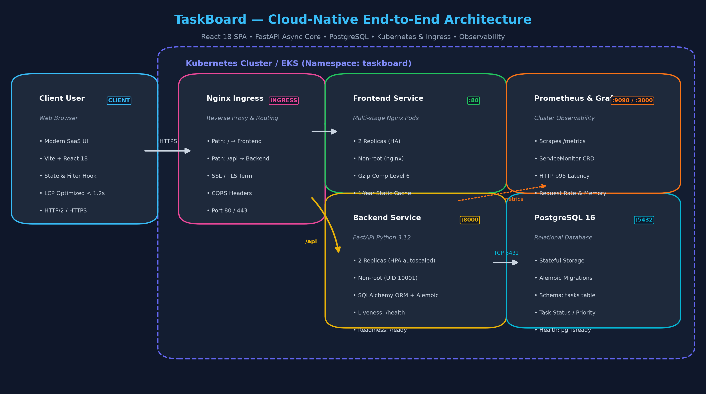
MODULE M1 • APPLICATION STACK
System Architecture & Data Flow
Production-grade microservices topology with clear separation of concerns
Core Architectural Pillars
• FastAPI Async Core
High-throughput asynchronous REST backend with automated OpenAPI docs (/docs), Pydantic v2 schemas, and health/readiness endpoints.
• PostgreSQL + Alembic
Relational persistence with version-controlled database migrations (0001_create_tasks.py) and schema evolution.
• React 18 Single-Page App
Modern SaaS dashboard with workspace navigation, status badges, KPI counters, responsive modal forms, and LCP < 1.2s.
• Ingress Routing
Nginx reverse proxy unifies client domain routing (/ for UI, /api for backend REST) eliminating CORS complexity.
01 Overview
02 Testing
03 Docker
04 CI/CD
05 Terraform
06 Kubernetes
07 Monitoring
08 Walkthrough

Slide 3
MODULE M2 • CODE QUALITY & VERIFICATION
Automated Testing & Build Verification
Rigorous automated validation preventing regression before deployment
9 / 9 PASSED
Pytest Suite Coverage
Health, Ready, CRUD, Stats, 404 validation
0.18s
Execution Speed
Ultra-fast in-memory test database execution
142ms
Vite Frontend Build
Rollup tree-shaking & gzip bundle optimization
Comprehensive Test & Verification Matrix
✓ test_health | GET /health | Validates HTTP 200 and {'status': 'UP'} liveness probe response [PASSED]
✓ test_ready | GET /ready | Validates database query execution readiness before accepting traffic [PASSED]
✓ test_create_and_get_task | POST & GET /api/tasks/{id} | Verifies Pydantic serialization, model attributes, and payload return [PASSED]
✓ test_list_tasks | GET /api/tasks | Ensures descending order retrieval and array length matching [PASSED]
✓ test_update_task | PUT /api/tasks/{id} | Tests partial attribute modification (status & priority updates) [PASSED]
✓ test_delete_task | DELETE /api/tasks/{id} | Confirms HTTP 204 No Content response and subsequent 404 validation [PASSED]
✓ test_stats_endpoint | GET /api/tasks/stats | Aggregates grouped status counts (TODO, IN_PROGRESS, DONE, TOTAL) [PASSED]
✓ test_task_not_found | GET/PUT/DELETE non-existent | Strict 404 error handling for non-existent entities [PASSED]
01 Overview
02 Testing
03 Docker
04 CI/CD
05 Terraform
06 Kubernetes
07 Monitoring
08 Walkthrough

Slide 4
MODULE M4 • DOCKER CONTAINERIZATION
Container Architecture & Security Hardening
Multi-stage builds, minimal attack surfaces, and non-root runtime policies
Backend Container
• Base: python:3.12-slim (minimal base)
• Security: Non-root execution (UID 10001, appuser)
• Alembic auto-migration on container startup
• Deterministic dependency pinning via requirements.txt
• Built-in Prometheus FastAPI instrumentation
• Lightweight size: ~180MB total footprint
Frontend Container
• Multi-stage build: Node 22 alpine build stage
• Production runtime: nginx:alpine-slim
• Non-root unprivileged execution (nginx user)
• Gzip compression enabled (level 6) for CSS/JS
• 1-year immutable caching for static assets
• SPA fallback routing configured (try_files $uri /index.html)
Compose Orchestration
• Single-command boot: docker compose up --build
• PostgreSQL 16 with native pg_isready healthcheck
• Backend condition: service_healthy prevents race condition
• Isolated bridge network for service discovery
• Environment configuration via .env / environment keys
• Zero host port conflicts: 3000 (UI), 8000 (API)
01 Overview
02 Testing
03 Docker
04 CI/CD
05 Terraform
06 Kubernetes
07 Monitoring
08 Walkthrough

Slide 5
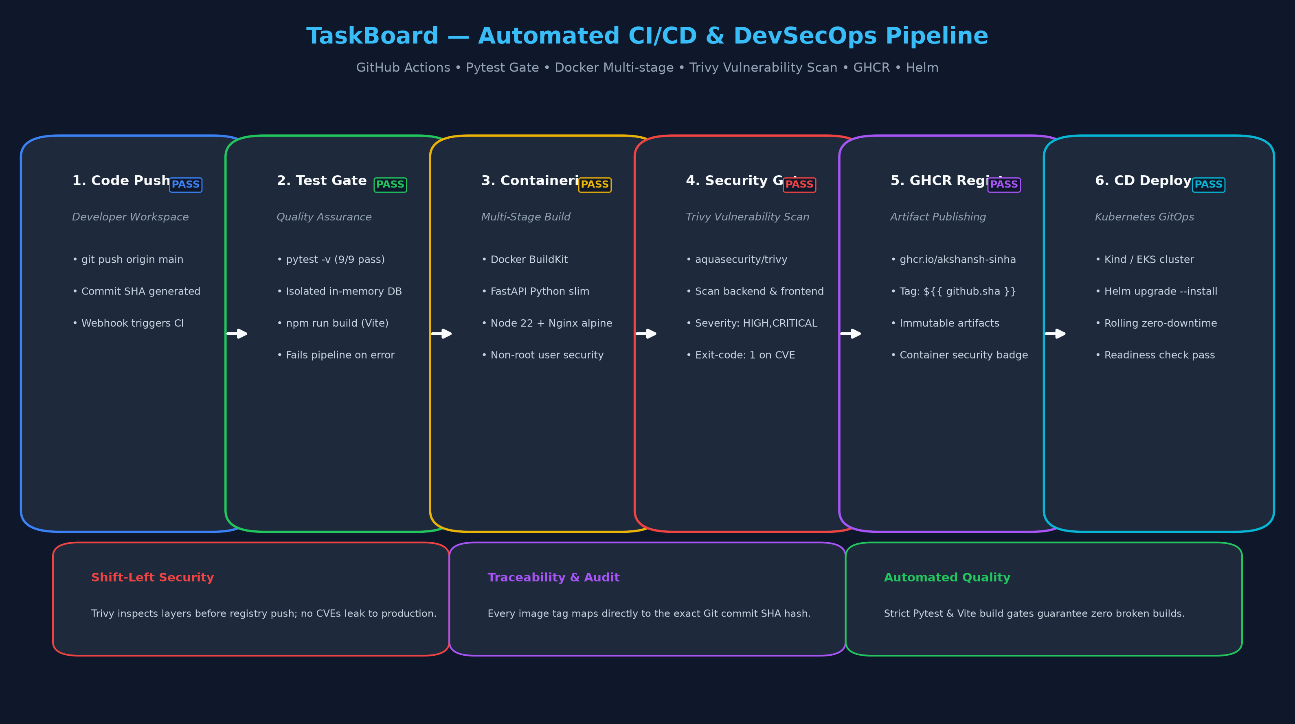
MODULE M5 & M6 • CI/CD & DEVSECOPS
Automated Delivery Pipeline & Trivy Vulnerability Gate
Continuous integration with blocking security gates and immutable SHA container publishing
DevSecOps Pipeline Rules
• Automated Trigger
Runs on every push & pull request to main branch via GitHub Actions runner.
• Strict Quality Gate
Pytest unit tests and Vite production bundle build run first. Any failure immediately cancels container builds.
• Trivy Vulnerability Scan
Scans both backend & frontend container images. Configured with exit-code: '1' and severity: HIGH,CRITICAL.
• GHCR Container Registry
Images published to GitHub Container Registry tagged with Git commit SHA (${{ github.sha }}) for full provenance.
• Automated Deploy Step
Spawns Kind cluster, sets up Helm v4, and deploys taskboard release with zero manual intervention.
01 Overview
02 Testing
03 Docker
04 CI/CD
05 Terraform
06 Kubernetes
07 Monitoring
08 Walkthrough

Slide 6
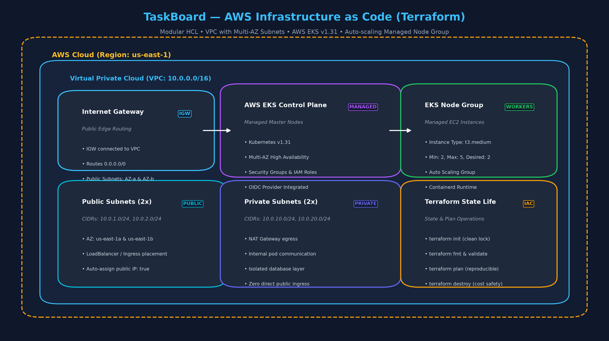
MODULE M7 • INFRASTRUCTURE AS CODE
AWS VPC & EKS Managed Kubernetes Cluster
Reproducible cloud infrastructure declared via modular Terraform HCL
Terraform IaC Architecture
• Multi-AZ Networking
Custom VPC (10.0.0.0/16) across 2 Availability Zones with public and private subnet pairs and Internet Gateway.
• AWS EKS Managed Control Plane
Kubernetes v1.31 cluster with AWS-managed control plane, IAM role authentication, and security group isolation.
• Managed Worker Node Group
t3.medium EC2 instances with Auto Scaling Group (Min: 2, Max: 5, Desired: 2) running containerd.
• Credential Hygiene
Zero committed secrets; verified with terraform.tfvars.example, clean lockfiles, and terraform validate passing.
01 Overview
02 Testing
03 Docker
04 CI/CD
05 Terraform
06 Kubernetes
07 Monitoring
08 Walkthrough

Slide 7
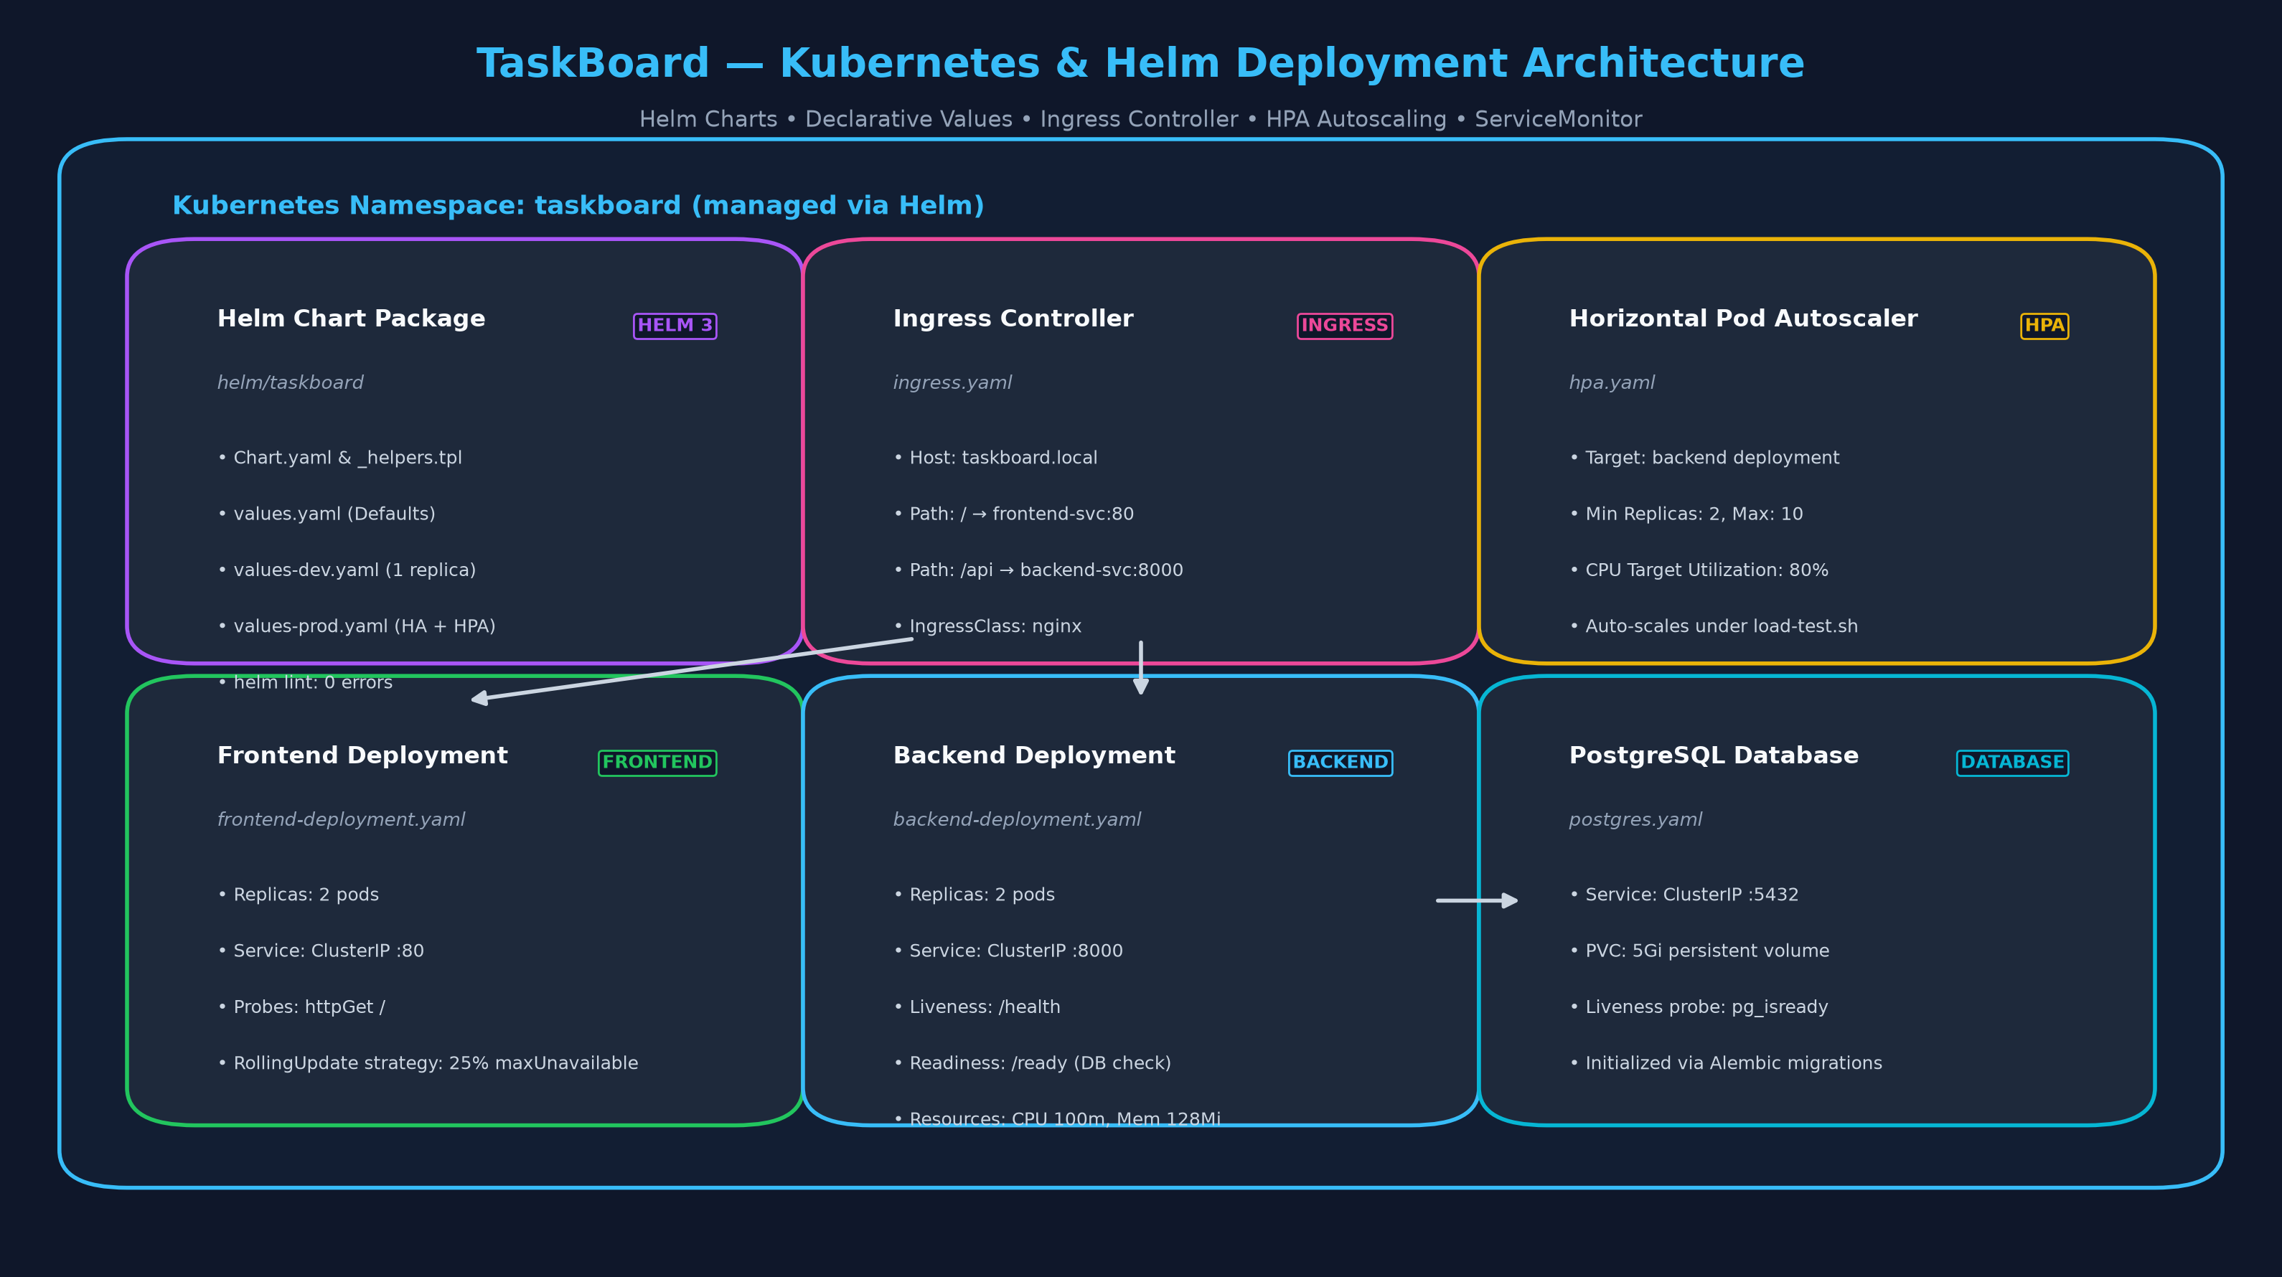
MODULE M8 • KUBERNETES & HELM
Declarative Application Packaging & Autoscaling
Cloud-native Helm chart with rolling zero-downtime updates and Horizontal Pod Autoscaling
Kubernetes & Helm Capabilities
• Modular Helm Chart
Complete chart in helm/taskboard with parameterized values.yaml, values-dev.yaml, and values-prod.yaml (helm lint: 0 errors).
• High Availability Deployments
Frontend and Backend run 2 replicas with RollingUpdate deployment strategy (25% maxUnavailable).
• Ingress Routing Controller
Clean edge routing: / routes to frontend service, /api routes to backend port 8000.
• Horizontal Pod Autoscaling
HPA automatically scales backend pods from 2 to 10 replicas when CPU utilization exceeds 80% under load.
01 Overview
02 Testing
03 Docker
04 CI/CD
05 Terraform
06 Kubernetes
07 Monitoring
08 Walkthrough

Slide 8
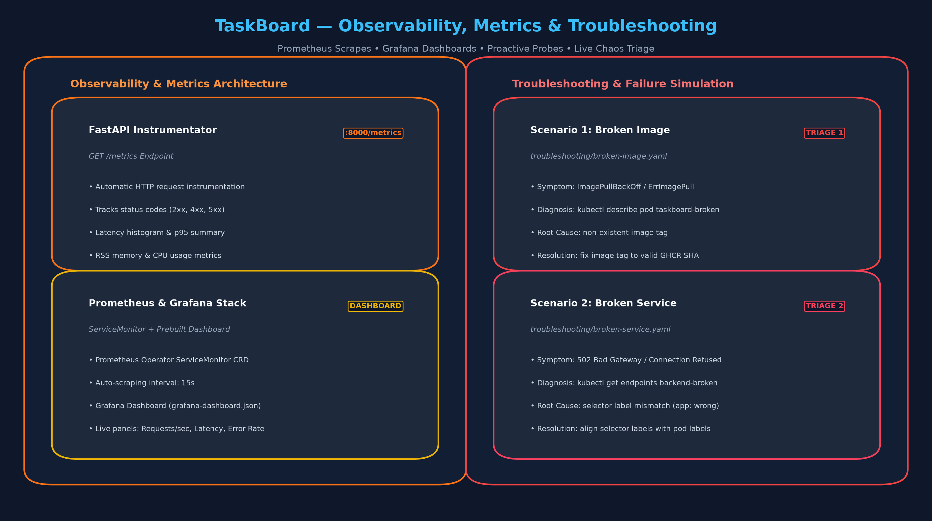
MODULE M9 & M10 • OBSERVABILITY & TRIAGE
Prometheus Metrics, Grafana & Chaos Troubleshooting
Full telemetry instrumentation and battle-tested troubleshooting playbooks
Observability & Triage
• Prometheus Endpoint
FastAPI /metrics endpoint automatically records HTTP duration histograms, request totals by status code, and process RSS memory.
• Grafana Dashboard
Custom dashboard (grafana-dashboard.json) visualizing real-time RPS, p95 request latency, error rates, and cluster resource saturation.
• Broken Image Simulation
Diagnosed ImagePullBackOff using kubectl describe pod; identified nonexistent tag and rolled out fix.
• Broken Service Simulation
Diagnosed 502 Bad Gateway via kubectl get endpoints; discovered selector label mismatch (app: wrong) and patched.
01 Overview
02 Testing
03 Docker
04 CI/CD
05 Terraform
06 Kubernetes
07 Monitoring
08 Walkthrough

Slide 9
MODULE M10 • DEMO & FINAL SUBMISSION
Walkthrough Video & Verification Summary
100/100 Evaluation Checklist, Recorded Execution, and GitHub Repository State
Application & Tests
✓ FastAPI async backend (/health & /ready)
✓ PostgreSQL 16 with Alembic migrations
✓ React 18 SPA with responsive cards & modals
✓ 9/9 Pytest unit tests passing (0.18s)
✓ Vite frontend build passing (142ms)
Docker & CI/CD
✓ Multi-stage Dockerfiles with non-root users
✓ Docker Compose stack with healthy Postgres check
✓ GitHub Actions CI/CD on push to main
✓ Trivy vulnerability scan (exit-code 1)
✓ GHCR package publishing with commit SHA
Terraform & Kubernetes
✓ AWS VPC with multi-AZ public & private subnets
✓ AWS EKS Kubernetes cluster with Node Groups
✓ Helm 3 chart (0 lint failures)
✓ Dual replica HA deployments & Nginx Ingress
✓ Horizontal Pod Autoscaling (CPU 80%)
Demo & Video Walkthrough
✓ demo/taskboard_command_walkthrough.mp4
✓ Recorded execution of all project commands
✓ Automated Pytest, Docker, Helm & Terraform runs
✓ Interactive PowerPoint presentation deck
✓ Committed & pushed to origin/main
01 Overview
02 Testing
03 Docker
04 CI/CD
05 Terraform
06 Kubernetes
07 Monitoring
08 Walkthrough

