Slide 1
Virtual Labs using MS Azure
IN THIS PROJECT A SQL LAB IS CREATED USING AZURE LAB SERVICE
A LINK IS PROVIDED IN GITHUB REPOSITRY USING WHICH USERS CAN ACCES THE LAB
EACH USER IS PROVIDED WITH THE QUOTA HOUR FOR LAB
AZURE LAB SERVICE , SQL SERVER VM ARE THE FEW SERVICES USED IN THE PROJECT
FOR USERNAME AND PASSWORD GO TO NEXT SLIDE

Slide 2
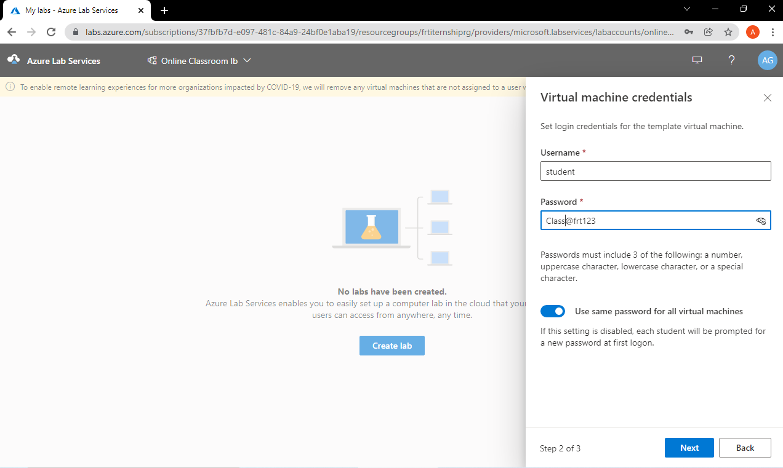

Slide 3
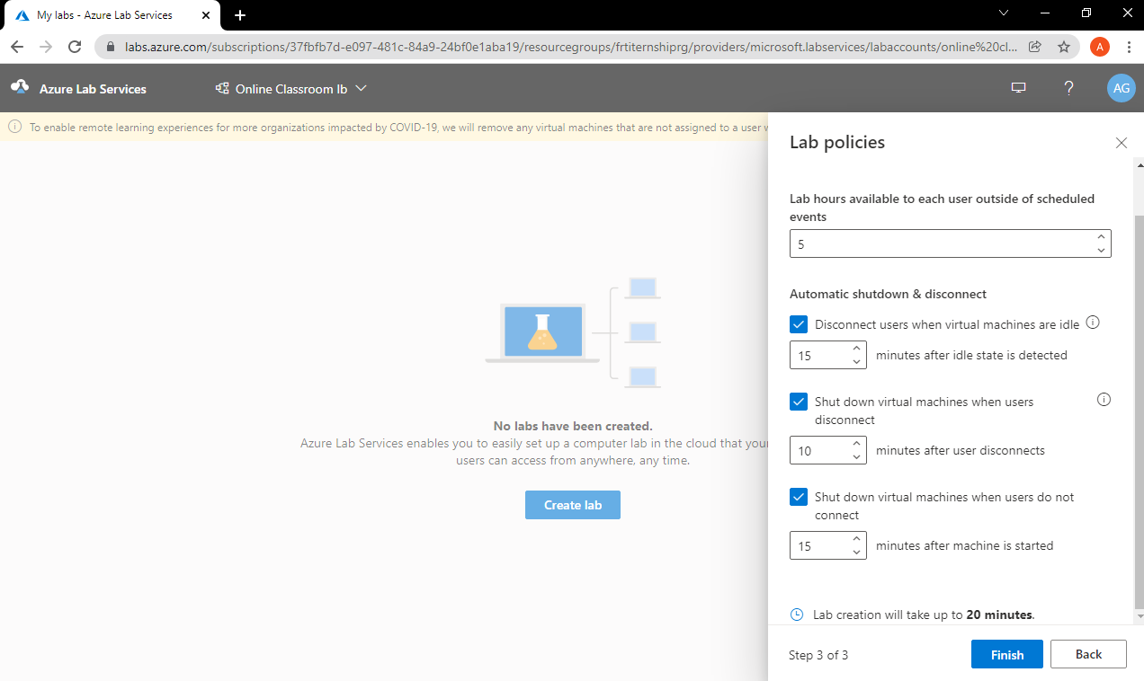

Slide 4
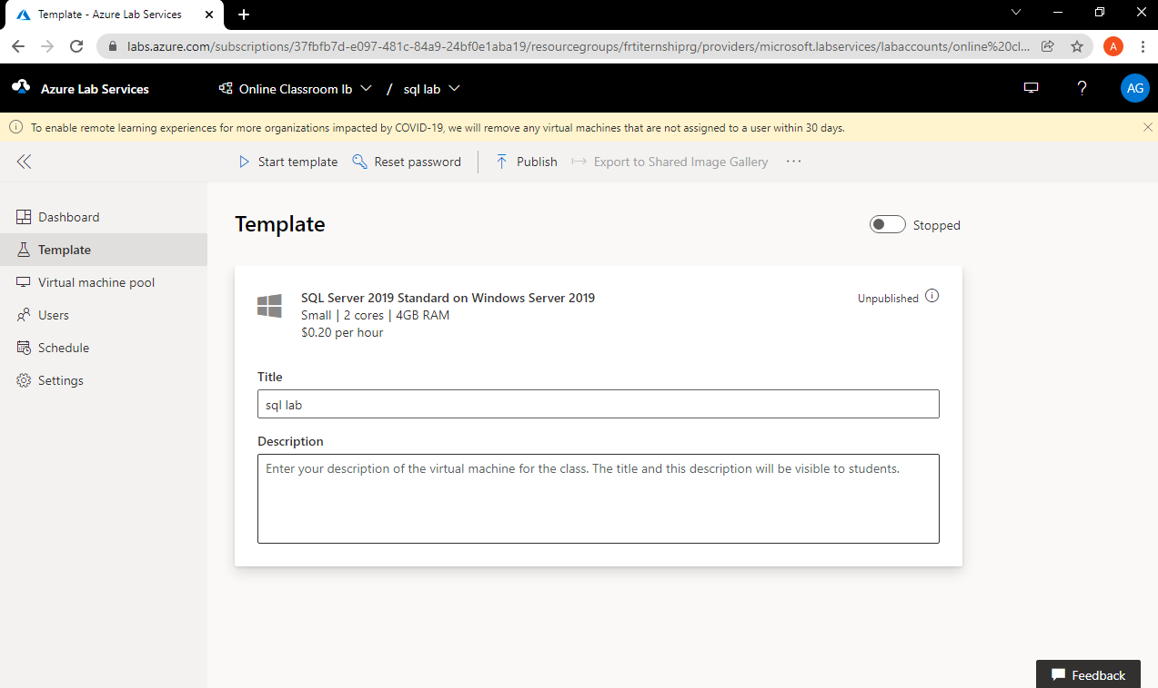

Slide 5
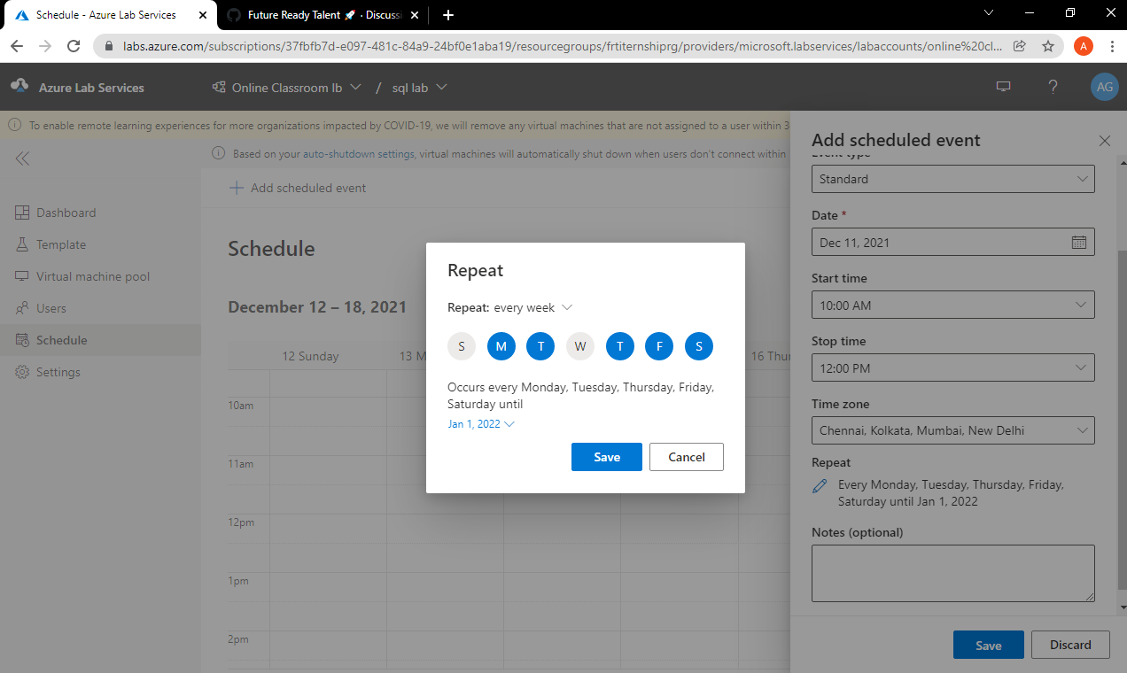

Slide 6
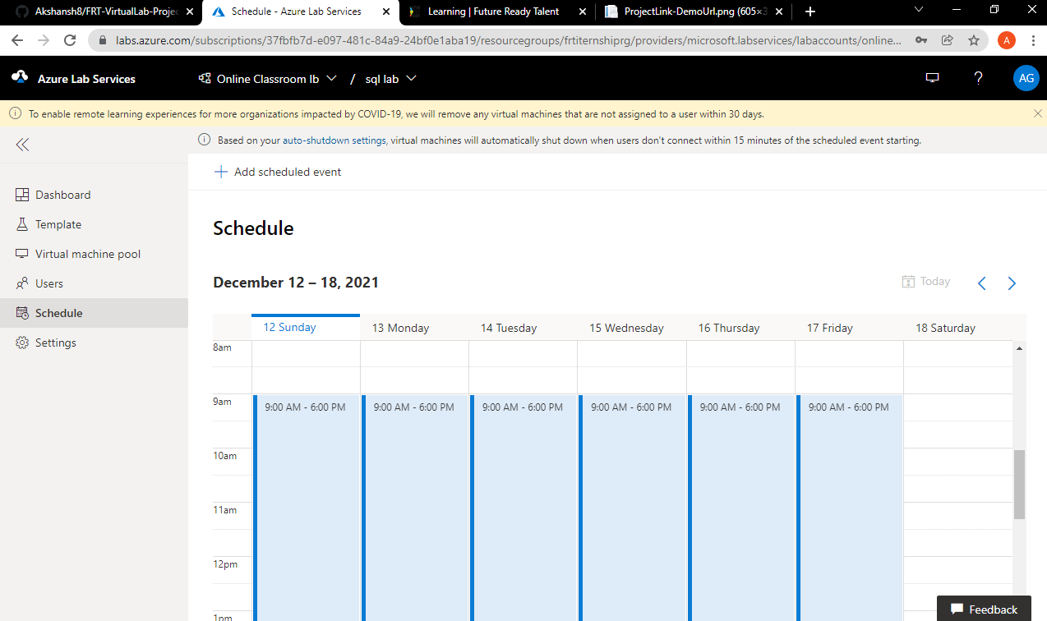
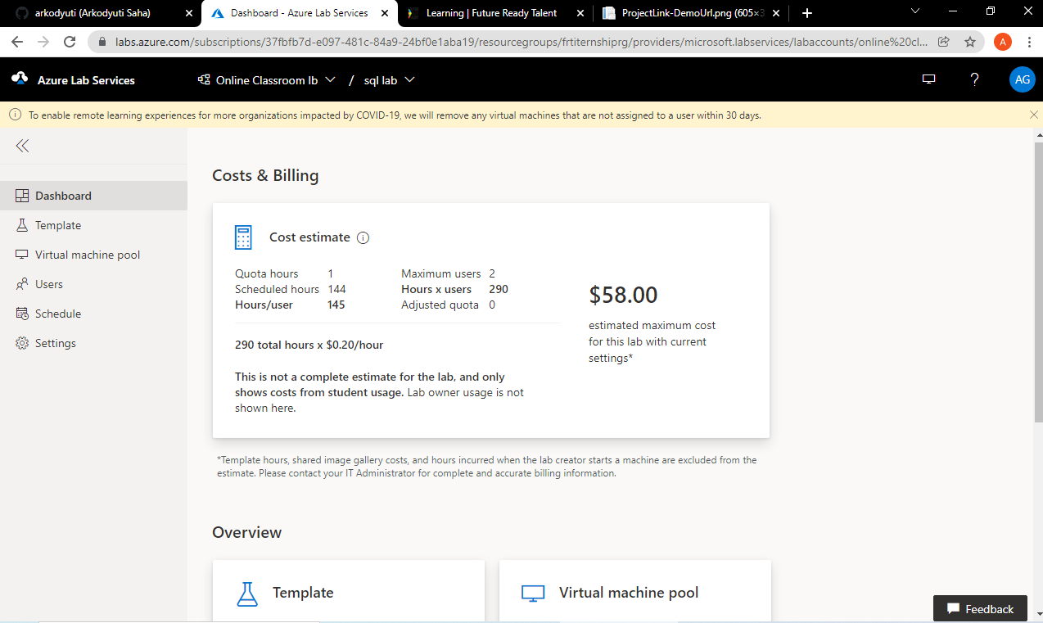

Slide 7

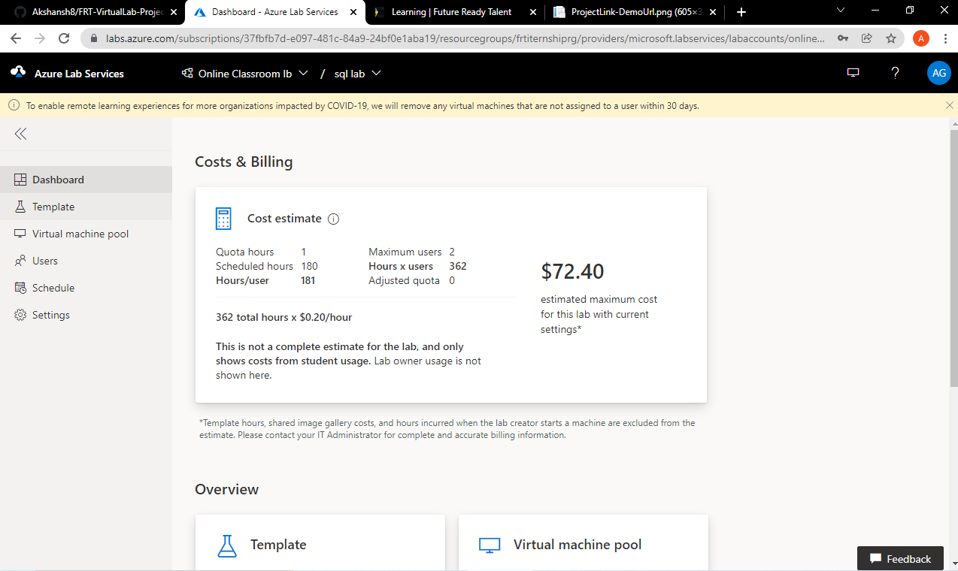

Slide 8
Project Submitted by:-
AKSHANSH SHARMA
GEC BHUBANESWAR
https://github.com/Akshansh8/FRT-VirtualLab-Project

