Slide 1

By:
Akshar Patel (07DCE060)
Notes:
© 2007 Microsoft Corporation. All rights reserved. Microsoft, Windows, Windows Vista and other product names are or may be registered trademarks and/or trademarks in the U.S. and/or other countries.
The information herein is for informational purposes only and represents the current view of Microsoft Corporation as of the date of this presentation. Because Microsoft must respond to changing market conditions, it should not be interpreted to be a commitment on the part of Microsoft, and Microsoft cannot guarantee the accuracy of any information provided after the date of this presentation.
MICROSOFT MAKES NO WARRANTIES, EXPRESS, IMPLIED OR STATUTORY, AS TO THE INFORMATION IN THIS PRESENTATION.

Slide 2


Slide 3

Project Title | Social Networking Website
Project Name | eNetwork
Front End | JSP 2.0
Back End | MySQL 5.5
Web and Scripting | HTML , CSS, JavaScript, AJAX
Application Server | GlassFish 3.0.1
Integrated Development Environment(IDE) | NetBeans 6.9.1
Operating System | Fedora 14

Slide 4


Social Networking Website is a website in which people can share information and build social relations.

Slide 5

Easy to use User Interface
Share Profile Information
Profile Privacy
Share Content
Content Privacy

Slide 6


Slide 7

Create and manage profile
Search people
Add or remove friends.
Send/Receive messages.
Send/Receive posts.
Upload and share photos.
Upload and share videos.
Add videos from YouTube.
Set privacy
Comment on photo, video, posts.

Slide 8

Profile
Friends
Posts
Messages
Photos
Videos
Privacy
Search

Slide 9


Slide 10



Slide 11


Slide 12



Slide 13



Slide 14



Slide 15



Slide 16



Slide 17



Slide 18



Slide 19


Slide 20

Field Name | Data Type | Length | Not Null? | P.K? | F.K? | Reference Table | Description
uid | INT | 11 | Y | Y | N | - | Unique ID of User
username | VARCHAR | 45 | Y | N | N | - | Username
password | VARCHAR | 45 | Y | N | N | - | Password
email | VARCHAR | 45 | Y | N | N | - | Email ID
first_name | VARCHAR | 45 | Y | N | N | - | First Name
last_name | VARCHAR | 45 | Y | N | N | - | Last Name
gender | VARCHAR | 6 | Y | N | N | - | Gender
birthdate | DATE | - | Y | N | N | - | Birthdate

Slide 21

Field Name | Data Type | Length | Not Null? | P.K? | F.K? | Reference Table | Description
pid | INT | 11 | Y | Y | N | - | Unique ID of Profile
uid | INT | 11 | Y | N | Y | user | Unique ID of User
photo | BOOL | - | N | N | N | - | Profile Photo of User
city | VARCHAR | 45 | N | N | N | - | City
hometown | VARCHAR | 45 | N | N | N | - | Hometown
languages | TEXT | - | N | N | N | - | Languages
aboutme | TEXT | - | N | N | N | - | About User
rl_status | VARCHAR | 45 | N | N | N | - | Relationship Status
employer | VARCHAR | 45 | N | N | N | - | Employer
college | VARCHAR | 45 | N | N | N | - | College/University
high_school | VARCHAR | 45 | N | N | N | - | High School
religion | VARCHAR | 45 | N | N | N | - | Religion
activities | VARCHAR | 45 | N | N | N | - | Activities
interests | TEXT | - | N | N | N | - | Interests

Slide 22

Field Name | Data Type | Length | Not Null? | P.K? | F.K? | Reference Table | Description
mid | INT | 11 | Y | Y | N | - | Unique ID of Message
uid_from | INT | 11 | Y | N | Y | user | Unique ID of User who sent message.
uid_to | IN | 11 | Y | N | Y | user | Unique ID of User whom message has been sent.
text | TEXT | - | - | N | N | - | Content of Message

Slide 23

Field Name | Data Type | Length | Not Null? | P.K? | F.K? | Reference Table | Description
psid | INT | 11 | Y | Y | N | - | Unique ID of Post
uid | INT | 11 | Y | N | Y | user | Unique ID of User who published the post.
text | TEXT | - | Y | N | N | - | Content of Post

Slide 24

Field Name | Data Type | Length | Not Null? | P.K? | F.K? | Reference Table | Description
pscid | INT | 11 | Y | Y | N | - | Unique ID of Comment
psid | INT | 11 | Y | N | Y | post | Unique ID of Post
uid | INT | 11 | Y | N | Y | user | Unique ID of User
text | TEXT | - | Y | N | N | - | Content of Post

Slide 25

Field Name | Data Type | Length | Not Null? | P.K? | F.K? | Reference Table | Description
mdaid | INT | 11 | Y | Y | N | - | Uniqu Album ID
uid | INT | 11 | Y | N | Y | user | Unique ID of User
name | VARCHAR | 45 | Y | N | N | - | Name of Album
cover | INT | 11 | N | N | Y | media | Cover Photo of Album

Slide 26

Field Name | Data Type | Length | Not Null? | P.K? | F.K? | Reference Table | Description
mdid | INT | 11 | Y | Y | N | - | Unique ID of Media
mdaid | INT | 11 | Y | N | Y | media_album | Media Album ID
name | VARCHAR | 45 | N | N | N | - | Name of Media
path | VARCHAR | 100 | Y | N | N | - | Path of Media
type | CHAR | 1 | Y | N | N | - | Type of Media either Photo or Video

Slide 27

Field Name | Data Type | Length | Not Null? | P.K? | F.K? | Reference Table | Description
mdcid | INT | 11 | Y | Y | N | - | Unique ID of Comment
mdid | INT | 11 | Y | N | Y | media | Unique ID of Media
uid | INT | 11 | Y | N | Y | user | Unique ID of User
text | TEXT | - | Y | N | N | - | Content of Comment

Slide 28

Field Name | Data Type | Length | Not Null? | P.K? | F.K? | Reference Table | Description
fid | INT | 11 | Y | Y | N | - | Unique Friendship ID
uid1 | INT | 11 | Y | N | Y | user | Unique ID of User
uid2 | INT | 11 | Y | N | Y | user | Unique ID of User

Slide 29

Field Name | Data Type | Length | Not Null? | P.K? | F.K? | Reference Table | Description
frid | INT | 11 | Y | Y | N | - | Unique ID of Friend Request
uid_from | INT | 11 | Y | N | Y | user | Unique ID of User
uid_to | INT | 11 | Y | N | Y | user | Unique ID of User

Slide 30

Field Name | Data Type | Length | Not Null? | P.K? | F.K? | Reference Table | Description
prid | INT | 11 | Y | Y | N | - | Unique Privacy ID
uid | INT | 11 | Y | N | Y | user | Unique ID of User
photos | VARCHAR | 11 | N | N | N | - | Photo Privacy
videos | VARCHAR | 11 | N | N | N | - | Video Privacy
posts | VARCHAR | 11 | N | N | N | - | Post Privacy
profile | VARCHAR | 11 | N | N | N | - | Profile Privacy
comments | VARCHAR | 11 | N | N | N | - | Comment Privacy
birthdate | VARCHAR | 11 | N | N | N | - | Birthdate Privacy
gender | VARCHAR | 11 | N | N | N | - | Gender Privacy

Slide 31


Slide 32
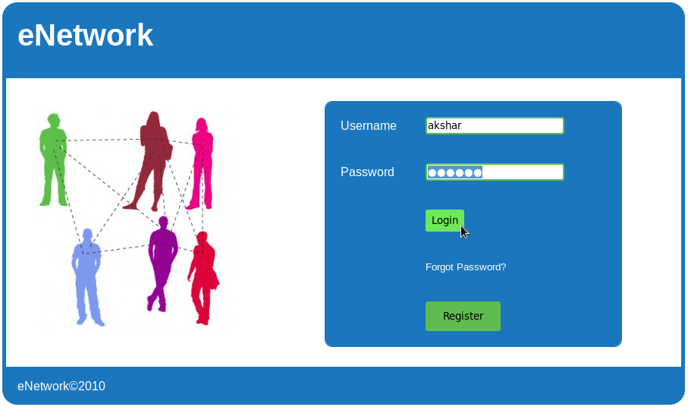

Slide 33
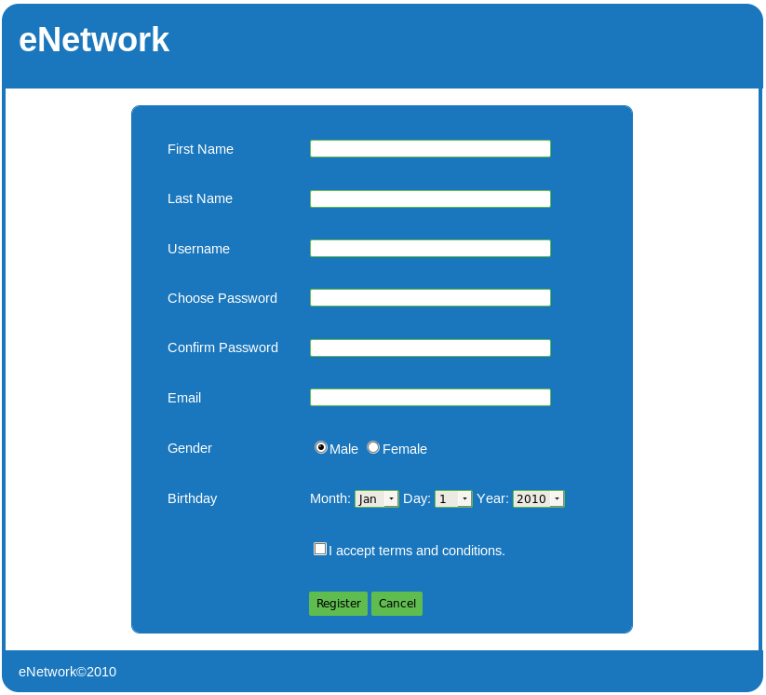

Slide 34
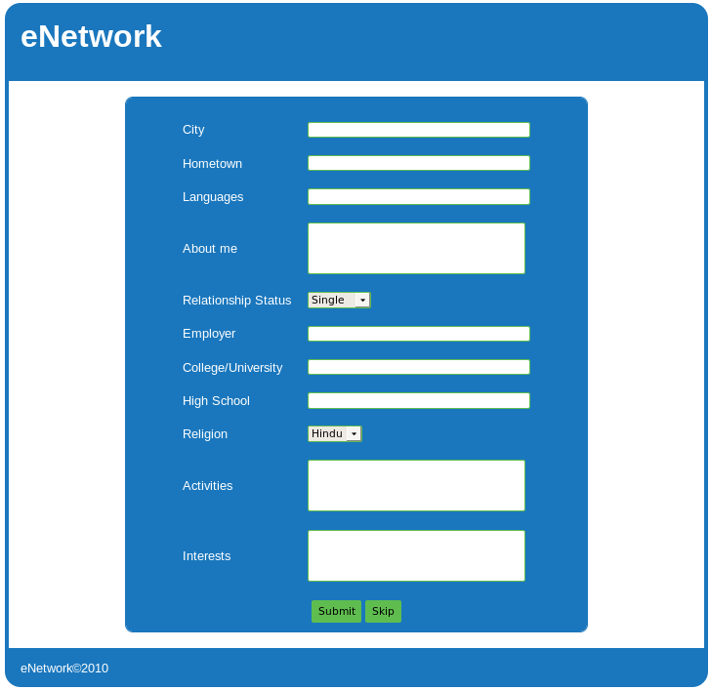

Slide 35
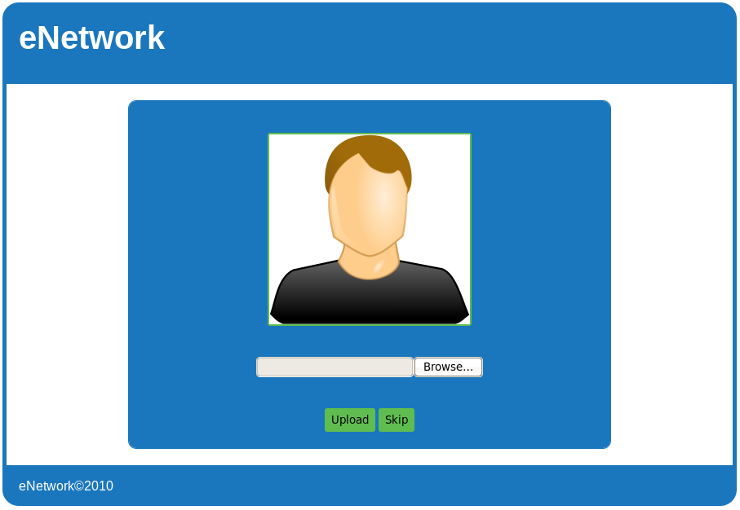

Slide 36
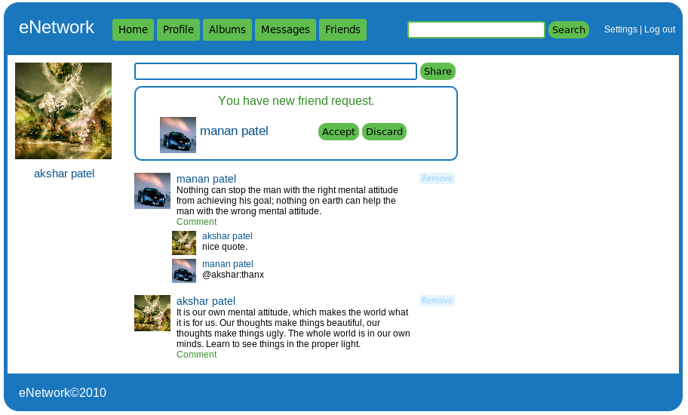

Slide 37
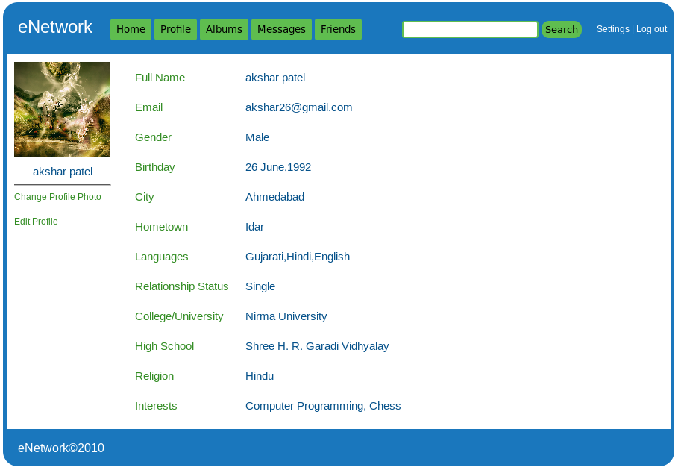

Slide 38
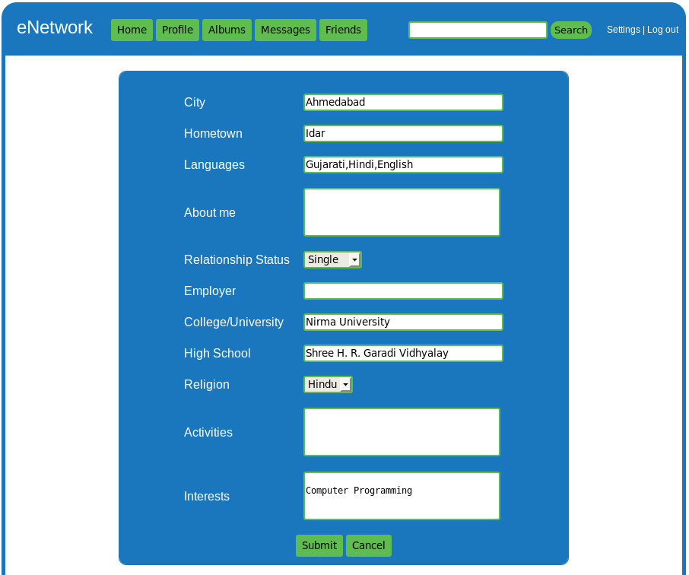

Slide 39
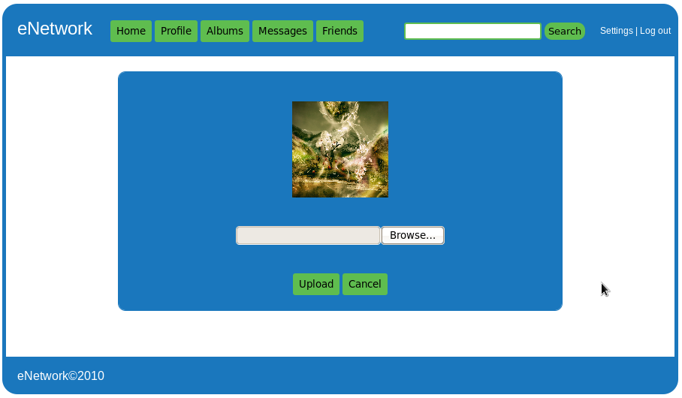

Slide 40
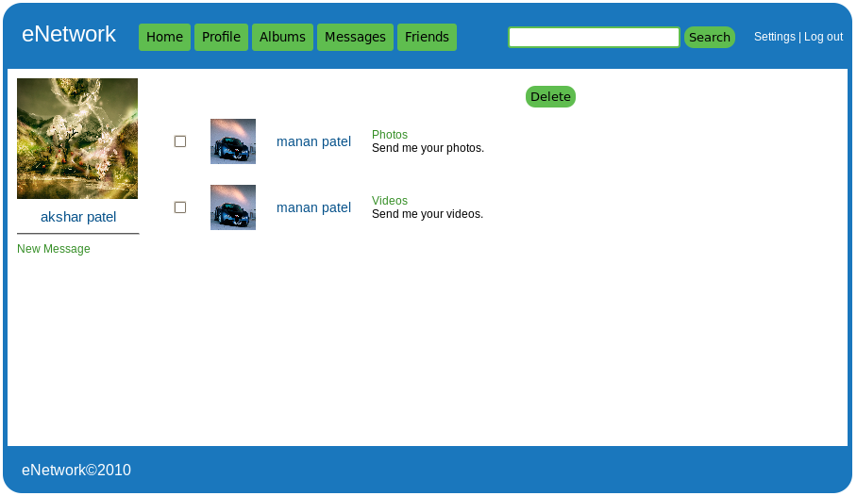

Slide 41
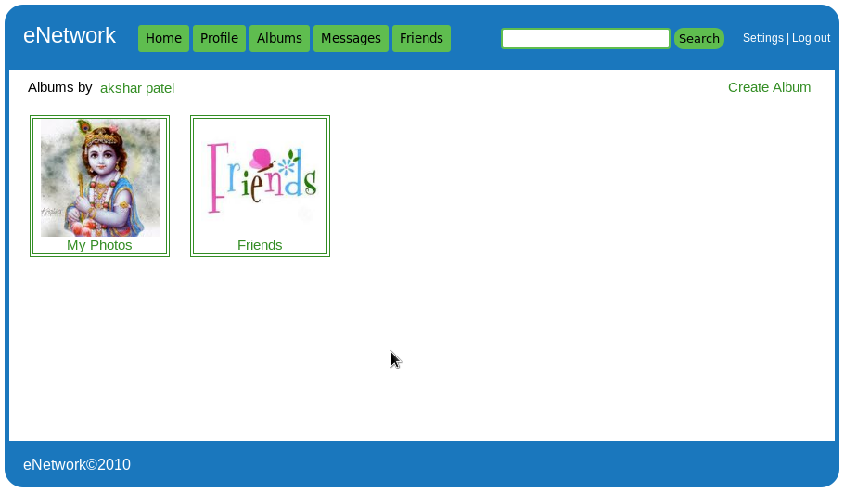

Slide 42
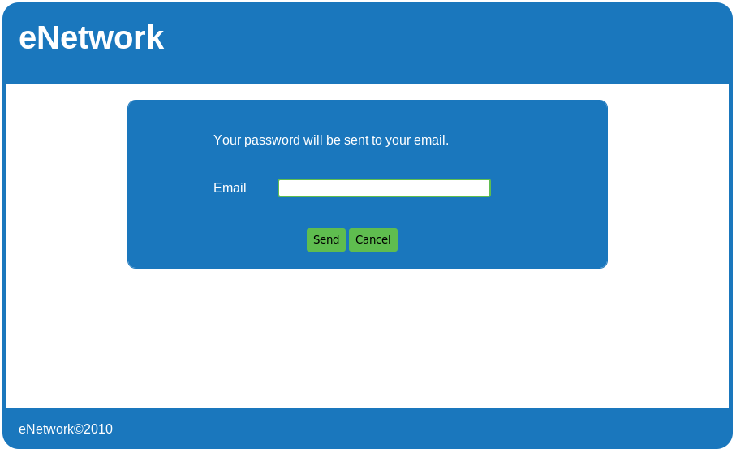

Slide 43


Slide 44


