Slide 1

Personal Productivity Application (Prodelp)
Presented by: Internal Guide:
Akshar Patel Prof. Maitrey Patel
(120563107026)

Slide 2
Outline
Introduction
Tools and Techniques
Survey
Project Management
System Requirements Specifications
Alternatives
Features
System Design
Data Dictionary
User Interface Design
Demo
Conclusion and Future Plan
References and Bibliography

Slide 3
Introduction

Slide 4
What is Prodelp?
Prodelp is a mobile app which is aimed at improving the personal productivity of any user.
Routines
Goals
Prodelp
Progress
Review

Slide 5
Routines
Time is limited
Accomplish more with less effort
Make better decisions
Reduce stress
High quality work
Less procrastination
Mind control

Slide 6
Goals
Work towards objectives
Helps in time management
Direct the effort
Prioritize the tasks
Gives clarity
Establishes habits

Slide 7
Progress and Review
Measure efficiency
Make changes
Strengths and Weaknesses
Sense of direction

Slide 8
Objectives
Make better use of time
Accomplish more goals
Assess and track the progress

Slide 9
Tools and Techniques

Slide 10
Tools and Techniques
Agile development methodology
Platform – Android
Front End – Java & XML
Back End – SQLite
Editor – Eclipse with ADT Plug-in

Slide 11
Survey

Slide 12
Literature Survey

Slide 13
Literature Survey
Daily Routines makes us more productive www.lifehack.org [1]
  Our daily routines can make a huge difference to how healthy, happy and productive we are.
  Remembering to track each activity is the hardest part.
  Instead of running around with a vague idea of what we want to accomplish, the right lifestyle routine can turn us into a productivity monster.

Slide 14
Literature Survey Contd...
Artists make the best use of time everyday
Daily Rituals: How Artists Work [2]
  Routine, in an intelligent man, is a sign of ambition.
  Artists followed regular practice to be more creative and productive.
Daily planning is essential for productivity
The Seven Habits of Highly Effective People [3]
  Daily planning is needed to accomplish important goals and activities
  Daily planning prioritizes the things and gets more done.

Slide 15
Literature Survey Contd...
Goal setting is important for accomplishing any target
www.lifehack.org [1]
  Setting a goal puts ourselves into the target as if we’d already accomplished it.
  Goal setting is one of the foremost weapons in the battle for self improvement.
  By having clear goals we can regularly check that the work we are busy with everyday is in alignment with our dreams.

Slide 16
User Survey

Slide 17
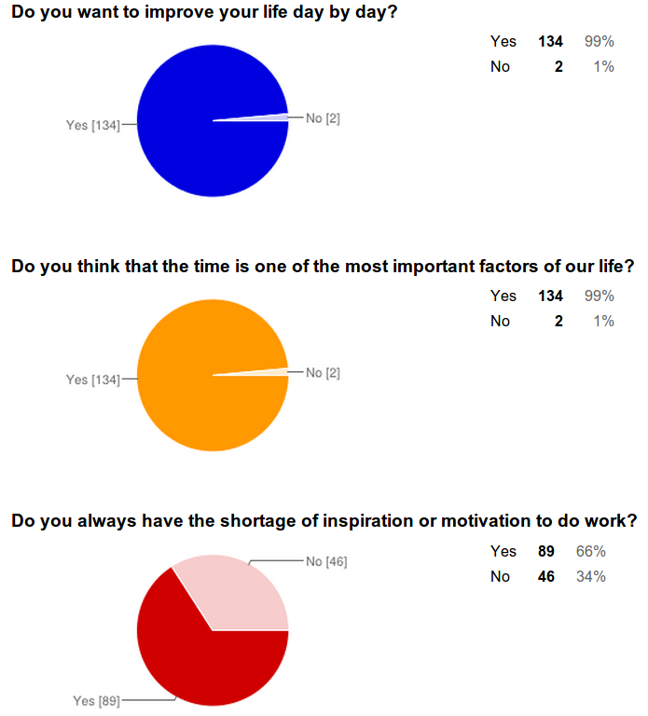

Slide 18
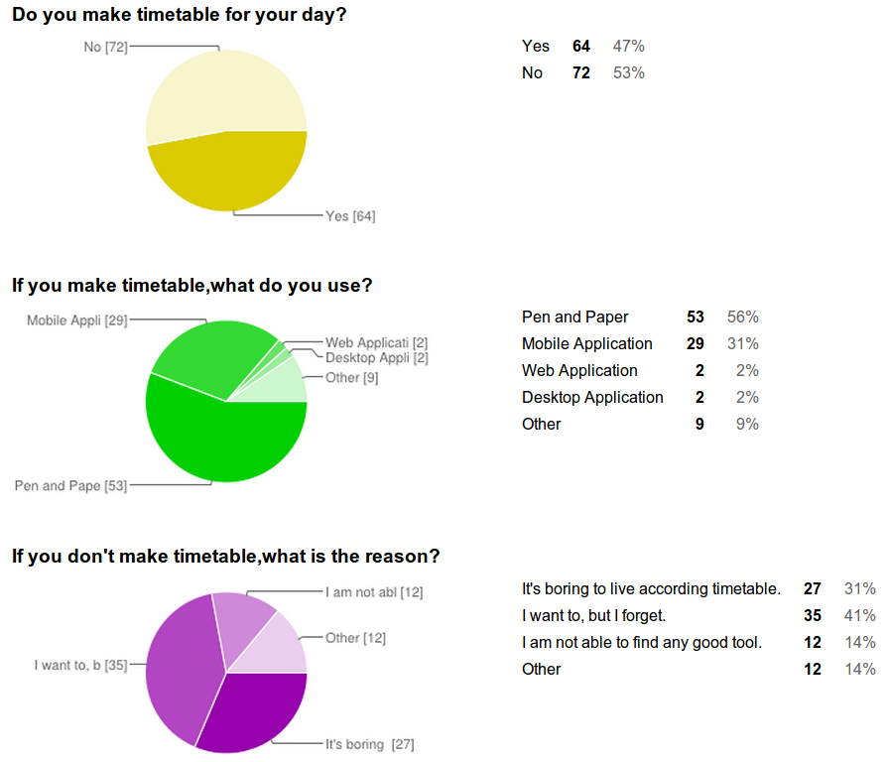

Slide 19
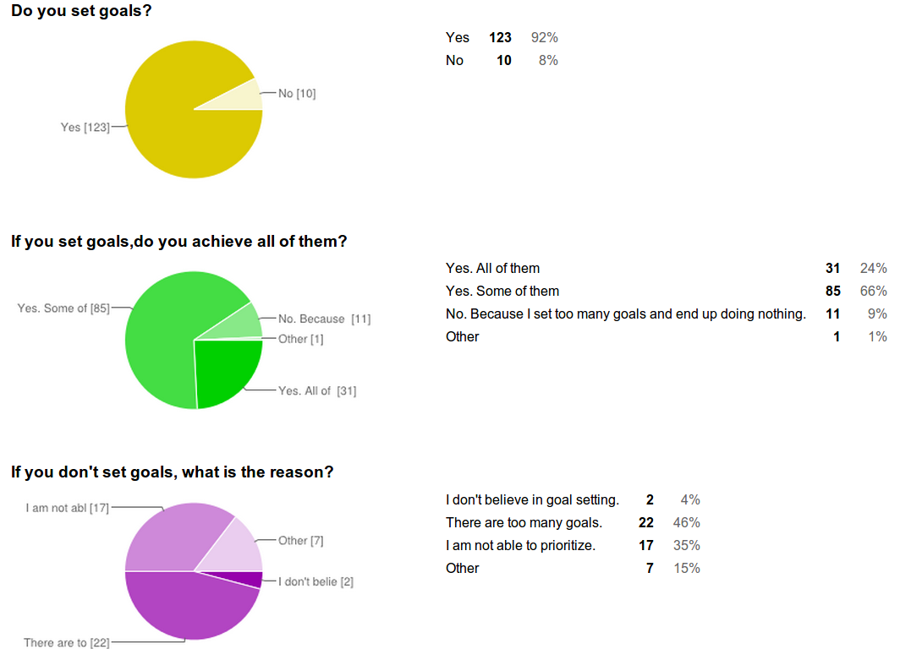

Slide 20
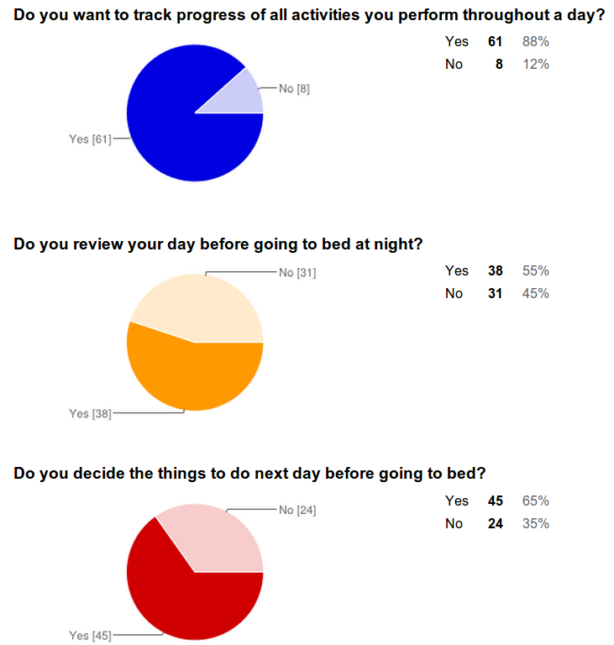

Slide 21
Project Management

Slide 22
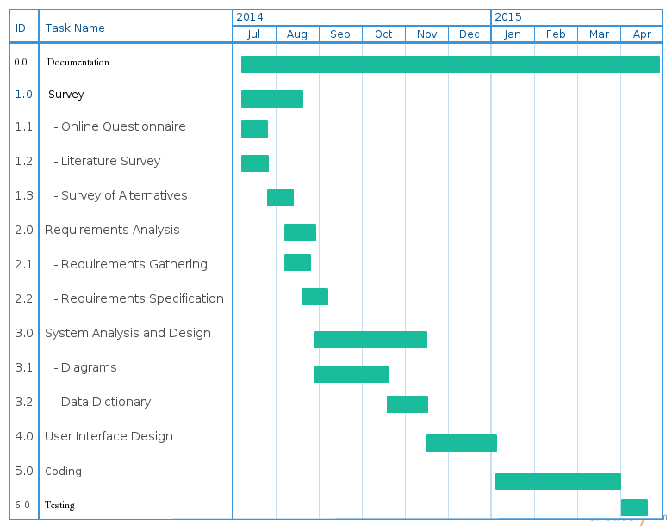
Gantt Chart

Slide 23
Software Requirements Specification

Slide 24
Functional Requirements
R.1 Manage routines
  R1.1 Add routine
    Input: new routine details
    Output: list of routines
  R1.2 Edit routine
    Input: modified routine details
    Output: list of routines
  R1.3 Delete routine
    Input: selected routine
    Output: list of routines
  R1.4 View routine
    Input: selected routine
    Output: list of activities

Slide 25
Functional Requirements Contd...
R.2 Manage goals
  R.2.1 Add goal
    Input: new goal details
    Output: list of goals
  R.2.2 Edit goal
    Input: modified goal details
    Output: list of goals
  R.2.3 Delete goal
    Input: selected goal
    Output: list of goals
  R.2.4 View goal
    Input: selected goal
    Output: goal information

Slide 26
Functional Requirements Contd...
R.3 View progress of routine and goals
  R3.1 View progress of today
    Input: select today
    Output: progress information
  R3.2 View progress of selected days
    Input: select required days
    Output: progress information

Slide 27
Functional Requirements Contd...
R.4 Review routine and goals
  R4.1 Review routine
    Input: check completed activities
    Output: progress information
  R4.2 Review goals
    Input: check completed goals
    Output: progress information

Slide 28
Alternatives

Slide 29
Limitations of Pen and Paper
No recommendations
No easy modifications
Not easy to manage
No reminders
Not able to track progress
Manual work
Not environment friendly

Slide 30
Limitations of Todo App
No recommendations
No routine feature
No progress tracking
No day review feature
Too basic features
No time limit on task
No visual information

Slide 31
Limitations of Calendar App
No recommendations
Not easy to copy routine
No progress tracking
No day review feature
Not focused on a day
Little complex for novice
No templates

Slide 32
Limitations of Project Management App
No recommendations
No routine feature
Not focused on a day
Not for personal productivity
Focused on team
Very much complex
Less flexible

Slide 33
Features

Slide 34
Features of Prodelp
Pen and Paper
Todo App
Prodelp
Calendar App
Project Management App

Slide 35
Features of Prodelp
Better routine
Effective goal setting
Day review
Progress tracking
Visual information
Automatic recommendations

Slide 36
Modules
Routines
Goals
Progress
Review

Slide 37
System Design

Slide 38
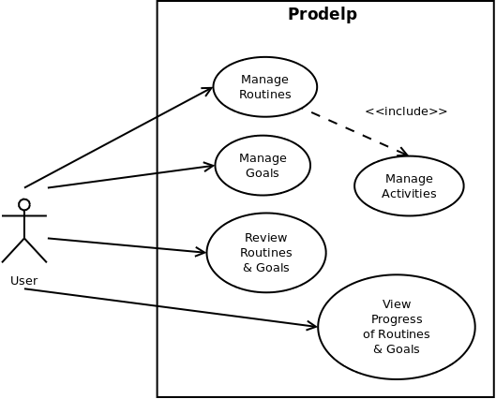
Use case Diagram

Slide 39
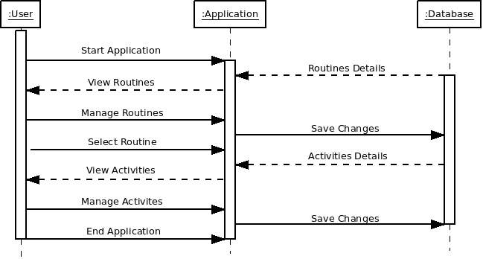
Sequence Diagram for
Manage Routines

Slide 40
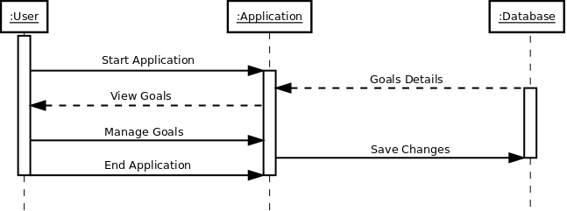
Sequence Diagram for
Manage Goals

Slide 41
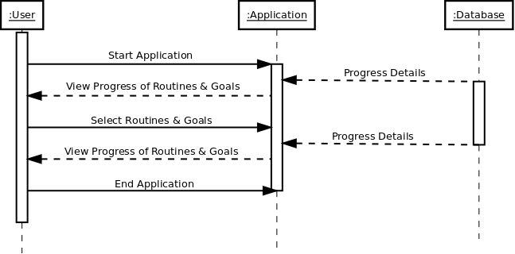
Sequence Diagram for
View Progress of Routines & Goals

Slide 42
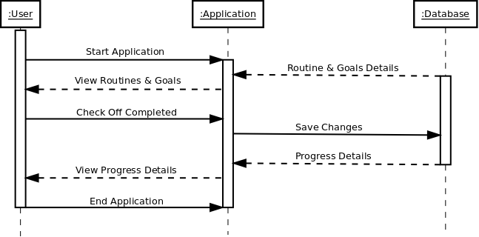
Sequence Diagram for
Review Routines & Goals

Slide 43
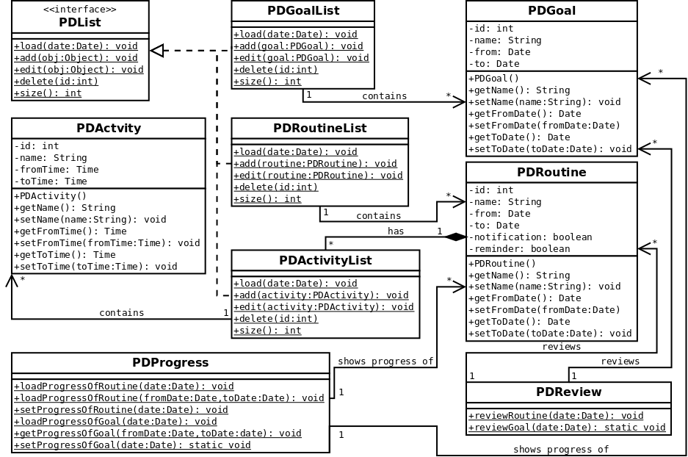
Class Diagram

Slide 44
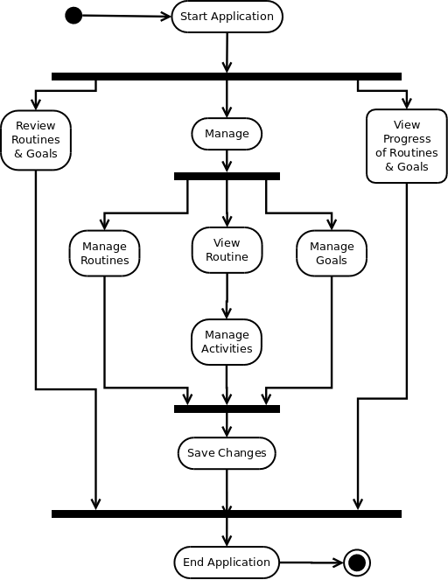
Activity Diagram for Prodelp

Slide 45
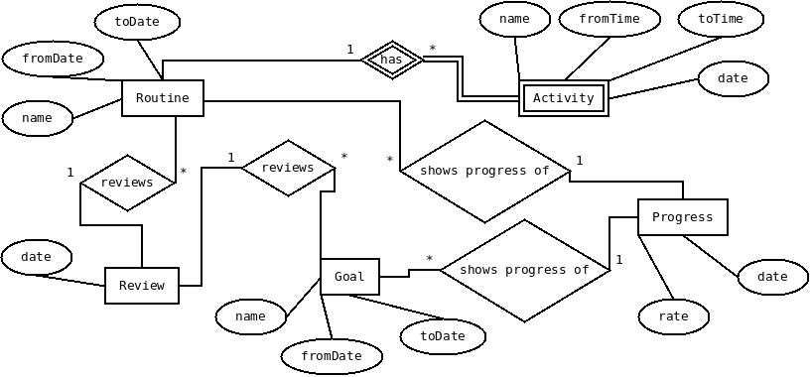
E-R Diagram

Slide 46
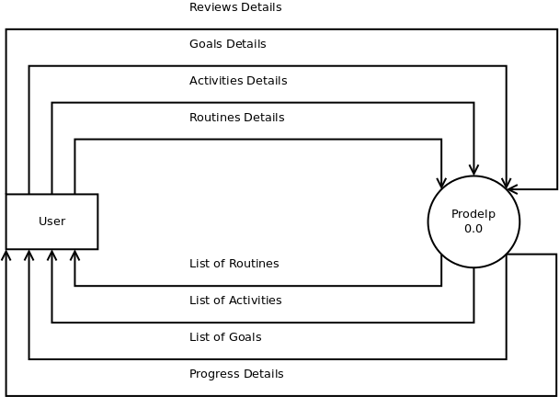
Context Level DFD

Slide 47
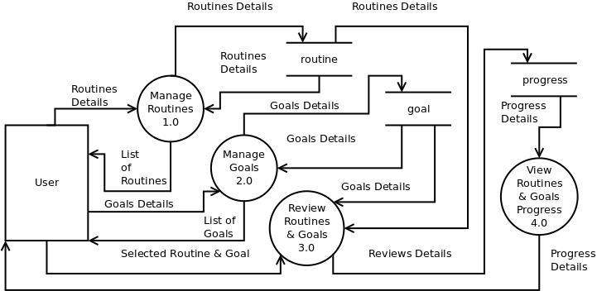
1st Level DFD

Slide 48
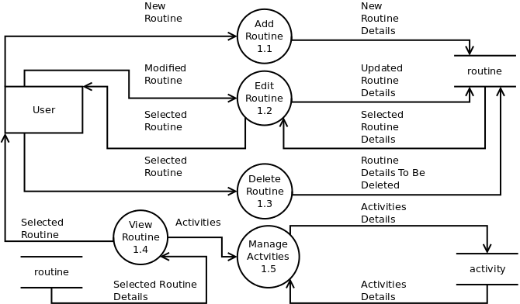
2nd Level DFD of Manage Routines

Slide 49
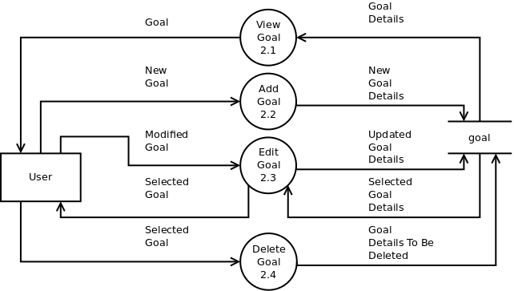
2nd Level DFD of Manage Goals

Slide 50
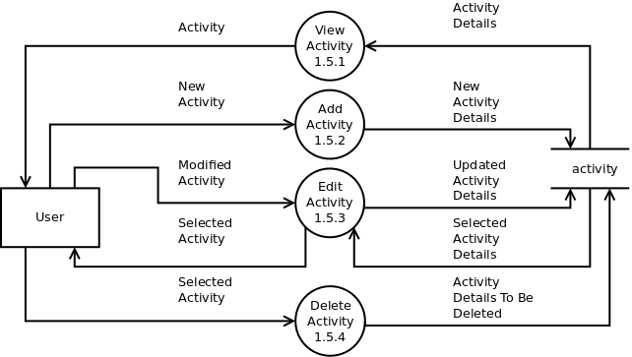
3rd Level DFD of Manage Activities

Slide 51
Data Dictionary

Slide 52
Routine Table
Field Name | Data Type | Not Null | Primary Key | Foreign Key | Reference Table | Description
r_id | INTEGER | Y | Y | -- | -- | Unique ID of Routine
r_name | TEXT | N | N | -- | -- | Name of Routine
r_fromDate | TEXT | N | N | -- | -- | Routine Start Date
r_toDate | TEXT | N | N | -- | -- | Routine End Date

Slide 53
Activity Table
Field Name | Data Type | Not Null | Primary Key | Foreign Key | Reference Table | Description
a_id | INTEGER | Y | Y | -- | -- | Unique ID of Activity
a_name | TEXT | N | N | -- | -- | Name of Activity
a_fromTime | TEXT | N | N | -- | -- | Activity Start Time
a_toTime | TEXT | N | N | -- | -- | Activity End Time
r_id | INTEGER | Y | N | Y | routine | Routine ID from Routine Table

Slide 54
Goal Table
Field Name | Data Type | Not Null | Primary Key | Foreign Key | Reference Table | Description
g_id | INTEGER | Y | Y | -- | -- | Unique ID of Goal
g_name | TEXT | N | N | -- | -- | Name of Goal
g_fromDate | TEXT | N | N | -- | -- | Goal Start Date
g_toDate | TEXT | N | N | -- | -- | Goal End Date

Slide 55
Progress Table
Field Name | Data Type | Not Null | Primary Key | Foreign Key | Reference Table | Description
p_id | INTEGER | Y | Y | -- | -- | Unique ID of Progress
p_date | TEXT | N | N | -- | -- | Date of Review
p_rate | TEXT | N | N | -- | -- | Calculated Progress Percentage

Slide 56
Database Implementation

Slide 57
View
Cursor Adapter
AsyncTask
Database

Slide 58
View
Cursor Adapter
Cursor Loader
AsyncTask
Database

Slide 59
App 1
SyncAdapter
Widgets
App 2
Content Providers
Search
Cursor Loader
Not SQLite
SQLite

Slide 60
View
Content Resolver
Cursor Adapter
Data Contract
Content Providers
Cursor Loader
Database Helper
Database

Slide 61
User Interface Design

Slide 62
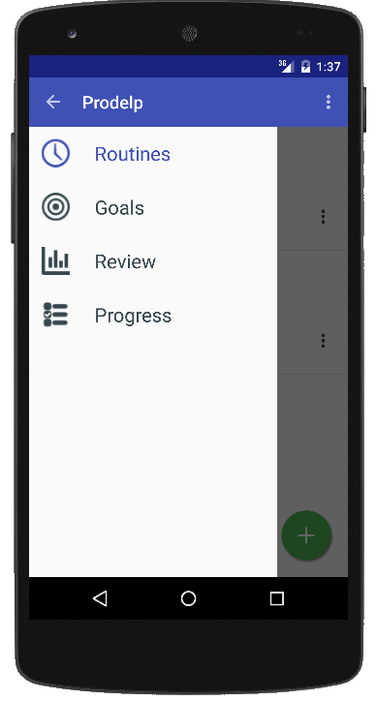

Slide 63
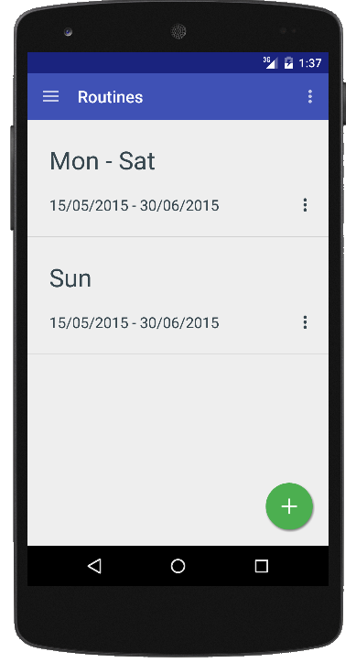

Slide 64
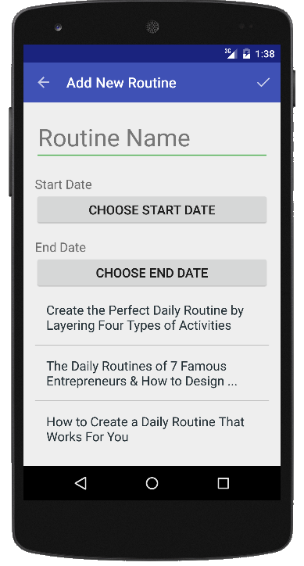

Slide 65
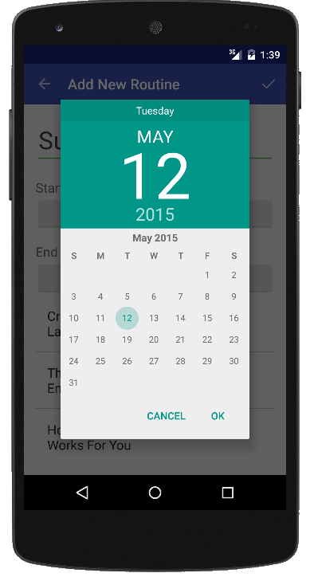

Slide 66
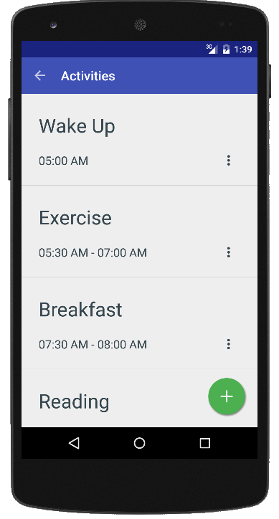

Slide 67
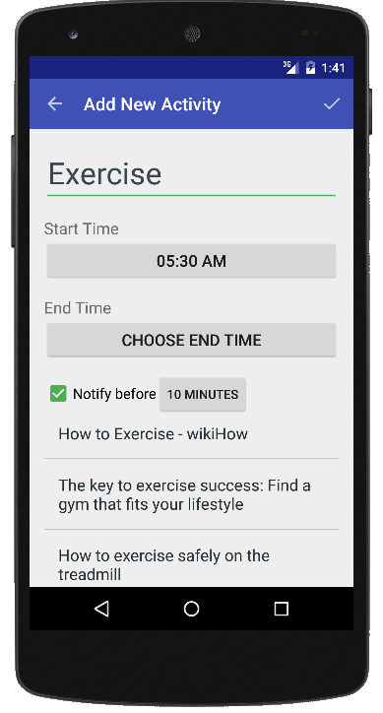

Slide 68
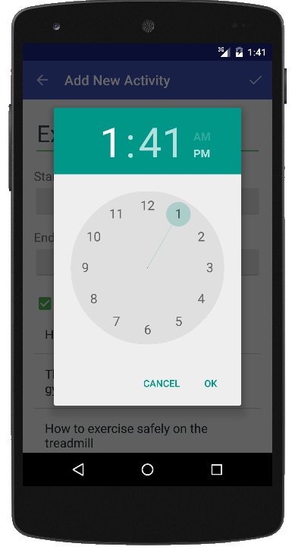

Slide 69
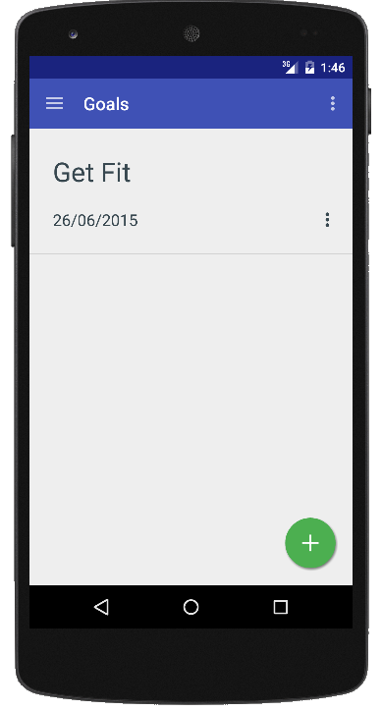

Slide 70
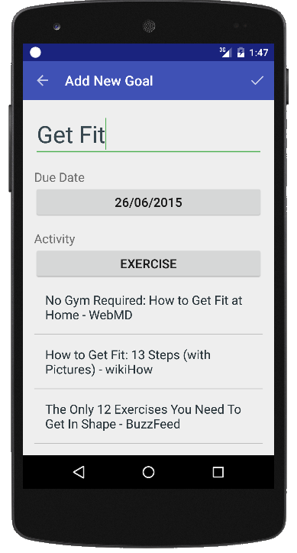

Slide 71
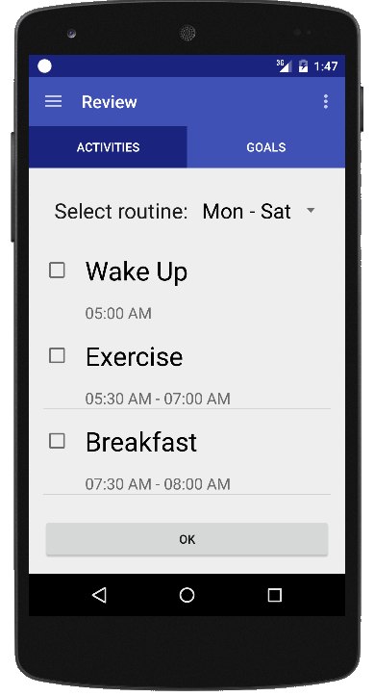

Slide 72
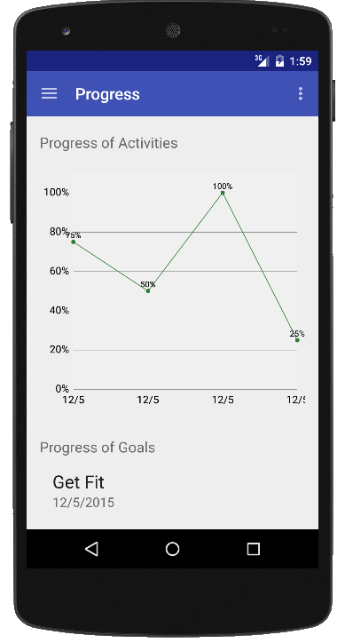

Slide 73
Auto Recommendations

Slide 74
Auto Recommendations
Keyword
Google
HTML Page
Filter
Links
Parser
Recommendations

Slide 75
Demo

Slide 76
Conclusion and Future Plan

Slide 77
Conclusion and Future Plan
Conclusion
  Analysis and Design
  User Interface Design
  Coding
    Database Implementation
    Routines, Activities and Goals
    Progress and Review
    Auto recommendations and Notification
Future Plan
  First time help wizard
  Templates
  SMS and Email Notifications
  More formats for Date and Time

Slide 78
References and Bibliography

Slide 79
References and Bibliography
Websites
  [1] www.lifehack.org
    Siobhan Harmer, Lifehack, ”Amazing routine of 7 successful entrepreneurs”,
    Available: http://www.lifehack.org/articles/productivity/use-these-daily-routines-7-famous-entrepreneurs-create-your-own-routine.html
    Last Access: 8/10/2014 12:00 PM
    Joel Runyon, Lifehack, “Routines make you more productive. You probably just never knew how”
    Available: http://www.lifehack.org/articles/productivity/why-using-routines-will-make-you-more-productive.html
    Last Access: 1/10/2014 11:00 AM

Slide 80
References and Bibliography Contd...
Websites
  [1] www.lifehack.org
    Dustin Wax, Lifehack, “The Science of setting goals”
    Available: http://www.lifehack.org/articles/productivity/the-science-of-setting-goals.html
    Last Access: 25/9/2014 8:20 PM
    Barbara, Lifehack, “Evaluating you goals for more productivity”
    Available: http://www.lifehack.org/articles/lifehack/evaluating-your-goals-for-more-productivity.html
    Last Access: 5/10/2014 9:30 PM

Slide 81
References and Bibliography Contd...
Books
  [2] Mason Currey, “Routine of W H Auden” in Daily Rituals: How Artists Work, 1st ed. New York: Knopf Doubleday Publishing Group, 2013, pp. 13-15
  [3] Stephen Covey, ”Fourth Generations of Time Management” in The Seven Habits of Highly Effective People, 1st ed. New York: Simon and Schuster,2004, pp. 75-80

Slide 82
Thank You
Your time is limited, so don't waste it living someone else's life. Don't be trapped by dogma - which is living with the results of other people's thinking. Don't let the noise of others' opinions drown out your own inner voice. And most important, have the courage to follow your heart and intuition.
Steve Jobs

