Slide 1
TOPIC
Budget Based Tourist Destination Expert System
A rule-based Prolog expert system that recommends destinations by budget, travel type and season
Name: Akshar D Patel, Purva Patel
Enrollment number: 12502120601005, 26D2DAI017
Department: AIDS
Subject: Artificial Intelligence Concepts and Application (AICA)
Subject code: 102120301
Division: 3AI1 Batch: 1A12, 1D12

Slide 2
Introduction
Aim
Why an expert system?
Suggest tourist destinations that fit a traveller's budget, travel type and number of days
Replace manual searching with logical, explainable reasoning
Knowledge stored as facts and IF-THEN rules
Inference engine derives recommendations
Can explain why a place was suggested
Easy to extend with new destinations
Tools: SWI-Prolog | Concepts: Predicate logic, Unification, Backward reasoning, Backtracking
AICA | 3AI1 | Budget Based Tourist Destination Expert System
2

Slide 3
Modules of Project
1
2
Knowledge Base
Rule Engine
Destination facts: name, type, cost per day, best season
Rules for budget, type and season matching
3
4
Inference & Query
User Interface
Backward chaining with backtracking to list all matches
Console menu to enter budget, days and preference
AICA | 3AI1 | Budget Based Tourist Destination Expert System
3

Slide 4
Implementation: Knowledge Base & Rules
destination(manali, hills, low).
destination(munnar, hills, low).
destination(goa, beach, mid).
destination(gokarna, beach, mid).
destination(jaipur, heritage, high).
destination(udaipur, heritage, high).
flood_prone(goa).
category(B, low) :- B < 10000.
category(B, mid) :- B >= 10000, B =< 25000.
category(B, high) :- B > 25000.
recommend(Budget, Type, Place) :-
category(Budget, Cat),
destination(Place, Type, Cat).
recommend(Budget, Type, monsoon, Place) :-
recommend(Budget, Type, Place),
\+ flood_prone(Place).
Facts store destination, type and budget category
category/2 converts budget into low / mid / high
recommend/3 applies rules R1–R3
recommend/4 applies R4: avoid flood-prone places
AICA | 3AI1 | Budget Based Tourist Destination Expert System
4

Slide 5
Sample Rules & Working
Rule | IF (conditions) | THEN (recommend)
R1 | Budget < 10,000 AND Type = Hills | Suggest budget hill stations
R2 | Budget 10,000–25,000 AND Type = Beach | Suggest mid-range beach spots
R3 | Budget > 25,000 AND Type = Heritage | Suggest premium heritage trips
R4 | Season = Monsoon | Avoid flood-prone destinations
Flow: User input → Match rules → Filter by budget → Rank → Display + explain
AICA | 3AI1 | Budget Based Tourist Destination Expert System
5

Slide 6
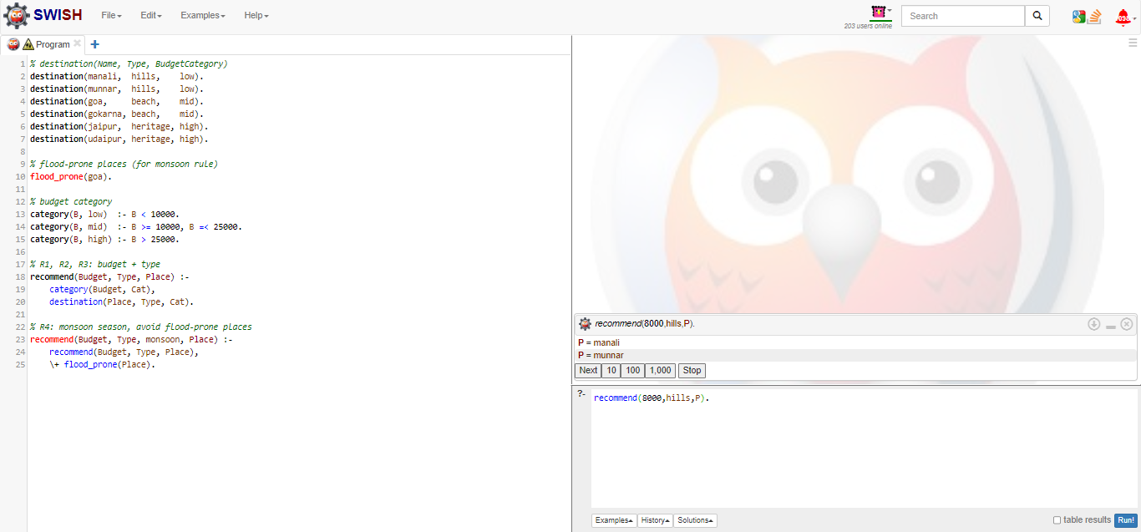
Snapshot 1: Low Budget, Hills (Rule R1)
Query recommend(8000, hills, P): budget 8000 is below 10,000, so category/2 gives "low" (R1). Prolog then finds hills destinations in the low category and returns manali; backtracking gives munnar.
AICA | 3AI1 | Budget Based Tourist Destination Expert System
6

Slide 7
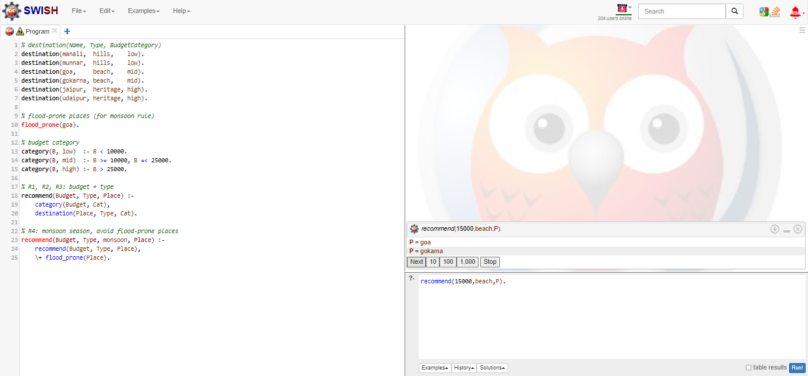
Snapshot 2: Mid Budget, Beach (Rule R2)
Query recommend(15000, beach, P): 15000 lies between 10,000 and 25,000, so the category is "mid" (R2). Matching beach places are goa and gokarna, shown one by one through backtracking.
AICA | 3AI1 | Budget Based Tourist Destination Expert System
7

Slide 8
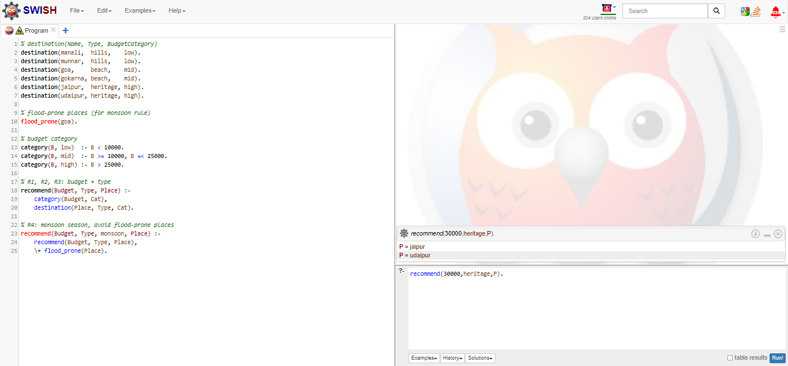
Snapshot 3: High Budget, Heritage (Rule R3)
Query recommend(30000, heritage, P): 30000 is above 25,000, so the category is "high" (R3). The system returns the premium heritage destinations jaipur and udaipur.
AICA | 3AI1 | Budget Based Tourist Destination Expert System
8

Slide 9
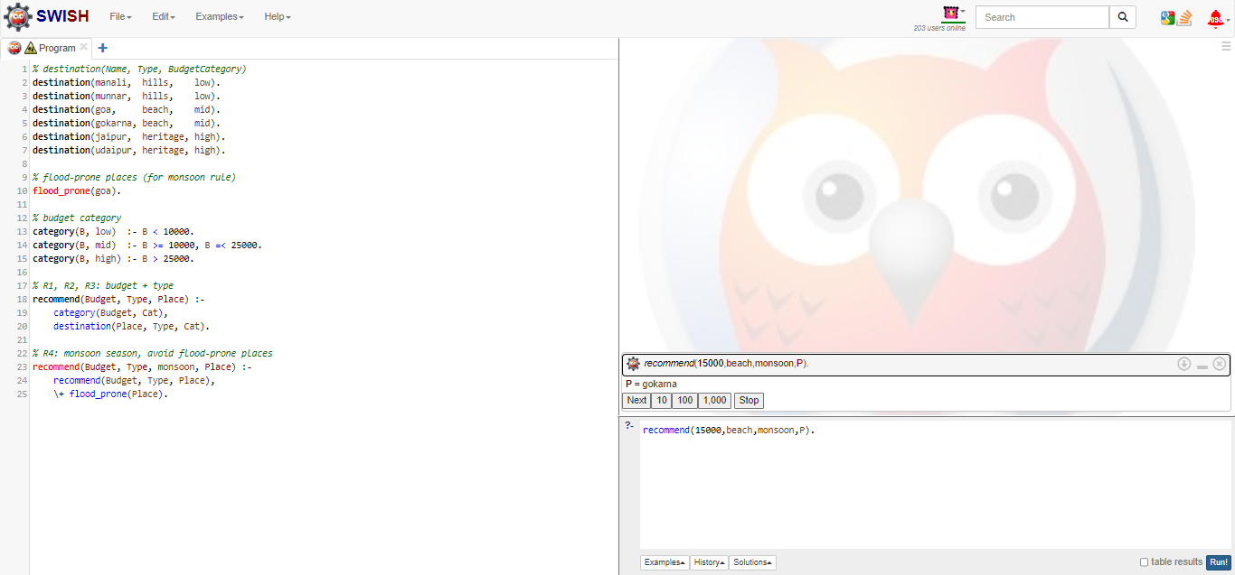
Snapshot 4: Monsoon Season Rule (Rule R4)
Query recommend(15000, beach, monsoon, P): the normal rule gives goa and gokarna, but goa is a flood-prone fact, so \+ flood_prone(Place) removes it. Only gokarna is recommended.
AICA | 3AI1 | Budget Based Tourist Destination Expert System
9

Slide 10
Conclusion
The expert system recommends destinations using facts, rules and logical inference
Budget, days and travel type are combined to filter suitable places
Prolog unification and backtracking give all possible answers
Future scope: add more cities, hotels, fuzzy logic for preferences, and a GUI
GitHub Repository: https://github.com/<username>/<repository>
AICA | 3AI1 | Budget Based Tourist Destination Expert System
10

Slide 11
Breadth First Search
Theory
Definition
Algorithm
Breadth First Search (BFS) is an uninformed search technique that explores a tree or graph level by level. It visits all nodes at the current depth before moving to the next depth, and uses a queue (FIFO) to remember which node to visit next.
Put the start (root) node in the queue.
Remove the front node from the queue and visit it.
Add all its unvisited neighbours to the back of the queue.
Repeat steps 2 and 3 until the goal is found or the queue is empty.
Properties
Complete for finite branching
Finds the shortest path (unweighted)
Time and space: O(b^d)
AICA | 3AI1 | Budget Based Tourist Destination Expert System
11

Slide 12
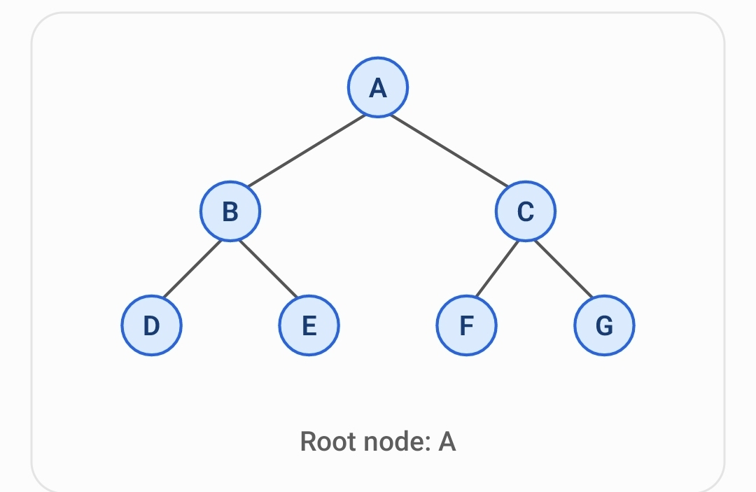
Breadth First Search
Working
BFS traversal step by step
Step | Node visited | Queue after adding neighbors
1 | A | B, C
2 | B | C, D, E
3 | C | D, E, F, G
4 | D | E, F, G
5 | E | F, G
6 | F | G
7 | G | Empty
BFS traversal order: A → B → C → D → E → F → G
AICA | 3AI1 | Budget Based Tourist Destination Expert System
12

Slide 13
Breadth First Search
Advantages & Disadvantages
Notice that BFS visits A first, then its children B and C, and finally the next level D, E, F, and G.
Advantages
Disadvantages
Easy to understand and implement.
Complete for finite branching graphs.
Finds the shortest path in an unweighted graph.
Requires more memory because it stores nodes in a queue.
Can be slow for very large search spaces.
AICA | 3AI1 | Budget Based Tourist Destination Expert System
13

