Slide 1

G2M Case Study
Virtual Internship
21-July-2022

Slide 2
G2M Cab Industry Case Study
Summary: XYZ is a private equity firm in US. Due to remarkable growth in the Cab Industry in last few years and multiple key players in the market, it is planning for an investment in Cab industry.
Objective : Identifying the right company for making investment.
Operations:
Data Wrangling.
Feature analysis and visualization.
Finding possible variable to take decision
Recommendations for investment

Slide 3
Data Sets
Four datasets.
Cab_Data.csv – this file includes details of transaction for 2 cab companies
Customer_ID.csv – this is a mapping table that contains a unique identifier which links the customer’s demographic details
Transaction_ID.csv – this is a mapping table that contains transaction to customer mapping and payment mode
City.csv – this file contains list of US cities, their population and number of cab users

Slide 4
Expected Answer
Which company is operating better in the different cities?
Which company have strong balance sheet at the month/year end?
Which company earns more profit?
Which company have big market share?

Slide 5
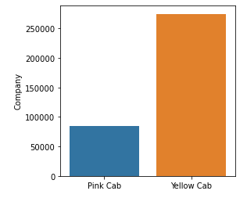
Profit Analysis
Company-wise Distribution

Slide 6
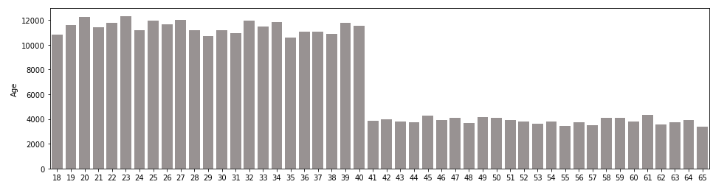
Profit Analysis
Age distribution

Slide 7
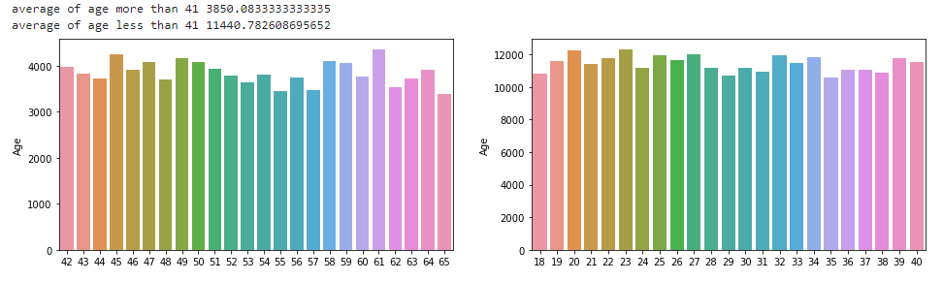
Profit Analysis
Age-Group distribution

Slide 8
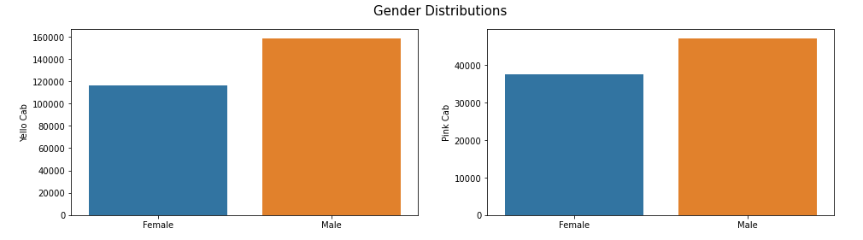
Profit Analysis
Gender Distribution

Slide 9
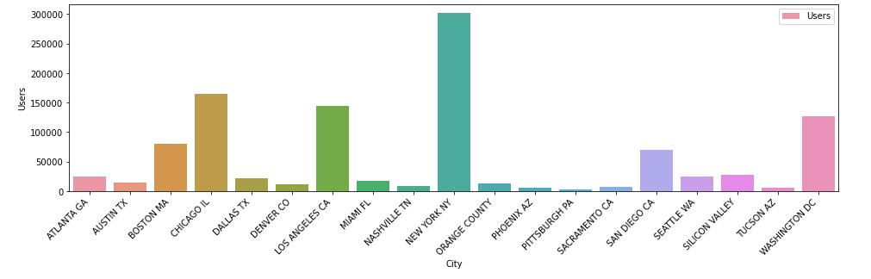
Profit Analysis
City-wise User Distribution

Slide 10
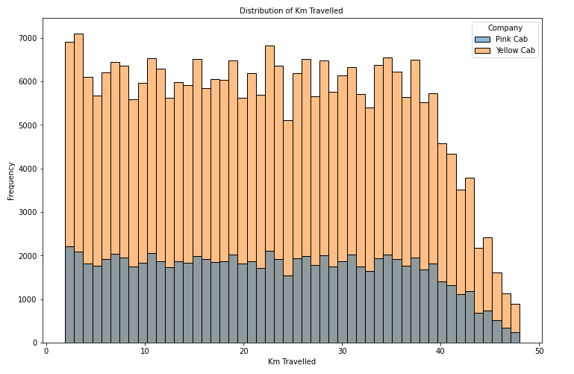
Profit Analysis
KM Travelled Distribution

Slide 11
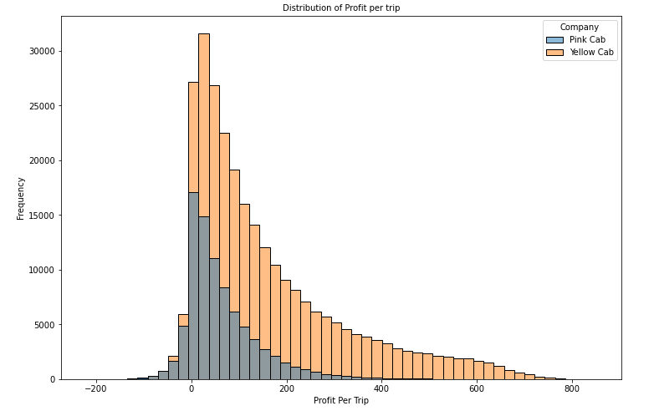
Profit Analysis
Profit per trip

Slide 12
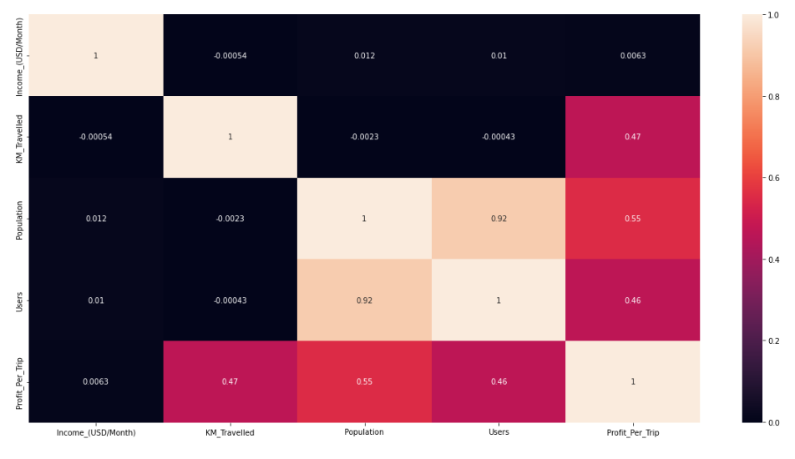
Profit Analysis
Correlations across variable

Slide 13
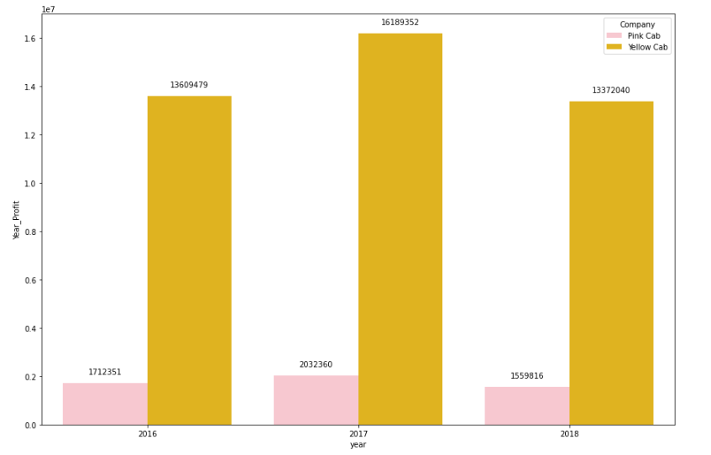
Yearly Profit Analysis

Slide 14
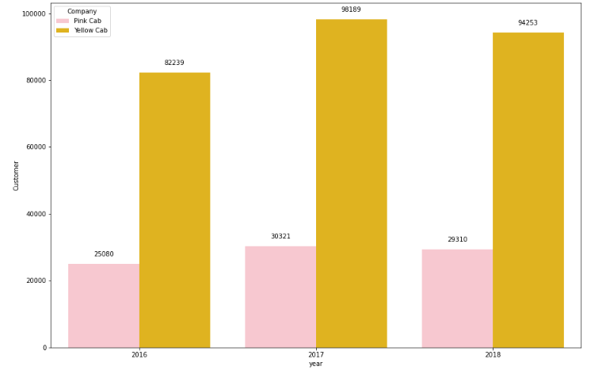
Customer base Analysis

Slide 15
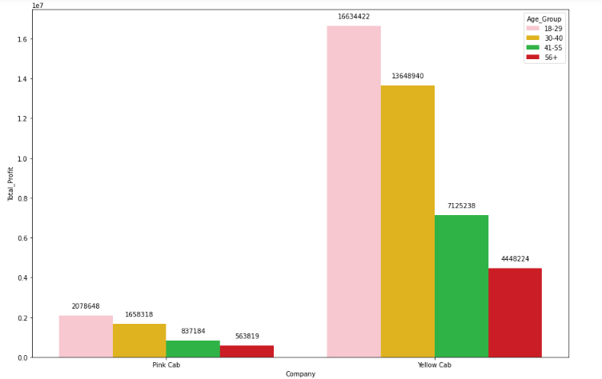
Age-wise distribution

Slide 16
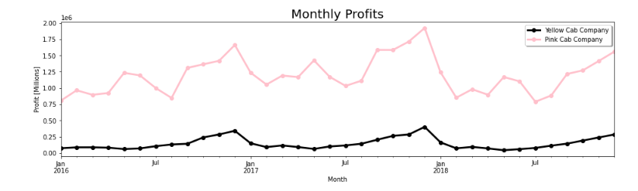
Monthly Revenue

Slide 17
Recommendations
Which company is operating better in the different cities?
Yellow Cab company is operating better in the different cities
Which company has a strong balance sheet at the month/year end?
Yellow Cab Company has higher profit compared to Pink Cab company, monthly as well as Yearly.
Which company earns more profit?
Yellow Cab Company earns more profit
Which company has a greater market?
Yellow Cab Company

Slide 18
Thank You

