Slide 1
Lesson 4:

Slide 2
Last Workshop we discussed about modelling algorithms, however there’s one technique which we did not talk about

Slide 3
“When in doubt use Xgboost”

Slide 4
A
Quick
Recap

Slide 5
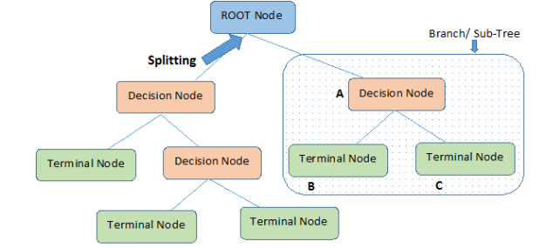
Decision Trees
In this technique, we split the population or sample into two or more sets based on most significant splitter / differentiator in features.

Slide 6
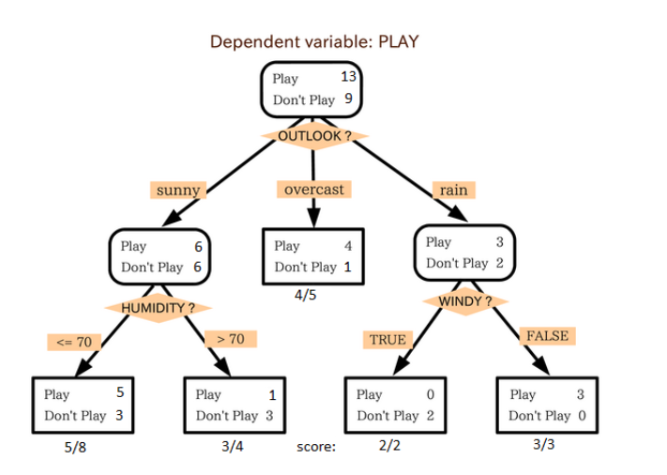
Decision Trees - Example
.

Slide 7
Ensembling

Slide 8
Ensemble
Ensemble models in machine learning operate on a similar idea as crowdsourcing. They combine the decisions from multiple models to improve the overall performance.
They can be classified into two parts :
Simple
Advanced
The difference is on how we combine outputs from different models

Slide 9
Simple Ensemble
Simple Ensemble models is when we combine the outputs from various models in any of these three ways:
Max Voting
Averaging
Weighted Average - more priority to some

Slide 10
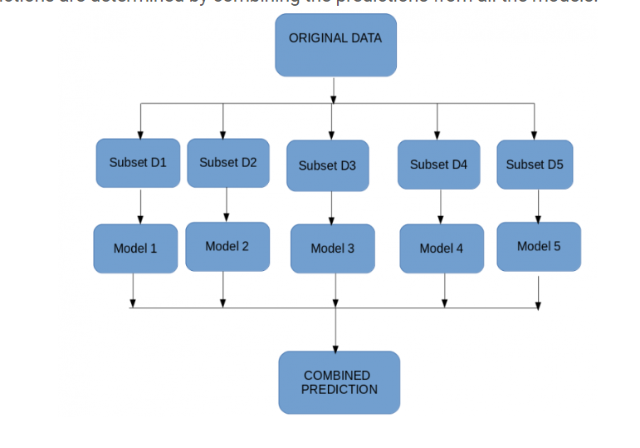
Advanced Ensemble
Simple Ensemble models is when we combine the outputs from various models in any of these three ways:
Stacking - In this technique we fit the training set on many models and the predictions from one model is build to build features for the next model. Thus, different models are stacked together
Bagging -

Slide 11
We have already seen one advanced ensembling technique

Slide 12
Random Forest Classifiers
It is an ensemble of Decision Trees
We basically work with a forest of trees
Each trees chooses one class
The class with the most votes from the most trees wins
Say I want 5 trees,
I will split the training data into 5 parts
Say for a certain record, 3 trees predicted higher for class 1
The output of the forest will be 1

Slide 13
Advanced Ensemble
3) Boosting :
Creates a strong learner from the weighted average of weak classifiers
Boosting is a sequential process, where each subsequent model attempts to correct the errors of the previous model. The succeeding models are dependent on the previous model.
The observations which are incorrectly predicted, are given higher weights. The succeeding model tries to fix these errors
subset creation is not random and depends upon the performance of the previous models: every new subsets contains the elements that were (likely to be) misclassified by previous models

Slide 14
Used a boosting algorithm on our titanic set
XGBOOST!!!

Slide 15
Now that we have found the best algorithm to use, lets finally fit the model on the whole training set and see how well it performs on the testing set

Slide 16
MODEL EVALUATION

Slide 17
Model Evaluation
Metrics to choose the the best model for our dataset
So for all the modelling till now we have just used accuracy_score, but there are so many other metrics which might make more sense than just a simple accuracy check
Since the outputs of regression and classification models are very different, we have different metrics for regression and classification

Slide 18
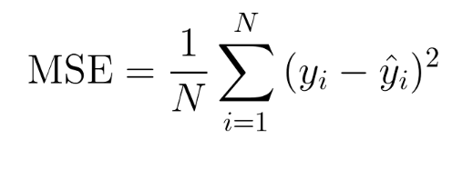
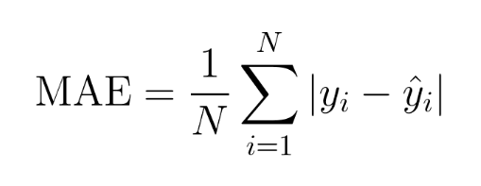
Regression evaluation metrics
Mean Square Error:
Mean Absolute Error:

Slide 19
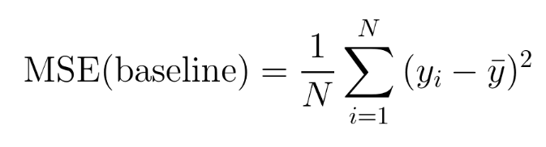
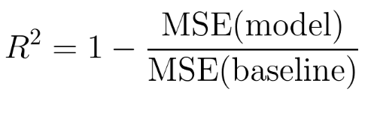
Regression evaluation metrics
R2:
It is similar to MSE
Easier to interpret
Always between 0 and 1
Thus the error cannot be too large or too small
Closer to 1 less the error
Can be seen as a ‘general scale’ measurement

Slide 20
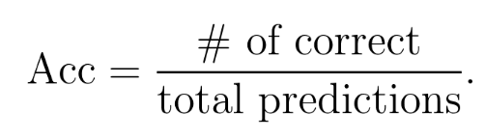
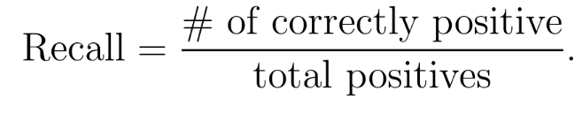
Classification evaluation metrics
Accuracy_score:
Recall
It is a useful metric when one class has only a handful of entries
Tells us that for the class which has a very few entries, how many did we get write
Accuracy doesnt make sense. Say if we have 5 entries for class 1 and 50000 for class 0, our model predicted 0 for all entries, It would still lead to high accuracy

Slide 21
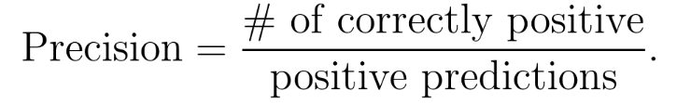
Classification evaluation metrics
Precision
It is a useful metric when one class has only a handful of entries
Out of all the positive predictions the model made, how many were correct
Measure of false positives

Slide 22

Classification evaluation metrics
F1 Score
Harmonic mean of precision and recall
Thus is a great measure of how good the model is
It has a great property that any of the metric is much lower than the other, then the value of F1 will be low. Indicating inaccuracy

