Slide 1
Lesson 2: Data Processing

Slide 2
Data Processing
A Series of operations to transform, combine and analyze data
Data Exploration
Data Cleaning
Feature Engineering

Slide 3
Data Exploration
Initial Analysis to get a better understanding of the dataset
It can be done by the following methods
Data Visualization
Mathematical Tools - Measure of Central Tendencies
We will look at three of the most common techniques
Feature Identification
Univariate Analysis
Multivariate Analysis

Slide 4
Feature Identification
Differentiate features from target variables
Identify the features as either continuous or categorical
Identify the problem as a Regression or Classification

Slide 5
Categorical vs Continuous Variables
Categorical variables contain a finite number of categories or distinct groups. They may or may not have a logical order
Continuous Variables can contain infinite number of values and are not limited to a class of values
Let us identify the categorical and continuous features

Slide 6
Classification vs Regression - Mini-introduction
Types of Supervised Learning algorithms
Classification: The target variable is categorical
Regression: The target variable is continuous

Slide 7
Univariate Analysis
Continuous Variables:
Mathematical Tools: Central tendency - Mean, Median, Standard Deviation
Graph: Histogram graph to understand spread of the data
Great way to identify outliers
Categorical Variables:
Mathematical Tools: Frequency - Count/Total
Graph: Bar graph to understand spread of data

Slide 8
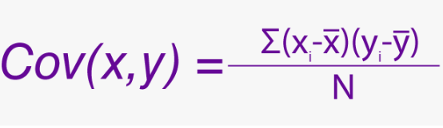
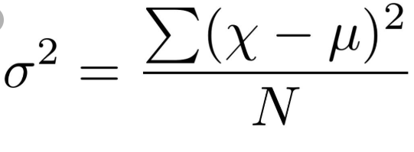

Multivariate Analysis
Helps us find relations between multiple variables. For our case, let us consider 2 variables.
Continuous Variable vs Continuous Variable
Mathematical Tool: Correlation = Covariance(X,Y) / sqrt( Var(X)* Var(Y))
Graph: Scatter plot to visualize relationship
Categorical Variable vs Categorical Variable :
Mathematical Tool: Chi-Square test - Helps in determinary dependence of variables and thus removal of a variable if completely dependent on the other
Graph: Two way table - A table with (m,n) rows and columns where m,n are number of categories in both each variable.

Slide 9
Data Cleaning
Process of identifying irrelevant,corrupt,incorrect and missing data and treating it by either removal or replacement. Popular Methods used:
Removal of Duplicates
Greater importance to one record than other.
Sometimes intentionally performed in classification problems with uneven class distribution
Usually arises when combining data from various sources
Removal of Irrelevant Records
Irrelevant data without exceptions must be removed
Example would be having unnecessary classes in categorical feature

Slide 10
Data Cleaning
Fix data errors
Convert text ‘123’ to 123. Conversion of actual text to numerical equivalents happens in Feature Engineering
If a feature has the same value represented in two ways then make them the same. Example if a feature has ‘Mr Sid’ and ‘Mr.Sid’
Removal of whitespaces
Spell Check
Filling in missing values - Data Imputation

Slide 11
Data Imputation
Dropping missing values is sub-optimal because when you drop observations, you drop information.
Data Imputation is the method of filling in missing values. Even if we impute values to missing fields, you’re not adding any real information. You’re just reinforcing the patterns already provided by other features.
Data Imputation is necessary because some learning algorithms fail otherwise
These are the popular methods to Impute Data:

Slide 12
Data Imputation
Create new value
Applicable to just categorical features
Create a new value called ‘Missing’. The learning algorithm will deal with it by treating it as a completely separate class
Makes sense if the column being missing implies something
Flag and Fill
Flag - identify the rows with missing data
Fill - fill a random value like 0.
Used for continuous features
It can lead to issues if zero exists in the feature
Cannot use any random value since it is a continuous feature

Slide 13
Data Imputation
Fill in Mean and Median Values
If using mean then the best way to approach this is to remove extremities
This is an easy technique which can be described as a diplomatic approach
Does not take into account the other features which could be used to make smarter guesses
Cannot be used for Categorical features
Fill in the most frequent
Find the class with the most occurences
Fill the missing data with this class
Applicable only for categorical features
Does not take into account the other features which could be used to make smarter guesses
Cannot be used for Continuous features

Slide 14
Data Imputation
Analyze features
Using Multivariate analysis, realize which is the most optimum value
Takes into account other features
K Means Clustering
Make the most logical choice based on feature similarity
Interpolation
Draw best fitting line through the data
Does not take into account other features

