Slide 1
Welcome to Data Science/Machine Learning
Sid
Computer Engineering 2B
I like Big Data and I cannot lie

Slide 2

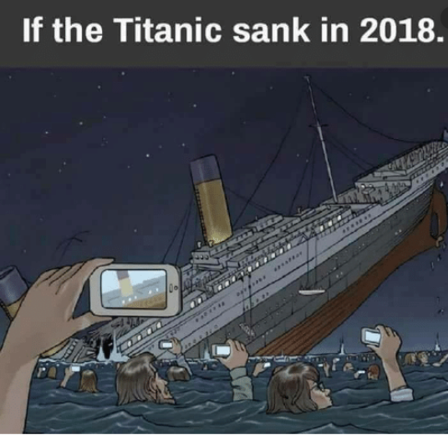
PREDICTING SURVIVAL ON THE TITANIC

Slide 3
Agenda
Course Goals
Course Syllabus
Introduction to Machine Learning
Setting up with Development environment
Python Basics
Analyzing the Titanic dataset
Visualizing the Titanic dataset

Slide 4
Course Goals
Pickup practical experience in various critical stages of a machine learning pipeline - data visualization, data cleaning, feature engineering, feature selection, modelling, model evaluation
Uncover the blackbox that is machine learning by understanding the workings of popular machine learning algorithms.
Make a cool project and have fun!!!!

Slide 5
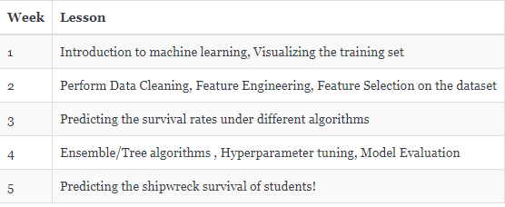
Course Outline

Slide 6
Pair Programming

Slide 7
Setting up the Development Environment
Anaconda,Jupyter

Slide 8
Downloading Anaconda
Anaconda is simply an open source distribution of Python
Go to : https://www.anaconda.com/distribution/
Windows: Open Anaconda Navigator, Mac OS: Open Launchpad -> Anaconda-Navigator icon
On the application pane, click install Jupyter notebooks if not already present

Slide 9

Running our First Python program
On the Anaconda Navigator, hit launch on Jupyter Notebook
Click File -> New -> Python 3
Close the Notebook by File -> Close and Halt

Slide 10



Checking Installation
Open Anaconda Prompt

Slide 11
Python Basics

Slide 12
Python
Dynamically, implicitly, Strongly typed
Case sensitive
Object Oriented
Relies on white spaces to define scope
Relies on new line to complete commands

Slide 13
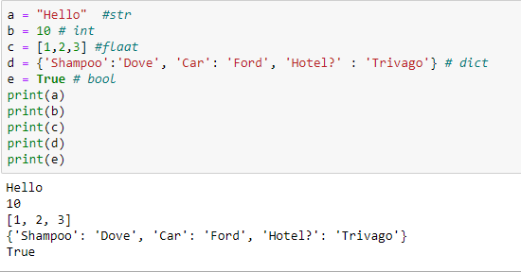
Variables

Slide 14
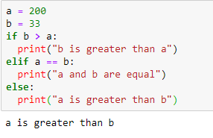
Selection Statements

Slide 15
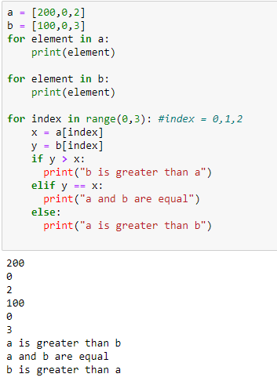
Loop Statements

Slide 16
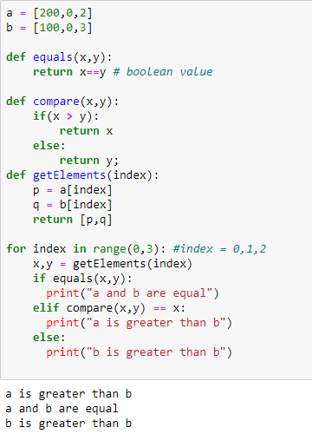
Functions

Slide 17
Import
Import to include External libraries
From <library name> include <function name> to include a particular function from <library name>

Slide 18
Introduction to Machine Learning

Slide 19
What is Machine Learning
Field of study that gives computers the ability to learn without being explicitly programmed
A computer program is said to learn from experience E with respect to some class of tasks T and performance measure P, if its performance at tasks in T, as measured by P, improves with experience E. Eg: Chess
How is ML different from AI?
Why is ML so prevalent?
ML vs Deep Learning?

Slide 20
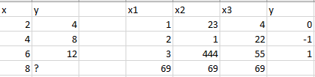
Applications of ML
Computer Vision -> Understanding Photos -> Google photos
Natural Language Processing -> Understanding Text -> Siri
All applications boil down to this

Slide 21
Learning Algorithms
Previously we spoke about Learning Algorithms - it is the method through which E is improved while doing T
Supervised Learning - Feed the machine input and output pairs for the machine to learn on. Machine will make predictions based on previously learned “facts”
Features
Labels
Unsupervised Learning - Give the machine unlabelled data and it will find patterns and similarities between the data
Applications

Slide 22
Looking at the Titanic Dataset

Slide 23
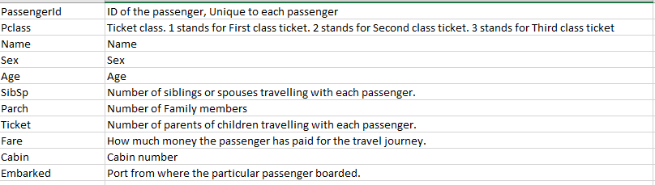
Features
What is missing from the above dataset?

Slide 24
Visualize and Analyze the Titanic Dataset

Slide 25

Place the training data
Open Jupyter Notebooks through the Anaconda Navigator
Run:
Place the train.csv file in that folder

Slide 26
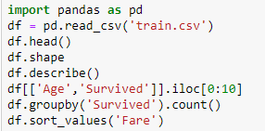
Analysis with Pandas

Slide 27
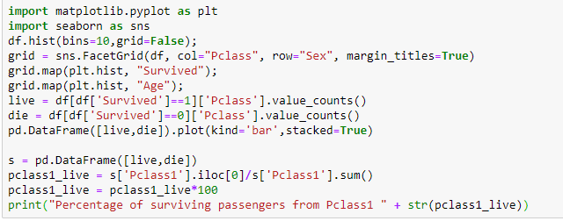
Analysis with Matplotlib and Seaborn

