Slide 1
Modelling

Slide 2
Most popular Machine Learning Algorithms
Linear Regression
Logistic Regression
Decision Tree
Random Forest
Gradient Boosting algorithms
Dimensionality Reduction Algorithms - PCA
SVM
Naive Bayes

Slide 3
A
Quick
Recap

Slide 4
Learning Algorithms
Previously we spoke about Learning Algorithms - it is the method through which E is improved while doing T
Supervised Learning - Feed the machine input and output pairs for the machine to learn on. Machine will make predictions based on previously learned “facts”
Features
Labels

Slide 5
Categorical vs Continuous Variables
Categorical variables contain a finite number of categories or distinct groups. They may or may not have a logical order
Continuous Variables can contain infinite number of values and are not limited to a class of values
Let us identify the categorical and continuous features

Slide 6
Classification vs Regression
Types of Supervised Learning algorithms
Classification: The target variable is categorical
Regression: The target variable is continuous

Slide 7
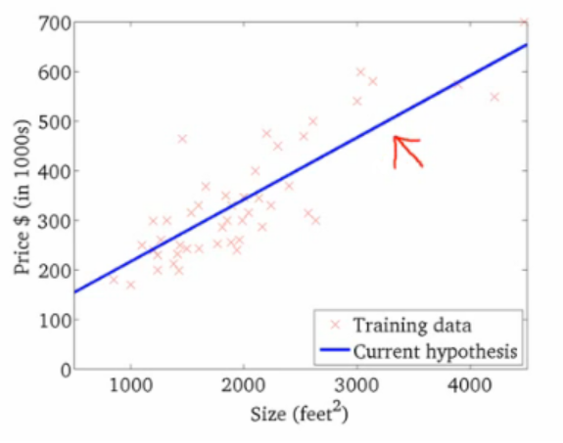
Linear Regression
We try to establish relationship between features and labels by fitting a best line.

Slide 8
Linear Regression
What does Linear Regression do? Simply outputs a hypothesis function
Linear Regression in one variable - Simple Linear Regression
Linear Regression in multiple variable - Multiple Linear Regression
If we fit a polynomial hypothesis function - Polynomial Regression

Slide 9
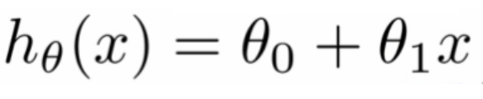
Hypothesis Function
What is the simplest hypothesis function for simple linear regression
x - my sole feature
Thetas - parameters
This is a simple line with y = h, theta0 = intercept , theta1 = slope
What would hypothesis function for linear regression look like for x1,x2?
What would hypothesis function for polynomial regression look like for x1,x2 (d=2)

Slide 10
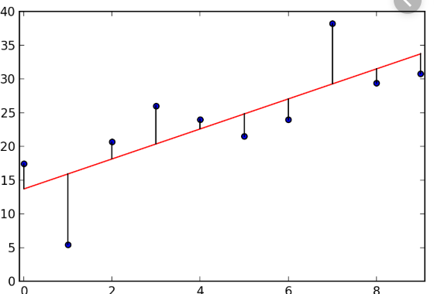
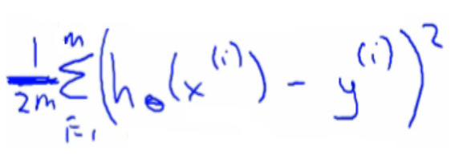
How to find the hypothesis function
What do we have to find while making a hypothesis function?
Consider simple linear regression
while(cost is super low) {
Choose parameters
Find cost of parameters

Slide 11
How to find the hypothesis function
For every iteration, how do we update the parameters?
— Gradient Descent
— Normal Equation
— Partial differentiation
Discussed later

Slide 12
Let us fit linear regression to our dataset

Slide 13
Cross Validation
Cross-validation is a statistical method used to estimate the accuracy of our model.
It is commonly used in applied machine learning to compare and select a model
It also used in hyperparameter tuning and testing other factors like the degree of the hypothesis function
Basically it can be used anywhere where we need to ‘test’ out something and not touch the test set.
The testing set should be the last thing you test on after you have used Cross validation to confirm your model
That is the reason why I haven't provided you with the testing csv yet. And you probably won’t see it today.

Slide 14
Cross Validation
Cross-validation is a statistical method used to estimate the accuracy of our model.
It is commonly used in applied machine learning to compare and select a model
It also used in hyperparameter tuning and testing other factors like the degree of the hypothesis function
Basically it can be used anywhere where we need to ‘test’ out something and not touch the test set.
The testing set should be the last thing you test on after you have used Cross validation to confirm your model
That is the reason why I haven't provided you with the testing csv yet. And you probably won’t see it today.

Slide 15
K fold - Cross Validation
K here represents the number of groups we split our training set into.
These are the general steps to go about Cross Validation:

Slide 16
K fold - Cross Validation
Shuffle the dataset randomly.
Split the dataset into k groups
For each unique group:
Take the group as a hold out or test data set
Take the remaining groups as a training data set
‘Fit’ (scikit) a model on the training set and evaluate it on the test set
Retain the evaluation score and discard the model
Summarize the accuracy by considering all the evaluation scores
Say if have 3 groups - A,B,C
Case1: A+B = train, C = test
Case2: A+C = train, B = test
Case3: B + C = train, A = test

Slide 17
Logistic Regression
Really poor naming, logistic ‘regression’ is used for ‘classification’
The problem at hand is a binary class problem.
Logistic Regression can only be applied to binary class problems at once, but there is a work-around it which we will see later
Logistic Regression outputs a value between 0 and 1. The higher the value (closer to 1), the more chances that the class is 1
Thus 1 - (output of Logistic regression) = probability of class 0
Thus, we need to assign the target value to either 0 or 1
Does it matter that which class gets 1 and which class gets 0?

Slide 18
Logistic Regression
Like Linear Regression, logistic regression needs:
Hypothesis function which takes in x and outputs a value between 0 and 1
Parameters for the hypothesis function
A way to calculate how good the parameters are - cost function
A way to to choose parameters
Can we use the same hypothesis function as before?
We have to find a way to change the hypothesis function to give out values between 0 and 1

Slide 19

Logistic Regression - Hypothesis function
Sigmoid function:
Z here is the hypothesis function from linear regression
When Z —> infinity : g(z) = 1
When Z —> -infinity: g(z) = 0
Thus the value will always be between 0 and 1
Have a look at this graph:

Slide 20
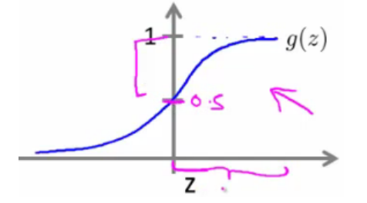
Logistic Regression - Hypothesis function
Thus if Z > 0 : Probability of 1 is more,
If Z < 0: Probability of 0 is more
Thus just with the hypothesis function we can predict which class has the more probability

Slide 21
Last piece of math, bear with me
Then we will go back to coding

Slide 22
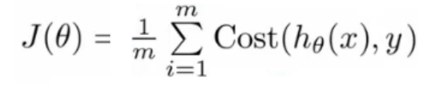
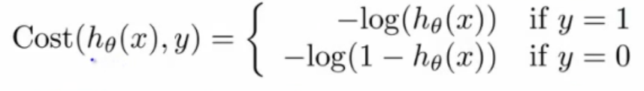
Logistic Regression - Cost function

Slide 23
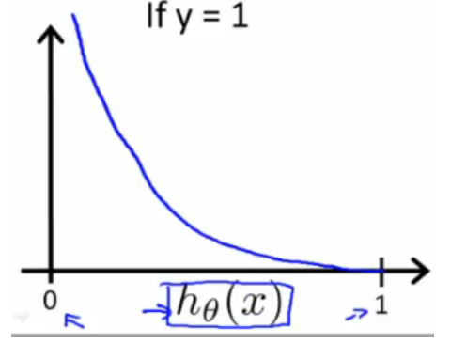
Logistic Regression - Cost function

Slide 24
Now onto applying logistic regression to our dataset

Slide 25
What to do when we have multiclasses?
Remember Logistic Regression works with binary classes
We use a one vs all.
Say we have 3 classes - A,B,C
We make 3 logistic regression models
For each dataset, we run against all 3 models
The model for which the probability is highest is chosen
Or NEURAL NETWORKS!!!!!!!!!

Slide 26
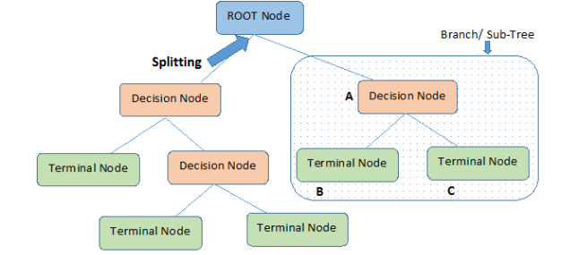
Decision Trees
In this technique, we split the population or sample into two or more sets based on most significant splitter / differentiator in features.

Slide 27
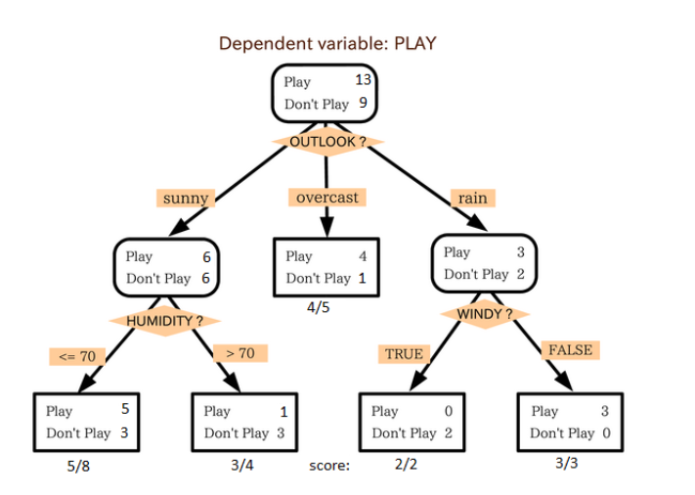
Decision Trees - Example
.

Slide 28
Random Forest Classifiers
It is an ensemble of Decision Trees
We basically work with a forest of trees
Each trees chooses one class
The class with the most votes from the most trees wins
Say I want 5 trees,
I will split the training data into 5 parts
Say for a certain record, 3 trees predicted higher for class 1
The output of the forest will be 1

Slide 29
Now onto applying Random Forest to our dataset

