Slide 1

Predicting Tags for Stack Overflow Questions
Professional Certification in Machine Learning and Artificial Intelligence
-Akshar Solanki

Slide 2

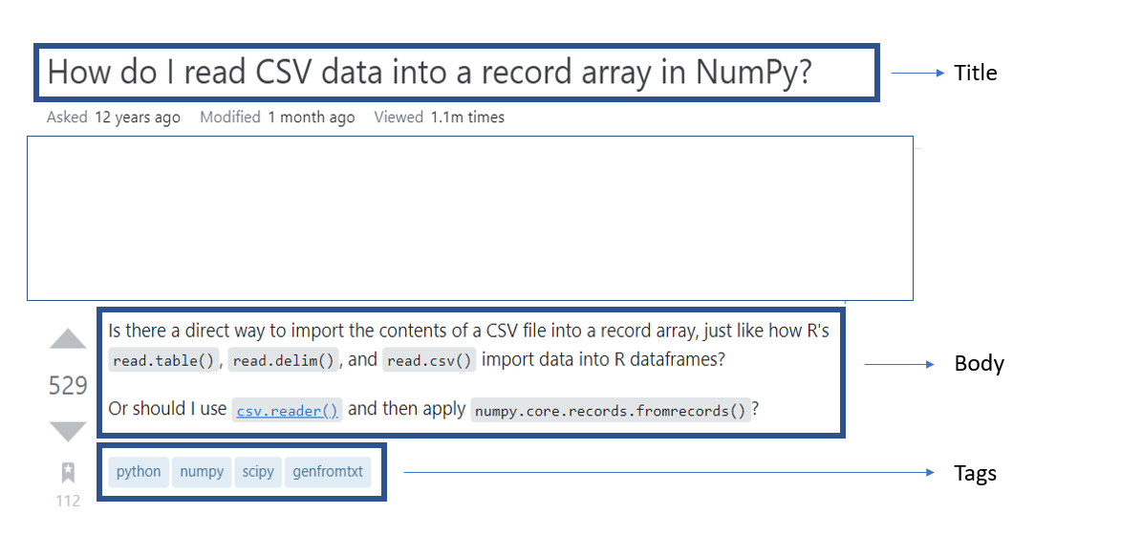
What is
Stack Overflow is a community based Q&A website and is the largest online community for programmers to learn, share their knowledge, and advance their careers.
It has been the single source of truth to answer programming questions for even the best of programmers.
Along with having an active community that eagerly helps in providing answers to new questions, the sheer volume of of those questions asked is so large that it is impossible to prevent duplicate questions

Slide 3

Problem Statement
Stack Overflow has come up with multiple solutions to prevent question replication.
It automatically “TAGS” the questions so that community members can search for the appropriate questions before having to ask the same question again.
It does this using multiple methods like Text Processing, Neural Networks and various Machine Learning algorithms.
This project is an humble effort to duplicate the "TAG" feature for Stack Overflow questions.

Slide 4


Data Source
The data was sourced from Kaggle and is part of a larger Stack Overflow dataset that was extracted using Google's Big Query data warehousing tool.
The original dataset includes an archive of Stack Overflow content, including posts, votes, tags, and badges.
The dataset is updated to mirror the Stack Overflow content on the Internet Archive, and is also available through the Stack Exchange Data Explorer.
The dataset was sampled by Kaggle and only 10% of the original dataset was divided into multiple .csv files
The link for the dataset: https://www.kaggle.com/datasets/stackoverflow/stackoverflow

Slide 5
Data Cleaning
The following methods for data cleaning were performed:
Data Merge based on “GroupId” in the data [only merged questions and tags data].
Handle Duplicates
Deleted extra columns since they would not be used for analysis
Cleaned the text data – Used a library called Beautiful Soup that extracts information from web pages (removes HTML tags)
Other methods of data preparation were also performed which will be explained in the future parts of the presentation.
Performed Exploratory Data Analysis and results of the data are shown in the slides below.

Slide 6
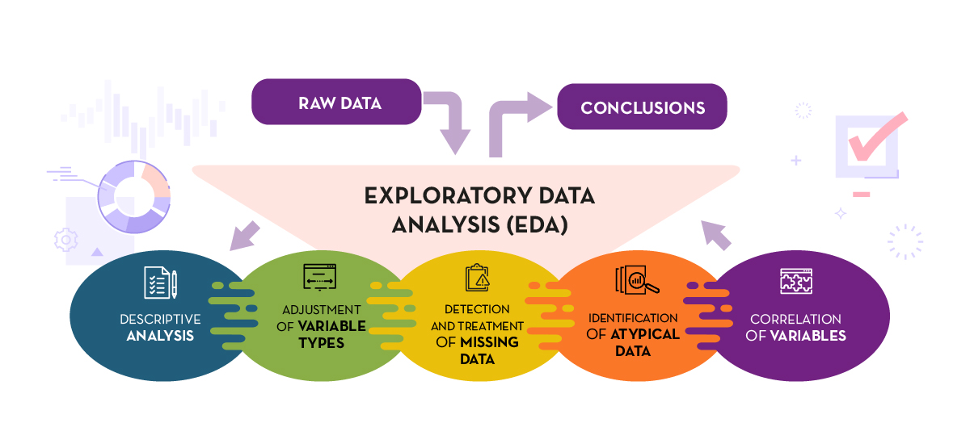
Exploratory Data Analysis

Slide 7
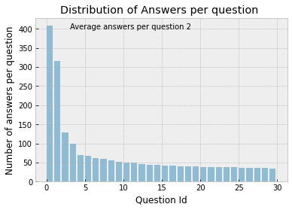
Distribution of Answers per question

Slide 8
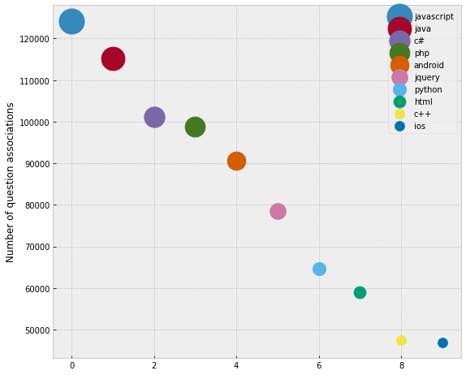
10 Most common tags in the questions

Slide 9
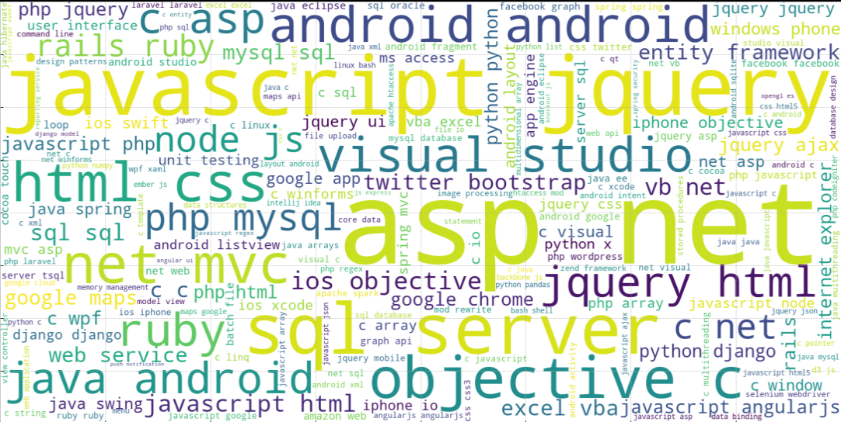
Word Cloud to highlight the most frequent Tags

Slide 10
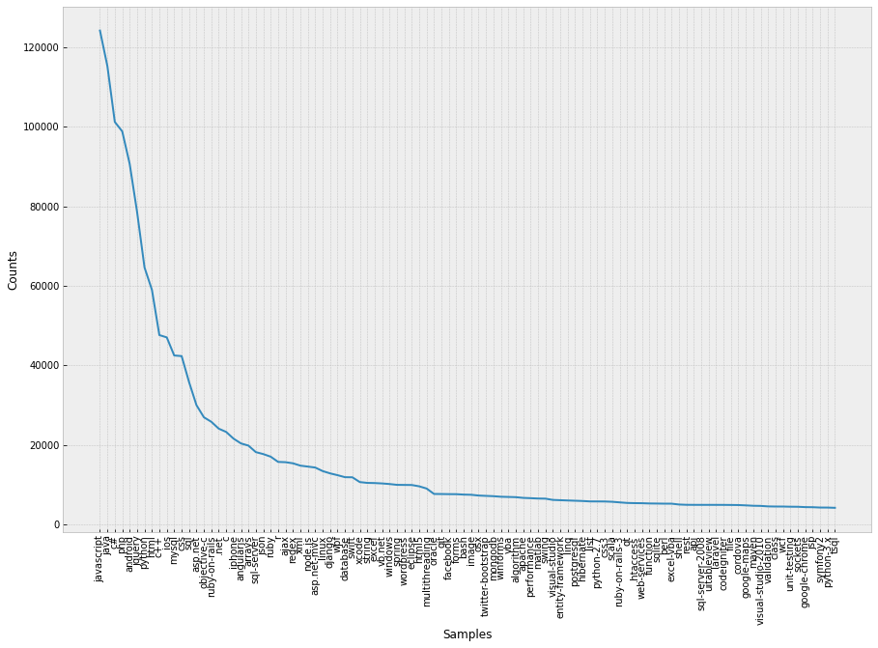
Occurrence of ~10% tags (by frequency)

Slide 11
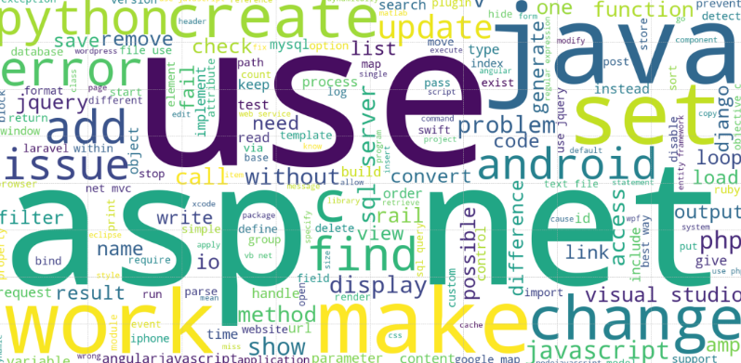
Word Cloud to highlight prominent words in the Question Title

Slide 12

Data Preparation
The following functions were created in order to prep the data for the ML classifiers:
clean_text() : substitutes most common made errors while typing
remove_punctuation() : Removes punctuation marks '!"#$%&\'()*+,./:;<=>?@[\\]^_{|}~'
lemmatize_words() : Lemmatizes the words using the TokTokTokenizer in the NLTK library
most_common_tags_and_keywords() : returns a Tuple of most common tags and keywords
TfIdfVectorizer() : Converts the text into an array of words and their counts for the models to learn

Slide 13

Machine Learning Models
The following ML classifiers were tested in order to prep the data to classify a multiple tags given a question text:
Dummy Classifier (Baseline Prediction)
Stochastic Gradient Classifier*
Logistic Regression Classifier*
MultiNomial Naïve Bayes Classifier
Linear Support Vector Classifier*
Perceptron
Passive Aggressive Classifier
*GridSearchCV was used for the best models in order to hyper tune the parameters for best training and test set prediction accuracy

Slide 14
Accuracy Metrics
The following accuracy metrics were used:
Average Jaccard Similarity Score:
Range: 0% – 100% (best-case, all tags correctly predicted)
The Jaccard Similarity Index is a measure of the similarity between two sets of data.
Hamming Loss: The Hamming loss is the fraction of labels that are incorrectly predicted
Range: 0 – 1 (worst-case, complete incorrect tags predicted)

Slide 15
Final Results
Classifier | Dummy | Stochastic Gradient | Logistic Regression | MultiNomial NaiveBayes | LinearSVC | Perceptron | Passive Aggressive
Jaccard Similarity Score | 44.749% | 63.295% | 65.945% | 62.589% | 65.556% | 56.917% | 58.173%
Hamming Loss | 0.2136659626 | 0.13003797740 | 0.12312183652 | 0.138 | 0.123 | 0.171 | 0.161

Slide 16
Thank you!

