Slide 2
HashSets and HashMaps

Slide 3
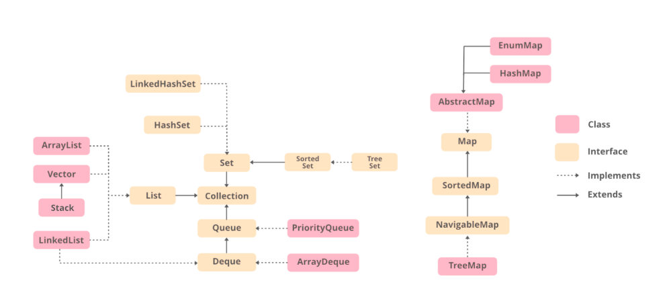
COLLECTION FRAME-WORK IN JAVA

Slide 4

sets
The Set interface defines an unordered collection.
We cannot store duplicate values in this.
The Set Interface is implemented by popular classes like HashedSet, LinkedHashSet, and TreeSet.

Slide 5
hash-set
The HashSet class implements the Set Interface.
It uses a hash table for storage which uses a mechanism called Hashing.
Contains unique elements only
We can store Null values in this.
HashSet is non-synchronized means multiple threads at a time can access the code. This means if one thread is working on HashSet, other threads can also get a hold of it.
Multiple operations on HashSet can be performed at a time.

Slide 6
Syntax: HashSet
HashSet<Datatype> hs = new HashSet<Datatype>();

Slide 7
IMPORTANT METHODS
add(): Adds an element in the set
remove(): Removes a particular element from the set
removeAll(): Removes all elements
size(): Returns the number of elements in the set
isEmpty(): Checks if the set is empty or not

Slide 8
Code snippet
package hashset;
import java.util.*;
public class HashSet1 {
public static void main(String args[]){
HashSet <String> hs= new HashSet <String>();
//add()
System.out.println("Adding elements inside the hashset");
hs.add("Ravi");
hs.add("Vijay");
hs.add("Arun");
hs.add("Sumit");
System.out.println(hs);
//remove()
System.out.println("Removing a Specific element");
hs.remove("Vijay");
System.out.println(hs);
//size()
System.out.println("Return the number of elements");
System.out.println(hs.size());
//isEmpty()
System.out.println("Checking if the hashset is empty");
System.out.println(hs.isEmpty());
}
}

Slide 9
MAPs
Maps are perfect to use for key-value association mapping such as dictionaries.
The maps are used to perform lookups by keys or when someone wants to retrieve and update elements by keys. Some common scenarios are as follows:
Examples:
A map of zip codes and cities.
A map of managers and employees. Each manager (key) is associated with a list of employees (value) he manages.

Slide 10
hash-map
The HashMap class implements the Map Interface.
It stores data in the form of key-value pairs
They keys should have unique elements only

Slide 11
Syntax: HashMap
HashMap<Keytype, Valtype> hs = new HashMap<Keytype, Valtype>();

Slide 12
IMPORTANT METHODS
put(): Adds an element in the ser
remove(): Removes a particular element from the set
containsKey(): Checks for the key values
containsValue(): Checks for the bales

Slide 13
Code snippet
import java.util.*;
public class HashMap1
{
public static void main (String args[])
{
HashMap<Integer, String> hm= new HashMap<Integer, String>();
//Put()
System.out.println("Adding Elements to the map");
hm.put(1,"Akshara");
hm.put(2,"Ananya");
hm.put(3,"Bindu");
hm.put(4,"Sneha");
System.out.println(hm);
//containsKey()
System.out.println("Check for key values");
System.out.println(hm.containsKey(6));
System.out.println(hm.containsKey(1));
//containsValues()
System.out.println("Check for values");
System.out.println(hm.containsValue("Akshara"));
System.out.println(hm.containsValue("Wendy"));
}
}

