Slide 1
Setting Up A Virtual Hacking Lab BUILD,PRACTICE,PROTECT…
Internship Presentation

Slide 2
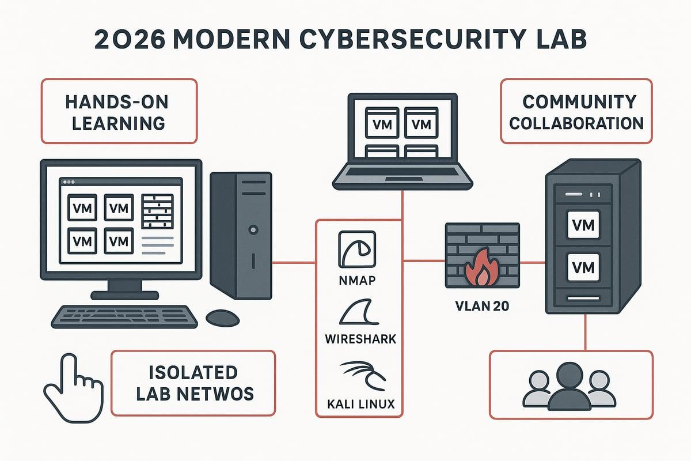
Virtual Lab Setup
A virtual lab provides a safe cybersecurity environment.
It allows testing without affecting real systems.
Virtualization separates the lab from the host
machine.
Kali Linux is commonly used for ethical hacking.
Labs help develop practical cybersecurity skills.

Slide 3
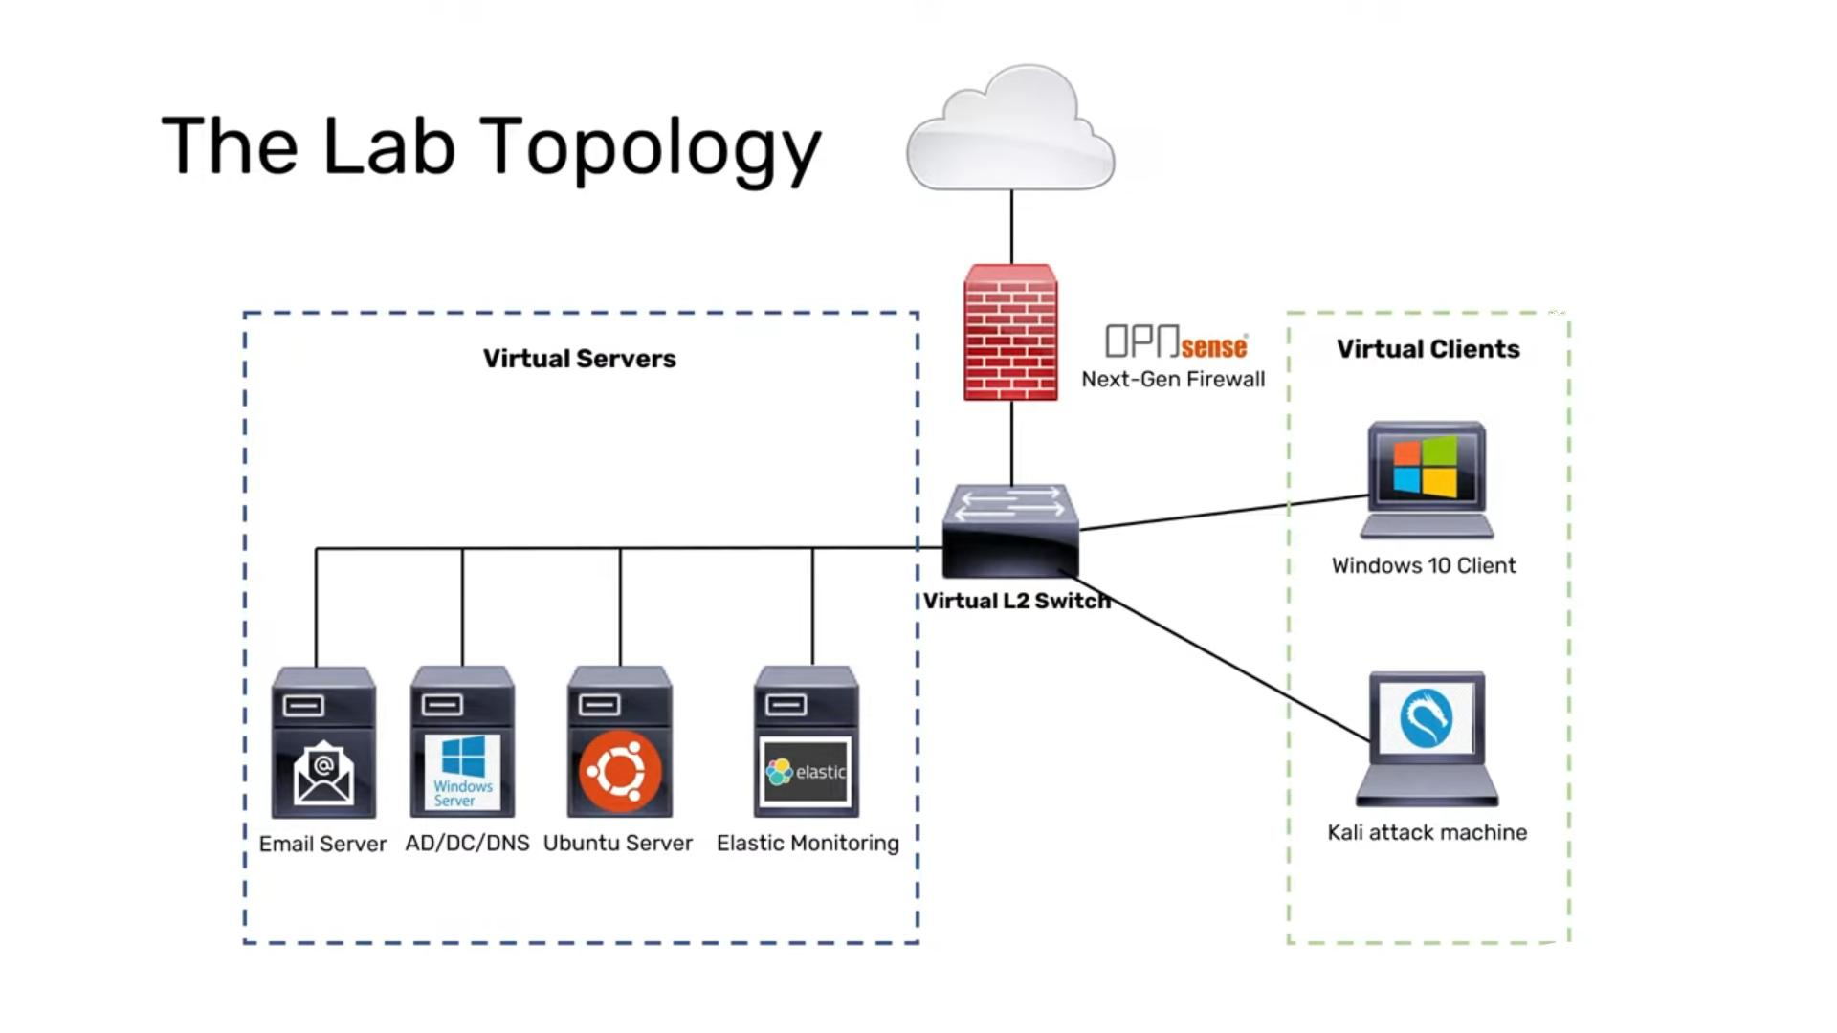
Objectives of the Virtual Lab
Create a secure practice environment.
Learn virtualization technology.
Install and configure Kali Linux.
Understand ethical hacking basics.
Practice cybersecurity techniques safely.
Build hands-on technical experience.

Slide 4

Installing VirtualBox
Download VirtualBox from the official website.
Run the installation package.
Accept default installation settings.
Install required network components.
Complete the setup process.
Launch VirtualBox successfully.

Slide 5
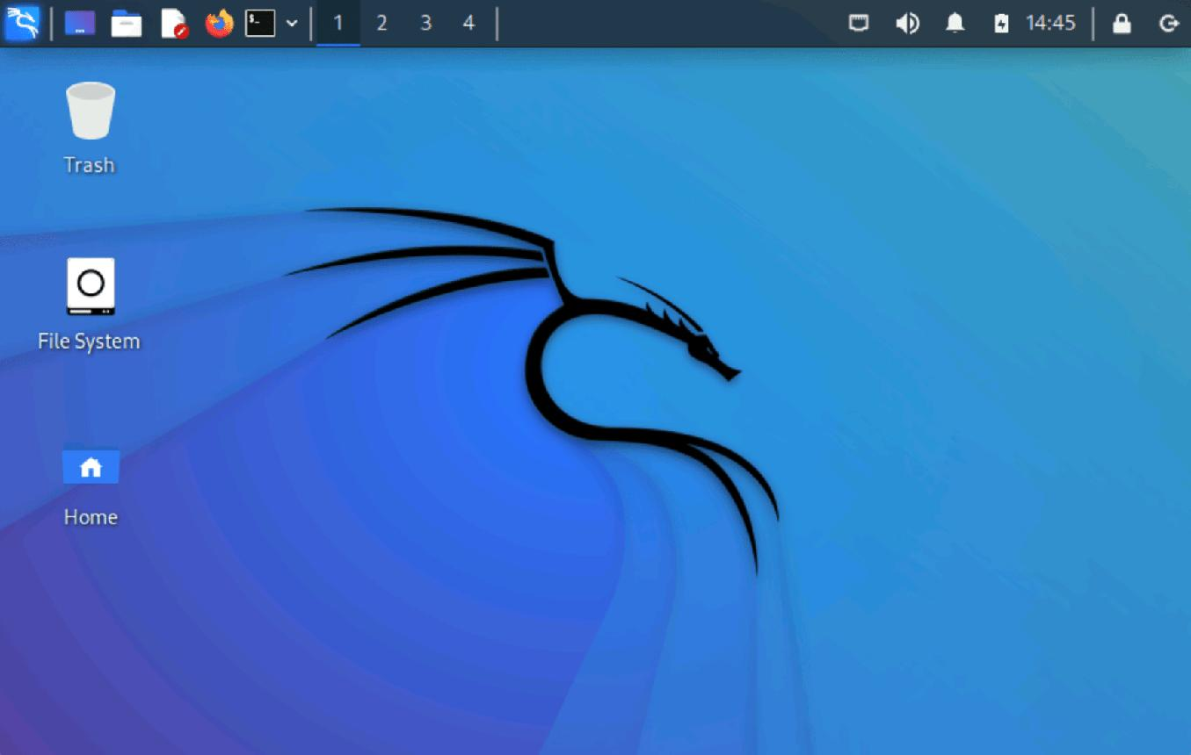
Downloading Kali Linux ISO
Visit the official Kali Linux website.
Select the latest stable version.
Download the 64-bit ISO file.
Verify the downloaded file.
Save the ISO in a secure location.
Prepare it for VM installation.

Slide 6
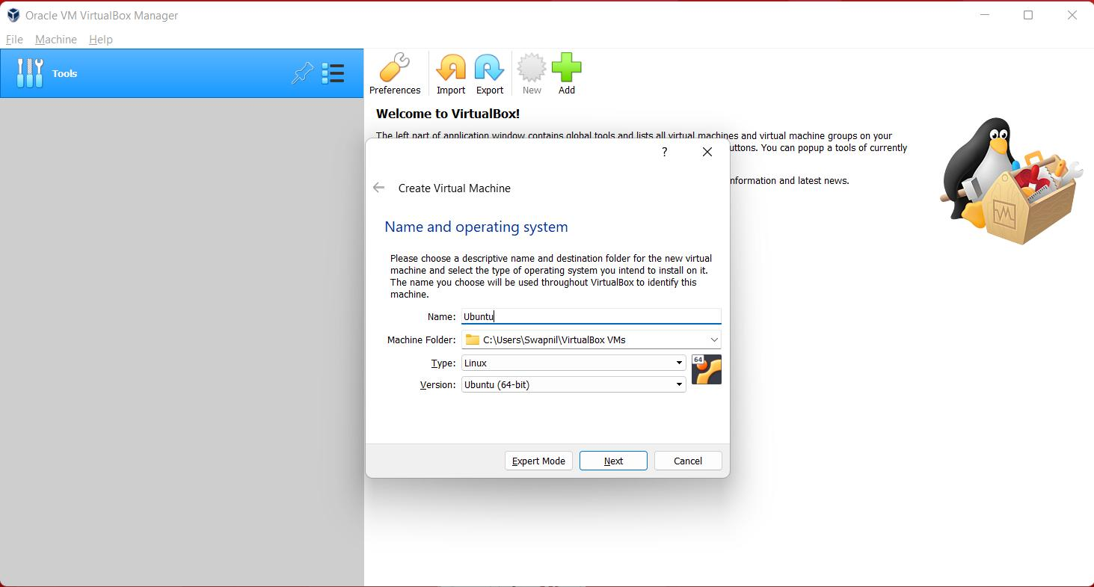
Creating a Virtual Machine
Open VirtualBox and click New.
Enter the VM name as Kali Linux.
Select Linux as the operating system.
Choose Debian (64-bit) version.
Allocate memory to the VM.
Create a new virtual hard disk.

Slide 7
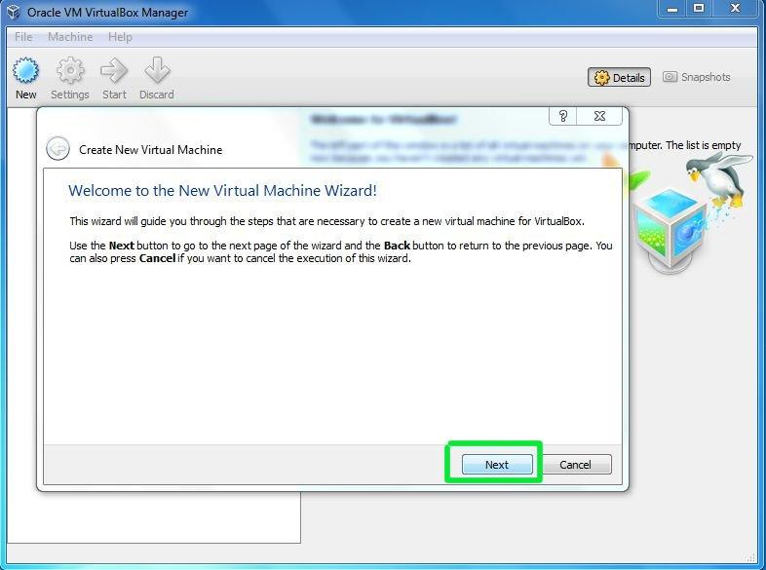
Configuring VM Settings
Allocate at least 4 GB RAM.
Assign 40 GB or more storage.
Enable virtualization features.
Attach Kali Linux ISO file.
Configure system settings.
Save all configurations.

Slide 8
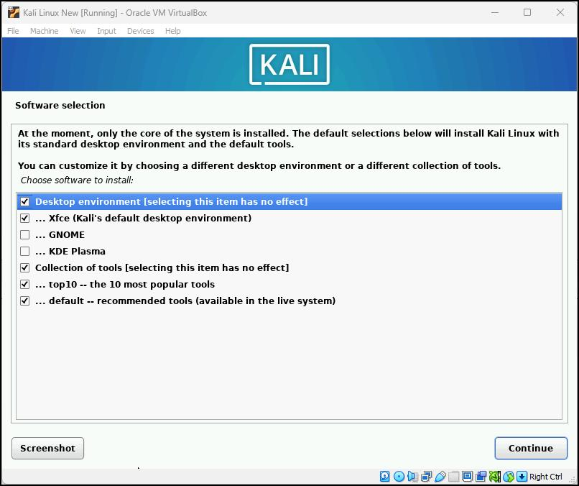
Installing Kali Linux
Start the virtual machine.
Select Graphical Install option.
Configure language and region.
Create a username and password.
Install required system files.
Complete installation and restart.

Slide 9
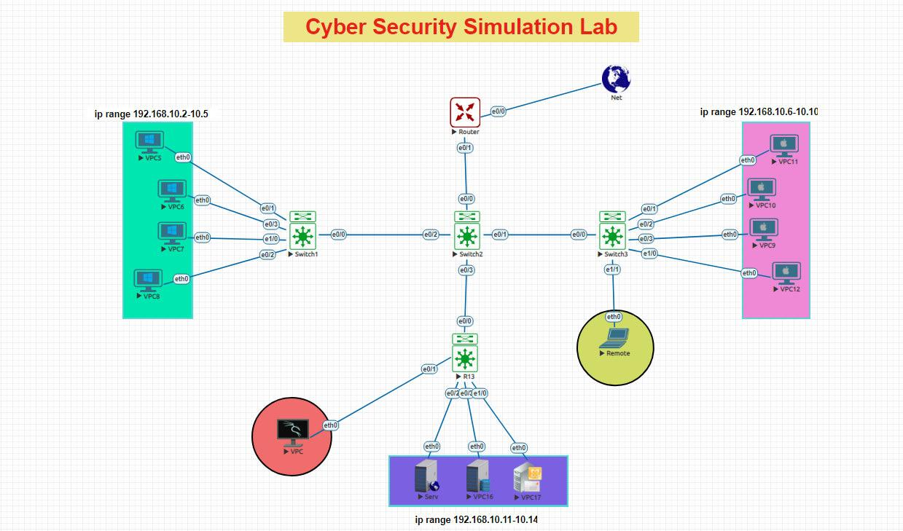
Lab Environment Overview
Kali Linux acts as the attacker machine.
Windows VM can be used as a target.
DVWA provides vulnerable web applications.
Metasploit able offers practice vulnerabilities.
Multiple VMs create realistic scenarios.
Isolation keeps testing safe.

Slide 10

Importance of Controlled Environments
Ensures ethical cybersecurity practice.
Prevents damage to real systems.
Reduces security risks.
Provides a safe learning space.
Supports experimentation and testing.
Encourages responsible hacking practices.

Slide 11

Conclusion
Virtual labs are essential for learning.
Kali Linux provides powerful security tools.
VirtualBox enables safe virtualization.
Controlled environments improve skills.
Ethical hacking requires proper authorization.
Continuous practice strengthens cybersecurity knowledge.

