Slide 1
INTEGRATION OF OPENEAAGLES AND ZENOH-C FOR REAL TIME AIRCRAFT SIMULATION AND SURFACE TO AIR MISSILE (SAM) ENGAGEMENT
OE
Z
AIR
Presented By - Akshara Agarwal
2401200019
Jaypee Institute of Information Technology, Noida
Guide & Mentor
Mr. Gaurav Gupta
Sc- ‘F’ , Institute for Systems Studies & Analyses (ISSA) , DRDO, New Delhi
Training Period - 22 June 2026 - 4 August 2026

Slide 2
01 / CONTEXT
ISSA • DRDO / INTERNSHIP
From an internship assignment to a working system
A legacy C++ simulation framework was connected to a modern real-time data layer, then validated through an aircraft–SAM scenario.
I started with two independent technologies and ended with a connected simulation pipeline.
01
02
03
04
05
Understand
Build
Integrate
Simulate
Engage
OpenEaagles
Zenoh-C
Zenoh Bridge
Aircraft
SAM + PN
What I personally built
Integration bridge between the two frameworks
Custom aircraft + SAM simulation components
Build, debugging, communication testing and validation
02
OpenEaagles × Zenoh-C

Slide 3
02 / OBJECTIVE
ISSA • DRDO / INTERNSHIP
What was I actually trying to solve and Why?
The challenge was not simply writing a model. It was making independent software components work together reliably.
Simulation
Communication
End-to-end proof
Use OpenEaagles as the authoritative simulation engine for aircraft and missile entities.
Expose live aircraft state through Zenoh-C using publish–subscribe messaging.
Use a SAM engagement scenario to demonstrate that the complete pipeline works.
KEY QUESTION
Can a legacy C++ simulation be extended without coupling external consumers to its internal object tree?
03
OpenEaagles × Zenoh-C

Slide 4
03 / TECHNOLOGY
ISSA • DRDO / INTERNSHIP
TECHNICAL STACK
Each layer solved a different problem.
OpenEaagles
Simulation engine • object model • scheduling • EDL
Custom C++
Aircraft • SAM • Zenoh Bridge
Zenoh-C
Sessions • publishers • subscribers • key expressions
Build & debug
CMake • MinGW • MSVC 2017 • GDB / ASan
OpenGL Visualization of simulation state and trajectory playback.
04
OpenEaagles × Zenoh-C

Slide 5
04 / SCOPE OF WORK
05
04 / SCOPE OF WORK
ISSA • DRDO / INTERNSHIP
What I built — and what I used
What I built — and what I used
A critical distinction for the presentation: OpenEaagles and Zenoh-C are existing frameworks; the integration and project-specific components were my work.
A critical distinction for the presentation: OpenEaagles and Zenoh-C are existing frameworks; the integration and project-specific components were my work.
EXISTING FRAMEWORKS
MY PROJECT COMPONENTS
EXISTING FRAMEWORKS
MY PROJECT COMPONENTS
OpenEaagles — simulation framework
Zenoh integration bridge
OpenEaagles — simulation framework
Zenoh integration bridge
Zenoh-C — communication middleware
Aircraft state generation + publishing
Zenoh-C — communication middleware
Aircraft state generation + publishing
CMake / premake / MinGW / MSVC 2017
Custom SAM model with PN guidance
CMake / premake / MinGW / MSVC 2017
Custom SAM model with PN guidance
EDL — scenario configuration
Thread-safe command/data boundary
EDL — scenario configuration
Thread-safe command/data boundary
Testing and validation workflow
Testing and validation workflow
05
OpenEaagles × Zenoh-C
ISSA • DRDO / INTERNSHIP

Slide 6
05 / PHASE I
ISSA • DRDO / INTERNSHIP
First milestone: Make the frameworks work independently
Integration came only after both sides were verified.
OpenEaagles
Zenoh-C
• Studied examples and project structure
• Built from source using MinGW during initial setup
• Resolved dependencies / configuration issues
• Ran sample simulations successfully
• Migrated the integrated solution to MSVC 2017
• Built from source using CMake + MinGW
• Studied sessions, publishers, subscribers and key expressions
• Ran publisher / subscriber examples
• Verified continuous message delivery
• Established a clean communication baseline
BUILD → VERIFY → INTEGRATE
06
OpenEaagles × Zenoh-C

Slide 7
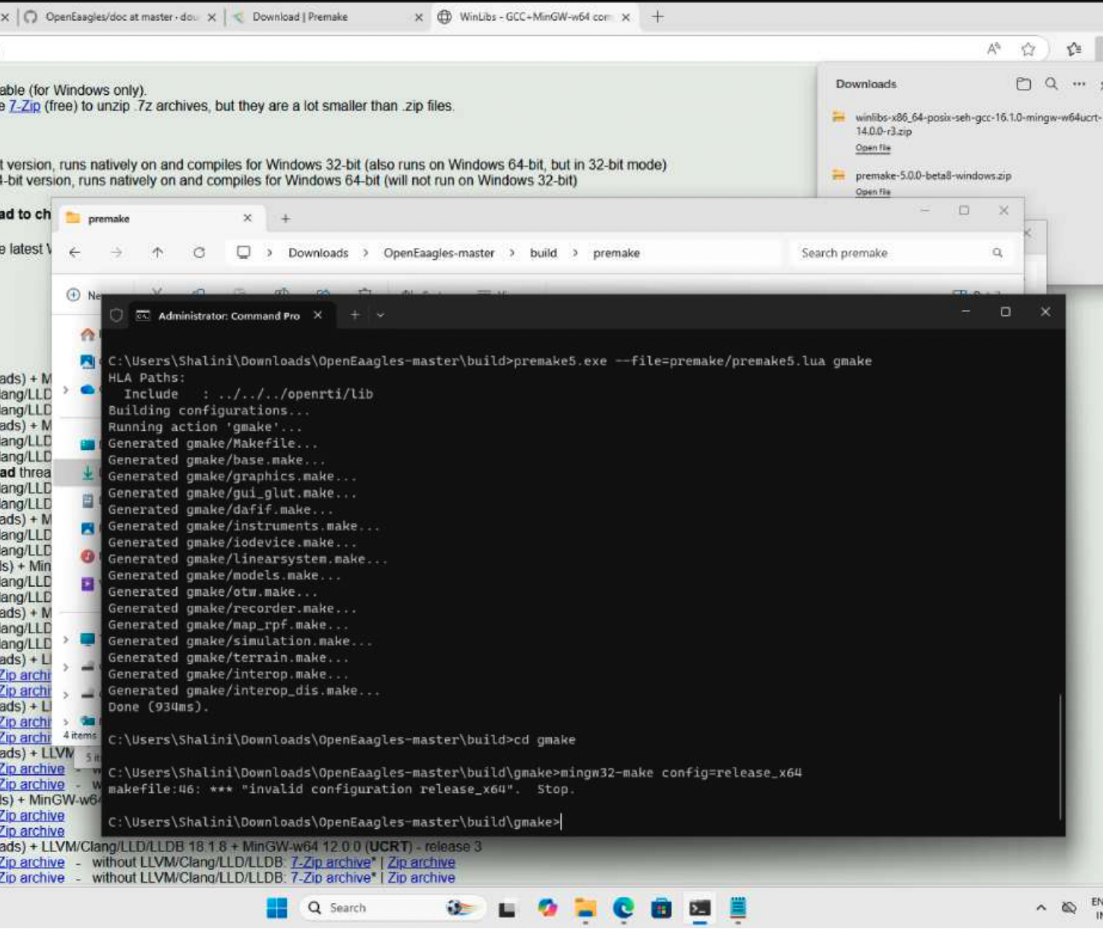
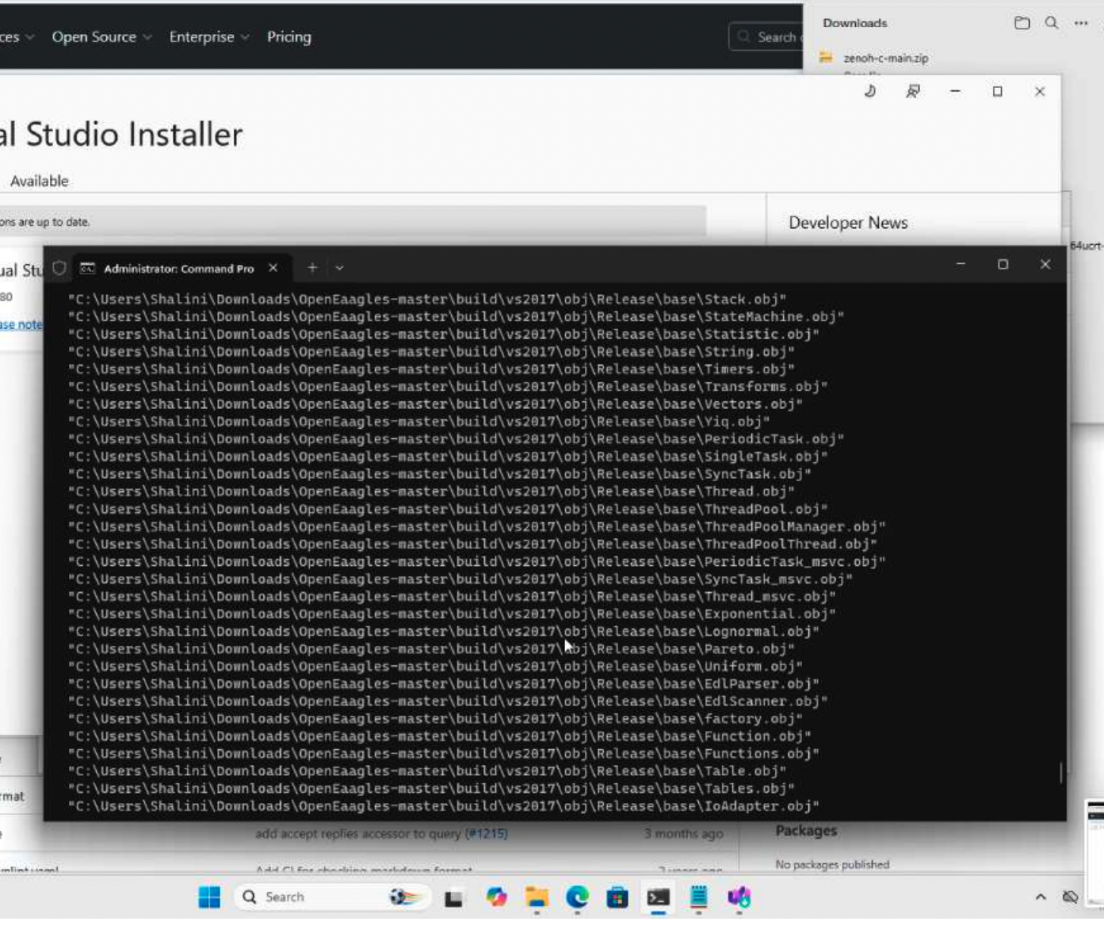
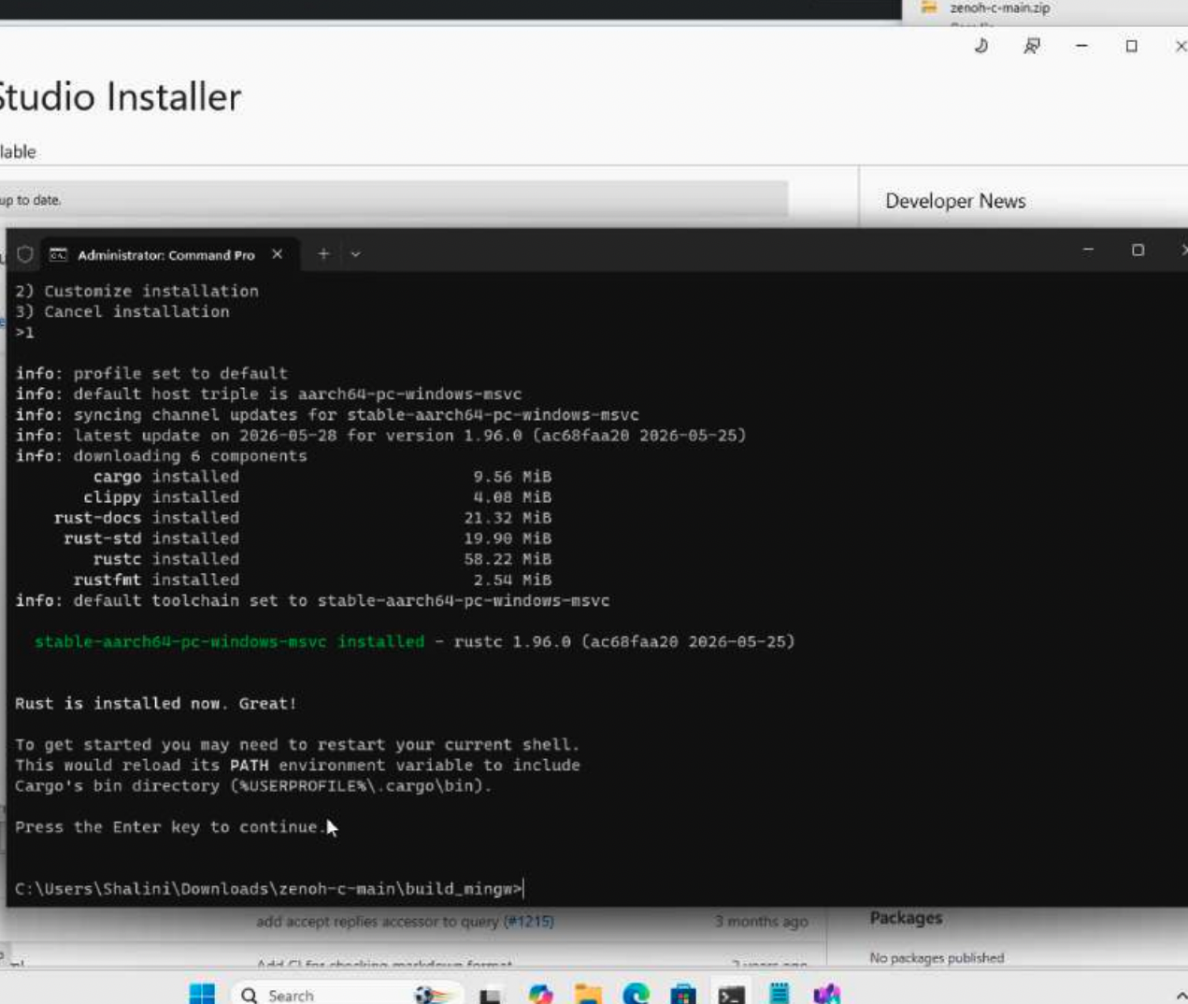
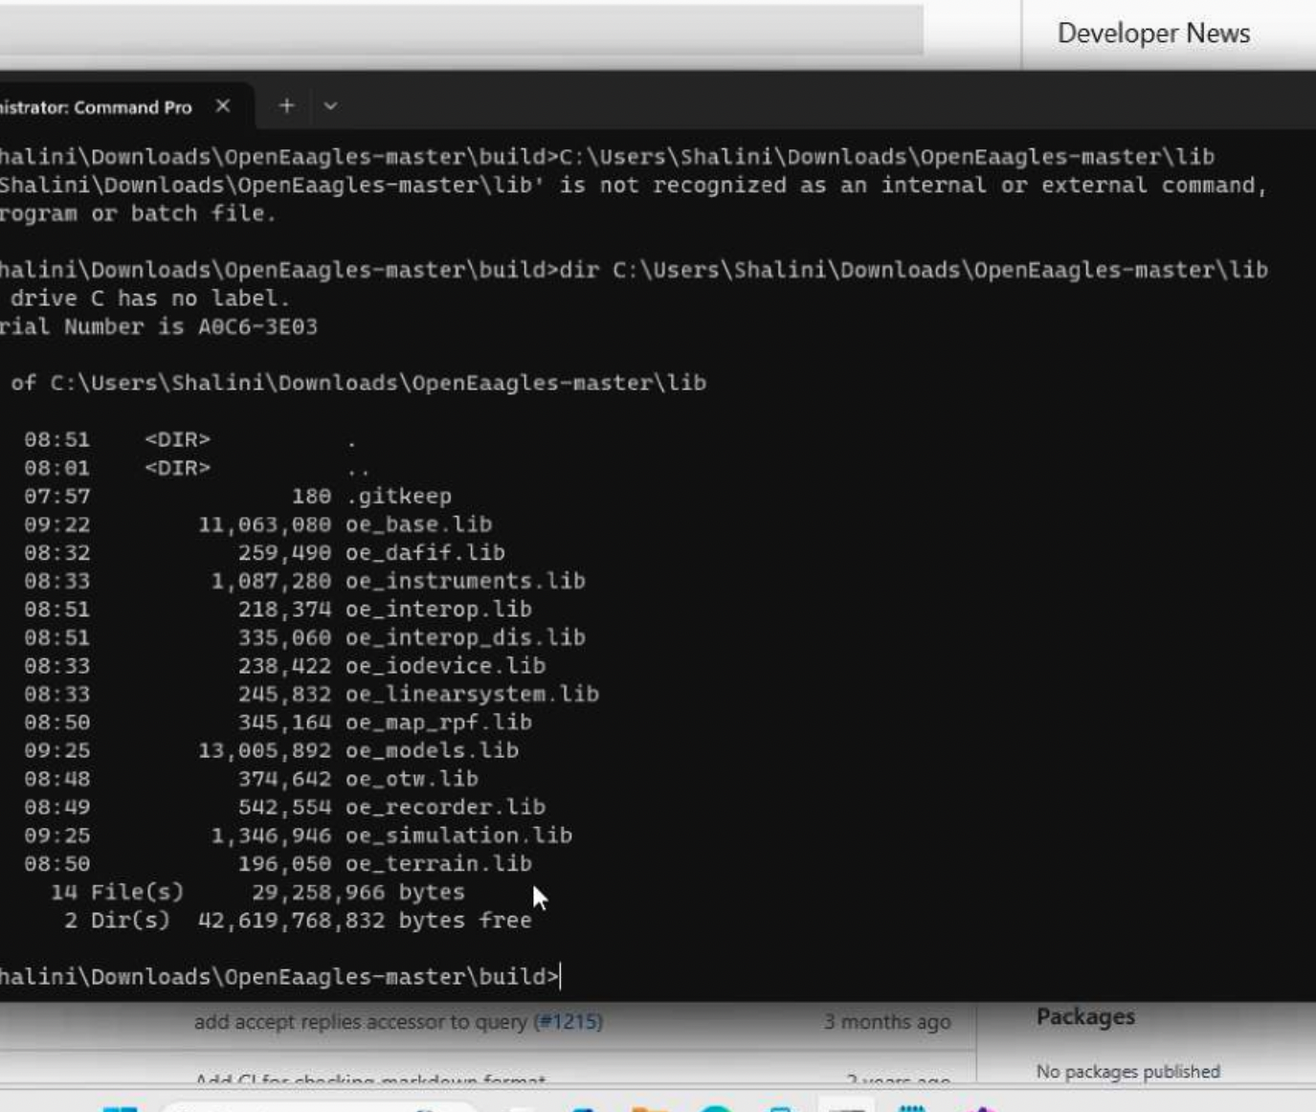
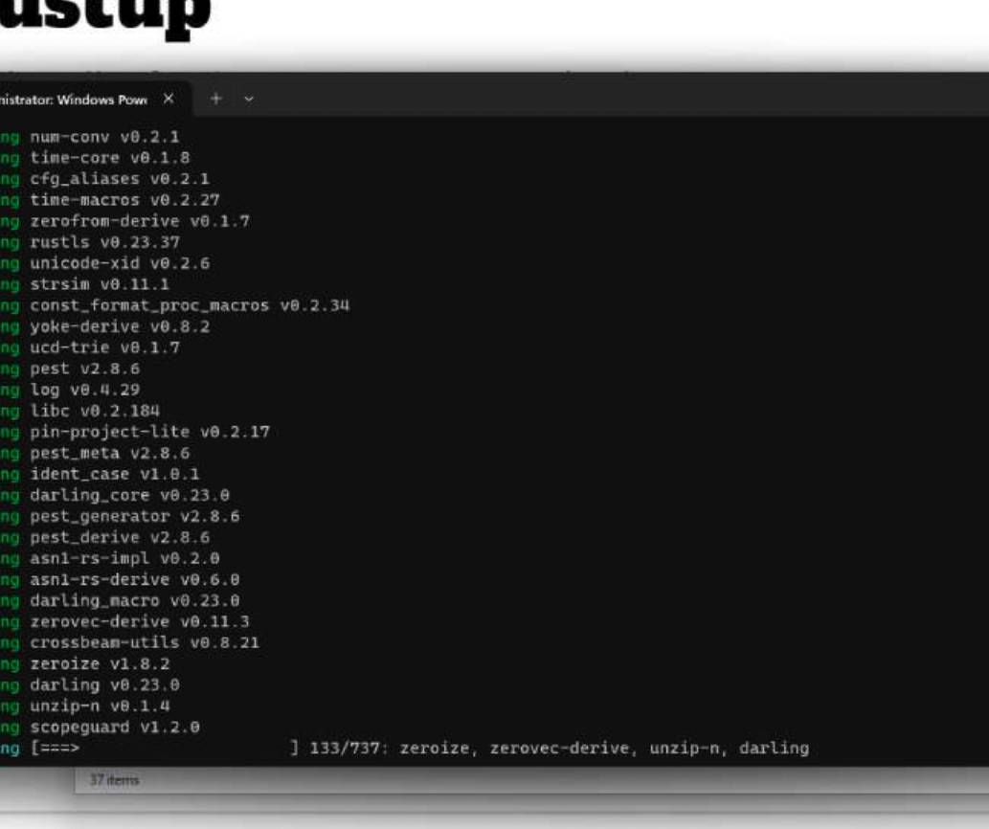
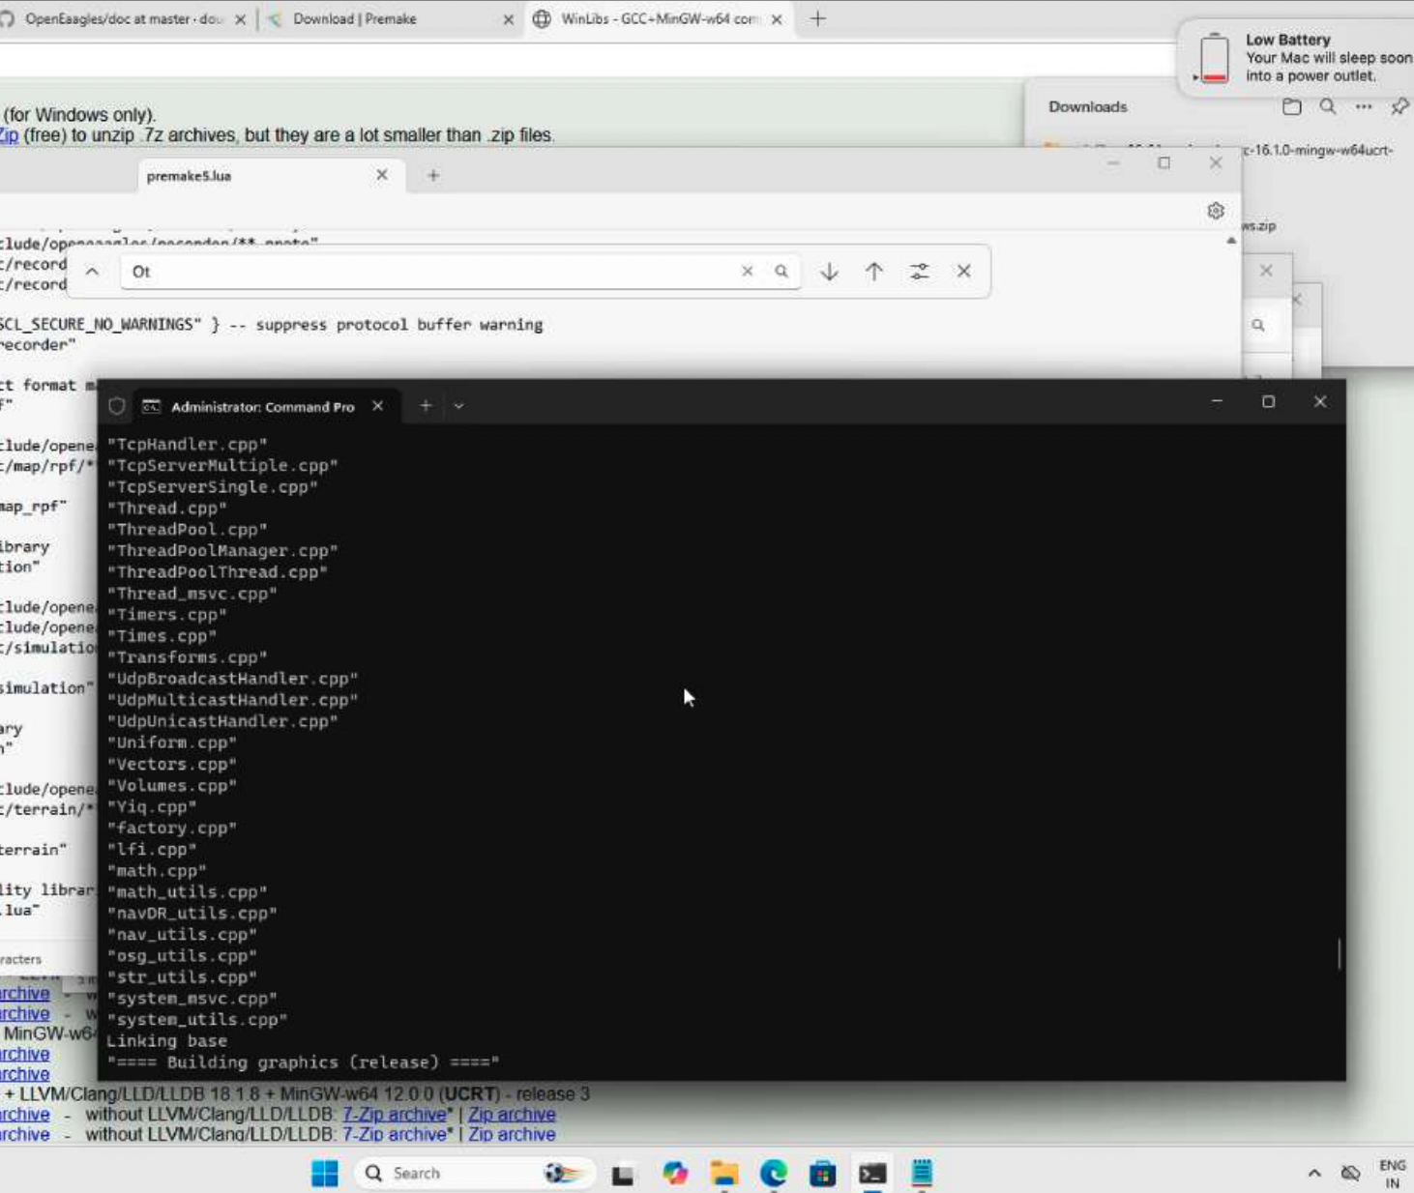

Slide 8
06 / PHASE II
ISSA • DRDO / INTERNSHIP
The Integration Architecture
Keep simulation authority inside OpenEaagles , keep transport decoupled.
AIRCRAFT (OpenEaagles)
SUBSCRIBER (Zenoh-C)
ZENOH BRIDGE
SAM
position • velocity
altitude • heading
acceleration
publish state
consume commands
preserve boundaries
monitoring
visualization
analysis
target state
LOS angle
PN guidance
The architecture separates simulation execution from communication and external observation.
DESIGN PRINCIPLE
Transport should move data — not own the simulation logic.
07
OpenEaagles × Zenoh-C

Slide 9
07 / PHASE III
ISSA • DRDO / INTERNSHIP
Aircraft Simulation: Turning state into Telemetry
The aircraft became the live data source for the rest of the pipeline.
POSITION
HEADING
AIRCRAFT
X / Y
Direction
VELOCITY
ACCELERATION
Speed
Change in velocity
ALTITUDE
Measured in ft
The important learning: a simulation is useful beyond its own process when its state can be exposed cleanly.
08
OpenEaagles × Zenoh-C

Slide 10
08 / PHASE IV
ISSA • DRDO / INTERNSHIP
Zenoh-C: The Real-Time Communication Layer
A simple publish–subscribe model, placed inside a time-critical simulation.
PUBLISHER
ZENOH
SUBSCRIBER
Aircraft state
↓
Serialize telemetry
↓
Publish
Session
Key expression
Transport
Receive message
↓
Queue / process
↓
External consumer
WHY THIS MATTERS
External observation becomes possible without embedding the observer into the simulation executable.
09
OpenEaagles × Zenoh-C

Slide 11
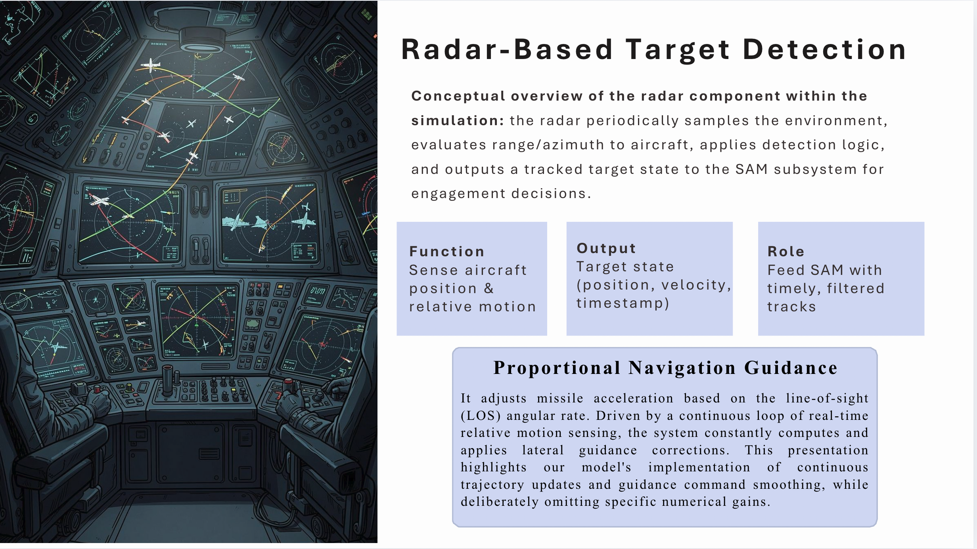

Slide 12
09 / PHASE V
ISSA • DRDO / INTERNSHIP
SAM Engagement: Closing the Loop
The missile consumes the target state and continuously updates its trajectory.
AIRCRAFT
LOS
PN
CMD
MISSILE
Target position
Line-of-sight
Proportional
Navigation
Steering
Updated path
The guidance logic was not treated as a black box: the target state, trajectory and relative distance were monitored during execution.
10
OpenEaagles × Zenoh-C

Slide 13
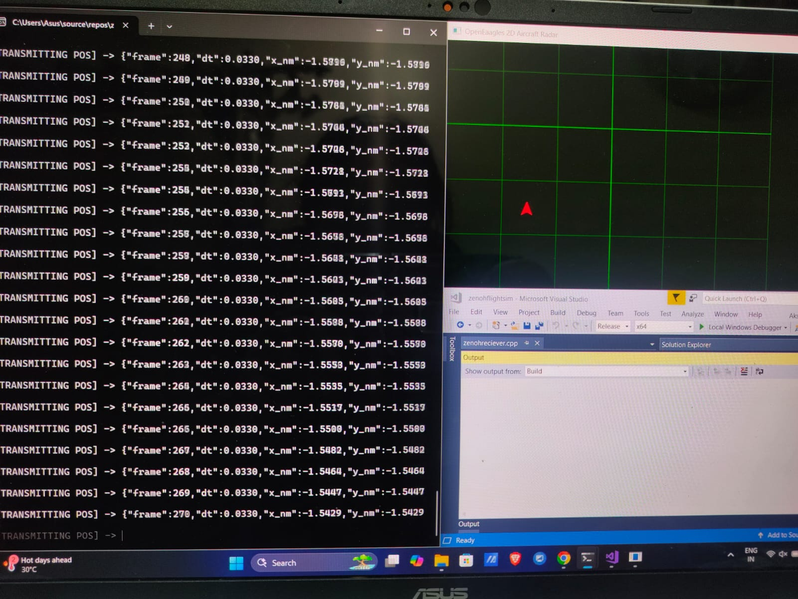
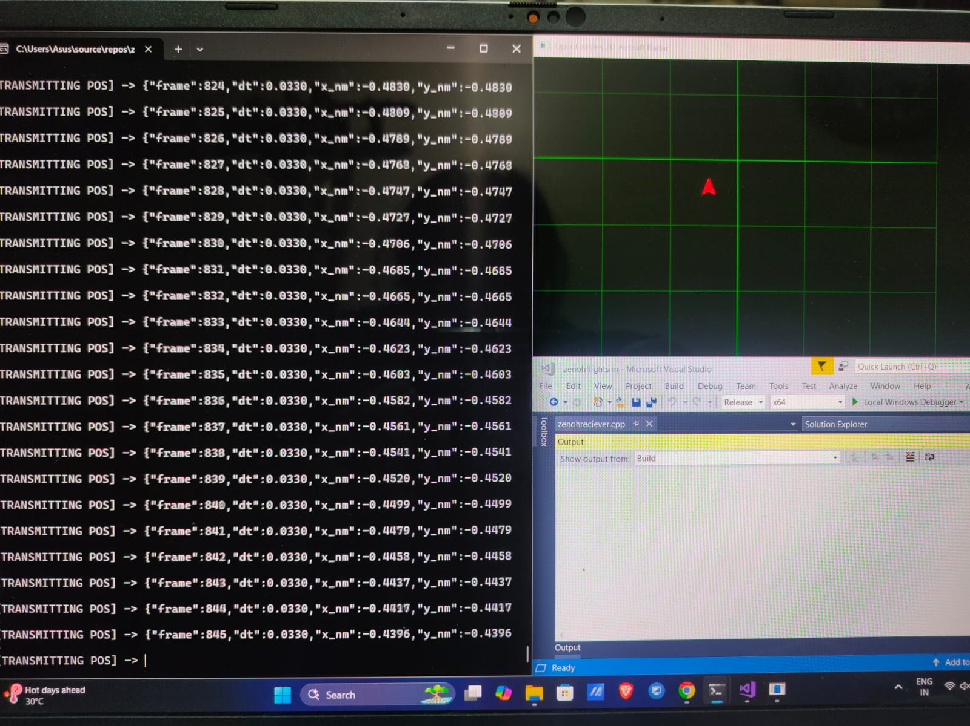
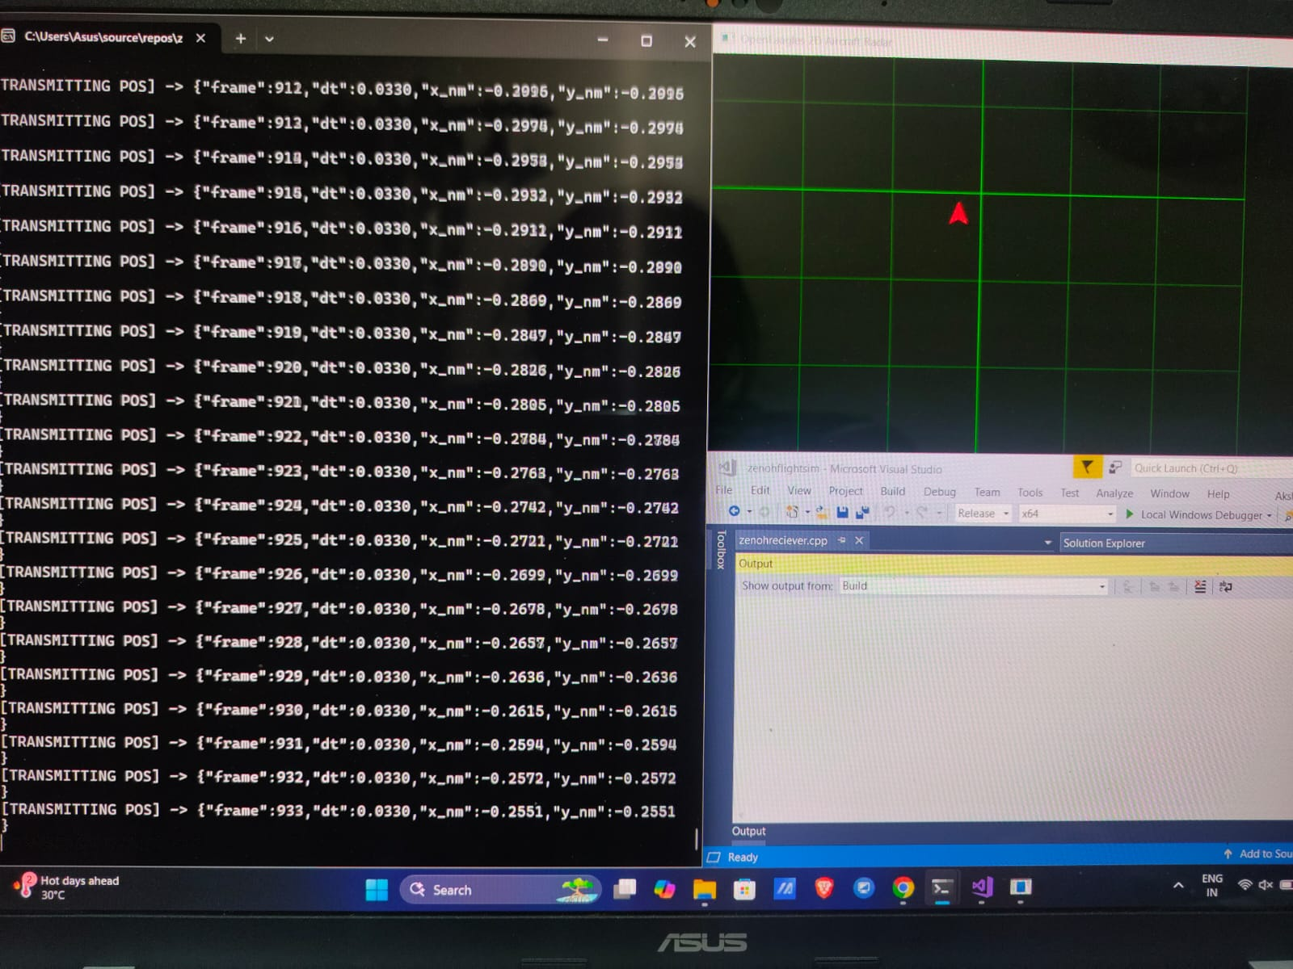
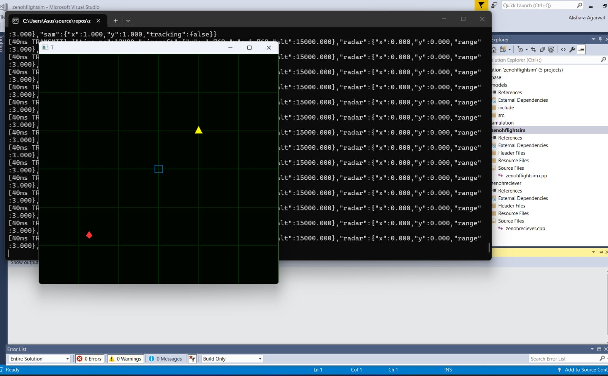
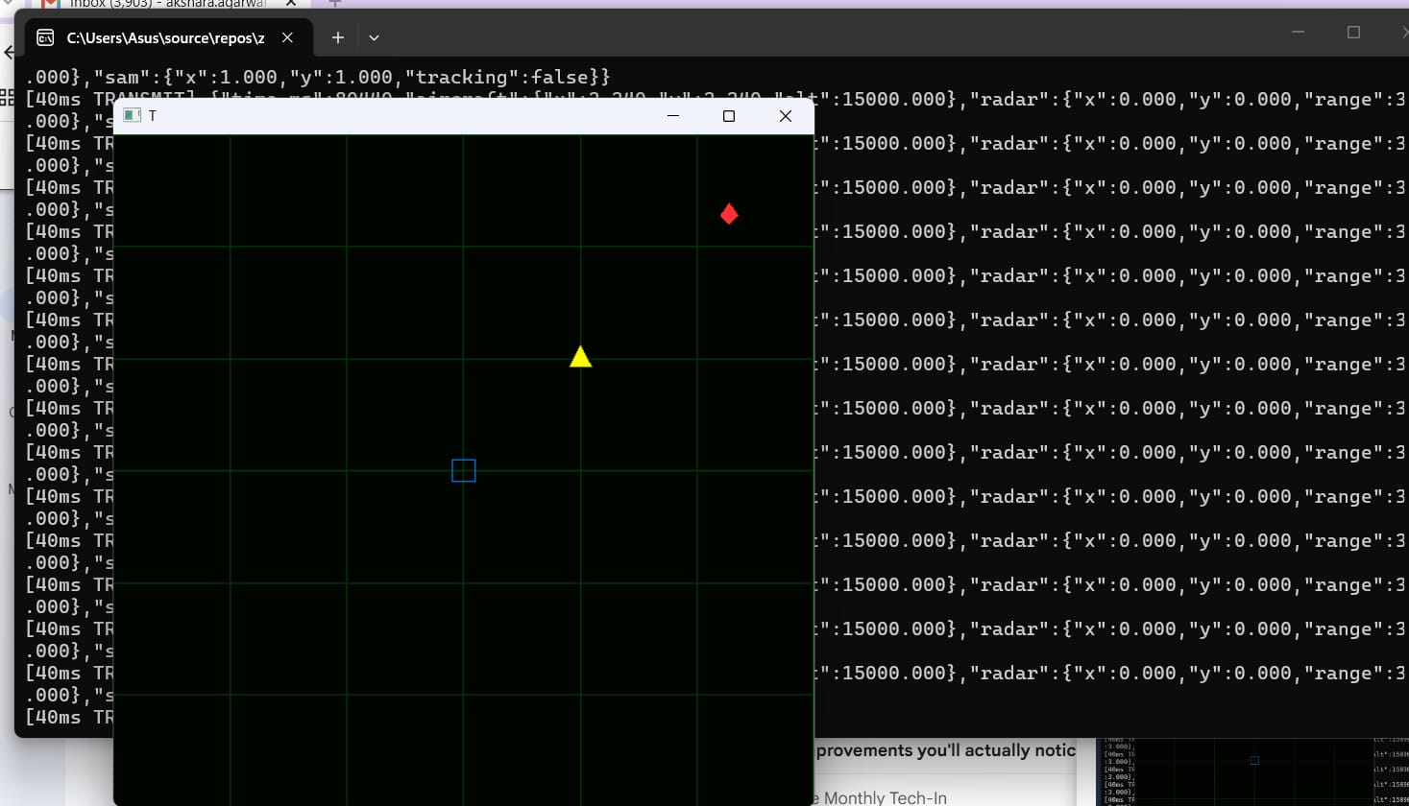

Slide 14
10 / INTEGRATION
ISSA • DRDO / INTERNSHIP
The Critical Engineering Problem: Threads
The first implementation worked conceptually — but it was not safe.
EARLY PROTOTYPE
RESOLVED DESIGN
Zenoh callback thread
↓
Thread-safe queue
↓
Simulation thread consumes updates
↓
OpenEaagles object tree
Zenoh callback thread
↓
Directly updates OpenEaagles objects
↓
Intermittent crashes / unstable behaviour
Problem: communication thread → simulation object
Result: communication remains outside the simulation object's thread.
NOTE :-
Real-time systems are not only about speed , they are about ownership, timing and safe boundaries.
11
OpenEaagles × Zenoh-C

Slide 15
11 / DEBUGGING
ISSA • DRDO / INTERNSHIP
Problems That Taught Me The Most
Every failure became a systems-level debugging exercise.
01
Resolved dependency order: oe_simulation → oe_base relationship
Library linking order
Undefined references
02
Matched every slot-table entry to its slot-map handler
Slot table / slot map
Compile-time mismatch
03
Thread synchronization
Runtime crash / instability
Separated Zenoh callback work from simulation-thread object updates
04
Numerics
LOS wraparound / near-zero velocity produced invalid guidance behaviour
Normalized angle difference and guarded low-velocity division.
12
OpenEaagles × Zenoh-C

Slide 16
12 / ENGINEERING
ISSA • DRDO / INTERNSHIP
Build Environment: What I Learned Beyond Coding
The project forced me to understand the software around the code.
MinGW (Minimalist GNU for Windows)
CMake
MSVC 2017
It is a software development toolset that lets you compile and run native C, C++, and Fortran programs on Windows
It is a free, open-source, and cross-platform build system generator used in Zenoh-C build + project build
A C++ compiler released by Microsoft on March 7, 2017, as part of Visual Studio 2017
EDL (Eaagles Description Language)
GDB / ASan
It is an object-oriented text language used exclusively within the framework to configure, initialize simulation components without hardcoding those definitions directly into C++.
Ascan is a fast memory error detector built into compilers like GCC and Clang, while GDB is the tool used to inspect the code when those errors trigger.
SHIFT IN MINDSET
I stopped treating build errors as blockers and started treating them as evidence about how a system is structured.
13
OpenEaagles × Zenoh-C

Slide 17
13 /VALIDATION
ISSA • DRDO / INTERNSHIP
Validated The Layers Before Trusting The System
The validation strategy deliberately separated framework correctness, communication correctness and simulation correctness.
1
OpenEaagles
Compile + run samples
PASS
2
Zenoh-C
Publisher ↔ subscriber
PASS
3
Integration
State published / received
PASS
4
Aircraft
State updates continuously
PASS
5
SAM guidance
Missile tracks target
PASS
Testing principle
Verify each layer first. Then trust the integrated result.
14
OpenEaagles × Zenoh-C

Slide 18
14 / END-TO-END
ISSA • DRDO / INTERNSHIP
The Complete Execution Flow
This is the slide to narrate while showing your live demo / recording.
1
2
3
4
5
6
Aircraft
moves
State
updates
Zenoh
publishes
Subscriber
receives
SAM
tracks
Trajectory
updates
Position : [x,y]
Velocity : v
Altitude : h
Heading : ψ
One changing aircraft state → one continuous information flow → one observable engagement.
DEMO RECORDING - https://drive.google.com/file/d/1U5I7jNPDC-3QvcGuHitnxE25Rw_zP4Xe/view?usp=sharing
15
OpenEaagles × Zenoh-C

Slide 19
15 / RESULTS
ISSA • DRDO / INTERNSHIP
What Was Successfully Demonstrated
The result is a working integration, not just separate prototypes.
Build
Communication
OpenEaagles + Zenoh-C compiled and configured
Real-time aircraft state transmitted and received
Simulation
PN Guidance
Aircraft state updated continuously
SAM tracked the moving target using PN guidance
Stability
Integrated pipeline operated reliably during validation
16
OpenEaagles × Zenoh-C

Slide 20
16 / Learning
ISSA • DRDO / INTERNSHIP
What changed in my technical skill set
The strongest outcome was learning to work across system boundaries.
Guidance & Tracking
Radar tracking and PN guidance require continuous, timely state updates.
Real-time communication
Publish–subscribe, sessions, key expressions
Systems Integration
Cross-library builds, adapters, and interface validation are critical.
Simulation
Aircraft state, scenario configuration, Entity-based updates, deterministic ticks, state management.
Debugging
Compile → link → runtime → thread safety
Communication
Zenoh-C for low-latency telemetry and decoupled producers/consumers.
C++ Structure
Understand and extend a legacy simulation codebase
17
OpenEaagles × Zenoh-C

Slide 21
17 / CAREER VALUE
ISSA • DRDO / INTERNSHIP
Why This Internship Matters For My Career
It moved my profile from algorithm implementation toward systems engineering.
BEFORE
✓
Build and integrate large C++ codebases
Coding / algorithms
✓
Work with real-time communication middleware
AFTER
✓
Debug across compiler, linker and runtime layers
Systems + integration + validation
✓
Reason about simulation state and numerical behaviour
This experience directly strengthens my interest in software engineering, simulation, systems and research-oriented development.
✓
Design interfaces between independent components
18
OpenEaagles × Zenoh-C

Slide 22
18 / FUTURE SCOPE
ISSA • DRDO / INTERNSHIP
Where I would take the system next
The current implementation is a foundation for deeper experimentation.
01 Multiple aircraft / missiles
02 More realistic flight dynamics
03 Advanced guidance algorithms
04 Real-time visualization dashboard
05 Distributed multi-machine simulation
06 Additional sensor models
07 Latency / trajectory / engagement analysis
NEXT RESEARCH QUESTION
How does the architecture behave as realism, scale and distributed execution increase?
19
OpenEaagles × Zenoh-C

Slide 23
19 / TAKEAWAY
ISSA • DRDO / INTERNSHIP
Things I Would Carry Forward
The internship changed how I approach technical problems.
01 Understand before extending
02 Integrate incrementally
03 Engineer the boundary
Study the framework, examples and execution model before changing it.
Build → verify → connect → validate. Isolate failures before adding complexity.
Thread safety, data ownership and interfaces matter as much as the algorithm.
The project taught me not just how to make a program run — but how to make multiple systems work together.
20
OpenEaagles × Zenoh-C

Slide 24

20

