Slide 1
Laravel Certificate Course
BUSINESS
Akshar Thakkkar
23000030
BCA(SY)
CMP304

Slide 2
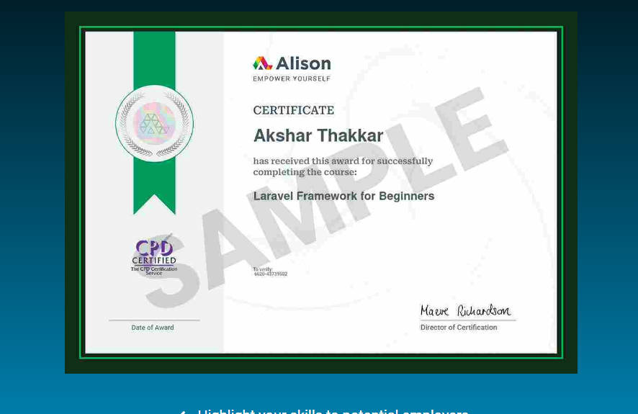

Slide 3

CONTENTS
01-
02-
03-
Introduction to the Course
Advantages of Laravel
Community and Support
04-
05-
06-
Modern Tooling and Features
Significance of MVC Pattern
Examples of MVC in Laravel

Slide 4
Introduction to the Course
01

Slide 5

Course Objectives
Review Framework Capabilities
Understand the core functionalities and features that Laravel provides for web development.
MVC Concept Introduction
Get acquainted with the Model-View-Controller architecture and how it organizes code effectively.
Web Application Initialization
Learn how to set up a new Laravel project and get your development environment ready.

Slide 6


Basics of Laravel Framework
Overview of Key Features
Explore essential features like routing, authentication, and session management in Laravel.
Importance of Framework
Understand the significance of using a framework to expedite and simplify web development processes.

Slide 7
Advantages of Laravel
02

Slide 8

Scalability and Maintainability
MVC Architecture Benefits
Ease of Updates
Discuss how MVC promotes organization and maintains separation of concerns in code.
Highlight how a well-structured application allows for easier upgrades and maintenance.

Slide 9

Extensive Ecosystem
01
02
Use of Packages
Leverage Existing Solutions
Examine the various Laravel packages available to extend functionality without starting from scratch.
Explain how developers can easily integrate existing tools and solutions via packages.

Slide 10
Community and Support
03

Slide 11
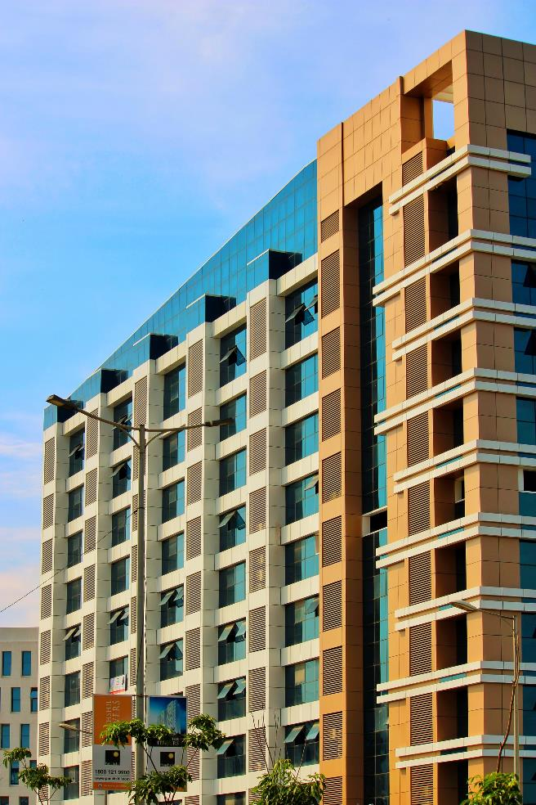

Member Contributions
Active Forums and Discussion
Details on how vibrant community forums foster collaboration and knowledge sharing among developers.
Availability of Tutorials
Discuss the wealth of online tutorials and resources available for learners of all levels.

Slide 12


Documentation Access
Comprehensive Guides
Staying Updated
Look into the documentation that covers almost every aspect of Laravel, ensuring guidance at all stages.
Importance of keeping up with trends and best practices through community updates and official documentation.

Slide 13
Modern Tooling and Features
04

Slide 14
Eloquent ORM
Database Interactions
Understand how Eloquent ORM simplifies database operations through a fluent and expressive syntax.
Relationships Management
Explore how Eloquent manages relationships between different data models effortlessly.

Slide 15
Blade Templating Engine
View Creation
Discuss how Blade allows the creation of dynamic views and simplifies HTML structures.
Template Inheritance
Explain the advantages of using template inheritance to maintain consistency across views.

Slide 16
Significance of MVC Pattern
05

Slide 17
Separation of Concerns
Clear Structure
Facilitates Collaboration
Emphasize how MVC leads to better organization of code, which simplifies understanding and maintenance.
Describe how the separation of responsibilities allows team members to work independently on different components.

Slide 18
Testing Support
Unit Testing Capabilities
Ensuring Quality
Explain how easily unit testing can be performed with separated MVC components for each functionality.
Discuss the significance of testing in maintaining high-quality code and identifying issues early.

Slide 19
Examples of MVC in Laravel
06

Slide 20

Model in Laravel
Eloquent ORM Entity Example
Showcase a simple example of a model using Eloquent to represent and interact with database records.

Slide 21

View in Laravel
Blade Template Example
Present an example of a Blade template that displays user information dynamically.

Slide 22

Controller in Laravel
Controller Class Example
Provide an example of a controller that retrieves user data and passes it to a view for rendering.

Slide 23
Thank you for
watching.
Reporter

