Slide 1
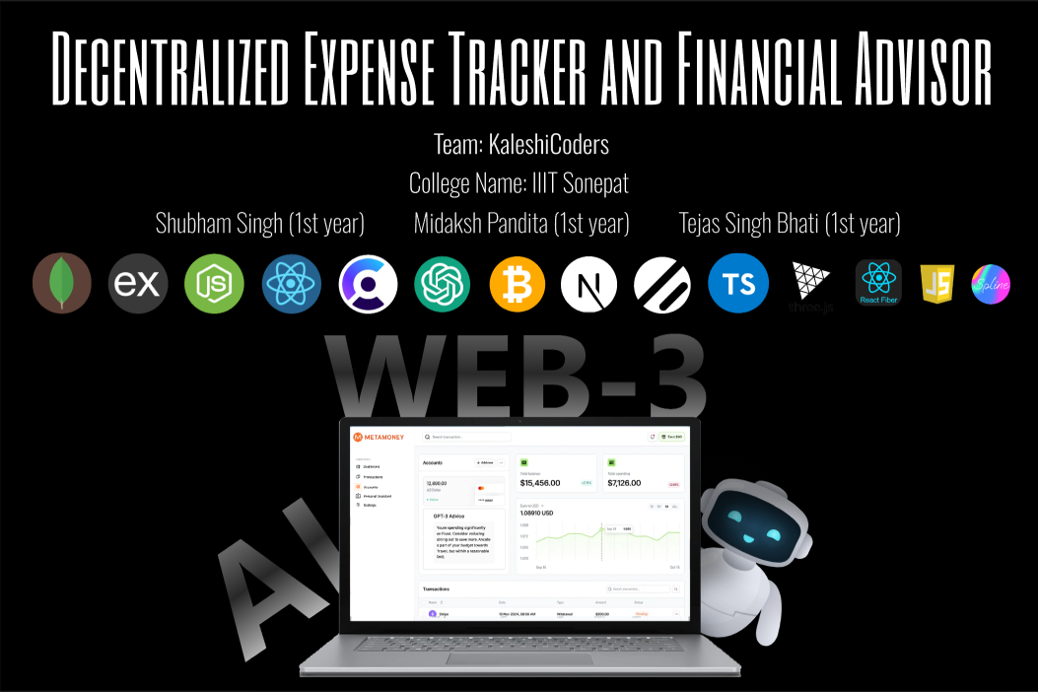








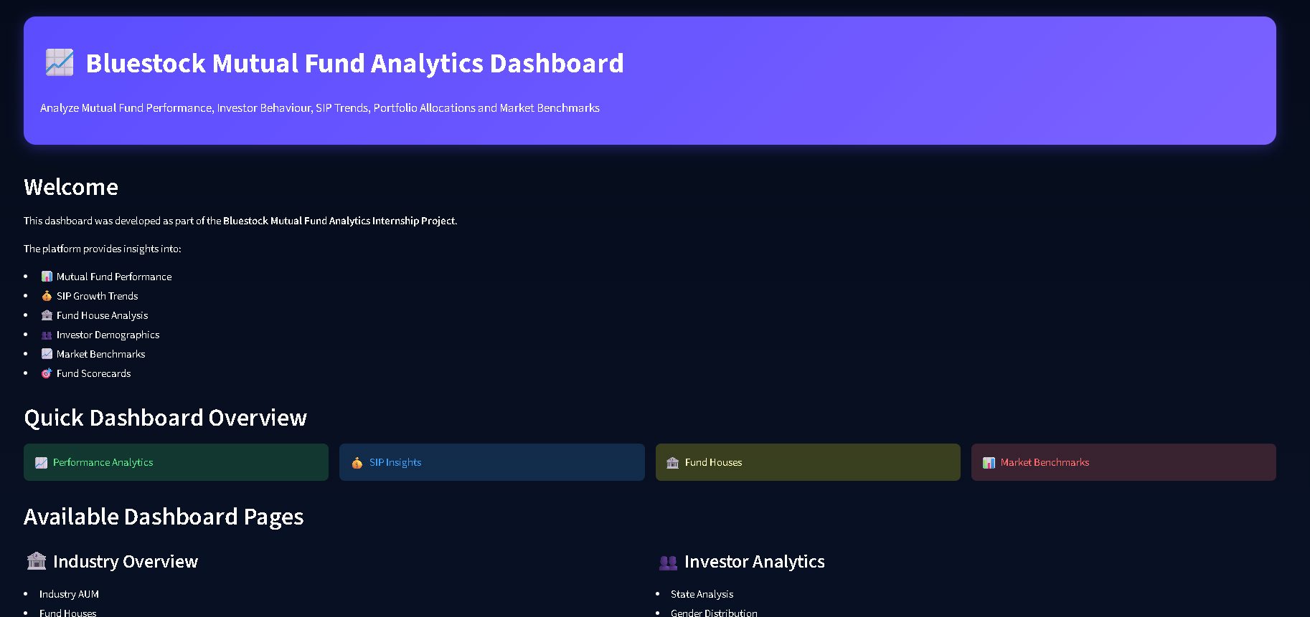
Bluestock Mutual Fund Analytics Capstone
Bluestock Internship Program
Submitted By: Akshat Bansal
YodhaX
Akshat Bansal (2nd year)
Saksham Mawari (2nd year)
Jitesh Kumar(2nd year)
Kushal Gurjar(2nd year))

Slide 2
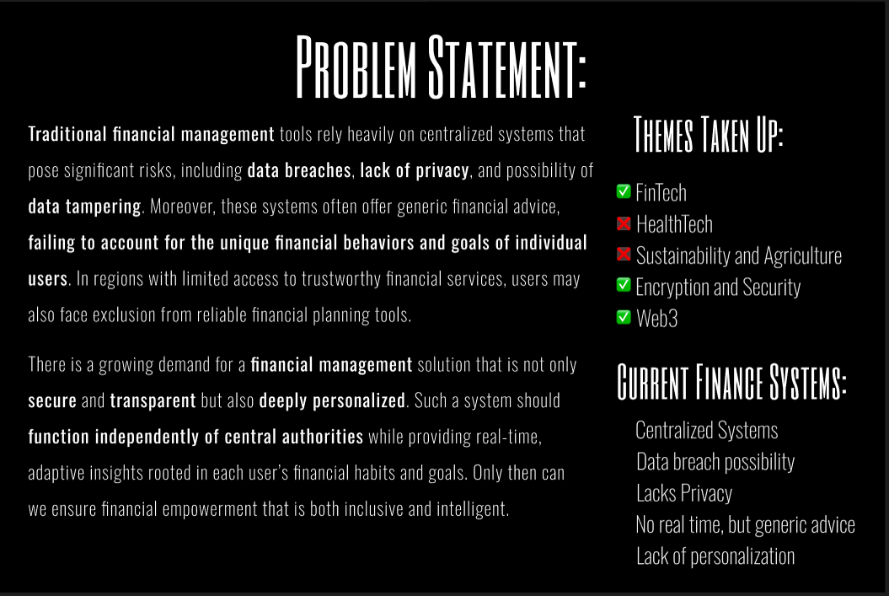

Problem Statement
Mutual fund investors and fund managers need data-driven insights to:
Evaluate fund performance
Understand investor behavior
Monitor SIP growth
Compare risk-adjusted returns
Analyze market trends
Problem Statement
Mutual fund investors and fund managers need data-driven insights to:
Evaluate fund performance
Understand investor behavior
Monitor SIP growth
Compare risk-adjusted returns
Analyze market trends
AI/ML
Open Innovation
Objectives
✔ Build ETL pipeline
✔ Perform EDA
✔ Develop dashboard
✔ Implement advanced analytics
✔ Generate actionable insights

Slide 3
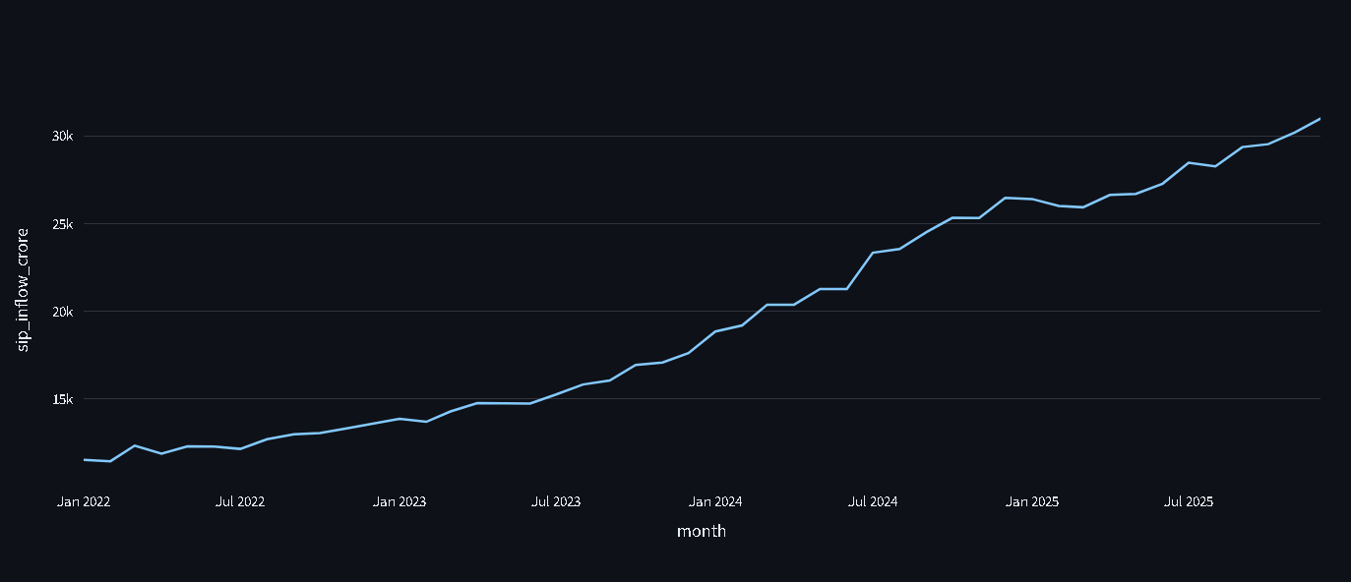
Data Sources
Data Used
Fund Data
Fund Master
Fund Performance
NAV History
Database Tables
fact_fund_master fact_performance fact_nav fact_transactions fact_aum_house fact_monthly_sip_inflows fact_category_inflows fact_industry_folio_count fact_portfolio_holdings fact_benchmark_indices
Investor Data
Transactions
SIP Inflows
Market Data
Benchmark Indices
Portfolio Holdings

Slide 4
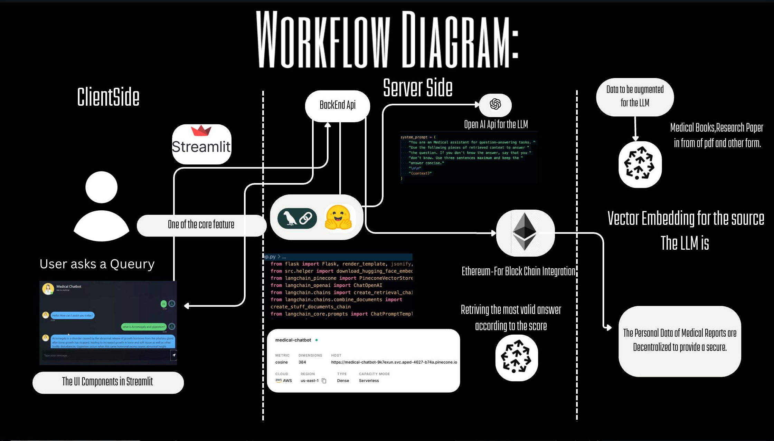
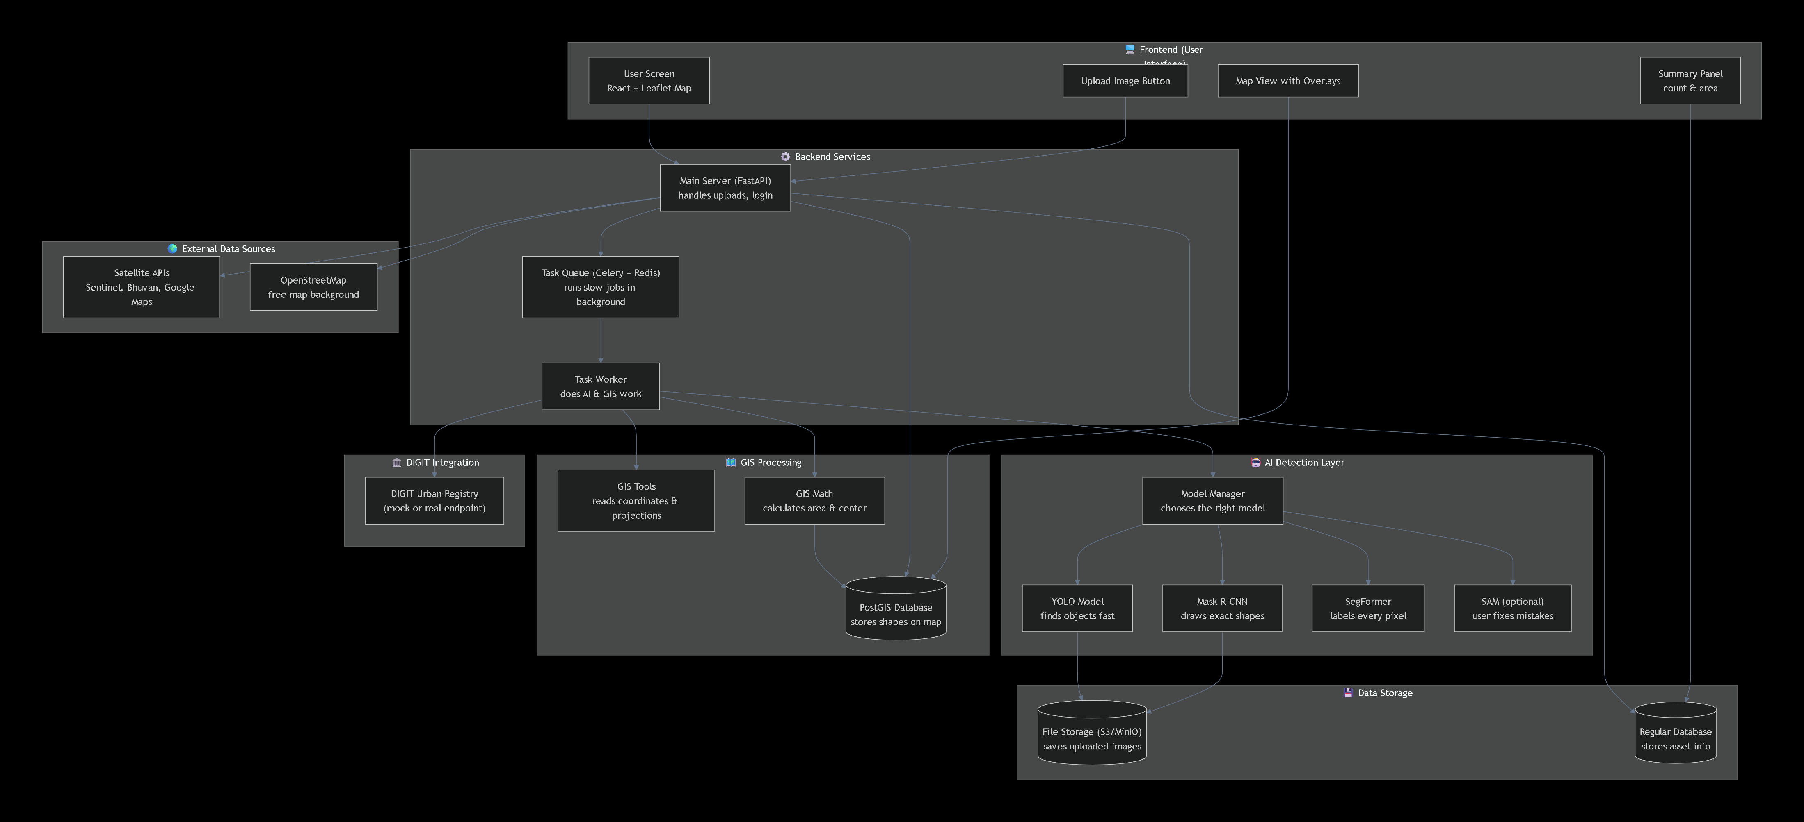
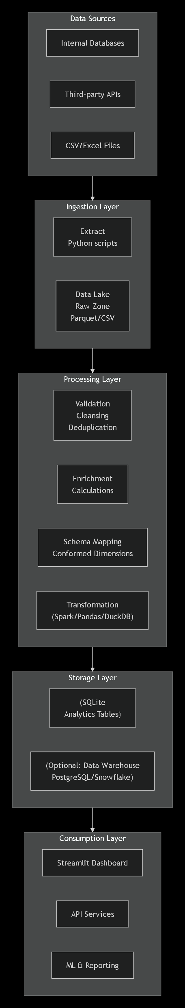
System Architecture

Slide 5
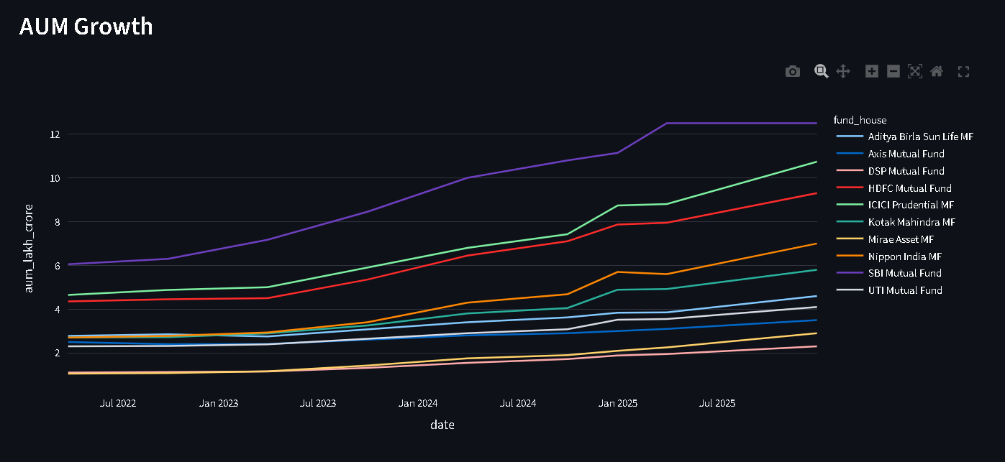
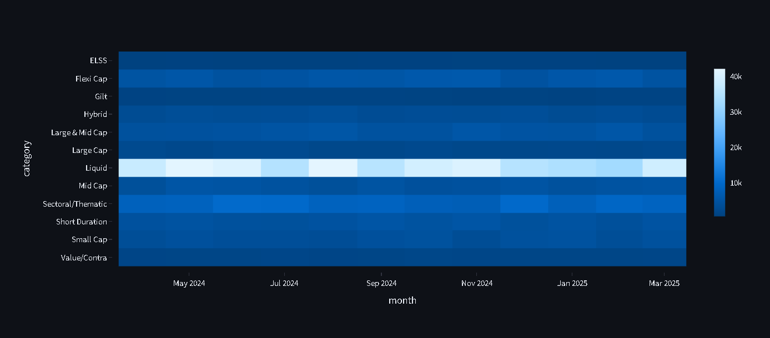
EDA Highlight #1
Industry Overview
Key Findings
Industry AUM increased consistently
SIP inflows reached record highs
Total folios showed strong growth
Mutual fund participation expanded rapidly
KPIs
Industry AUM
Monthly SIP
Total Folios
Number of Schemes

Slide 6
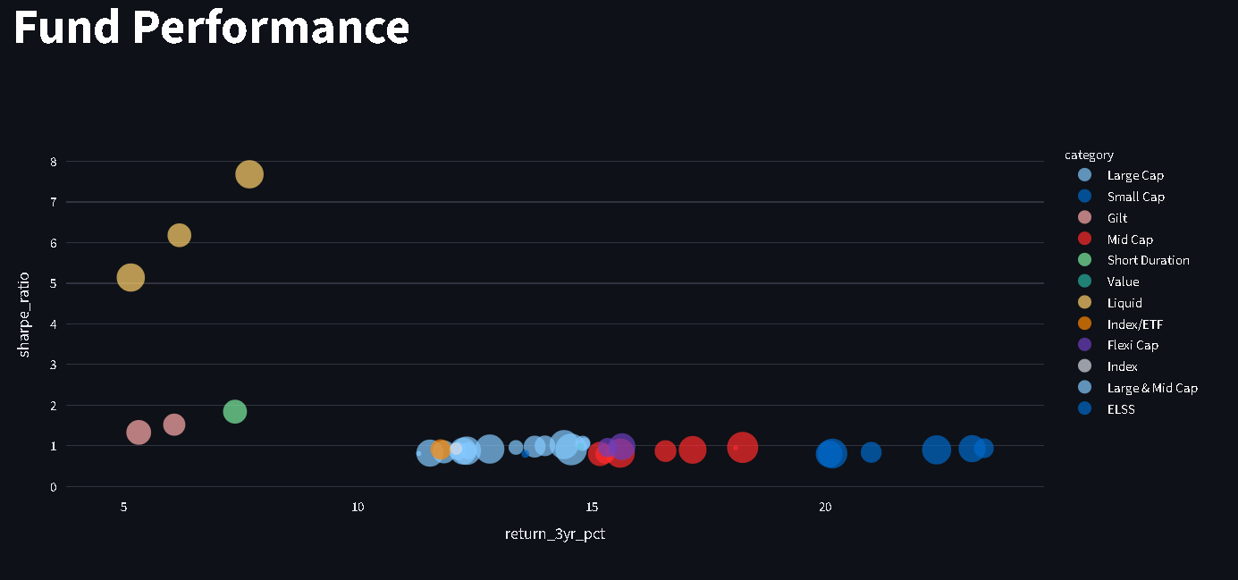
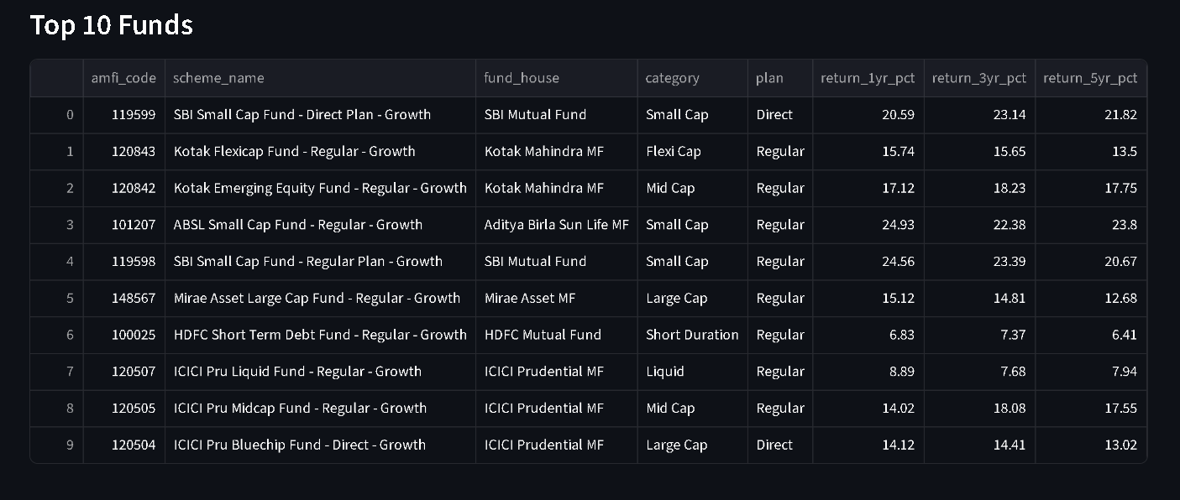
EDA Highlight #2
Fund Performance Analysis
Metrics Analyzed
Returns
Alpha
Beta
Sharpe Ratio
Expense Ratio
Findings
Large-cap funds showed lower volatility
Moderate-risk funds had balanced returns
High Sharpe funds outperformed peers

Slide 7
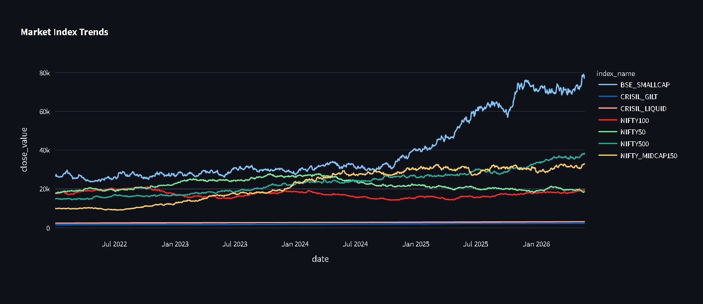
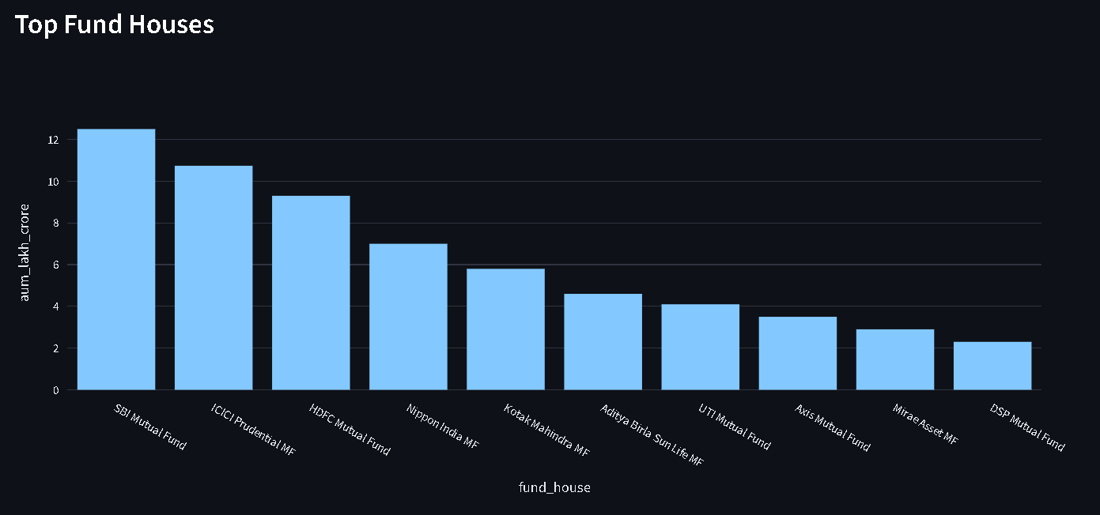
Performance Metrics
Risk Analytics
Value at Risk (VaR)
Measures potential loss at 95% confidence.
Conditional VaR (CVaR)
Measures average loss beyond VaR.
Key Findings
Some funds showed higher downside risk.
Equity-heavy funds had higher VaR.

Slide 8
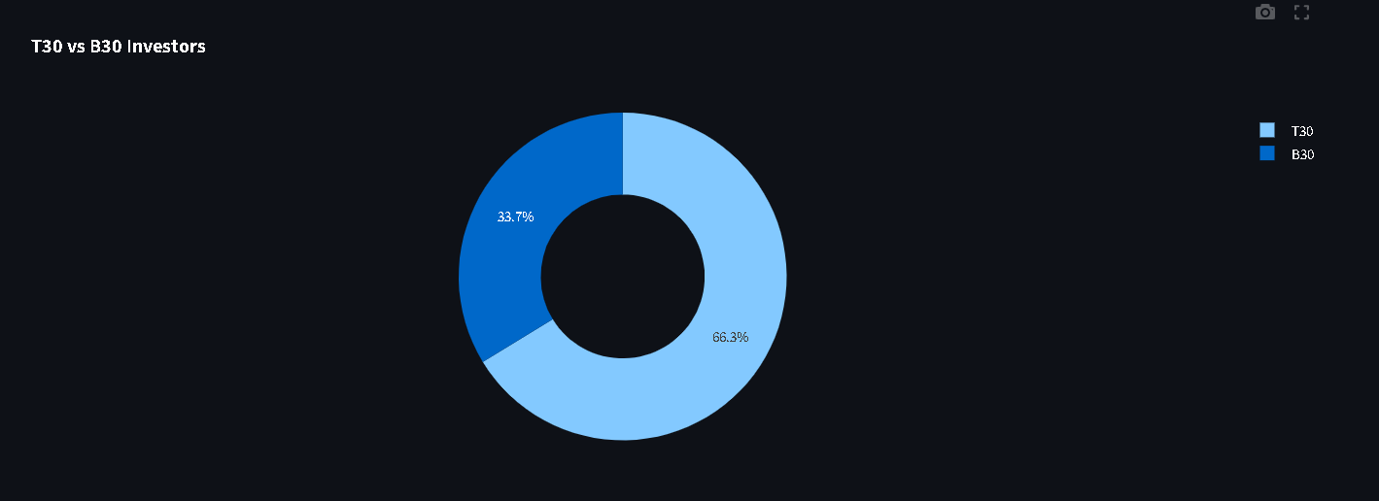
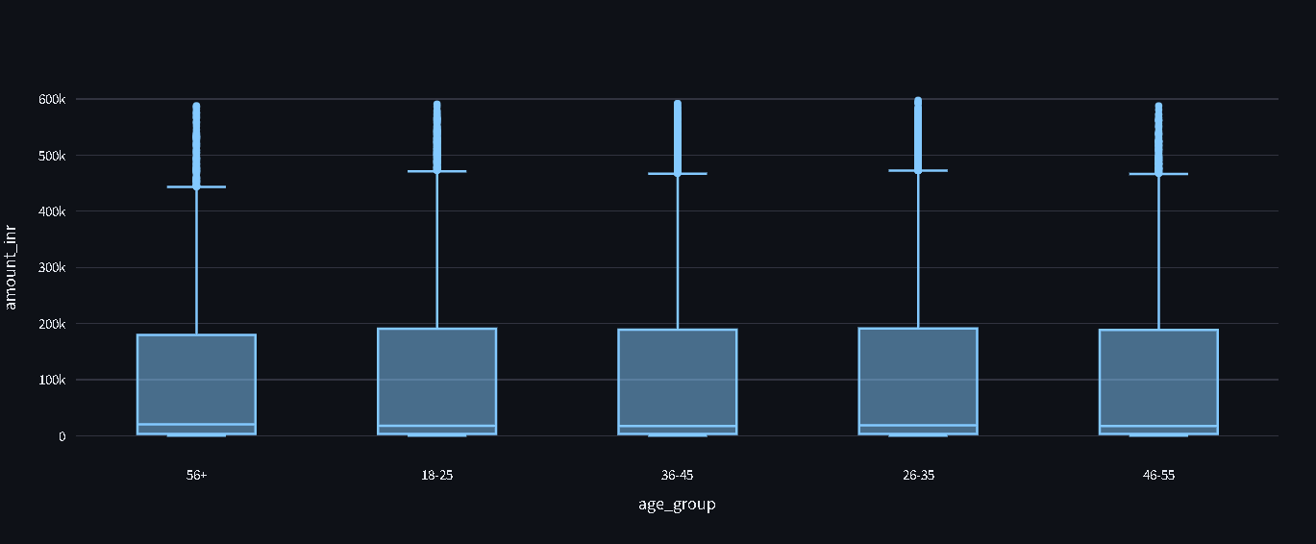
Performance Metrics
Advanced Analytics
Rolling Sharpe Ratio
Measures changing risk-adjusted performance.
HHI Concentration Index
Measures portfolio diversification.
Findings
Diversified funds had lower HHI.
High-HHI funds carried concentration risk.

Slide 9
Dashboard Showcase
.
Industry Overview Dashboard
Features:
Industry KPIs
AUM Trends
Top Fund Houses
SIP Analysis
Analytics Dashboards
Fund Performance
Risk vs Return
Fund Scorecards
Investor Analytics
State Analysis
T30 vs B30
Market Trends
Benchmark Tracking
SIP Growth

Slide 10
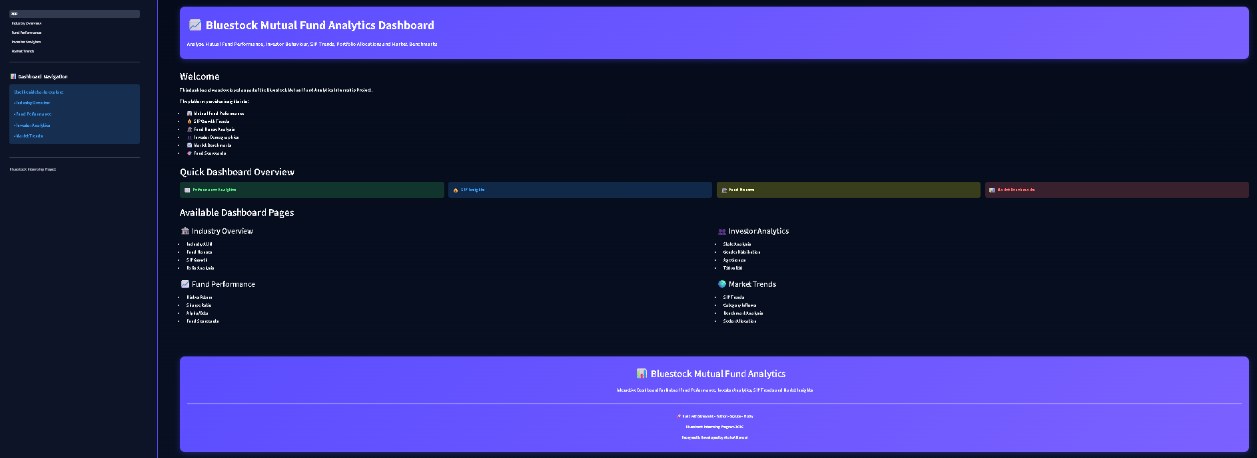

Slide 11
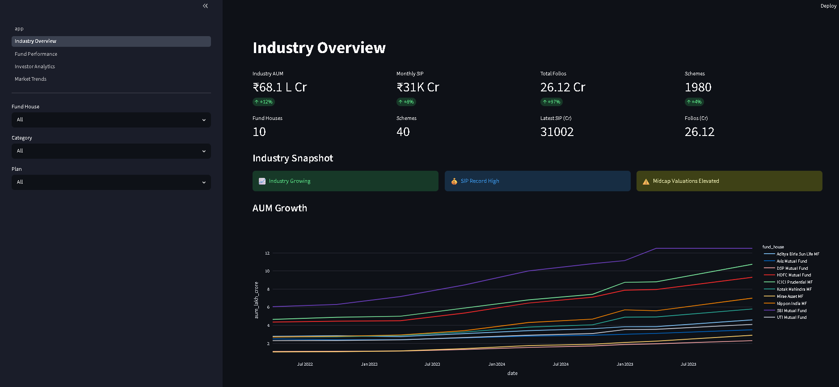

Slide 12
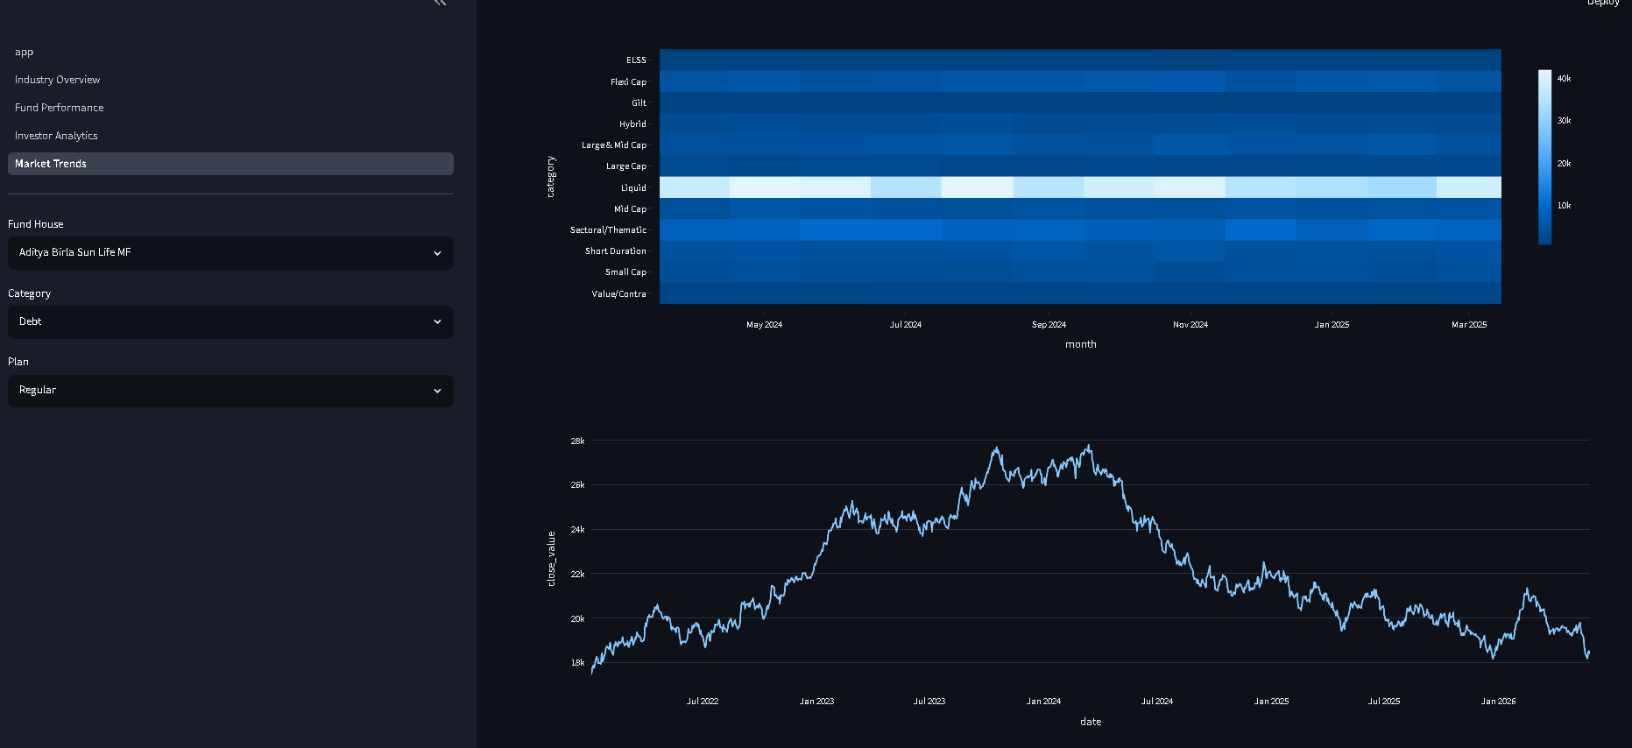

Slide 13
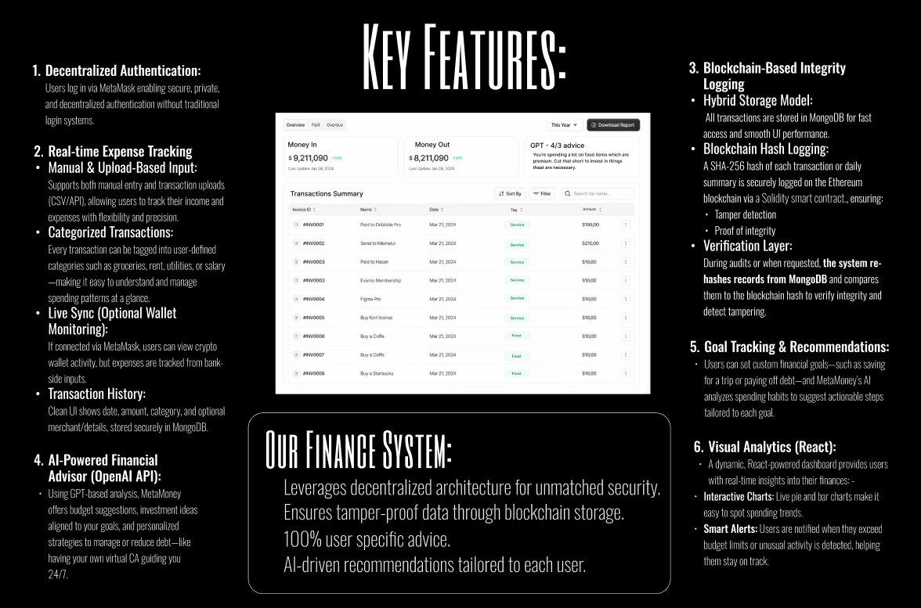

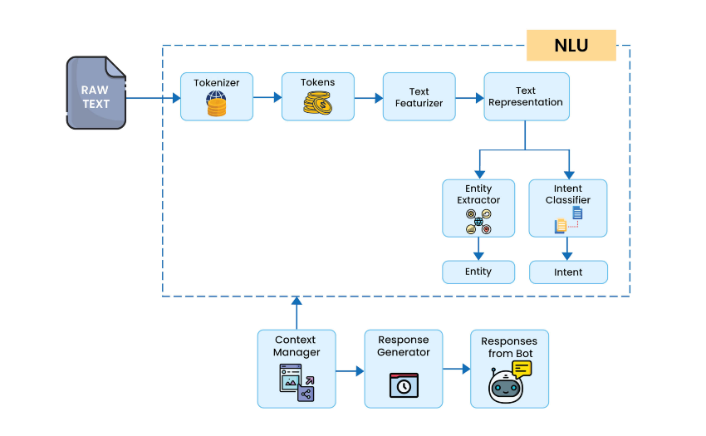
Insight 1
Industry SIP inflows continue to grow.
Insight 2
Moderate-risk funds generated the best risk-adjusted returns.
Insight 3
T30 cities dominate mutual fund investments.
Insight 4
Some portfolios show high concentration risk.
Insight 5
Investor continuity improves long-term wealth creation.
A few leading fund houses manage a significant portion of the industry's total AUM, highlighting strong investor trust in established asset management companies.
Moderate-risk funds delivered better risk-adjusted performance than several high-risk funds, as reflected by higher Sharpe and Sortino ratios.
Investment activity was concentrated among middle-aged investors and T30 cities, indicating stronger mutual fund adoption in urban regions.
We prioritize precision and safety. Our system is rigorously designed to provide highly accurate information you can trust, minimizing errors and focusing on reliable guidance.

Slide 14
Thank You
Submitted By
Akshat Bansal
Contact
GitHub Repository Link
https://github.com/Akshat-1508/bluestock_mf_capstone

