Slide 1

AE642
Satellite Attitude Dynamics and Control
Term Paper Presentation
Optimized Attitude Control of an Underactuated Satellite using Two Reaction Wheels
Presenter: Akshat Kumar ,B.Tech-M.Tech Aerospace Engineering,210091.
Presented to:
Prof. Dipak Kumar Giri

Slide 2
Abstract
This paper builds upon the foundational work of Jefferson R. Chaurais, Henrique C. Ferreira,†
Jo˜ao Y. Ishihara, ‡ and Renato A. Borges§, introducing a new controller algorithm to optimize the satellite response to disturbance input. The proposed improvements include the proposal of a modified quaternion kinematic equation. These enhancements are evaluated through simulations in MATLAB to demonstrate reduced settling time when the satellite is subjected to disturbances in space. Comparisons with the previously existing Quaternion Kinematic Equation highlight the advantages of this modified approach, making it more effective for operations where a reduction of 10–20% in settling time from the existing model is desired. The findings provide valuable insights for advancing space exploration and interplanetary missions

Slide 3
Introduction
Horri and Palmer proposed control solutions for
underactuated satellites with two reaction wheels.
While their control law, validated in UoSAT-12, en-
sured steady-state operation, it resulted in a long
settling time of around 4000 s. This highlights the
need for improvements in time response and distur-
bance robustness, especially against Earth’s mag-
netic field.
Then furthermore, Jefferson R. Chaurais, Hen-
rique C. Ferreira,† Jo˜ao Y. Ishihara, ‡ and Re-
nato A. Borges§ proposed an additional to Horri
and Palmer’s work which included an modified
Kinematic Algorithm.However, they did not take
Disturbance into consideration in their analysis.
This paper extends works from previous authors
by proposing modifications to the kinematic con-
trol law. Simulations conducted on the Ukrainian
nanosatellite UYS-1 demonstrate faster response
times and reduced errors, offering significant im-
provements in satellite attitude control.
Horri and Palmer proposed control solutions for
underactuated satellites with two reaction wheels.
While their control law, validated in UoSAT-12, en-
sured steady-state operation, it resulted in a long
settling time of around 4000 s. This highlights the
need for improvements in time response and distur-
bance robustness, especially against Earth’s mag-
netic field.
Then furthermore, Jefferson R. Chaurais, Hen-
rique C. Ferreira,† Jo˜ao Y. Ishihara, ‡ and Re-
nato A. Borges§ proposed an additional to Horri
and Palmer’s work which included an modified
Kinematic Algorithm.However, they did not take
Disturbance into consideration in their analysis.
This paper extends works from previous authors
by proposing modifications to the kinematic con-
trol law. Simulations conducted on the Ukrainian
nanosatellite UYS-1 demonstrate faster response
times and reduced errors, offering significant im-
provements in satellite attitude control.
Horri and Palmer proposed control solutions for underactuated satellites with two reaction wheels. While their control law, validated in UoSAT-12, ensured steady-state operation, it resulted in a long settling time of around 4000 s. This highlights the need for improvements in time response and disturbance robustness, especially against Earth’s magnetic field.
Then furthermore, Jefferson R. Chaurais , Henrique C. Ferreira,† Jo˜ao Y. Ishihara, ‡ and Renato A. Borges§ proposed an additional to Horri and Palmer’s work which included an modified Kinematic Algorithm . However, they did not take Disturbance into consideration in their analysis. This paper extends works from previous authors by proposing modifications to the kinematic control law. Simulations conducted on the Ukrainian nanosatellite UYS-1 demonstrate faster response times and reduced errors, offering significant improvements in satellite attitude control.

Slide 4
Modelling
A satellite can be represented as a rigid body subjected to external torques. Its angular velocity over time can be described using Euler’s rotational equations, while its orientation relative to an inertial reference frame can be determined through a kinematic model.
Dynamic Modelling
Kinematic Modelling

Slide 5
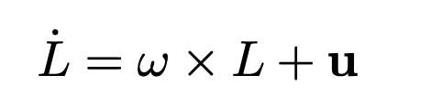


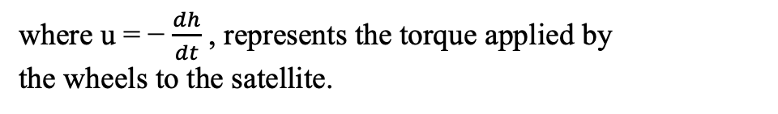
Dynamic Modelling
The Euler Rotational equation is used:
(i)
where ω is the angular velocity of the body, and the total angular momentum , L for a satellite
equipped with reaction wheels is given by:
(ii)
where I is the inertia matrix, and h is the angular momentum of the reaction wheels.
Substituting Eq. (ii) into Eq. (i), the dynamic model becomes:
(iii)
where u = − $\frac{dh}{dt}$ , represents the torque applied by
the wheels to the satellite.

Slide 6

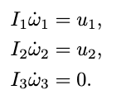
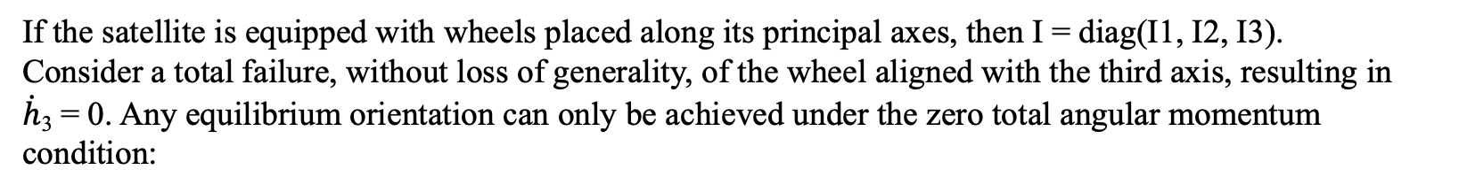
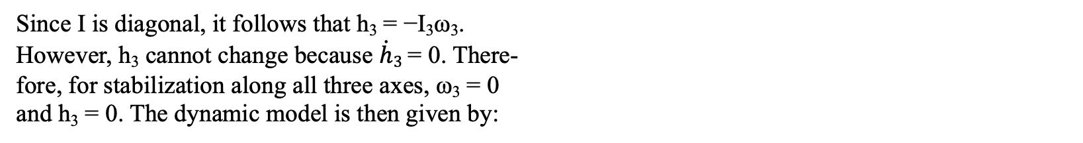
Dynamic Modelling
If the satellite is equipped with wheels placed along its principal axes, then I = diag(I1, I2, I3).
Consider a total failure, without loss of generality, of the wheel aligned with the third axis, resulting in
$\dot{h}$₃ = 0. Any equilibrium orientation can only be achieved under the zero total angular momentum condition:
(iv)
Since I is diagonal, it follows that h₃ = −I₃ω₃.
However, h₃ cannot change because $\dot{h}3$= 0. There-
fore, for stabilization along all three axes, ω₃ = 0
and h₃ = 0. The dynamic model is then given by:
(v)

Slide 7
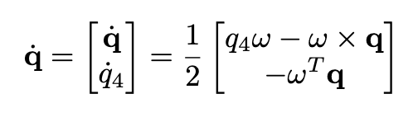


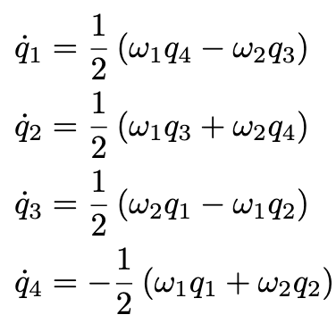
Kinematic Modelling
The kinematic model of a rigid body, using quaternion parametrization, is given by:
(vi)
where q = represents the vector part of the quaternion,
q4 is the scalar part, and q = , is the attitude quaternion.
Considering the zero total angular momentum condition from Eq. (4), Eq. (6) can be rewritten as:
(vii-a)
(vii-b)
(vii-c)
(vii-d)

Slide 8
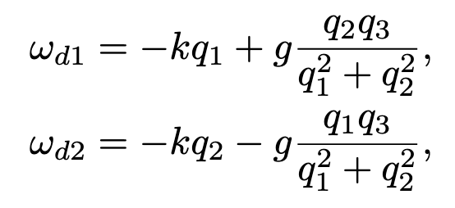
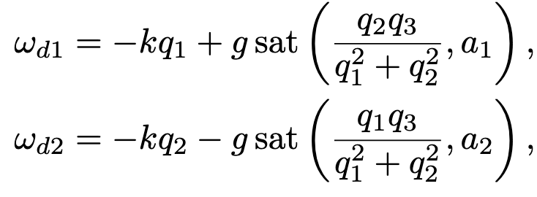
Singular Nonlinear Controller (SNLC)
Horri and Palmer proposed the following controller:
(viii-a)
(viii-b)
where k > 0 and g > 0 are positive constants. This controller is referred to as the singular nonlinear controller (SNLC).
When q1 → 0 and q2 → 0, the fractional terms may reach high values. Therefore, for practical implementation, a saturated form of the controller in Eq [8a],[8b] can be used, as given by:
(ix-a)
(ix-b)
where sat(x, a) is the saturation function with an upper limit of a and a lower limit of −a.

Slide 9
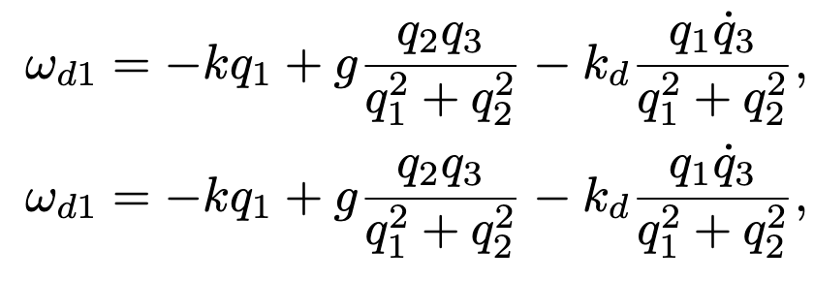

Quaternion-Based Nonlinear Controller (QBNC)
Jefferson R. Chaurais, Henrique C. Ferreira,† Jo˜ao Y. Ishihara, ‡ and Renato A. Borges§ proposed the following controller:
(x-a)
(x-b)
with k_{d} defined by:
(xi)
where k0 and d are constants, and sign(·) denotes the
signum function.

Slide 10
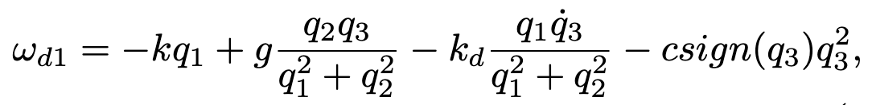
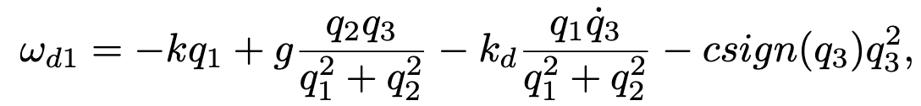
Optimized Quaternion-Based Nonlinear Controller (OQBNC)
The previous work was based upon the Quaternion responses in an ideal environment without the disturbances,
but in real scenario, there are disturbances to a satellite in space due to due to Solar Radiation Pressure.
Such disturbances are lesser in magnitude, but they can cause significant deviation acting for a prolonged period of time.
This paper involves simulating the quaternion responses from the previously existing results, then applying disturbances to the previous work, and then compare the quaternion response between the QBNC and OQBNC.
The QBNC is less sensitive to the under-actuated axis quaternion q3, so this paper proposes a new Kinematic control law which is as follows:
(xii-a)
(xii-b)
where c proposed damping constant
Additional term compared to QBNC

Slide 11



Simulations
Consider the inertia matrix of the UYS-1 nanosatellite given by:
I = $\begin{matrix}0.1521 & 0 & 0 \\ 0 & 0.1521 & 0 \\ 9 & 9 & 0.0375\end{matrix}$ kg.m²
and the following parameters adjusted by simulations:
a₁ = 0.2 , a₂ = 0.2, k = 0.9, g = 3, c = 1, K = $\begin{matrix}10 & 0 & 0 \\ 0 & 10 & 0 \\ 0 & 0 & 10\end{matrix}$
and the maximum torque u_{max}=0.002 N.m
Also, consider the sampling time:
and the initial conditions of the attitude are:

Slide 12
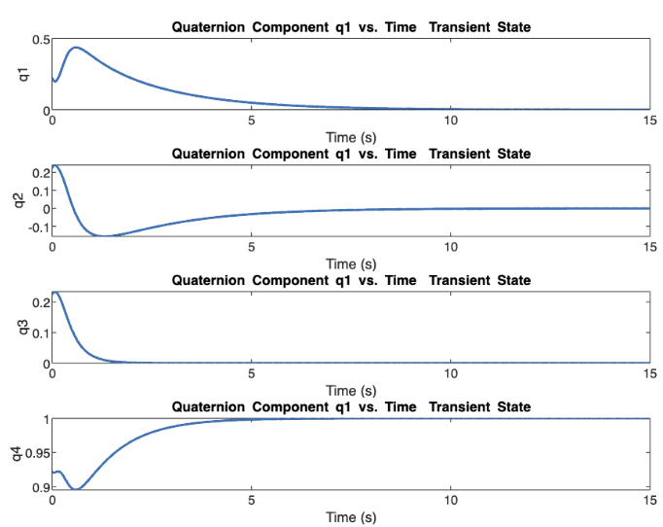
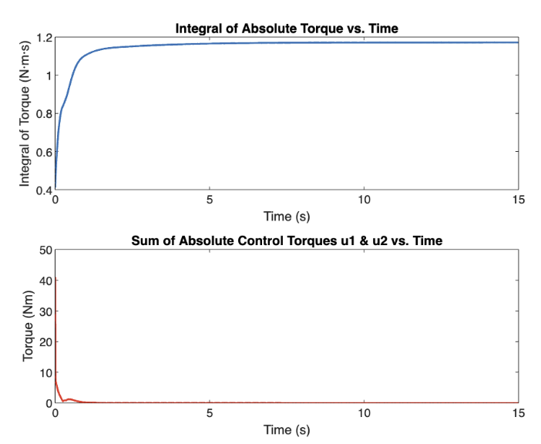
Non-saturated and Disturbance less
Closed-Loop System Simulations

Slide 13
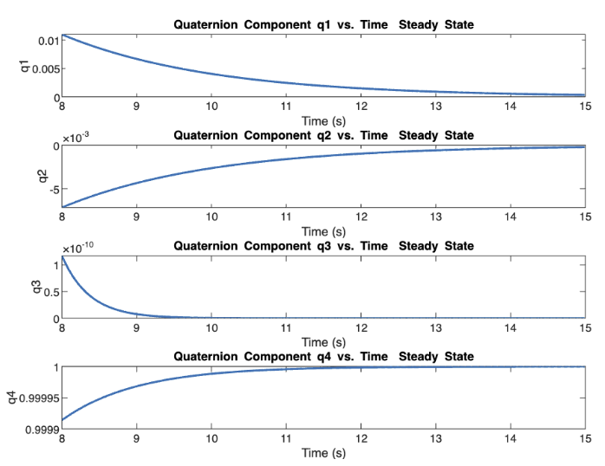
Non-saturated and Disturbance less
Closed-Loop System Simulations

Slide 14
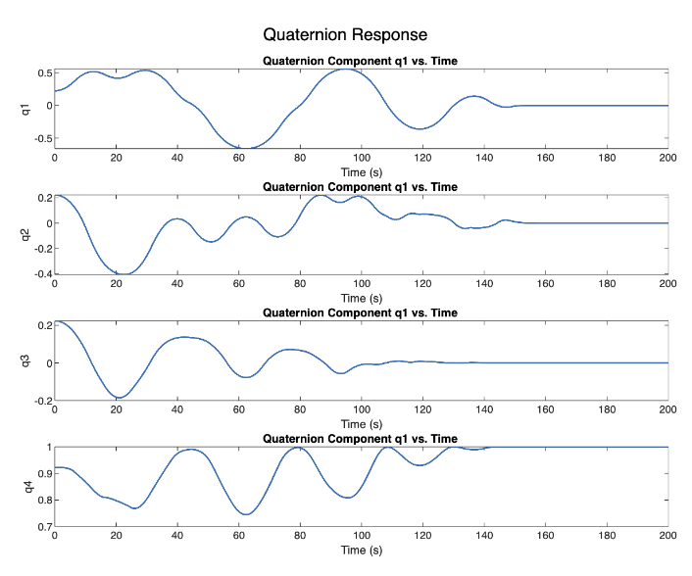
Saturated and Disturbance less
Closed-Loop System Simulations

Slide 15
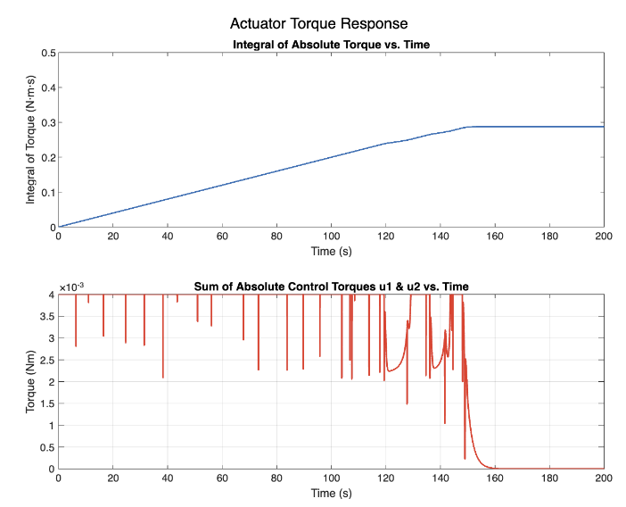
Saturated and Disturbance less
Closed-Loop System Simulations

Slide 16
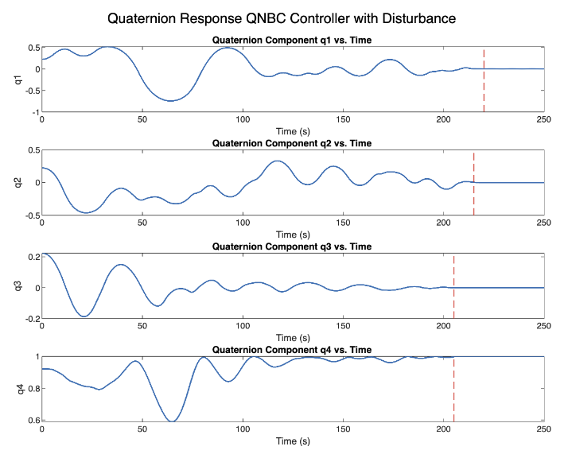

QBNC Responses with Disturbances
This is the Quaternion response of a QBNC Controller in presence sinusoidal disturbances. Red dotted line indicated settling time.
As observed, the Settling time (t_{s}) is:$\left[\begin{aligned}220 \\ 215 \\ 205 \\ 207\end{aligned}\right]$s,

Slide 17
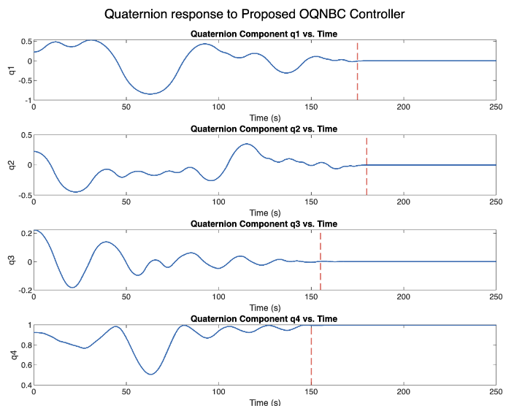

OQBNC Responses with Disturbances
This is the Quaternion response of a OQBNC Controller in presence sinusoidal disturbances. Red dotted line indicated settling time.
As observed, the Settling time (t_{s}) is:$\left[\begin{aligned}175 \\ 180 \\ 155 \\ 152\end{aligned}\right]$s,

Slide 18
Quaternion Response Comparison:
OQBNC vs QBNC
QBNC
OQBNC
Inferences
Quaternion q₁
t_{s}=220 seconds
Quaternion q₂
t_{s}=215 seconds
Quaternion q₃
t_{s}=205 seconds
Quaternion q₄
t_{s}=207 seconds
Quaternion q₁
t_{s}=175 seconds
Quaternion q₂
t_{s}=180 seconds
Quaternion q₃
t_{s}=155 seconds
Quaternion q₄
t_{s}=152 seconds
~20% Reduction in t_{s}
~16% Reduction in t_{s}
~24% Reduction in t_{s}
~26% Reduction in t_{s}

Slide 19
Conclusion
The proposed “Optimized Quaternion Based Non-Linear Controller (OQBNC)” has outperformed the foundational QBNC controller in the presence of disturbance with respect to the settling times.
This has been proved via the simulation results in MATLAB.
I would like to express my gratitude to Prof. Dipak Giri Sir to give me this opportunity to work on this amazing domain for satellite attitude control.
Thank You

