Slide 1


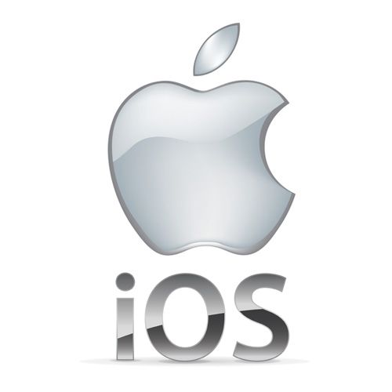

To Present Android, Mac OS, iOS, Windows
By Akshat Rahangdale

Slide 2

Presentation on Android
BY AKSHAT RAHANGDALE

Slide 3
What is Android?
Android is an open-source operating system designed primarily for mobile devices like smartphones and tablets.
Developed by Google and based on the Linux kernel.
First commercially released in 2008.

Slide 4

Key Features of Android:
Open Source: Developers can modify and customize the OS.
User Interface (UI): Intuitive and touch-friendly interface.
App Ecosystem: Access to millions of apps via Google Play Store.
Notifications: Provides real-time notifications for apps, messages, and calls.
Multi-tasking: Run multiple apps at the same time.
Connectivity: Supports Wi-Fi, Bluetooth, NFC, GPS, and mobile networks.
Voice Control: Integration with Google Assistant for voice commands.
Customization: Widgets, themes, and launcher apps to personalize devices

Slide 5
Presentation on Mac OS
BY AKSHAT RAHANGDALE

Slide 6
What is Mac OS?
Mac OS is a desktop and laptop operating system developed by Apple Inc.
It is designed exclusively for Mac computers such as MacBook, iMac, Mac Mini, and Mac Pro.
Known for its graphical user interface (GUI) and stability.
First introduced in 1984 as Mac OS, renamed Mac OS in 2012.

Slide 7

Key Features of Mac OS:
User-Friendly Interface: Clean, intuitive, and visually appealing.
Security & Privacy: Built-in security features like Gatekeeper, FileVault, and sandboxing.
Integration: Seamlessly works with other Apple devices like iPhone, iPad, and Apple Watch (Handoff, AirDrop, iCloud).
Pre-installed Apps: Safari, Mail, Calendar, Photos, Music, and productivity apps.
Multitasking: Supports multiple desktops (Spaces) and Mission Control for easy app management.
Regular Updates: Apple provides frequent system updates with new features and security improvements.
Performance Optimization: Efficient resource management and smooth performance.

Slide 8
Presentation on iOS
BY AKSHAT RAHANGDALE

Slide 9
What is Ios?
iOS is a mobile operating system developed by Apple Inc.
Designed exclusively for Apple devices like iPhone, iPad, and iPod Touch.
First released in 2007 alongside the first iPhone.
Known for smooth performance, security, and user-friendly interface.

Slide 10
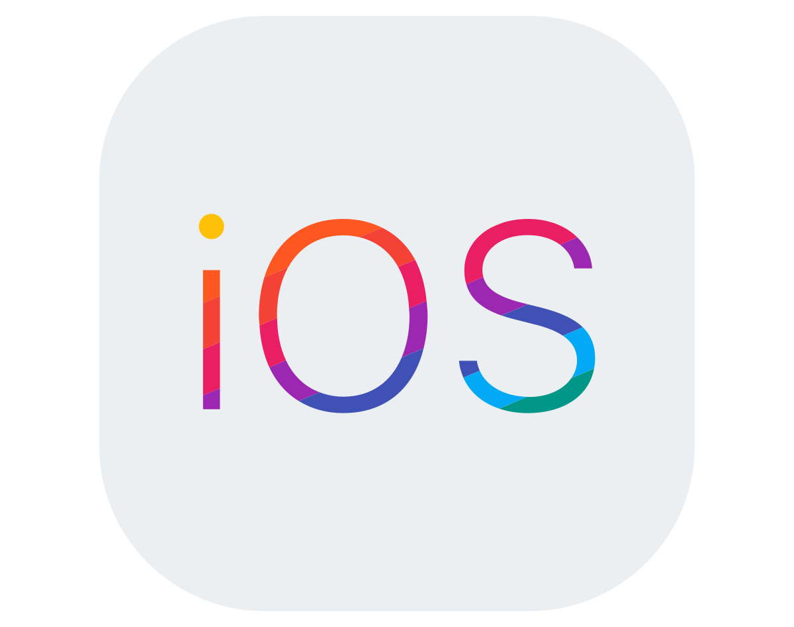
Key Features of iOS:
User Interface: Intuitive, touch-friendly, smooth animations, consistent design.
App Store: Access to millions of apps, all vetted by Apple for quality and security.
Security: Strong privacy features, encrypted messaging, Face ID/Touch ID.
Ecosystem Integration: Seamless integration with Mac, Apple Watch, iCloud, and Apple TV.
Notifications: Organized and interactive notifications.
Multitasking: Supports app switching, split-view (on iPad), and background processes.
Voice Assistant: Siri for voice commands, reminders, and smart home control.
Regular Updates: Timely OS updates available for all supported devices.

Slide 11
Presentation on Windows
BY AKSHAT RAHANGDALE

Slide 12
What is Windows?
Windows is a graphical operating system developed by Microsoft.
Designed for personal computers, laptops, tablets, and servers.
First released in 1985 as Windows 1.0.
Known for its user-friendly interface and widespread use worldwide.

Slide 13
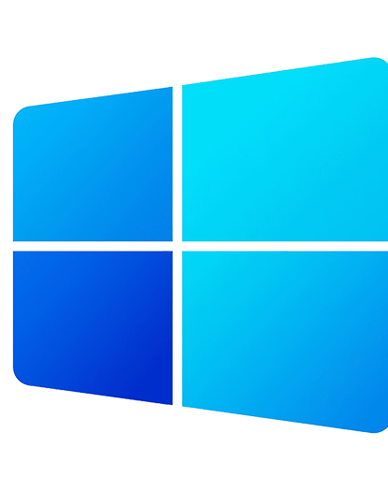
Key Features of Windows:
Graphical User Interface (GUI): Uses windows, icons, and menus for ease of use.
Start Menu & Taskbar: Quick access to apps, files, and system settings.
File Management: File Explorer allows easy access and organization of files.
Multitasking: Run multiple applications at the same time.
Security Features: Windows Defender, firewall, and user account control (UAC).
Compatibility: Supports a wide range of hardware and software applications.
Networking: Easy connection to networks, cloud services, and the internet.
Virtual Desktops: Manage multiple desktops for different tasks.

